Slide 1
dRDF: Entailment for Domain-Restricted RDF
Reinhard Pichler ¹ Axel Polleres ² Fang Wei ¹ Stefan Woltran ¹
¹Institute for Information Systems, TU Vienna, Austria
² DERI, National University of Ireland, Galway
Blank nodes are fun (at least for theoreticians)
Blank nodes ain’t THAT evil! ☺

Slide 2
RDF Entailment: G₁ = G₂
Does graph G₁ entail G₂ ?
Boils down to:
“Is there a blank node renaming µ for blank nodes in G₂ such that µ(G₂) ⊆G₁”
“Folklore”: Well-known to be NP-complete (cf. RDF Semantics [Hayes, 2004])
Observation: Blank nodes are causing the “trouble” of making the problem intractable… ground entailment well known to be in P.
Starting point for our work:
Besides completely forbidding blank nodes…
… What else can we do to make this problem tractable?

Slide 3
Restrictions on RDF graphs considered in this paper:
Domain-Restricted Graphs: Restrict the domain blank nodes can range over to a finite set of objects.
Graphs with Bounded Treewidth: Restrict the graph structure of RDF graphs: bounded-treewidth (a generalization of acyclicity)
Effects:
…OOPS! With finite domains, complexity actually jumps from NP to coNP^{NP =} Π^{p} ☹
Not all is lost: bounded treewidth guarantees tractability for general entailment and coNP bound for domain-restricted graphs.
Summary:
₂
 | domain-restricted graphs | Unrestricted graphs
bounded treewitdth | coNP-complete | in P ☺
unbounded treewidth | Π^{p}₂ -complete | NP-complete

Slide 4
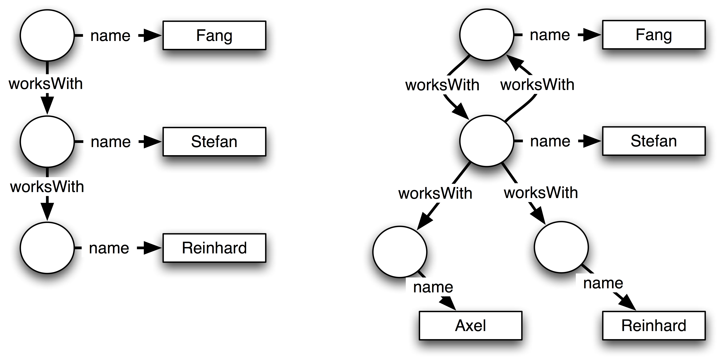
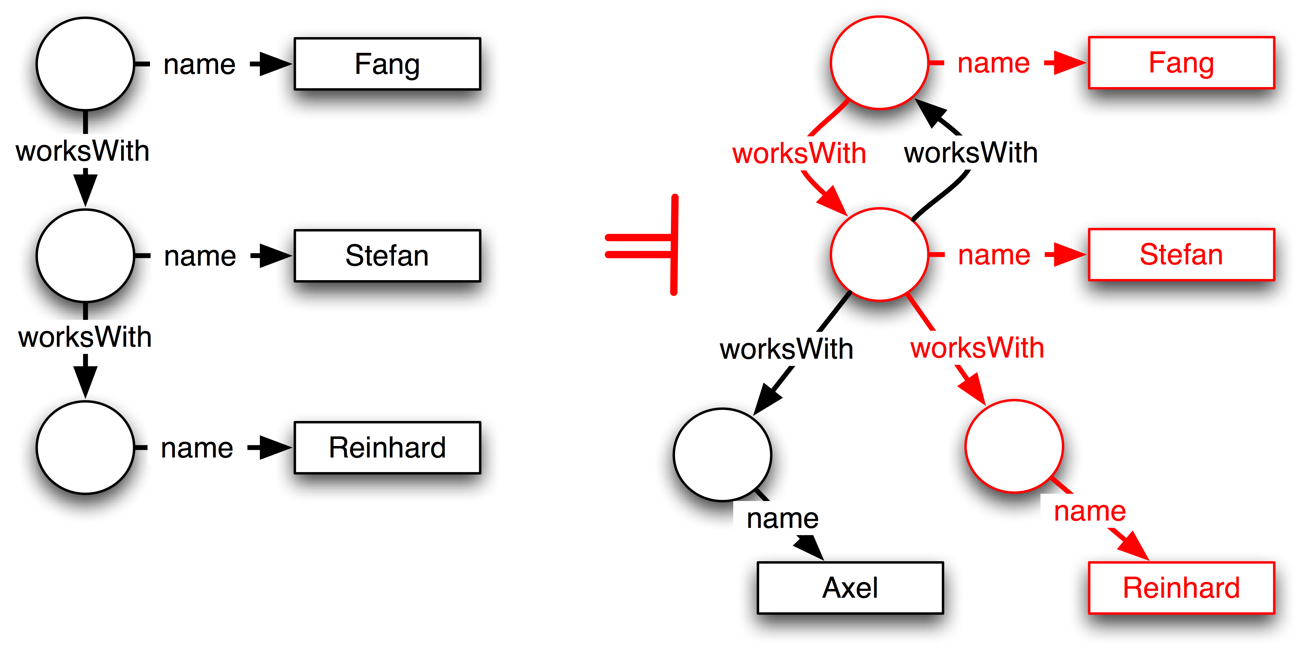
Domain-Restricted Graphs: Example

Slide 5
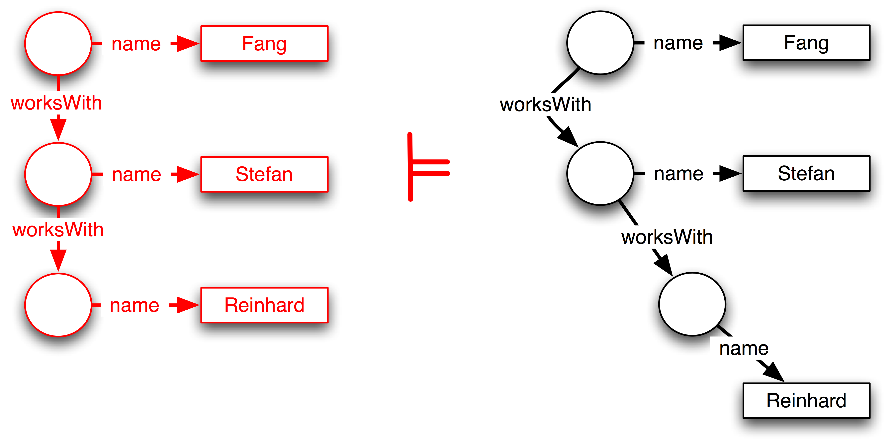
Domain-Restricted Graphs: Example

Slide 6
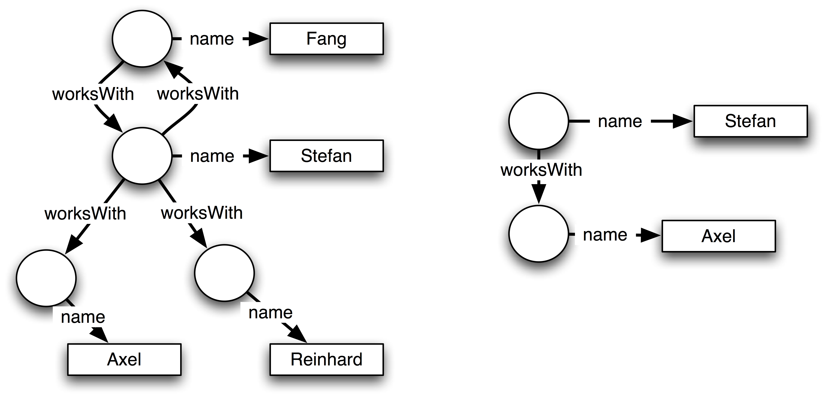
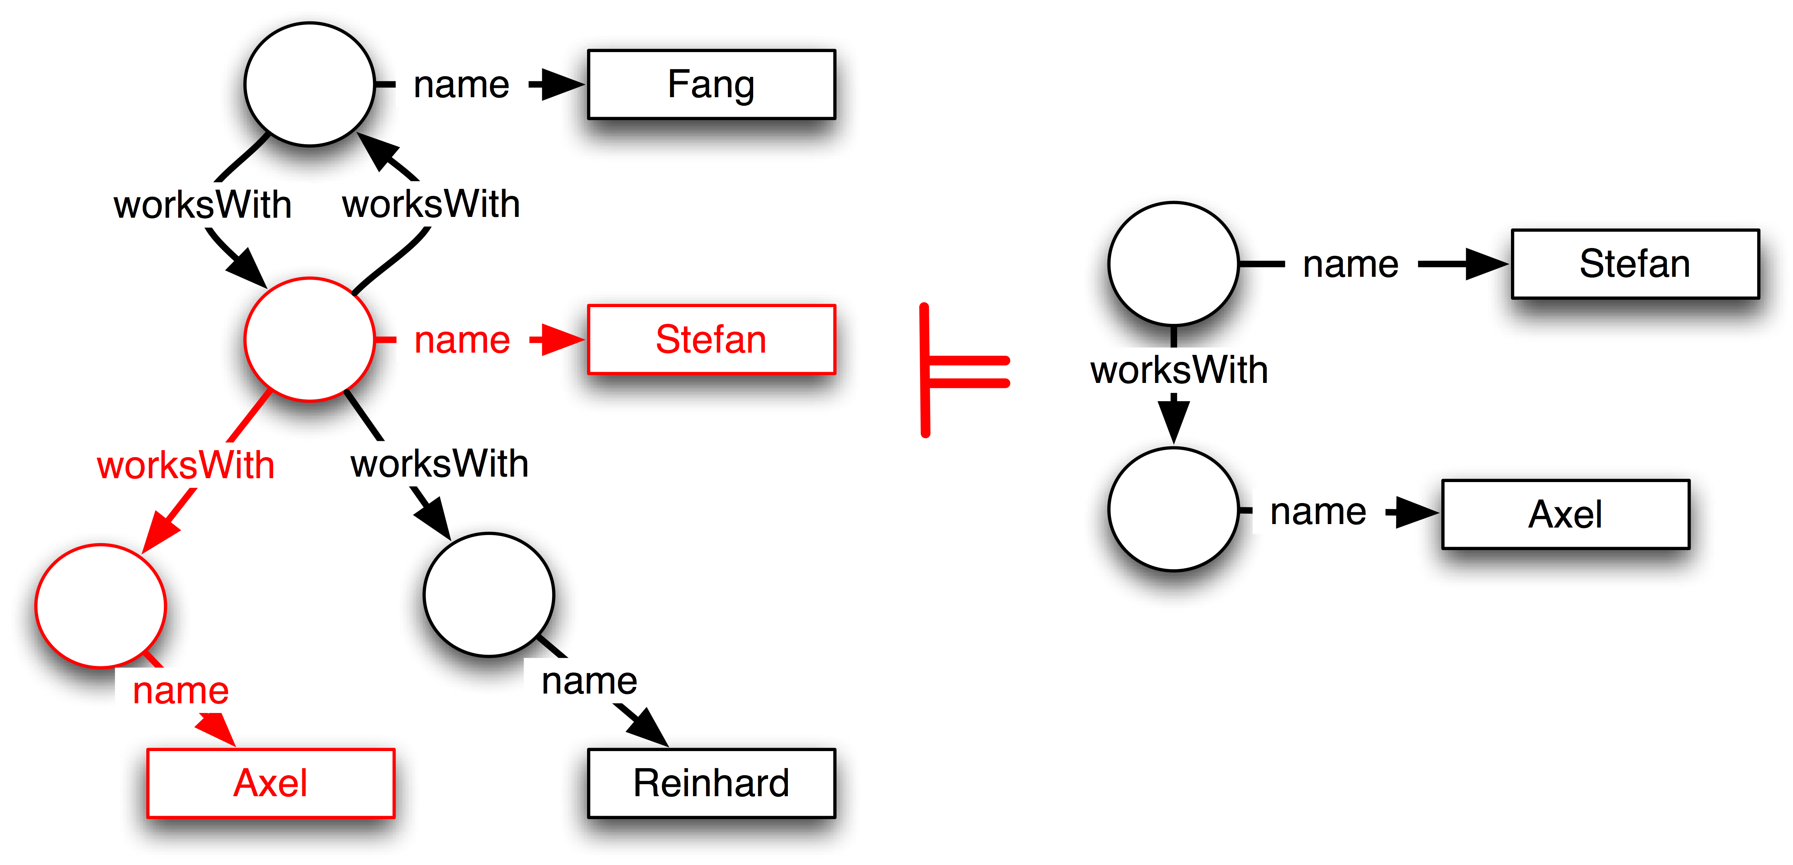
Domain-Restricted Graphs: Example

Slide 7
Domain-Restricted Graphs: Example
Fang Wei
Stefan Woltran
Stefan Decker
D₁
D₂
D₃
D₁ = TUV =
{:fangwei, :stefanwoltran,
:reinhardpichler, :thomaseiter, … }
D₂ = TUV ∪ Alumni =
{:fangwei, :stefanwoltran,
:reinhardpichler, :thomaseiter,
:axelpolleres, :manfredhauswirth, … }
D₃ = DERI =
{:stefandecker,
:axelpolleres, :manfredhauswirth … }

Slide 8
Domain-Restricted Graphs: Example
Fang Wei
Stefan Woltran
Stefan Decker
D₁
D₂
D₃
D₁ ⊆ D₂
∈D₁
∈D₂
∈D₁
∈D₂
∈D₁
∈D₂
∈D₂

Slide 9
Domain-Restricted Graphs: Example
D₁ ⊆ D₂
∈D₁
∈D₂
∈D₁
∈D₂
∈D₁
∈D₂

Slide 10
Domain-Restricted Graphs: Example
Fang Wei
Stefan Woltran
Stefan Decker
D₁
D₂
D₃
D₂ ⊆ D_{3 ,} D₃ ⊆ D₂
∈D₂
∈D₃
∈D₂
∈D₃
∈D₂
∈D₂

Slide 11
Domain-Restricted Graphs ⟨G , D⟩ : Definition
Base notion in RDF semantics: RDF interpretation for a Graph G
I = (Res, Prop, Lit, ε, IS, IL)
We define the D-restriction of RDF interpretations:
I_{D} = (Res ∩ D, Prop, Lit ∩ D, ε, IS_{Res∩D}, IL_{Res∩D} )
Entailment for domain-restricted graphs, defined as wrt. D-restriction of RDF interpretations:
⟨G₁ , D₁ ⟩ ⟨G₂ , D₂ ⟩

Slide 12
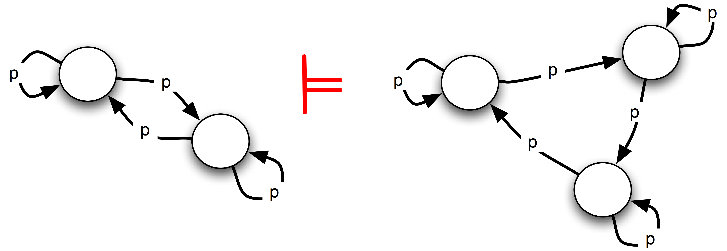
Domain-Restricted Graphs: Properties
D₁ ⊆ D₂ implies ⟨G₁ , D₁ ⟩ ⟨G₂ , D₂ ⟩
G₁ G₂ implies ⟨G₁ , D⟩ ⟨G₂ , D⟩
But: Complexity of D-entailment is Π^{p} ... Uh?
Example:
D = {a,b}
Intuitively:
More entailments by implicit equalities if |D| is small enough!
₂
∈D
∈D
∈D
∈D
∈D

Slide 13
Complexity proof (Ideas)
Membership: non-entailment in Π^{p} :
We can assume w.l.o.g. that G₁ is ground
“⟨G₁, D⟩ does not d-entail ⟨G₂, D⟩” can be decided in Σ^{p} by
Guessing a D-interpretation such that G₁ is true
Check that G₂ is false for all possible assignments of bnodes to elements of D
Hardness proof by a reduction from a special variant of
H-subsumption*, for |D| ≥ 4 … long version.
₂
₂
* “total binary H-subsumption” i.e., no constants are allowed in clauses and only binary predicates,
fixed finite Herbrand universe

Slide 14
Now how to remedy the mess we did…
… we saw the first “restriction” made things more complex.
But: bounded treewidth helps!

Slide 15
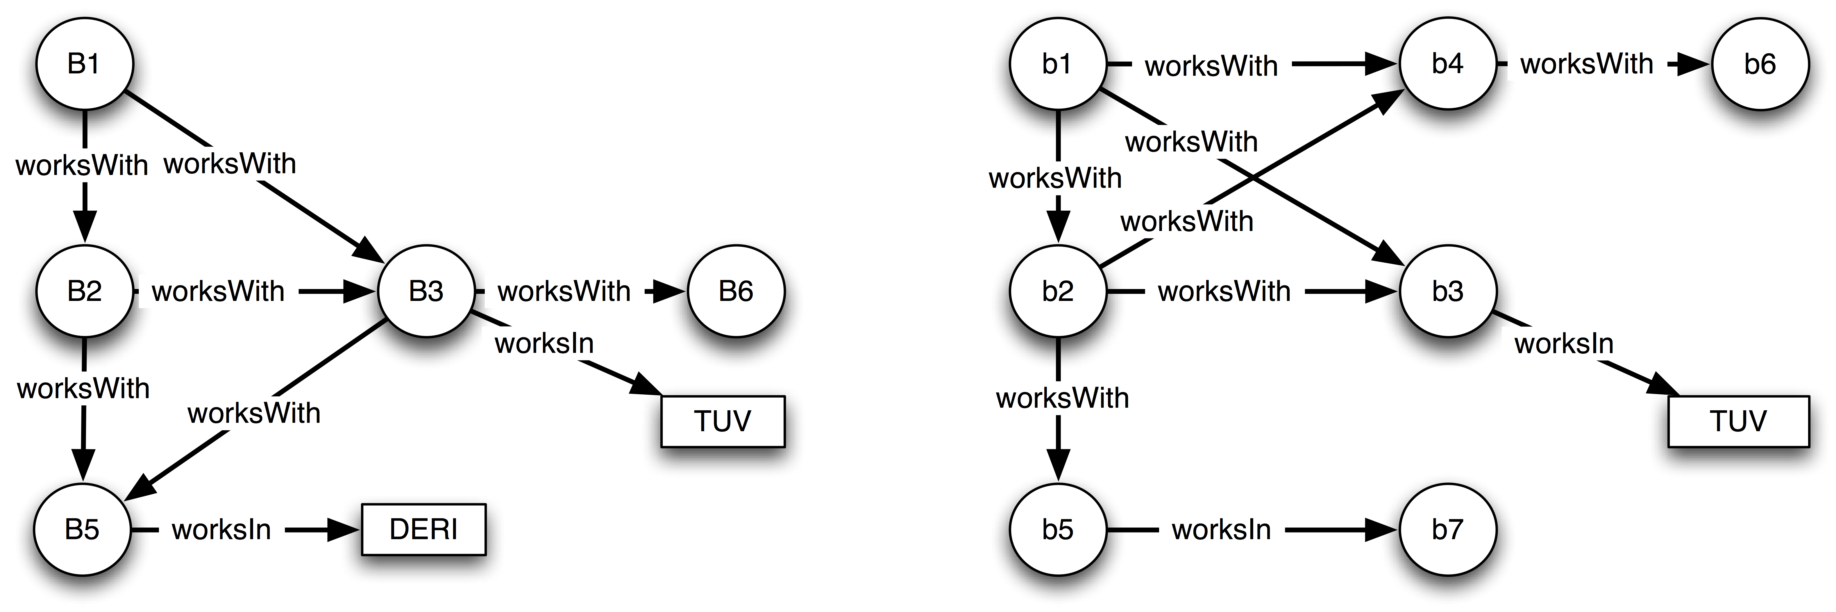
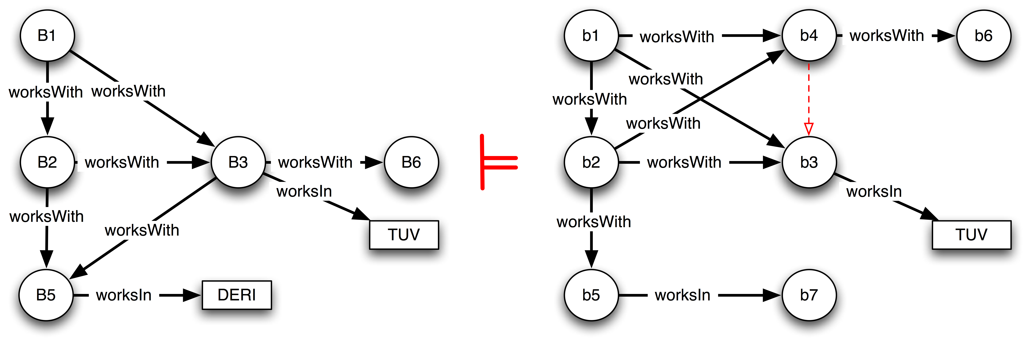
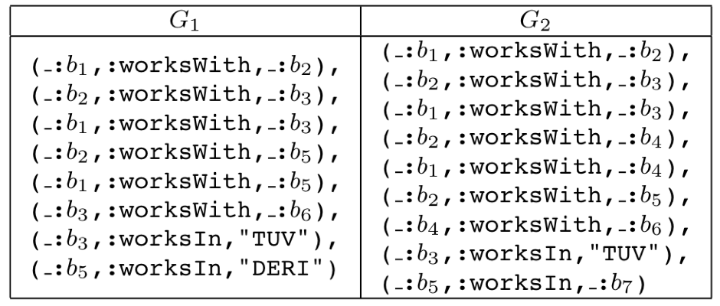
Bounded Treewidth for RDF graphs:
Measure of “acyclicity”
Roughly:
“If I can decompose the graph to a tree of hyper-edges with at most
k -1 nodes per edge, then the graph has treewidth k”
Example:
“Skeleton” relevant for tree-decomposition:
b1 b2 b3
tw(G₂) = 2
b1 b2 b4
b2 b5
b4 b6
b5 b7

Slide 16
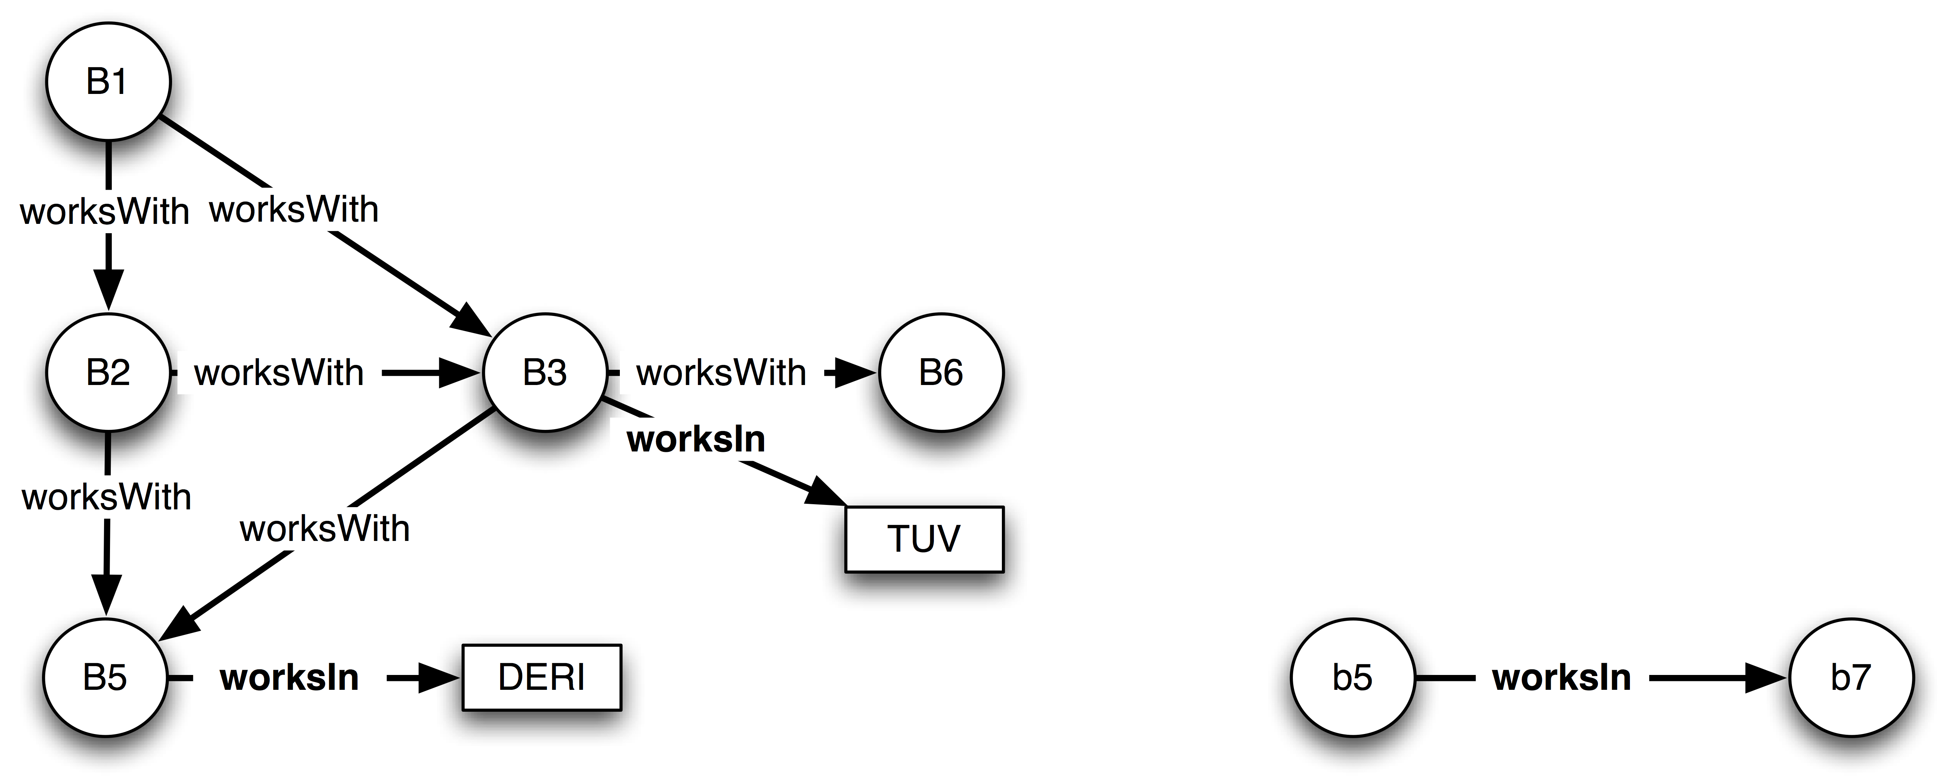
Polynomial time Algorithm for Entailment with Bounded Treewidth for G₂ (Idea):
✔
b1 b2 b3
B1 B2 B3
B1 B2
B2 B3
B1 B3
B2 B5
B3 B6
B1 B5
B1 B2 B3
B1 B2 B5
b1 b2 b4
b2 b5
B1 B2
B2 B3
B1 B3
B2 B5
B3 B6
B1 B5
b4 b6
b5 b7
B3 TUV
B5 DERI
From the decomposition, process the induced subgraphs “bottom-up” in a modular fashion,
computing partial bnode assignments.
When going upwards, filter allowed assignments by semi-joins with the assignments for the child nodes.
If an assignment “survives” at the root, entailment holds.
O(n^{k}) for entailment checks per node
O(n^{2k}) per semi-join
Thus, for |G₂| = m we get as upper bound: O(m²+mn^{2k})

Slide 17
Now what about D-entailment with bounded treewidth?
Overall complexity drops from Π^{p} to coNP:
Recall from above:
“⟨G₁, D⟩ does not d-entail ⟨G₂, D⟩” can be decided in Σ^{p} by
Guessing a D-interpretation such that G₁ is true
Check that G₂ is false for all possible assignments of bnodes to elements of D
Step 2. can be done in polynomial time for bounded tree-width.
coNP-hardness still holds (proof by 3-colorability, see paper.)
₂
₂

Slide 18
Summary:
Some form of domain-restriction may be useful for graphs on the Web…
… but comes at some cost!
Things are not that bad unless we expect small domains (less elements than bnodes)
Similar results for
enumerated classes in (fragments of) OWL?
entailment with finite datatypes?, etc.
➔ Future work!
Bounded treewidth is more general than acyclicity. Good news! (if we don’t expect graphs with large cycles among bnodes)

