Slide 1
Can Semantics catch up with the Web?
Axel Polleres
ISWSA2010
Monday, 14/06/2010
Amman, Jordan

Slide 2




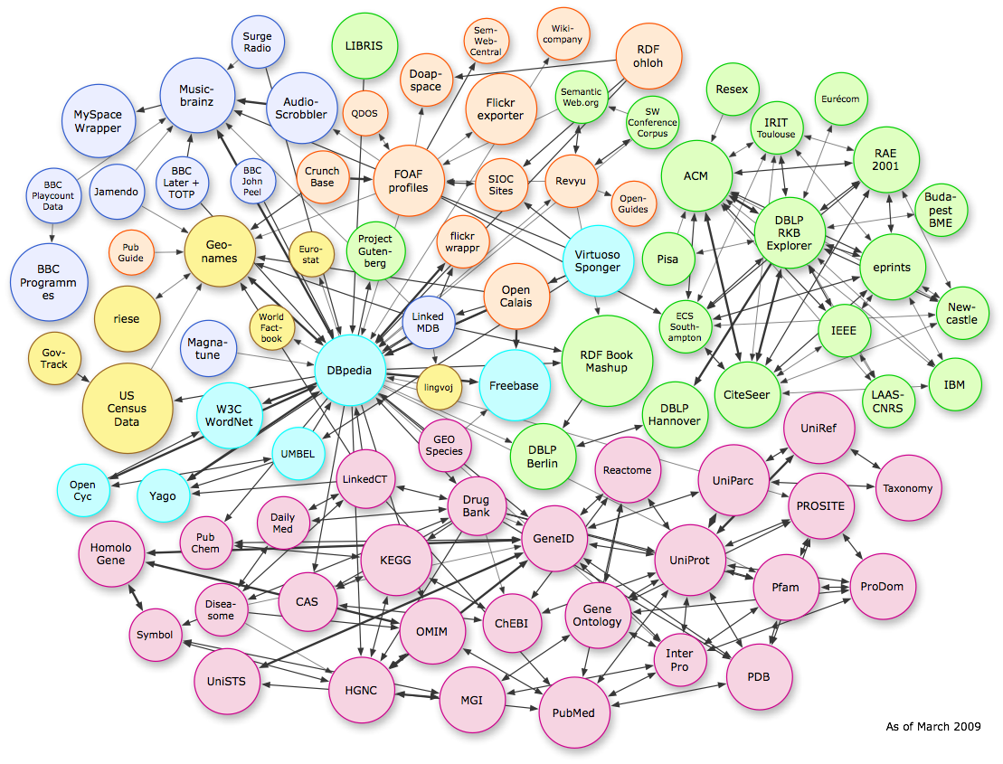
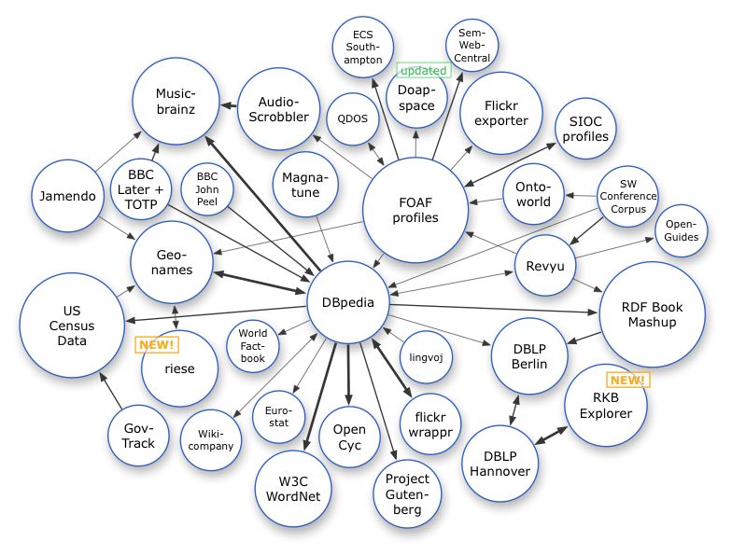






Linked Open Data
Excellent tutorial here: http://www4.wiwiss.fu- berlin.de/bizer/pub/LinkedDataTutorial/
Great!
So, Can we go home and declare success?
Not yet…
…
2

Slide 3
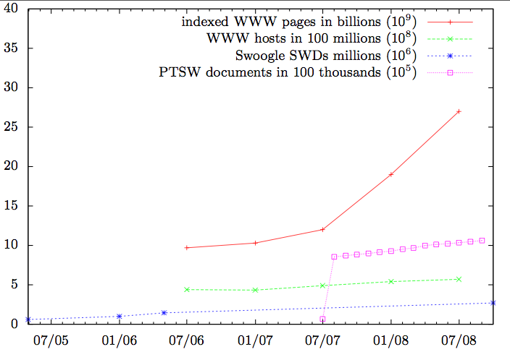





Problem1: We’re lagging behind… ☹
From: S.Auer et al. Triplify - lightweight linked data publication from relational databases. WWW 2009.
3

Slide 4
Problem2: We’re overwhelmed… ☹
After a rough estimation, it looks like the services hosted on DBTune provide access to 13.1 billion triples, therefore making a significant addition to the data web!
http://blog.dbtune.org/post/2008/04/02/DBTune-is-providing-131-billion-triples
…
However:
Full DL Reasoners choke on far less…
… they’re not made for Web Data
4

Slide 5
Problem1: Too little Data… more details…
HTML Web grows much faster… How to inject SW technology cleverly?
… How to lift Web Data, how to reuse Semantic Web Data?
Too little “agreed” vocabularies… How to build them?
Too little links/reuse … Reasoning to the rescue?
5

Slide 6

How to inject SW technology cleverly?
Example: Injecting SW Technology in Drupal
6

Slide 7

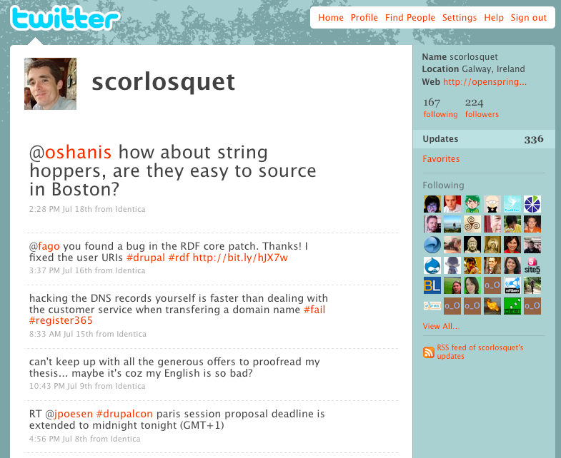
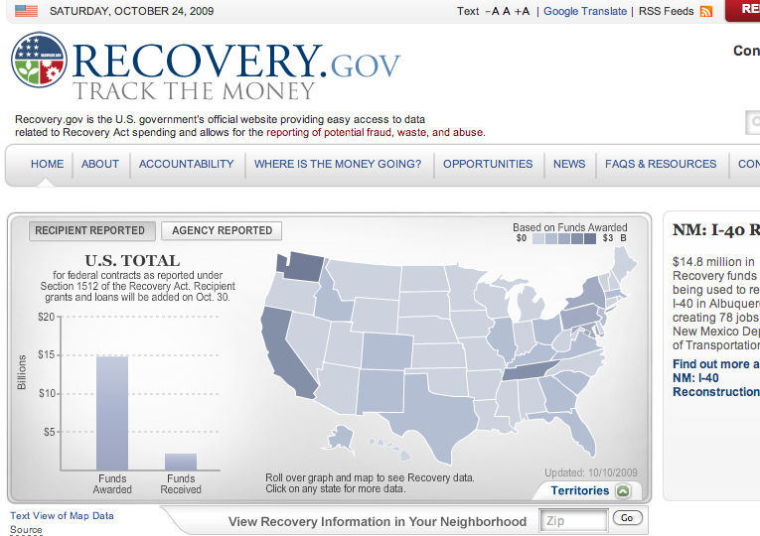

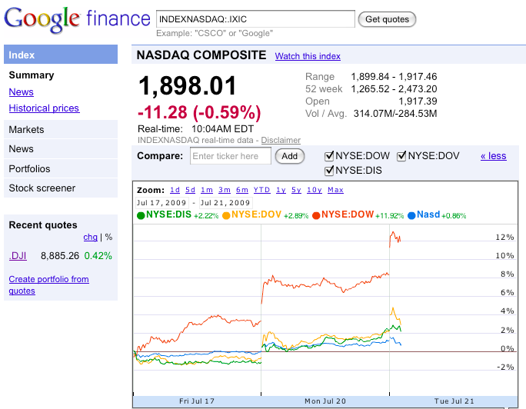


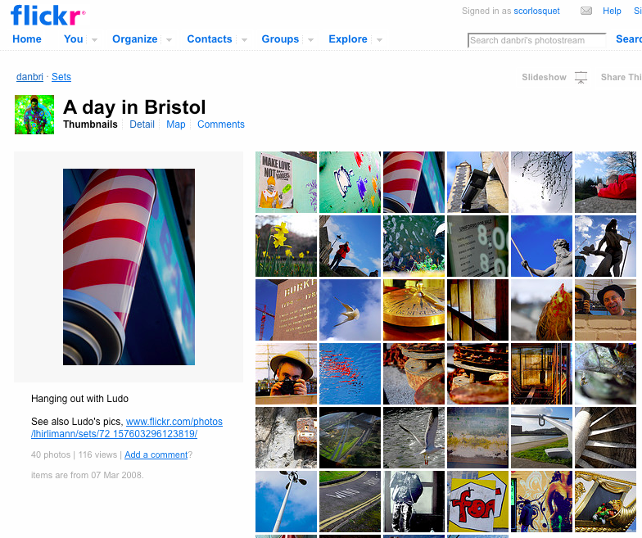


Loads of Data on the Web in CMS...
Digital Enterprise Research Institute
www.deri.ie
7

Slide 8

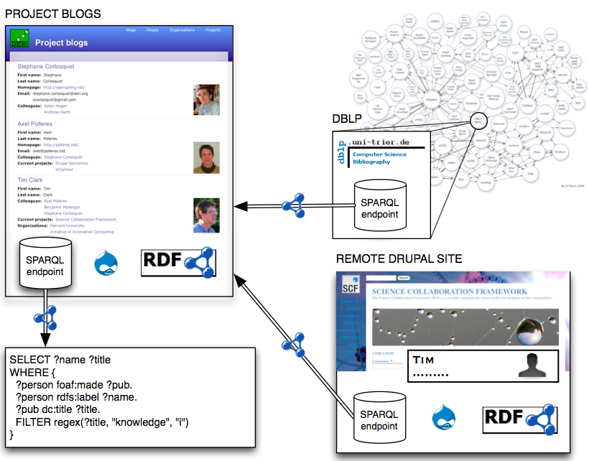

So, here’s our idea of a CMS:
Digital Enterprise Research Institute
www.deri.ie
Demo site: http://drupal.deri.ie/projectblogs/
8

Slide 9
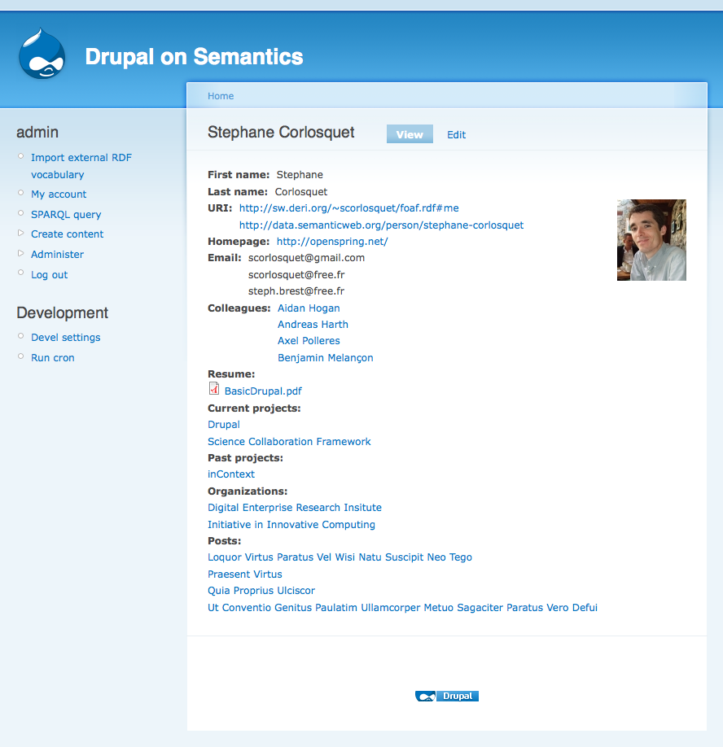
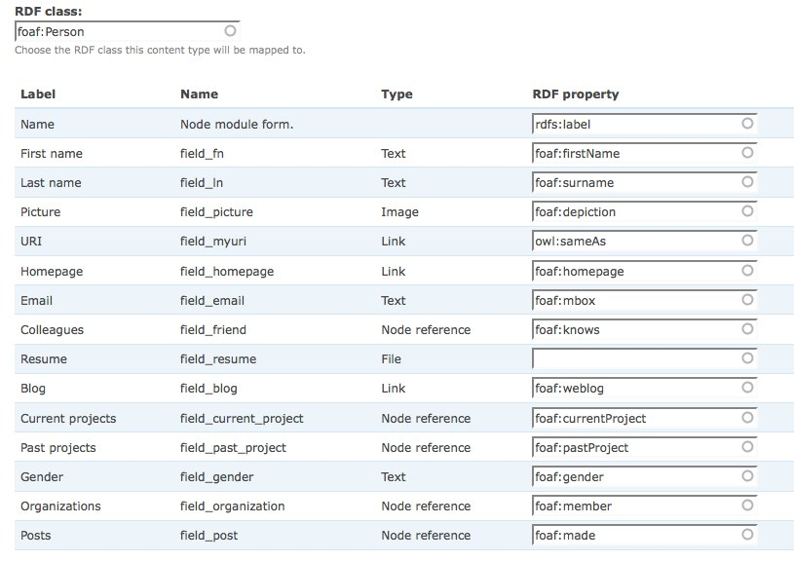
Semantic Drupal:
Enables data mining techniques, text-analysis, reasoning, aggregation, trend detection over different platforms

Slide 10
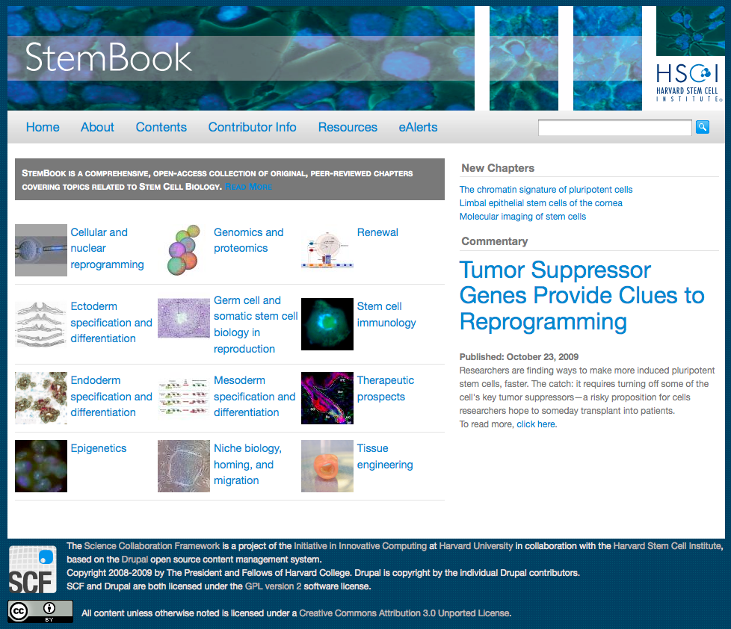
Where is it used?
Science Collaboration Framework:
Digital Enterprise Research Institute
www.deri.ie
  Stembook (Stem Cell articles and reviews)
    http://www.stembook.org/
10

Slide 11
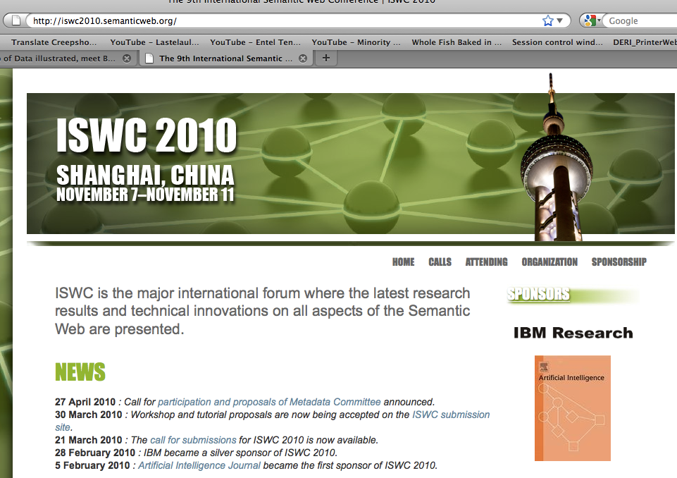
ISWC2010
Digital Enterprise Research Institute
www.deri.ie
11

Slide 12
Semantic Drupal
Out-of-the-box Linked Data from any Drupal site
Out-of-the-box “site ontology”
Out-of-the-box SPARQL endpoint
Advanced: tie to existing vocabularies
Advanced: import Data via SPARQL
Drupal 6 modules:
    http://drupal.org/project/rdfcck
    http://drupal.org/project/evoc
    http://drupal.org/project/sparql_ep
    http://drupal.org/project/rdfproxy
12

Slide 13

Good news from Drupal 7:
Digital Enterprise Research Institute
www.deri.ie
RDF mapping feature committed to Drupal 7 core
  RDFa output by default (blogs, forums, comments, etc.)
  using FOAF, SIOC, DC, SKOS.
  Download development snapshot
      http://ftp.drupal.org/files/projects/drupal-7.x-dev.tar.gz
Currently more than 200.000* sites on Drupal 6
  waiting to make the switch to Drupal 7
  waiting to massively increase the amount of RDF data
  on the Web
  Huge boost for RDF on the Web!
* http://drupal.org/project/usage/drupal
13
Notes:
- Reaching outside the RDF community
- data from people who never heard of RDF

Slide 14
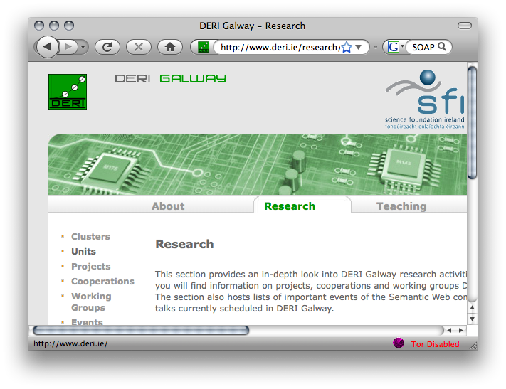







How to lift Web Data, how to reuse Semantic Web Data?
XSLT/XQuery
HTML
RSS
XSPARQL
<XML/>
SPARQL
SOAP/WSDL
14

Slide 15
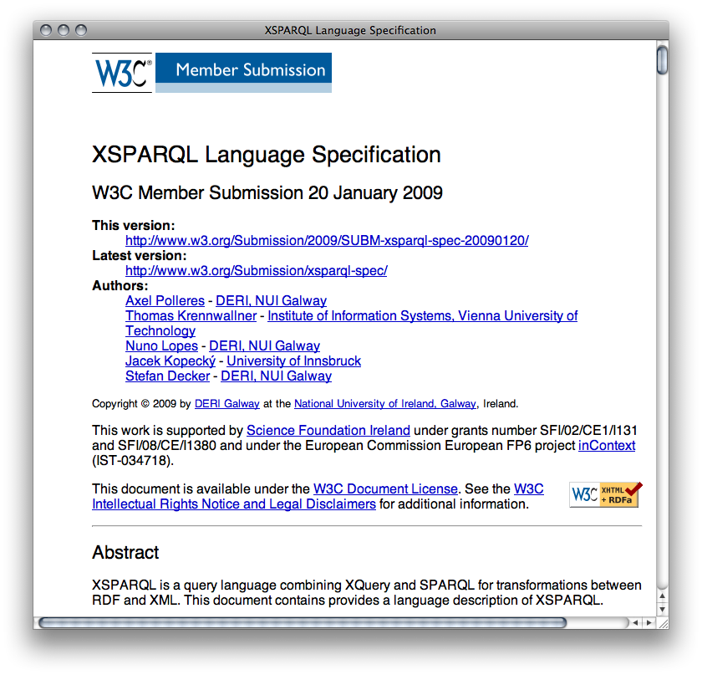
XQuery + SPARQL = XSPARQL

Slide 16

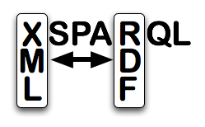
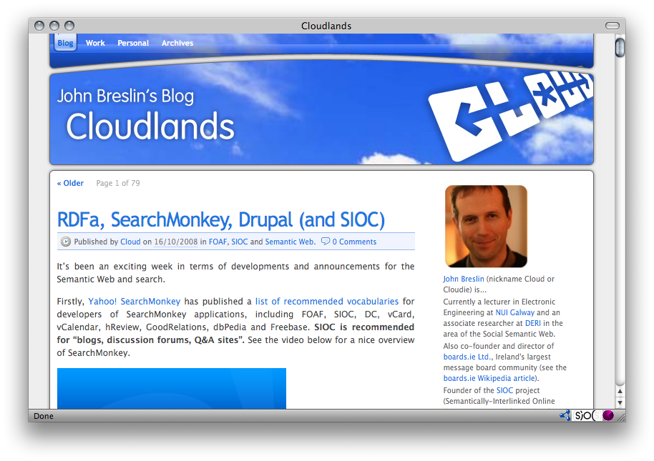

Example: SIOC-2-RSS
XSPARQL+SIOC enables customised RSS export:
<channel>
<title>
{for $name
from <http://www.johnbreslin.com/blog/index.php?sioc_type=site>
where { [a sioc:Forum] sioc:name $name }
return $name}
</title>
{for $seeAlso
from <http://www.johnbreslin.com/blog/index.php?sioc_type=site>
where { [a sioc:Forum] sioc:container_of [rdfs:seeAlso $seeAlso] } return <item>
{for $title $descr $date
from $seeAlso
where { [a sioc:Post] dc:title $title ;
sioc:content $descr;
dcterms:created $date }
return <title>$title</title>
<description>$descr</description>
<pubDate>$date</pubDate>}
</item>
RSS2.0
“Great stuff,... I have not seen any SIOC to RSS xslt examples or vice versa” (John Breslin, creator of SIOC)

Slide 17
Problem1: Too little Data… more details…
HTML Web grows much faster… How to inject SW technology cleverly?
… How to lift Web Data, how to reuse Semantic Web Data?
Too little “agreed” vocabularies… How to build lightweight vocabularies?
Too little links/reuse … Reasoning to the rescue?
17

Slide 18

… How to build lightweight vocabularies? An example:
Semantic Interlinking of Online Community Sites (SIOC) –
Seeding a Standard
18

Slide 19
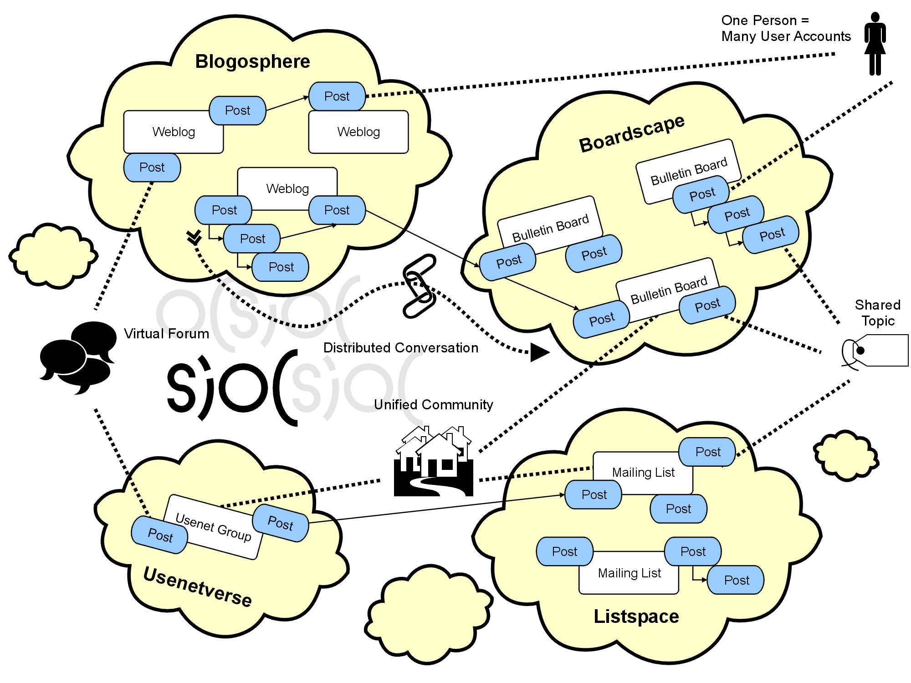

Slide 20
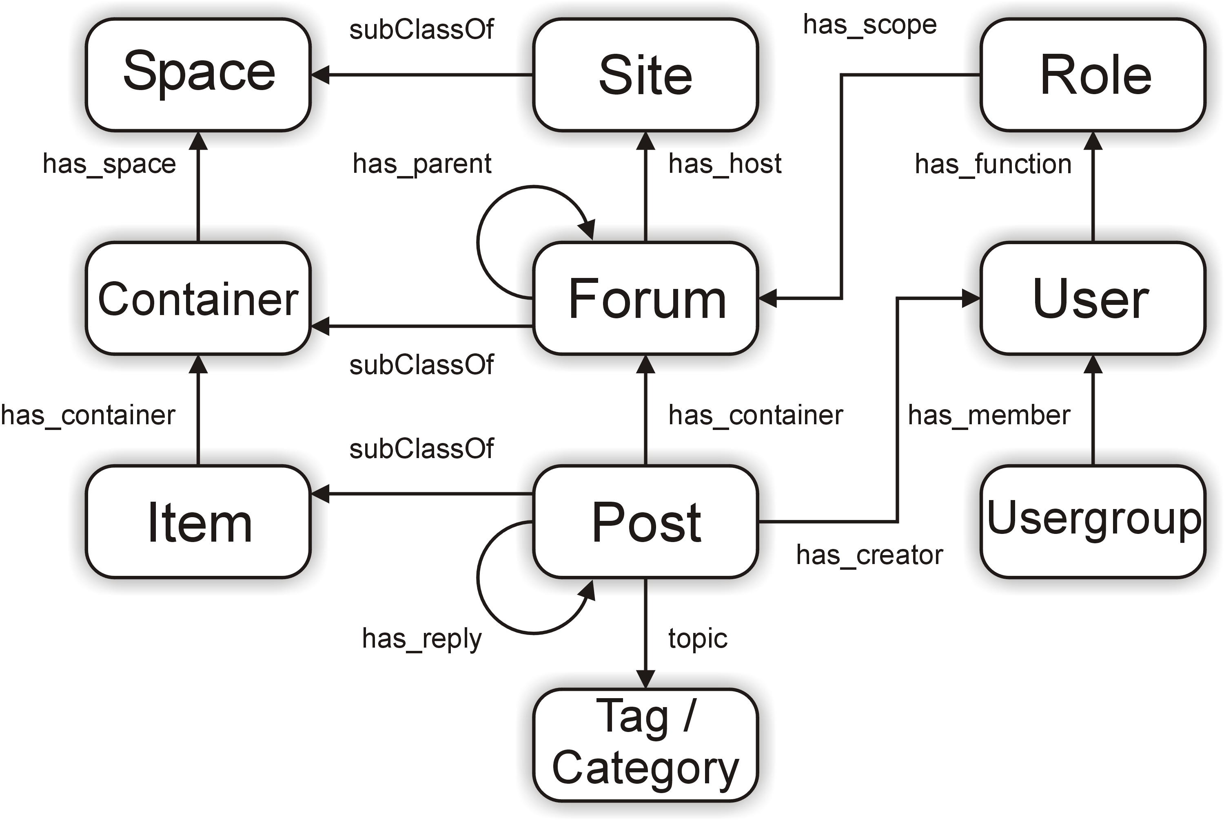
The SIOC ontology
The main classes and properties are:
20

Slide 21
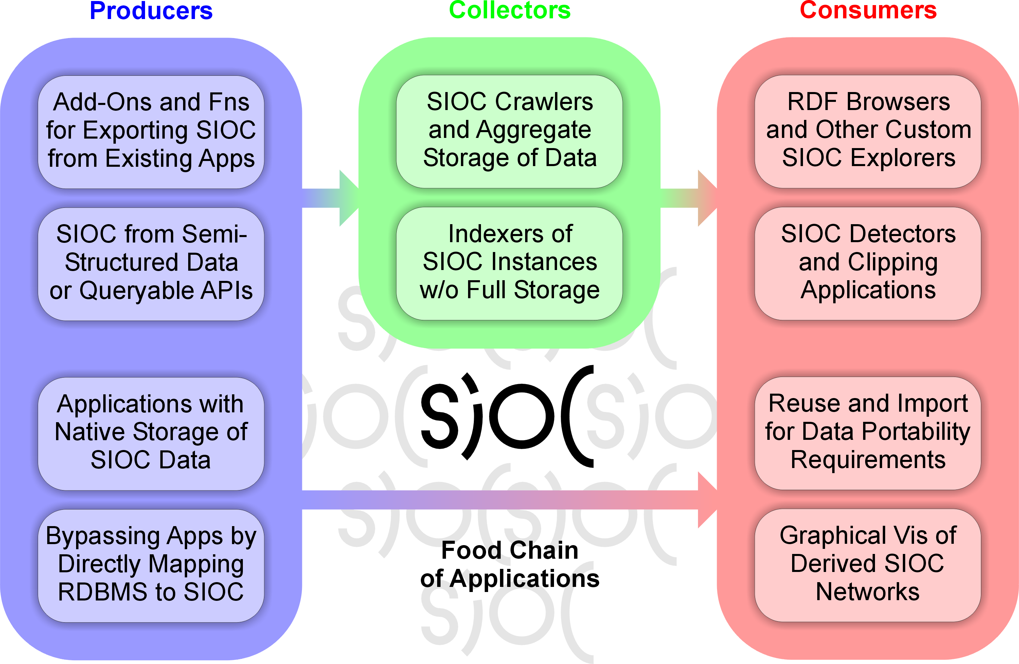
The SIOC food chain
21

Slide 22
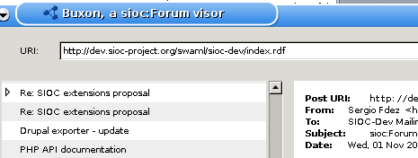
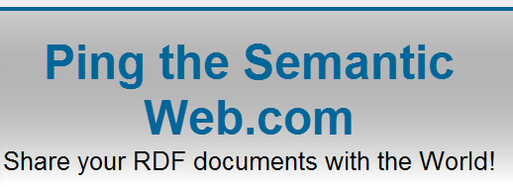

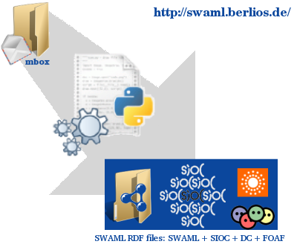


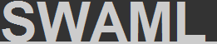

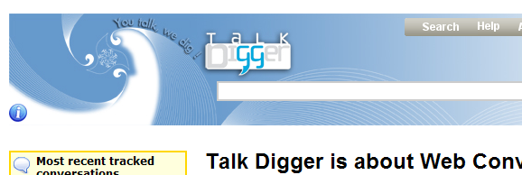


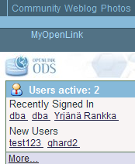









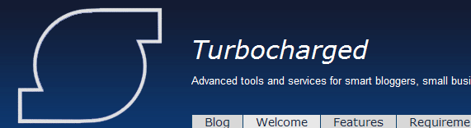







Adoption of SIOC
22

Slide 23
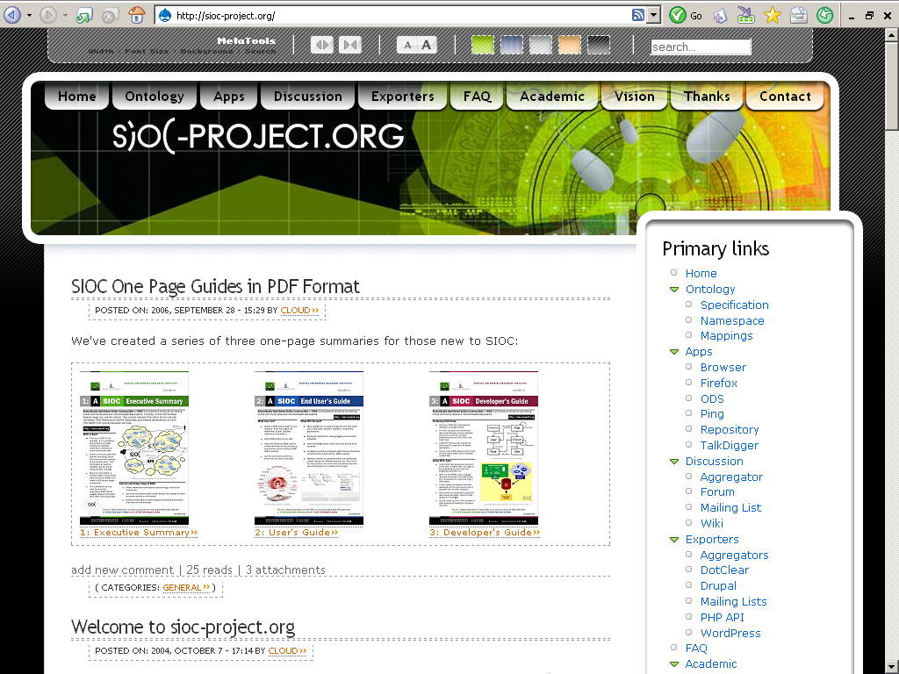
Dissemination

Slide 24
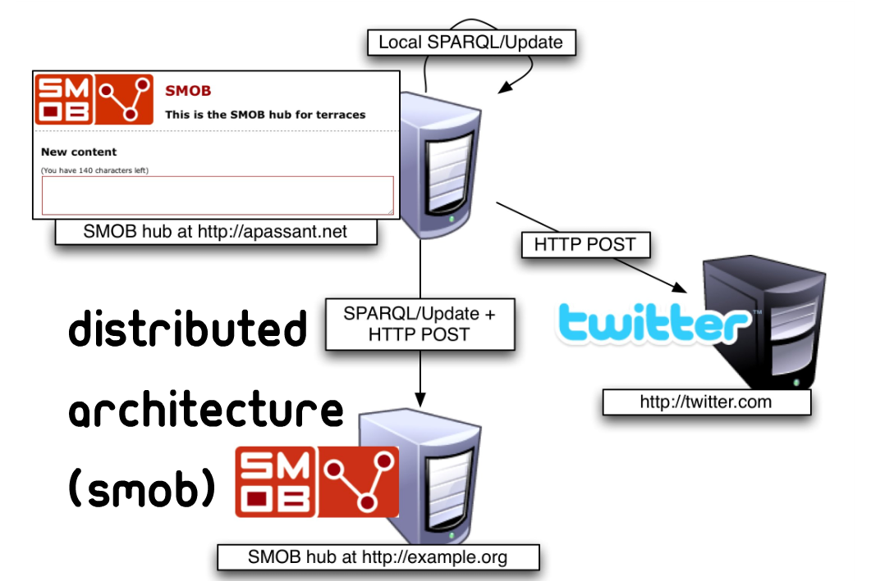
Another example of leveraging SW Data: SMOB

Slide 25

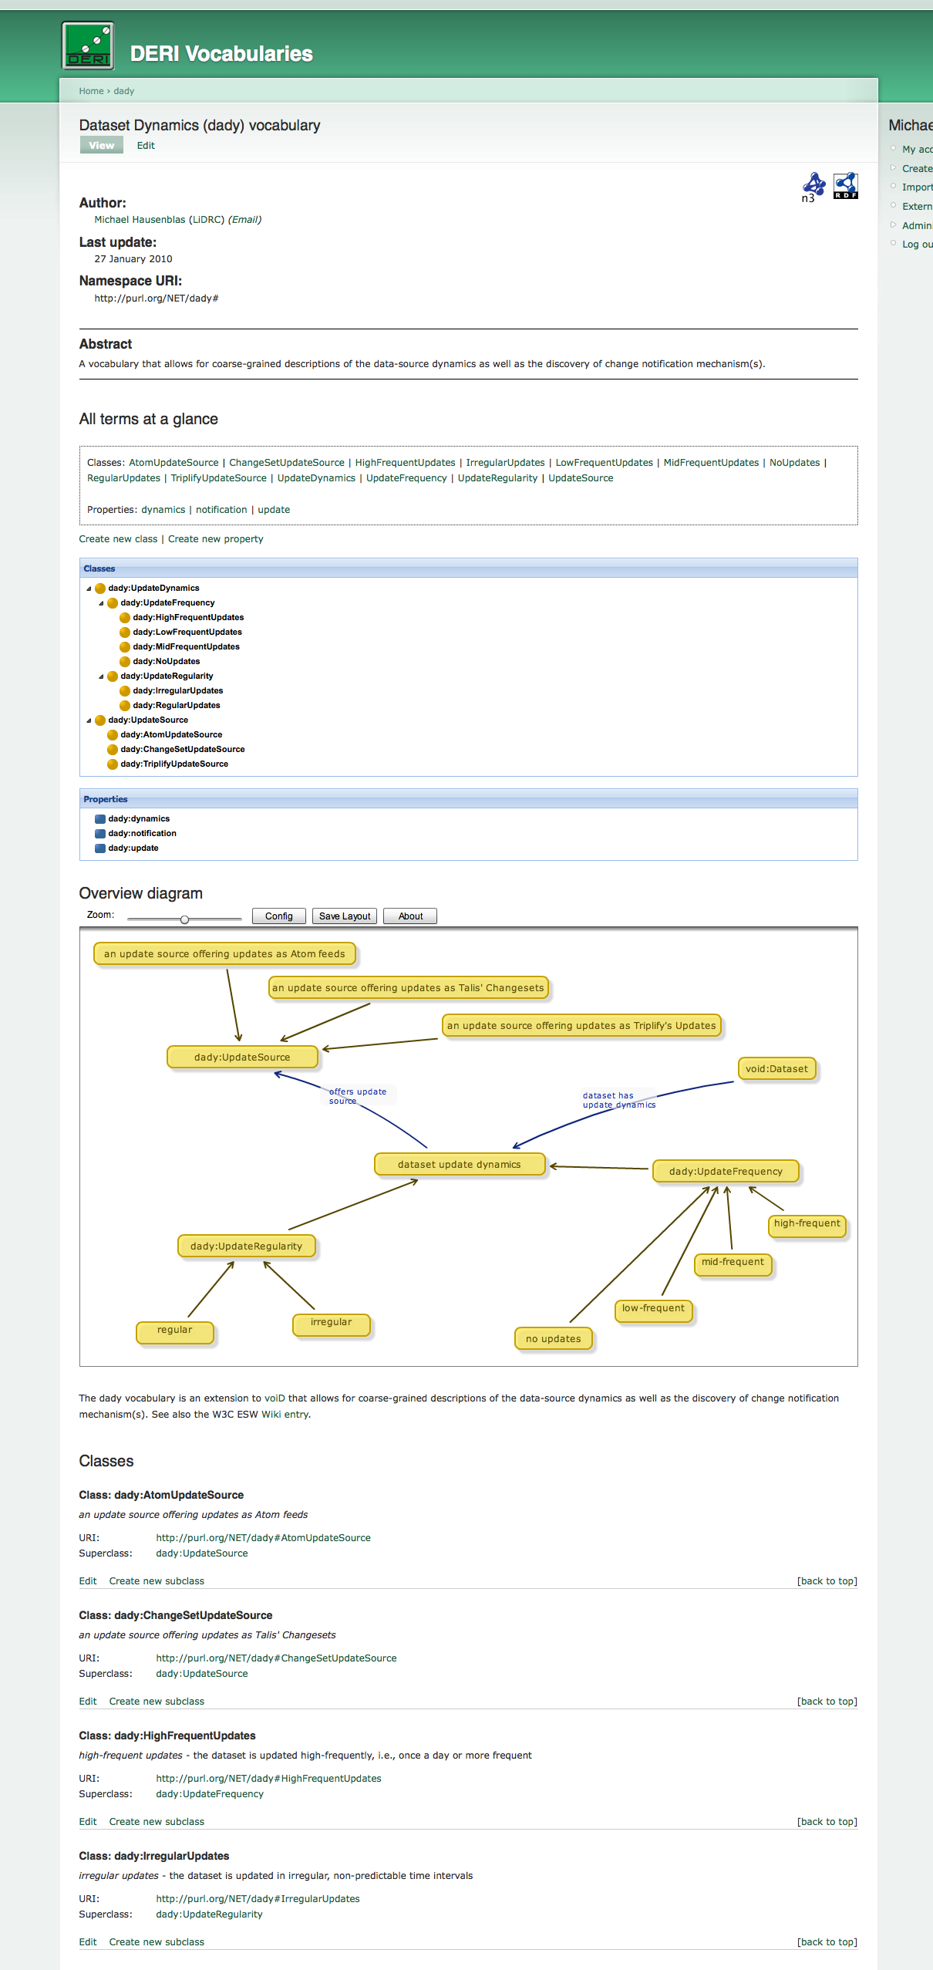

Making ontology building more Web-user-friendly:
http://vocab.deri.ie/
Neologism is a web-based editor for
RDF Schema vocabularies and
lightweight OWL ontologies.
  Collaborate to create and maintain
  vocabularies and ontologies
  Publish the vocabulary on the Web
  according to W3C and Linked Data
  best practices, with views for humans
  (HTML, graph) and machines (RDF/XML, Turtle)
  Import existing vocabularies
  Also works with external namespaces
  (e.g., via PURL.org)
  Based on the popular Drupal CMS
  More at http://neologism.deri.ie/
25

Slide 26
Problem2: We’re overwhelmed… ☹
After a rough estimation, it looks like the services hosted on DBTune provide access to 13.1 billion triples, therefore making a significant addition to the data web!
http://blog.dbtune.org/post/2008/04/02/DBTune-is-providing-131-billion-triples
…
However:
Full DL Reasoners choke on far less…
… they’re not made for Web Data
26

Slide 27

Simplified “added value” proposition of Semantic Search…
“explicit” data
RDF
“implicit” data? Via inference using
OWL2, RDF Schema!
Fig 1: RDF Web Dataset
27
27

Slide 28
Example: Finding experts/reviewers?
Tim Berners-Lee, Dan Connolly, Lalana Kagal, Yosi Scharf, Jim Hendler: N3Logic: A logical framework for the World Wide Web. Theory and Practice of Logic Programming (TPLP), Volume 8, p249-269
Who are the right reviewers? Who has the right expertise?
Which reviewers are in conflict?
Most of the necessary data already on the Web, even as RDF!
28

Slide 29
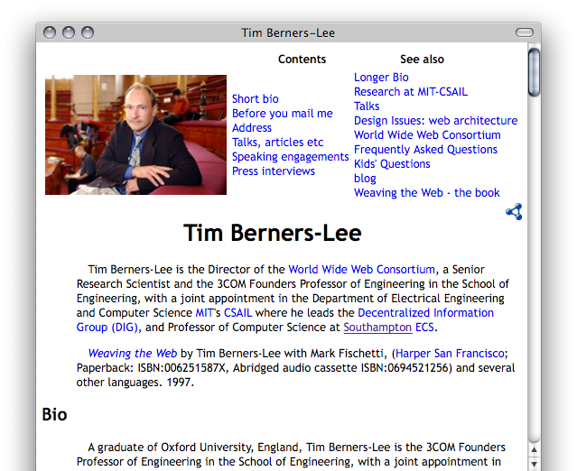
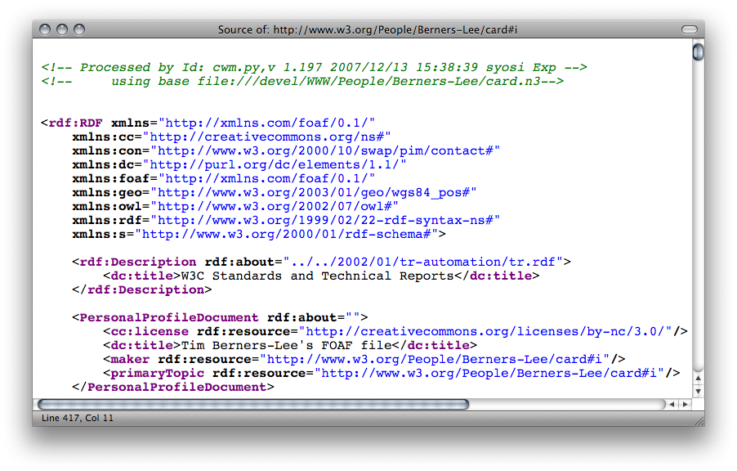
Tim BL’s FOAF file…
29

Slide 30
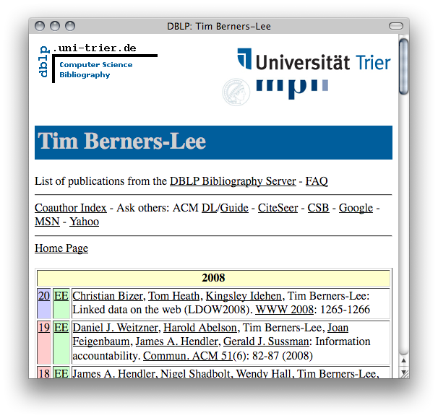
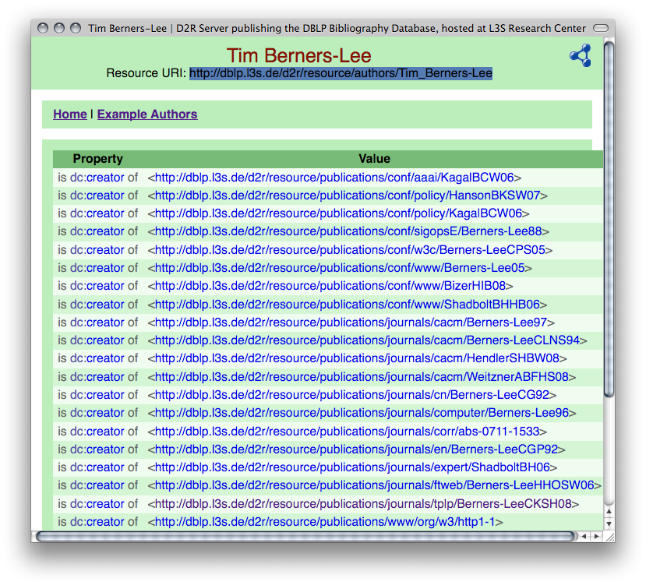
DBLP as Linked Date
Gives unique URIs to authors, documents, etc. on DBLP! E.g.,
http://dblp.l3s.de/d2r/resource/authors/Tim_Berners-Lee,
http://dblp.l3s.de/d2r/resource/publications/journals/tplp/Berners-LeeCKSH08
Provides RDF version of all DBLP data + query interface!
30

Slide 31
RDF Data online: Example
Data in RDF: Triples
  DBLP:
  <http://dblp.l3s.de/…/journals/tplp/Berners-LeeCKSH08> rdf:type swrc:Article.
  <http://dblp.l3s.de/…/journals/tplp/Berners-LeeCKSH08> dc:creator
  <http://dblp.l3s.de/d2r/…/Tim_Berners-Lee> .
  …
  <http://dblp.l3s.de/d2r/…/Tim_Berners-Lee> foaf:homepage
  <http://www.w3.org/People/Berners-Lee/> .
  …
  <http://dblp.l3s.de/d2r/…/Dan_Brickley> foaf:name “Dan Brickley”^^xsd:string.
  Tim Berners-Lee’s FOAF file:
  <http://www.w3.org/People/Berners-Lee/card#i> foaf:knows
  <http://dblp.l3s.de/d2r/…/Dan_Brickley> .
  <http://www.w3.org/People/Berners-Lee/card#i> rdf:type foaf:Person .
  <http://www.w3.org/People/Berners-Lee/card#i> foaf:homepage
  <http://www.w3.org/People/Berners-Lee/> .
31

Slide 32
An example in SPARQL
    “Names of all persons who co-authored with authors of http://dblp.l3s.de/d2r/…/Berners-LeeCKSH08 or known by co-authors”
    SELECT ?Name WHERE
    { <http://dblp.l3s.de/d2r/resource/publications/journals/tplp/Berners-LeeCKSH08> dc:creator ?Author.
    ?D dc:creator ?Author.
    ?D dc:creator ?CoAuthor.
    { ?CoAuthor foaf:name ?Name . }
    UNION
    { ?CoAuthor foaf:knows ?Person.
    ?Person rdf:type foaf:Person.
    ?Person foaf:name ?Name }
    }
Doesn’t work… no foaf:knows relations in DBLP ☹
Needs Linked Data! E.g. TimBL’s FOAF file!
32

Slide 33
Back to the Data:
  DBLP:
  <http://dblp.l3s.de/…/journals/tplp/Berners-LeeCKSH08> rdf:type swrc:Article.
  <http://dblp.l3s.de/…/journals/tplp/Berners-LeeCKSH08> dc:creator
  <http://dblp.l3s.de/d2r/…/Tim_Berners-Lee> .
  …
  <http://dblp.l3s.de/d2r/…/Tim_Berners-Lee> foaf:homepage
  <http://www.w3.org/People/Berners-Lee/> .
  Tim Berners-Lee’s FOAF file:
  <http://www.w3.org/People/Berners-Lee/card#i> foaf:knows
  <http://dblp.l3s.de/d2r/…/Dan_Brickley> .
  <http://www.w3.org/People/Berners-Lee/card#i> foaf:homepage
  <http://www.w3.org/People/Berners-Lee/> .
Even if I have the FOAF data, I cannot answer the query:
  Different identifiers used for Tim Berners-Lee
  Who tells me that Dan Brickley is a foaf:Person?
Linked Data needs Reasoning!
33
33

Slide 34
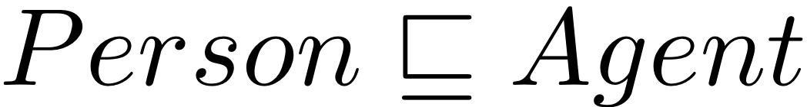

The FOAF ontology…
foaf:knows rdfs:domain foaf:Person
  Everybody who knows someone is a Person
  foaf:knows rdfs:range foaf:Person
  Everybody who is known is a Person
  foaf:Person rdfs:subclassOf foaf:Agent
  Everybody Person is an Agent.
  foaf:homepage rdf:type owl:inverseFunctionalProperty .
  A homepage uniquely identifies its owner (“key” property)
  …
34
34

Slide 35
RDFS+OWL inference by rules 1/2
Semantics of RDFS can be partially expressed as (Datalog like) rules:
rdfs1: { ?S rdf:type ?C } :- { ?S ?P ?O . ?P rdfs:domain ?C . }
rdfs2: { ?O rdf:type ?C } :- { ?S ?P ?O . ?P rdfs:range ?C . }
rdfs3: { ?S rdf:type ?C2 } :- {?S rdf:type ?C1 . ?C1 rdfs:subclassOf ?C2 . }
cf. informative Entailment rules in [RDF-Semantics, W3C, 2004], [Muñoz et al. 2007]
35
35

Slide 36
RDFS+OWL inference by rules 2/2
OWL Reasoning e.g. inverseFunctionalProperty can also (partially) be expressed by Rules:
owl1: { ?S1 owl:SameAs ?S2 } :-
{ ?S1 ?P ?O . ?S2 ?P ?O . ?P rdf:type owl:InverseFunctionalProperty }
owl2: { ?Y ?P ?O } :- { ?X owl:SameAs ?Y . ?X ?P ?O }
owl3: { ?S ?Y ?O } :- { ?X owl:SameAs ?Y . ?S ?X ?O }
owl4: { ?S ?P ?Y } :- { ?X owl:SameAs ?Y . ?S ?P ?X }
cf. pD* fragment of OWL, [ter Horst, 2005], or, more recent: OWL2 RL
36
36

Slide 37
RDFS+OWL inference by rules: Example:
By rules of the previous slides we can infer additional information needed, e.g.
TimBL’s FOAF: <…/Berners-Lee/card#i> foaf:knows <…/Dan_Brickley> .
FOAF Ontology: foaf:knows rdfs:range foaf:Person
by rdfs2 → <…/Dan_Brickley> rdf:type foaf:Person.
TimBL’s FOAF: <…/Berners-Lee/card#i> foaf:homepage
  <http://www.w3.org/People/Berners-Lee/> .
DBLP: <…/dblp.l3s.de/d2r/…/Tim_Berners-Lee> foaf:homepage
  <http://www.w3.org/People/Berners-Lee/> .
FOAF Ontology: foaf:homepage rdfs:type owl:InverseFunctionalProperty.
by owl1 → <…/Berners-Lee/card#i> owl:sameAs <…/Tim_Berners-Lee>.
  Who tells me that Dan Brickley is a foaf:Person? → solved!
  Different identifiers used for Tim Berners-Lee → solved!
37
37

Slide 38
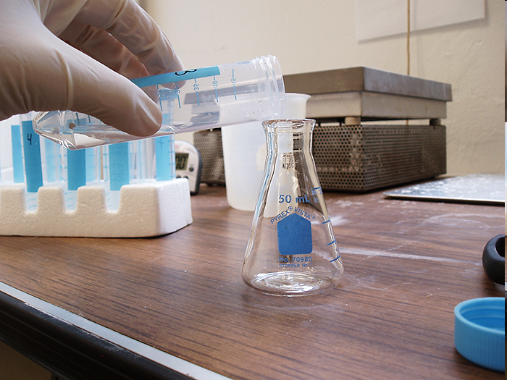

Web Reasoning: Challenges
Scalability
  Billions or tens of billions of statements (for the moment)
    Near linear scale!!!
Noisy data
  Inconsistencies galore
  Publishing errors
  “Ontology hijacking”
38

Slide 39
Noisy Data: Omnipotent Being
Proposition 1
Web data is noisy.
Proof:
08445a31a78661b5c746feff39a9db6e4e2cc5cf
sha1-sum of ‘mailto:’
common value for foaf:mbox_sha1sum
  An inverse-functional (uniquely identifying) property!!!
  Any person who shares the same value will be considered the same
Q.E.D.
39

Slide 40
Noisy Data: Redefining Everything
…and home in time for tea
More Proof:
From http://www.eiao.net/rdf/1.0
<owl:Property rdf:about="http://www.w3.org/1999/02/22-rdf-syntax-ns#type">
<rdfs:label xml:lang="en">type</rdfs:label>
<rdfs:comment xml:lang="en">Type of resource</rdfs:comment>
<rdfs:domain rdf:resource="http://www.eiao.net/rdf/1.0#testRun"/>
<rdfs:domain rdf:resource="http://www.eiao.net/rdf/1.0#pageSurvey"/>
<rdfs:domain rdf:resource="http://www.eiao.net/rdf/1.0#siteSurvey"/>
<rdfs:domain rdf:resource="http://www.eiao.net/rdf/1.0#scenario"/>
<rdfs:domain rdf:resource="http://www.eiao.net/rdf/1.0#rangeLocation"/>
<rdfs:domain rdf:resource="http://www.eiao.net/rdf/1.0#startPointer"/>
<rdfs:domain rdf:resource="http://www.eiao.net/rdf/1.0#endPointer"/>
<rdfs:domain rdf:resource="http://www.eiao.net/rdf/1.0#header"/>
<rdfs:domain rdf:resource="http://www.eiao.net/rdf/1.0#runs"/>
</owl:Property>
Ontology hijacking!!
40

Slide 41
The Web…
…forecast is for muck
41

Slide 42
Okay, so let’s do forward-chaining OWL 2 RL on billions of triples collected from the Web…
foaf:mbox_sha1sum a owl:InverseFunctionalProperty .
?x foaf:mbox_sha1sum 08445a31a78661b5c746feff39a9db6e4e2cc5cf .
OWL 2 RL rule prp-ifp:
?p a owl:InverseFunctionalProperty . ?x₁ ?p ?z . ?x₂ ?p ?z .
⇒ ?x₁ owl:sameAs ?x₂ .
10⁴ ?x₁/?x₂ bindings in body
10⁸ inferred pair-wise and reflexive owl:sameAs statements
…or in simpler terms:
pow!
42

Slide 43
Our Approach…
…pragmatic approach, making the necessary compromises…
…(and some more besides)
43

Slide 44
SAOR:
Scalable Authoritative OWL Reasoner
Apply a subset of OWL reasoning to the billion triple challenge dataset
Forward-chaining rule based approach, e.g.[ter Horst, 2005]
Reduced output statements for the SWSE use case…
  Must be scalable, must be reasonable
… incomplete w.r.t. OWL BY DESIGN!
  SCALABLE: Tailored ruleset
    file-scan processing
    avoid joins
  AUTHORITATIVE: Avoid Non-Authoritative inference
    (“hijacking”, “non-standard vocabulary use”)
44

Slide 45
Scalable Reasoning
Scan 1:
Scan all data (1.1b statements), separate T-Box statements, load T-Box statements (8.5m) into memory, perform authoritative analysis.
Scan 2:
Scan all data and join all statements with in-memory T-Box .
  Only works for inference rules with 0-1 A-Box patterns
  No T-Box expansion by inference
  → Needs “tailored” ruleset
45

Slide 46
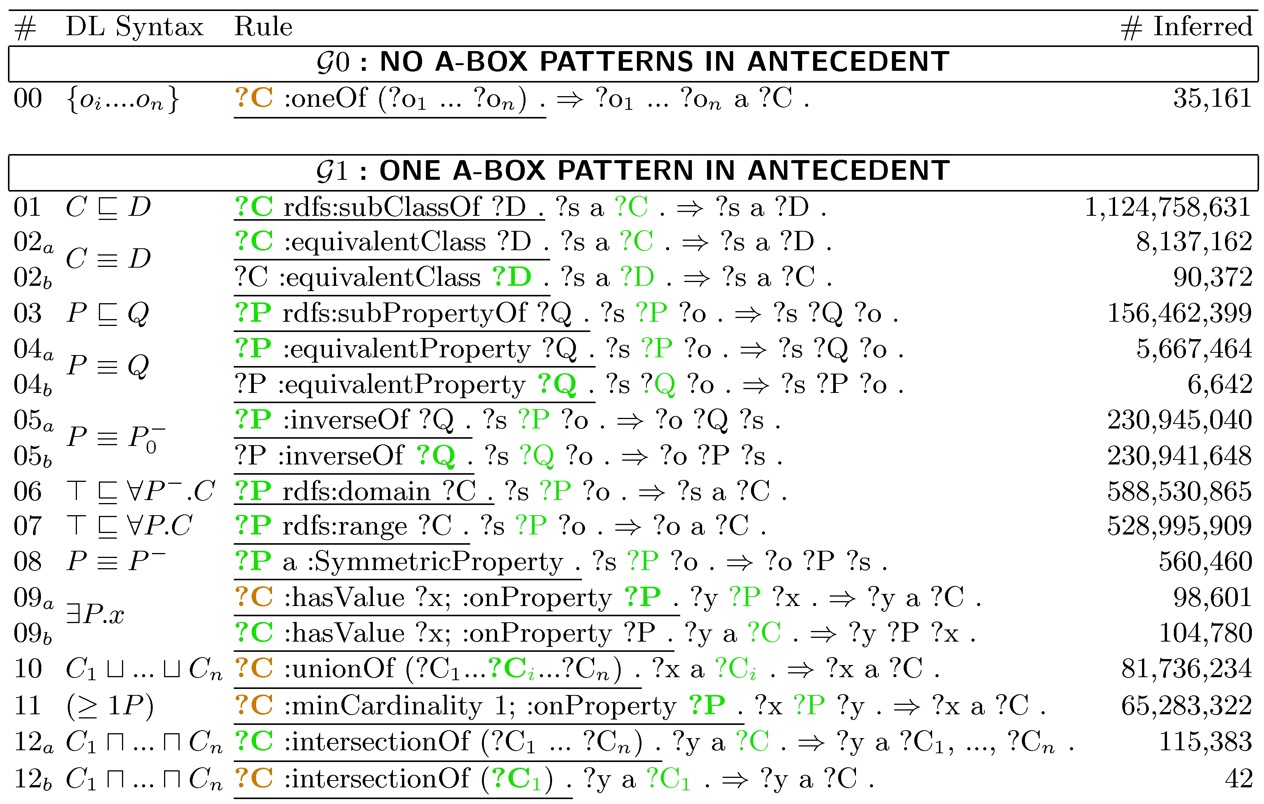
Rules Applied:
Tailored version of [ter Horst, 2005]

Slide 47
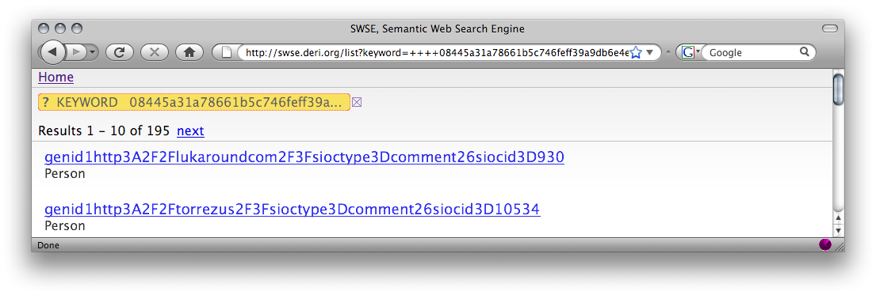
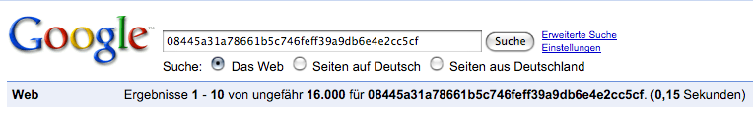
Good “excuses” to avoid G2 rules
The obvious:
  G2 rules would need joins, i.e. to trigger restart of file-scan
The interesting one:
  Take for instance IFP rule:
  Maybe not such a good idea on real Web data
  More experiments including G2, G3 rules in [Hogan, Harth, Polleres, IJSWIS 2009]
47

Slide 48
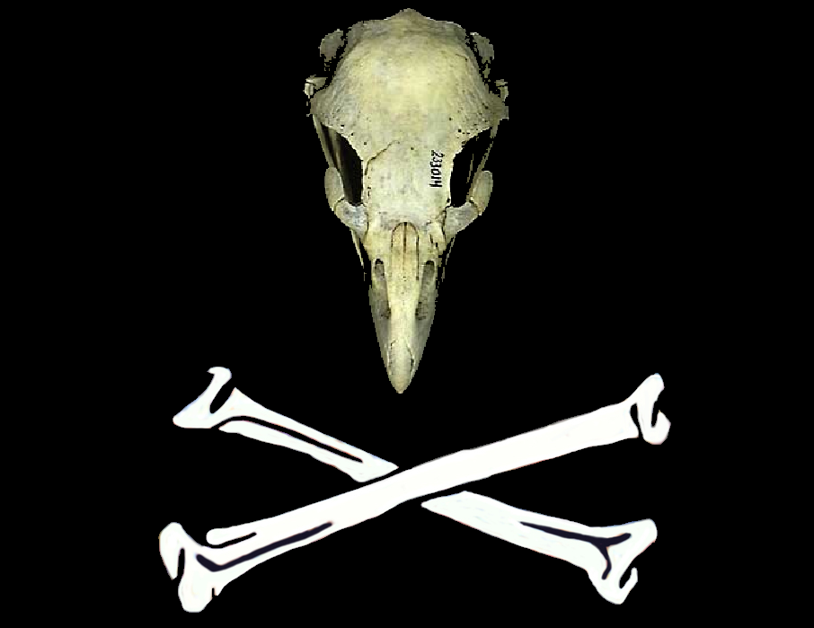
Authoritative Reasoning
Document D authoritative for concept C iff:
  C not identified by URI
    OR
  De-referenced URI of C coincides with or redirects to D
  FOAF spec authoritative for foaf:Person ✓
  MY spec not authoritative for foaf:Person ✘
Only allow extension in authoritative documents
  my:Person rdfs:subClassOf foaf:Person . (MY spec) ✓
BUT: Reduce obscure memberships
  foaf:Person rdfs:subClassOf my:Person . (MY spec) ✘
Similarly for other T-Box statements.
In-memory T-Box stores authoritative values for rule execution
Ontology Hijacking
48

Slide 49
Rules Applied
The 17 rules applied including statements considered to be T-Box, elements which must be authoritatively spoken for (including for bnode OWL abstract syntax), and output count
49

Slide 50
Authoritative Resoning covers rdfs: owl: vocabulary misuse
http://www.polleres.net/nasty.rdf:
rdfs:subClassOf rdfs:subPropertyOf rdfs:Resource.
rdfs:subClassOf rdfs:subPropertyOf rdfs:subPropertyOf.
rdf:type rdfs:subPropertyOf rdfs:subClassOf.
rdfs:subClassOf rdf:type owl:SymmetricProperty.
Naïve rules application would infer O(n³) triples
By use of authoritative reasoning SAOR/SWSE doesn’t stumble over these ☺
:rdfs :owl Hijacking
50

Slide 51
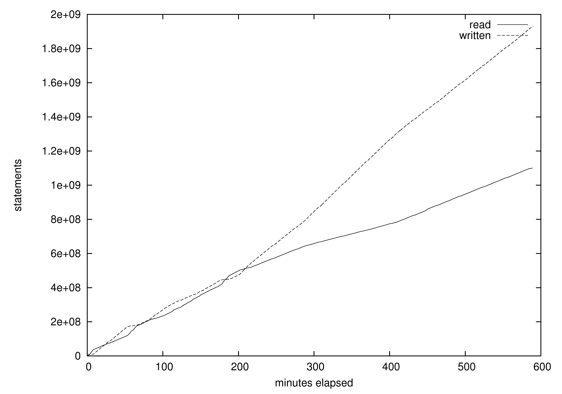
Performance
Graph showing SAOR’s rate of input/output statements per minute for reasoning on 1.1b statements: reduced input rate correlates with increased output rate and vice-versa
51
Notes:
Akami

Slide 52
Results
SCAN 1: 6.47 hrs
  In-mem T-Box creation, authoritative analysis:
SCAN 2: 9.82 hrs
  Scan reasoning – join A-Box with in-mem authoritative T-Box:
1.925b new statements inferred in 16.29 hrs
On our agenda:
  More valuable insights on our experiences from Web data
  G2 and G3 rules still difficult
1.1b + 1.9b inferred = 3 billion triples in SWSE
52

Slide 53
Is that enough?
Well, good starting points, we believe…
… but still many open challenges…
  Parallelise Reasoning [Wevaer, Hendler ISWC2009, Urbani et al. ESWC2010] … still only for RDFS or synthetic data.
  Alternative approaches for Object consolidation needed, e.g. [Hogan et al. NeFoRS2010]
  Query live data [Harth et al. WWW2010]
  Full SPARQL querying (SPARQL 1.1)
  More on Data Quality on the Web [Hogan et al. LDOW2010]
53

Slide 54
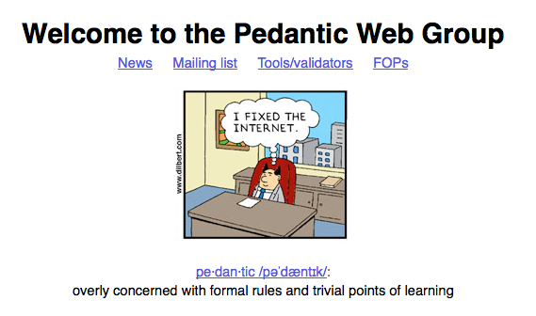
Visit: http://pedantic-web.org/
Already several successes in finding/fixing: FOAF, dbpedia, NYtimes,
even W3C specs… etc.

Slide 55
Linked Open Data
So, Can we go home and declare success?
Not yet…
But a lot of work in the right direction ongoing! …
…
Good: leaves us some more research to do ;-)
55

Slide 56
Acknowledgements
  This talk had a lot of work from different research groups in DERI:
  Unit for Social Software (SIOC - John Breslin, SMOB - Alexandre Passant and their students)
  Unit for Reasoning and Querying (SAOR – Aidan Hogan, XSPARQL – Nuno Lopes, Semantic Drupal – Stephane Corlosquet, Lin Clark)
  Other people involved: Stefan Decker, Andreas Harth, Thomas Krennwallner, …
  Thanks to all!

