Slide 1
SPARQL1.1: An introduction
@AxelPolleres
Digital Enterprise Research Institute, National University of Ireland, Galway
These slides are provided under creative commons
Attribution-NonCommercial-ShareAlike 3.0 Unported License!

Slide 2
What is SPARQL?
Query Language for RDF
  SQL “look-and-feel” for the Semantic Web
  Means to query the Web of Data
  Means to map between vocabularies
  Means to access RDF stores
SPARQL1.0 (standard since 2008):
  Query Language
  Protocol
  Result Format
SPARQL1.1 (in progress):
  SPARQL 1.1 query language (additional features: aggregate functions, subqueries, negation, project expressions, property paths, basic federated queries)
  SPARQL 1.1 Entailment regimes
  SPARQL 1.1 Update: A full data manipulation language
  SPARQL 1.1 Uniform HTTP Protocol for Managing RDF Graphs
  SPARQL 1.1 Service Descriptions
2

Slide 3
What you’ll hear
Run through SPARQL1.0
New features in SPARQL 1.1 Query
SPARQL 1.1 Entailment Regimes
Implementations, Status
3

Slide 4
RDF a plain data format for the Web
Chile
Subject Predicate Object
Subject U x B
Predicate U
Object U x B x L
isLocatedIn
Santiago
label
”Santiago”@es
isLocatedIn
label
“Claudio Gutierrez”
URIs, e.g.
http://www.w3.org/2000/01/rdf-schema#label
http://ontology.dumontierlab.com/isLocatedIn
http://dbpedia.org/resource/Santiago
http://dbpedia.org/resource/Chile
Various syntaxes, RDF/XML, Turtle, N3, RDFa,…
Blanknodes:
“existential variables in the data” to express incomplete information, written as _:x or []
<http://dbpedia.org/resource/Santiago> <http://ontology.dumontierlab.com/isLocatedIn>
<http://dbpedia.org/resource/Chile> .
<http://dbpedia.org/resource/Santiago> <http://www.w3.org/2000/01/rdf-schema#label>
”Santiago”@es .
_:x <http://www.w3.org/2000/01/rdf-schema#label> "Claudio Gutierrez" .
_:x <http://ontology.dumontierlab.com/isLocatedIn> <http://dbpedia.org/resource/Santiago> .
Literals, e.g.
"2010"^^xsd:gYear
"Brixen"@de
"Bressanone"@it
"Santiago”@es
“Claudio Gutierres
4

Slide 5

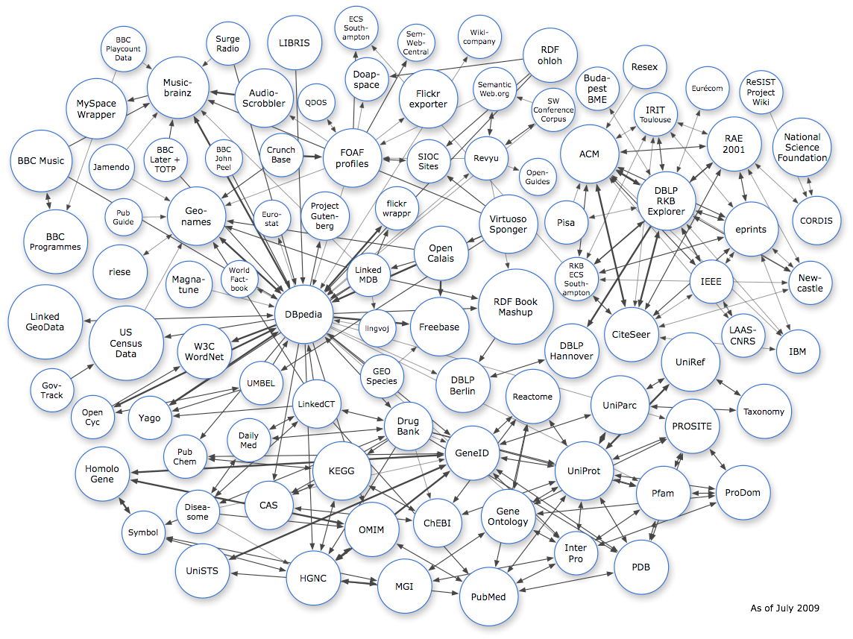

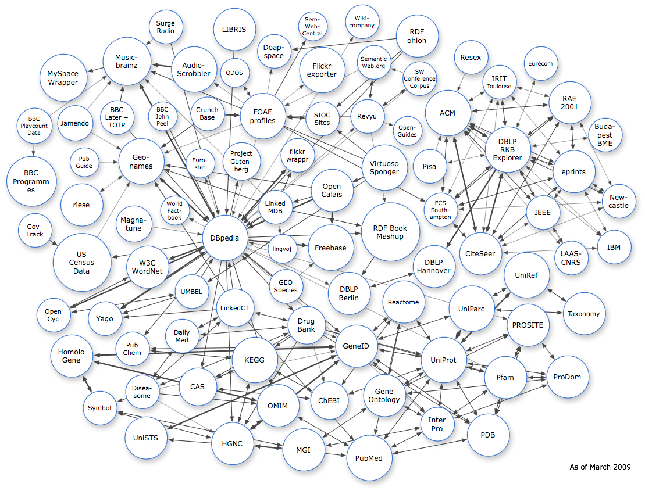
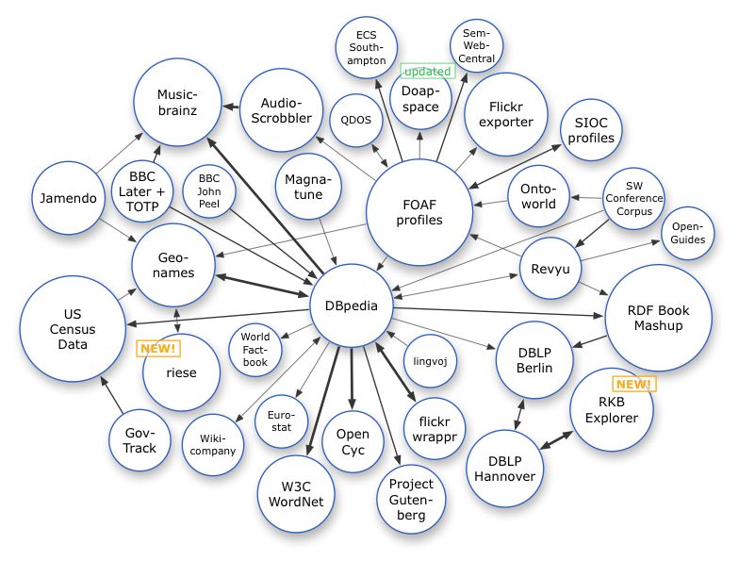



RDF Data on the Web: Linked Open Data
Excellent tutorial here: http://www4.wiwiss.fu- berlin.de/bizer/pub/LinkedDataTutorial/
…
March 2008
March 2009
July 2009
5

Slide 6
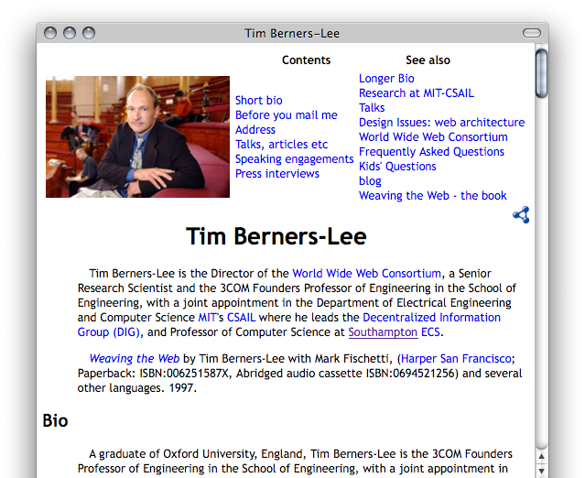
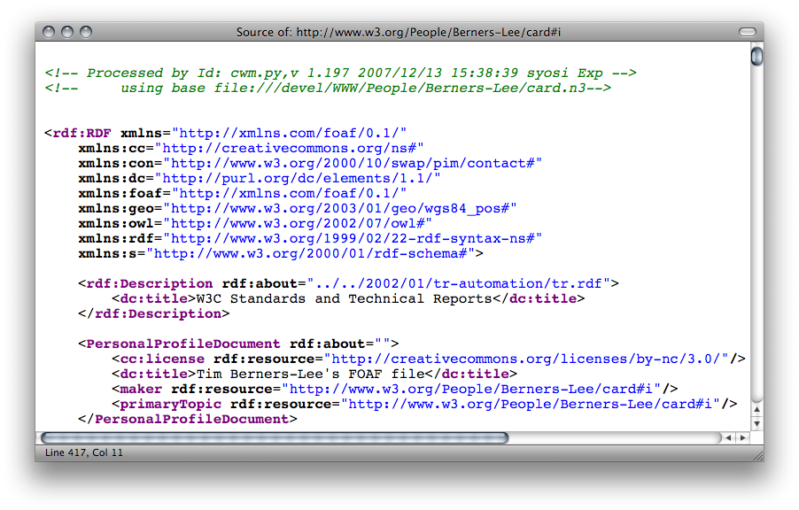
RDF Data online: Example 1/4
(i) directly by the publishers
(ii) by exporters
FOAF/RDF linked from a home page: personal data (foaf:name, foaf:phone, etc.), relationships foaf:knows, rdfs:seeAlso )
6

Slide 7
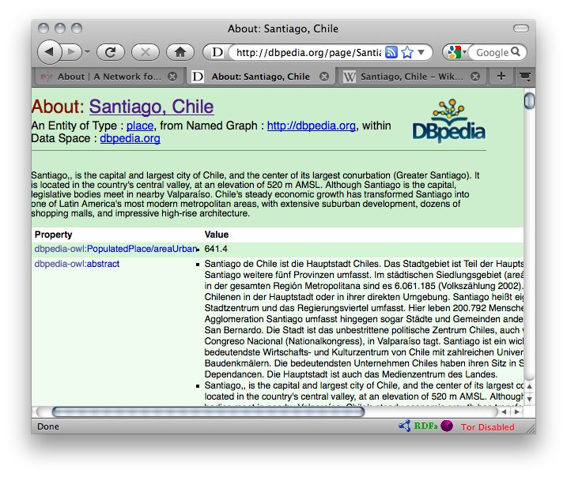
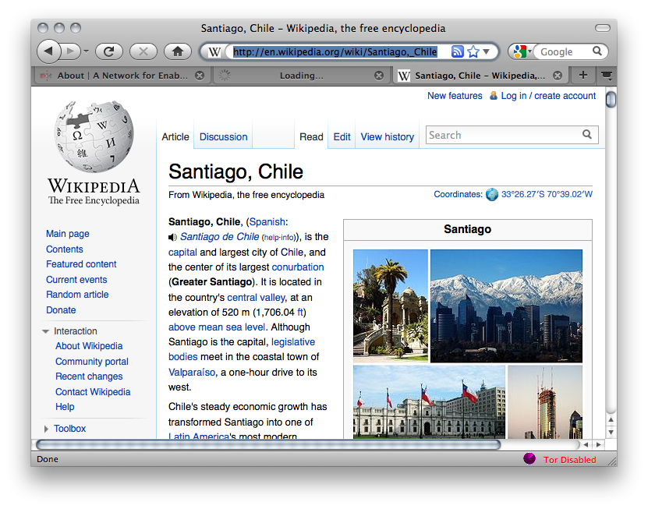
RDF Data online: Example 2/4
(i) directly by the publishers
(ii) by exporters, e.g. OpenLink’s Virtuoso.
e.g. DBPedia, an export of Wikipedia’s structured Data, using OpenLink’s Virtuoso (http://dbpedia.org)
Gives unique URIs to cities, countries, persons, etc. from wikipedia! E.g.,
http://dbpedia.org/resource/Santiago%2C_Chile
http://dbpedia.org/resource/Chile
Provides RDF version of all wikipedia structured data (infoboxes) and even a SPARQL query interface!
7

Slide 8
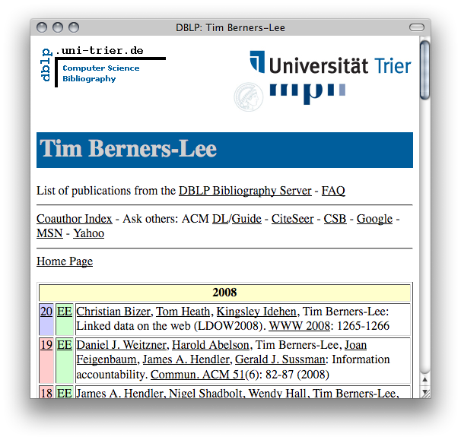
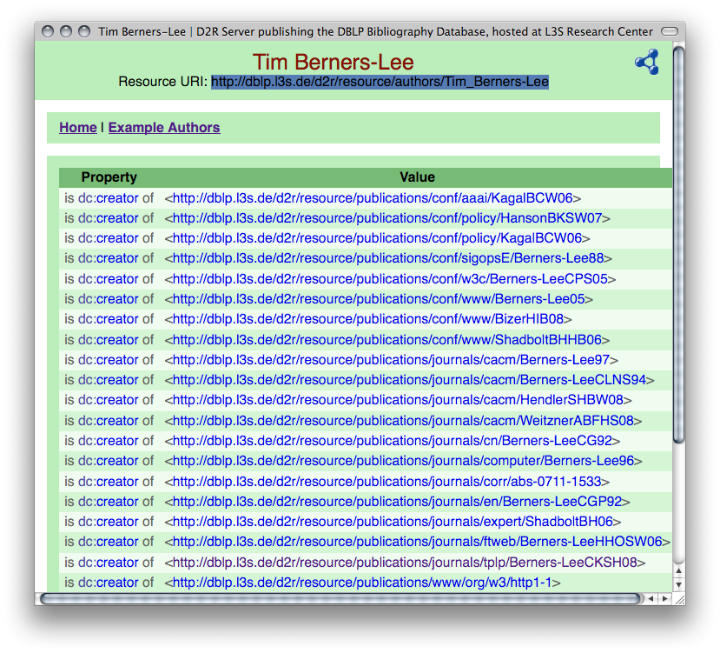
RDF Data online: Example 3/4
(i) directly by the publishers
(ii) by exporters, e.g. D2R.
e.g. L3S’ RDF export of the DBLP citation index, using FUB’s D2R (http://dblp.l3s.de/d2r/)
Gives unique URIs to authors, documents, etc. on DBLP! E.g.,
http://dblp.l3s.de/d2r/resource/authors/Tim_Berners-Lee,
http://dblp.l3s.de/d2r/resource/publications/journals/tplp/Berners-LeeCKSH08
Provides RDF version of all DBLP data and even a SPARQL query interface!
8

Slide 9
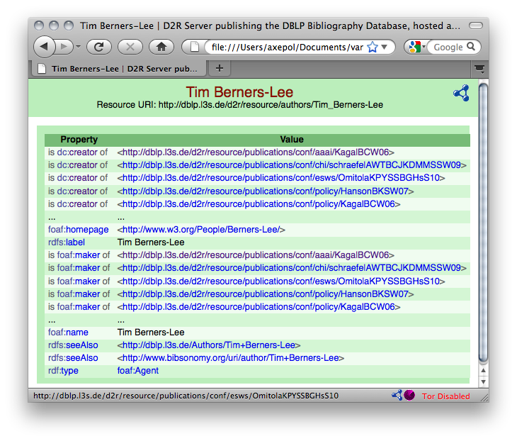
RDF Data online: Example 4/4
http://dblp.l3s.de/d2r/resource/authors/T
9

Slide 10
RDF Data online: Example – Turtle Syntax
  DBLP Data in RDF: Triples Turtle Syntax:
  @prefix rdf: <http://www.w3.org/1999/02/22-rdf-syntax-ns#>.
  @prefix dcterms: <http://purl.org/dc/terms/> .
  @prefix foaf: <http://xmlns.com/foaf/0.1/> .
  @prefix xsd: <http://www.w3.org/2001/XMLSchema#> .
  @prefix swrc: <http://swrc.ontoware.org/ontology#> .
  <http://dblp.l3s…/journals/tplp/Berners-LeeCKSH08> rdf:type swrc:Article.
  <http://dblp.l3s…/journals/tplp/Berners-LeeCKSH08> dcterms:issued "2008"^^xsd:gYear .
  <http://dblp.l3s…/journals/tplp/Berners-LeeCKSH08> foaf:maker <http://dblp.l3s…/Tim_Berners-Lee> .
  <http://dblp.l3s…/journals/tplp/Berners-LeeCKSH08> foaf:maker <http://dblp.l3s…/Dan_Connolly> .
  <http://dblp.l3s…/journals/tplp/Berners-LeeCKSH08> foaf:maker <http://dblp.l3s…/Jim_Hendler> .
  <http://dblp.l3s…/journals/tplp/Berners-LeeCKSH08> foaf:maker <http://dblp.l3s…/Lalana_Kagal> .
  <http://dblp.l3s…/journals/tplp/Berners-LeeCKSH08> foaf:maker <http://dblp.l3s…/Yosi_Scharf> .
  …
  <http://dblp.l3s…/conf/aaai/KagalBCW06> rdf:type swrc:inProceedings .
  <http://dblp.l3s…/conf/aaai/KagalBCW06> foaf:maker <http://dblp.l3s…/Tim_Berners-Lee> .
  …
  <http://dblp.l3s…/Tim_Berners-Lee> foaf:homepage <http://www.w3.org/People/Berners-Lee/> .
  <http://dblp.l3s…/Tim_Berners-Lee> foaf:name "Tim Berners-Lee" .
10

Slide 11
RDF Data online: Example – Turtle Syntax
  DBLP Data in RDF: Triples Turtle Syntax:
  @prefix rdf: <http://www.w3.org/1999/02/22-rdf-syntax-ns#>.
  @prefix dcterms: <http://purl.org/dc/terms/> .
  @prefix foaf: <http://xmlns.com/foaf/0.1/> .
  @prefix xsd: <http://www.w3.org/2001/XMLSchema#> .
  @prefix swrc: <http://swrc.ontoware.org/ontology#> .
  <http://dblp.l3s…/journals/tplp/Berners-LeeCKSH08> rdf:type swrc:Article ;
  dcterms:issued "2008"^^xsd:gYear ;
  foaf:maker <http://dblp.l3s…/Tim_Berners-Lee> ,
  <http://dblp.l3s…/Dan_Connolly> ,
  <http://dblp.l3s…/Jim_Hendler> ,
  <http://dblp.l3s…/Lalana_Kagal> ,
  <http://dblp.l3s…/Yosi_Scharf> .
  …
  <http://dblp.l3s…/conf/aaai/KagalBCW06> rdf:type swrc:inProceedings ;
  foaf:maker <http://dblp.l3s…/Tim_Berners-Lee> .
  …
  <http://dblp.l3s…/Tim_Berners-Lee> foaf:homepage <http://www.w3.org/People/Berners-Lee/> ;
  foaf:name "Tim Berners-Lee" .
11

Slide 12
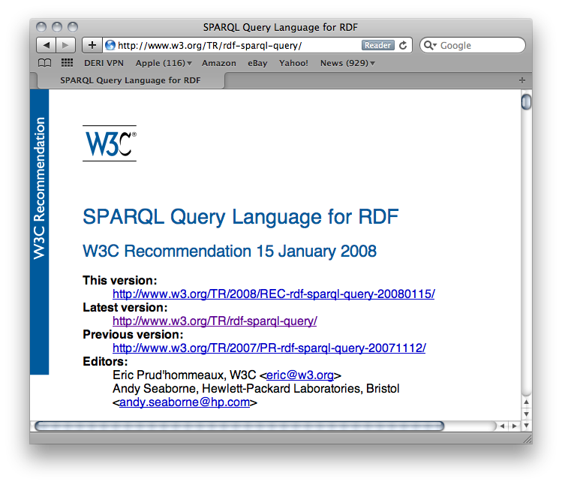
Linked Data: What’s the point?
Loads of structured data out there
You want to do structured queries on top of it …
SPARQL1.0 W3C Rec 15 January 2008… Now you can!
Without exaggeration, SPARQL is probably a not too small a part of the LOD success story! … at least an important building block
12

Slide 13
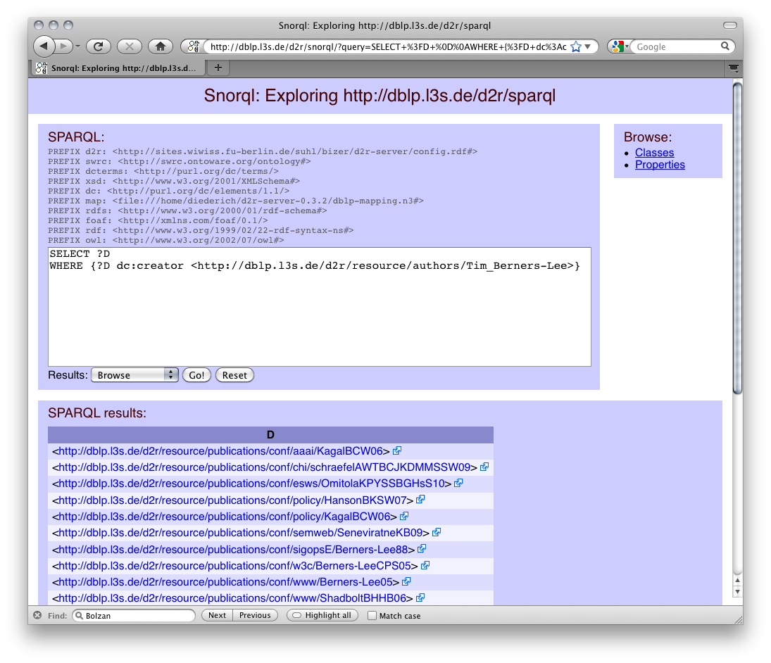
How can I query that data? SPARQL
Basic graph pattern matching ~ Conjunctive queries
Example DBLP:
“Give me all documents by Tim Berners-Lee”
PREFIX foaf: <http://xmlns.com/foaf/0.1/>
SELECT ?D
FROM <http://dblp.l3s.de/…/authors/Tim_Berners-Lee>
WHERE {?D foaf:maker <http://dblp.l3s.de/…/authors/Tim_Berners-Lee>}
Basic Graph Pattern (BGP) … set of RDF triples with variables in S,P,O , e.g.:
{?D foaf:maker <http://dblp.l3s.de/…/authors/Tim_Berners-Lee>}
FROM clause/Dataset can be implicit, e.g. when querying DBLP’s SPARQL endpoint
13

Slide 14
SPARQL: Basic Graph Patterns
Basic graph pattern matching ~ Conjunctive queries
Example DBPEDIA:
“Give me all names of people born in Santiago”
How can I find the right properties for my query?
→ Look at the data!
Basic Graph Pattern (BGP) … set of RDF triples with variables in S,P,O , e.g.:
{?P “born in” <http://dbpedia.org/resource/Santiago%2C_Chile>;
“name” ?N }

Slide 15
SPARQL: Basic Graph Patterns
Basic graph pattern matching ~ Conjunctive queries
Example DBPEDIA:
“Give me all names of people born in Santiago”
Basic Graph Pattern (BGP) … set of RDF triples with variables in S,P,O , e.g.:
{?P dbpedia-owl:birthPlace <http://dbpedia.org/resource/Santiago%2C_Chile>;
rdfs:label ?N }

Slide 16
SPARQL: Basic Graph Patterns
Basic graph pattern matching ~ Conjunctive queries
Example DBPEDIA:
“Give me all names of people born in Santiago”
Lesson learned: I can build SPARQL queries, from looking at the data and the URIs used (for properties and classes) in the data!
PREFIX dbpedia-owl: <http://dbpedia.org/ontology/>
PREFIX rdfs: <http://www.w3.org/2000/01/rdf-schema#>
SELECT ?N
{?P dbpedia-owl:birthPlace <http://dbpedia.org/resource/Santiago%2C_Chile>;
rdfs:label ?N }

Slide 17
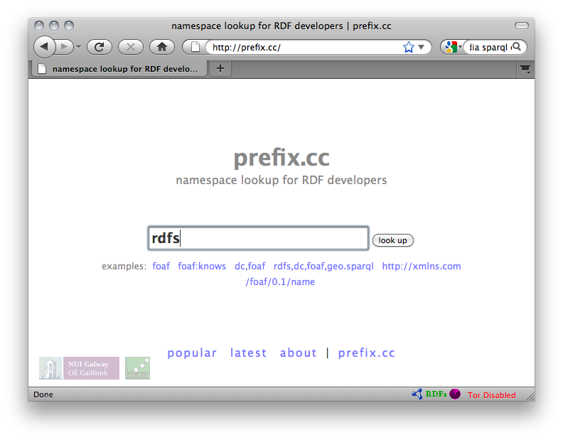
SPARQL: and how should I know all those prefixes? E.g. use prexif.cc !!!
PREFIX dbpedia-owl: <http://dbpedia.org/ontology/>
PREFIX rdfs: <http://www.w3.org/2000/01/rdf-schema#>
SELECT ?N
{?P dbpedia-owl:birthPlace <http://dbpedia.org/resource/Santiago%2C_Chile>;
rdfs:label ?N }

Slide 18
SPARQL: Basic Graph Patterns
Basic graph pattern matching ~ Conjunctive queries
Example DBLP:
“Give me all names of co-authors of Tim Berners-Lee”
PREFIX foaf: <http://xmlns.com/foaf/0.1/>
SELECT ?N
WHERE { ?D foaf:maker <http://dblp.l3s.de/…/authors/Tim_Berners-Lee>.
?D foaf:maker ?CoAuth .
?CoAuth foaf:name ?N }
PREFIX foaf: <http://xmlns.com/foaf/0.1/>
SELECT ?N
WHERE { _:D foaf:maker <http://dblp.l3s.de/…/authors/Tim_Berners-Lee>.
_:D foaf:maker _:C .
_:C foaf:name ?N }
Blank nodes in Queries play a similar role as (non-distinguished) variables.
PREFIX foaf: <http://xmlns.com/foaf/0.1/>
SELECT ?N
WHERE { [ foaf:maker <http://dblp.l3s.de/…/authors/Tim_Berners-Lee>,
[ foaf:name ?N ] ] . }
Blank nodes in Queries play a similar role as (non-distinguished) variables.
Turtle style shortcuts are allowed (a bit extreme here, admittedly)
Link
18

Slide 19
SPARQL: Basic Graph Patterns
Avoid Duplicates: keyword DISTINCT
Example DBLP:
“Give me all names of co-authors of Tim Berners-Lee”
PREFIX foaf: <http://xmlns.com/foaf/0.1/>
SELECT DISTINCT ?N
WHERE { [ foaf:maker <http://dblp.l3s.de/…/authors/Tim_Berners-Lee>,
[ foaf:name ?N ] ] . }
Blank nodes in Queries play a similar role as (non-distinguished) variables.
Turtle style shortcuts are allowed (a bit extreme here, admittedly)
19

Slide 20
SPARQL: Basic Graph Patterns
Basic graph pattern matching ~ Conjunctive queries
Example DBLP:
“Give me all names of co-authors of Tim Berners-Lee, their identifiers and their authored documents”
“ SELECT * ” outputs all variables in the pattern
PREFIX foaf: <http://xmlns.com/foaf/0.1/>
SELECT ?N ?CoAuth ?D
WHERE { ?D foaf:maker <http://dblp.l3s.de/…/authors/Tim_Berners-Lee>.
?D foaf:maker ?CoAuth .
?CoAuth foaf:name ?N }
PREFIX foaf: <http://xmlns.com/foaf/0.1/>
SELECT *
WHERE { ?D foaf:maker <http://dblp.l3s.de/…/authors/Tim_Berners-Lee>.
?D foaf:maker ?CoAuth .
?CoAuth foaf:name ?N }
Link
20

Slide 21
More complex patterns in SPARQL 1.0
UNION
OPTIONAL
FILTER
Querying named GRAPHs
Solution Modifiers (ordering, slicing/dicing results)
… plus some non-trivial combinations of these
21

Slide 22
UNIONs of conjunctive queries…
Unions of conjunctive queries
Example:
“Give me all names of co-authors or friends of Tim Berners-Lee”
Note: again Duplicates
possible!
PREFIX foaf: <http://xmlns.com/foaf/0.1/>
SELECT ?N
WHERE {
{ [ foaf:maker <http://dblp.l3s.de/…/authors/Tim_Berners-Lee>,
[ foaf:name ?N ] ] . }
UNION
{ <http://www.w3.org/People/Berners-Lee/card#i> foaf:knows ?F .
?F foaf:name ?N }
}
?N
"Lalana Kagal"
"Tim Berners-Lee"
"Dan Connolly”
"Jim Hendler”
…
"Michael Hausenblas”
"Jim Hendler”
"Charles McCathieNevile”
…
?N
"Lalana Kagal"
"Tim Berners-Lee"
"Dan Connolly”
"Jim Hendler”
…
?N
"Michael Hausenblas”
"Jim Hendler”
"Charles McCathieNevile”
…
U
=
22

Slide 23
UNIONs of conjunctive queries…
Avoid Duplicates: keyword DISTINCT
Example:
“Give me all names of co-authors or friends of Tim Berners-Lee”
PREFIX foaf: <http://xmlns.com/foaf/0.1/>
SELECT DISTINCT ?N
WHERE {
{ [ foaf:maker <http://dblp.l3s.de/…/authors/Tim_Berners-Lee>,
[ foaf:name ?N ] ] . }
UNION
{ <http://www.w3.org/People/Berners-Lee/card#i> foaf:knows ?F .
?F foaf:name ?N }
}
?N
"Lalana Kagal"
"Tim Berners-Lee"
"Dan Connolly”
"Jim Hendler”
…
"Michael Hausenblas”
"Charles McCathieNevile”
…
?N
"Lalana Kagal"
"Tim Berners-Lee"
"Dan Connolly”
"Jim Hendler”
…
?N
"Michael Hausenblas”
"Jim Hendler”
"Charles McCathieNevile”
…
U
=
23

Slide 24
UNIONs of conjunctive queries…
Unions of conjunctive queries
Example:
“Give me all names of co-authors or friends of Tim Berners-Lee”
Note: variables can be
unbound in a result!
PREFIX foaf: <http://xmlns.com/foaf/0.1/>
SELECT ?CoAuthN ?FrN
WHERE {
{ [ foaf:maker <http://dblp.l3s.de/…/authors/Tim_Berners-Lee>,
[ foaf:name ?CoAuthN ] ] . }
UNION
{ <http://www.w3.org/People/Berners-Lee/card#i> foaf:knows ?F .
?F foaf:name ?FrN }
}
?CoAuthN | ?FrN
"Lalana Kagal"
"Tim Berners-Lee"
"Dan Connolly”
"Jim Hendler”
…
 | "Michael Hausenblas”
 | "Jim Hendler”
 | "Charles McCathieNevile”
 | …
24

Slide 25
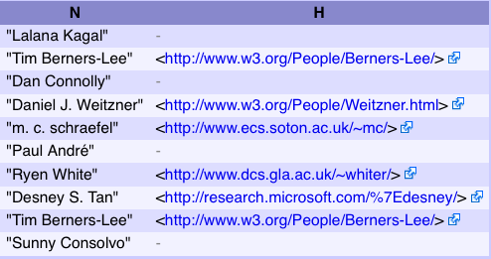
OPTIONAL query parts
Optional parts in queries (Left Outer Join)
Example:
“Give me all names of co-authors of Tim Berners-Lee
and optionally their homepage”
Another example where
variables can be
unbound in results!
PREFIX foaf: <http://xmlns.com/foaf/0.1/>
SELECT ?N ?H
WHERE {
?D foaf:maker <http://dblp.l3s.de/…/authors/Tim_Berners-Lee>.
?D foaf:maker ?CoAuth .
?CoAuth foaf:name ?N .
OPTIONAL { ?CoAuth foaf:homepage ?H }
}
25

Slide 26
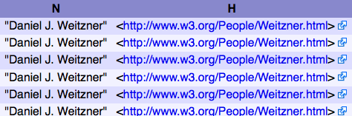
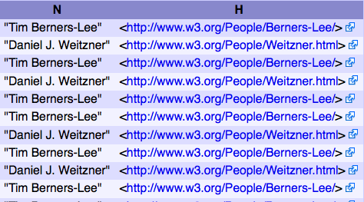
FILTERING out query results
FILTERs allow to specify FILTER conditions on patterns
Example:
“Give me all names of co-authors of Tim Berners-Lee
and whose homepage starts with http://www.w3…”
different from Tim B.-L. himself”
PREFIX foaf: <http://xmlns.com/foaf/0.1/>
SELECT ?N ?H
WHERE {
?D foaf:maker <http://dblp.l3s.de/…/authors/Tim_Berners-Lee>.
?D foaf:maker ?CoAuth .
?CoAuth foaf:name ?N .
?CoAuth foaf:homepage ?H .
FILTER( regex( str(?H) , "^http://www.w3" ) )
}
PREFIX foaf: <http://xmlns.com/foaf/0.1/>
SELECT ?N ?H
WHERE {
?D foaf:maker <http://dblp.l3s.de/…/authors/Tim_Berners-Lee>.
?D foaf:maker ?CoAuth .
?CoAuth foaf:name ?N .
?CoAuth foaf:homepage ?H .
FILTER( regex( str(?H) , "^http://www.w3" ) &&
?CoAuth != <http://dblp.l3s.de/…/authors/Tim_Berners-Lee> )
}
26

Slide 27
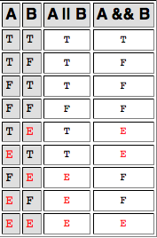
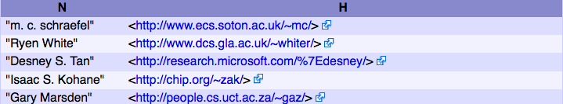
FILTERING out query results
FILTERs allow to specify FILTER conditions on pattern
Can use an extensible library of built-in functions
  checking: bound(), isIRI(), isBlank(), regex() …
  Conversion/extraction: str(), datatype(), lang() …
Can be complex: && , ||, !
ATTENTION: Evaluated in a 3-valued logic: true, false, error
Example:
Will result in E for unbound ?H
Whole FILTER expr
always E for unbound ?H
PREFIX foaf: <http://xmlns.com/foaf/0.1/>
SELECT ?N ?H
WHERE {
?D foaf:maker <http://dblp.l3s.de/…/authors/Tim_Berners-Lee>.
?D foaf:maker ?CoAuth . ?CoAuth foaf:name ?N .
OPTIONAL { ?CoAuth foaf:homepage ?H . }
FILTER( ! regex( str(?H) , "^http://www.w3" ) &&
?CoAuth != <http://dblp.l3s.de/…/authors/Tim_Berners-Lee> )
}
A | !A
T | F
F | T
E | E
27

Slide 28
FILTERING out query results
ATTENTION: FILTERs can NOT assign/create new values…
PREFIX ex: <http://example.org/>
SELECT ?Item ?NewP
WHERE { ?Item ex:price ?Pr FILTER (?NewP = ?Pr + 10 ) }
Non-safe variable in
FILTERs are considered
unbound. The Filter will
just always result in E
➔ Result always empty
Obviously, common query languages like SQL can do this…
SELECT Item, Price+10 AS NewPrice FROM Table
… FILTER in SPARQL is like WHERE in SQL, but SPARQL1.0 doesn’t have AS
28

Slide 29
Querying named GRAPHs
Find me people who have been involved with at least three ISWC or ESWC conference events.
(from SPARQL endpoint at data.semanticweb.org)
SELECT ?person WHERE {
GRAPH ?g1 { ?person a foaf:Person }
GRAPH ?g2 { ?person a foaf:Person }
GRAPH ?g3 { ?person a foaf:Person }
FILTER(?g1 != ?g2 && ?g1 != ?g3 && ?g2 != ?g3) . }
The GRAPH ?g construct allows a pattern to match against one of the named graphs in the RDF dataset. The URI of the matching graph is bound to ?g (or whatever variable was actually used).
The FILTER assures that we're finding a person who occurs in three distinct graphs.
Link
29

Slide 30
Slicing and Dicing results
Solution Modifiers
  DISTINCT/REDUCED
  ORDER BY
  LIMIT/OFFSET
Example:
SELECT DISTINCT ?person WHERE {
GRAPH ?g1 { ?person a foaf:Person }
GRAPH ?g2 { ?person a foaf:Person }
GRAPH ?g3 { ?person a foaf:Person }
FILTER(?g1 != ?g2 && ?g1 != ?g3 && ?g2 != ?g3) . }
ORDER BY ?person
LIMIT 10
Link

Slide 31
ASC, DESC, ORDER BY Expressions
31

Slide 32
More complex query examples 1/2
“IF-THEN-ELSE”
  “Give me the names of persons, if it exists, otherwise the nicknames, if it exists, otherwise the labels”
      SELECT ?X ?N
      WHERE{ ?X rdf:type foaf:Person
      OPTIONAL { ?X foaf:name ?N }
      OPTIONAL { ?X foaf:nickname ?N }
      OPTIONAL { ?X rdfs:label ?N } }
“Conditional OPTIONAL”
  “Give me the names and - only of those whose name starts with ‘D’ - the homepage”
      SELECT ?N ?H
      WHERE{ ?X foaf:name ?N
      OPTIONAL { ?X foaf:homepage ?H
      FILTER ( regex( str(?N), "^D" ) ) }
      }
OPTIONAL is
order-dependent!
OPTIONAL is
order-dependent!
OPTIONAL is NOT
“modular”/compositional
Non-compositionality raised some eyebrows… [Angles&Gutierrez, 2008] showed that compositional semantics can be
achieved by rewriting.
32

Slide 33

More complex query examples 2/2
Negation (“NOT EXISTS” in SQL)
  “Give me all Persons without a homepage”
  Option 1: by combination of OPTIONAL and FILTER(!bound(…) )
      SELECT ?X
      WHERE{ ?X rdf:type foaf:Person
      OPTIONAL { ?X foaf:homepage ?H }
      FILTER( !bound( ?H ) ) }
  Option 2: by even weirder combination of OPTIONAL with GRAPH queries…
      SELECT ?X
      WHERE{ ?X rdf:type foaf:Person
      OPTIONAL { ?X foaf:homepage ?H }
      GRAPH boundcheck.ttl {?H :is :unbound } }
  where the aux. graph boundcheck.ttl contains the single triple [] :is :unboud.
Please forget this immediately again…
“These aren’t the droids you’re looking for”
33

Slide 34
Constructing Graphs
Construct new graphs:
“everybody knows their co-authors”
CONSTRUCT { ?X foaf:knows ?Y }
WHERE{ ?D foaf:maker ?X, ?Y .
  FILTER( ?X != ?Y ) }
34

Slide 35


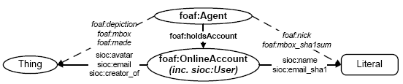
Constructing Graphs
Map between ontologies:
E.g. for expressing complex ontology mappings between and
“an sioc:name of a sioc:User is a foaf:nick”
CONSTRUCT { ?X foaf:nick ?Y }
WHERE{ ?X foaf:holdsAccount [sioc:name ?Y ]. }
    Actually, expressible in new OWL2 ( but not in OWL1):
    foaf:nick owl:propertyChainAxiom (foaf:holdsAccount sioc:name)
35

Slide 36
Constructing Graphs
Limitations
  Again, no assignment, creation of values
    How to concatenate first name and last name?
  No aggregation (e.g. COUNT, SUM, …):
    How to create a graph that has publication count per person for DBLP?
    No RDFS/OWL inference (so combining mappings in RDFS/OWL with queries in SPARQL not possible)
36

Slide 37
SPARQL1.0 Formal Semantics
Graph patterns:
    BGPs
    P1 P2
    P FILTER R
    P1 UNION P2
    P1 OPTIONAL P2
Semantics
  eval(D(G), graph pattern) … D is a dataset,
  G is the “active graph”
  recursively defined for all graph patterns in Section 12.5 of
  http://www.w3.org/TR/rdf-sparql-query/
  Spec. semantics is a bit hard to read …
  Explained in more “accessible” terms in extended version of this Tutorial: http://www.polleres.net/presentations/20101006SPARQL1.1Tutorial.pptx
37

Slide 38
Academic works around SPARQL
SPARQL semantics
  [Perez et al. 2006] (pre-dates the spec) [Perez et al. 2009]
SPARQL equivalences
  also in [Perez et al. 2006],[Perez et al. 2009]
  More in [Schmidt et al. 2010]
SPARQL expressivity
  Reducible to datalog with negation [Polleres 2007]
  Other way around also works [Angles &Gutierrez 2008]
Proposed Extensions
  Aggregates [Polleres et al. 2007]
  Property Paths [Alkhateeb et al. 2009], [Perez et al. 2008]
38

Slide 39

SPARQL1.1
WG might still change some of the syntax/semantics definitions presented here based on community input
39

Slide 40
This is where SPARQL1.1 starts
Missing common feature requirements in existing implementations or requested urgently by the community:
  Assignment/Project Expressions
  Aggregate functions (SUM, AVG, MIN, MAX, COUNT, …)
  Subqueries
  Property paths
    complaint: SPARQL1.0 isn’t quite a “graph” query language
Ease of use:
  Why is Negation “hidden” in SPARQL1.0?
Interplay with other SW standards:
  SPARQL1.0 only defined for simple RDF entailment
  Other Entailment regimes missing:
    RDF(S), OWL
    OWL2
    RIF

Slide 41
Goals of SPARQL1.1
Per charter (http://www.w3.org/2009/05/sparql-phase-II-charter.html)
  “The scope of this charter is to extend SPARQL technology to include some of the features that the community has identified as both desirable and important for interoperability based on experience with the initial version of the standard.”
No inclusion of new features that still require research
Upwards compatible with SPARQL1.0
The name SPARQL1.1 shall indicate an incremental change rather than any fundamental changes.
41

Slide 42
Goals of SPARQL1.1
List of agreed features:
Additions to the Query Language:
  Project Expressions
  Aggregate functions
  Subqueries
  Negation
  Property Paths (time permitting)
  Extend the function library (time permitting)
  Basic federated Queries (time permitting)
Entailment (time permitting)
SPARQL Update
  Full Update language
  plus simple RESTful update methods for RDF graphs (HTTP methods)
Service Description
  Method for discovering a SPARQL endpoint’s capabilities
  Summary of its data
We will focus on these in today’s Tutorial
42

Slide 43
Part 1: new query features
Project Expressions
  Aggregate functions
  Subqueries
  Negation
  Property Paths
43

Slide 44
Project Expressions
Assignments, Creating new values…
PREFIX ex: <http://example.org/>
SELECT ?Item ?NewP
WHERE { ?Item ex:price ?Pr FILTER (?NewP = ?Pr * 1.1) }
PREFIX ex: <http://example.org/>
SELECT ?Item (?Pr * 1.1 AS ?NewP )
WHERE { ?Item ex:price ?Pr }
Data:
Results:
Leaves errors unbound!
@prefix ex: <http://example.org/> .
ex:lemonade1 ex:price 3 .
ex:beer1 ex:price 3.
ex:wine1 ex:price 3.50 .
?Item | ?NewP
lemonade1 | 3.3
beer1 | 3.3
wine1 | 3.85
?Item | ?NewP
lemonade1 | 3.3
beer1 | 3.3
wine1 | 3.85
liqueur1
ex:liqueur1 ex:price "n/a".
44

Slide 45
Project expressions – Restriction:
Assignments, Creating new values…
Note: Variables “already bound” cannot be used for project expressions!
PREFIX ex: <http://example.org/>
SELECT ?Item (?Pr * 1.1 AS ?NewP )
WHERE { ?Item ex:price ?Pr }
PREFIX ex: <http://example.org/>
SELECT ?Item (?Pr * 1.1 AS ?Pr )
WHERE { ?Item ex:price ?Pr }
45

Slide 46
Aggregates
46

Slide 47
Aggregates
“Count items”
PREFIX ex: <http://example.org/>
SELECT (Count(?Item) AS ?C)
WHERE { ?Item ex:price ?Pr }
Data:
Results:
@prefix ex: <http://example.org/> .
ex:lemonade1 ex:price 3 ;
rdf:type ex:Softdrink.
ex:beer1 ex:price 3;
rdf:type ex:Beer.
ex:wine1 ex:price 3.50 ;
rdf:type ex:Wine.
ex:wine2 ex:price 4 .
rdf:type ex:Wine.
ex:wine3 ex:price "n/a”;
rdf:type ex:Wine.
?C
5
47

Slide 48
Aggregates
“Count categories”
PREFIX ex: <http://example.org/>
SELECT (Count(?T AS ?C)
WHERE { ?Item rdf:type ?T }
PREFIX ex: <http://example.org/>
SELECT (Count(DISTINCT ?T) AS ?C)
WHERE { ?Item rdf:type ?T }
Data:
Results:
@prefix ex: <http://example.org/> .
ex:lemonade1 ex:price 3 ;
rdf:type ex:Softdrink.
ex:beer1 ex:price 3;
rdf:type ex:Beer.
ex:wine1 ex:price 3.50 ;
rdf:type ex:Wine.
ex:wine2 ex:price 4 .
rdf:type ex:Wine.
ex:wine3 ex:price "n/a”;
rdf:type ex:Wine.
?C
5
?C
3
48

Slide 49
Aggregates - Grouping
“Count items per categories”
PREFIX ex: <http://example.org/>
SELECT ?T (Count(?Item) AS ?C)
WHERE { ?Item rdf:type ?T }
GROUP BY ?T
Data:
Results:
@prefix ex: <http://example.org/> .
ex:lemonade1 ex:price 3 ;
rdf:type ex:Softdrink.
ex:beer1 ex:price 3;
rdf:type ex:Beer.
ex:wine1 ex:price 3.50 ;
rdf:type ex:Wine.
ex:wine2 ex:price 4 .
rdf:type ex:Wine.
ex:wine3 ex:price "n/a”;
rdf:type ex:Wine.
?T | ?C
Softdrink | 1
Beer | 1
Wine | 3

Slide 50
Aggregates – Filtering Groups
“Count items per categories, for those categories having more than one item”
PREFIX ex: <http://example.org/>
SELECT ?T (Count(?Item) AS ?C)
WHERE { ?Item rdf:type ?T }
GROUP BY ?T
HAVING Count(?Item) > 1
Data:
Results:
@prefix ex: <http://example.org/> .
ex:lemonade1 ex:price 3 ;
rdf:type ex:Softdrink.
ex:beer1 ex:price 3;
rdf:type ex:Beer.
ex:wine1 ex:price 3.50 ;
rdf:type ex:Wine.
ex:wine2 ex:price 4 .
rdf:type ex:Wine.
ex:wine3 ex:price "n/a”;
rdf:type ex:Wine.
?T | ?C
Wine | 3
50

Slide 51
Other Aggregates
SUM … as usual
AVG … as usual
MIN … as usual
MAX … as usual
SAMPLE … “pick” one non-deterministically
GROUP_CONCAT … concatenate values with a designated separator string
…this list is extensible … new built-ins will need to define
error-behaviour, extra-parameters
(like SEPARATOR in GROUP_CONCAT)
51

Slide 52
Example SUM
“Sum Prices per categories”
PREFIX ex: <http://example.org/>
SELECT ?T (Sum(?Pr) AS ?P)
WHERE { ?Item rdf:type ?T; ex:price ?Pr }
GROUP BY ?T
PREFIX ex: <http://example.org/>
SELECT ?T (Sum(?Pr) AS ?P)
WHERE { ?Item rdf:type ?T; ex:price ?Pr
FILTER( isNumeric(?Pr) ) }
GROUP BY ?T
PREFIX ex: <http://example.org/>
SELECT ?T (Sum(COALESCE(xs:decimal(?Pr),0) AS ?P)
WHERE { ?Item rdf:type ?T; ex:price ?Pr }
GROUP BY ?T
PREFIX ex: <http://example.org/>
SELECT ?T (Sum(IF(isNumeric(?Pr),?Pr,0) AS ?P)
WHERE { ?Item rdf:type ?T; ex:price ?Pr }
GROUP BY ?T
PREFIX ex: <http://example.org/>
SELECT (Count(?T AS ?C)
WHERE { ?Item rdf:type ?T }
Data:
Results:
@prefix ex: <http://example.org/> .
ex:lemonade1 ex:price 3 ;
rdf:type ex:Softdrink.
ex:beer1 ex:price 3;
rdf:type ex:Beer.
ex:wine1 ex:price 3.50 ;
rdf:type ex:Wine.
ex:wine2 ex:price 4 .
rdf:type ex:Wine.
ex:wine3 ex:price "n/a";
rdf:type ex:Wine.
?T | ?C
Softdrink | 3
Beer | 3
Wine
?T | ?C
Softdrink | 3
Beer | 3
Wine | 7.5
52

Slide 53

Example GROUP_CONCAT, SAMPLE
“pick one sample name per person, plus a concatenated list of nicknames ”
PREFIX foaf: <http://xmlns.com/foaf/0.1/>
SELECT ( SAMPLE(?N) as ?Name)
( GROUP_CONCAT(?M; SEPARATOR = ", ") AS ?Nicknames )
WHERE { ?P a foaf:Person ;
foaf:name ?N ;
foaf:nick ?M . }
GROUP BY ?P
@prefix ex: <http://example.org/> .
@prefix foaf: <http://xmlns.com/foaf/0.1/> .
ex:alice a foaf:Person; foaf:name "Alice Wonderland";
foaf:nick "Alice", "The real Alice".
ex:bob a foaf:Person;
foaf:name "Robert Doe", "Robert Charles Doe",
"Robert C. Doe";
foaf:nick "Bob","Bobby","RobC","BobDoe".
ex:charles a foaf:Person;
foaf:name "Charles Charles";
foaf:nick "Charlie" .
53

Slide 54
Subqueries
54

Slide 55
Subqueries to realise complex mappings
    How to concatenate first name and last name?
    Now possible without problems per subqueries!
PREFIX foaf: <http://xmlns.com/foaf/0.1/>
PREFIX fn: <http://www.w3.org/2005/xpath-functions#>
CONSTRUCT{ ?P foaf:name ?FullName }
WHERE {
SELECT ?P ( fn:concat(?F, " ", ?L) AS ?FullName )
WHERE { ?P foaf:firstName ?F ; foaf:lastName ?L. }
}
55

Slide 56
Subqueries “Limit per resource”
Give me all titles of papers of 10 persons who co-authored with Tim Berners-Lee
  Returns titles for 10 persons, instead of just 10 rows
SELECT ?T
WHERE {
?D foaf:maker ?P ; rdfs:label ?T .
{
SELECT DISTINCT ?P
WHERE { ?D foaf:maker <http://dblp.l3s.de/…/authors/Tim_Berners-Lee>, ?P .
FILTER ( ?P != <http://dblp.l3s.de/…/authors/Tim_Berners-Lee> )
}
LIMIT 10
}
}
SELECT ?T
WHERE {
?D foaf:maker ?P ; rdfs:label ?T .
{
SELECT DISTINCT ?P
WHERE { ?D foaf:maker <http://dblp.l3s.de/…/authors/Tim_Berners-Lee>, ?P .
FILTER ( ?P != <http://dblp.l3s.de/…/authors/Tim_Berners-Lee> )
}
LIMIT 10
}
}
56

Slide 57
Subqueries – Known Limitations
Attention: Subqueries do not allow to “inject values” from outside, but that limits some use cases, one might think of… e.g. an alternative “limit per resource” query:
… does NOT return 3 titles per author!
Different ?P/ different scope than the ?P outside of the subquery… i.e. no correlation
SELECT ?P ?T
WHERE { ?P rdf:type Person .
{ SELECT ?T
WHERE { ?D foaf:maker ?P ; dc:title ?T }
LIMIT 3 }
}
?P | ?T
:jim | “Doc1”
:jim | “Doc2”
:jim | “Doc3”
:tim | “Doc1”
:tim | “Doc2”
:tim | “Doc3”
:jim a foaf:Person .
:tim a foaf:Person .
:d1 foaf:maker :tim, :jim; dc:title “Doc1” .
:d2 foaf:maker :tim, :jim; dc:title “Doc2” .
:d3 foaf:maker :jim; dc:title “Doc3” .
:d4 foaf:maker :tim; dc:title “Doc4” .
57

Slide 58
FROM in Subqueries? NO!
Note: At this point, no Dataset Clauses in Subselects, i.e.:
PREFIX foaf: <http://xmlns.com/foaf/0.1/>
SELECT ?N
WHERE {
{ SELECT ?N
FROM <http://www.w3.org/People/Berners-Lee/card>
<http://www.w3.org/People/Berners-Lee/card#i> foaf:knows ?F .
?F foaf:name ?N }
UNION
{ SELECT ?N
FROM <http://dblp.l3s.de/…/authors/Tim_Berners-Lee>
{ [ foaf:maker <http://dblp.l3s.de/…/authors/Tim_Berners-Lee>,
[ foaf:name ?N ] ] . } }
}
58

Slide 59
MINUS and NOT EXISTS
59

Slide 60
MINUS and NOT EXISTS
Negation as failure in SPARQL1.0 is “ugly”:
      SELECT ?X
      WHERE{ ?X rdf:type foaf:Person
      OPTIONAL { ?X foaf:homepage ?H }
      FILTER( !bound( ?H ) ) }
SPARQL1.1 has two alternatives to do the same
  NOT EXISTS in FILTERs
    detect non-existence
  (P1 MINUS P2 ) as a new binary operator
    “Remove rows with matching bindings”
    only effective when P1 and P2 share variables
      SELECT ?X
      WHERE{ ?X rdf:type foaf:Person
      FILTER ( NOT EXISTS { ?X foaf:homepage ?H } ) }
      SELECT ?X
      WHERE{ ?X rdf:type foaf:Person
      MINUS { ?X foaf:homepage ?H } ) }
60

Slide 61
Property Path Expressions

Slide 62
Property Path expressions
Concatenate property paths, Arbitrary Length paths, etc.
E.g. names of people Tim Berners-Lee transitively co-authored papers with…
SELECT DISTINCT ?N
WHERE {<http://dblp…/Tim_Berners-Lee>,
(^foaf:maker/foaf:maker)+/foaf:name ?N
}
62

Slide 63
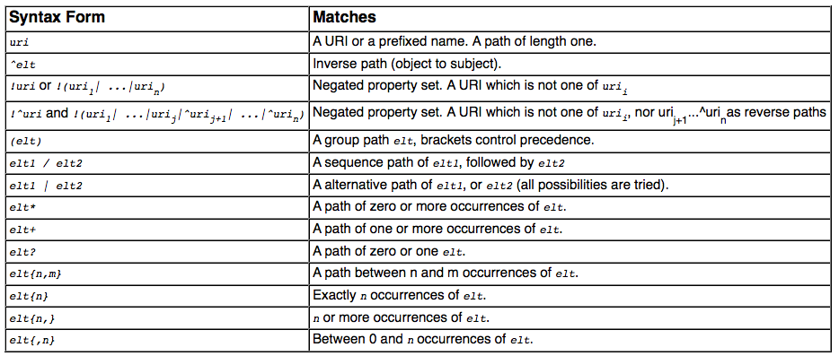
Path expressions full list of operators
elt … Path Element
Semantics: by translation to native SPARQL with two core property paths Operators:
  ArbitraryPath(X, path, Y)
  ZeroLengthPath(X, path, Y)
63

Slide 64
Path expressions
Can be used for some ontological inference (well known since [Perez et al. 2008]
E.g. Find all Beers in the Beer ontology
PREFIX beer: <http://www.purl.org/net/ontology/beer#>
PREFIX rdf: <http://www.w3.org/1999/02/22-rdf-syntax-ns#>
PREFIX rdfs: <http://www.w3.org/2000/01/rdf-schema#>
SELECT ?beer
FROM <http://www.purl.org/net/ontology/beer>
WHERE {
?beer rdf:type/rdfs:subClassOf* beer:Beer .
}
PREFIX beer: <http://www.purl.org/net/ontology/beer#>
PREFIX rdf: <http://www.w3.org/1999/02/22-rdf-syntax-ns#>
PREFIX rdfs: <http://www.w3.org/2000/01/rdf-schema#>
SELECT ?beer
FROM <http://www.purl.org/net/ontology/beer>
WHERE {
?beer rdf:type beer:Beer .
}
No results under simple entailment…
Link
64

Slide 65
Implementations of SPARQL 1.1 Query:
Some current (partial) SPARQL1.1 implementations:
ARQ
  http://sourceforge.net/projects/jena/
  http://sparql.org/sparql.html
OpenAnzo
  http://www.openanzo.org/
Perl RDF
  http://github.com/kasei/perlrdf/
Corese
  http://www-sop.inria.fr/teams/edelweiss/wiki/wakka.php?wiki=CoreseDownloads
etc.
Others probably forthcoming…
Loads of SPARQL1.0 endpoints around
  Dbpedia: http://dbpedia.org/snorql/
  DBLP: http://dblp.l3s.de/d2r/snorql/
  Etc.
65

Slide 66
Part 2: Entailment Regimes
SPARQL 1.1 querying over RDFS+OWL2 ontologies and RIF rulesets?
66

Slide 67
SPARQL1.1 Entailment Regimes
SPARQL1.1 will define SPARQL query answering over OWL2 ontologies and RIF rule sets:
  http://www.w3.org/TR/sparql11-entailment/
  RDF Entailment Regime
  RDFS Entailment Regime
  D-Entailment Regime
  OWL 2 RDF-Based Semantics Entailment Regime
  OWL 2 Direct Semantics Entailment Regime
  RIF Core Entailment
    Won’t go into details of those, but sketch the main ideas!
67

Slide 68
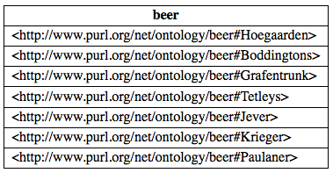
RDFS/OWL2 and SPARQL1.1
General Idea: Answer Queries with implicit answers
E.g. example from before:
PREFIX beer: <http://www.purl.org/net/ontology/beer#>
PREFIX rdf: <http://www.w3.org/1999/02/22-rdf-syntax-ns#>
PREFIX rdfs: <http://www.w3.org/2000/01/rdf-schema#>
SELECT ?beer
FROM <http://www.purl.org/net/ontology/beer>
WHERE {
?beer rdf:type beer:Beer .
}
beer:Boddingtons rdf:type beer:Ale .
beer:Grafentrunk rdf:type beer:Bock .
beer:Hoegaarden rdf:type beer:White .
beer:Jever rdf:type beer:Pilsner .
beer:Krieger rdf:type beer:Lager .
beer:Paulaner rdf:type beer:White .
beer:Tetleys rdf:type beer:Ale .
beer:Ale rdfs:subClassOf beer:TopFermentedBeer .
beer:Bock rdfs:subClassOf beer:BottomFermentedBeer .
beer:Lager rdfs:subClassOf beer:BottomFermentedBeer .
beer:Pilsner rdfs:subClassOf beer:BottomFermentedBeer .
beer:White rdfs:subClassOf beer:TopFermentedBeer .
beer:TopFermentedBeer rdfs:subClassOf beer:Beer.
beer:BottomFermentedBeer rdfs:subClassOf beer:Beer.

Slide 69
Essential idea behind RDFS inference:
SPARQL executes “inference” rules on the data, when answering queries, e.g.:
rdfs1: { ?S rdf:type ?C } :- { ?S ?P ?O . ?P rdfs:domain ?C . }
rdfs2: { ?O rdf:type ?C } :- { ?S ?P ?O . ?P rdfs:range ?C . }
rdfs3: { ?S rdf:type ?C2 } :- {?S rdf:type ?C1 . ?C1 rdfs:subclassOf ?C2 . }
beer:Boddingtons rdf:type beer:Ale .
beer:Grafentrunk rdf:type beer:Bock .
beer:Hoegaarden rdf:type beer:White .
…
beer:Boddingtons rdf:type beer:Ale ;
rdf:type beer:TopFermentedBeer;
rdf:type beer:Beer.
beer:Grafentrunk rdf:type beer:Bock .
rdf:type beer:BottomFermentedBeer;
rdf:type beer:Beer.
beer:Hoegaarden rdf:type beer:White ;
rdf:type beer:TopFermentedBeer;
rdf:type beer:Beer.
…
beer:Ale rdfs:subClassOf beer:TopFermentedBeer .
beer:Bock rdfs:subClassOf beer:BottomFermentedBeer .
beer:Lager rdfs:subClassOf beer:BottomFermentedBeer .
beer:Pilsner rdfs:subClassOf beer:BottomFermentedBeer .
beer:White rdfs:subClassOf beer:TopFermentedBeer .
beer:TopFermentedBeer rdfs:subClassOf beer:Beer.
beer:BottomFermentedBeer rdfs:subClassOf beer:Beer.

Slide 70
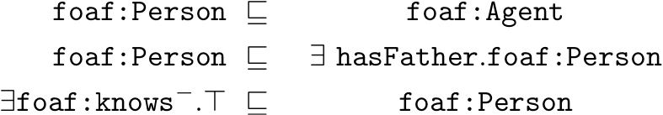
OWL2 and SPARQL1.1
General Idea: Answer Queries with implicit answers
E.g. Graph/Ontology:
T-Box:
A-Box:
SELECT ?X { ?X a foaf:Person }
Pure SPARQL 1.0 returns only :Jeff,
should also return :aidan
foaf:Person rdfs:subClassOf foaf:Agent .
foaf:Person rdfs:subclassOf
[ a owl:Restriction ;
owl:onProperty :hasFather ;
owl:someValuesFrom foaf:Person ] .
foaf:knows rdfs:range foaf:Person.
:jeff a Person .
:jeff foaf:knows :aidan .
:jeff a Person .
:jeff foaf:knows :aidan .
70

Slide 71
SPARQL1.1+RDFS/OWL: Challenges+Pitfalls
Challenges+Pitfalls:
  Possibly Infinite answers (by RDFS ContainerMembership properties, OWL datatype reasoning, etc.)
  Conjunctive Queries: non-distinguished variables
  SPARQL 1.1 features: Aggregates
71

Slide 72
SPARQL1.1+RDFS/OWL: Challenges+Pitfalls
Current Solution:
  Possibly Infinite answers (by RDFS ContainerMembership properties, OWL datatype reasoning, etc.)
    Restrict answers to rdf:/rdfs:/owl:vocabulary minus rdf:_1 … rdf:_n plus terms occurring in the data graph
  Non-distinguished variables
    No non-distinguished variables, answers must result from BGP matching, projection a post-processing step not part of SPARQL entailment regimes.
  SPARQL 1.1 other features: e.g. Aggregates, etc.
    Again not affected, answers must result from BGP matching, projection a post-processing step not part of entailment.
  Simple, BUT: maybe not always entirelty intuitive, so
    Good to know ;-)
72

Slide 73
Possibly Infinite answers RDF(S): Container Membership
Graph:
  :rr2010Proceedings :hasEditors [ a rdf:Seq;
  rdf:_1 :pascal_hitzler;
  rdf:_2 :thomas_lukasiewicz
  ] .
  Query with RDFS Entailment in mind:
  SELECT ?CM { ?CM a rdfs:ContainerMembershipProperty}
  Entailed by RDFS (axiomatic Triples):
  rdfs:_1 a rdfs:ContainerMembershipProperty .
  rdfs:_2 a rdfs:ContainerMembershipProperty .
  rdfs:_3 a rdfs:ContainerMembershipProperty .
  rdfs:_4 a rdfs:ContainerMembershipProperty .
  …
73

Slide 74
Possibly Infinite answers RDF(S): Container Membership
Graph:
  :rr2010Proceedings :hasEditors [ a rdf:Seq;
  rdf:_1 :pascal_hitzler;
  rdf:_2 :thomas_lukasiewicz
  ] .
  Query with RDFS Entailment in mind:
  SELECT ?CM { ?CM a rdfs:ContainerMembershipProperty}
  SPARQL 1.1 restricts answers to rdf:/rdfs:/owl:vocabulary minus rdf:_1 … rdf:_n plus terms occurring in the data graph
  So, the only answers in SPARQL1.1 are:
  { ?CM/rdfs:_1, ?CM/rdfs:_2, }
74

Slide 75
Non-distinguished variables:
E.g. Graph
foaf:Person rdfs:subClassOf foaf:Agent .
foaf:Person rdfs:subclassOf
[ a owl:Restriction ;
owl:onProperty :hasFather ;
owl:someValuesFrom foaf:Person ] .
foaf:knows rdfs:range foaf:Person.
:jeff a Person .
:jeff foaf:knows :aidan .
SELECT ?X ?Y { ?X :hasFather ?Y }
No answer, because no known value for ?Y in the data graph.
75

Slide 76
Non-distinguished variables:
E.g. Graph
foaf:Person rdfs:subClassOf foaf:Agent .
foaf:Person rdfs:subclassOf
[ a owl:Restriction ;
owl:onProperty :hasFather ;
owl:someValuesFrom foaf:Person ] .
foaf:knows rdfs:range foaf:Person.
:jeff a Person .
:jeff foaf:knows :aidan .
SELECT ?X { ?X :hasFather ?Y }
But what about this one? ?Y looks like a “non-distinguished” variable
Solution: In SPARQL 1.1 answers must result from BGP matching, projection a post-processing step not part of entailment ➔ so, still no answer.
76

Slide 77
SPARQL 1.1/OWL other features: Aggregates
Similar as before… aggregates are evaluated within algebra after BGP matching, so, no effect:
foaf:Person rdfs:subClassOf foaf:Agent .
foaf:Person rdfs:subclassOf
[ a owl:Restriction ;
owl:onProperty :hasFather ;
owl:someValuesFrom foaf:Person ] .
:jeff a Person .
:jeff foaf:knows :aidan .
foaf:knows rdfs:range foaf:Person.
SELECT ?X { ?X a foaf:Person }
Under RDFS/OWL entailment returns : {?X/jeff, ?X/aidan}
77

Slide 78
SPARQL 1.1/OWL other features: Aggregates
Similar as before… aggregates are evaluated as post-processing after BGP matching, so, no effect:
foaf:Person rdfs:subClassOf foaf:Agent .
foaf:Person rdfs:subclassOf
[ a owl:Restriction ;
owl:onProperty :hasFather ;
owl:someValuesFrom foaf:Person ] .
:jeff a Person .
:jeff foaf:knows :aidan .
foaf:knows rdfs:range foaf:Person.
SELECT (Count(?X) AS ?Y) { ?X a foaf:Person }
Attention! owl:sameAs inference does NOT affect counting!!!
Attention! owl:sameAs inference does NOT affect counting!!! …
But bnodes do!
:jeff :hasFather [a Person].
:jeff owl:sameAs :aidan.
Under RDFS/OWL entailment returns : {?Y/2}
{?Y/2}
{?Y/3}
78

Slide 79
SPARQL1.1 + RIF
RIF … Rule Interchange format, Rec. since 2010
  RIF: Rule Interchange Format (rather than Rule language)
    Framework for Rule Languages
    Support RDF import: interesting for rule languages on top of RDF
    Built-Ins support (close to XPath/XQuery functions and operators)
    RIF Dialects:
      RIF BLD: basic logic dialect = Horn rules with Built-ins, Equality
      RIF Core: Datalog fragment (no logical function symbols, no head-equality)
      RIF PRD: Production rules dialect
    Normative XML syntax
  Commonalities with OWL:
    RIF can model OWL2 RL
    Share same Datatypes (XSD Datatypes, most OWL2 Datatypes)
    Combinations of RIF with RDF, RDFS, and OWL defined in:
    http://www.w3.org/TR/rif-rdf-owl/
79

Slide 80
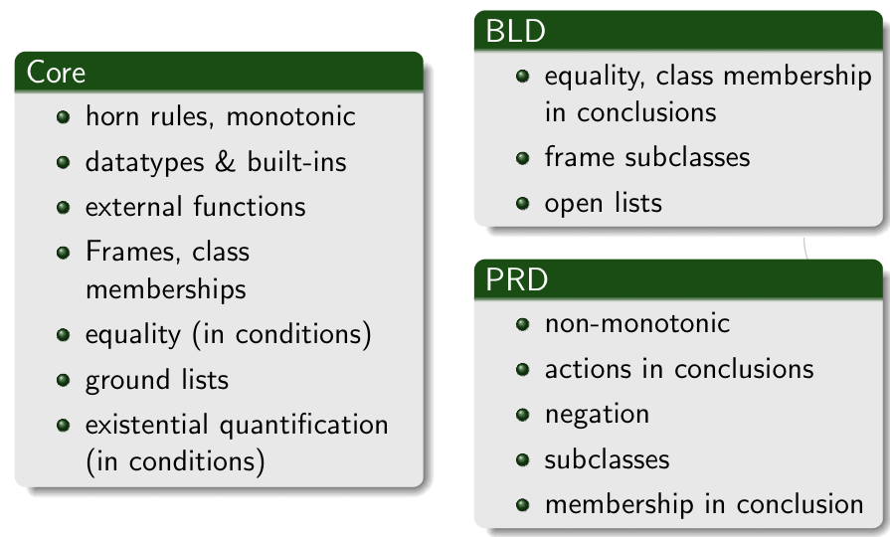
RIF Dialects
SPARQL1.1 so far only defines
Entailment for RIF Core… room for improvement (cf. e.g. Demo Obermeier et al. RR2010)
80

Slide 81
SPARQL1.1 + RIF Core + RDFS/OWL
RIF Core allows to encode RDFS, e.g.:
RIF Core allows to encode OWL2 RL, e.g. :
Plus more (custom rules, including Built-ins):
rdfs1: { ?S rdf:type ?C } :- { ?S ?P ?O . ?P rdfs:domain ?C . }
rdfs2: { ?O rdf:type ?C } :- { ?S ?P ?O . ?P rdfs:range ?C . }
rdfs3: { ?S rdf:type ?C2 } :- {?S rdf:type ?C1 . ?C1 rdfs:subclassOf ?C2 . }
owl1: { ?S1 owl:SameAs ?S2 } :-
{ ?S1 ?P ?O . ?S2 ?P ?O . ?P rdf:type owl:InverseFunctionalProperty}
owl2: { ?Y ?P ?O } :- { ?X owl:SameAs ?Y . ?X ?P ?O }
owl3: { ?S ?Y ?O } :- { ?X owl:SameAs ?Y . ?S ?X ?O }
owl4: { ?S ?P ?Y } :- { ?X owl:SameAs ?Y . ?S ?P ?X }
{?X foaf:name ?FullN } :- { ?X foaf:firstName ?F. ?X foaf:lastName ?L }
AND ?FullN = fn:concat(?F, " ", ?L)
<http://ruleset1.rif>
81

Slide 82
How to reference to a RIF Ruleset from SPARQL?
In OWL Entailment Regime, OWL is assumed to be part of the RDF Graph (OWL/RDF)
RIF’s so far only a normative syntax is RIF/XML
  RIF encoding in RDF (RIF/RDF) underway:
  http://www.w3.org/2005/rules/wiki/RIF_In_RDF
  Will also provide a new RDF property rif:usedWithProfile to import RIF rulesets (in RIF/XML or RIF/RDF). e.g.
In current draft called rif:imports
  <http://ruleset1.rif> rif:usedWithProfile
  <http://www.w3.org/ns/entailment/Simple> .
  <http://dblp.l3s…/Tim_Berners-Lee>
  foaf:homepage <http://www.w3.org/People/Berners-Lee/> ;
  foaf:name "Tim Berners-Lee" .
  <http://www.w3.org/People/Berners-Lee/card#i>
  foaf:homepage <http://www.w3.org/People/Berners-Lee/> ;
  foaf:firstName "Timothy”;
  foaf:lastName "Berners-Lee" .
?P | ?N
<dblp/Tim> | Tim Berners-Lee
?P | ?N
<dblp/Tim> | Tim Berners-Lee
<w3/B-Lee/card#i> | Tim Berners-Lee
<dblp/Tim> | Timothy Berners-Lee
<w3/B-Lee/card#i> | Timothy Berners-Lee
  SELECT ?P ?N { ?P foaf:name ?N }
w/o RIF Entailment…
82

Slide 83
Wrapping up
SPARQL 1.0
  UNIONs of Conjunctive Queries, FILTERs, GRAPH queries, OPTIONAL, (hidden) negation
  contributed largely to the current Linked Data boom
  Inspired interesting academic work
SPARQL 1.1
  A reasonable next step
    Incorporating highly demanded features
    Closing the gaps to neighbour standards (OWL2, RIF)
  Not all of it is trivial → SPARQL1.1 takes a very pragmatic path
Hopefully inspiring for more research, more data, and more applications!
83

Slide 84
What I didn’t talk about…
List of agreed features:
Additions to the Query Language:
  Project Expressions
  Aggregate functions
  Subqueries
  Negation
  Property Paths (time permitting)
  Extend the function library (time permitting)
  Basic federated Queries (time permitting)
Entailment (time permitting)
SPARQL Update
  Full Update language
  plus simple RESTful update methods for RDF graphs (HTTP methods)
Service Description
  Method for discovering a SPARQL endpoint’s capabilities
  Summary of its data
84

Slide 85
Extended Function Library
Functions Library in SPARQL1.0 is insufficient:
  Bound( . )
  isLiteral( . )
  isBlank( . )
  isIRI( . )
  Str( . )
  Regex( . , .)
  +,-,*, <, >, =
New functions to be included in standard library:
  COALESCE, IF
  Functions from the Xpath/Xquery function library
    String manipulation, more math, etc. … e.g. fn:concat
Essentially: rubber-stamp common functions present in current implementations
85

Slide 86
  Basic federated Queries (time permitting)
http://www.w3.org/TR/sparql11-federated-query/
  Will be integrated in Query spec
Essentially new pattern SERVICE
  Similar to GRAPH
  allows delegate query parts to a specific (remote) endpoint
Recall: We were cheating in this query before!!
PREFIX foaf: <http://xmlns.com/foaf/0.1/>
SELECT ?N
WHERE {
{ <http://www.w3.org/People/Berners-Lee/card#i> foaf:knows ?F .
?F foaf:name ?N }
UNION
{ [ foaf:maker <http://dblp.l3s.de/…/authors/Tim_Berners-Lee>,
[ foaf:name ?N ] ] . }
}
Tim’s FOAF
file
DBLP SPARQL endpoint
86

Slide 87
  Basic federated Queries (time permitting)
http://www.w3.org/TR/sparql11-federated-query/
  Will be integrated in Query spec
Essentially new pattern SERVICE
  Similar to GRAPH
  allows delegate query parts to a specific (remote) endpoint
PREFIX foaf: <http://xmlns.com/foaf/0.1/>
SELECT ?N
FROM <http://www.w3.org/People/Berners-Lee/card>
WHERE {
{ <http://www.w3.org/People/Berners-Lee/card#i> foaf:knows ?F .
?F foaf:name ?N }
UNION
{ SERVICE <http://dblp.l3s.de/d2r/sparql>
{ [ foaf:maker <http://dblp.l3s.de/…/authors/Tim_Berners-Lee>,
[ foaf:name ?N ] ] . } }
}

Slide 88
Basic Federated Queries - BINDINGS
Sometimes you want to “inject” or “fix” some bindings into the query to be sent to an external endpoint.
Goal: reduce data to be transferred:
Example:
… WHERE { ?s :p2 ?v2 } BINDINGS ?s ?v2 { ( <s1> 7 ) ( <s2> UNBOUND ) }
… WHERE { { ?s :p2 ?v2 }
{ {SELECT ( <s1> AS ?s ) ( 7 AS ?v2 ) WHERE {} }
UNION
{SELECT ( <s2> AS ?s ) WHERE {} }
➔ i.e. can be viewed as “syntactic sugar”, may be helpful…

Slide 89
SPARQL1.1 Update
Like SQL … SPARQL/RDF Stores need a standard Data Manipulation Languagehttp://www.w3.org/TR/sparql11-update/
SPARQL 1.1 Update Language
  Graph Update
    INSERT DATA
    DELETE DATA
    DELETE/INSERT
    DELETE
    INSERT
    DELETE WHERE
    LOAD
    CLEAR
  Graph Management
    CREATE
    DROP
Issue: Graph-aware stores vs. Quad Stores
89

Slide 90
Service Description
Base vocabulary to describe
features of SPARQL endpoints
datasets (via vocabularies external to the Spec,e.g. VOID)
http://www.w3.org/TR/sparql11-service-description/
3.2 Classes
3.2.1 sd:Service
3.2.2 sd:Language
3.2.3 sd:Function
3.2.4 sd:Aggregate
3.2.5 sd:EntailmentRegime
3.2.6 sd:EntailmentProfile
3.2.7 sd:GraphCollection
3.2.8 sd:Dataset
3.2.9 sd:Graph
3.2.10 sd:NamedGraph
3.3 Instances
3.3.1 sd:SPARQL10Query
3.3.2 sd:SPARQL11Query
3.3.3 sd:SPARQL11Update
3.3.4 sd:DereferencesURIs
3.3.5 sd:UnionDefaultGraph
3.3.6 sd:RequiresDataset
3.3.7 sd:EmptyGraphs
3.4 Properties
3.4.1 sd:url
3.4.2 sd:feature
3.4.3 sd:defaultEntailmentRegime
3.4.4 sd:supportedEntailmentProfile
3.4.5 sd:entailmentRegime
3.4.6 sd:extensionFunction
3.4.7 sd:extensionAggregate
3.4.8 sd:languageExtension
3.4.9 sd:supportedLanguage
3.4.10 sd:propertyFeature
3.4.11 sd:defaultDatasetDescription
3.4.12 sd:availableGraphDescriptions
3.4.13 sd:resultFormat
3.4.14 sd:defaultGraph
3.4.15 sd:namedGraph
3.4.16 sd:name
3.4.17 sd:graph

Slide 91
Relevant W3C Specs
SPARQL Query Language for RDF http://www.w3.org/TR/rdf-sparql-query/
SPARQL1.1 Query Language for RDF (working draft) http://www.w3.org/TR/sparql11-query/
SPARQL1.1 Entailment Regimes (working draft) http://www.w3.org/TR/sparql11-entailment/
RDF(S) Entailment/D-Entailment:
RDF Semantics http://www.w3.org/TR/rdf-mt/
OWL Entailment:
OWL2 Web Ontology Language Primer http://www.w3.org/TR/owl2-primer/
OWL2 Web Ontology Language Profiles http://www.w3.org/TR/owl2-profiles/
RIF Entailment:
RIF Core Dialect http://www.w3.org/TR/rif-core/
RIF Basic Logic Dialect http://www.w3.org/TR/rif-bld/
RIF RDF and OWL compatibility http://www.w3.org/TR/rif-rdf-owl/
91

Slide 92
References: Academic Results on SPARQL
[Alkhateeb et al. 2009] Faisal Alkhateeb, Jean-Francois Baget, and Jerome Euzenat. Extending SPARQL with regular expression patterns (for querying RDF). JWS, 7(2), 2009.
[Angles & Gutierrez, 2008] Renzo Angles and Claudio Gutierrez. The expressive power of SPARQL, ISWC 2008.
[Eiter et al. 2006] Thomas Eiter, Giovambattista Ianni, Roman Schindlauer and Hans Tompits. Effective Integration of Declarative Rules with External Evaluations for Semantic-Web Reasoning, ESWC 2006.
[Perez et al. 2006] Jorge Perez, Marcelo Arenas, Claudio Gutierrez. Semantics and complexity of SPARQL. ISWC 2006.
[Perez et al. 2009] Jorge Perez, Marcelo Arenas, Claudio Gutierrez. Semantics and complexity of SPARQL. ACM ToDS 34(3), 2009.
[Perez et al. 2008] Jorge Perez, Marcelo Arenas, and Claudio Gutierrez. nSPARQL: A navigational language for RDF. In 7th International Semantic Web Conference, ISWC 2008.
[Polleres 2007] Axel Polleres From SPARQL to Rules (and back). WWW 2007
[Polleres et al. 2007] Axel Polleres,Francois Scharffe,and Roman Schindlauer. SPARQL++ for mapping between RDF vocabularies. ODBASE 2007.
[Schmidt et al. 2010] Michael Schmidt, Michael Meier, and Georg Lausen. Foundations of sparql query optimization. ICDT2010

Slide 93

Acknowledgements
The members of the W3C SPARQL WG, particularly Lee Feigenbaum, who I stole some examples from
The members of the W3C RIF WG
The EU project which sponsored my visit.
93

