Slide 1
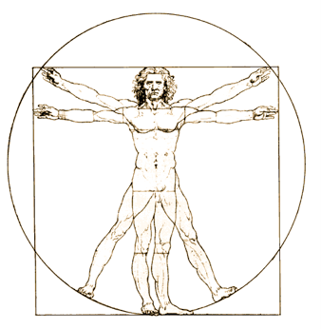
Life in Standard(isation) bodies… … some very subjective experiences

Slide 2
The W3C
The W3C standardisation process
Proposing a standard? W3C member submissions
General points…

Slide 3
W3C
First WWW Conference:
First International Conference on the World-Wide Web May 1994
First W3 Consortium Meeting: Dec 1994
Since then the W3C set up many important standard recommendations like XML (XML 1.0 Recommendation published on 10th February 1998), XML Schma, RDF, OWL, etc. .
http://www.w3.org

Slide 4
W3C
World Wide Web Consortium
Founded by CERN, MIT and others
ca. 250 participants (Companies, Academic partners)
Function: standardization of web formats
Not normative: gives only recommendations, no ISO bearing standards
Six types of documents
Note
Not a component in the standardization process
No declaration that W3C stands behind
Working Draft (WD)
Documentation of a discussion condition
Last Call WD
When the goals are reached
Candidate Recommendation (CR)
Confirmation of success
Proposed Recommendation
Extension; partial implementation
Recommendation
official W3C standard
Note
Working Draft
Last Call WD
CR
PR
Recommendation
Notes:
notes kann jeder w3c member einreichen

Slide 5
W3C depends on W3C members…
Big industry players
(Academic members)
… all pay membership fees (different for academics and industry)
Lemma1: Every W3C member typically comes in with a certain agenda
Corollary 1: Standards are necessarily compromise rather than consensus

Slide 6
Lemma 2: Limited time charter, allows limited work on “beautifying” things
Corollary1+Lemma2 ➔
Corollary2: W3C specs are necessarily unreadable. (to some extent) ☺
Not the purpose (with exceptions) of W3C to create
Teaching material, but agreed specifications. Work often stops after agreement, no time left for ““beautifying”

Slide 7
Editor vs. Member
Different styles of editors:
Editor does the job, group acknowledges
Group suggests, editor just writes up
The former more common… if you want to drive something, it’s not bad to be an editor ;-)
But: Editors are NOT authors!
And: spec work isn’t necessarily (academically) rewarding ☹
quotes from people I talked to
“all the citations for OWL1 went to the guide (a doc which was produced last minute) and not to the technical docs”
“OWL2 has a different model: naming editors and contributors”

Slide 8
Example RIF
W3C workshop on rules
Charter
http://www.w3.org/2005/rules/wg/charter.html
originally chartered Nov 2005 until until 30 November 2007
Very broad mission: “This Working Group is chartered to produce a core rule language plus extensions which together allow rules to be translated between rule languages and thus transferred between rule systems. “
Different stake holders in one group (production rules vendors, Semantic Web enthusiasts, Semantic Web companies)
Originally like 50 members…
… when 2/3rd had dropped out, work began to be productive
Recommendation docs:22 June 2010 !!!
My own role: member

Slide 9
Example SPARQL
Chartered with a much stricter/tigher agenda:
Per charter (http://www.w3.org/2009/05/sparql-phase-II-charter.html)
“The scope of this charter is to extend SPARQL technology to include some of the features that the community has identified as both desirable and important for interoperability based on experience with the initial version of the standard.”
No inclusion of new features that still require research, avoid mistakes of RIF, (OWL?)
Concrete features, relevance, implementations…
Still we will go probably at least half a year over the original plan… it’s normal
My own role: co-chair

Slide 10
RIF vs. SPARQL
You view things A LOT different as co-chair than as member:
It’s easiest to critizice from outside the group
It’s relatively easy to criticize as a member (but at some point you have to agree, to not block progress)
Member duties:
You are expeceted (per W3C rules), as a member to spend at least a day per week work to the group
Some WGs handle that stricter than others
Chair:
You should be impartial
Main goal: drive through the agenda

Slide 11
Having your own standard proposal?
W3C has an instrument for that for it’s members:
W3C member submission
Includes:
Actual proposal
Suggested action to W3C
Gain:
Submissions officially published on W3C page
Review by W3C team with comments
BUT: no official status

Slide 12
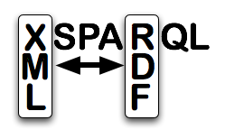
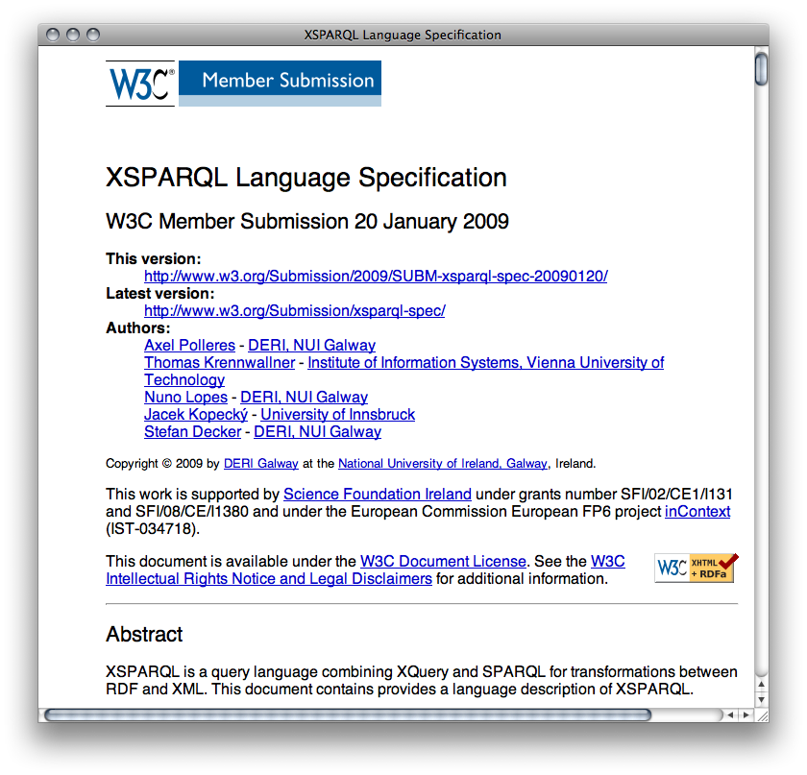
Standardization in DERI
Standards: One of DERI’s major assets
Strong presence in W3C
Involve/inform our partners in relevant standardisation activities
Push and promote DERI standard proposals:

Slide 13
Experiences from XSPARQL submission
You need an idea
You need support for it
It still can take long until it’s acknowldged
(You better lobby, ask within W3C team before as well)
In our case: XML activity and SW activity within W3C turned out to be fairly disconnected…

Slide 14
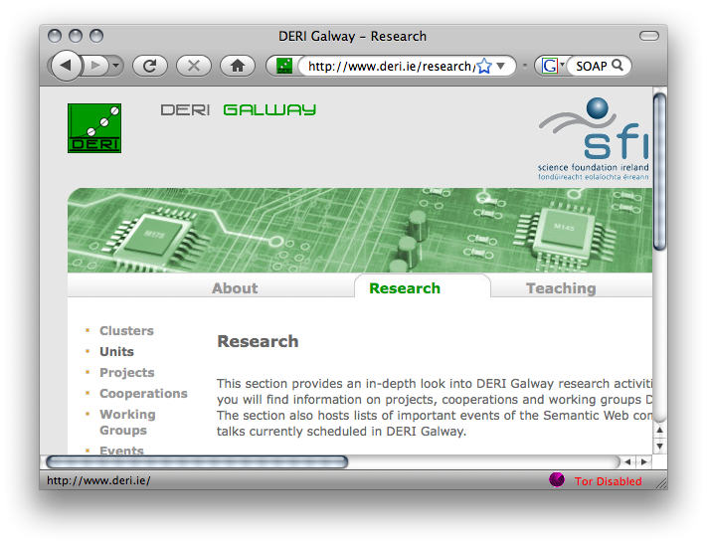
Idea:
XSLT/XQuery
HTML
RSS
XSPARQL
<XML/>
SPARQL
SOAP/WSDL

Slide 15
You need support (from industry & other members):
Davide Palmisano, Asemantics S.R.L. “Asemantics is aware of the potential offered by the mixed nature of XSPARQL that make this specification a major contribution for several data translation problems.”
Atanas Kiryakov, Ontotext “XSPARQL bears the potential to lower the cost of interoperability between XML and RDF, thus facilitating the transition to semantic technologies in a range of scenarios.”
Kingsley Idehen, OpenLink Software Inc. “We are a SQL, XML, and RDF data management, middleware, and integration specialist that offers industry standards compliant solutions that will benefit from the XQuery & SPARQL language fusion proposed by this specification.”
Tony McCormack, Nortel, “DERI's proposal of a novel query language, XSPARQL, to allow intuitive querying across XML and RDF is a timely step that has the potential for immediate impact in Nortel’s products.

Slide 16
Rules for member submissions:
http://www.w3.org/Submission/
Includes all kinds of tedious stuff
licencing/royalty-freeness
Formatting rules (pubrules-checker)… like submitting a conference paper, but stricter ;-)

Slide 17
Other ways to influence/create standards
Non-member can be invited as “Invited Experts”
W3C workshops are usually open to non-members… position papers… e.g.
http://www.w3.org/2009/12/rdf-ws/
Or: create a defacto standard yourself, and make it grow, examples FOAF, SIOC…
http://www.foaf-project.org/
http://sioc-project.org/
dissemination is often more work than actual technical contribution…

Slide 18
Conclusion
Standardisation work is exciting
Real-world (mostly)
Learnt a lot… (technically as well as “socially”)
Hopefully: helps us to shape the future of the Web/internet technology…

