Slide 1
Towards Formal Semantics for ODRL Policies: Defining Expressive Access Policies for Linked Data using the ODRL Ontology
Simon Steyskal & Axel Polleres
WU Wien, Austria
Twitter: @AxelPolleres web: http://www.polleres.net
Notes:
WU -> SEMANTICS 2015
AIM -> SHOW THAT ODRL COULD BE USED TO EXPRESS ACCESS POLICIES 4 LINKED DATA

Slide 2
Agenda
1
Motivation
Introducing ODRL
2
3
Example Policies
4
Reasoning over ODRL Policies

Slide 3
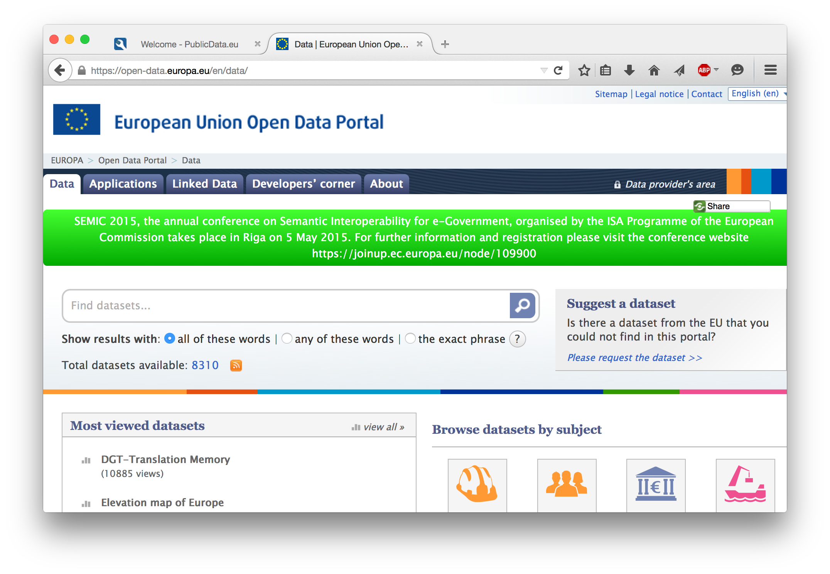
Open Data on the Web is great... But not all data is, or ever will be open.
A lot of activity in terms of standardization (in W3C) focused on
Formats (RDF)
Publishing best practices (Linked Data)
But: not all data is open. Different licenses, freemium usage models, API keys with different obligations to the user implied, etc.

Slide 4
Motivation hypothesis: companies won‘t offer you data for free
Dataset
Company
2
1
Data Consumer

Slide 5
Motivation from simple access conditions and machine-human interaction…
Data Publisher
authentification required!
Alice
******
Bob
*****
Data Consumer

Slide 6
Motivation … to high-level policies and machine-machine interaction!
Data Publisher
// access to dataset for 20€
<dataset> ownNS:pay „20“
linked
kk
?????
Data Consumer

Slide 7
Goal: Representation & Reasoning
Representation
Formalization of policies with ODRL
Present work
Reasoning
consuming and processing
high-level policies
future work

Slide 8
Representation:
Linked Data Rights v2.0 Rodríguez-Doncel et al.
ODRL
Obvious candidate …
Originally an XML representation of policies concerning digital rights management
RDF representation & ontology (ORDL 2.1 Ontology) → final draft just published by W3C community group.
Notes:
We both emphasize the necessity of an expressive, structured and standardized way to represent access conditions/policies AND we both propose to some extent ODRL for that purpose

Slide 9
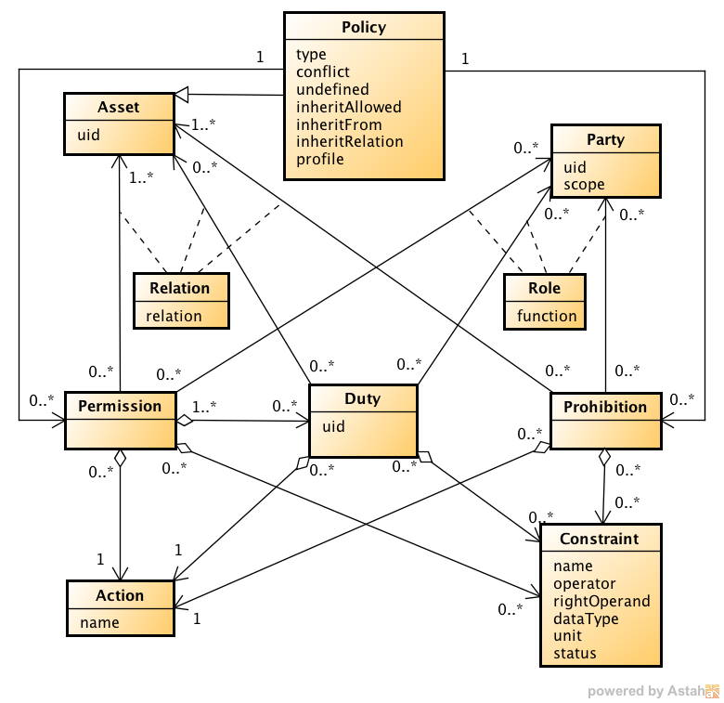
ODRL Core Model 2.0
http://www.w3.org/community/odrl/two/model/

Slide 10
ODRL Concepts 1/5 Policy
Policy
A Policy is the central entity that forms ODRL policy expressions. It can refer to Permissions and Prohibitions which hold for that Policy and be further distinguished into several subtypes such as:
Offer
Agreement
A Policy which proposes terms of usage from an Assigner to possible Assignees.
Alice allows anyone who pays her 20€ to read her dataset.
A Policy which contains all terms of usage between both an Assigner and an Assignee about an Asset.
Alice allows Bob to read her dataset if he pays her 20€.

Slide 11
ODRL Concepts 1/5 Policy
Request
Set
A Policy which proposes terms of usage from an Assignee to an Assigner (owner of the Asset).
Bob wants to pay Alice 20€ if she allows him to read her dataset.
A Policy which defines Prohibitions, Permissions and/or Duties for a certain Asset.
Dataset XY is licensed under CC-BY.
(i.e. duty to attribute asset owner)
Ticket
Privacy
A Policy which proposes terms of usage to any holder of a valid Ticket.
Dataset XY is accessible till May 2015 to any holder of a valid ticket.
A Policy which defines terms of usage over personal information.
Alice grants Bob to distribute her personal data but only for the purpose of contacting Alice. Furthermore he has to delete the asset after 30 days.

Slide 12
ODRL Concepts 2/5 Asset and Party
Asset
An Asset is the entity whose terms of usage are restricted by its surrounding policy expression. In the domain of Linked Data an Asset usually represents a dataset or parts of a dataset (triples) .
Party
A Party can be distinguished into Assigners (the parties who propose the policy statements) and Assignees (the ones who receive the policy statements).
Assigner
Asset
Assignee
owns
uses

Slide 13
ODRL Concepts 3/5 Permission, Prohibition, and Duty
Permission
A Permission specifies Actions which are allowed to be executed on a certain Asset.
Alice allows Bob to read her dataset.
Prohibition
Prohibitions are used to forbid specific Actions on an Asset and cannot refer to Duties.
Alice prohibits Bob to distribute her dataset.
Duty
Duties define Actions that have to be perfomed so that sorrounding Permissions or Policies become valid.
Alice allows Bob to read her dataset if he pays her 20€.
Permission
Duty

Slide 14
ODRL Concepts 4/5 Action
Action
Actions are operations on Assets that a potential Assignee is allowed (if related to a Permission), is prohibited (if related to a Prohibition) or has (if related to a Duty) to perform. In a Linked Data scenario actions could be:
aggregate – can be used to express the action of querying different datasets and aggregate the retrieved data.
read – the act of obtaining data from the asset (e.g. via SPARQL query).
copy - the action of copying data is fundamental when defining copyright restrictions and necessary for certain license definitions.
write - can be used to represent SPARQL INSERT queries, since it specifies the action of writing to an asset.
<custom> - although there are many prepoposed Actions that can be used out of the box, new actions which might fit the intended semantics more precisely can easily be added to the ontology.

Slide 15
ODRL Concepts 5/5 Constraint
Constraint
Constraints offer the possibility to restrict and limit the scope of Permissions, Prohibitions and Duties, using a simple mathematical structure with
two operands and one operator:
The number of query requests must be less or equal than 100.
Additionally a specific Purpose of the constrained Action can be defined:
Reading from a dataset using ASK queries shall be restricted to 100 executions.
operand
operator
operand
action
purpose
constraint

Slide 16
Access Policy Examples 1/7 Restricting access to specific parties and assets
@prefix odrl: <http://w3.org/ns/odrl/2/> .
@prefix : <http://www.example.com/> .
:policy1 a odrl:Agreement ;
odrl:permission [
a odrl:Permission;
odrl:action odrl:read;
odrl:target :dataset1, :dataset2;
odrl:assigner :owner;
odrl:assignee :alice
].
Listing 1

Slide 17
Access Policy Examples 2/7 Limiting number of allowed requests
@prefix spin: <http://spinrdf.org/sp/> .
@prefix odrl: <http://w3.org/ns/odrl/2/> .
@prefix : <http://www.example.com/> .
:policy2 a odrl:Agreement ;
odrl:permission [
a odrl:Permission;
odrl:assigner :owner;
odrl:assignee :alice;
odrl:action odrl:read;
odrl:target :dataset1; odrl:constraint [
a odrl:Constraint;
odrl:purpose spin:Ask;
odrl:operator odrl:lteq;
odrl:count "100"^^xsd:integer;
odrl:status "42"^^xsd:integer].].
Listing 2

Slide 18
Access Policy Examples 3/7 Permit access only in specific time frames
@prefix spin: <http://spinrdf.org/sp/> .
@prefix odrl: <http://w3.org/ns/odrl/2/> .
@prefix : <http://www.example.com/> .
:policy3 a odrl:Agreement ;
odrl:permission [
a odrl:Permission;
odrl:assigner :owner;
odrl:assignee :alice;
odrl:action odrl:read;
odrl:target :dataset1; odrl:constraint [
a odrl:Constraint;
odrl:purpose spin:Ask;
odrl:operator odrl:lteq;
odrl:dateTime "2016-12-31"^^xsd:date
] .
Listing 3

Slide 19
Access Policy Examples 4/7 Representing license information (CC-BY-NC-SA)
@prefix odrl: <http://w3.org/ns/odrl/2/> .
@prefix : <http://www.example.com/> .
:policy4 a odrl:Set;
odrl:permission [
a odrl:Permission;
odrl:action odrl:reproduce,
odrl:distribute,
odrl:derive;
odrl:duty odrl:attribution,
odrl:attachPolicy,
odrl:shareAlike
] .
odrl:prohibiton odrl:commercialize .
Listing 4
Villata et al. (ESWC 2014)

Slide 20
Access Policy Examples 5/7 Defining rights for derived data
@prefix odrl: <http://w3.org/ns/odrl/2/> .
@prefix : <http://www.example.com/> .
:policy5 a odrl:Set;
odrl:permission [
a odrl:Permission;
odrl:action odrl:distribute;
odrl:target :dataset;
odrl:duty [
a odrl:Duty;
odrl:action odrl:nextPolicy;
odrl:target :newPolicy ] .
:newPolicy a odrl:Set;
odrl:permission [
a odrl:Permission;
odrl:action odrl:display;
odrl:target :dataset] .
Listing 5

Slide 21
Access Policy Examples 6/7 Introducing payment duties
@prefix gr: <http://purl.org/goodrel/v1#> .
@prefix odrl: <http://w3.org/ns/odrl/2/> .
@prefix : <http://www.example.com/> .
:policy6 a odrl:Set;
odrl:permission [
a odrl:Permission;
odrl:action odrl:read;
odrl:target :dataset;
odrl:duty [
a odrl:Duty ;
odrl:action odrl:pay ;
odrl:constraint [
a odrl:Constraint ;
odrl:payAmount 50.00 ;
odrl:operator odrl:eq ;
odrl:unit <http://cvx.iptc.org/iso4217a:EUR>
] .
] .
Listing 6
odrl:unit & odrl:dataType with ODRL 2.1

Slide 22
Access Policy Examples 7/7 Combining prohibitions and permissions
@prefix gr: <http://purl.org/goodrel/v1#> .
@prefix odrl: <http://w3.org/ns/odrl/2/> .
@prefix gn: <http://www.geonames.org/ontology#">.
@prefix : <http://www.example.com/> .
:policy7 a odrl:Set;
odrl:permission [
a odrl:Permission;
odrl:action odrl:read;
odrl:target :dataset;
odrl:duty [
a odrl:Duty;
odrl:action odrl:pay;
odrl:constraint [
a odrl:Constraint ;
odrl:payAmount 50.00 ;
odrl:operator odrl:eq ;
odrl:unit
<http://cvx.iptc.org/iso4217a:EUR>
] .
Listing 7
odrl:prohibtion [
a odrl:Prohibition;
odrl:action odrl:distribute;
odrl:target :dataset;
odrl:constraint [
a odrl:Constraint;
odrl:operator odrl:eq;
odrl:spatial [
a gn:Feature.
gn:countryCode “AT”
] .
] .
] .

Slide 23
Reasoning Tasks:
As a first step, we look into implications between actions, permissions and duties associated with them which are not yet formally captured in ODRL
Next steps:
Consistency/Combinability of policies (for licences expressed in ODRL: done ;-) see last talk)
Alignment necessary in case policies refer to different RDF vocabularies?
E.g. Semantics of constraints needs more than plain OWL reasoning.
negotiation, etc. (not necessarily in scope of ODRL?)

Slide 24
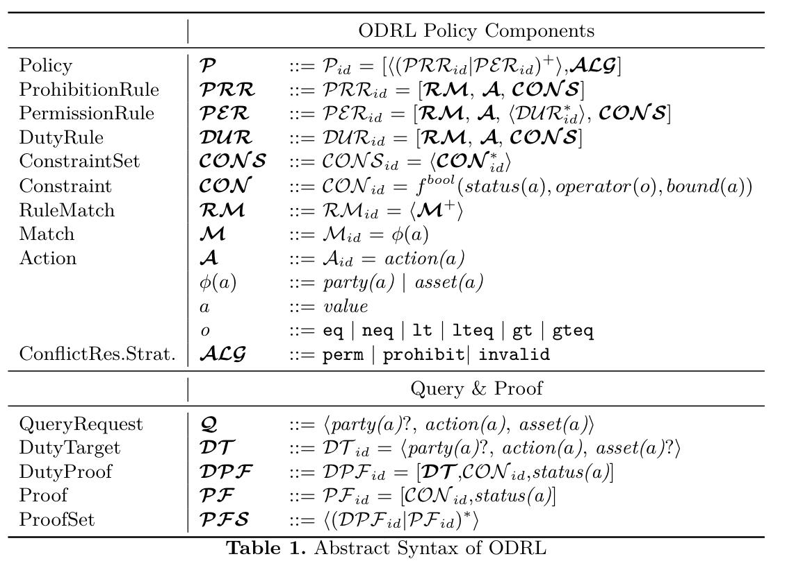
Just a starting point...
Formalizing ODRL 2.1:
Conceptual model:

Slide 25
Just a starting point...
Implicit Dependencies among ODRL Actions
Other dependencies expressed using SKOS (in the ODRL ontology):
Our current work:
1) express these dependencies in terms of rules
2) express conflict resolution strategies in rules

Slide 26
Remarks:
Some Duties/Prohibitions may be enforceable, others not. E.g.
"Limiting number of allowed requests" can be enforced by the server (block user)...
But how about controling distribution of items to which are readable only?
→ read implies the ability "can copy/distribute,
→ may make sense to distinguish between "enforcable" and non-enforcable" policies, between ability and enforcability?
Cf. existing work on policiy negotiation?

Slide 27
Summary: Representing &Reasoning about Linked Data policies with ODRL
(1) only a starting point
Many more things to do: reasoning, enforcement of fulfillment, …
(2) popular & emerging research topic
Rodríguez, Villata, Rotolo, Governatori...
Notes:
1) RIGHT to do something and the ABILITY to do something

Slide 28
Other topics related to Normative MAS,I'd love to discuss, except enabling Data Markets (but no time ☹ ) ... :
Policies and regulations in safety-critical engineering projects (national project SHAPE)
Belief revision and SPARQL Update with RDFS/OWL entailment
(national project SEE)
How to enable Semantic Search in legal texts / laws?
(project with the Federal Chancellery of Austria: RISearch)
Details: http://www.polleres.net/
... Hopefully time to discuss these offline with you! ☺
This work is being supported by the FFG project 845638
(SHAPE) and by the WWTF project ICT12-015 (SEE)

