Slide 1
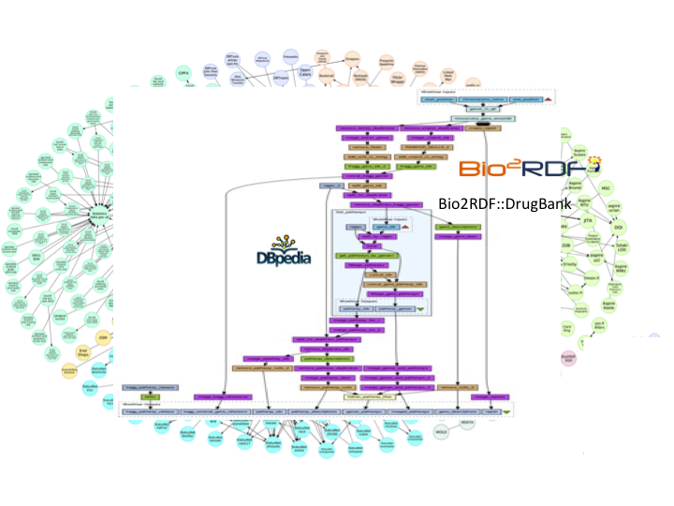
Data Management &
Data Workflows
Tutorial
Maria-Esther Vidal
Axel Polleres
http://polleres.net/presentations/

Slide 2
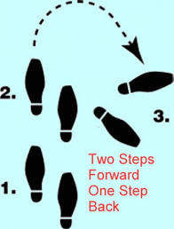
Data Management (today) vs.
Knowledge discovery/modeling (yesterday)

Slide 3
Outline
Motivation
  Integrating (Open) Data from different sources
  Not only Linked Data (NoLD)
  Data workflows and Data Management in the context of rise of Big Data
What is a "Data Workflow"?
  Different Views of Data Workflows in the context of the Semantic Web
  Key steps involved
  Tools?
Data Integration Systems
  GAV vs. LAV
  The Mediator and Wrapper Architecture
  Query rewriting vs. Materialisation
  Data Integration using Ontologies
Challenges:
  How to find Rules and ontologies?
  Handling Incompleteness
  How to find the data?
Open Problems – Research Tasks

Slide 4
Motivation
  Integrating (Open) Data from different sources

Slide 5
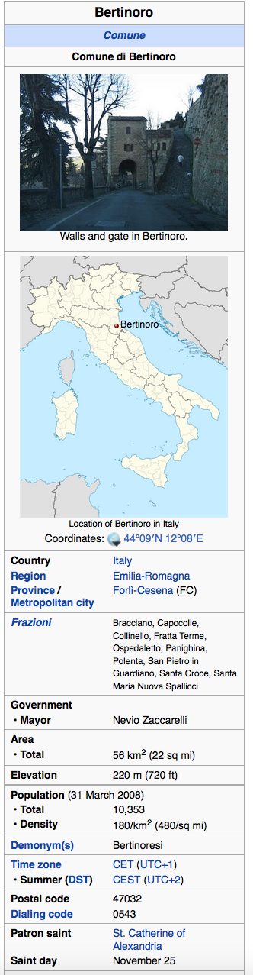











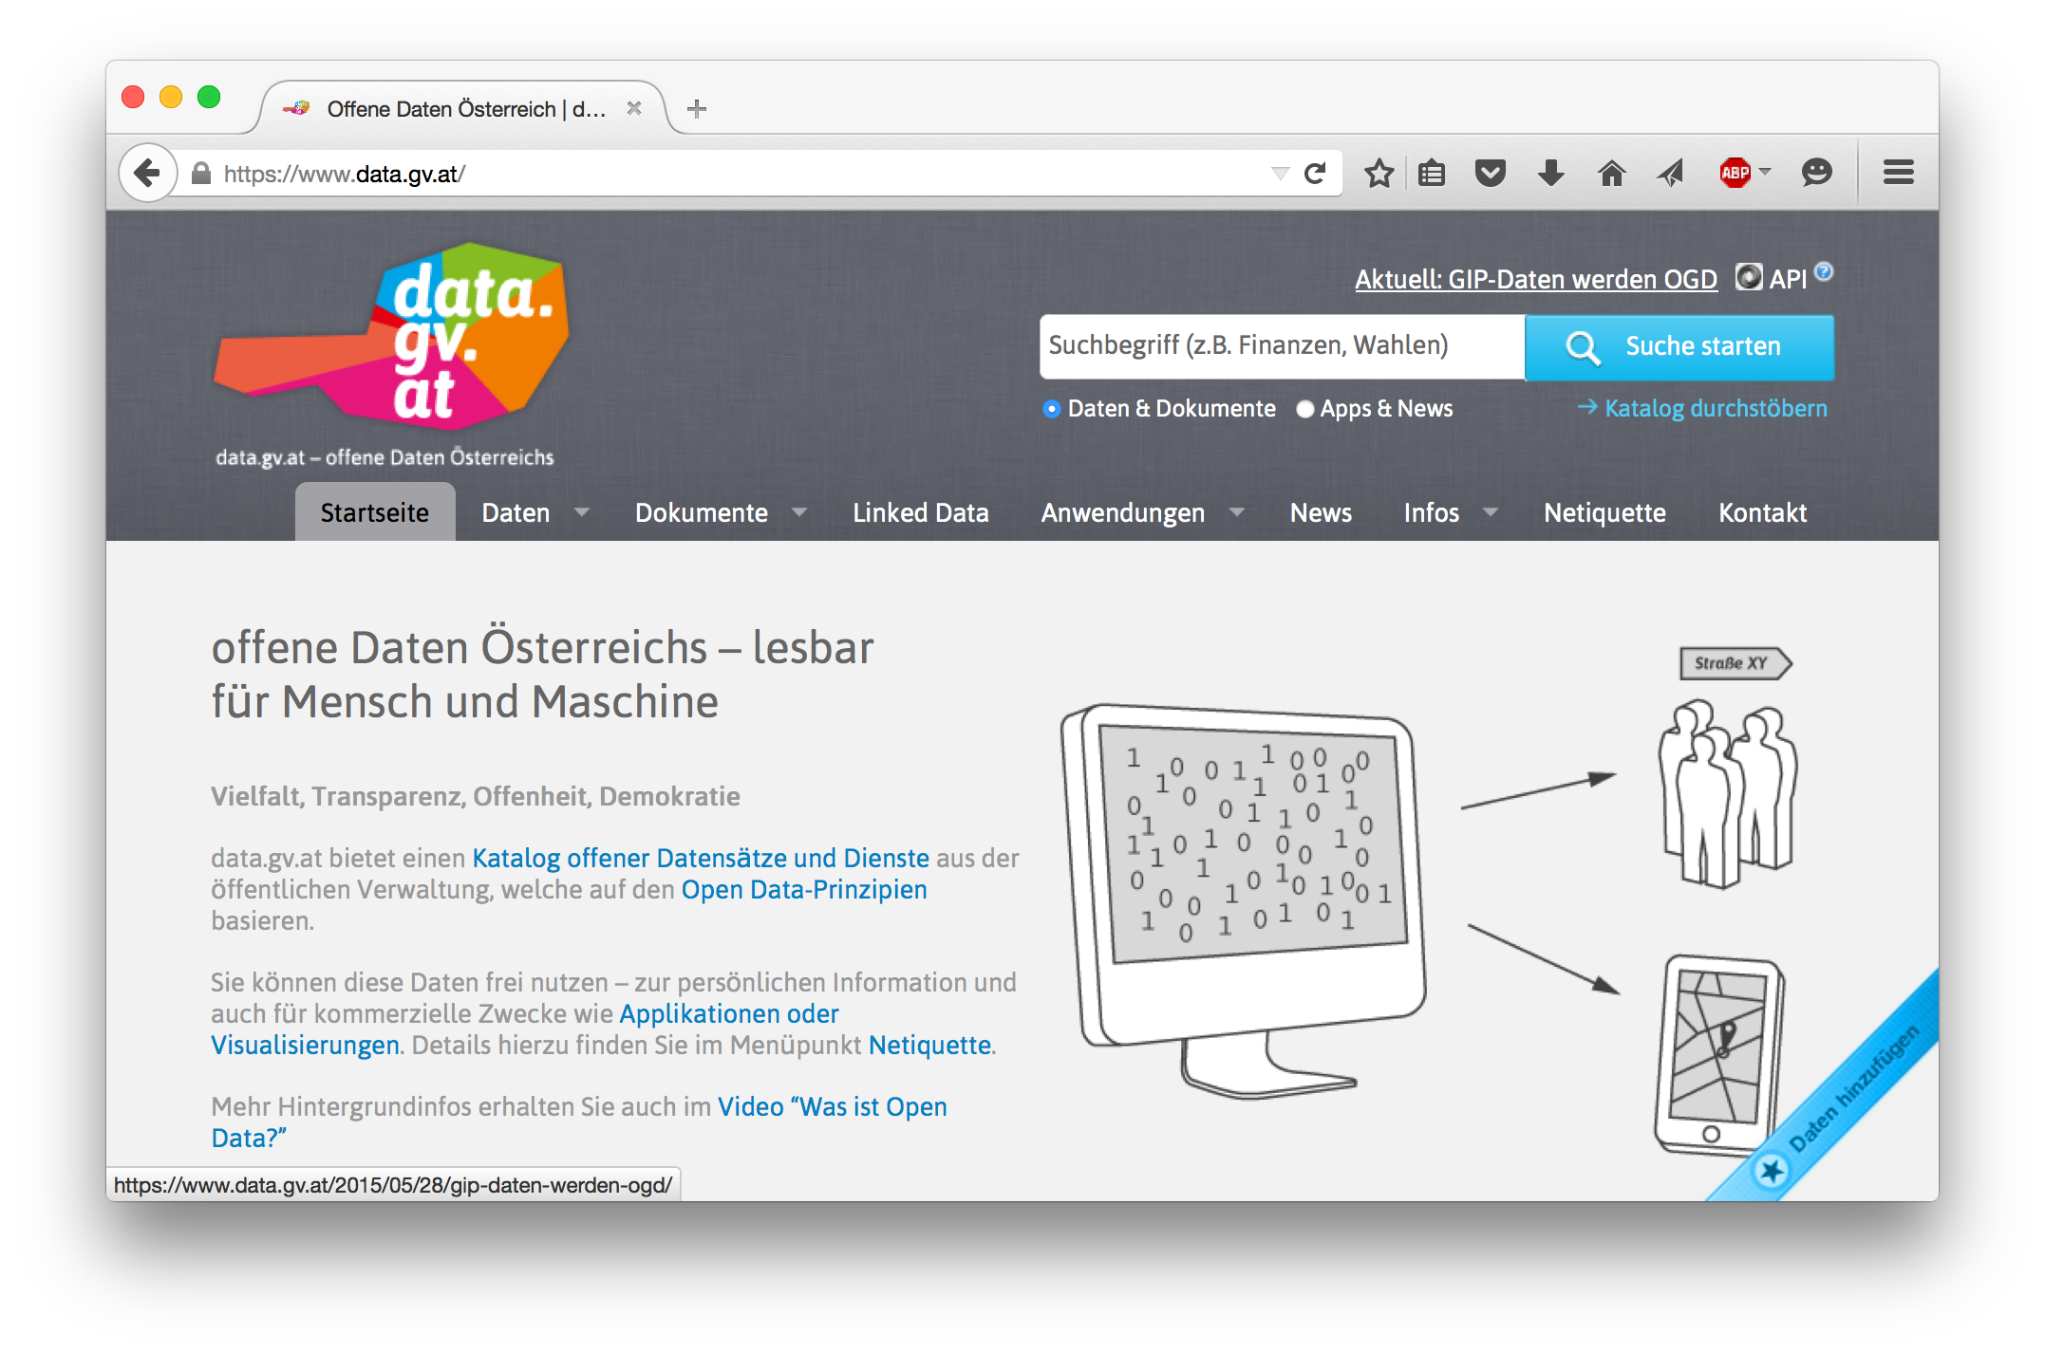
Open Data is a global trend – Good for us!
    Cities, International Organizations, National and European portals, etc.:
In general: more and more structured data available at our fingertipps
It's on the Web
It's open
  → no restrictions w.r.t. re-use
Notes:
5

Slide 6
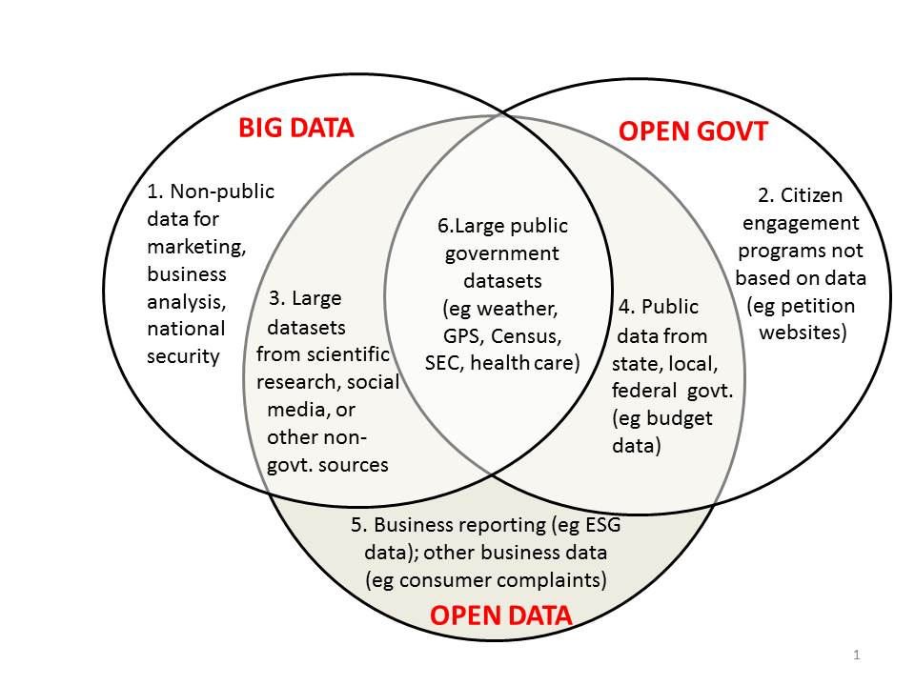
Buzzword Bingo 1/3:
Open Data vs. Big Data vs. Open Government
http://www.opendatanow.com/2013/11/new-big-data-vs-open-data-mapping-it-out/

Slide 7

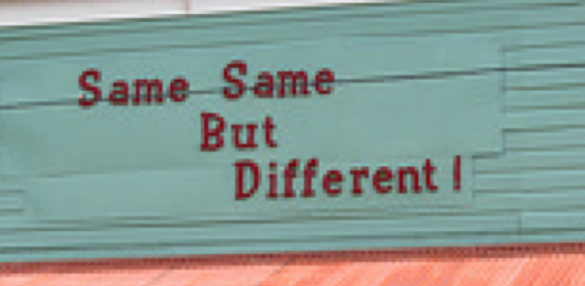



Buzzword Bingo 2/3:
Open Data vs. Big Data
Volume:
  It's growing! (we currently monitor 90 CKAN portals, 512543 resources/ 160069 datasets,
  at the moment (statically) ~1TB only CSV files...
Variety:
  different datasets (from different cities, countries, etc.), only partially comparable, partially not.
  Different metadata to describe datasets
  Different data formats
Velocity:
  Open Data changes regularly (fast and slow)
  New datasets appear, old ones disappear
Value:
  building ecosystems ("Data value chain") around Open Data is a key priority of the EC
Veracity:
  quality, trust

Slide 8

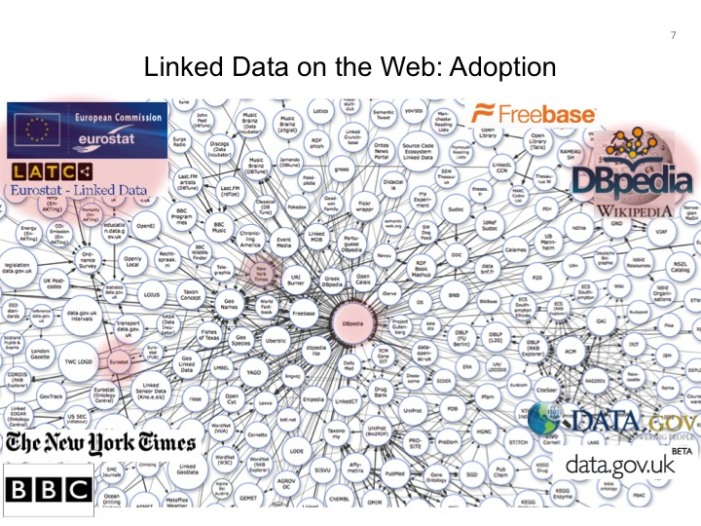
Buzzword Bingo 3/3:
Open Data vs. Linked Data
This talk is NOT about DL Reasoning over Linked Data:
cf.: [Polleres OWLED2013], [Polleres et al. Reasoning Web 2013]
LOD is still growing, but OD is growing faster and challenges aren't necessarily the exactly same…
So. let's focus on Open Data in general…
… more specifically on
Open Structured Data
Alternatives in the meantime: (wikidata...)
LD efforts discontinued?!
LOD in OGD growing, but slowly

Slide 9
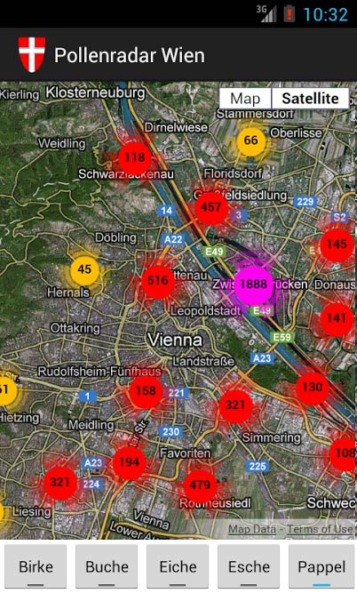
What makes Open Data useful beyond “single dataset“ Apps...
Great stuff, but limited potential...
More interesting:
Data Integration & building Data Workflows
from different Open Data sources!!!

Slide 10
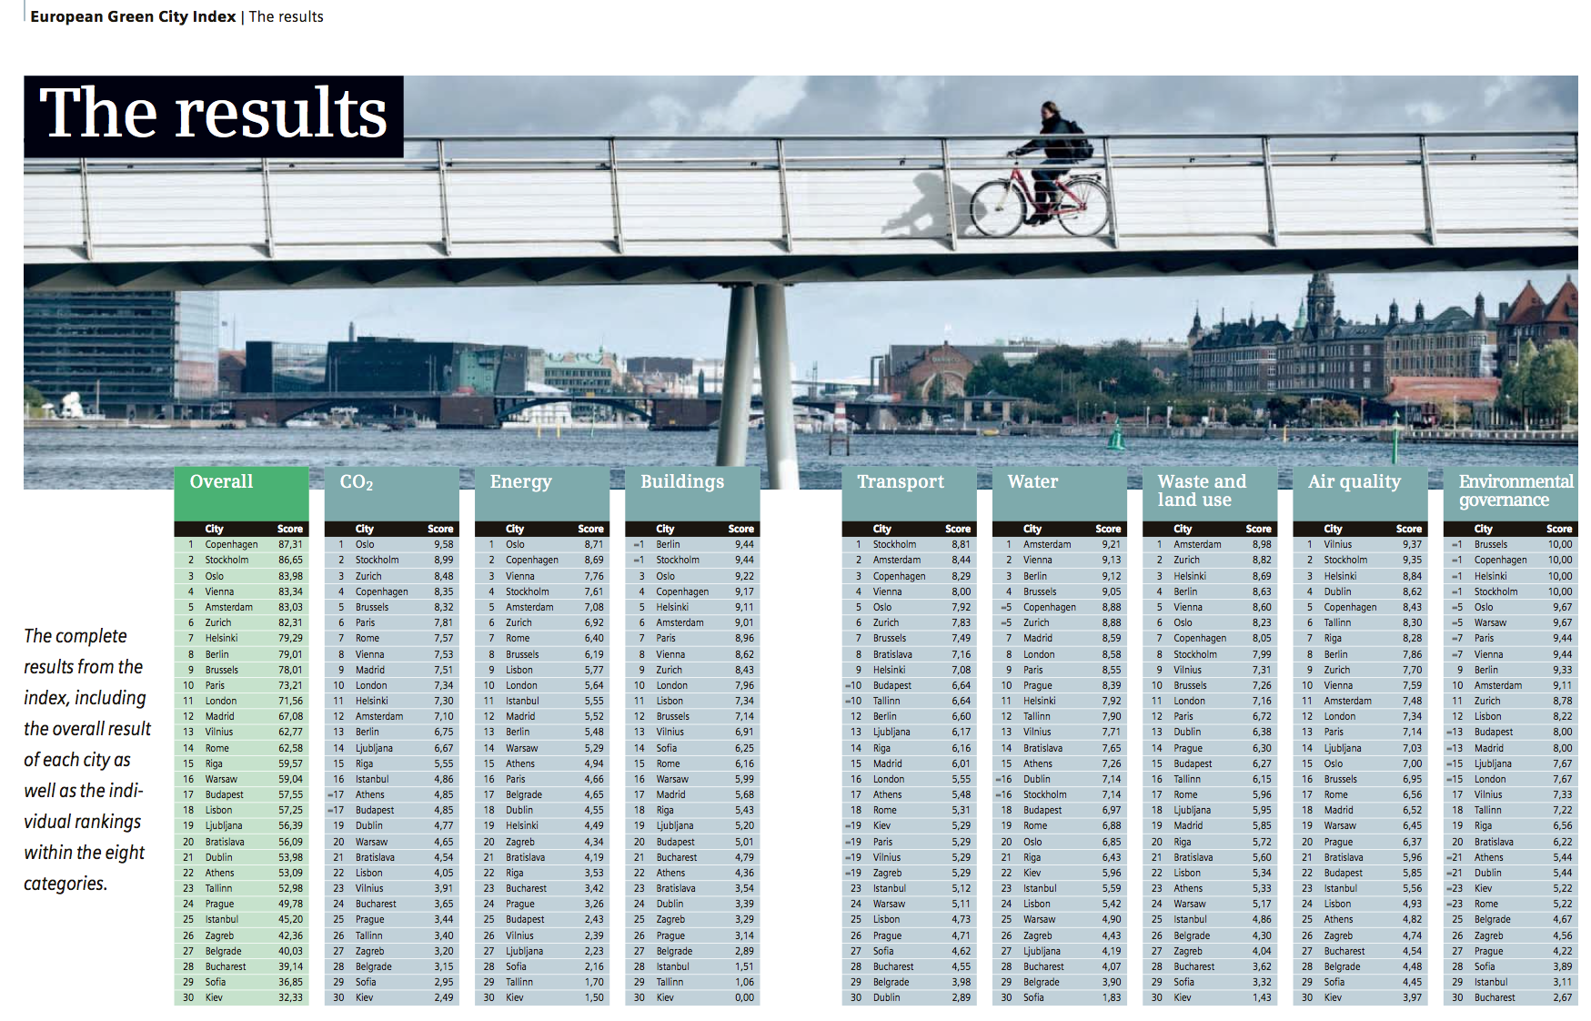
Is Open Data useful at all?
A concrete use case:
What is the population density of Athens?
What is the CO2/capita in Bologna?
What is the length of public transport in Vienna?
Overall ratings computed from (ideally most current) base indicators per cities

Slide 11
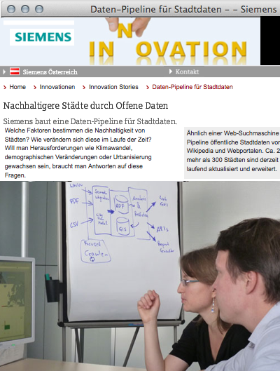
A concrete use case:
The "City Data Pipeline"
Idea – a "classic" Semantic Web use case!
Regularly integrate various relevant Open Data sources (e.g. eurostat, UNData, ...)
Make integrated data available for re-use
(How) can ontologies help me?
  Are ontology languages expressive enough?
  Which ontologies could I (re-)use?
  Is there enough data at all?
  Where to find the right data?
  Where to find the right ontologies?
  How to tackle inconsistencies?

Slide 12
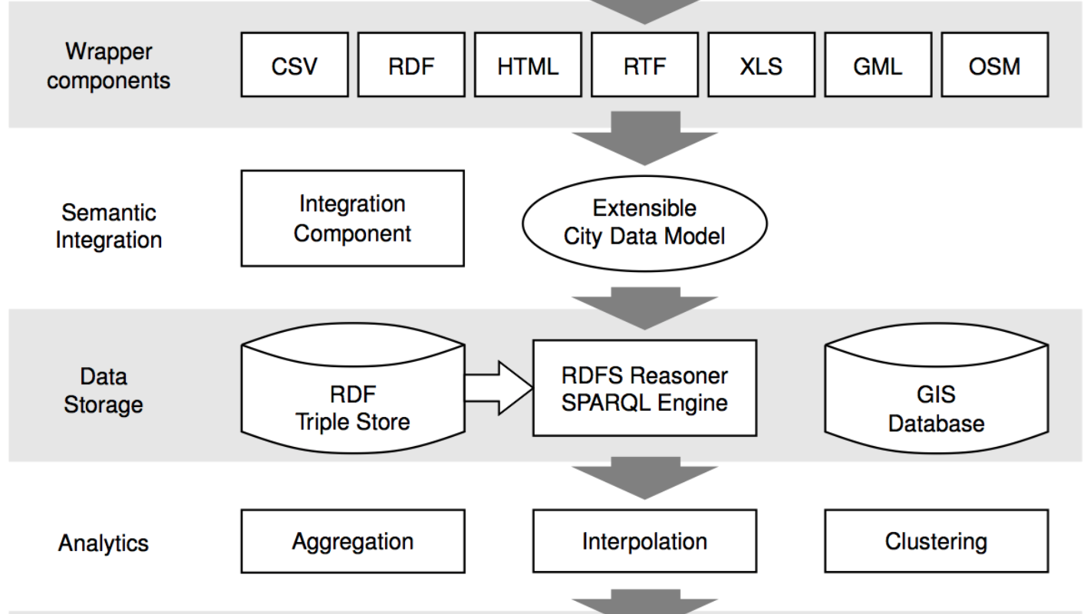


A concrete use case:
The "City Data Pipeline" – a "fairly standard" data workflow
That's a quite standard Data Workflow, isn't it?

Slide 13
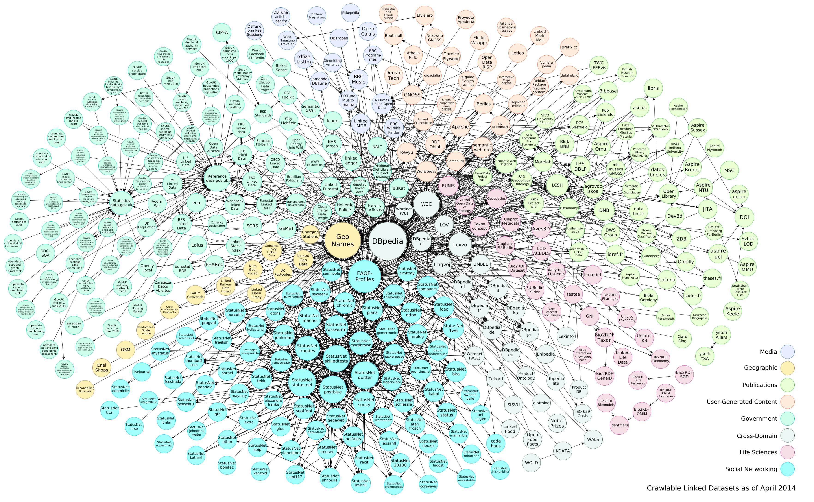





So: a) What is a "standard data workflow"? b) Where can/shall Semantic Technologies, but also traditional Data Integration technologies be used to build such workflows?
Data

Slide 14
Data Workflows
Well-defined functional units.
Data is streamed between
units or activities.
Access
Transform
Deliver
Data

Slide 15
Different Views & Examples of "What is a Data Workflow:

Slide 16
Different Views & Examples:
1/7 „Classic" ETL-Process in Datawarehousing
Wikipedia:
In computing, Extract, Transform and Load (ETL) refers to a process in database usage and
especially in data warehousing that:
  Extracts data from homogeneous or heterogeneous data sources
  Cleansing: deduplication, inconsistencies, missing data,...
  Transforms the data for storing it in proper format or structure for querying and analysis purpose
  Loads it into the final target (database, more specifically, operational data store, data mart, or data warehouse)
Typically assumes: fixed, static pipeline, fixed final schema in the final DB/DW
Cleansing sometimes viewed as a part of Transform, sometimes not.
Typically assumes complete/clean data at the “load" stage
Aggregation sometimes viewed as a part of tranformation, sometimes higher up in the Datawarehouse access layer (OLAP)
WARNING: At each stage, things can go wrong! Filtering/aggregation may bias the data!
References:[Golfarelli, Rizzi, 2009]
  https://en.wikipedia.org/wiki/Extract,_transform,_load
  https://en.wikipedia.org/wiki/Staging_%28data%29#Functions
"Hard-wired" Data integration

Slide 17
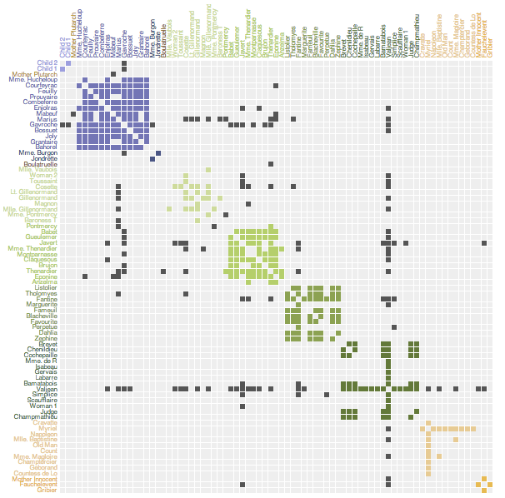
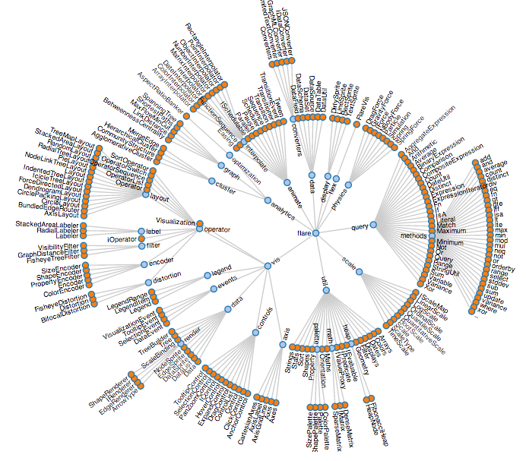
Different Views & Examples:
2/7 Linked Data Visualization Model
RDF Data
Access
Data Transformation
Analytical Extraction
Analytical Operators
Transform
Visualization Transformation
Visualization Abstraction
Visualization Operators
Visual Mapping Transformation
View
View Operators
Deliver
J. Brunetti , S. Auer, R. García,”The Linked Data Visualization Model’.

Slide 18
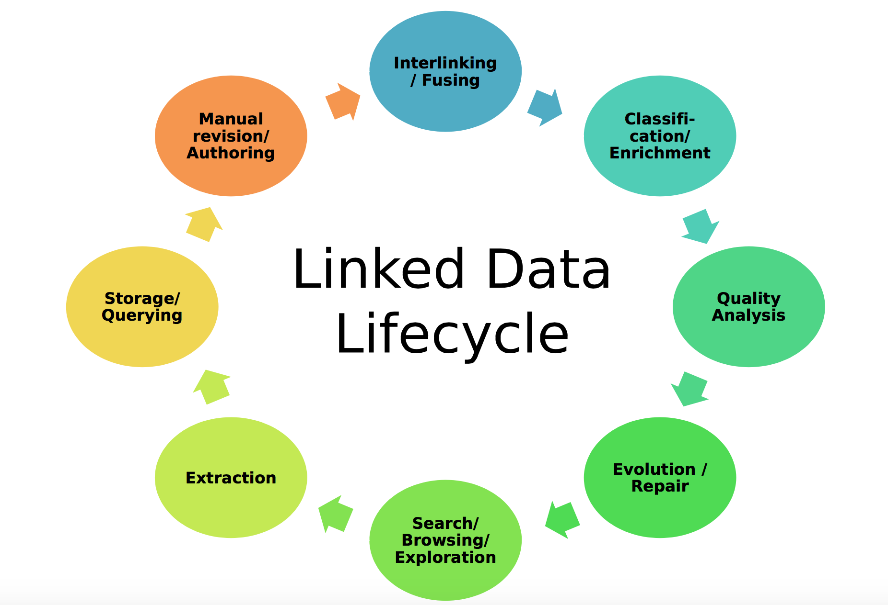
Different Views & Examples:
3/7 Or is it rather a Lifecycle...
E.g. good example: Linked Data Lifecycle
NOTE: Independent of whether Linked Data or other sources, you need to revisit/revalidate your workflow, either for improving it or for maintainance (sources changing, source formats changing, etc.)
Axel-Cyrille Ngonga Ngomo, Sören Auer, Jens Lehmann, Amrapali Zaveri. Introduction to Linked Data and Its Lifecycle on the Web. ReasoningWeb. 2014

Slide 19
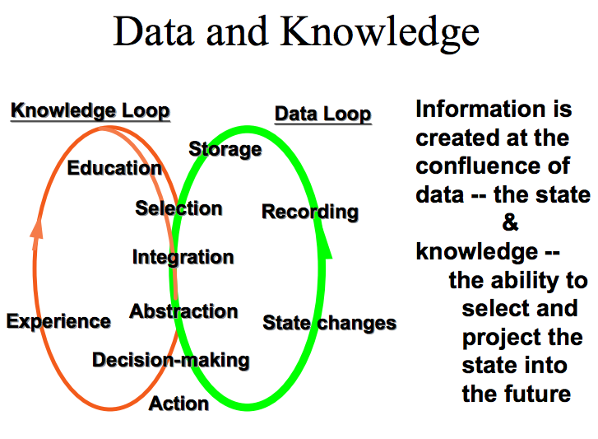
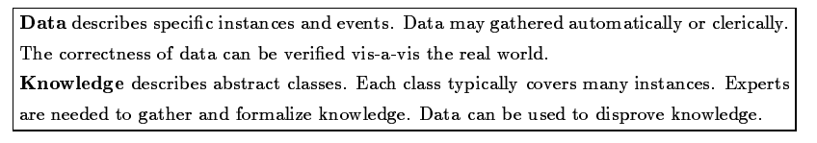
Different Views & Examples:
4/7 We‘re not the first ones to recognize this is actually a lifecycle…
[Wiederhold92]

Slide 20
Different Views & Examples:
5/6 The “Data Science” Process:
What Would a Next-Gen Data Scientist Do?
“[…] data scientists […] spend a lot more time trying to get data into shape than anyone cares to admit—maybe up to 90% of their time. Finally, they don’t find religion in tools, methods, or academic departments. They are versatile and interdisciplinary”
http://semanticommunity.info/Data_Science/Doing_Data_Science

Slide 21
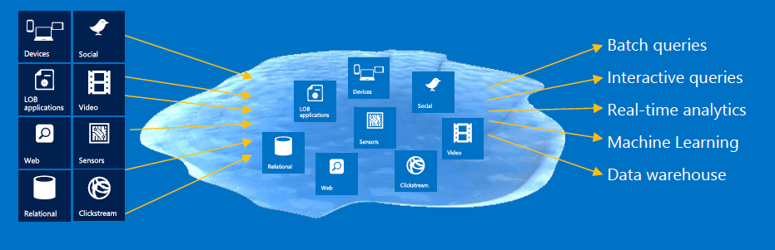
Different Views & Examples:
7/7 Big Data & Data Management against “Data Lake”
Install all data
Regardless of requirements
Store all data in native format without schema definition
Do analysis Using
analytic engines , Hadoop
Data Lake
Raghu Ramakrishnan, Big Data @ Microsoft

Slide 22
General challenges to be addressed
Syntactic heterogeneity (different formats)
Distributed data sources
Non-standard processing
Semantic heterogeneity
Naming ambiguity
Uncertainty and evolving concepts

Slide 23
Specific Steps (non-exhaustive, overlapping!)
Extraction
Inconsistency handling
Incompleteness handling (sometimes called "Enrichment“, sometimes imputation of missing values...)
Data Integration (alignment, source reconciliation)
Aggregation
Cleansing (removing outliers)
Deduplication/Interlinking (could involve "triplification")
Analytics
Enrichment
Change dedection (Maintainance/Evolution)
Validation (quality anaysis)
Efficient, sometimes distributed (query) processing
Visualization
Tools and current approaches support you partially in different parts of these steps.... Bad news: there is no "one-size-fits-all" solution.

Slide 24
Some Tools (again, exemplary and SW-biased!):
Linux-commandline Tools: curl, sed, awk, + postgresql does a good job in many cases...
LOD2 stack, stack of tools for integrating and generating Linked Data, http://stack.lod2.eu/
  e.g., SILK http://silk-framework.com/ (Interlinking/objec consolidation)
KARMA (extraction, data integration) http://usc-isi-i2.github.io/karma/
RapidMiner Linked Data extension http://dws.informatik.uni-mannheim.de/en/research/rapidminerlodextension/ [Gentile, Paulheim, et al. 2016]
XSPARQL (extraction from XML and JSON/triplicifation) http://sourceforge.net/projects/xsparql/ [Bischof et al. 2012]
  Seel also: https://ai.wu.ac.at/~polleres/20140826xsparql_st.etienne/
STTL: A SPARQL-based Transformation Language for RDF
  See also: https://hal.inria.fr/hal-01150623 [Corby et al. 2015]

Slide 25
Outline
Motivation
  Integrating (Open) Data from different sources
  Not only Linked Data
  Data workflows and Open data in the context of rise of Big Data
What is a "Data Workflow"?
  Different Views of Data Workflows in the context of the Semantic Web
  Key steps involved
  Tools?
Data Integration Systems & Query Processing
  Data Integration Systems - GAV vs. LAV
  The Mediator and Wrapper Architecture
  Query rewriting vs. Materialisation
Challenges:
  How to find Rules and ontologies?
  Incomplete Data
  How to find the data?

Slide 26
Data Integration Systems

Slide 27
Heterogeneous Sources
Data

Slide 28
Data Workflows accessing Heterogeneous Sources
Access
Transform
Deliver
Data

Slide 29
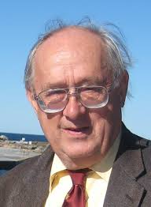

3072
2623
Proceedings of the twenty-first ACM SIGMOD-SIGACT-SIGART. Symposium on Principles of database systems. 2002

Slide 30
[Doan et al. 2012]

Slide 31
Data Integration Systems[Lenzerini2002]
IS=<O,S,M>
Let O be a set of general concepts in a general schema (virtual).
Let S={S1,..,Sn} be a set of data sources.
Let M be a set of mappings between sources in S and general concepts in O.
cf. [Lenzerini 2002]

Slide 32
Heterogeneous Sources
Data Integration System
Data

Slide 33
Heterogeneous Sources
Transform
Deliver
Access
Data Integration System
Data

Slide 34
Global Schema
(grossGDP rdf:type rdf:Property).
(avgTemp rdf:type rdf:Property).
(rating rdf:type rdf:Property).
(grossGDP rdfs:subPropertyOf rating).
(avgTemp rdfs:subPropertyOf rating).
(euroCity rdf:type rdfs:Class).
(amCity rdf:type rdfs:Class)
(afCity rdf:type rdfs:Class)

Slide 35
Global Schema
(grossGDP rdf:type rdf:Property).
(avgTemp rdf:type rdf:Property).
(rating rdf:type rdf:Property).
grossGDP(C,R)
avgTemp(C,R)
rating(C,R)

Slide 36
Global Schema
(grossGDP rdf:type rdf:Property).
(avgTemp rdf:type rdf:Property).
(rating rdf:type rdf:Property).
grossGDP(C,R)
avgTemp(C,R)
rating(C,R)
(grossGDP rdfs:subPropertyOf rating).
(avgTemp rdfs:subPropertyOf rating).

Slide 37
Global Schema
(grossGDP rdf:type rdf:Property).
(avgTemp rdf:type rdf:Property).
(rating rdf:type rdf:Property).
grossGDP(C,R)
avgTemp(C,R)
rating(C,R)
(grossGDP rdfs:subPropertyOf rating).
(avgTemp rdfs:subPropertyOf rating).
rdfs:subPropertyOf
rating(C,R)
rdfs:subPropertyOf
grossGDP(C,R)
avgTemp(C,R)

Slide 38
Global Schema
euroCity(C)
(euroCity rdf:type rdfs:Class).
(amCity rdf:type rdfs:Class)
(afCity rdf:type rdfs:Class)
amCity(C)
afCity(C)

Slide 39
Integration Systems
Global Schema
rdfs:subPropertyOf
rdfs:subPropertyOf
rating(C,R)
euroCity(C)
amCity(C)
grossGDP(C,R)
afCity(C)
avgTemp(C,R)

Slide 40



Source Schema
(amFinancial rdf:type rdf:Property).
(euClimate rdf:type rdf:Property).
(tunisRating rdf:type rdf:Property).
(similarFinancial rdf:type rdf:Property).
amFinancial(C,R) provides the financial rating R of an American city C.
euClimate(C,R) provides the climate rating R of an European city C.
tunisRating(T,R) tells the ratings R (T is climate and financial) of Tunis.
similarFinancial(C1,C1) relates two American cities C1 and C2 that have the same financial rating.

Slide 41
Integration Systems
euClimate(C,R)
similarFinancial(C1,C2)
amFinancial(C,R)
tunisRating(T,R)
amFinancial(C,R) provides the financial rating R of an American city C.
euClimate(C,R) provides the climate rating R of an European city C.
tunisRating(T,R) tells the ratings R (T is climate and financial) of Tunis.
similarFinancial(C1,C1) relates two American cities C1 and C2 that have the same financial rating.

Slide 42
Integration Systems
Global Schema
rdfs:subPropertyOf
rdfs:subPropertyOf
rating(C,R)
euroCity(C)
amCity(C)
grossGDP(C,R)
avgTemp(C,R)
afCity(C)
Local Schema
S={amFinancial(C,R), euClimate(C,R), tunisRating(T,R), similarFinancial(C1,C2) }

Slide 43
Integration Systems
IS=<O,S,M>
Global-as-View (GAV):
  Concepts in the Global Schema (O) are defined in terms of combinations of Sources (S).
Local-As-View (LAV):
    Sources in S are defined in terms of combinations of Concepts in O.
  Global- & Local-As-View (GLAV):
    Combinations of concepts in the Global Schema (O) are defined in combinations of Sources (S).

Slide 44
Conjunctive Rules
Q(X1,X2,..,Xn):-P1(Y11,..,Y1m),P2(Y21,…,Y2k),..,
Pt(Yt1,…,Ytl),
X1=Y1m, X2=Y2k, Xn=,Ytl.

Slide 45
Conjunctive Rules
Head of the Rule
Q(X1,X2,..,Xn):-P1(Y11,..,Y1m),P2(Y21,…,Y2k),..,
Pt(Yt1,…,Ytl),
X1=Y1m, X2=Y2k, Xn=,Ytl.

Slide 46
Conjunctive Rules
Body of the Rule
Q(X1,X2,..,Xn):-P1(Y11,..,Y1m),P2(Y21,…,Y2k),..,
Pt(Yt1,…,Ytl),
X1=Y1m, X2=Y2k, Xn=,Ytl.

Slide 47
Conjunctive Rules
Body of the Rule
Q(X1,X2,..,Xn):-P1(Y11,..,Y1m),P2(Y21,…,Y2k),..,
Pt(Yt1,…,Ytl),
X1=Y1m, X2=Y2k, Xn=,Ytl.
P1(Y11,..,Y1m),P2(Y21,…,Y2k),..,Pt(Yt1,…,Ytl),, X1=Y1m, X2=Y2k, Xn=,Ytl.
Q(X1,X2,..,Xn)

Slide 48
Global-As-View (GAV)
Global Schema
rdfs:subPropertyOf
rdfs:subPropertyOf
rating(C,R)
euroCity(C)
amCity(C)
grossGDP(C,R)
avgTemp(C,R)
afCity(C)
Local Schema
S={amFinancial(C,R), euClimate(C,R), tunisRating(T,R), similarFinancial(C1,C2) }
  α0: amCity(C):-amFinancial(C,R).
  α1: grossGDP(C,R):-amFinancial(C,R).
  α2: euroCity(C):-euClimate(C,R).
  α3: avgTemp(C,R):-euClimate(C,R).
  α4: grossGDP(“Tunis”,R):-tunisRating(“financial”,R).
  α5: avgTemp(“Tunis”,R):-tunisRating(“climate”,R)
  α6: afCity(“Tunis”).
  α7: amCity(C1):-similarFinancial(C1,C2).
  α8: amCity(C2):-similarFinancial(C1,C2).
  α9: grossGDP(C1,R):-similarFinancial(C1,C2), amFinancial(C2,R).

Slide 49
Query Rewriting GAV
A query Q in terms of the global schema elements in O.
Problem: Rewrite Q into a query Q’ expressed in sources in S.
Example GAV:
query(C):-grossGDP(C,R), amCity(C)
  α0: amCity(C):-amFinancial(C,R).
  α1: grossGDP(C,R):-amFinancial(C,R).
  α2: euroCity(C):-euClimate(C,R).
  α3: avgTemp(C,R):-euClimate(C,R).
  α4: grossGDP(“Tunis”,R):-tunisRating(“financial”,R).
  α5: avgTemp(“Tunis”,R):-tunisRating(“climate”,R)
  α6: afCity(“Tunis”).
  α7: amCity(C1):-similarFinancial(C1,C2).
  α8: amCity(C2):-similarFinancial(C1,C2).
  α9: grossGDP(C1,R):-similarFinancial(C1,C2), amFinancial(C2,R).

Slide 50
Query Rewriting GAV
A query Q in terms of the global schema elements in O.
Problem: Rewrite Q into a query Q’ expressed in sources in S.
  α1: grossGDP(C,R):-amFinancial(C,R).
  α7: amCity(C1):-similarFinancial(C1,C2).
Example GAV:
query(C):-grossGDP(C,R), amCity(C)
query1(C):-amFinancial(C,R),similarFinancial(C,C2).
Rewritings

Slide 51
Global-As-View (GAV)- Query Unfolding
query(X):-p1(Y1),p2(Y2),….,pn(Yn).
p1(Y1):-q11(Y11),…,q1m(Y1m)
p2(Y2):-q21(Y22),…,q2l(Y2l)
…
pn(Yn):-qn1(Yn1),…,qnk(Yn1)

Slide 52
Global-As-View (GAV)- Query Unfolding
query(X):-p1(Y1),p2(Y2),….,pn(Yn).
p1(Y1):-q11(Y11),…,q1m(Y1m)
p2(Y2):-q21(Y22),…,q2l(Y2l)
…
pn(Yn):-qn1(Yn1),…,qnk(Yn1)

Slide 53
Global-As-View (GAV)- Query Unfolding
query(X):-p1(Y1),p2(Y2),….,pn(Yn).
p1(Y1):-q11(Y11),…,q1m(Y1m)
p2(Y2):-q21(Y22),…,q2l(Y2l)
…
pn(Yn):-qn1(Yn1),…,qnk(Yn1)

Slide 54
Global-As-View (GAV)- Query Unfolding
query(X):-p1(Y1),p2(Y2),….,pn(Yn).
p1(Y1):-q11(Y11),…,q1m(Y1m)
p2(Y2):-q21(Y22),…,q2l(Y2l)
…
pn(Yn):-qn1(Yn1),…,qnk(Yn1)
query(X):-q11(Y11),…,q1m(Y1m) , q21(Y22),…,q2l(Y2l),.., qn1(Yn1),…,qnk(Ynk).

Slide 55
Query Rewriting GAV
A query Q in terms of the global schema elements in O.
Problem: Rewrite Q into a query Q’ expressed in sources in S.
Example GAV:
query(C):-grossGDP(C,R), amCity(C)
  α0: amCity(C):-amFinancial(C,R).
  α1: grossGDP(C,R):-amFinancial(C,R).
  α2: euroCity(C):-euClimate(C,R).
  α3: avgTemp(C,R):-euClimate(C,R).
  α4: grossGDP(“Tunis”,R):-tunisRating(“financial”,R).
  α5: avgTemp(“Tunis”,R):-tunisRating(“climate”,R)
  α6: afCity(“Tunis”).
  α7: amCity(C1):-similarFinancial(C1,C2).
  α8: amCity(C2):-similarFinancial(C1,C2).
  α9: grossGDP(C1,R):-similarFinancial(C1,C2), amFinancial(C2,R).

Slide 56
Query Rewriting GAV
A query Q in terms of the global schema elements in O.
Problem: Rewrite Q into a query Q’ expressed in sources in S.
α9:grossGDP(C1,R):-similarFinancial(C1,C2), amFinancial(C2,R).
Example GAV:
  α7: amCity(C1):-similarFinancial(C1,C2).
query(C):-grossGDP(C,R), amCity(C)
query1(C):-amFinancial(C,R),similarFinancial(C,C2).
Rewritings
query2(C):-similarFinancial(C,C2), amFinancial(C2,R),
similarFinancial(C,R1).

Slide 57
When to use GAV
Query rewriting is simpler (Polynomial time in the size of the query)
Sources do not change and global schema can change over time

Slide 58
Lower Bounds for the Space of Query Rewritings
CQs and OWL2QL-ontologies [Gottlob14]
  Exponential and Superpolynomial lower bounds on the size of pure rewritings.
  Polynomial-size under some restrictions.
[Gottlob14]
Georg Gottlob, Stanislav Kikot, Roman Kontchakov, Vladimir V. Podolskii, Thomas Schwentick, Michael Zakharyaschev: The price of query rewriting in ontology-based data access. Artif. Intell. 213: 42-59 (2014)

Slide 59
Integration Systems
IS=<O,S,M>
Global-as-View (GAV):
  Concepts in the Global Schema (O) are defined in terms of combinations of Sources (S).
Local-As-View (LAV):
    Sources in S are defined in terms of combinations of Concepts in O.
  Global- & Local-As-View (GLAV):
    Combinations of concepts in the Global Schema (O) are defined in combinations of Sources (S).

Slide 60
Local-As-View (LAV)
Global Schema
rdfs:subPropertyOf
rdfs:subPropertyOf
rating(C,R)
euroCity(C)
amCity(C)
grossGDP(C,R)
avgTemp(C,R)
afCity(C)
Local Schema
S={amFinancial(C,R), euClimate(C,R), tunisRating(T,R), similarFinancial(C1,C2) }
  α0:amFinancial(C,R):-amCity(C),grossGDP(C,R).
  α1:euClimate(C,R):-euCity(C),avgTemp(C,R).
  α2:tunisRating(“financial”,R):-afCity(“Tunis”),grosGDP(“Tunis”,R).
  α3:tunisRating(“climate”,R):-afCity(“Tunis”),avgTemp(“Tunis”,R).
  α4:similarFinancial(C1,C2):-amCity(C1),amCity(C2),
  grossGDP(C1,R),grossGDP(C2,R).

Slide 61
Query Rewriting LAV
  α0:amFinancial(C,R):-amCity(C),grossGDP(C,R).
  α1:euClimate(C,R):-euCity(C),avgTemp(C,R).
  α2:tunisRating(“financial”,R):-afCity(“Tunis”),grosGDP(“Tunis”,R).
  α3:tunisRating(“climate”,R):-afCity(“Tunis”),avgTemp(“Tunis”,R).
  α4:similarFinancial(C1,C2):-amCity(C1),amCity(C2),
  grossGDP(C1,R),grossGDP(C2,R).
Example LAV:
query(C):-grossGDP(C,R), amCity(C)
query1(C):-amFinancial(C,R).
Rewritings

Slide 62
Local As View-Query Rewriting
query(X1,X5):-C1(X1,X2),C2(X2,X3),C3(X3,X4),C4(X4,X5)
S1(X1,X2,X3):-C1(X1,X2),C2(X2,X3).
S2(X3,X4,X5):-C3(X3,X4),C4(X4,X5).
S3(X2,X3,X4):-C2(X2,X3),C3(X3,X4).
S4(X1,X2):-C1(X1,X2).

Slide 63
Local As View-Query Rewriting
query(X1,X5):-C1(X1,X2),C2(X2,X3),C3(X3,X4),C4(X4,X5)
S1(X1,X2,X3):-C1(X1,X2),C2(X2,X3).
S2(X3,X4,X5):-C3(X3,X4),C4(X4,X5).
S3(X2,X3,X4):-C2(X2,X3),C3(X3,X4).
S4(X1,X2):-C1(X1,X2).
query’(X1,X5):-C1(X1,X2),C2(X2,X3),C3(X3,X4),C4(X4,X5)
S1(X1,X2,X3)
S2(X3,X4,X5)

Slide 64
Local As View-Query Rewriting
query(X1,X5):-C1(X1,X2),C2(X2,X3),C3(X3,X4),C4(X4,X5)
S1(X1,X2,X3):-C1(X1,X2),C2(X2,X3).
S2(X3,X4,X5):-C3(X3,X4),C4(X4,X5).
S3(X2,X3,X4):-C2(X2,X3),C3(X3,X4).
S4(X1,X2):-C1(X1,X2).
query’(X1,X5):-C1(X1,X2),C2(X2,X3),C3(X3,X4),C4(X4,X5)
query’’(X1,X5):-C1(X1,X2),C2(X2,X3),C3(X3,X4),C4(X4,X5)
S1(X1,X2,X3)
S2(X3,X4,X5)
S4(X1,X2)
S3(X2,X3,X4)
S4(X3,X4,X5)

Slide 65
Query Rewriting
DB is a Virtual Database with the instances of the elements in O.
Query Containment: Q’ ⊆Q ←→∀DB Q’(DB) ⊆Q(DB)
query1(C):- amFinancial(C,R),similarFinancial(C,C2).
⊆
query(C):-grossGDP(C,R), amCity(C)
Washington
NYC
Miami
Caracas
Lima
……
Bogota
College Park
Quito
Washington
NYC
Miami
Caracas
Lima
⊆
Source Database
Virtual Database

Slide 66
Query Rewriting LAV
  α0:amFinancial(C,R):-amCity(C),grossGDP(C,R).
  α1:euClimate(C,R):-euCity(C),avgTemp(C,R).
  α2:tunisRating(“financial”,R):-afCity(“Tunis”),grosGDP(“Tunis”,R).
  α3:tunisRating(“climate”,R):-afCity(“Tunis”),avgTemp(“Tunis”,R).
  α4:similarFinancial(C1,C2):-amCity(C1),amCity(C2),
  grossGDP(C1,R),grossGDP(C2,R).
Example LAV:
query(C):-grossGDP(C,R), amCity(C)
query1(C):-amFinancial(C,R).
query2(C):-similarFinancial(C,C2).
Rewritings

Slide 67
Query Rewriting LAV
  α0:amFinancial(C,R):-amCity(C),grossGDP(C,R).
  α1:euClimate(C,R):-euCity(C),avgTemp(C,R).
  α2:tunisRating(“financial”,R):-afCity(“Tunis”),grosGDP(“Tunis”,R).
  α3:tunisRating(“climate”,R):-afCity(“Tunis”),avgTemp(“Tunis”,R).
  α4:similarFinancial(C1,C2):-amCity(C1),amCity(C2),
  grossGDP(C1,R),grossGDP(C2,R).
Example LAV:
query(C):-grossGDP(C,R), amCity(C)
query1(C):-amFinancial(C,R).
query2(C):-similarFinancial(C,C2).
Rewritings
query3(C):-similarFinancial(C1,C).

Slide 68
Time Complexity
To check whether there is a valid rewriting R of Q with at most the same number of goals as Q is an NP-complete problem.
Levy, A.; Mendelzon, A.; Sagiv, Y.; and Srivastava, D. 1995. Answering queries using views. In Proc. of PODS, 95–104.

Slide 69
Existing Approaches for LAV Query Rewriting
Bucket Algorithm [Levy & Rajaraman & Ullman 1996]
Inverse Rules Algorithm [Duscka & Genesereth 1997]
MiniCom Algorithm [Pottinger & Halevy 2001]
MDCSAT [Arvelo & Bonet & Vidal 2006]
SSSAT [Izquierdo & Vidal & Bonet 2011]
GQR [Konstantinidis & Ambite, 2011]
IQR [Vidal & Castillo 2015]

Slide 70
When to use LAV
A GAV catalog cannot be easily adapted to changes in the data sources
LAV views can be easily adapted to changes in the data sources
Data Sources can be easily described

Slide 71
Integration Systems
IS=<O,S,M>
Global-as-View (GAV):
  Concepts in the Global Schema (O) are defined in terms of combinations of Sources (S).
Local-As-View (LAV):
    Sources in S are defined in terms of combinations of Concepts in O.
  Global- & Local-As-View (GLAV):
    Combinations of concepts in the Global Schema (O) are defined in combinations of Sources (S).

Slide 72
Global-And-Local-As-View (GLAV)
Global Schema
rdfs:subPropertyOf
rdfs:subPropertyOf
rating(C,R)
euroCity(C)
amCity(C)
grossGDP(C,R)
avgTemp(C,R)
afCity(C)
Local Schema
S={amFinancial(C,R), euClimate(C,R), tunisRating(T,R), similarFinancial(C1,C2) }
  α0: amFinancial(C1,R),similarFinancial(C1,C2):-
  amCity(C1),amCity(C2),financial(C1,R),financial(C2,R).

Slide 73
Query Rewriting GLAV
  α0: amFinancial(C1,R),similarFinancial(C1,C2):-
  amCity(C1),amCity(C2),grossGDP(C1,R),grossGDP(C2,R).
Example GLAV:
query(C):-grossGDP(C,R), amCity(C)
query1(C):-: amFinancial(C,R),similarFinancial(C,C2)
Rewritings

Slide 74
Query Rewriting
DB is a Virtual Database with the instances of the elements in O.
Query Containment: Q’ ⊆Q ←→∀DB Q’(DB) ⊆Q(DB)
query1(C):-amFinancial(C,R),similarFinancial(C,C2).
⊆
query(C):-grossGDP(C,R), amCity(C)

Slide 75
When to use GLAV
A GLAV catalog cannot be easily adapted to changes in the data sources
Data Sources can be easily described

Slide 76
The Mediator and Wrapper Architecture [Wiederhold92]
Query
Data Integration System
Mediator
Catalog
Wrapper
Wrapper
Wrapper
Wrapper
amFinancial(C,R)
euClimate(C,R)
similarFinancial(C1,C2)
tunisRating(T,R)
[Wiederhold92]Gio Wiederhold: Mediators in the Architecture of Future Information Systems. IEEE Computer 25(3): 38-49 (1992)

Slide 77
The Mediator and Wrapper Architecture [Wiederhold92]
Query
Wrappers:
Software components specific for each type of data source.
Export unique schema
for heterogeneous sources.
Mediator
Catalog
Wrapper
Wrapper
Wrapper
Wrapper
amFinancial(C,R)
euClimate(C,R)
similarFinancial(C1,C2)
tunisRating(T,R)
[Wiederhold92]Gio Wiederhold: Mediators in the Architecture of Future Information Systems. IEEE Computer 25(3): 38-49 (1992)

Slide 78
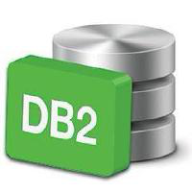




e.g. RDB2RDF Systems
Wrappers in the context of RDF Data:
RDF
Transformation Rules, e.g.,
R2RML
Cf. R2RML W3C standard: http://www.w3.org/TR/r2rml/ see also [Priyatna 2014]]
UltraWrap http://capsenta.com/ultrawrap/ [Sequeda & Miranker 2013],
D2RQ http://d2rq.org/

Slide 79
The Mediator and Wrapper Architecture [Wiederhold92]
Query
Mediators:
Export a unified schema.
Query Decomposition.
Identify relevant sources for each query.
Generate query execution plans.
Mediator
Catalog
Wrapper
Wrapper
Wrapper
Wrapper
amFinancial(C,R)
euClimate(C,R)
similarFinancial(C1,C2)
tunisRating(T,R)
[Wiederhold92]Gio Wiederhold: Mediators in the Architecture of Future Information Systems. IEEE Computer 25(3): 38-49 (1992)

Slide 80
Some recent works which implement Wiederhold’s mediator/wrapper architecture in the SW:
Linked Data-Fu [Stadtmüller et al. 2013]
SemLAV [Montoya et al. 2014]
… both LAV-inspired.

Slide 81
MATERIALIZED global schema- data warehouse

Slide 82
Data Warehouse-Materialized Global Schema
Global Schema
Data Integration System
amCity(C)
Data Warehouse
Engine
rdfs:subPropertyOf
rating(C,R)
rdfs:subPropertyOf
Catalog
financial(C,R)
climate(C,R)
euCity(C)
afCity(C)
GLAV rules
ETL
ETL
ETL
amFinancial(C1,R)
euClimate(C,R)
tunisIndicator(T,R)
This is a GLAV rule
similarFinancial(C1,C2)
  α0: amFinancial(C1,R),similarFinancial(C1,C2):-
  amCity(C1),amCity(C2),grossGDP(C1,R),grossGDP(C2,R).

Slide 83
Materialized versus Virtual Access
The Mediator and Wrapper Architecture requires to access remote data sources on the fly
Materialized Data can be locally accessed.
Convenient whenever data is static

Slide 84

Hybrid Architectures
Integration System
Query
Mediator
Catalog
Integration System
Data Warehouse
Catalog
Wrapper
Wrapper
Wrapper
Wrapper
Wrapper
Wrapper
Wrapper
Mediator

Slide 85
What is the role of Ontologies in Data Workflows/Data Integration Systems?

Slide 86
Linked Data integration using ontologies:
Also popular under the term Ontology-based data-access (OBDA) [Kontchakov et al. 2013]:
  Typically conisders a relational DB, mappings (rules), an ontology Tbox (typically OWL QL (DL-Lite), or OWL RL (rules))
Ontology (O)
OWL,RDFS
RDBMS
SQL
RDB2RDF Mappings
Datalog
OBDA
Query (Q)
SPARQL

Slide 87
Linked Data integration using ontologies:
Also popular under the term Ontology-based data-access (OBDA) [Kontchakov et al. 2013]:
  Typically conisders a relational DB, mappings (rules), an ontology Tbox (typically OWL QL (DL-Lite), or OWL RL (rules))
For simplicity, let's leave out the Relational DB part, assuming Data is already in RDF...
Ontology (O)
OWL,RDFS
Triple Store
RDF/SPARQL
OBDA
Query (Q)
SPARQL

Slide 88
Linked Data integration using ontologies (example)
"Places with a Population Density below 5000/km2"?

Slide 89
A concrete use case:
The "City Data Pipeline"

Slide 90
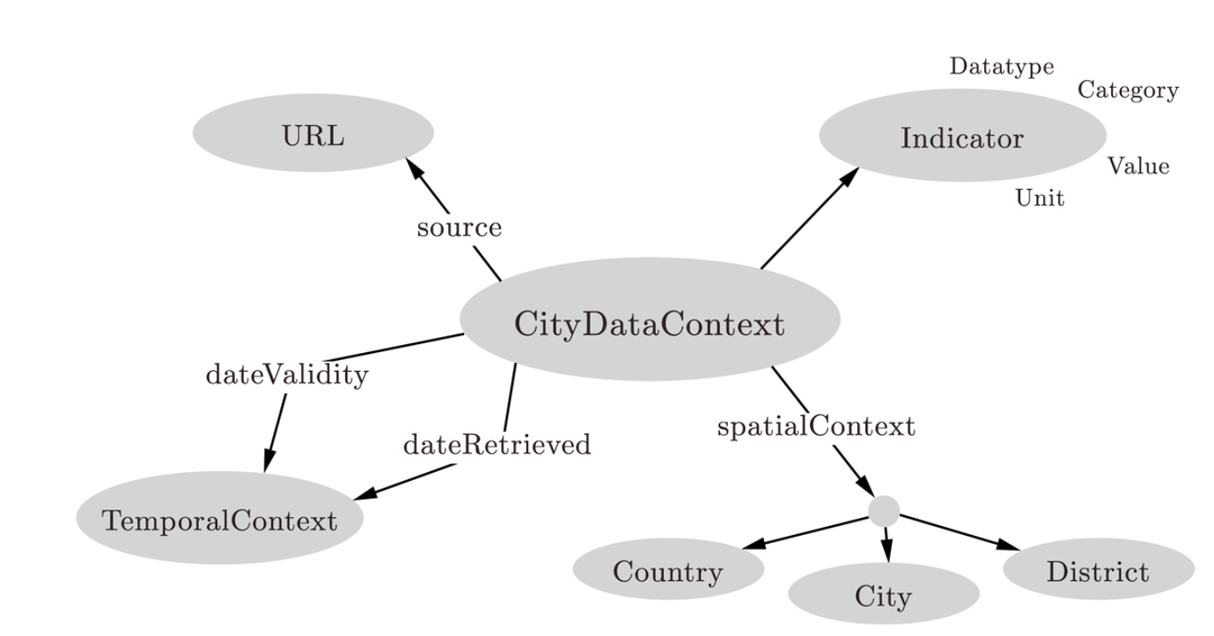
A concrete use case:
The "City Data Pipeline"
City Data Model: extensible ALH(D) ontology:
dbo:PopulatedPlace rdfs:subClassOf :Place.
dbo:populationDensity rdfs:subPropertyOf :populationDensity.
eurotstat:City rdfs:subClassOf :Place.
eurotstat:popDens rdfs:subPropertyOf :populationDensity.
dbpedia:areakm rdfs:subPropertyOf :area
eurostat:area rdfs:subPropertyOf :area
Indicators, e.g. area in km2, tons CO2/capita
Provenance
Temporal information
Spatial context

Slide 91

A concrete use case:
The "City Data Pipeline"
City Data Model: extensible ALH(D) ontology:
dbo:PopulatedPlace
:Place
Indicators, e.g. area in km2, tons CO2/capita
Provenance
dbo:populationDensity
:populationDensity
eurostat:City
:Place
eurostat:popDens
:populationDensity
dbo:areakm
:area
eurostat:area
:area
Temporal information
Spatial context

Slide 92
A concrete use case:
The "City Data Pipeline"
City Data Model: extensible ALH(D) ontology:
:Place(X)
Indicators, e.g. area in km2, tons CO2/capita
← dbo:PopulatedPlace(X)
Provenance
:populationDensity(X,Y)
← dbo:populationDensity(X,Y)
:Place(X)
← eurostat:City(X)
:populationDensity(X,Y)
← eurostat:popDens(X)
:area(X,Y)
← dbo:areakm(X,Y)
:area(X,Y)
← eurostat:area(X,Y)
Temporal information
Spatial context

Slide 93
A concrete use case:
The "City Data Pipeline"
"Places with a Population Density below 5000/km2"?
SELECT ?X WHERE { ?X a :Place . ?X :populationDensity ?Y .
FILTER(?Y < 5000) }
:Place(X)
← dbo:PopulatedPlace(X)
:populationDensity(X,Y)
← dbo:populationDensity(X,Y)
:Place(X)
← eurostat:City(X)
:populationDensity(X,Y)
← eurostat:popDens(X)
:area(X,Y)
← dbo:areakm(X,Y)
:area(X,Y)
← eurostat:area(X,Y)

Slide 94
Approach 1: Materialization
(input: triple store + Ontology output: materialized triple store)
SELECT ?X WHERE { ?X a :Place . ?X :populationDensity ?Y .
FILTER(?Y < 5000) }
:Vienna a dbo:PopulatedPlace.
:Vienna dbo:populationDensity 4326.1 .
:Vienna dbo:areaKm 414.65 .
:Vienna dbo:populationTotal 1805681 .
:Vienna a :Place.
:Vienna :populationDensity 4326.1 .
:Vienna :area 414.65
:Place(X)
← dbo:PopulatedPlace(X)
:populationDensity(X,Y)
← dbo:populationDensity(X,Y)
:Place(X)
← eurostat:City(X)
:populationDensity(X,Y)
← eurostat:popDens(X)
:area(X,Y)
← dbo:areakm(X,Y)
:area(X,Y)
← eurostat:area(X,Y)
RDF triple stores implement it naitively (OWLIM, Jena Rules, Sesame)
Can handle a large part of OWL [Krötzsch, 2012, Glimm et al. 2012]

Slide 95
Approach 2: Query rewriting
(input: conjunctive query (CQ) + Ontology output: UCQ)
SELECT ?X WHERE { ?X a :Place . ?X :populationDensity ?Y .
FILTER(?Y < 5000) }
:Vienna a dbo:PopulatedPlace.
:Vienna dbo:populationDensity 4326.1 .
:Vienna dbo:areaKm 414.65 .
:Vienna dbo:populationTotal 1805681 .
:Place(X)
← dbo:PopulatedPlace(X)
:populationDensity(X,Y)
← dbo:populationDensity(X,Y)
:Place(X)
← eurostat:City(X)
:populationDensity(X,Y)
← eurostat:popDens(X)
:area(X,Y)
← dbo:areakm(X,Y)
:area(X,Y)
← eurostat:area(X,Y)
SELECT ?X WHERE { { {?X a :Place . ?X :populationDensity ?Y . }
UNION {?X a dbo:Place . ?X :populationDensity ?Y . }
UNION {?X a :Place . ?X dbo:populationDensity ?Y . }
UNION {?X a dbo:Place . ?X dbo:populationDensity ?Y . }
UNION {?X a dbo:Place . ?X dbo:populationDensity ?Y . }
... }
FILTER(?Y < 5000) }

Slide 96
Approach 2: Query rewriting
(input: conjunctive query (CQ) + Ontology output: UCQ)
SELECT ?X WHERE { ?X a :Place . ?X :populationDensity ?Y .
FILTER(?Y < 5000) }
Observation: essentially, GAV-style rewriting
Can handle a large part of OWL (corresponding to DL-Lite [Calvanese et al. 2007]): OWL 2 QL
Query-rewriting- based tools and systems available, many optimizations to naive rewritings, e.g. taking into account mappings to a DB:
  REQUIEM [Perez-Urbina et al., 2009]
  Quest [Rodriguez-Muro, et al. 2012]
  ONTOP [Rodriguez-Muro, et al. 2013]
  Mastro [Calvanese et al. 2011]
  Presto [Rosati et al. 2010]
  KYRIE2 [Mora & Corcho, 2014]
Rewriting vs. Materialization – tradeoff: [Sequeda et al. 2014]
OBDA is a booming field of research!

Slide 97
Where to find suitable ontologies?
Ontology (O)
OWL,RDFS
Triple Store
RDF/SPARQL
OBDA
Query (Q)
SPARQL
Ok, so where do I find suitable ontologies?

Slide 98
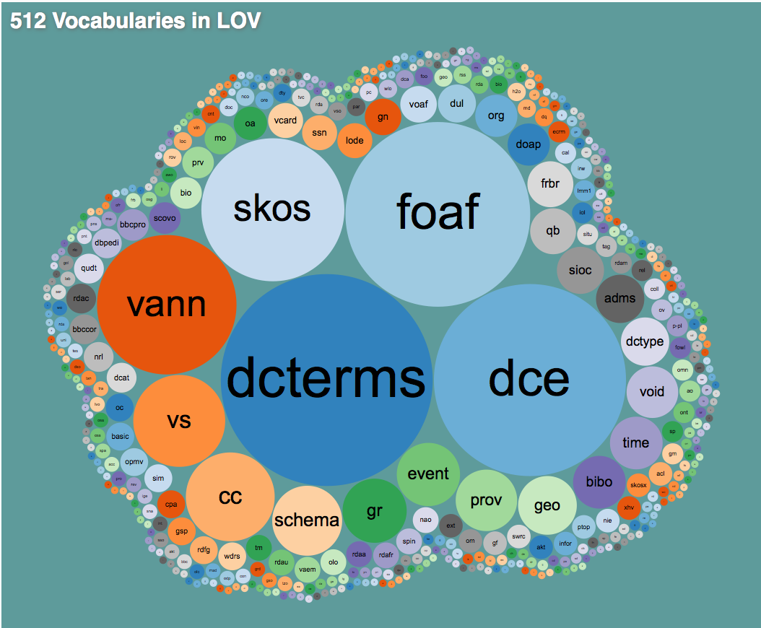
Ontologies and mapping between Linked Data Vocabularies
Good Starting points: Linked Open Vocabularies
    http://lov.okfn.org/dataset/lov/
Still, probably a lot of manual mapping...
  Literature search for suitable ontologies → don't re-invent the wheel, re-use where possible
  Crawl
  Ontology learning, i.e. learn mappings?
    e.g. using Ontology matching [Shvaiko&Euzenat, 2013]

Slide 99
Specific Steps (non-exhaustive, overlapping!)
Extraction
Inconsistency handling
Incompleteness handling (sometimes called "Enrichment“, sometimes imputation of missing values...)
Data Integration (alignment, source reconciliation)
Aggregation
Cleansing (removing outliers)
Deduplication/Interlinking (could involve "triplification")
Analytics
Enrichment
Change dedection (Maintainance/Evolution)
Validation (quality anaysis)
Efficient, sometimes distributed (query) processing
Visualization
Recall that slide from the beginning? What did we actually cover and where could Semantic Web techniques help?
Tools and current approaches support you partially in different parts of these steps.... Bad news: there is no "one-size-fits-all" solution.

Slide 100
Incompleteness Handling:
Are RDFS and OWL enough?
SELECT ?X WHERE { ?X a :Place . ?X :populationDensity ?Y .
FILTER(?Y < 5000) }
:Vienna a dbo:PopulatedPlace.
:Vienna dbo:populationDensity 4326.1 .
:Vienna dbo:areaKm 414.65 .
:Vienna dbo:populationTotal 1805681 .
:Bologna a dbo:PopulatedPlace.
:Bologna dbo:areaKm 140.7 .
:Bologna dbo:populationTotal 386298 .
:Place(X)
← dbo:PopulatedPlace(X)
:populationDensity(X,Y)
← dbo:populationDensity(X,Y)
:Place(X)
← eurostat:City(X)
:populationDensity(X,Y)
← eurostat:popDens(X)
:area(X,Y)
← dbo:areakm(X,Y)
:area(X,Y)
← eurostat:area(X,Y)
?
:populationDensity = :population/:area
:area = 0,386102 * dbpedia:areaMi2
Probably not...
A possible solution: [Bischof & Polleres, 2013]

Slide 101


[Bischof&Polleres 2013] Basic Idea: Consider clausal form of all variants of equations and use Query rewriting with "blocking":
:Bologna dbo:population 386298 .
:Bologna dbo:areaKm 140.7 .
Finally, the resulting UCQs with assignments can be rewritten back to SPARQL using BIND
  SELECT ?PD WHERE { :Bologna dbo:popDensity ?PD}
… infinite expansion even if only 1 equation is considered.
Solution: “blocking” recursive expansion of the same equation for the same value.
  SELECT ?PD WHERE { {:Athens dbo:popDensity ?PD }
  UNION
  { :Athens dbo:population ?P ; dbo:area ?A .
  BIND (?P/?A AS ?PD )}
  }

Slide 102
A concrete use case:
The "City Data Pipeline"
Indicators, e.g. area in km2, tons CO2/capita
Provenance
Ok, so where do I find these equations?
Temporal information
Spatial context

Slide 103
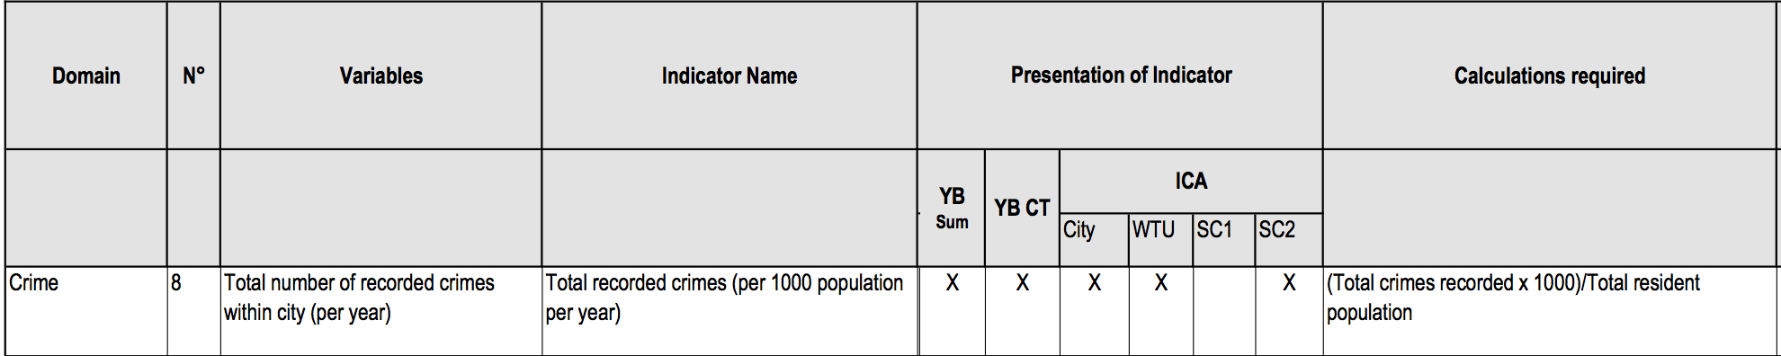
Equational knowledge:
Eurostat/Urbanaudit:
  http://ec.europa.eu/regional_policy/archive/urban2/urban/audit/ftp/vol3.pdf
Notes:
Not available as structured form, but ok, you can let a bachelor student write these down...

Slide 104
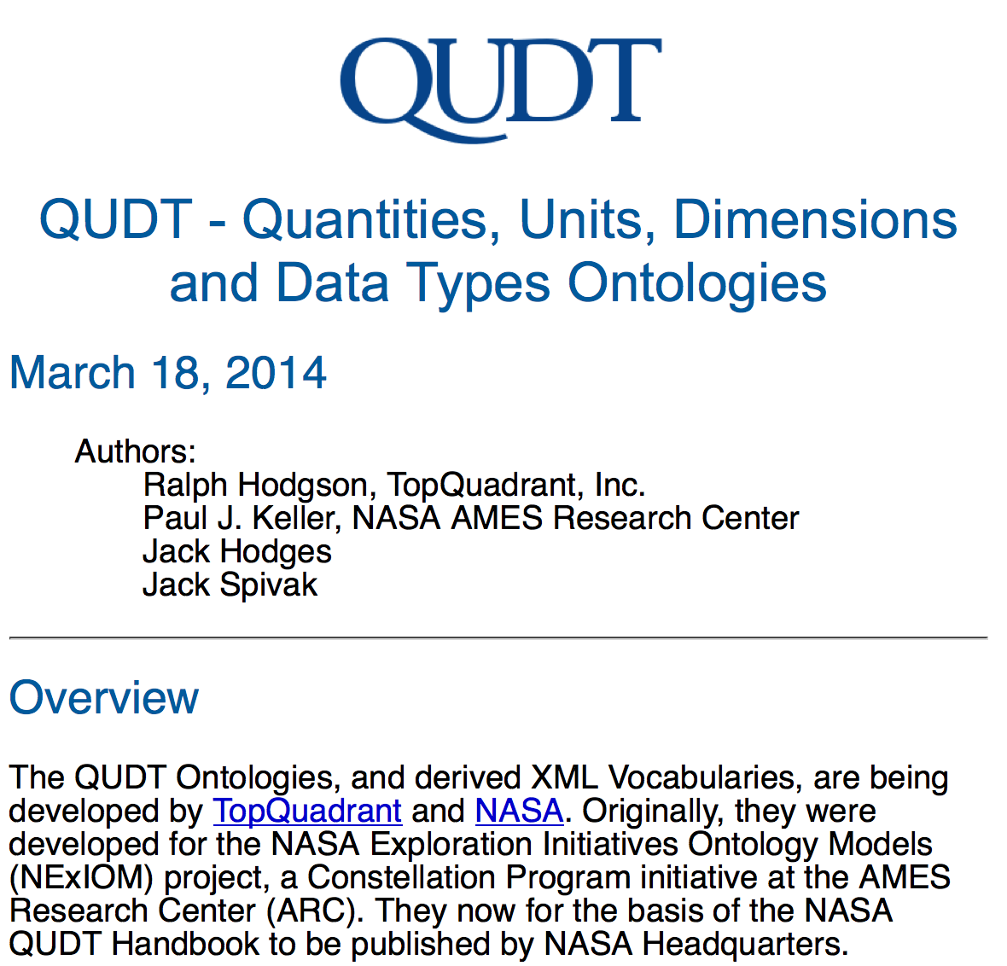
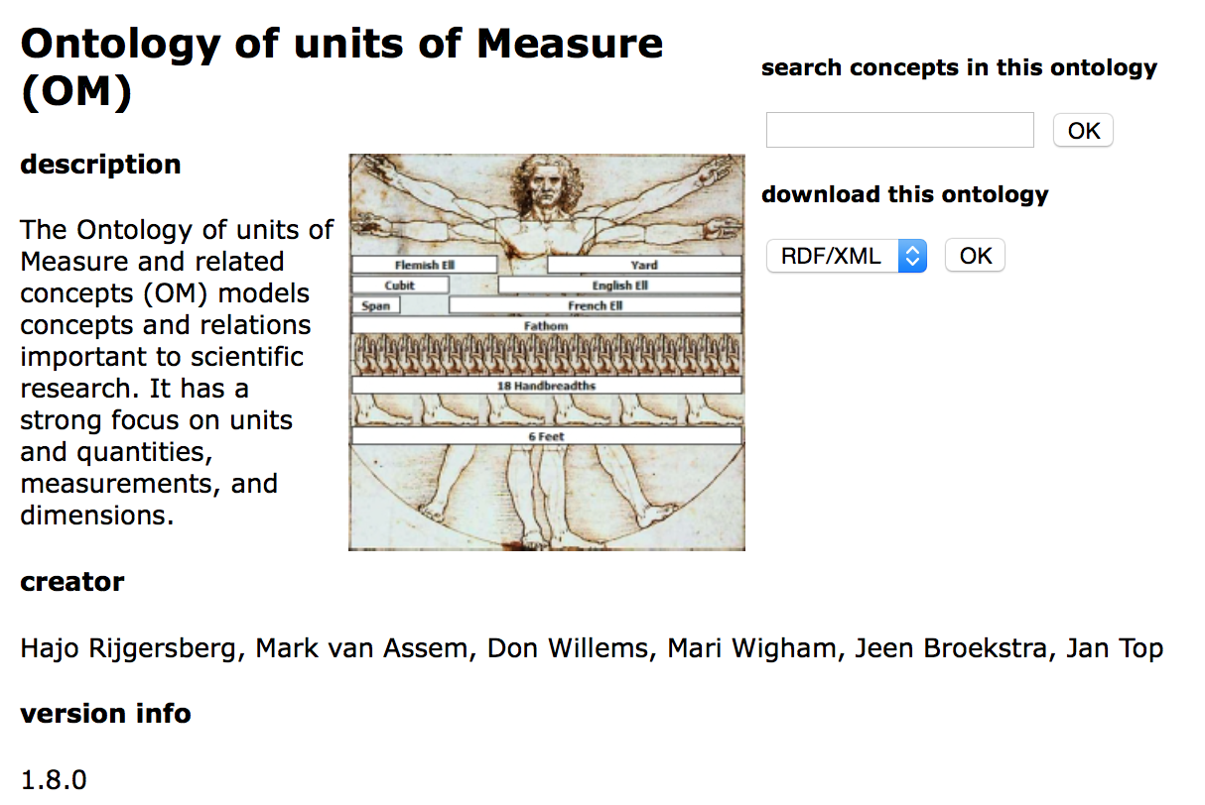
Equational knowledge:
Unit conversion
http://qudt.org/
http://www.wurvoc.org/vocabularies/om-1.8/
Notes:
Not available as structured form, but ok, you can let a bachelor student write these down...

Slide 105

Incompleteness Handling:
Are RDFS and OWL and equations enough?
City Data Model: extensible ALH(D) ontology:
Hmmm... Still a lot of work to do, e.g. adding aggregates for statistical data (Eurostat, RDF Data Cube Vocabulary) ... cf. [Kämpgen, 2014, PhD Thesis]
Indicators, e.g. area in km2, tons CO2/capita
:avgIncome per country is the
population-weighted average income of all its provinces.
Provenance
Temporal information
But Eurostat data is incomplete... I don't have the avg. income for all provinces or countries in the EU!
Spatial context
Hmmm...we actually need Claudia!
Notes:
Integration and Analysis of Distributed Multidimensional Datasets

Slide 106


Integrated Open Data is (too?)sparse
Challenges – Missing values [Bischof et al. 2015]
Individual datasets (e.g. from Eurostat) have lots of missing values
Merging together datasets with different indicators/cities adds sparsity
Indicators
51% values missing
97% values
missing
Cities
We don’t get very far here with equations…
Let’s try Data Mining/ML!

Slide 107
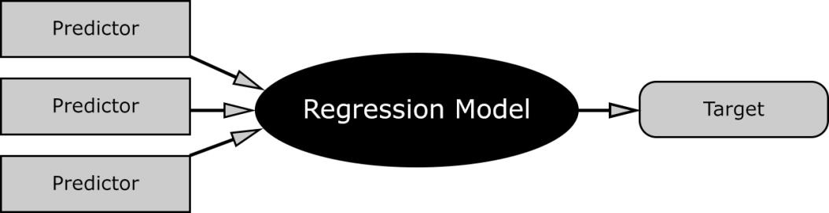
Missing Values – Hybrid approach choose best imputation method per indicator [Bischof et al. 2015]
Our assumption: every indicator has its own
distribution and relationship to others.
Basket of „standard“ regression methods:
  K-Nearest Neighbour Regression (KNN)
  Multiple Linear Regression (MLR)
  Random Forest Decision Trees (RFD)
Let’s pick the “best method per indicator:
Validation: 10-fold cross validation
However: many/most machine learning methods need more or less complete training data! More trickery needed, cf. e.g. [Bischof et al. 2015] … or ask Claudia ☺

Slide 108
Specific Steps (non-exhaustive, overlapping!)
Extraction
Inconsistency handling
Incompleteness handling (sometimes called "Enrichment“, sometimes imputation of missing values...)
Data Integration (alignment, source reconciliation)
Aggregation
Cleansing (removing outliers)
Deduplication/Interlinking (could involve "triplification")
Analytics
Enrichment
Change dedection (Maintainance/Evolution)
Validation (quality anaysis)
Efficient, sometimes distributed (query) processing
Visualization
Last but not least…Really Don’t forget the basic steps, e.g.
Tools and current approaches support you partially in different parts of these steps.... Bad news: there is no "one-size-fits-all" solution.

Slide 109
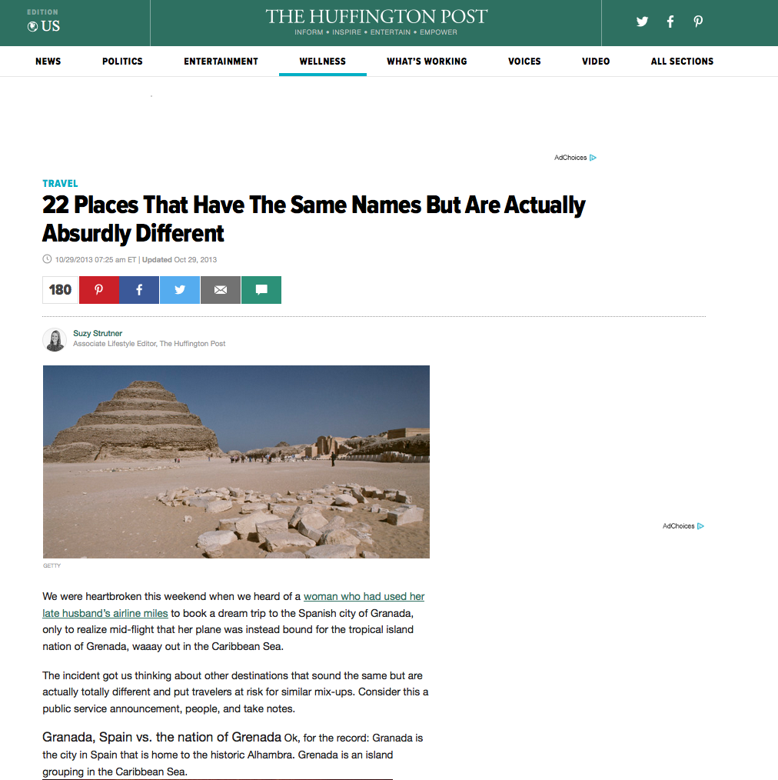
Duplicates/Ambiguities:
http://www.huffingtonpost.com/2013/10/29/12-places-with-the-same-n_n_4170470.html

Slide 110
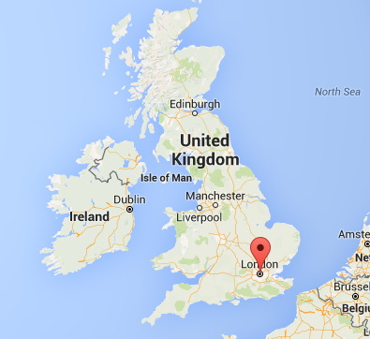
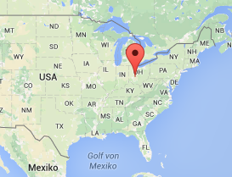

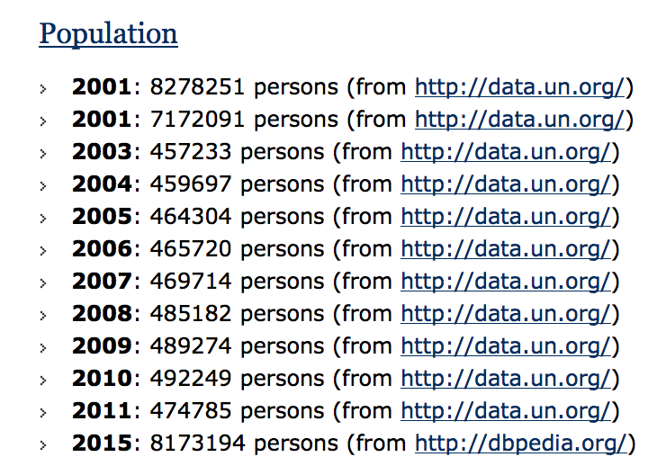
Ambiguities/Inconsistencies affected also some older versions of our City Data Pipeline:
  This example on the right was due to naïve object consolidation/deduplication, BUT:
  Open Data is often incomparable/inconsistent in itself (e.g. across years the method of data collection might change)
  → inconsistencies across and within datasets are common

Slide 111
A concrete use case:
The "City Data Pipeline"
Idea – a "classic" Semantic Web use case!
Regularly integrate various relevant Open Data sources (e.g. eurostat, UNData, ...)
Make integrated data available for re-use:
(How) can ontologies help me?
  Are ontology languages expressive enough?
  Which ontologies could I (re-)use?
  Is there enough data at all?
  Where to find the right data?
  Where to find the right ontologies?
  How to tackle inconsistencies?
citydata.wu.ac.at
  Where to find the right data?

Slide 112
Where to find the data?
Bad news:
  Finding suitable ontologies to map data sources to is not the only challenge:
  Foremost… even before a Data workflow starts, a main challenge is to find the right Datasets/Resources
  Semantic Web Search engines... Failed? ☹
      https://www.w3.org/wiki/Search_engines
... The obvious entry point:
  Open Data portals
    Still quite messy cf. http://data.wu.ac.at/portalwatch/
    Different formats, encodings, metdata of varying quality
    No proper Search!
… but again: Semantic Web Technologies could help here!
No reason not to try again and succeed this time! ☺

Slide 113
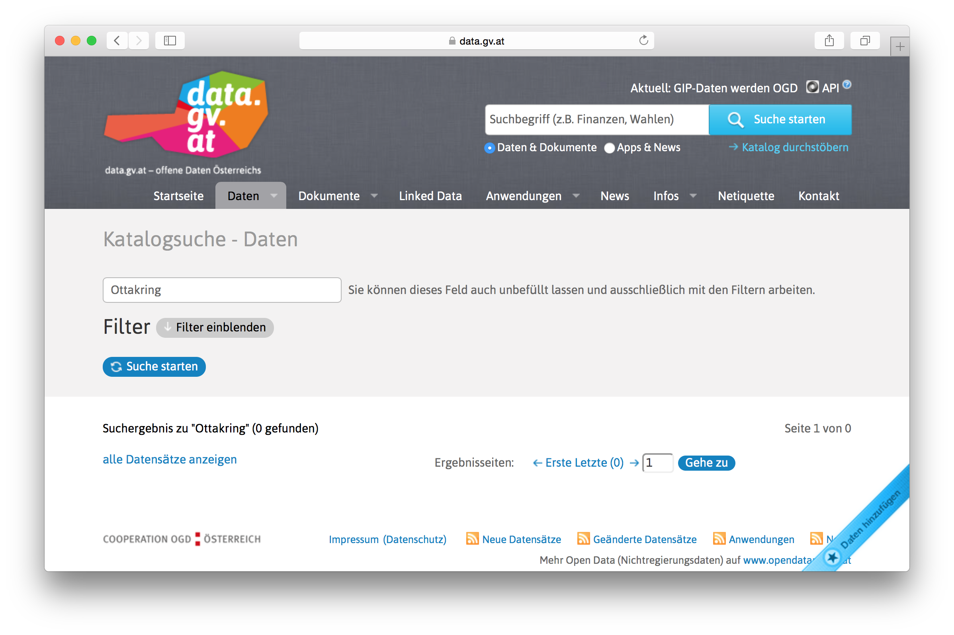
Open Data Portal search is a big problem... Why?

Slide 114
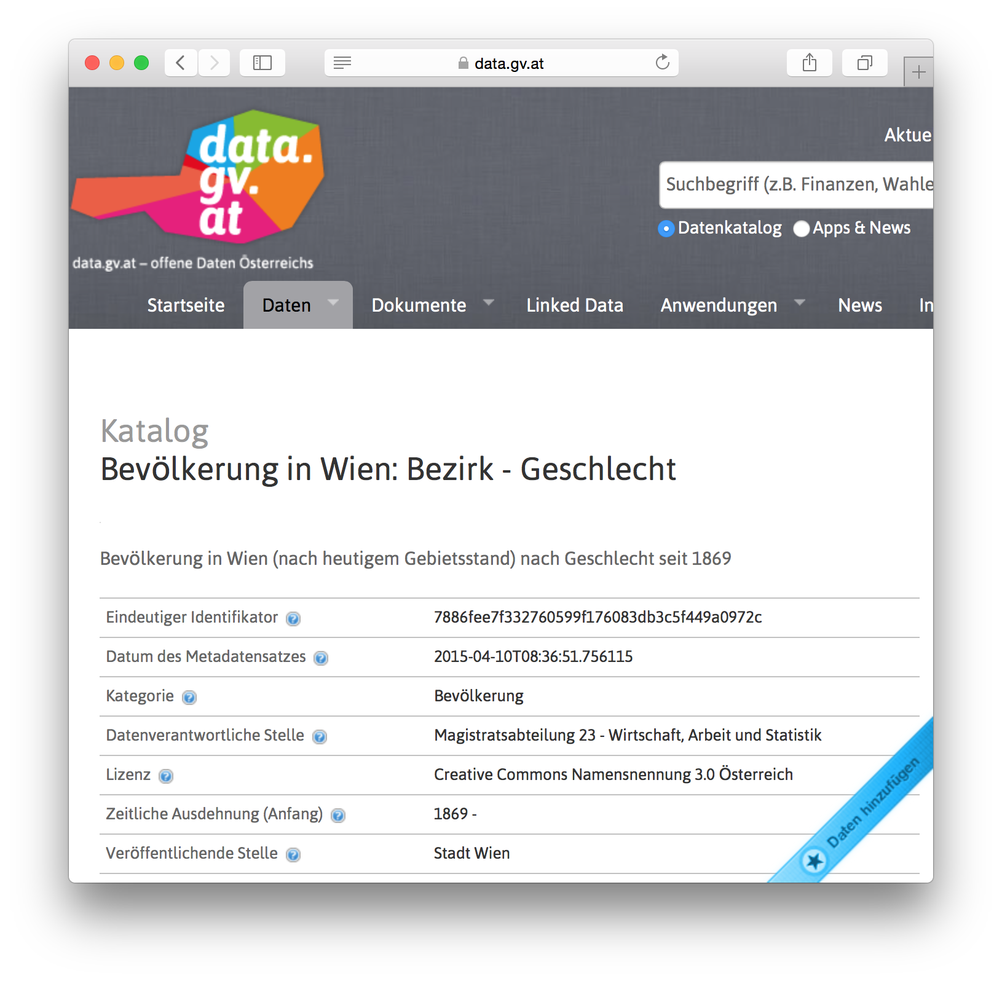
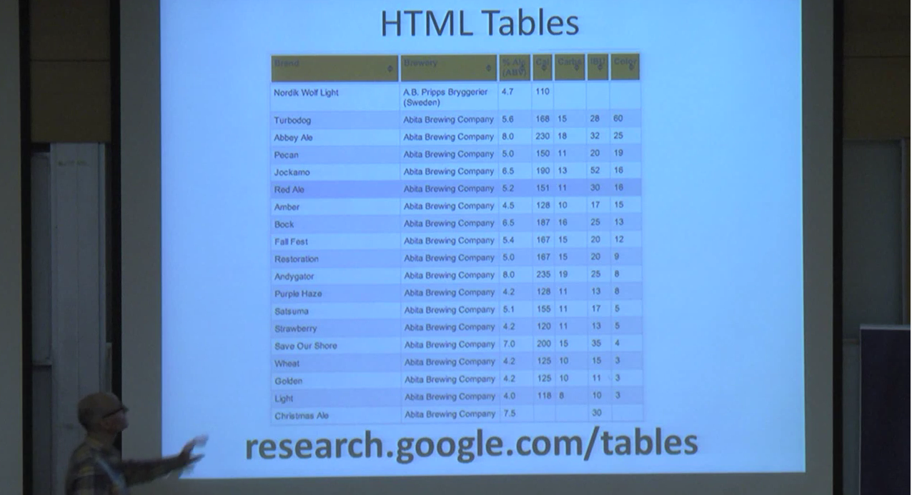
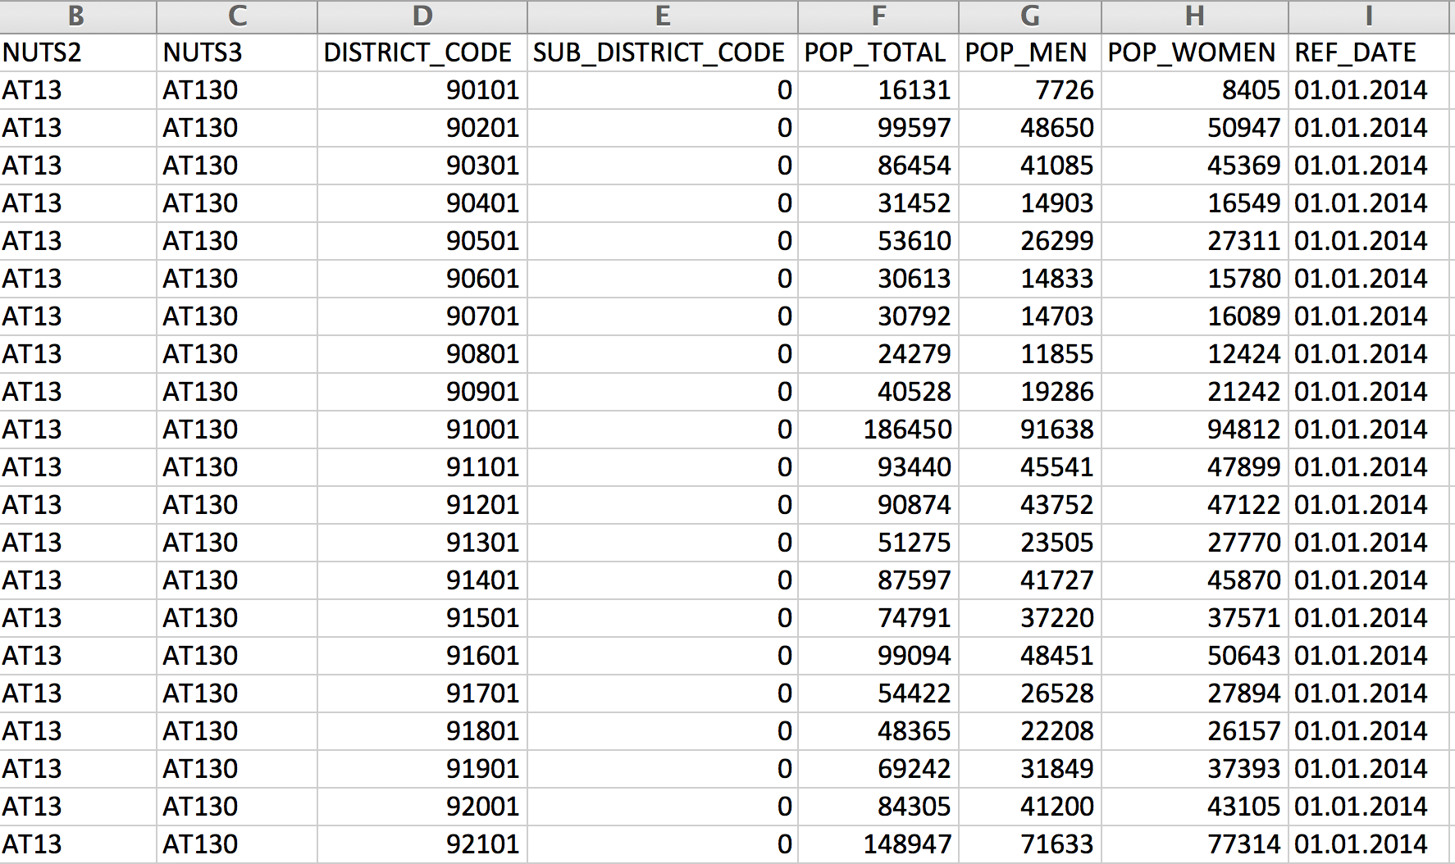
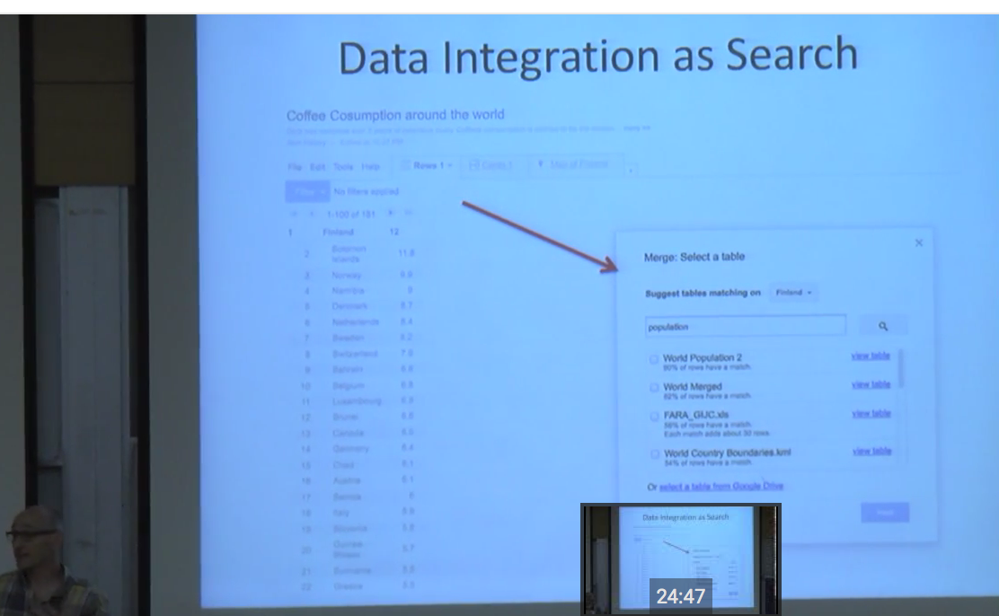
How to search in/for Open Data?
https://www.youtube.com/watch?v=kCAymmbYIvc
Cf. Work on structured Data in Web Search by Alon Halevy
... BTW: google has partially given it up on it it seems.
  → Some more recent work in a SW & Open Data context:
  [Neumaier et al., 2015+2016] [Ramnandan et al. 2015]
  cf. also mini-projects!
vs.
Compared to Web (Table) search...
This looks like a slightly different problem...
Can linking to "Open" knowledge graphs help?
(wikidata, dbpedia?) ... Probably.

Slide 115
Conclusions

Slide 116


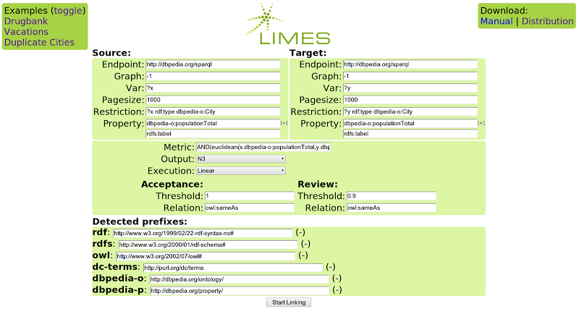

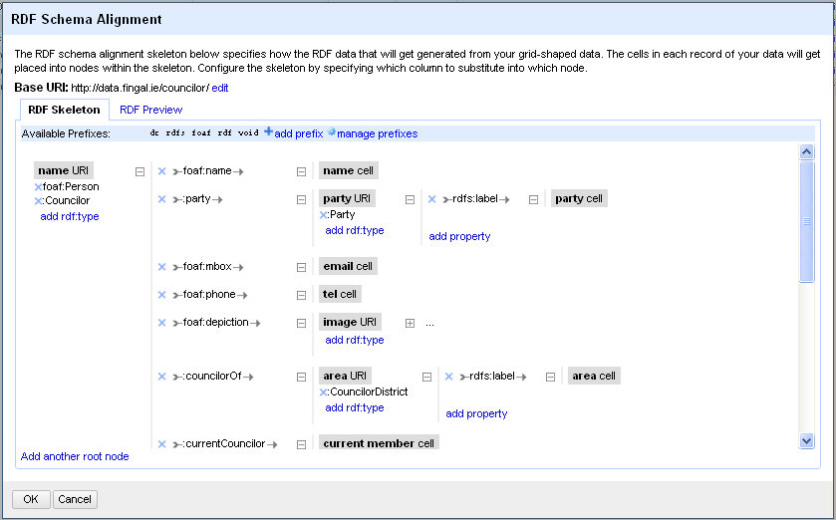

Conclusions
Heterogeneous Web Sources
Tools & Pipelines to Access/Integrate Web Sources
RDB2RDF
Systems
CSV2RDF
Systems

Slide 117
Conclusions
Query
Data Integration System
Mediator
Catalog
Wrapper
Wrapper
Wrapper
Wrapper
amFinancial(C,R)
euClimate(C,R)
similarFinancial(C1,C2)
tunisRating(T,R)
[Wiederhold92]Gio Wiederhold: Mediators in the Architecture of Future Information Systems. IEEE Computer 25(3): 38-49 (1992)

Slide 118
Integration Systems
Global Schema
rdfs:subPropertyOf
rdfs:subPropertyOf
rating(C,R)
euroCity(C)
amCity(C)
grossGDP(C,R)
avgTemp(C,R)
afCity(C)
GLAV
GAV
LAV
Local Schema
S={amFinancial(C,R), euClimate(C,R), tunisRating(T,R), similarFinancial(C1,C2) }

Slide 119
Take-home messages:
Semantic Web technologies help in Open Data Integration workflows and can add flexibility
It's worthwhile to consider traditional "Data Integration" approaches & literature AND more recently work on OBDA
Non-Clean Data requires: Statistics & machine learning (outlier detection, imputing missing values, resolving inconsistencies, etc.)
Despite 15 years into Semantic Web:“Finding the right data“ remains a major challenge!
Many Thanks!
Questions

Slide 120
References

Slide 121
References 1
[Polleres 2013] Axel Polleres. Tutorial "OWL vs. Linked Data: Experiences and Directions" OWLED2013. http://polleres.net/presentations/20130527OWLED2013_Invited_talk.pdf
[Polleres et al. 2013] Axel Polleres, Aidan Hogan, Renaud Delbru, Jürgen Umbrich:
RDFS and OWL Reasoning for Linked Data. Reasoning Web 2013: 91-149
[Golfarelli,Rizzi,2009] Matteo Golfarelli, Stefano Rizzi. Data Warehouse Design: Modern Principles and Methodologies. McGraw-Hill, 2009.
[Lenzerini2002] Maurizio Lenzerini: Data Integration: A Theoretical Perspective. PODS 2002: 233-246
[Auer et al. 2012] Sören Auer, Lorenz Bühmann, Christian Dirschl, Orri Erling, Michael Hausenblas, Robert Isele, Jens Lehmann, Michael Martin, Pablo N. Mendes, Bert Van Nuffelen, Claus Stadler, Sebastian Tramp, Hugh Williams:
Managing the Life-Cycle of Linked Data with the LOD2 Stack. International Semantic Web Conference (2) 2012: 1-16 see also http://stack.lod2.eu/
[Taheriyan et al. 2012] Mohsen Taheriyan, Craig A. Knoblock, Pedro A. Szekely, José Luis Ambite: Rapidly Integrating Services into the Linked Data Cloud. International Semantic Web Conference (1) 2012: 559-574
[Gentile, et al. 2016] Anna Lisa Gentile, Sabrina Kirstein, Heiko Paulheim and Christian Bizer. Extending RapidMiner with Data Search and Integration Capabilities
[Bischof et al. 2012] Stefan Bischof, Stefan Decker, Thomas Kr ennwallner, Nuno Lopes, Axel Polleres:
Mapping between RDF and XML with XSPARQL. J. Data Semantics 1(3): 147-185 (2012)
[Corby et al. 2015] Olivier Corby, Catherine Faron-Zucker, Fabien Gandon:
A Generic RDF Transformation Software and Its Application to an Online Translation Service for Common Languages of Linked Data. International Semantic Web Conference (2) 2015: 150-165
  [Nonaka & Takeuchi, 1995] "The Knowledge-Creating Company - How Japanese Companies Create the Dynamics of Innovation" (Nonaka, Takeuchi, New York Oxford 1995)
  [Bischof et al. 2015] Stefan Bischof, Christoph Martin, Axel Polleres, Patrik Schneider:
  Collecting, Integrating, Enriching and Republishing Open City Data as Linked Data. International Semantic Web Conference (2) 2015: 57-75

Slide 122
References 2
[Doan et al. 2012] AnHai Doan, Alon Y. Halevy, Zachary G. Ives:
Principles of Data Integration. Morgan Kaufmann 2012, ISBN 978-0-12-416044-6, pp. I-XVIII, 1-497
[Levy & Rajaraman & Ullman 1996] Alon Y. Levy, Anand Rajaraman, Jeffrey D. Ullman: Answering Queries Using Limited External Processors. PODS 1996: 227-237
[Duscka & Genesereth 1997]
[Pottinger & Halevy 2001] Rachel Pottinger, Alon Y. Halevy: MiniCon: A scalable algorithm for answering queries using views. VLDB J. 10(2-3): 182-198 (2001)
[Arvelo & Bonet & Vidal 2006] Yolifé Arvelo, Blai Bonet, Maria-Esther Vidal: Compilation of Query-Rewriting Problems into Tractable Fragments of Propositional Logic. AAAI 2006: 225-230
[Konstantinidis & Ambite, 2011] George Konstantinidis, José Luis Ambite: Scalable query rewriting: a graph-based approach. SIGMOD Conference 2011: 97-108
[Izquierdo & Vidal & Bonet 2011] Daniel Izquierdo, Maria-Esther Vidal, Blai Bonet: An Expressive and Efficient Solution to the Service Selection Problem. International Semantic Web Conference (1) 2010: 386-401
[Wiederhold92] Gio Wiederhold: Mediators in the Architecture of Future Information Systems. IEEE Computer 25(3): 38-49 (1992)
[Stadtmüller et al. 2013] Steffen Stadtmüller, Sebastian Speiser, Andreas Harth, Rudi Studer: Data-Fu: a language and an interpreter for interaction with read/write linked data. WWW 2013: 1225-1236
[Montoya et al. 2014] Gabriela Montoya, Luis Daniel Ibáñez, Hala Skaf-Molli, Pascal Molli, Maria-Esther Vidal. SemLAV: Local-As-View Mediation for SPARQL Queries. T. Large-Scale Data- and Knowledge-Centered Systems 13: 33-58 (2014).

Slide 123
References 3
[Priyatna et al. 2014] Freddy Priyatna, Óscar Corcho, Juan Sequeda:
Formalisation and experiences of R2RML-based SPARQL to SQL query translation using morph. WWW 2014: 479-490
[Sequeda & Miranker 2013] Juan Sequeda, Daniel P. Miranker. Ultrawrap: SPARQL execution on relational data. J. Web Sem. 22: 19-39 (2013)
[Krötzsch 2012] Markus Krötzsch: OWL 2 Profiles: An Introduction to Lightweight Ontology Languages. Reasoning Web 2012: 112-183
[Glimm et al. 2012] Birte Glimm, Aidan Hogan, Markus Krötzsch, Axel Polleres: OWL: Yet to arrive on the Web of Data? LDOW 2012
[Kontchakov et al. 2013] Roman Kontchakov, Mariano Rodriguez-Muro, Michael Zakharyaschev: Ontology-Based Data Access with Databases: A Short Course. Reasoning Web 2013: 194-229
[Calvanese et al. 2007] Diego Calvanese, Giuseppe De Giacomo, Domenico Lembo, Maurizio Lenzerini, Riccardo Rosati: Tractable Reasoning and Efficient Query Answering in Description Logics: The DL-Lite Family. J. Autom. Reasoning 39(3): 385-429 (2007)
[Perez-Urbina et al., 2009] Héctor Pérez-Urbina, Boris Motik and Ian Horrocks, A Comparison of Query Rewriting Techniques for DL-Lite, In Proc. of the Int. Workshop on Description Logics (DL 2009), Oxford, UK, July 2009.
[Rodriguez-Muro, et al. 2012] Mariano Rodriguez-Muro, Diego Calvanese:
Quest, an OWL 2 QL Reasoner for Ontology-based Data Access. OWLED 2012
[Rodriguez-Muro, et al. 2013] Mariano Rodriguez-Muro, Roman Kontchakov, Michael Zakharyaschev: Ontology-Based Data Access: Ontop of Databases. International Semantic Web Conference (1) 2013: 558-573
[Calvanese et al. 2011] Diego Calvanese, Giuseppe De Giacomo, Domenico Lembo, Maurizio Lenzerini, Antonella Poggi, Mariano Rodriguez-Muro, Riccardo Rosati, Marco Ruzzi, Domenico Fabio Savo:
The MASTRO system for ontology-based data access. Semantic Web 2(1): 43-53 (2011)
[Rosati et al. 2010] Riccardo Rosati, Alessandro Almatelli: Improving Query Answering over DL-Lite Ontologies. KR 2010
[Mora & Corcho, 2014] José Mora, Riccardo Rosati, Óscar Corcho: kyrie2: Query Rewriting under Extensional Constraints in ELHIO. Semantic Web Conference (1) 2014: 568-583
[Sequeda et al. 2014] Juan F. Sequeda, Marcelo Arenas, Daniel P. Miranker:
OBDA: Query Rewriting or Materialization? In Practice, Both! Semantic Web Conference (1) 2014: 535-551

Slide 124
References 4
[Acosta et al 2011] M. Acosta, M.-E. Vidal, T. Lampo, J. Castillo, and E. Ruckhaus. Anapsid: an adaptive query processing engine for sparql endpoints. ISWC 2011.
[Basca and Bernstein 2014] C. Basca and A. Bernstein. Querying a messy web of data with avalanche. In Journal of Web Semantics, 2014.
[Cohen-Boalaki and . Leser. 2013] S. Cohen-Boalakia, U. Leser. Next Generation Data Integration for the Life Sciences. Tutorial at ICDE 2013. https://www2.informatik.hu-berlin.de/~leser/icde_tutorial_final_public.pdf
[Doan et el. 2012] A. Doan, A. Halevy, Z. Ives, Data Integration. Morgan Kaukman 2012.
[Halevy et al 2006] A. Y. Halevy, A. Rajaraman, J. Ordille: Data Integration: The Teenage Years. VLDB 2006: 9-16.
[Halevy et al 2001] A. Y. Halevy. Answering queries using views: A survey. VLDB J., 2001.
[Hassanzadeh et al. 2013] Oktie Hassanzadeh, Ken Q. Pu, Soheil Hassas Yeganeh, Renée J. Miller, Lucian Popa, Mauricio A. Hernández, Howard Ho: Discovering Linkage Points over Web Data. PVLDB 2013
[Gorlitz and Staab 2011] O. Gorlitz and S. Staab. SPLENDID: SPARQL Endpoint Federation Exploiting VOID Descriptions. In Proceedings of the 2nd International Workshop on Consuming Linked Data, 2011.
[Schwarte et al. 2011] A. Schwarte, P. Haase, K. Hose, R. Schenkel, and M. Schmidt. Fedx: Optimization techniques for federated query processing on linked data. ISWC 2011.
[Verborgh et al. 2014] Ruben Verborgh, Olaf Hartig, Ben De Meester, Gerald Haesendonck, Laurens De Vocht, Miel Vander Sande, Richard Cyganiak, Pieter Colpaert, Erik Mannens, Rik Van de Walle: Querying Datasets on the Web with High Availability. ISWC2014

Slide 125
References 5
[Acosta et al. 2015] Maribel Acosta, Amrapali Zaveri, Elena Simperl, Dimitris Kontokostas, Sören Auer, Jens Lehmann: Crowdsourcing Linked Data Quality Assessment. ISWC 2013
[Lenz 2007] Hans - J. Lenz. Data Quality Defining, Measuring and Improving. Tutorial at IDA 2007.
[Naumann02] Felix Naumann: Quality-Driven Query Answering for Integrated Information Systems. LNCS 2261, Springer 2002
[Ngonga et al. 2011] Axel-Cyrille Ngonga Ngomo, Sören Auer: LIMES - A Time-Efficient Approach for Large-Scale Link Discovery on the Web of Data. IJCAI 2011
[Saleem et al 2014] Muhammad Saleem, Maulik R. Kamdar, Aftab Iqbal, Shanmukha Sampath, Helena F. Deus, Axel-Cyrille Ngonga Ngomo: Big linked cancer data: Integrating linked TCGA and PubMed. J. Web Sem. 2014
[Soru et al. 2015] Tommaso Soru, Edgard Marx, Axel-Cyrille Ngonga Ngomo: ROCKER: A Refinement Operator for Key Discovery. WWW 2015
[Volz et al 2009] Julius Volz, Christian Bizer, Martin Gaedke, Georgi Kobilarov: Discovering and Maintaining Links on the Web of Data. ISWC 2009
[Zaveri,et al 2015] Amrapali J. Zaveri, Anisa Rula, Andrea Maurino, Ricardo Pietrobon, Jens Lehmann, and Sören Auer. Quality Assessment for Linked Data: A Survey. Semantic Web Journal 2015
[Hernandez&Stolfo, 1998] M. A. Hernández, S. J. Stolfo: Real-world Data is Dirty: Data Cleansing and The Merge/Purge Problem.
Data Min. Knowl. Discov. 2(1): 9-37 (1998)
[Sarma et al. 2012] Das Sarma, A., Fang, L., Gupta, N., Halevy, A., Lee, H., Wu, F., Xin, R., Yu, C.: Finding related tables. In: Proceedings of the 2012 ACM SIGMOD International Conference on Management of Data. pp. 817–828. ACM (2012)
[Venetis et al. 2011] Venetis, P., Halevy, A.Y., Madhavan, J., Pasca, M., Shen, W., Wu, F., Miao, G., Wu, C.: Recovering semantics of tables on the web. PVLDB 4(9), 528–538 (2011)
[Ramnandan et al. 2015] Ramnandan, S.K., Mittal, A., Knoblock, C.A., Szekely, P.A.: Assigning semantic labels to data sources. In: ESWC 2015. pp. 403–417
[Neumaier et al. 2015] Jürgen Umbrich, Sebastian Neumaier, and Axel Polleres. Quality assessment & evolution of open data portals. In IEEE International Conference on Open and Big Data, Rome, Italy, August 2015.
[Neumaier et al. 2016] S. Neumaier, J. Umbrich, J. Parreira, A. Polleres. Multi-level semantic labelling of numerical values, ISWC2016, to appear.

Slide 126
trends & OPEN Research Questions (some)

Slide 127
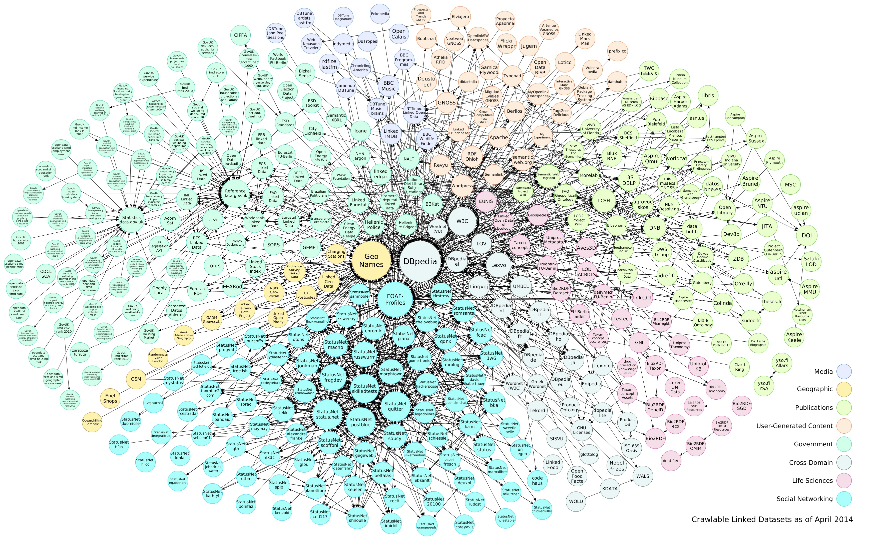



Federations of SPARQL Endpoints
Publicly available SPARQL endpoints
Federated
query processing
ANAPSID

Slide 128




Federation of SPARQL Endpoints
http://data.linkedmdb.org/sparql := http://data.linkedmdb.org/resource/movie/personal_film_appearance;
http://www.w3.org/2002/07/owl#sameAs;
http://www.w3.org/1999/02/22-rdf-syntax-ns#type;
http://xmlns.com/foaf/0.1/based_near;
http://xmlns.com/foaf/0.1/name;
…..
http://dbtune.org/jamendo/sparql := http://www.w3.org/1999/02/22-rdf-syntax-ns#type;
http://purl.org/dc/elements/1.1/title;
http://xmlns.com/foaf/0.1/based_near;
http://xmlns.com/foaf/0.1/homepage;
http://purl.org/ontology/mo/biography;
….
http://dbpedia.org/sparql := http://xmlns.com/foaf/0.1/name;
http://dbpedia.org/ontology/award;
http://dbpedia.org/ontology/almaMater;
http://www.geonames.org/ontology#name;
http://www.geonames.org/ontology#parentFeatures;
….
http://www.lotico.com:3030/lotico/sparq := http://www.geonames.org/ontology#name;
http://www.geonames.org/ontology#parentFeatures;
http://www.geonames.org/ontology#officialName;
http://www.geonames.org/ontology#postalCode;
…..

Slide 129
SPARQL Query Processing
@PREFIX foaf:<http://xmlns.com/foaf/0.1/>
@PREFIX geonames:http://www.geonames.org/ontology#
SELECT ?name ?location WHERE {
?artist foaf:name ?name .
?artist foaf:based_near ?location .
?location geonames:parentFeature ?germany .
?germany geonames:name 'Federal Republic of Germany’ .}
Federated Query Engine
{'news': '', 'name': 'Michael Bartels^^<http://www.w3.org/2001/XMLSchema#string>', 'location': 'http://sws.geonames.org/2911297/'}
{'news': '', 'name': 'Melophon^^<http://www.w3.org/2001/XMLSchema#string>', 'location': 'http://sws.geonames.org/2911297/'}
{'news': '', 'name': 'Remote Controlled^^<http://www.w3.org/2001/XMLSchema#string>', 'location': 'http://sws.geonames.org/2911297/'}
{'news': '', 'name': 'Arne Pahlke^^<http://www.w3.org/2001/XMLSchema#string>', 'location': 'http://sws.geonames.org/2911297/'}
{'news': '', 'name': 'Superdefekt^^<http://www.w3.org/2001/XMLSchema#string>', 'location': 'http://sws.geonames.org/2911297/'}
{'news': '', 'name': 'Chaos^^<http://www.w3.org/2001/XMLSchema#string>', 'location': 'http://sws.geonames.org/2911297/'}
{'news': '', 'name': 'The Gay Romeos^^<http://www.w3.org/2001/XMLSchema#string>', 'location': 'http://sws.geonames.org/2911297/'}
{'news': '', 'name': 'Der tollw\\u00FCtige Kasper^^<http://www.w3.org/2001/XMLSchema#string>', 'location': 'http://sws.geonames.org/2911297/'}
{'news': '', 'name': 'the ad.kowas^^<http://www.w3.org/2001/XMLSchema#string>', 'location': 'http://sws.geonames.org/2911297/'}
{'news': '', 'name': 'herr gau^^<http://www.w3.org/2001/XMLSchema#string>', 'location': 'http://sws.geonames.org/2911297/'}
{'news': '', 'name': 'The Rodeo Five^^<http://www.w3.org/2001/XMLSchema#string>', 'location': 'http://sws.geonames.org/2911297/'}

Slide 130
References
Andreas Schwarte, Peter Haase, Katja Hose, Ralf Schenkel, Michael Schmidt: FedX: Optimization Techniques for Federated Query Processing on Linked Data. International Semantic Web Conference (1) 2011: 601-616
http://www2.informatik.uni-freiburg.de/~mschmidt/docs/iswc11_fedx.pdf
Maribel Acosta, Maria-Esther Vidal, Tomas Lampo, Julio Castillo, Edna Ruckhaus: ANAPSID: An Adaptive Query Processing Engine for SPARQL Endpoints. International Semantic Web Conference (1) 2011: 18-34
http://iswc2011.semanticweb.org/fileadmin/iswc/Papers/Research_Paper/03/70310017.pdf

Slide 131
RQ1: Can a federation of SPARQL Endpoints be seen as a Data Integration System?
Describe the problem presented in the related papers as a Data Integration System.
Select the most suitable mapping approach to describe the Data Integration System.
Use the mediator and wrapper architecture to describe masters and workers.
Illustrate with an example the Data Integration System, and show the features implemented by the mediator and wrappers of the Data Integration System

Slide 132
SPARQL Query Execution using LAV views
Publicly available Linked Data Fragments (LAV views)
Linked Data Fragment Server
Linked Data Fragment Client

Slide 133
SPARQL Query Processing
@PREFIX foaf:<http://xmlns.com/foaf/0.1/>
@PREFIX geonames:http://www.geonames.org/ontology#
SELECT ?name ?location WHERE {
?artist foaf:name ?name .
?artist foaf:based_near ?location .
?location geonames:parentFeature ?germany .
?germany geonames:name 'Federal Republic of Germany’ .}
Linked Data Fragment Client
Linked Data Server
{'news': '', 'name': 'Michael Bartels^^<http://www.w3.org/2001/XMLSchema#string>', 'location': 'http://sws.geonames.org/2911297/'}
{'news': '', 'name': 'Melophon^^<http://www.w3.org/2001/XMLSchema#string>', 'location': 'http://sws.geonames.org/2911297/'}
{'news': '', 'name': 'Remote Controlled^^<http://www.w3.org/2001/XMLSchema#string>', 'location': 'http://sws.geonames.org/2911297/'}
{'news': '', 'name': 'Arne Pahlke^^<http://www.w3.org/2001/XMLSchema#string>', 'location': 'http://sws.geonames.org/2911297/'}
{'news': '', 'name': 'Superdefekt^^<http://www.w3.org/2001/XMLSchema#string>', 'location': 'http://sws.geonames.org/2911297/'}
{'news': '', 'name': 'Chaos^^<http://www.w3.org/2001/XMLSchema#string>', 'location': 'http://sws.geonames.org/2911297/'}
{'news': '', 'name': 'The Gay Romeos^^<http://www.w3.org/2001/XMLSchema#string>', 'location': 'http://sws.geonames.org/2911297/'}
{'news': '', 'name': 'Der tollw\\u00FCtige Kasper^^<http://www.w3.org/2001/XMLSchema#string>', 'location': 'http://sws.geonames.org/2911297/'}
{'news': '', 'name': 'the ad.kowas^^<http://www.w3.org/2001/XMLSchema#string>', 'location': 'http://sws.geonames.org/2911297/'}
{'news': '', 'name': 'herr gau^^<http://www.w3.org/2001/XMLSchema#string>', 'location': 'http://sws.geonames.org/2911297/'}
{'news': '', 'name': 'The Rodeo Five^^<http://www.w3.org/2001/XMLSchema#string>', 'location': 'http://sws.geonames.org/2911297/'}

Slide 134
References
SPARQL Query Execution using Linked Data Fragments
Ruben Verborgh, Miel Vander Sande, Olaf Hartig, Joachim Van Herwegen, Laurens De Vocht, Ben De Meester, Gerald Haesendonck, Pieter Colpaert:
Triple Pattern Fragments: A low-cost knowledge graph interface for the Web. J. Web Sem. 37: 184-206 (2016)
http://www.sciencedirect.com/science/article/pii/S1570826816000214
Maribel Acosta, Maria-Esther Vidal: Networks of Linked Data Eddies: An Adaptive Web Query Processing Engine for RDF Data. International Semantic Web Conference (1) 2015: 111-127
http://www.aifb.kit.edu/images/f/f0/Acosta_vidal_iswc2015.pdf

Slide 135
RQ2: Can a federation of Linked Data Fragments be seen as a Data Integration System?
Describe the problem presented in the related papers as a Data Integration System.
Select the most suitable mapping approach to describe the Data Integration System.
Use the mediator and wrapper architecture to describe masters and workers.
Illustrate with an example the Data Integration System, and show the features implemented by the mediator and wrappers of the Data Integration System

Slide 136
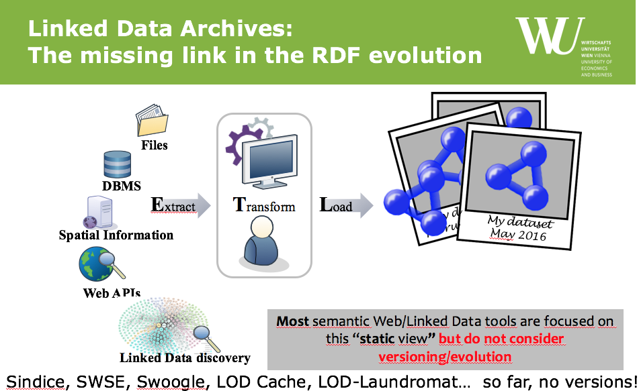
RQ3: What challenges does archiving of RDF and Open Data involve?
If Open Data is Big Data, archiving Open Data and RDF Data is even one order of magnitude more!
Challenges on creating (crawling), maintaining, storing and querying such archives:
cf. slides
“On Archiving Linked and Open Data"
at the 2nd Workshop on Managing
the Evolution and Preservation
of the Data Web (MEPDaW 2016),
http://polleres.net/presentations/20160530Keynote-MEPDaW2016.pptx

Slide 137
RQ4: How to publish and use Linked Open Data alongside Closed Data?
Which policies need to be supported?
How to describe these policies?
How to enforce them, how to protect and securely store closed linked data?
Surprisingly few starting points in our community on access control/encryption for RDF/Linked Data, cf. e.g.
  S. Kirrane. Linked data with access control. PhD thesis, 2015. NUI Galway https://aran.library.nuigalway.ie/handle/10379/4903
  Mark Giereth: On Partial Encryption of RDF-Graphs. International Semantic Web Conference 2005: 308-322
Lots of work on policy languages, e.g. ODRL:
  Simon Steyskal, Axel Polleres:
  Towards Formal Semantics for ODRL Policies. RuleML 2015: 360-375
  Simon Steyskal, Axel Polleres: Defining expressive access policies for linked data using the ODRL ontology 2.0. SEMANTICS 2014: 20-23

Slide 138
Your Research Task(s) for the rest of the day:
Work on one of the overall Research Questions (too generic on purpose!!!!) RQ1-RQ6 from the slides before in your mini-project groups!
4 questions/11 groups → 1 RQ can be chosen by at most 3 groups!
  RQ1-2 → Maria Esther
  RQ3-4 → Axel
For each problem you work on:
1) Problems: Why is it difficult? Find obstacles. Define concrete open (sub-)research questions!
2) Solutions: What could be strategies to overcome these obstacles?
3) Systems: What could be a strategy/roadmap/method to implement these strategies?
4) Benchmarks: What could be a strategy/roadmap/method to evaluate a solution?
Result: short presentation per group addressing these 4 questions and findings.
Tips:
Think about how much time you dedicate to which of these four questions.
Don’t start with 3)
Prepare some answers or discussions for afinal plenary session which can be presented in a 2-3 min pitch SUMMARIZING your discussion
  no more than 2 slides
  focus on take-home messages
mandatory
optional
Please email your notes and (link to) slides to axel[at]polleres.net ... We will review them and provide feedback during tmrw morning!
Notes:
Any better ideas how to prepare/present the results?

