Slide 1
Open Data as the fuel for complexity science?
Axel Polleres,
joint work with Stefan Bischof, Sebastian Neumaier, Jürgen Umbrich, etc.
web: http://polleres.net twitter: @AxelPolleres

Slide 2
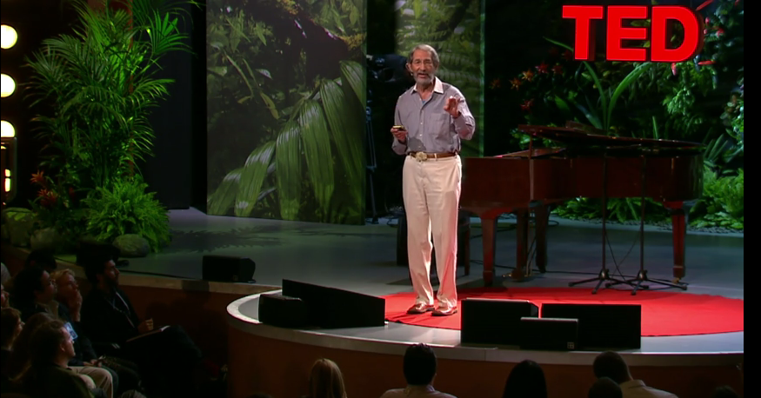
Geoffrey West (former director of the Santa Fe Institute) 2011
… my first impression of Complexity Science, if you want…
Exponential increase of Urbanization
Sustainability
Lifecycle od cities
Urgent need for a scientific, quantifiable [i.e., data-driven] theory of cities, a predictive framework
https://www.ted.com/talks/geoffrey_west_the_surprising_math_of_cities_and_corporations/
Notes:
Danke für Die Einladung!
Lassen Sie mich beginnen mit der Ankündigung zum heutigen event…. Hier stechen einige Begriffe ins Auge:
Es geht um “Cognitive Computing” ... Was ist das überhaupt?
Es hat offensichtlich etwas mit künstlicher Intelligenz zu tun... Was ist das überhaupt? Wie wir feststellen ist Artificial Intelligence im Rahmen der “:Digitalen Transformation“ selbst im Wandel und hat in den letzen Jahren einige Veränderungen durchlebt...
Eine Frage die gestellt wird ist die welche Lösungen bereits im Einsatz sind worauf ich versuchen werde zumindest aus meiner Forschungsperspektive – der Erforschung von Daten am und aus dem Web – ein paar Antworten zu geben...
Last, but not least, ist eine Frage in der Ankündigung, mit welchen Themen wir uns befassen sollten, und ich werde versuchen, Sie bis zum Ende dieses Vortrages davon zu überzeugen, dass Open Data, also offene Daten ein solches Thema sind!

Slide 3
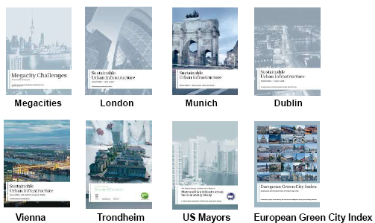
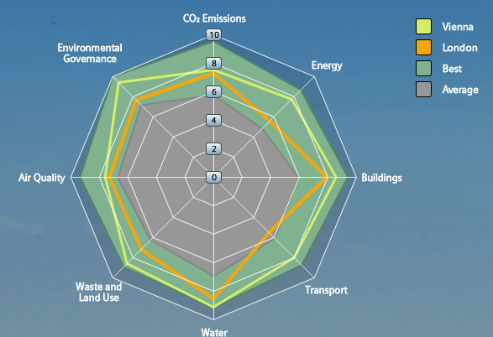
Back at that time… City Data – Important for Infrastructure Providers & for City Decision Makers
City Assessment and Sustainability reports
Tailored offerings by Infrastructure Providers
… however, these are often outdated before even published!
Goal (short term):
Leverage Open Data for calculating a city’ performance from public sources on the Web automatically
Needs up-to-date City Data and calculates City KPIs in a way that allows to display the current state and run scenarios of different product applications.
e.g. towards a “Dynamic”
Green City Index:
Goal (long term):
Define and Refine KPI models to assess specific impact of infrastructural investments and gather/check input automatically
Notes:
3

Slide 4
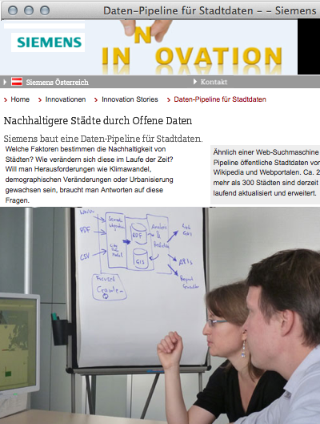
City Data Pipeline (started 2012)
http://citydata.wu.ac.at/

Slide 5
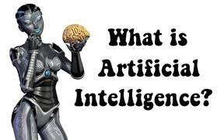
My background
Logic Programming
Artificial Intelligence
Knowledge Representation
Semantic Web
Web Data Integration

Slide 6
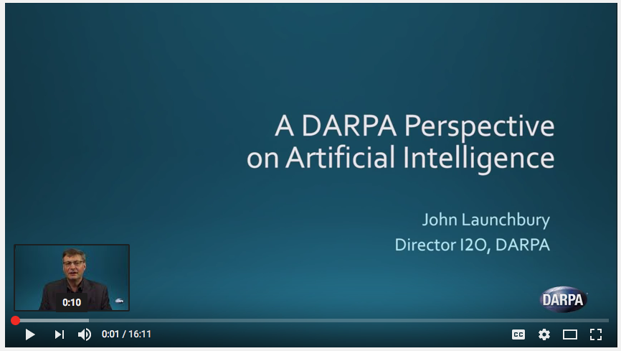
2. What is Artificial Intelligence?
John Launchbury, the Director of DARPA's Information Innovation Office
Video, published on Feb 15, 2017
“demistify” Artificial Intelligence

Slide 7
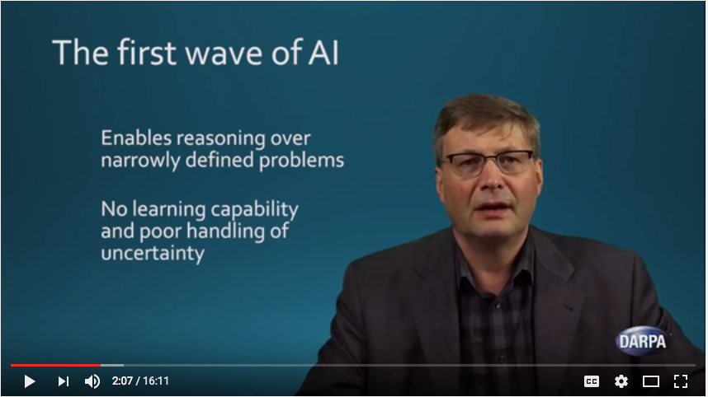
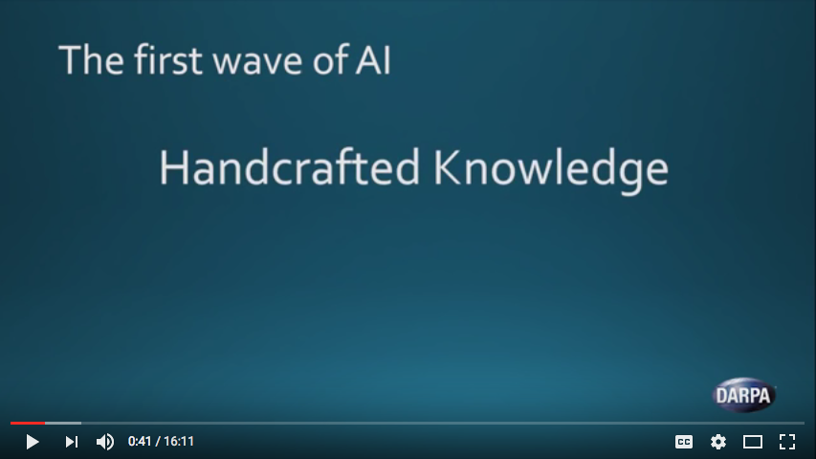
2. What is Artificial Intelligence?
John Launchbury, the Director of DARPA's Information Innovation Office
Video, published on Feb 15, 2017

Slide 8
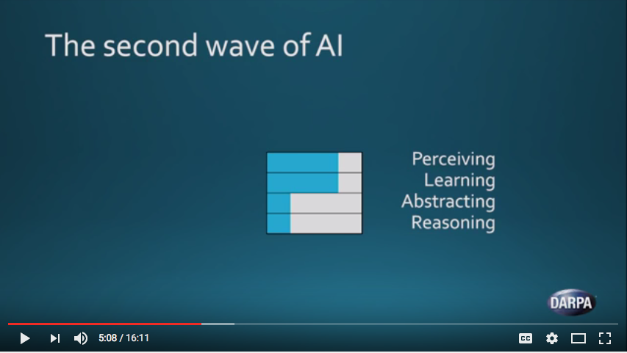
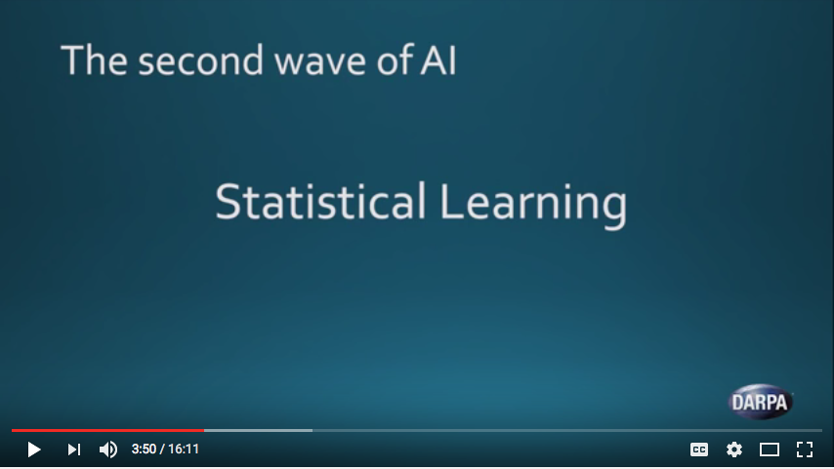
2. What is Artificial Intelligence?
John Launchbury, the Director of DARPA's Information Innovation Office
Video, published on Feb 15, 2017
“learn from data, like spreadsheets on steroids”

Slide 9
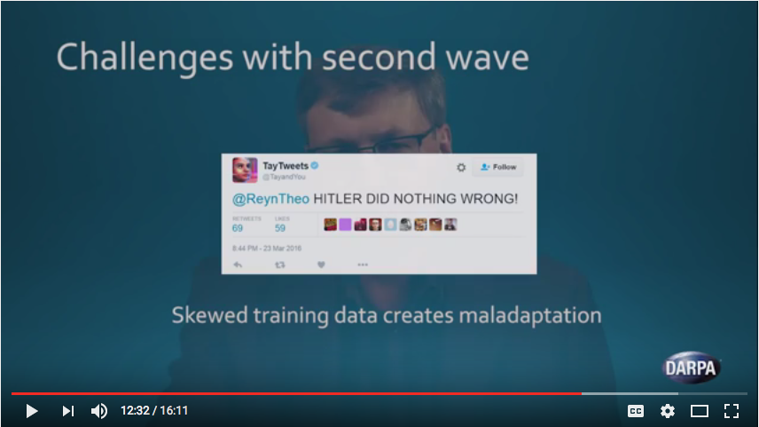
2. What is Artificial Intelligence?
John Launchbury, the Director of DARPA's Information Innovation Office
Video, published on Feb 15, 2017
Recall: “Machine intelligence is not human intelligence, the difference lies in the errors it makes.” is it?

Slide 10
2. What is Artificial Intelligence?
John Launchbury, the Director of DARPA's Information Innovation Office
Video, published on Feb 15, 2017
needs – if you want a combination of first and second wave AI – rules/explanations to model common sense and act in new contexts
Again, data is at it’s heart!

Slide 11
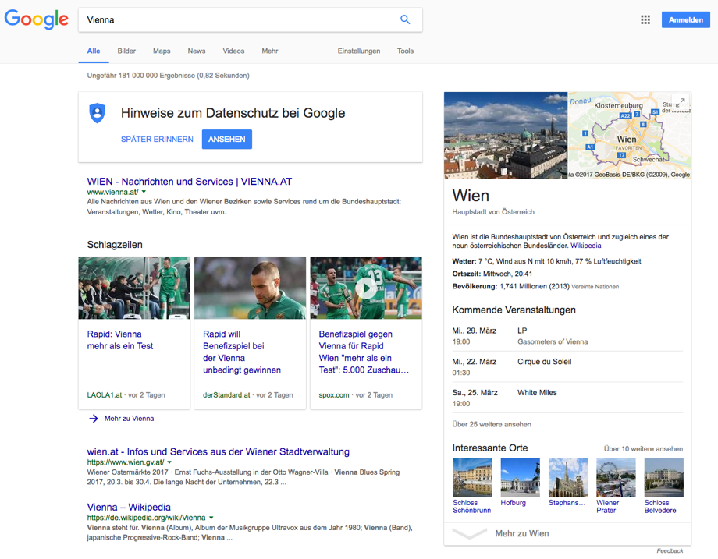
Which “AI” solutions exist now (on the Web)?
Example 1: Google’s Knowledge Graph

Slide 12
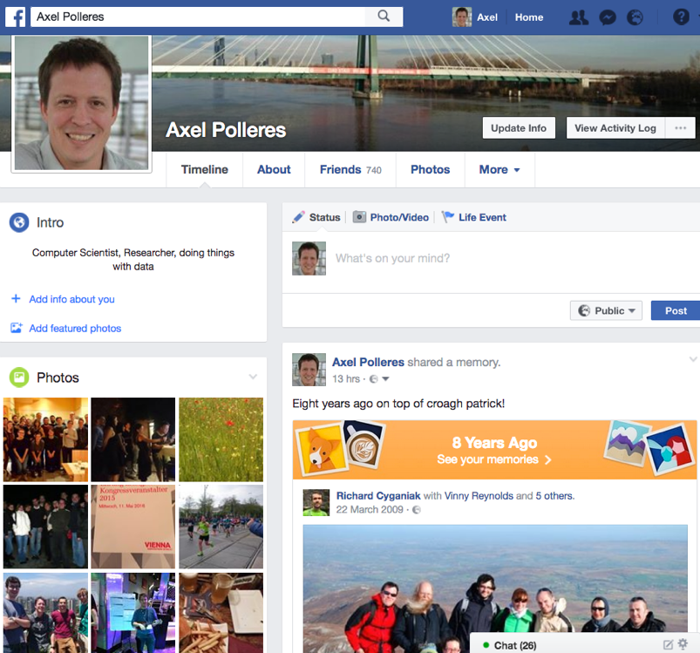
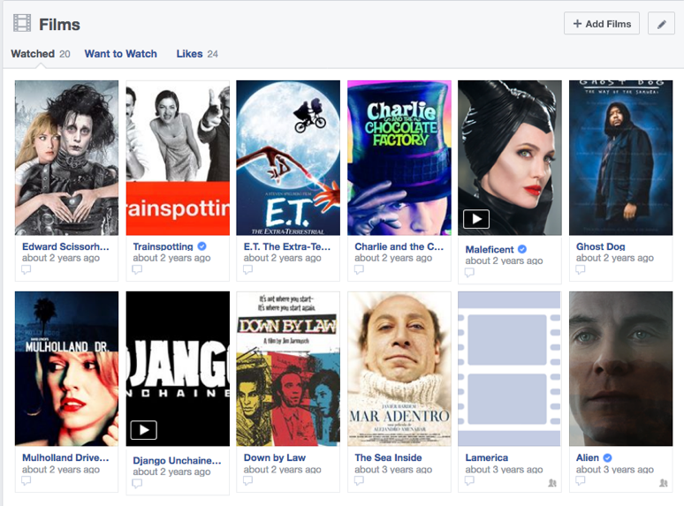
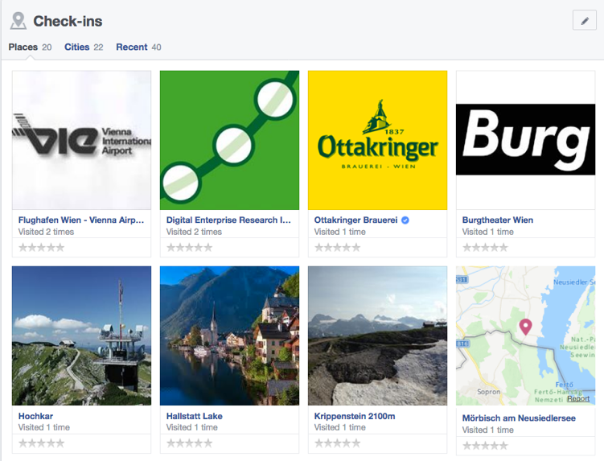
Which “AI” solutions exist now (on the Web)?
Example 2: FB’s Social Graph & News Recommendations
Also uses a knowledge graph...

Slide 13
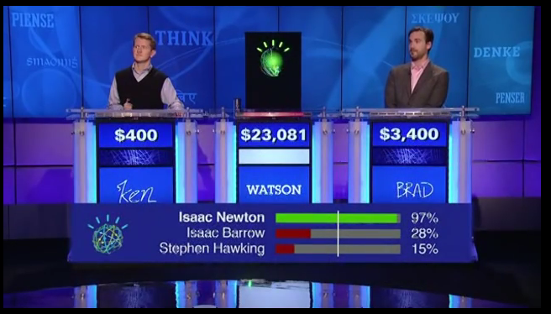
Which “AI” solutions exist now (on the Web)?
Example 3: IBM Watson!
Also uses a knowledge graph...
https://youtu.be/P0Obm0DBvwI?t=951

Slide 14
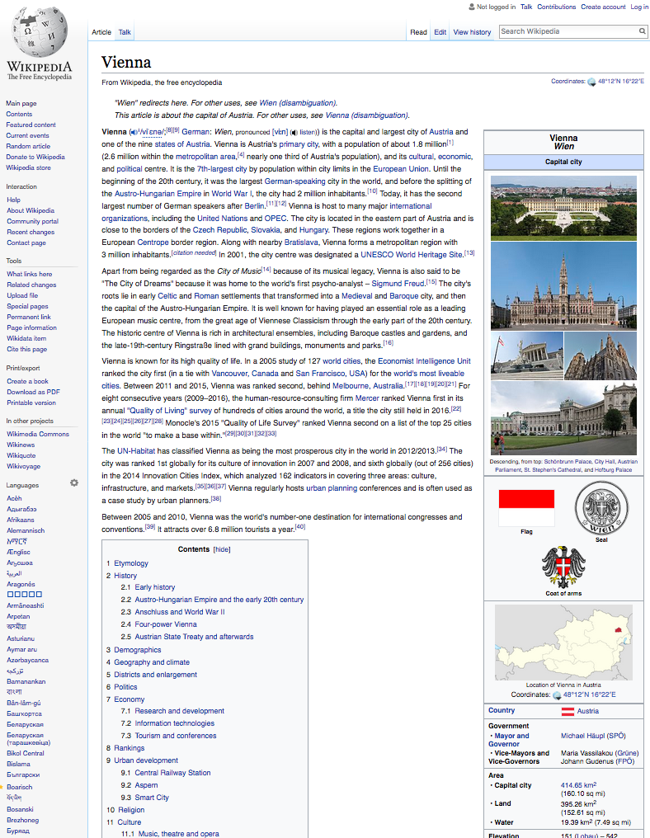
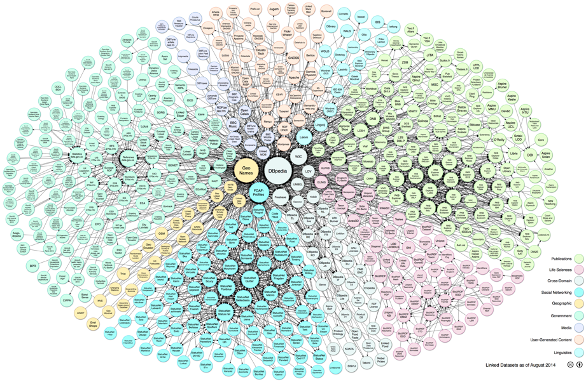
This is the knowledge Graph that IBM Watson used:
Open Data from the Web!
Linking Open Data cloud diagram 2017, by Andrejs Abele, John P. McCrae, Paul Buitelaar, Anja Jentzsch and Richard Cyganiak. http://lod-cloud.net/

Slide 15
Open Data is a global trend (also apart from Linked Data):
Cities, International Organizations, National and European Portals, Int'l. Conferences:
Notes:
15

Slide 16
Ok, now… how can I use it?
Recall my background:
Logic Programming
Artificial Intelligence
Knowledge Representation
Semantic Web
Web Data Integration
Attempt 1: use “first wave AI”

Slide 17
A concrete use case: The "City Data Pipeline"
That's a standard ETL pipeline, isn't it?

Slide 18
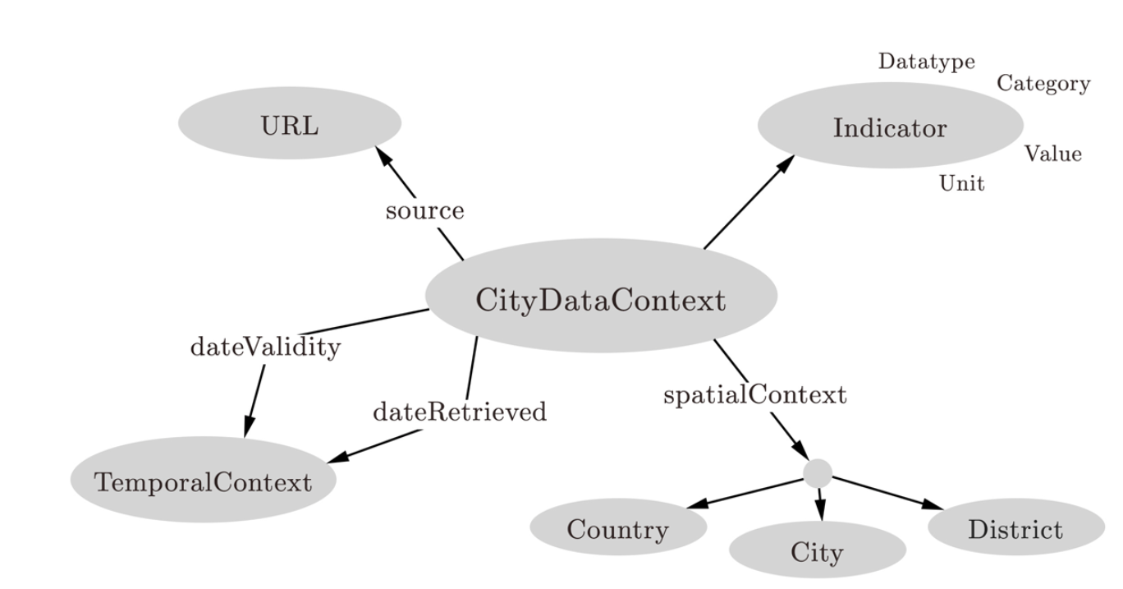
A concrete use case: The "City Data Pipeline"
City Data Model: extensible ALH(D) ontology:
Indicators, e.g. area in km2, tons CO2/capita
Provenance
But we use and flexible Semantic integration using ontologies and reasoning!
Temporal information
Spatial context

Slide 19
A concrete use case: The "City Data Pipeline"
City Data Model: extensible ALH(D) ontology:
dbpedia:areakm
:area
eurostat:area
:area
Indicators, e.g. area in km2, tons CO2/capita
Provenance
Ok, we only need role hierarchies here? Are we done?
Temporal information
Spatial context

Slide 20
A concrete use case: The "City Data Pipeline"
City Data Model: extensible ALH(D) ontology:
dbpedia:areakm2
:area
eurostat:area
:area
Indicators, e.g. area in km2, tons CO2/capita
Provenance
?
:populationDensity = :population/:area
:area = 0,386102 * dbpedia:areaMi2
Temporal information
Spatial context
Hmmm, not quite... Let me come up with a solution...

Slide 21
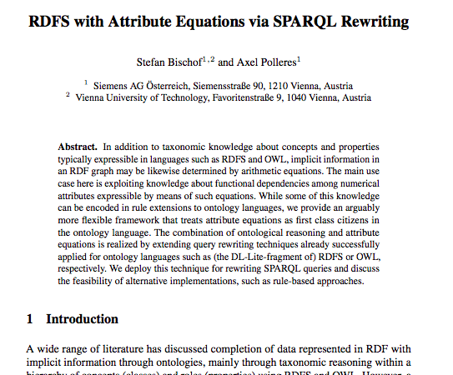
Can equational knowledge co-exist with OWL?
Stefan Bischof, Axel Polleres. ESWC2013

Slide 22
Can equational knowledge co-exist with OWL?
Can equational knowledge co-exist with OWL?
We need a syntax & define a formal semantics
Syntax:
Semantics:
Requirements:
“Fit” with common model-theoretic semantics for OWL and RDFS
Treat equivalent equations equivalently, combine with query rewriting and rule-based reasoning techniques:
:populationDensity = :population/:area
:area = 0,386102 * dbpedia:areaMi2
:populationDensity :defineByEquation “population/:area” .
:area :defineByEquation “areaMi2 * 0,386102 ” .
dbPedia:populationTotal :rdfs:subPropertyOf :population.
:area = 0,386102 * dbpedia:areaMi2
:areaMi2 = 2,589988 * :area

Slide 23
Challenges – Too many Missing values
Indicators
Goal: euqational knowledge is not enough…
Idea: using both first-wave and second wave AI methods
Notes:
Note that so far we have considered the whole thing as an integrated single dataset.
Now lets focus on these white spots specifially
The question is: can we predict the indicators of eurostat for cities that are not in europoe, the green arrow, or the un indicators for cities which are only in eurostat the blue arrow
We again used aproach 2 to fill in the missing values of a single dataset and use that as training set for the indicatosr of the other dataset.

Slide 24
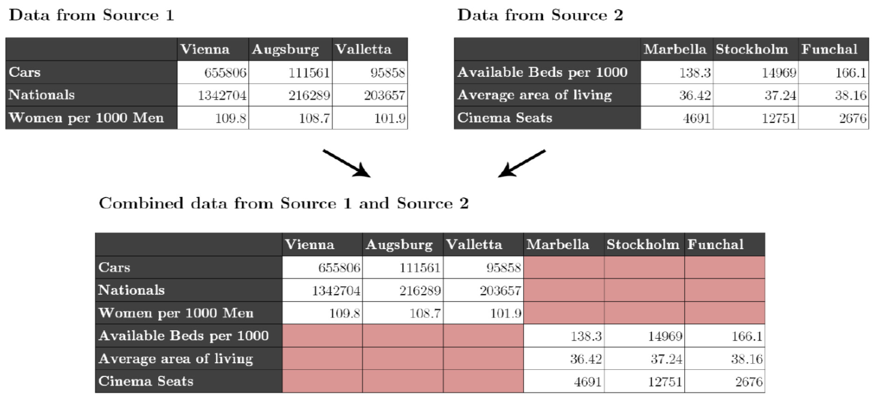
Challenges – Too many Missing values
Individual datasets (e.g. from Eurostat) have missing values
Merging together datasets with different indicators/cities adds sparsity

Slide 25
Missing Values – Hybrid approach choose best prediction method per indicator:
Our assumption: every indicator has its own
distribution and relationship to others.
Basket of „standard“ regression methods:
K-Nearest Neighbour Regression (KNN)
Multiple Linear Regression (MLR)
Random Forest Decision Trees (RFD)

Slide 26
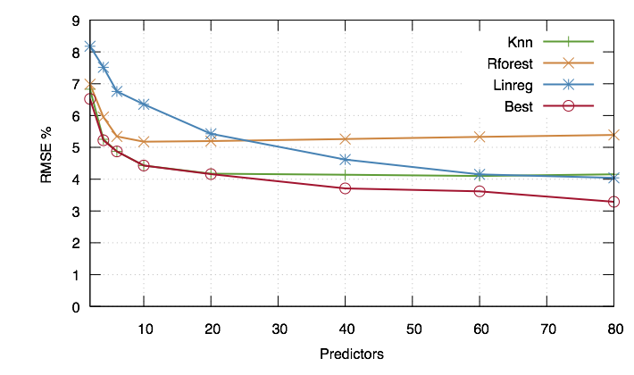
Missing Values – Hybrid approach choose best prediction method per indicator:
Instead of using indicators directly we use Principle Components, built from the indicators
For buidling the PCs, fill in missing data points with neutral values → predict all rows

Slide 27
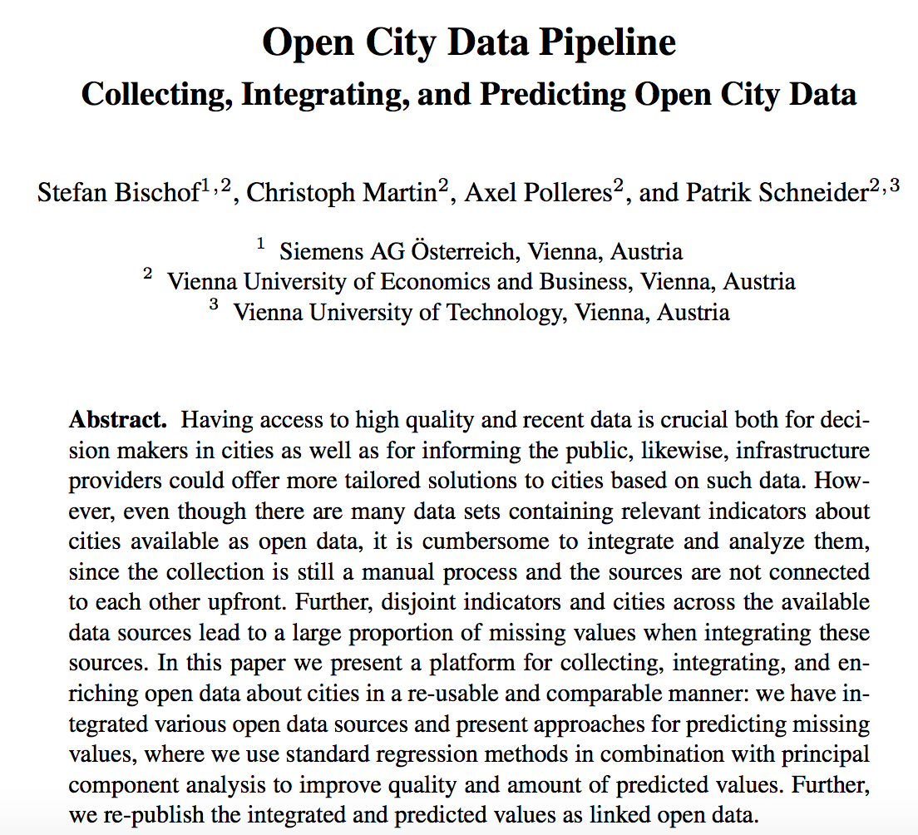
More Details:
Stefan Bischof, Christoph Martin, Axel Polleres, and Patrik Schneider. Open City Data Pipeline: Collecting, Integrating, and Predicting Open City Data. In 4th Workshop on Knowledge Discovery and Data Mining Meets Linked Open Data (Know@LOD), co-located with ESWC2015, Portoroz, Slovenia, May 2015.
Next step:
Combine ML and equations “iteratively” (under submission)
http://epub.wu.ac.at/5438/

Slide 28
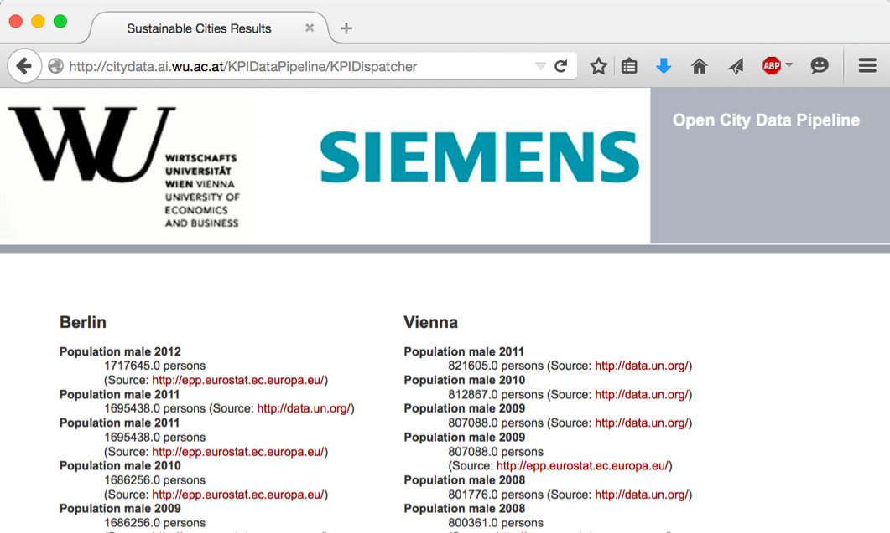
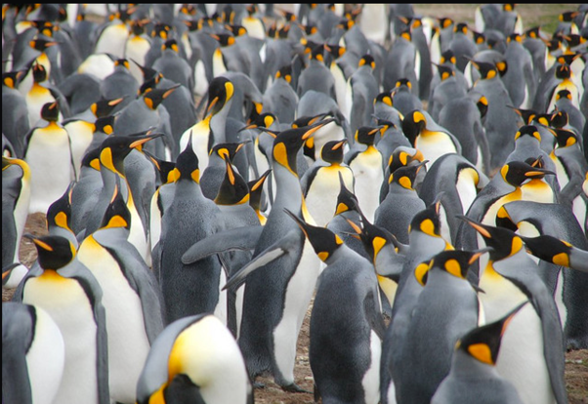
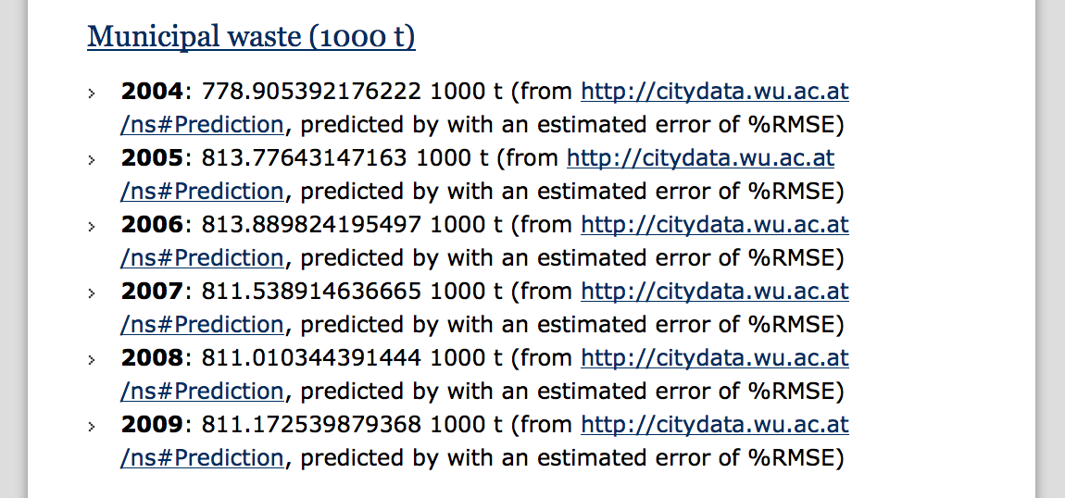
City Data Pipeline
citydata.wu.ac.at
Search for indicators & cities
obtain results incl. sources
Integrated data served as Linked Open Data
Predicted values AND estimated error rates for missing data...
...it‘s not finished, but:
assumption: Predictions get better, the more Open data we integrate...
Open Data: The more, the merrier!

Slide 29
However:
(Strong)Limitations:
We combined 3-4 specific OD sources (there are 100s of Open Data Portals out there)
We manually created an ontology for mapping those sources and set of equations from eurostat?
Open Questions:
How can I build a scalable repository of Open Data?
How can I automate finding relevant data?
How can I automatize building an Open Data Knowledge graph?

Slide 30
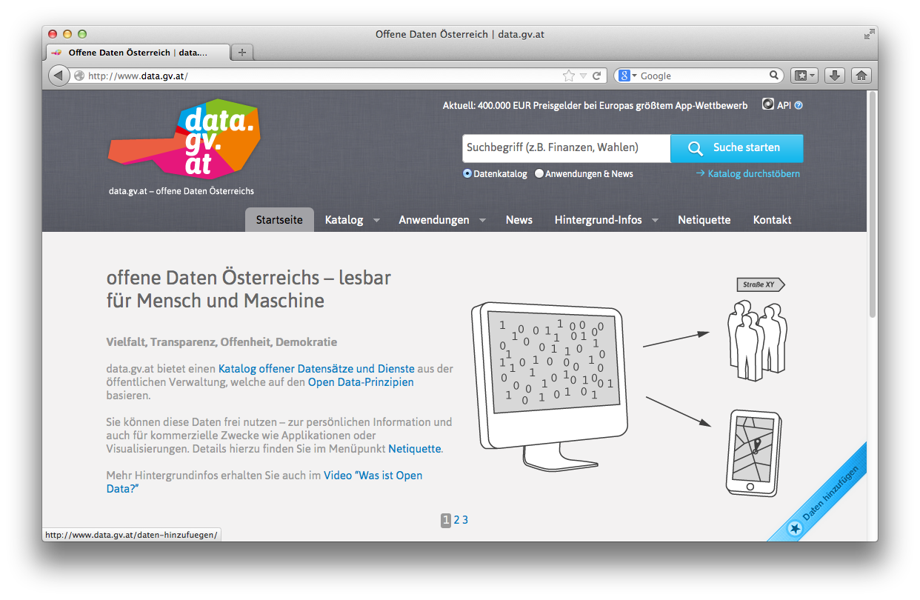
Open Data Portals
CKAN ... http://ckan.org/
almost „de facto“ standard for Open Data Portals
facilitates search, metadata (publisher, format, publication date, license, etc.) for datasets
http://opendataportal.at/
http://data.gv.at/
machine-processable? ...
... partially

Slide 31
Our ongoing research: data.wu.ac.at
What is the status of Open Data and what are the challenges using Open Data?
OpenData PortalWatch – a project at WU
Improving Open Data Quality and Access: ADEQUATE (FFG)
What's next?
Making Open Data Searchable
Building an Open Data Knowledge Graph!
A striving Data Economy needs no silos… re-democratise the Web by Congitive Intelligence based on Open Data?

Slide 32
Ongoing Projects (data.wu.ac.at)

Slide 33
OPEN DATA PORTAL WATCH
http://data.wu.ac.at/portalwatch/
Periodically monitoring a list of Open Data Portals
260 CKAN powered Open Data Portals worldwide
Quality assessment
Evolution tracking
Meta data
Data
Formats, growth

Slide 34
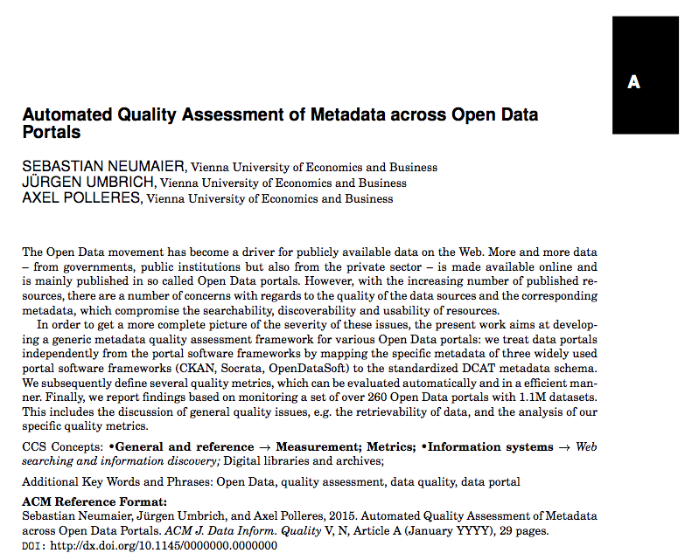
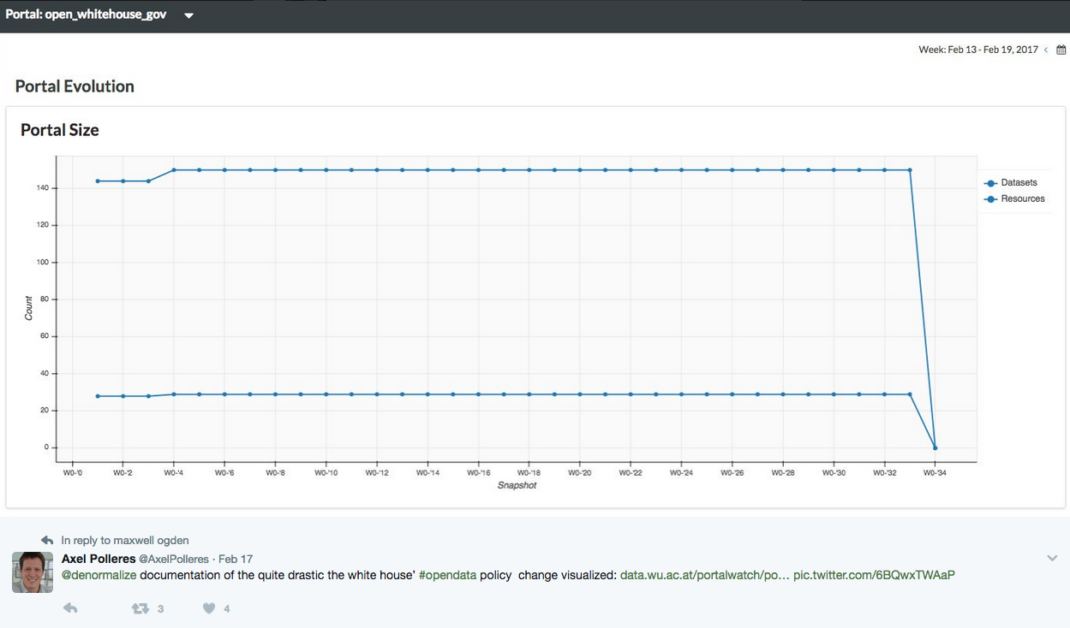
Portalwatch Example:
http://data.wu.ac.at/portalwatch/portal/data_gv_at/1724

Slide 35
Our research: data.wu.ac.at
What is the status of Open Data and what are the challenges using Open Data?
OpenData PortalWatch – a project at WU
Improving Open Data Quality and Access: ADEQUATE (FFG)
What's next?
Making Open Data Searchable
Building an Open Data Knowledge Graph!
A striving Data Economy needs no silos… re-democratise the Web by Congitive Intelligence based on Open Data?

Slide 36
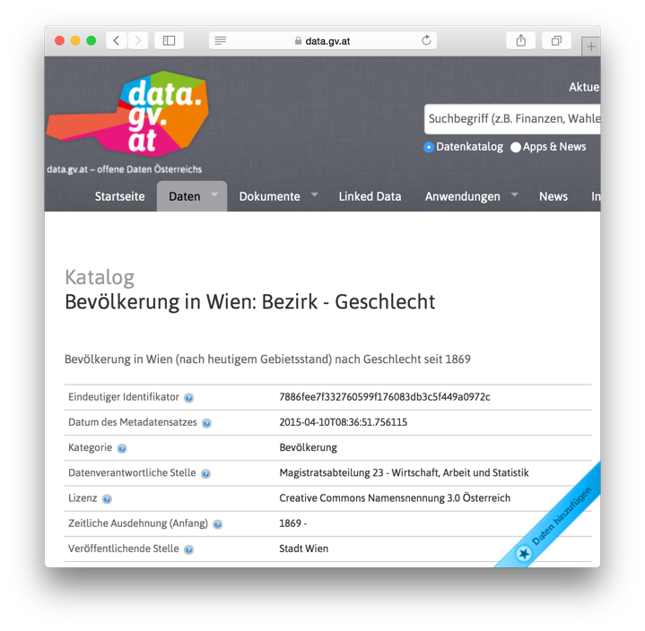
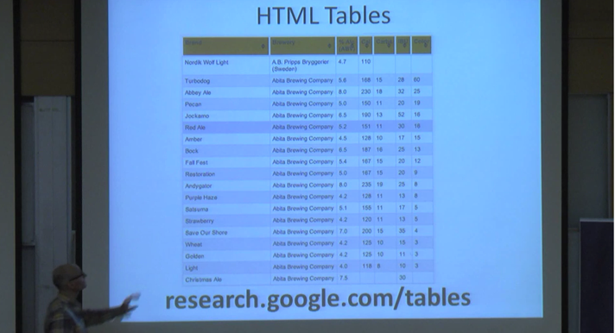
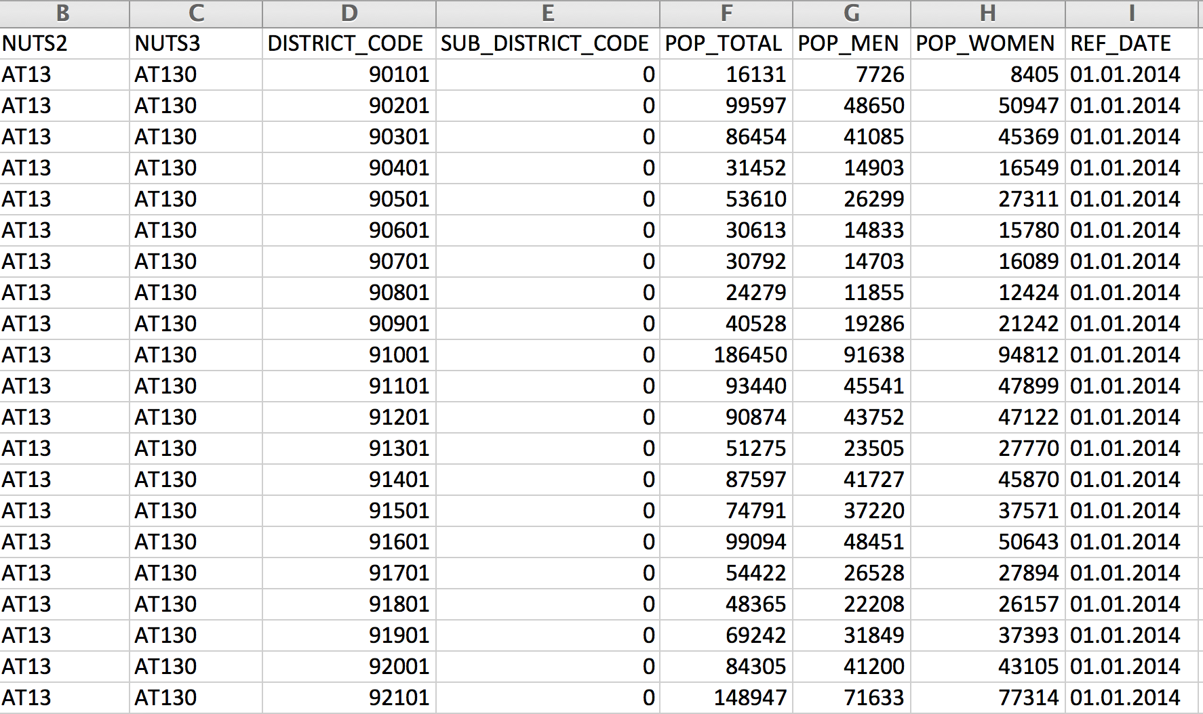
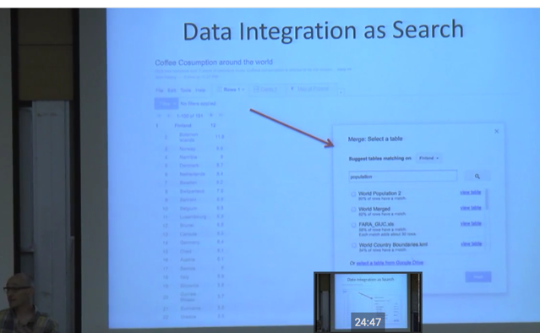
Why is Search in Open Data a problem?
https://www.youtube.com/watch?v=kCAymmbYIvc
Structured Data in Web Search by Alon Halevy
vs.
Open Data Search is hard...
No natural language „cues“ like in Web tables...
Existing knowledge graphs don‘t cover the domain of "Open Data“
Open Data is not properly geo-referenced

Slide 37
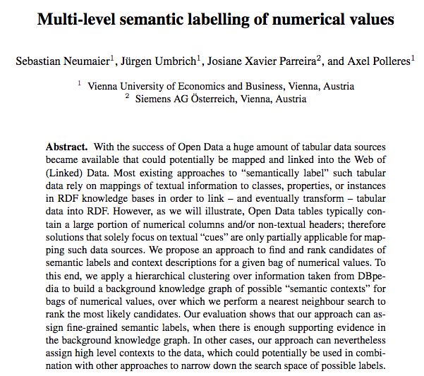
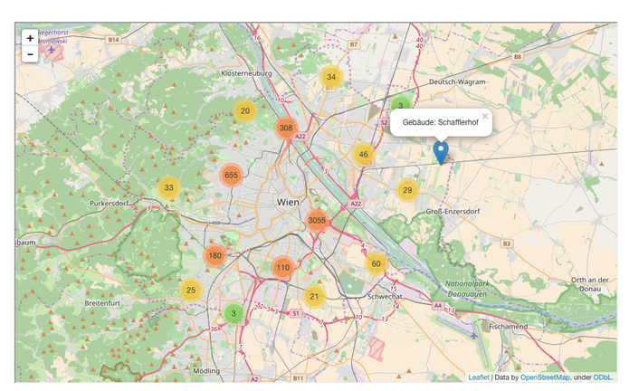
Some starting points:
First baby steps on building an Open Data Knowledge Graph:
Ongoing work to make
Open Data geo-searchable e.g. in our project communidata.at:
International Semantic Web conference 2016:

Slide 38
Towards linking Open Data to a Knowledge Graph
Attempt to link numeric Open data to the dbpedia knowledge graph…
International Semantic Web conference 2016:

Slide 39
Example
dpo:Stadium
dpo:City
dpo:Country
dbp:capacity
stadium name | capacity | city | country
Emirates Stadium | 60361 | London | England
Villa Park | 42785 | Birmingham | England
Ewood Park | 31154 | Blackburn | England
… | … | … | …
Notes:
Of course we are not the first ones who work with tabular data

Slide 40
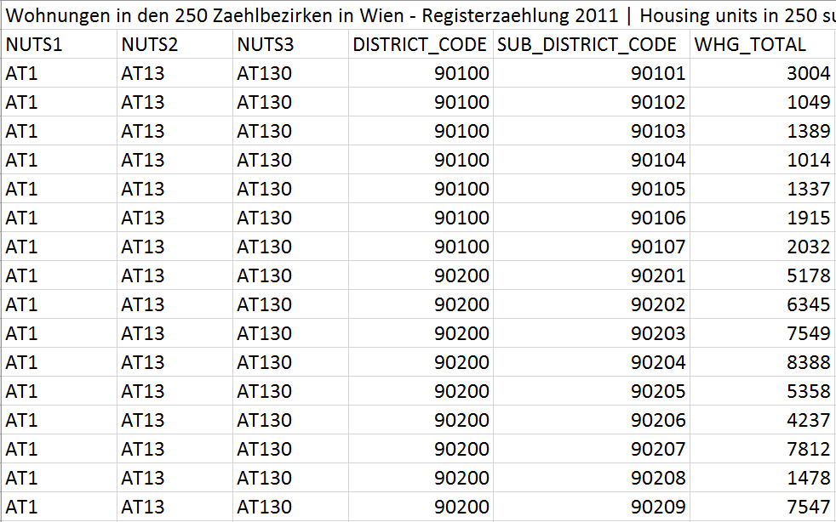
But:
Web/HTML tables differ from typical Open Data tables:
Domain: e.g., public administration data, statistical data, weather data, elections, …
Structure: OD tables contain large amount of numerical columns

Slide 41
Example (Cont’d)
stadium | capacity | city | country
Emirates Stadium | 60361 | London | England
Villa Park | 42785 | Birmingham | England
Ewood Park | 31154 | Blackburn | England
… | … | … | …
Notes:
Realistic open data csv would look more like this
Which makes the previous showed job much more harder

Slide 42
Example (Cont’d)
 | TOTAL | DISTRICT_CODE | ISO_2
Emirates Stadium | 60361 | SW1A 0AA | GB
Villa Park | 42785 | B23 7QG | GB
Ewood Park | 31154 | B26 6QA | GB
… | … | … | …
Notes:
Realistic open data csv would look more like this
Which makes the previous showed job much more harder

Slide 43
Why not use numeric values?
Identifying the most likely semantic label for a bag of numerical values
Deliberately ignore surroundings
 | TOTAL | DISTRICT_CODE | ISO_2
Emirates Stadium | 60361 | SW1A 0AA | GB
Villa Park | 42785 | B23 7QG | GB
Ewood Park | 31154 | B26 6QA | GB
… | … | … | …

Slide 44
Why not use numeric values?
Identifying the most likely semantic label for a bag of numerical values
Deliberately ignore surroundings
Emirates Stadium | 60361 | SW1A 0AA | GB
Villa Park | 42785 | B23 7QG | GB
Ewood Park | 31154 | B26 6QA | GB
… | … | … | …

Slide 45
Why not use numeric values?
Identifying the most likely semantic label for a bag of numerical values
Deliberately ignore surroundings
60361
42785
31154
…

Slide 46
Why not use numeric values?
Identifying the most likely semantic label for a bag of numerical values
Deliberately ignore surroundings
capacity <a stadium> <country England>
 | 60361
 | 42785
 | 31154
 | …

Slide 47
Our Approach
Hierarchical clustering over an RDF knowledge base
to build background knowledge graph (BKG)
nodes consist of typical numerical values, annotated with context information, i.e.: grouped by properties and their shared domain (subject) pairs
k-nearest neighbors search
Aggregation of the results at different levels to find the most likely context:
property
type
context

Slide 48
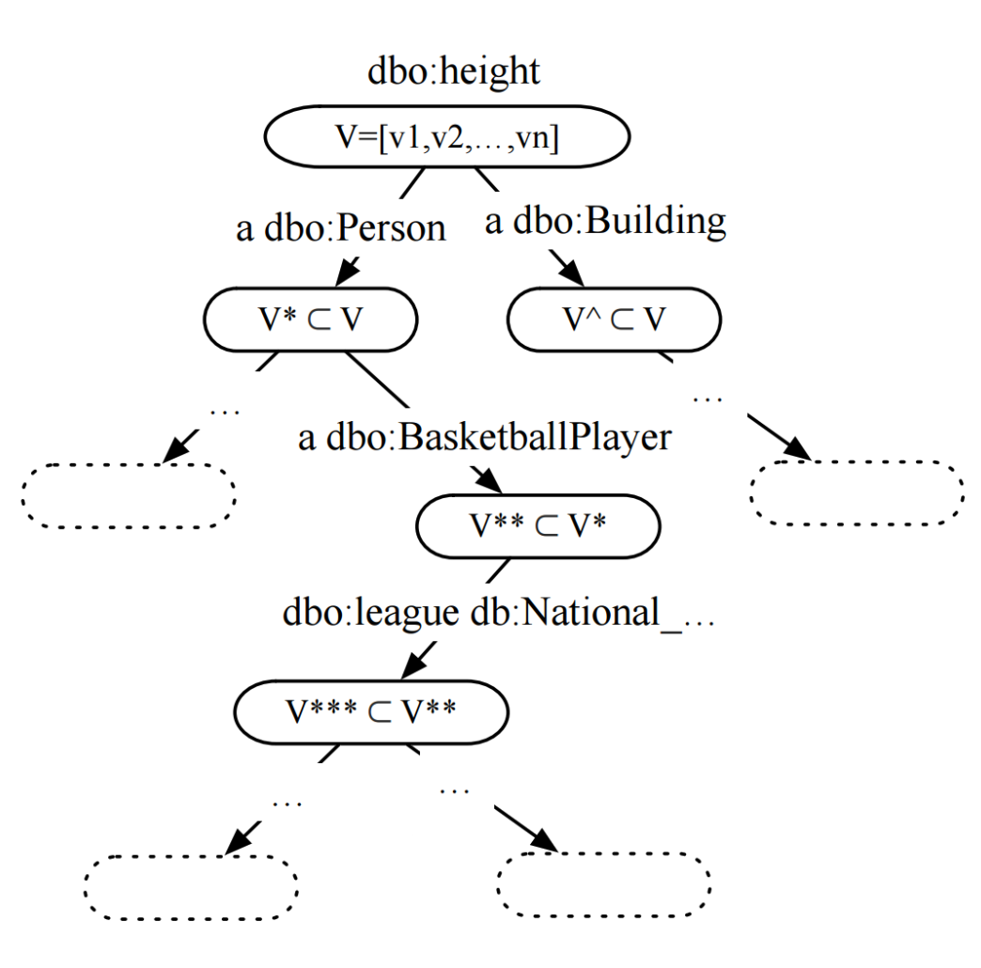
1. Background Knowledge Graph
Find properties with numerical range
Hierarchical clustering approach
Two hierarchical layers:
Type hierarchy (using OWL classes)
Property-object hierarchy (shared property-object pairs)

Slide 49
2. k-Nearest neighbor search
Mapping bags of numerical value to vector space (feature vector)

Slide 50
Our research: data.wu.ac.at
What is the status of Open Data and what are the challenges using Open Data?
OpenData PortalWatch – a project at WU
Improving Open Data Quality and Access: ADEQUATE (FFG)
What's next?
Making Open Data Searchable
Building an Open Data Knowledge Graph!
A striving Data Economy needs no silos… re-democratise the Web by Congitive Intelligence based on Open Data?

Slide 51
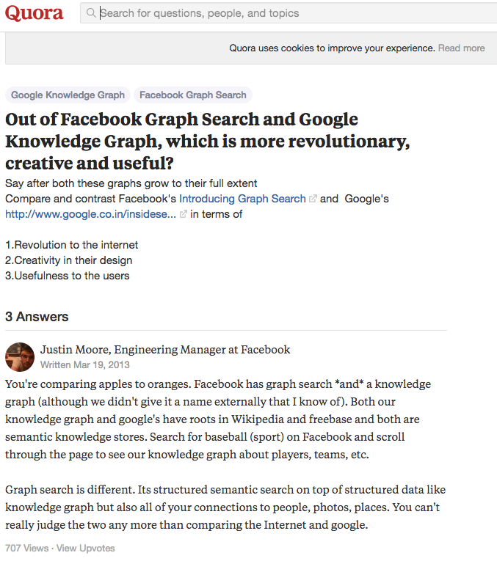
This is the knowledge Graph that IBM Watson used:
“Both our knowldege graph and google’s habe roots in Wikipedia and freebase” – but none of Google and FB make their knowledge graphs freely and openly available again as Open Data!
Open Data from the Web!
Linking Open Data cloud diagram 2017, by Andrejs Abele, John P. McCrae, Paul Buitelaar, Anja Jentzsch and Richard Cyganiak. http://lod-cloud.net/

Slide 52
This is a fundamental threat to the Web itself:
https://www.theguardian.com/technology/2017/mar/11/tim-berners-lee-web-inventor-save-internet
1) We’ve lost control of our personal data
2) It’s too easy for misinformation to spread on the web
3) Political advertising online needs transparency and understanding
Open-Data-Fueled Complexity Science to the rescue?

Slide 53
Still Open Questions (with some starting points presented…)
How can I build a scalable repository of Open Data?
How can I automate finding relevant data?
How can I automatize building an Open Data Knowledge graph?
What is the right form of Knowledge Representation for Knowledge graphs?
OWL, Rules, Equations, Property-domain pairs?)
How to represent models in an exchangeable manner?
Eventually: How can I enable fact checking, verify information on the Web, understand cities,… by Open Data?

Slide 54
Thanks! Things I did NOT have time to talk about:
Open Data and licences → DALICC
Open Data Archiving → Javier
Open Data adoption barriers → see our recent paper to be presented at CEDEM2017
Privacy and data on the Web → http://privacylab.at
→ http://specialprivacy.eu/
Something completely different (but maybe related to Ruggiero’s work?) Resource allocation in BPM → https://ai.wu.ac.at/shape-project/
Organizing Semantic Web conferences: https://iswc2017.semanticweb.org/
https://www.wu.ac.at/en/infobiz/

