Slide 1
SPECIAL (a Scalable Policy-awarE linked data arChitecture for prIvacy, trAnsparency and compLiance)
Project Launch:
Axel Polleres, Vienna University of Economics and Business (WU Wien)
MyData 2017, Tallinn/Helsinki
30/08/2017

Slide 2
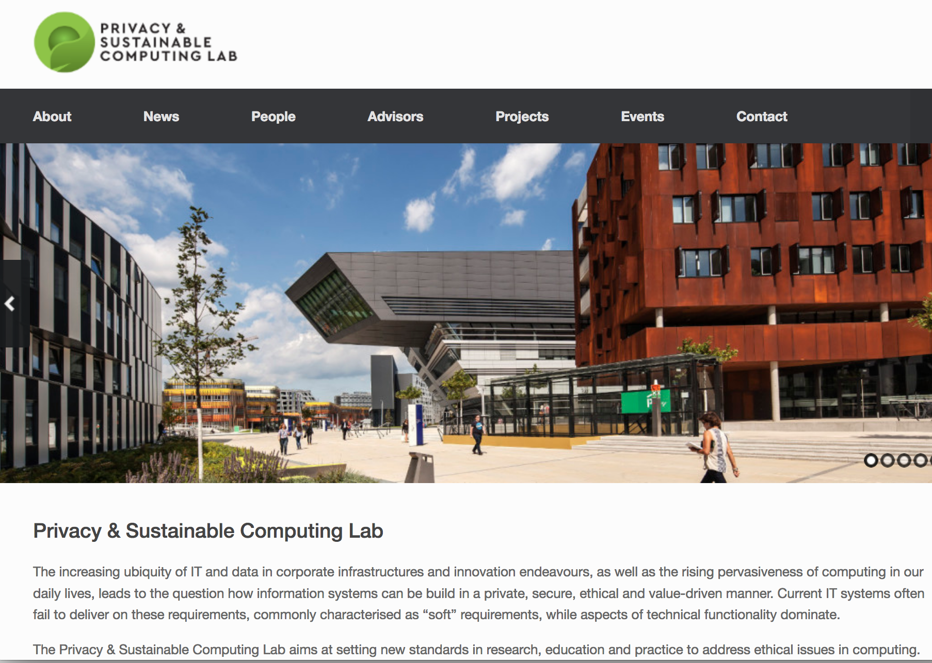

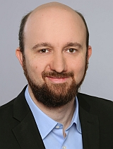
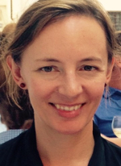

Where I am coming from, collaborators…
Privacy & Sustainable Computing Lab
http://www.privacylab.at/
Launched September 2016, launch event with various important stakeholders: technologists, standardization, activists…
Goal: setting new standards in research, education and practice to address ethical issues in computing.
Dr. Sabrina Kirrane
(Lab co-Director)
Dr. Benjamin Wagner
(Lab co-Director)
Prof. Sarah Spiekermann (co-founder)
Prof. Axel
Polleres
(co-founder)

Slide 3
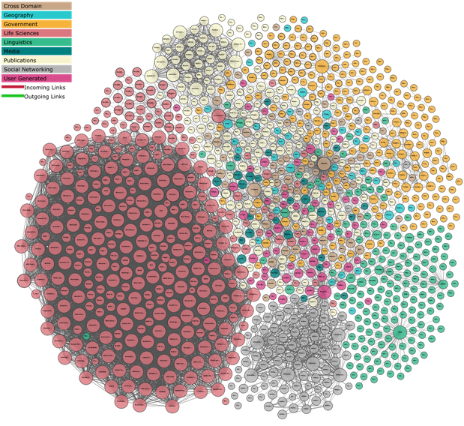
Where I am coming from, collaborators…
Privacy & Sustainable Computing Lab
http://www.privacylab.at/
Launched September 2016, launch event with various important stakeholders: technologists, standardization, activists…
Goal: setting new standards in research, education and practice to address ethical issues in computing.
What can we bring in here:
  Web Standards
  Linked Data
  Ontologies
  Scalable Data Processing and Querying
Dr. Sabrina Kirrane
(Lab Director)
Prof. Sarah Spiekermann (co-founder)
Prof. Axel
Polleres
(co-founder)

Slide 4











Privacy in the EU: all about the upcoming GDPR,
How can we support it technically?…
Trilogue starts
6/24/2015
Draft of the regulation
EU Council finalises the chapters
Comes into force
7/22/2012
8/6/2015
5/15/2018
Revisions in the draft
Discussions in the EU Council
Trilogue agrees
3/12/2013
5/19/2014
12/17/2015
2013
2014
2015
2016
2017
2018
2017-2019
(3 years)

Slide 5
The SPECIAL project: Objectives
Policy management framework
  Give users control of their personal data
  Represent access/usage policies and legislative requirements in a machine readable format
Transparency and compliance framework
    Provide information on how data is processed and with whom it is shared in a common format (RDF) via standard interfaces
    Allows data subjects as well as regulators to check compliance (via automated reasoning)
Scalable policy-aware Linked Data architecture
    Build on top of the Big Data Europe (BDE) platform scalability and elasticity mechanisms
    Extended BDE with robust policy, transparency and compliance protocols

Slide 6

SPECIAL Technical Components:
Big Data Europe scalability and elasticity
PrimeLife policy languages, access control policies, release policies and data handling policies

Slide 7

SPECIAL Use Cases:
An example scenario:
Sue
uses activity tracking and consents to Ads
BeFit
(ActivityTracking & Advertisement)

Slide 8
SPECIAL Use Cases:
An example scenario:
Policy layer allows Sue to revoke her consent
Transparency ledger reveals that the ad was sent according to Sue’s consent
Scalable due to a distributed architecture based on encrypted, compressed Linked Data
All her data gets automatically deleted from the Gym’s and the BeFit’s database
Sue’s
activity tracker is malfunctioning
BeFit
sends unwanted ad
by a local Gym to Sue

Slide 9

SPECIAL Results so far:
6 months into the project:
Recent Publications:
    Self-Enforcing Access Control for Encrypted Linked Data. Javier D. Fernández, Sabrina Kirrane, Axel Polleres, and Simon Steyskal. Extended Semantic Web Conference (ESWC 2017). May 2017
    Transparent Personal Data Processing: The Road Ahead. Piero Bonatti, Sabrina Kirrane, Axel Polleres, and Rigo Wenning. TELERISE: 3rd International Workshop on TEchnical and LEgal aspects of data pRIvacy and Security. Sep 2017
Next deliverables forthcoming:
  D1.3 Policy, transparency and compliance guidelines: Requirements for an Ontology and Policy Language for formalizing and reasoning about Policies and Consent
  D1.4 Technical requirements: First architecture blueprint, based on the BigData-Europe architecture (https://www.big-data-europe.eu/)
Community building, common Standards and Best Practices: Planned W3C workshop and Community group on Linked data Vocabularies for Transparency and Privacy controls (planned for early of 2018) – Please join us!
We need your help!

Slide 10
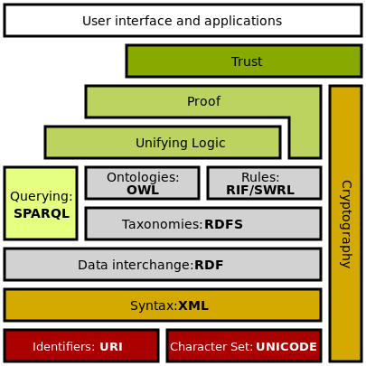
SPECIAL Results so far:
    Self-Enforcing Access Control for Encrypted Linked Data. Javier D. Fernández, Sabrina Kirrane, Axel Polleres, and Simon Steyskal. Extended Semantic Web Conference (ESWC 2017). May 2017
Security and encrytion still missing in the Linked Data standards
Storing consent, transparency records in RDF requires technology to harness RDF with:
Queryable encryption
Acces control
Compression (build on top of HDT)

Slide 11
SPECIAL Results so far:
6 months into the project:
Recent Publications:
    Self-Enforcing Access Control for Encrypted Linked Data. Javier D. Fernández, Sabrina Kirrane, Axel Polleres, and Simon Steyskal. Extended Semantic Web Conference (ESWC 2017). May 2017
    Transparent Personal Data Processing: The Road Ahead. Piero Bonatti, Sabrina Kirrane, Axel Polleres, and Rigo Wenning. TELERISE: 3rd International Workshop on TEchnical and LEgal aspects of data pRIvacy and Security. Sep 2017
Next deliverables forthcoming:
  D1.3 Policy, transparency and compliance guidelines: Requirements for an Ontology and Policy Language for formalizing and reasoning about Policies and Consent
  D1.4 Technical requirements: First architecture blueprint, based on the BigData-Europe architecture (https://www.big-data-europe.eu/)
Community building, common Standards and Best Practices: Planned W3C workshop and Community group on Linked data Vocabularies for Transparency and Privacy controls (planned for early of 2018) – Please join us!
We need your help!

Slide 12
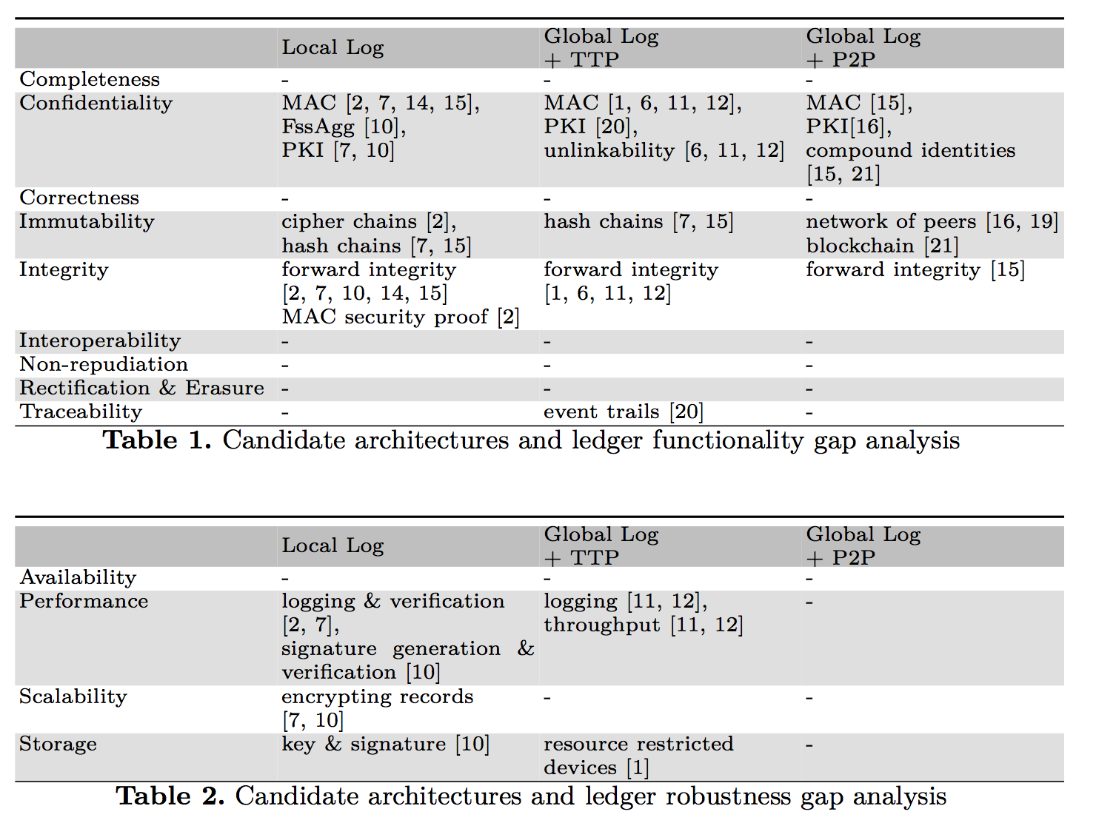
SPECIAL Results so far:
    Transparent Personal Data Processing: The Road Ahead. Piero Bonatti, Sabrina Kirrane, Axel Polleres, and Rigo Wenning. TELERISE: 3rd International Workshop on TEchnical and LEgal aspects of data pRIvacy and Security. Sep 2017
Bottomline:
Blockchain is ONE possible implementation of an immutable transparency layer, but not the only option!

Slide 13
SPECIAL Results so far:
6 months into the project:
Recent Publications:
    Self-Enforcing Access Control for Encrypted Linked Data. Javier D. Fernández, Sabrina Kirrane, Axel Polleres, and Simon Steyskal. Extended Semantic Web Conference (ESWC 2017). May 2017
    Transparent Personal Data Processing: The Road Ahead. Piero Bonatti, Sabrina Kirrane, Axel Polleres, and Rigo Wenning. TELERISE: 3rd International Workshop on TEchnical and LEgal aspects of data pRIvacy and Security. Sep 2017
Next deliverables forthcoming:
  D1.3 Policy, transparency and compliance guidelines: Requirements for an Ontology and Policy Language for formalizing and reasoning about Policies and Consent
  D1.4 Technical requirements: First architecture blueprint, based on the BigData-Europe architecture (https://www.big-data-europe.eu/)
Community building, common Standards and Best Practices: Planned W3C workshop and Community group on Linked data Vocabularies for Transparency and Privacy controls (planned for early of 2018) – Please join us!
We need your help!

Slide 14
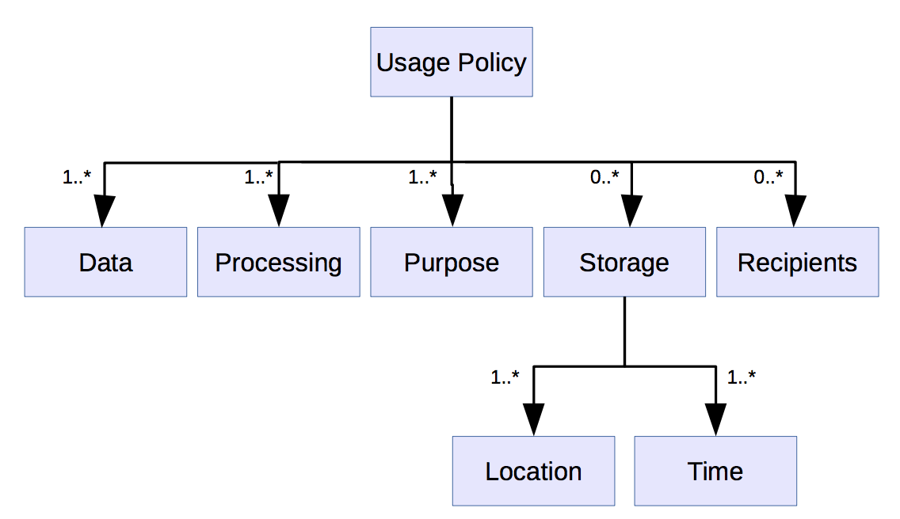
SPECIAL Results so far:
Next deliverables forthcoming:
  D1.3 Policy, transparency and compliance guidelines: Requirements for an Ontology and Policy Language for formalizing and reasoning about Policies and Consent
  D1.4 Technical requirements: First architecture blueprint, based on the BigData-Europe architecture (https://www.big-data-europe.eu/)
Community building, common Standards and Best Practices: Planned W3C workshop and Community group on Linked data Vocabularies for Transparency and Privacy controls (planned for early of 2018) – Please join us!
e.g.
W3C ODRL/POE (2017)
W3C PROV (2013)
We need your help!

Slide 15

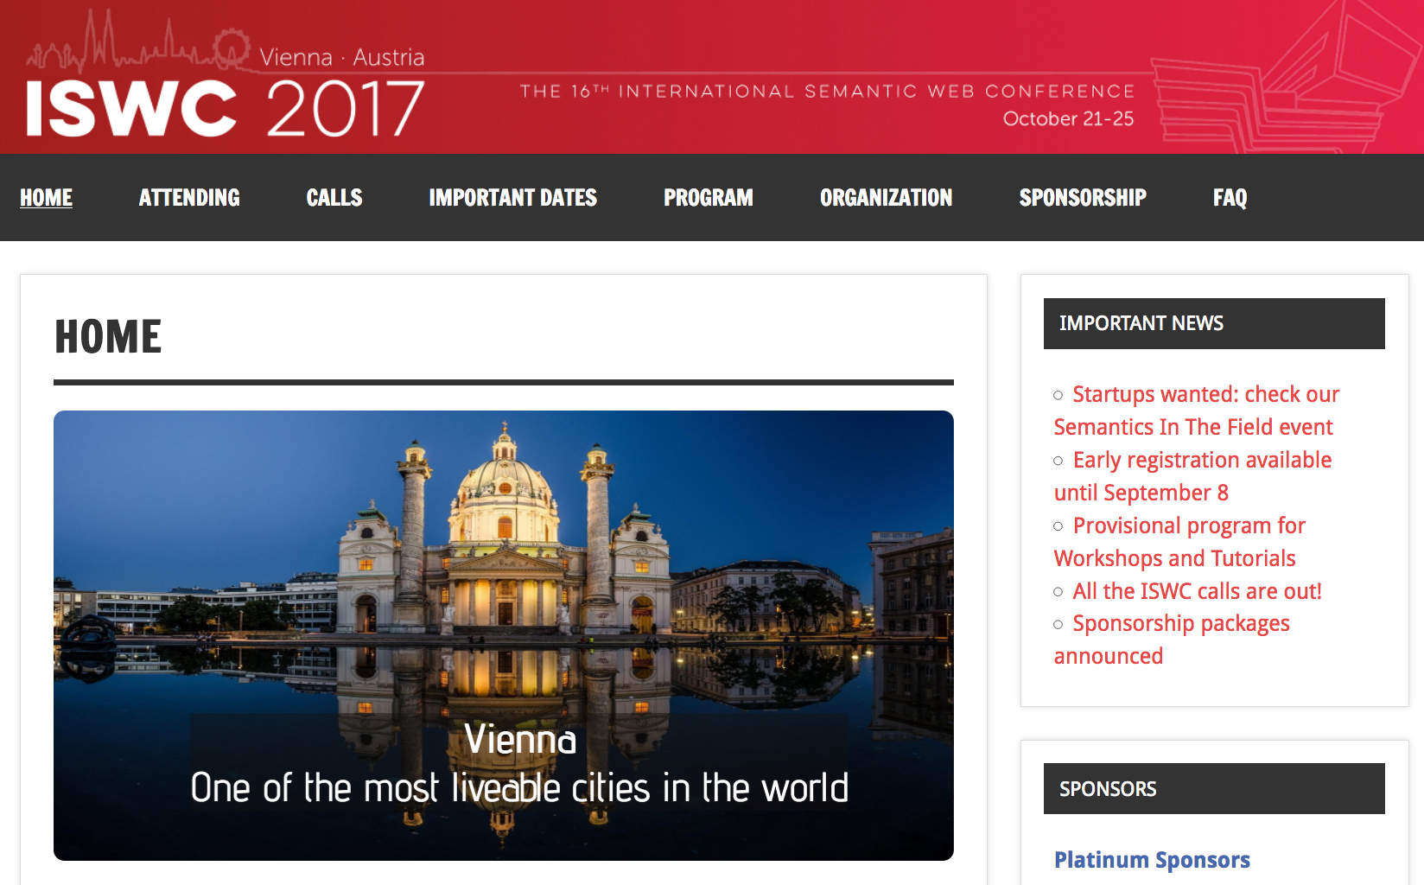
Last, but not least:
Looking fwd to interesting 3 days here in Tallinn/Helsinki…
…and hope to see many of you in Vienna (21-25 October) for
http://iswc2017.semanticweb.org/
Privacy/Data Protection Community
(Semantic) Web/ Linked Data Community
Web: https://www.specialprivacy.eu/
Twitter: @specialprivacy

