Slide 1
Data Integration for (Linked?) Open Data on the Web
Axel Polleres twitter: @AxelPolleres web: polleres.net
web: http://polleres.net twitter: @AxelPolleres

Slide 2
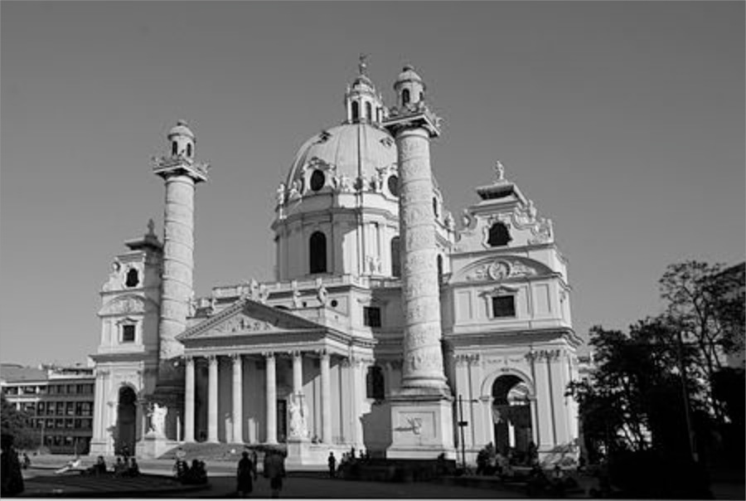
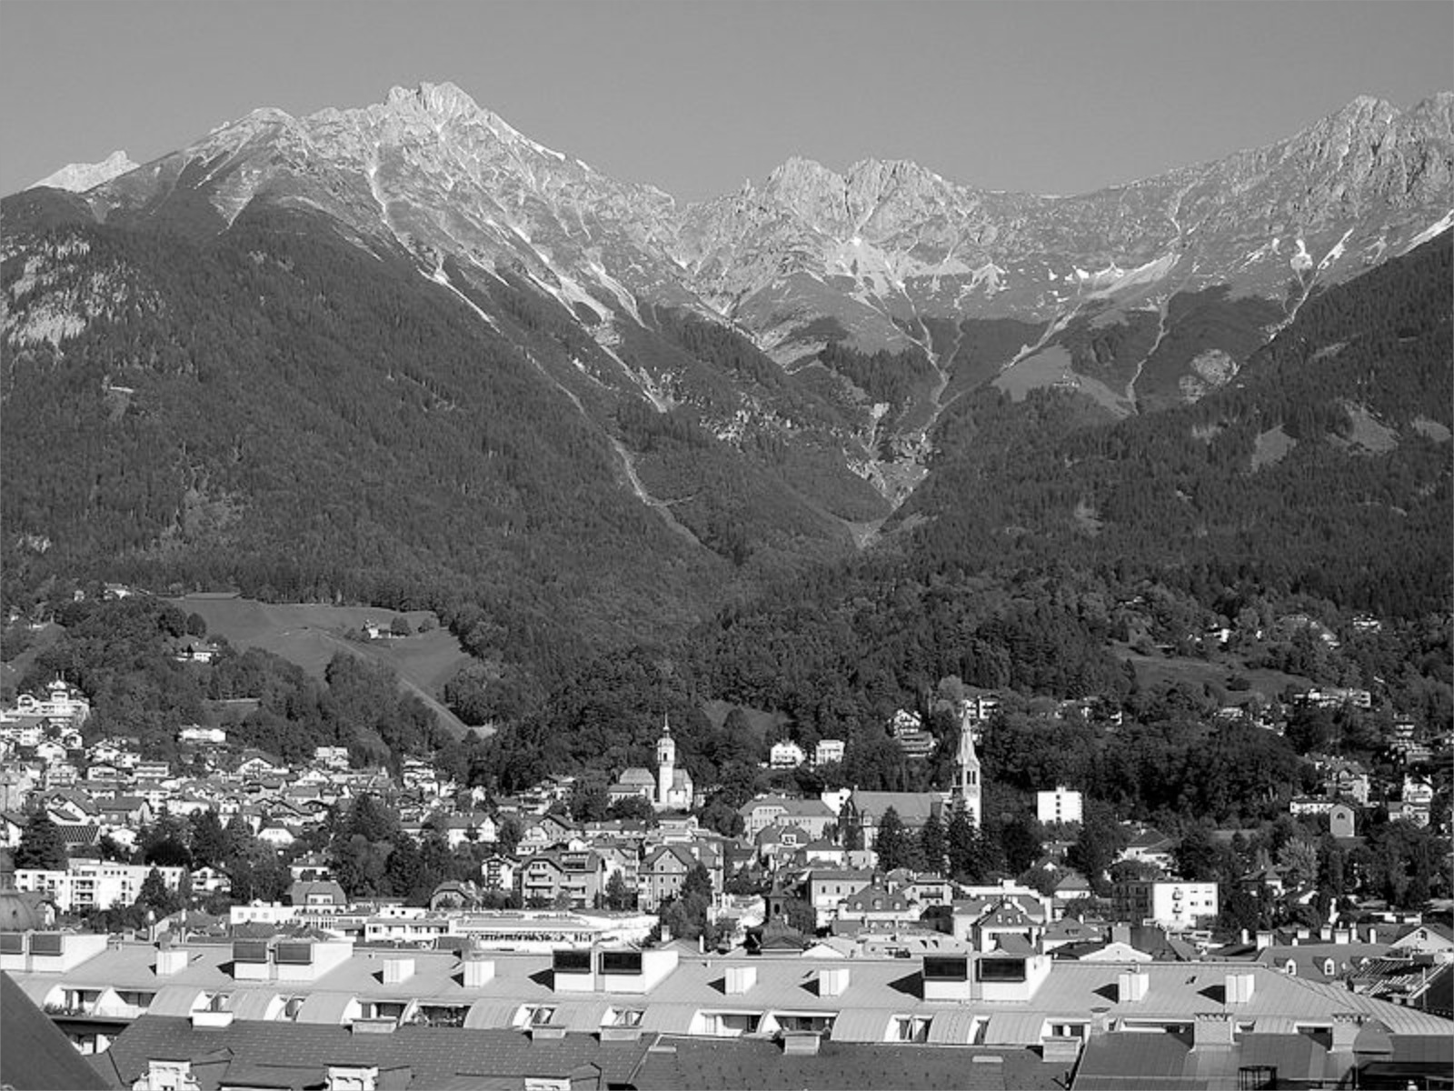
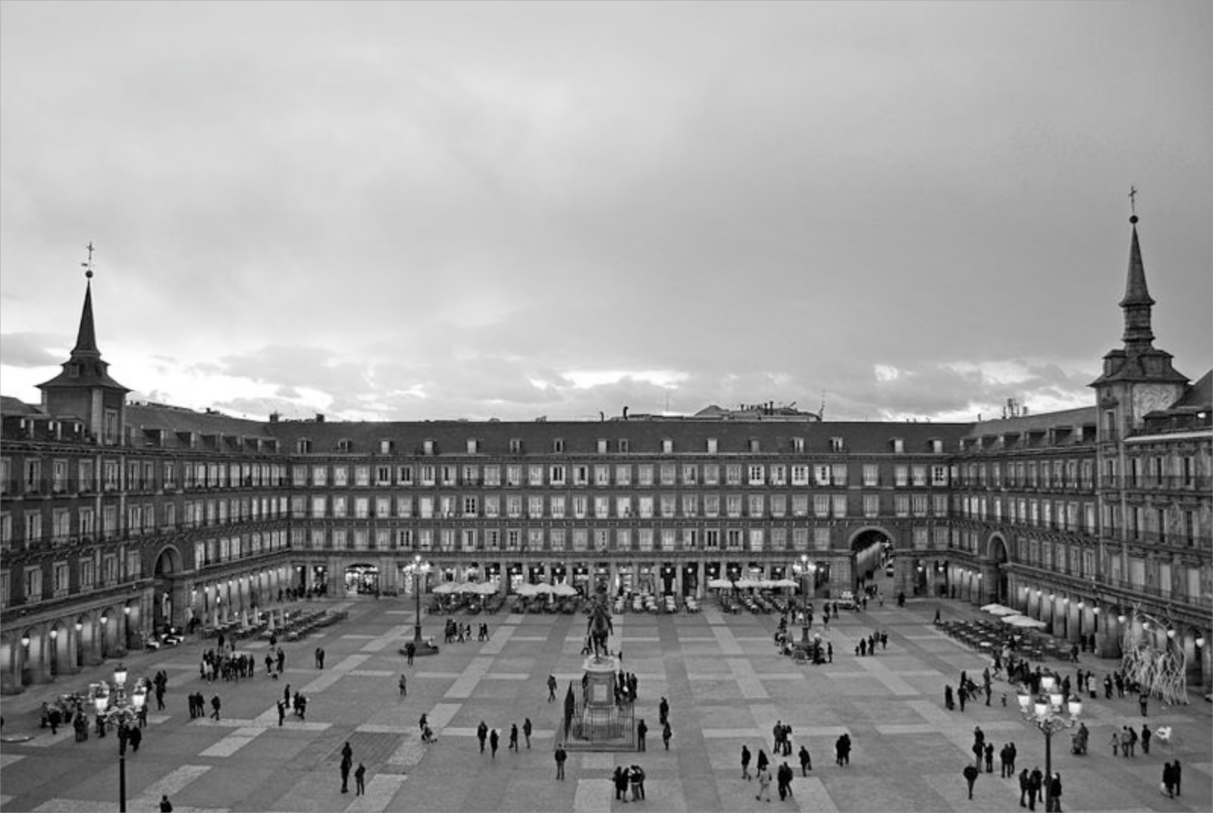
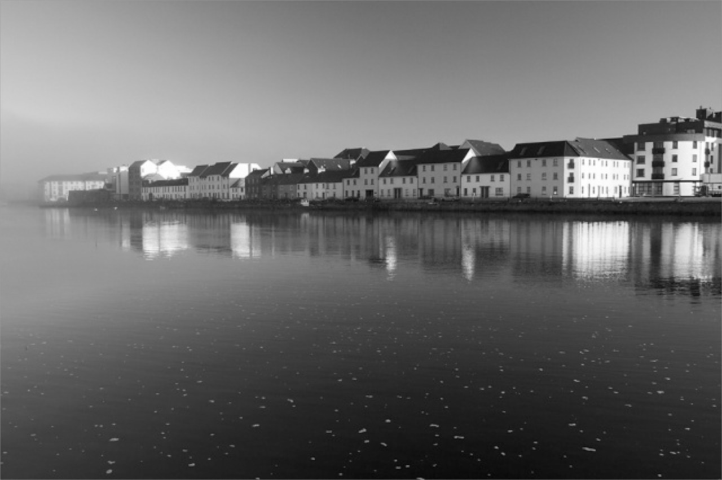
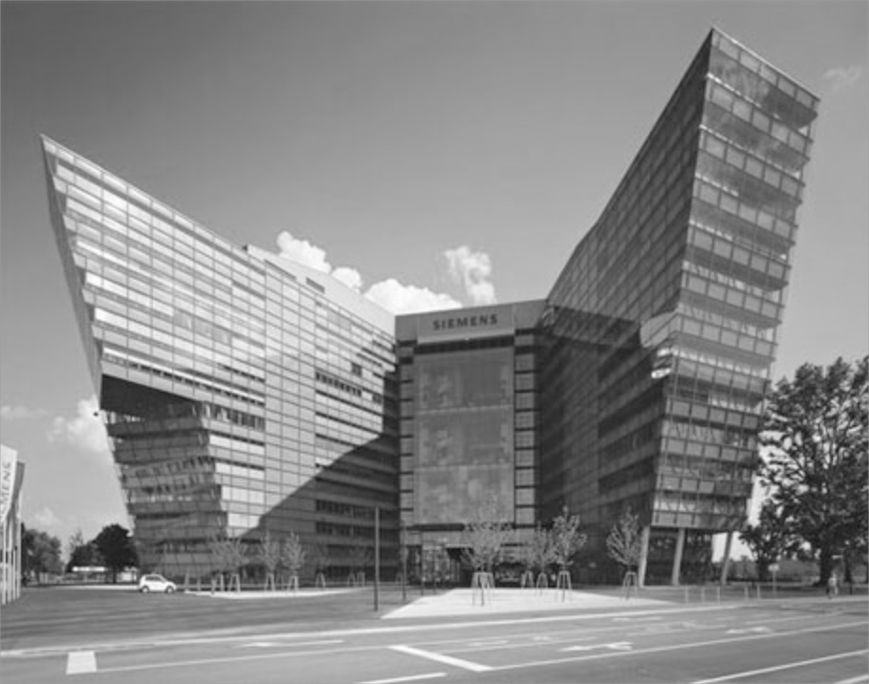
My background
Logic Programming, Artificial Intelligence
Semantic Web, Knowledge Representation & Reasoning
Web Standard, Query Language, Linked Data
Data Integration, Open Data
Let’s start here
2003
2005
2007
2011
2013
TU Vienna
Univ. Innsbruck
Univ. Rey Juan Carlos Madrid
DERI, NUI Galway, Ireland
Siemens AG Österreich
WU Vienna
Disclaimer: this talk is meant as a “teaser” …
(technical details in my class in spring term: BIOMEDIN 274)

Slide 3
A motivating use case: Geoffrey West (former director of the Santa Fe Institute) 2011
Conjecture: the functioning of cities can be explained by data
Exponential increase of Urbanization
Sustainability
Lifecycle of cities
Urgent need for a scientific, quantifiable [i.e., data-driven] theory of cities, a predictive framework
https://www.ted.com/talks/geoffrey_west_the_surprising_math_of_cities_and_corporations/
Notes:
Danke für Die Einladung!
Lassen Sie mich beginnen mit der Ankündigung zum heutigen event…. Hier stechen einige Begriffe ins Auge:
Es geht um “Cognitive Computing” ... Was ist das überhaupt?
Es hat offensichtlich etwas mit künstlicher Intelligenz zu tun... Was ist das überhaupt? Wie wir feststellen ist Artificial Intelligence im Rahmen der “:Digitalen Transformation“ selbst im Wandel und hat in den letzen Jahren einige Veränderungen durchlebt...
Eine Frage die gestellt wird ist die welche Lösungen bereits im Einsatz sind worauf ich versuchen werde zumindest aus meiner Forschungsperspektive – der Erforschung von Daten am und aus dem Web – ein paar Antworten zu geben...
Last, but not least, ist eine Frage in der Ankündigung, mit welchen Themen wir uns befassen sollten, und ich werde versuchen, Sie bis zum Ende dieses Vortrages davon zu überzeugen, dass Open Data, also offene Daten ein solches Thema sind!

Slide 4
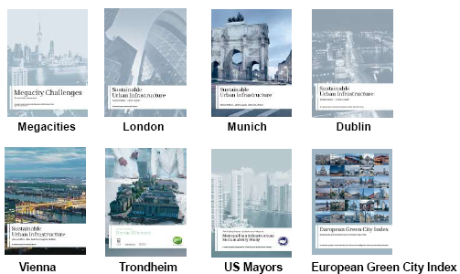
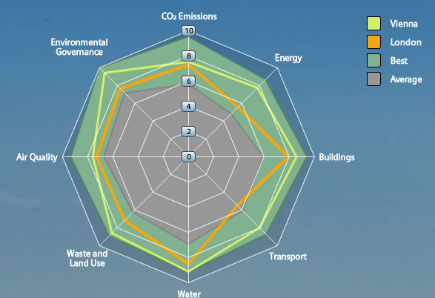
Back at around that time… City Data – Important for Infrastructure Providers & for City Decision Makers
City Assessment and Sustainability reports
Tailored offerings by Infrastructure Providers
… however, these are often outdated before even published!
Goal (short term):
Leverage Open Data for calculating a city’ performance from public sources on the Web automatically
Needs up-to-date City Data and calculates City KPIs in a way that allows to display the current state and run scenarios of different product applications.
e.g. towards a “Dynamic”
Green City Index:
Goal (long term):
Define and Refine KPI models to assess specific impact of infrastructural investments and gather/check input automatically
Notes:
4

Slide 5
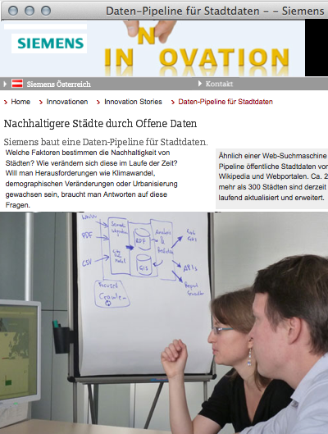
City Data Pipeline (started 2012)
http://citydata.wu.ac.at/

Slide 6
Which assets can we* draw from? *the Semantic Web community
Where do we find Data?
Semantic Search
Linked Data
How do we combine Data?
RDFS and OWL inference
Is that enough?
Probably not…

Slide 7
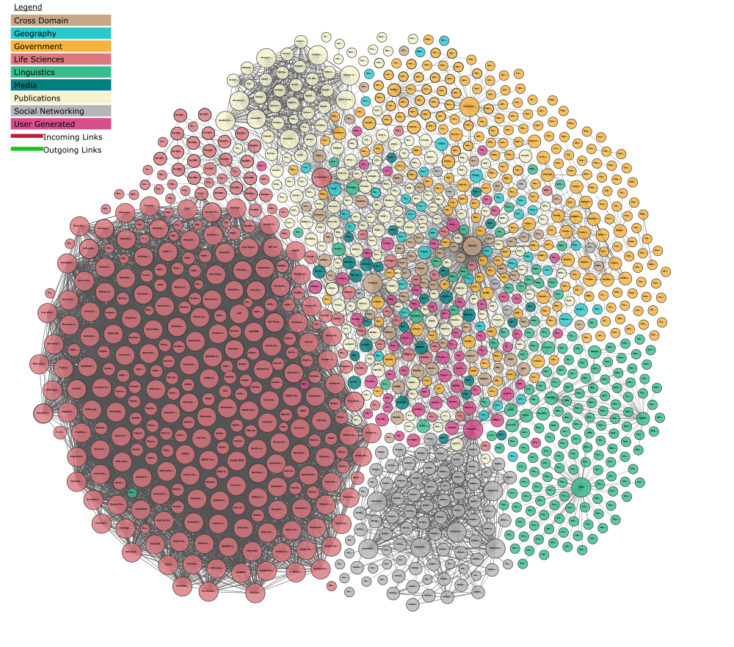
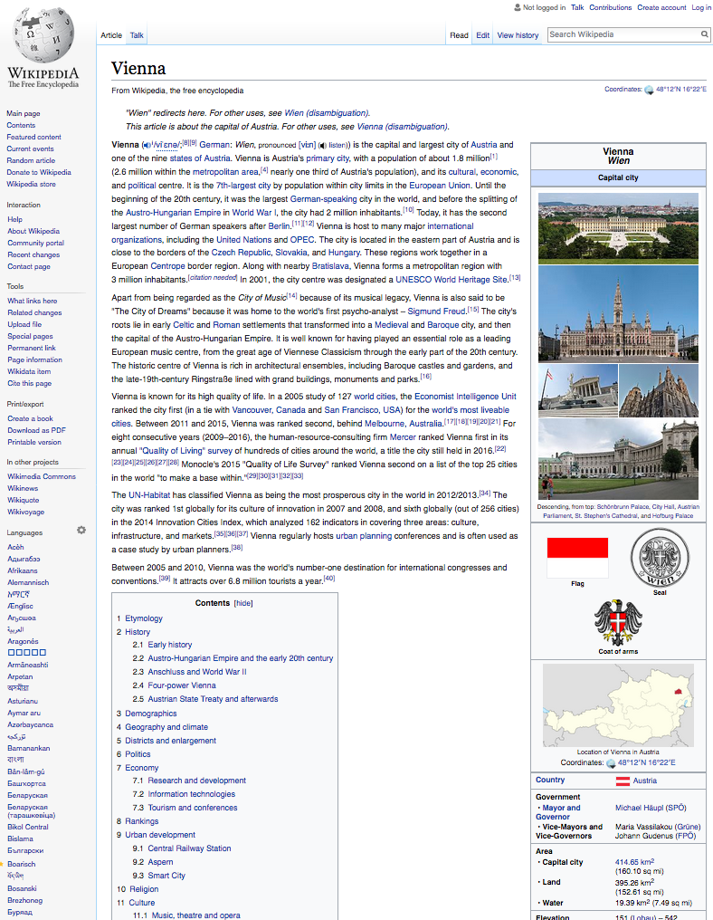
This is what Linked Data offers us:
Open Data from the Web!
Linking Open Data cloud diagram 2017, by Andrejs Abele, John P. McCrae, Paul Buitelaar, Anja Jentzsch and Richard Cyganiak. http://lod-cloud.net/

Slide 8
But: there’s a lot of Open Data missing (apart from Linked Data):
Cities, International Organizations, National and European Portals, Int'l. Conferences:
Notes:
8

Slide 9
Ok, now… how can I use it?
Attempt 1: use OWL&RDFS

Slide 10
A concrete use case: The "City Data Pipeline"
That's a standard ETL pipeline, isn't it?

Slide 11
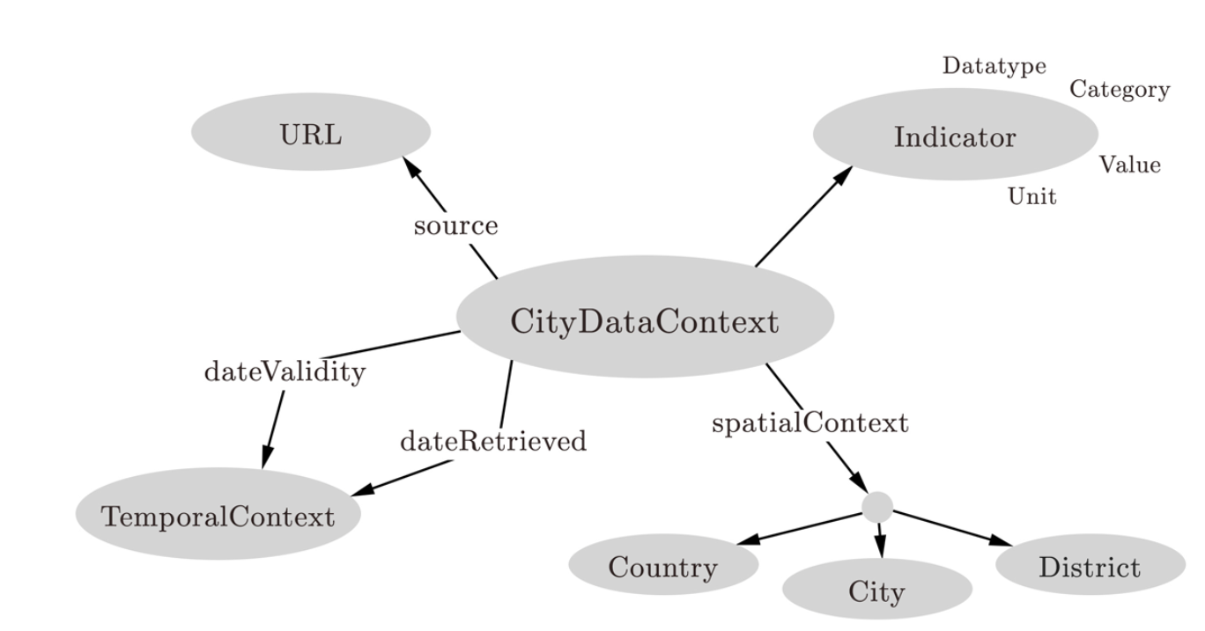
A concrete use case: The "City Data Pipeline"
City Data Model: extensible ALH(D) ontology:
Indicators, e.g. area in km2, tons CO2/capita
Provenance
But we use and flexible Semantic integration using ontologies and reasoning!
Temporal information
Spatial context

Slide 12
A concrete use case: The "City Data Pipeline"
City Data Model: extensible ALH(D) ontology:
dbpedia:areakm
:area
eurostat:area
:area
Indicators, e.g. area in km2, tons CO2/capita
Provenance
Ok, we only need role hierarchies here? Are we done?
Temporal information
Spatial context

Slide 13
A concrete use case: The "City Data Pipeline"
City Data Model: extensible ALH(D) ontology:
dbpedia:areakm2
:area
eurostat:area
:area
Indicators, e.g. area in km2, tons CO2/capita
Provenance
?
:populationDensity = :population/:area
:area = 0,386102 * dbpedia:areaMi2
Temporal information
Spatial context
Hmmm, not quite... Let me come up with a solution...

Slide 14
Can equational knowledge co-exist with OWL?
Can equational knowledge co-exist with OWL?
We need a syntax & define a formal semantics
Syntax:
Semantics:
Requirements:
“Fit” with common model-theoretic semantics for OWL and RDFS
Treat equivalent equations equivalently, combine with query rewriting and rule-based reasoning techniques:
:populationDensity = :population/:area
:area = 0,386102 * dbpedia:areaMi2
:populationDensity :defineByEquation “population/:area” .
:area :defineByEquation “areaMi2 * 0,386102 ” .
dbPedia:populationTotal :rdfs:subPropertyOf :population.
:area = 0,386102 * dbpedia:areaMi2
:areaMi2 = 2,589988 * :area

Slide 15
Can equational knowledge co-exist with OWL?
Semantics:
Requirements:
“Fit” with common model-theoretic semantics for OWL and RDFS
Treat equivalent equations equivalently, combine with query rewriting and rule-based reasoning techniques:
:Vienna dbPedia:populationTotal 1852997.
:Vienna :area 414.65.
dbPedia:populationTotal :rdfs:subPropertyOf :population.
:populationDensity :defineByEquation “population/:area” .
:area :defineByEquation “areaMi2 * 0,386102 ” .
dbPedia:populationTotal :rdfs:subPropertyOf :population.
:Vienna :populationDensity 4 467.
:area = 0,386102 * dbpedia:areaMi2
:areaMi2 = 2,589988 * :area

Slide 16
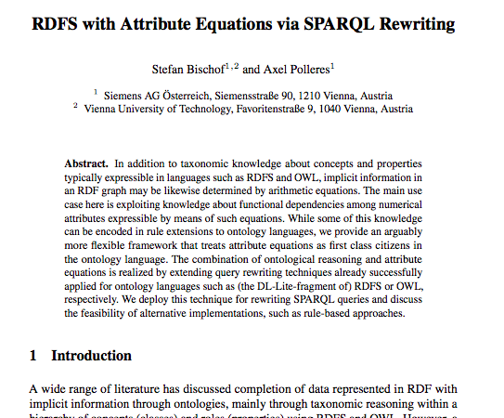
Can equational knowledge co-exist with OWL?
So:
RDFS and OWL inference
& Equational Knowlege
Is that enough?
Probably not…
Stefan Bischof, Axel Polleres. ESWC2013

Slide 17
Challenges – Too many Missing values
Indicators
Problem: Equational knowledge is not enough to deal with many missing values…
Idea: using both first-wave and second wave AI (ML&statistics) methods
Notes:
Note that so far we have considered the whole thing as an integrated single dataset.
Now lets focus on these white spots specifially
The question is: can we predict the indicators of eurostat for cities that are not in europoe, the green arrow, or the un indicators for cities which are only in eurostat the blue arrow
We again used aproach 2 to fill in the missing values of a single dataset and use that as training set for the indicatosr of the other dataset.

Slide 18
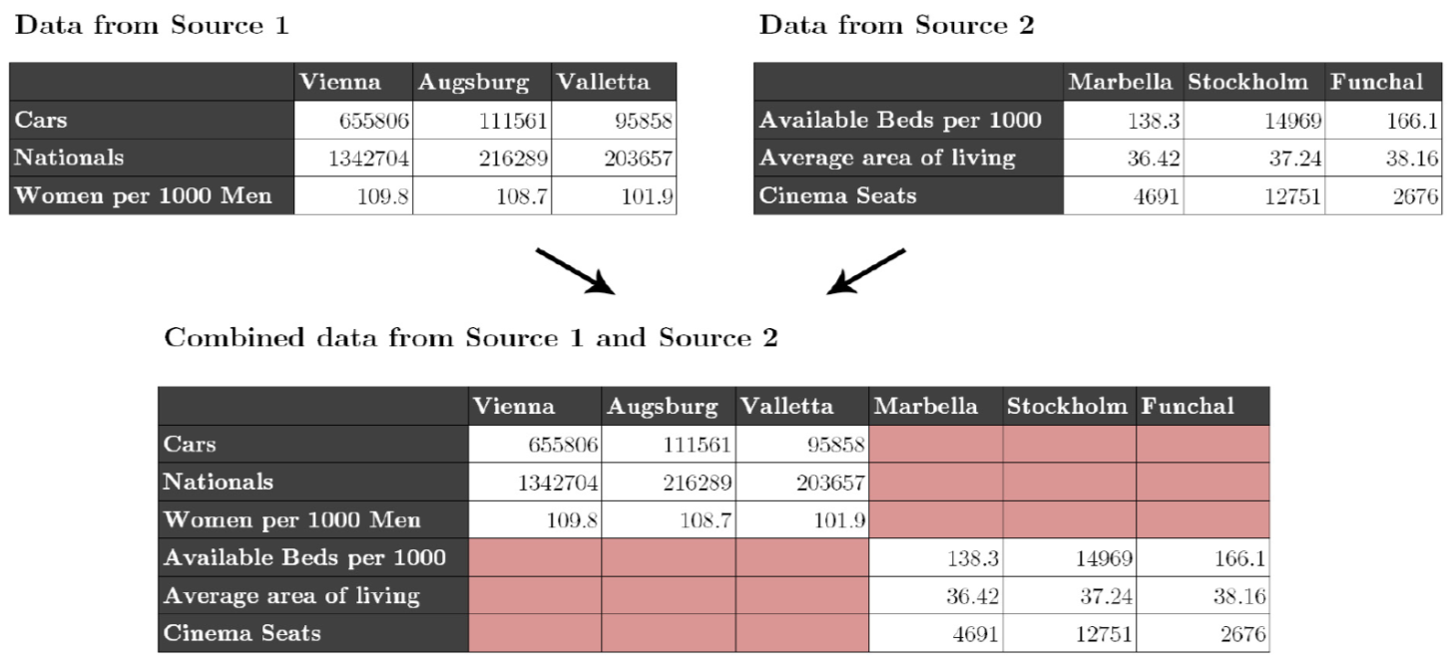
Challenges – Too many Missing values
Individual datasets (e.g. from Eurostat) have missing values
Merging together datasets with different indicators/cities adds sparsity

Slide 19
Missing Values – Hybrid approach choose best prediction method per indicator:
Our assumption: every indicator has its own
distribution and relationship to others.
Basket of „standard“ regression methods:
K-Nearest Neighbour Regression (KNN)
Multiple Linear Regression (MLR)
Random Forest Decision Trees (RFD)

Slide 20
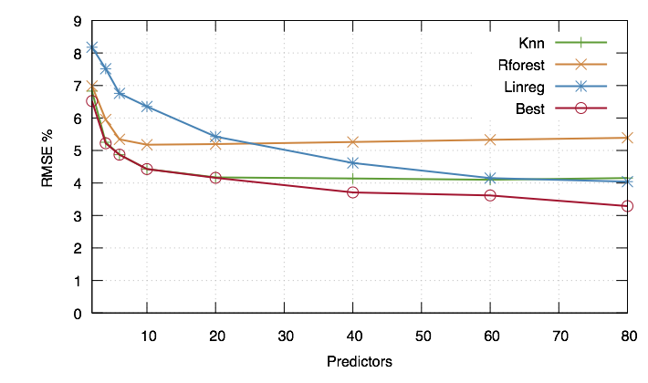
Missing Values – Hybrid approach choose best prediction method per indicator:
Instead of using indicators directly we use Principle Components (PCA), built from the indicators
For buidling the PCs, fill in missing data points with neutral values → predict all rows

Slide 21
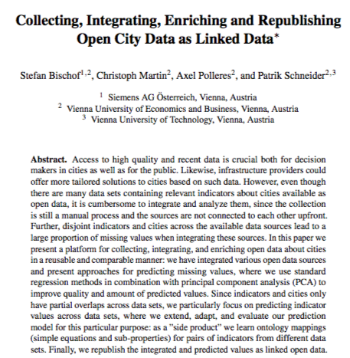
More Details:
Stefan Bischof, Christoph Martin, Axel Polleres, and Patrik Schneider.Collecting, integrating, enriching and republishing open city data as linked data. In Proceedings of the 14th International Semantic Web Conference (ISWC 2015)
Next step:
Combine ML and equations “iteratively” (under submission)
http://epub.wu.ac.at/5438/

Slide 22
QB equations: Combine ML and equations “iteratively” … How?
First of all, RDF data about cities doesn’t look like this:
But like this:
:Vienna :population 1852997.
city
Vienna
year
2016
indicator
value
population
1 852 997

Slide 23
RDF Attribute Equations are not enough
Data from some sources like eurostat come as multidimensional data - Data Cube vocabulary (QB):
Temporal (December)
Unit of measurement (degrees Celsius)
Aggregation (mean, min, max, …)
Indicator (temperature, population density)
city
Vienna
year
2016
indicator
source
value
error
population
1 852 997
eurostat
0.0
Notes:
Eurostat example
Data from some sources like eurostat come as multidimensional data
RDF Attribute Equations are not applicable

Slide 24
Example QB equations: compute population density
population
area
indicator
indicator
city
Vienna
city
year
year
value
2016
error
error
value
1 852 997
city
0.0
year
0.0
414.650
indicator
derived From
error
value
population density
0.0
4 467

Slide 25
QB equations: deal with approximated values by using error propagation
population
area
indicator
indicator
city
Vienna
city
year
year
source
value
2016
error
error
value
city
KNN prediction
1 852 997
year
$$ϵ$$
0.0
414.650
indicator
derived From
error
value
population density
$$eq_{1}$$
4 467
?
$$propagate(0.0,ε,eq_{1})$$

Slide 26
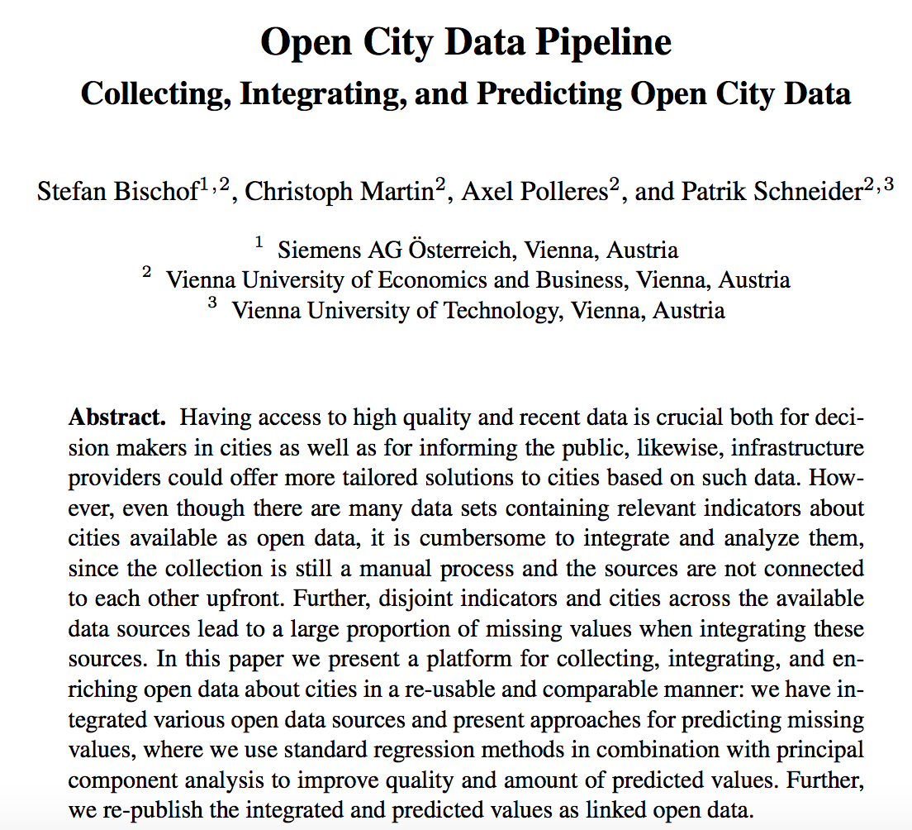
More Details:
Stefan Bischof, Andreas Harth, Benedikt Kämpgen, Axel Polleres, and PatrikSchneider.Enriching integrated statistical open city data by combining equational knowledge and missing value imputation. Journal of Web Semantics (JWS), October 2017.In press.
Main idea:
Combine
(1) ontological reasoning, (2)ML, (3) equations “iteratively” with
QB equations

Slide 27
Evaluation Combination PCA Regression + QB Equations
Statistics one iteration (PCA regression + QB Equations)
991k observations from crawled data
522k new or better observations from PCA regression
230k better observations from QB Equations
232k new observations from QB Equations
Same or better values (improved RMSE) for 80 of 82 indicators
QB Equations are sensitive to correct error estimates
More details: http://www.stefanbischof.at/slides/Rigorosum_Bischof.pdf
Notes:
Population change over 1 year not directly expressible
Precision = tp / (tp + fp)
Accuracy = (tp + tn) /(tp + tn + fp + fn)
Evaluation on Real world data
Statistics on the data and workflow

Slide 28
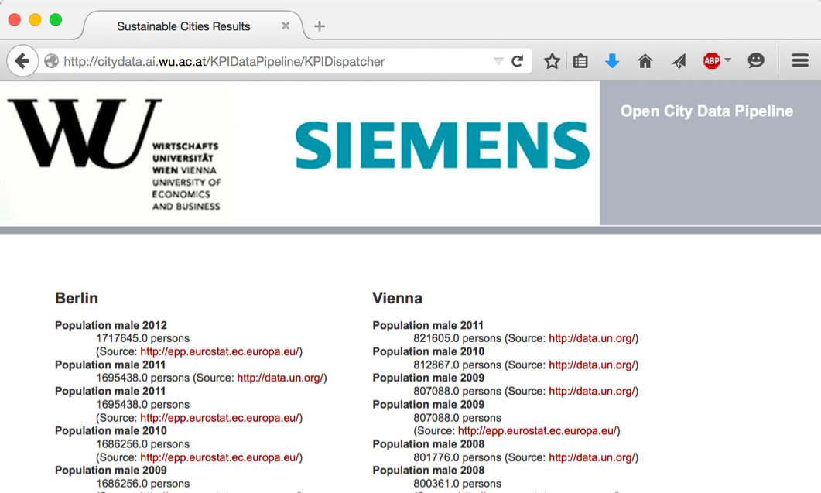
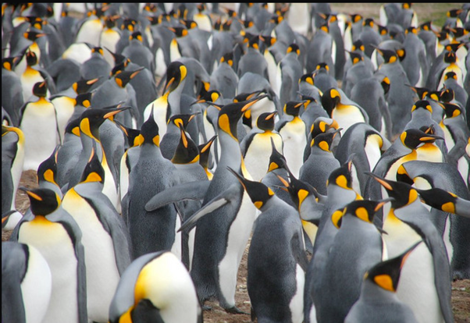
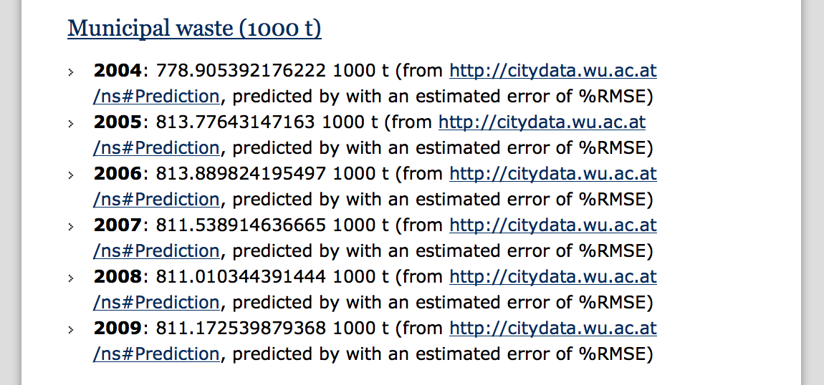
City Data Pipeline Prototype
citydata.wu.ac.at
Search for indicators & cities
obtain results incl. sources
Integrated data served as Linked Open Data
Predicted values AND estimated error rates for missing data...
...it‘s not finished, but:
assumption: Predictions get better, the more Open data we integrate...
Open Data: The more, the merrier!

Slide 29
However:
(Strong)Limitations:
We combined 3-4 specific OD sources (there are 100s of Open Data Portals out there)
We manually created an ontology for mapping those sources and set of equations from Eurostat?
Open Questions:
How can I build a scalable repository of Open Data?
How can I automate finding relevant data?
How can I automatize building an Open Data Knowledge graph?

Slide 30
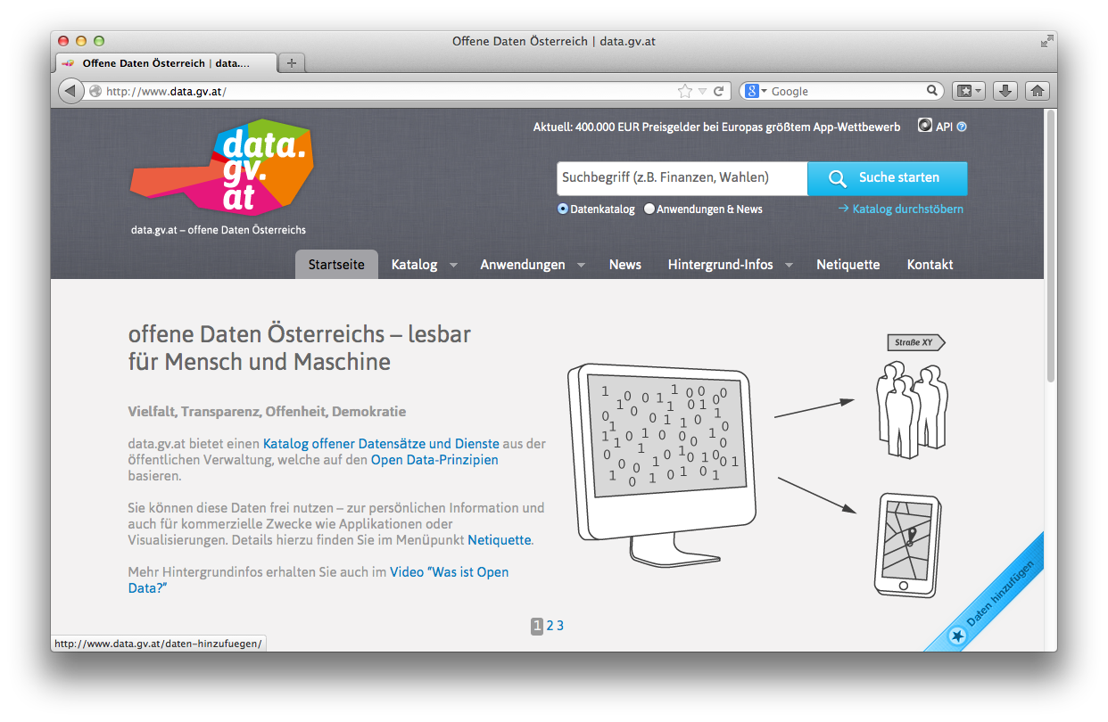
Open Data Portals
CKAN ... http://ckan.org/
almost „de facto“ standard for Open Data Portals
facilitates search, metadata (publisher, format, publication date, license, etc.) for datasets
http://opendataportal.at/
http://data.gv.at/
machine-processable? ...
... partially

Slide 31
Our ongoing research: data.wu.ac.at
What is the status of Open Data and what are the challenges using Open Data?
OpenData PortalWatch – a project at WU
Improving and assessing Open Data Quality : ADEQUATE (FFG)
What's next?
Making Open Data Searchable
Building an Open Data Knowledge Graph!

Slide 32
Ongoing Projects (data.wu.ac.at)

Slide 33
OPEN DATA PORTAL WATCH
http://data.wu.ac.at/portalwatch/
Periodically monitoring a list of Open Data Portals
260 CKAN powered Open Data Portals worldwide
Quality assessment
Evolution tracking
Meta data
Data
Formats, growth

Slide 34
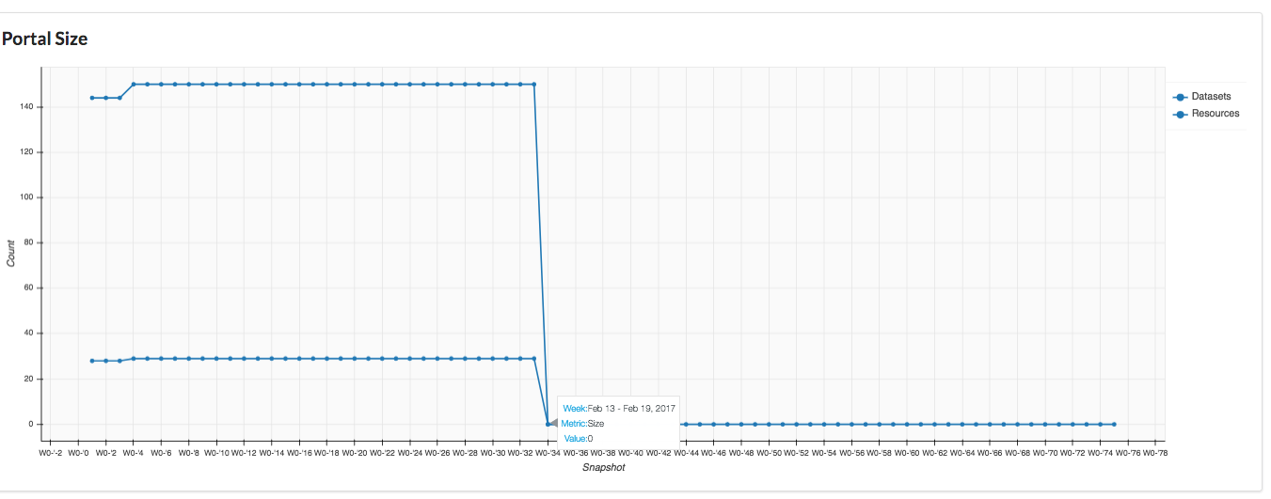
Portalwatch Example:
http://data.wu.ac.at/portalwatch/portal/open_whitehouse_gov/1804/

Slide 35
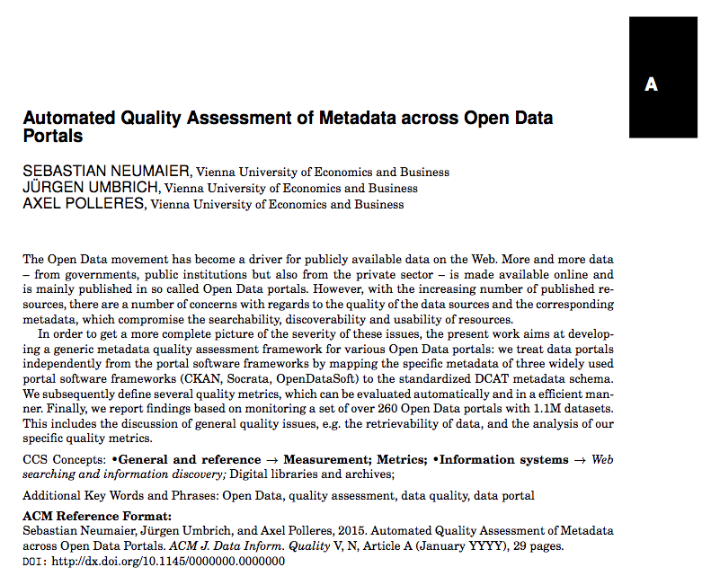
Portalwatch Example:
http://data.wu.ac.at/portalwatch/portal/open_whitehouse_gov/1804/

Slide 36
Our research: data.wu.ac.at
What is the status of Open Data and what are the challenges using Open Data?
OpenData PortalWatch – a project at WU
Improving and assessing Open Data Quality: ADEQUATE (FFG)
What's next?
Making Open Data Searchable
Building an Open Data Knowledge Graph!

Slide 37
Why is Search in Open Data a problem?

Slide 38
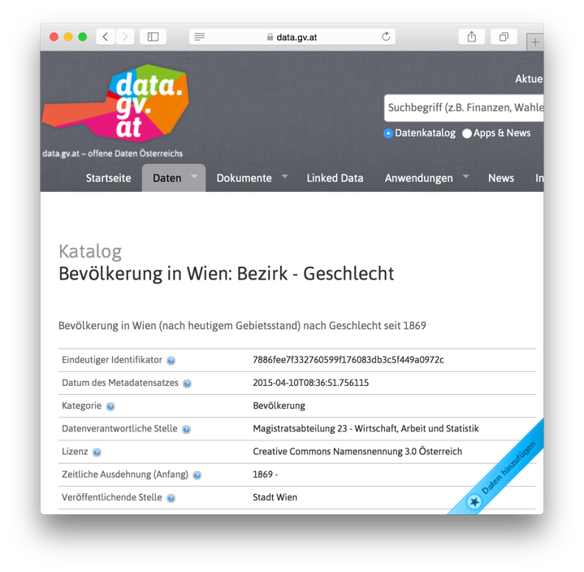
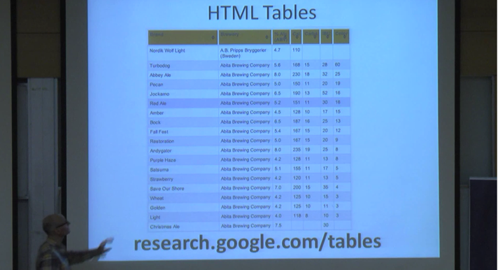
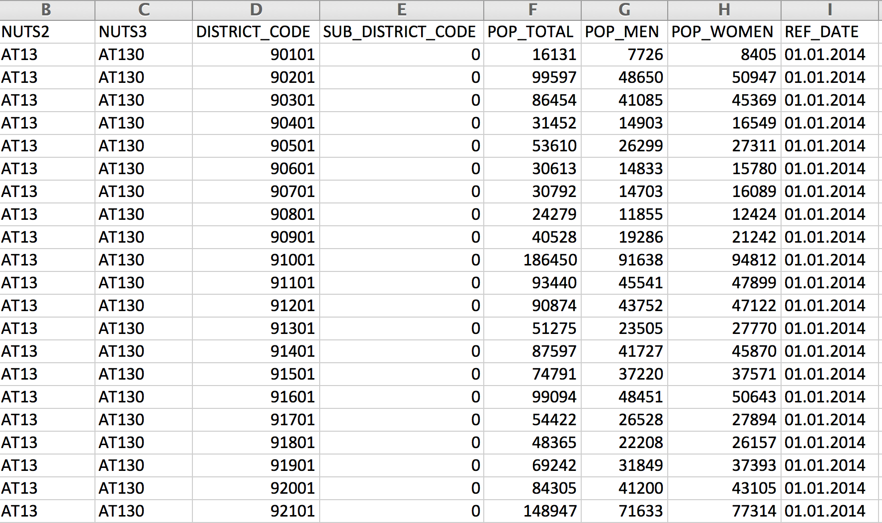
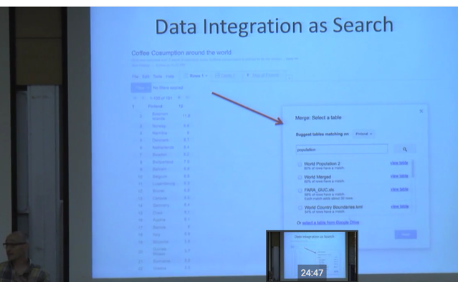
Why is Search in Open Data a problem?
https://www.youtube.com/watch?v=kCAymmbYIvc
Structured Data in Web Search by Alon Halevy
vs.
Open Data Search is hard...
No natural language „cues“ like in Web tables...
Existing knowledge graphs don‘t cover the domain of "Open Data“
Open Data is not properly geo-referenced

Slide 39
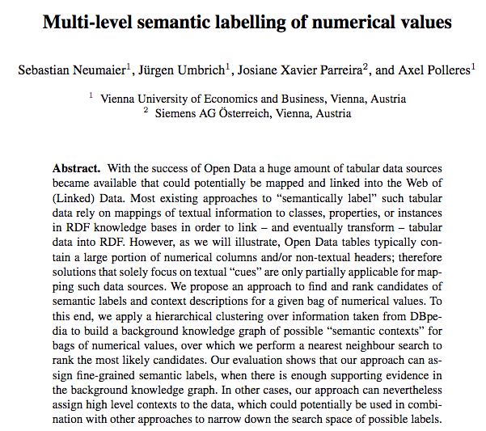
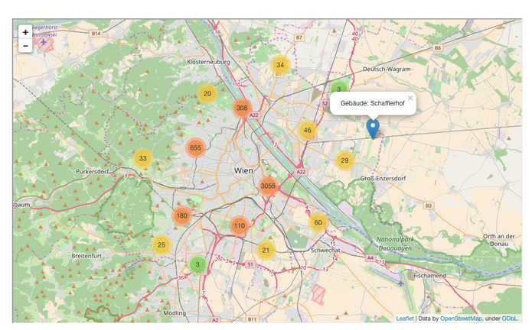
Some starting points:
First baby steps on building an Open Data Knowledge Graph:
Ongoing work to make Open Data geo-searchable e.g. in our project communidata.at (just submitted to ESWC)
International Semantic Web conference 2016:

Slide 40
Towards linking Open Data to a Knowledge Graph
Attempt to link numeric Open data to the dbpedia knowledge graph…
International Semantic Web conference 2016:

Slide 41
Example
dpo:Stadium
dpo:City
dpo:Country
dbp:capacity
stadium name | capacity | city | country
Emirates Stadium | 60361 | London | England
Villa Park | 42785 | Birmingham | England
Ewood Park | 31154 | Blackburn | England
… | … | … | …
Notes:
Of course we are not the first ones who work with tabular data

Slide 42
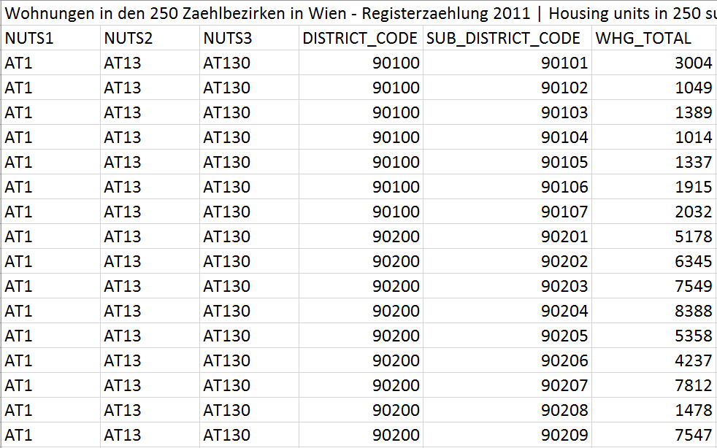
But:
Web/HTML tables differ from typical Open Data tables:
Domain: e.g., public administration data, statistical data, weather data, elections, …
Structure: OD tables contain large amount of numerical columns

Slide 43
Example (Cont’d)
stadium | capacity | city | country
Emirates Stadium | 60361 | London | England
Villa Park | 42785 | Birmingham | England
Ewood Park | 31154 | Blackburn | England
… | … | … | …
Notes:
Realistic open data csv would look more like this
Which makes the previous showed job much more harder

Slide 44
Example (Cont’d)
 | TOTAL | DISTRICT_CODE | ISO_2
Emirates Stadium | 60361 | SW1A 0AA | GB
Villa Park | 42785 | B23 7QG | GB
Ewood Park | 31154 | B26 6QA | GB
… | … | … | …
Notes:
Realistic open data csv would look more like this
Which makes the previous showed job much more harder

Slide 45
Why not use numeric values?
Identifying the most likely semantic label for a bag of numerical values
Deliberately ignore surroundings
 | TOTAL | DISTRICT_CODE | ISO_2
Emirates Stadium | 60361 | SW1A 0AA | GB
Villa Park | 42785 | B23 7QG | GB
Ewood Park | 31154 | B26 6QA | GB
… | … | … | …

Slide 46
Why not use numeric values?
Identifying the most likely semantic label for a bag of numerical values
Deliberately ignore surroundings
Emirates Stadium | 60361 | SW1A 0AA | GB
Villa Park | 42785 | B23 7QG | GB
Ewood Park | 31154 | B26 6QA | GB
… | … | … | …

Slide 47
Why not use numeric values?
Identifying the most likely semantic label for a bag of numerical values
Deliberately ignore surroundings
60361
42785
31154
…

Slide 48
Why not use numeric values?
Identifying the most likely semantic label for a bag of numerical values
Deliberately ignore surroundings
capacity <a stadium> <country England>
 | 60361
 | 42785
 | 31154
 | …

Slide 49
Our Approach
Hierarchical clustering over an RDF knowledge base
to build background knowledge graph (BKG)
nodes consist of typical numerical values, annotated with context information, i.e.: grouped by properties and their shared domain (subject) pairs
k-nearest neighbors search
Aggregation of the results at different levels to find the most likely context:
property
type
context

Slide 50
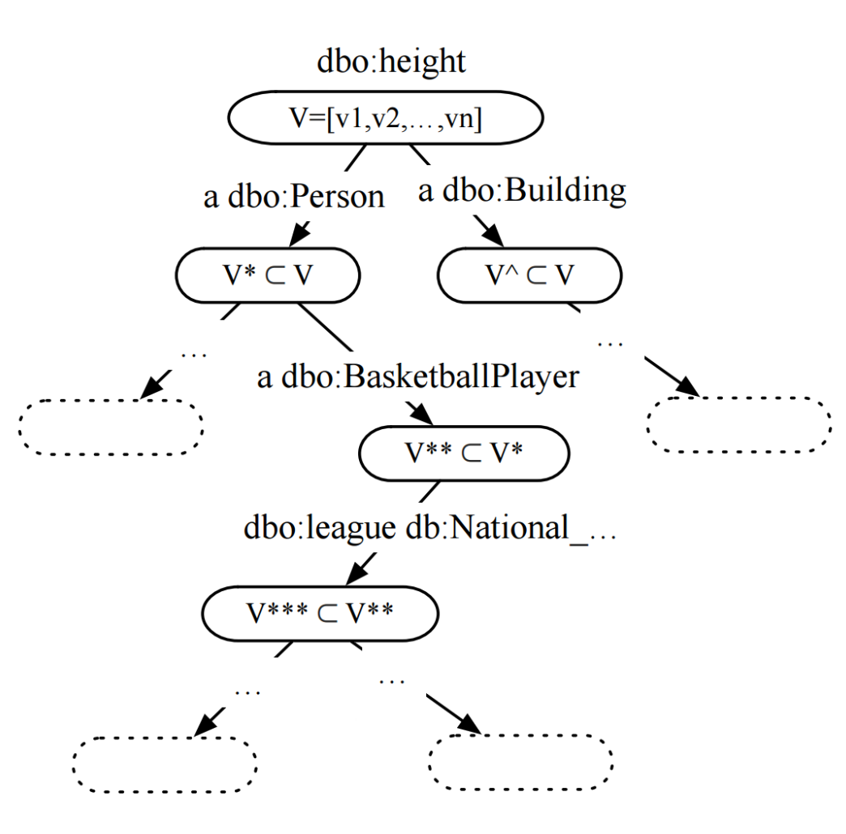
1. Background Knowledge Graph
Find properties with numerical range
Hierarchical clustering approach
Two hierarchical layers:
Type hierarchy (using OWL classes)
Property-object hierarchy (shared property-object pairs)

Slide 51
2. k-Nearest neighbor search
Mapping bags of numerical value to vector space (feature vector)

Slide 52
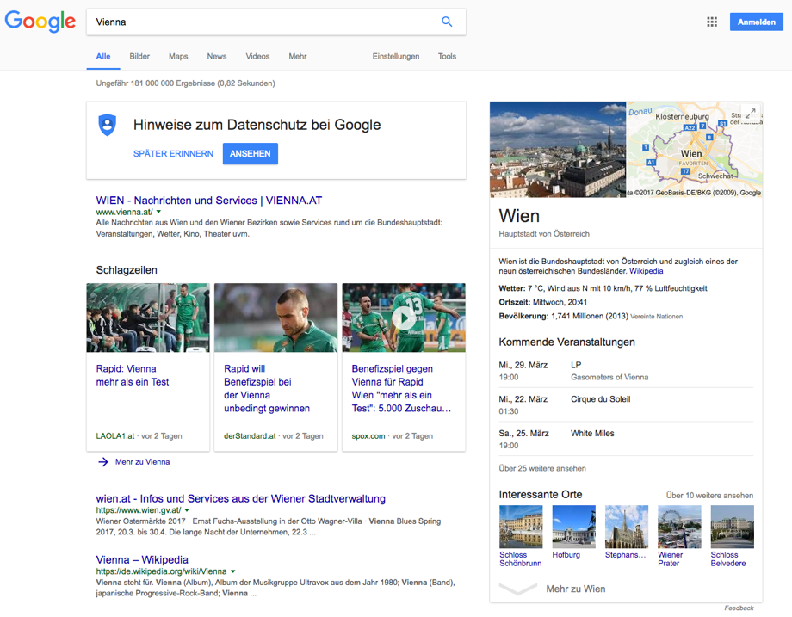
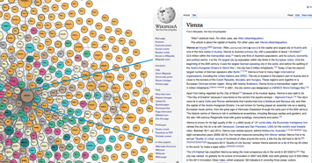
Towards linking Open Data to a Knowledge Graph
International Semantic Web conference 2016:
Attempt to link numeric Open data to the dbpedia knowledge graph…
Some Caveats:
Method works well if you have a suitable knowledge graph, but:
Open Data has a lot of attributes that do not match current knowledge graphs … like these:

Slide 53
Some starting points:
First baby steps on building an Open Data Knowledge Graph:
Ongoing work to make Open Data geo-searchable e.g. in our project communidata.at
International Semantic Web conference 2016:
Sneak preview (just submitted to ESWC):
http://data.wu.ac.at/odgraph/

Slide 54
Still Open Questions (with some starting points presented…)
How can I build a scalable repository of Open Data?
How can I automate finding relevant data?
(How) can I automatize
cleansing of metadata
building an Open Data Knowledge graph?
What is the right form of Knowledge Representation for Knowledge graphs?
OWL, Rules, Equations, Property-domain pairs?)
How to represent models in an exchangeable manner?
Eventually: How can I enable fact checking, verify information on the Web, understand cities,… by Open Data?

Slide 55
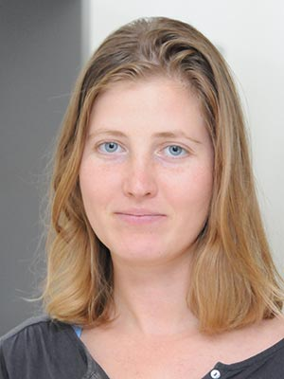
Collaborators/Current Team:
What I talked about →
Dr. Stefan Bischof
(City Data Pipeline)
Sebastian Neumaier
(OpenData Quality,
Knowledge Graphs)
Dr. Jürgen Umbrich
(Search, Crawling,
Knowledge Graphs)
What I tdidn’t yet talk about
→
Dr. Sabrina Kirrane
(Policies, Privacy, Access Control)
Dr. Javier Fernandez
(Compression, HDT, Archiving Indexing, Query Processing)
Svitlana Vakulenko
(NLP, event detection, social media analysis)
Erwin Filtz
(Legal Knowledge Graphs, Graph
Data Processing)
Dr. Vadim Savenkov
(Database Updates, OBDM, Open Data)
Simon Steyskal
(Policies ODRL, Constraints, SHACL)
Martin Beno (Open Data, Server Admin)
Giray Havur
(Business Processes, Resource allocation, Constraints/ Logic Programming)

Slide 56
Thanks! Things I did NOT have time to talk about in detail, but would be interested to talk about collaborations:
Linked/Open Data Monitoring/Archiving, Temporal querying → (Jürgen, Javier)
RDF Query Processing, Path queries and Updates (Vadim)
Privacy and data on the Web, Licenses
→ http://privacylab.at
→ http://specialprivacy.eu/
→ https://dalicc.net/
…
https://www.wu.ac.at/en/infobiz/

