Slide 1
Building an Open Knowledge Graphs for and from Open Data
Axel Polleres
Joint work with: Sebastian Neumaier, Jürgen Umbrich

Slide 2
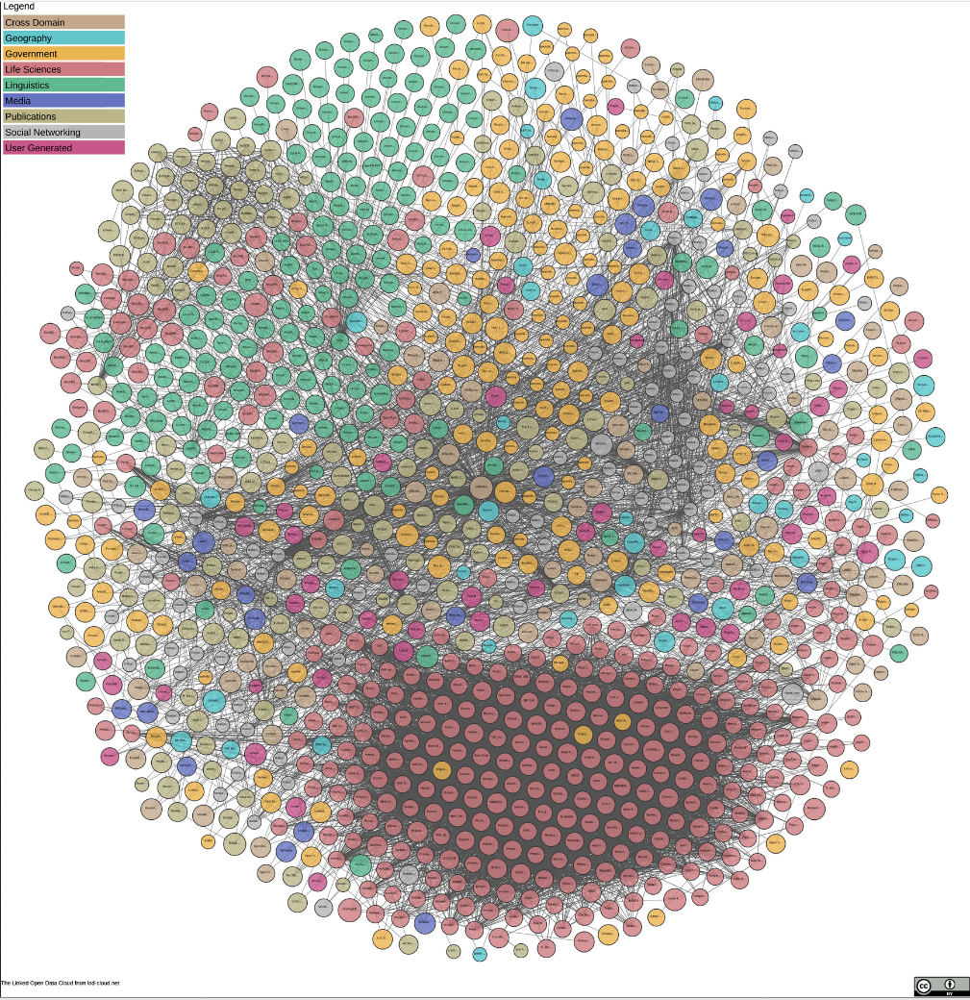
When we hear about Open Data and Knowledge Graphs… many think about Linked Open Data…
The Linked Open Data Diagram from lod-cloud.net Latest release 04-30-2018- 1184 Datasets
2
But: Open Data is more than Linked Open Data…
Notes:
1184 datasets and counting … however, and on a side note only half of those are indeed dereferenceable at the moment.

Slide 3


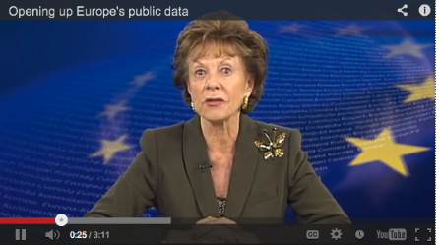
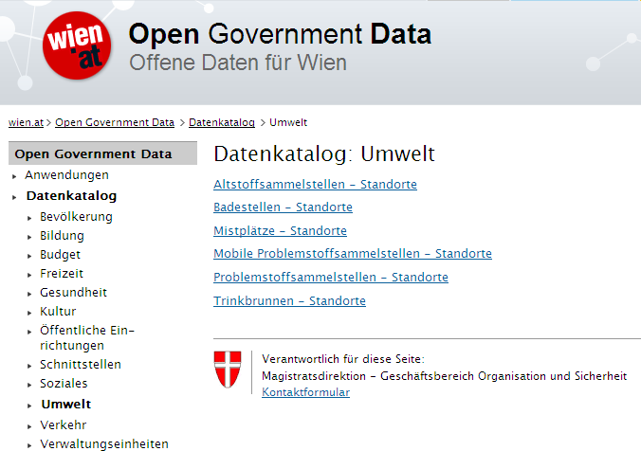
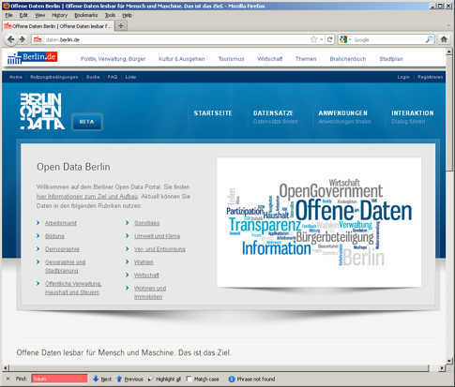
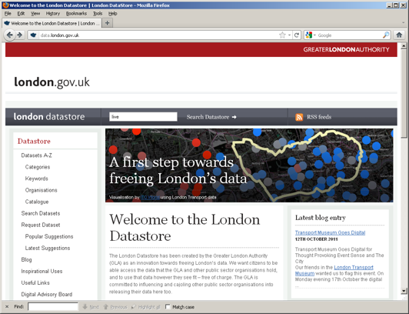
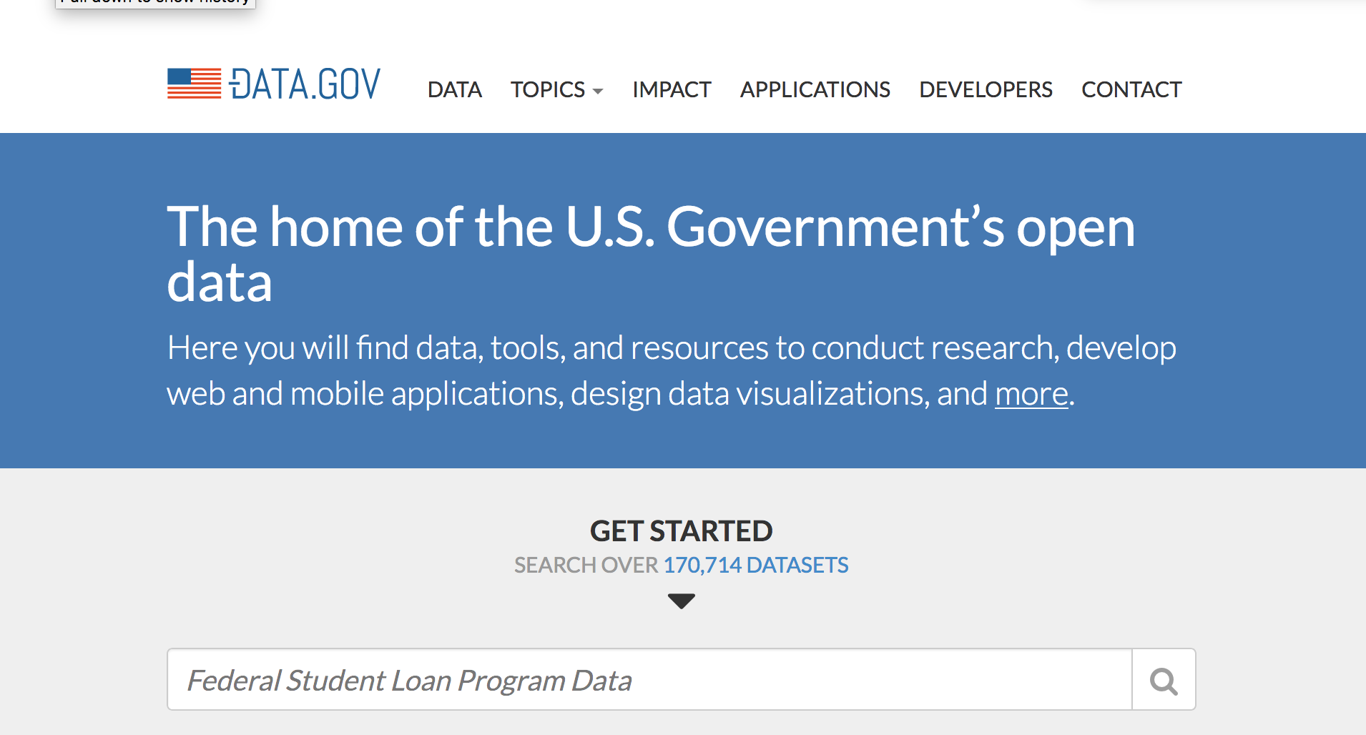
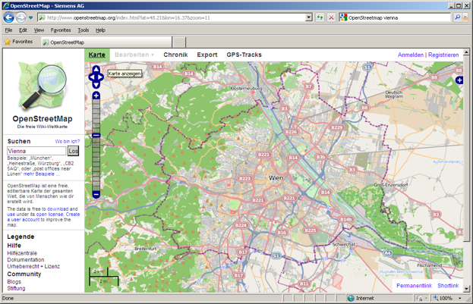



Open Data is a Global Trend!
EU & Austria, but also the (previous) US and UK administration are/were pushing Open Data!
DIRECTIVE 2007/2/EC INSPIRE

Slide 4





(Structured) Open Data comes in various ways
Available data is only partially structured and not linked [1]:
CSV (3-star)
Excel (2-star)
RDF/Linked Data? Not significant
PDF (1start)
Unknown format (1-star)
82 data portals 160K datasets
[1] | Umbrich, J., Neumaier, S., Polleres, A.: Quality assessment & evolution of open data portals. International Conference on Open and Big Data (2015)

Slide 5
Open Data as a Global Trend:
Country | URL | Datasets
United States | data.gov | 170.7k
Canada | open.canada.ca | 79.1k
UK | data.gov.uk | 45.1k
France | www.data.gouv.fr | 34.2k
Russia | opengovdata.ru | 30.3k
Japan | data.go.jp | 21k
Italy | dati.gov.it | 20.4k
Germany | govdata.de | 19.8k
Data portals of the G8 countries

Slide 6
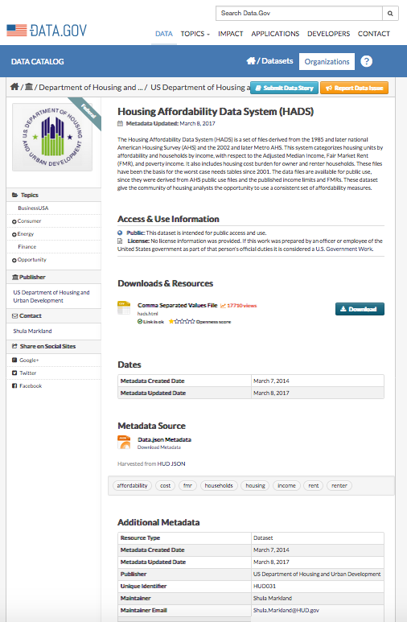
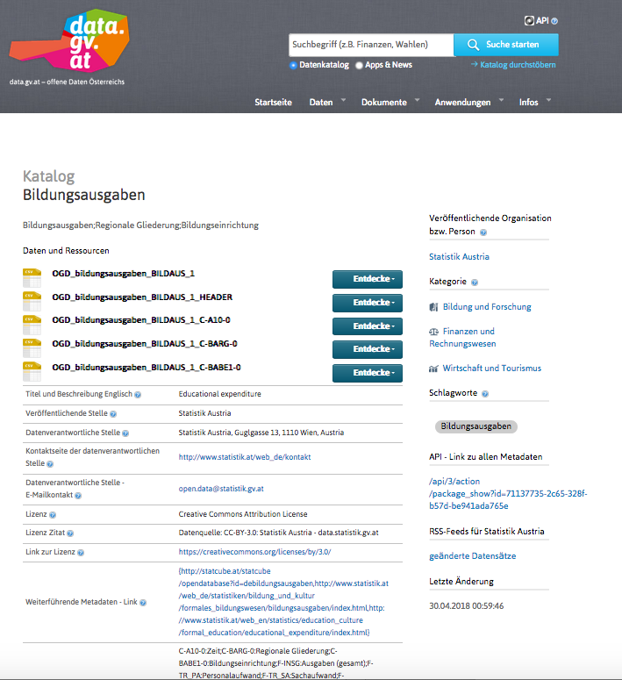
Different portals…
Notes:
Different datesets, different metadata, even different portal software used.

Slide 7
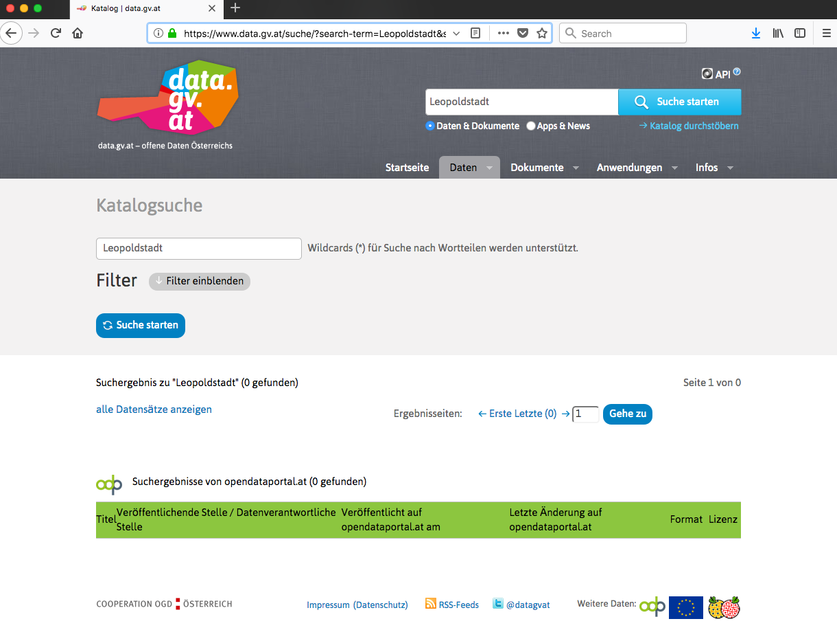

What do you find on Open Data Portals?
Not too much!

Slide 8
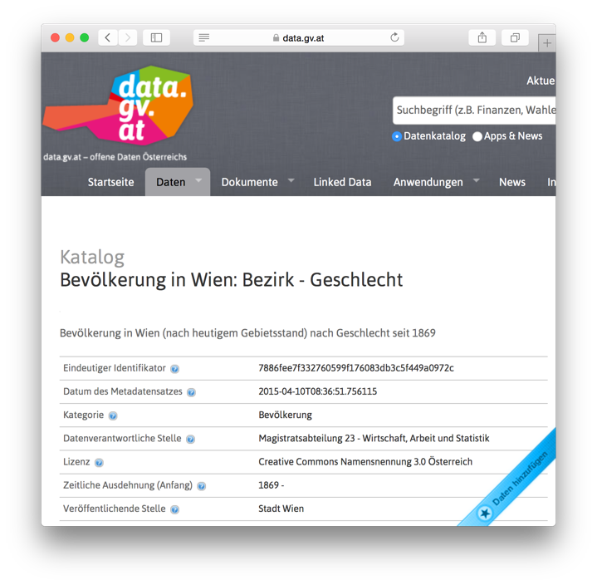
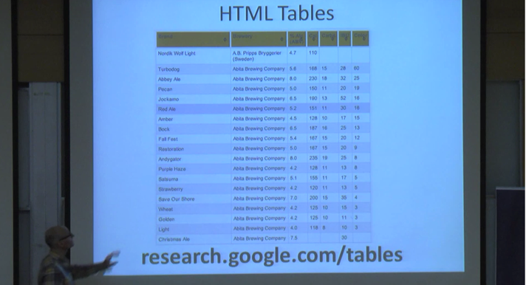
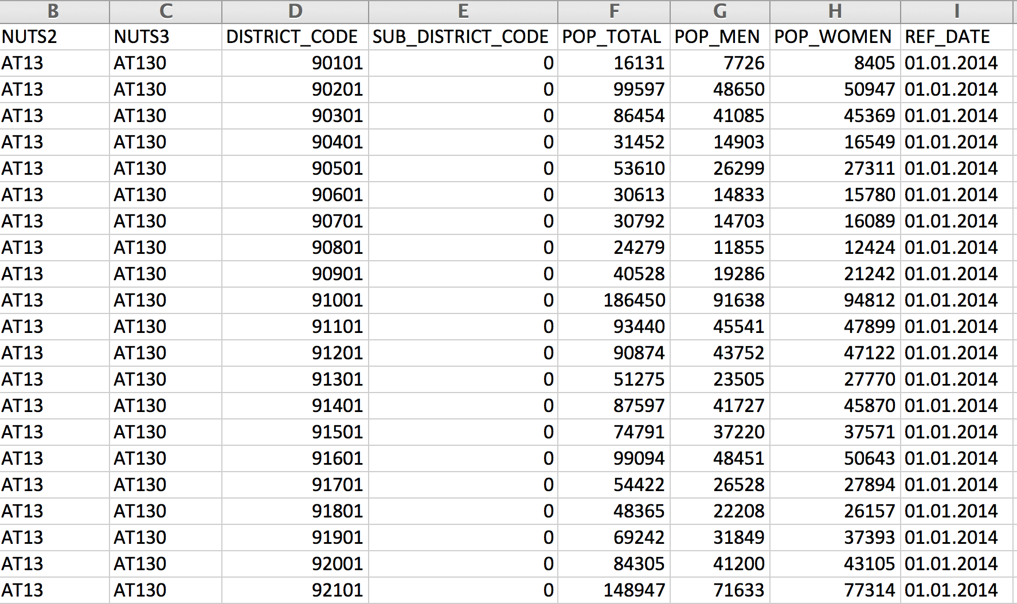
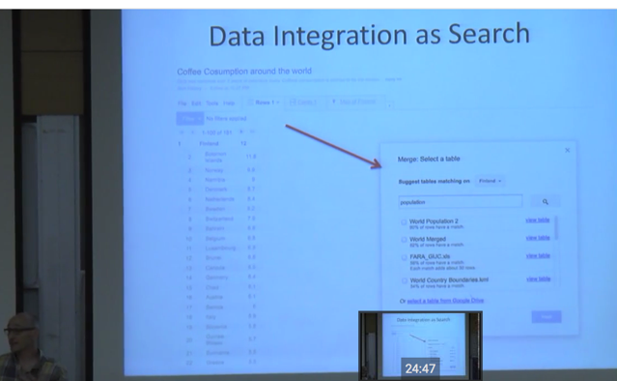
Why is Search in Open Data a problem?
https://www.youtube.com/watch?v=kCAymmbYIvc
Structured Data in Web Search by Alon Halevy
vs.
Open Data Search is hard...
No natural language „cues“ like in Web tables...
Existing knowledge graphs don‘t cover the domain of "Open Data“ well
Open Data is not properly geo-referenced

Slide 9
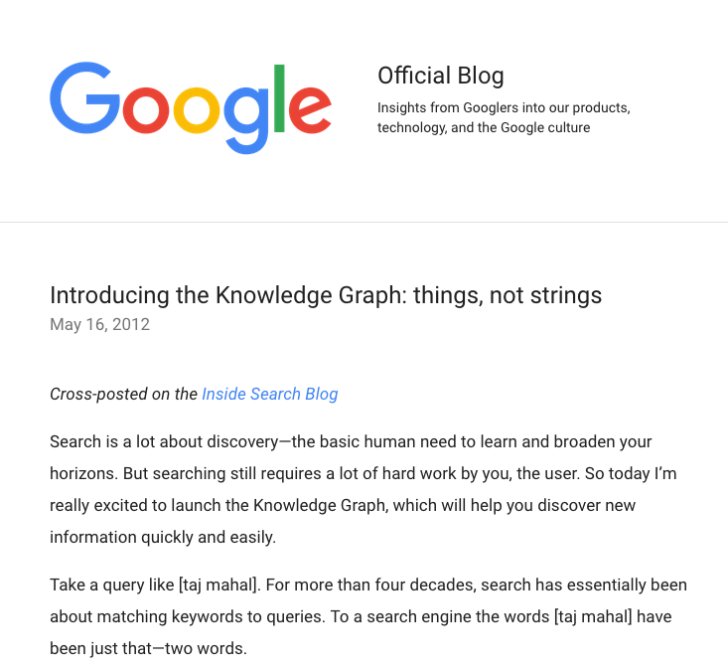
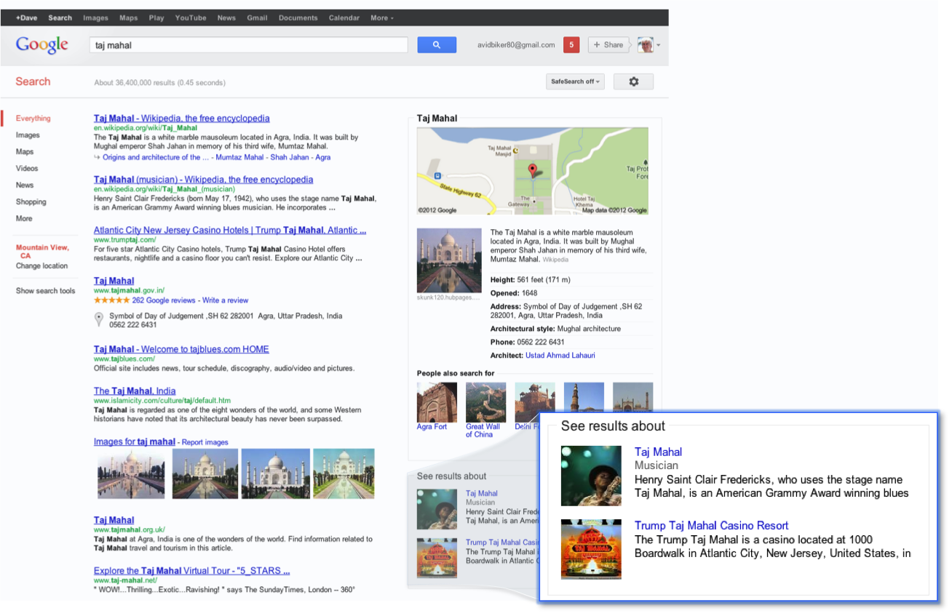
Not in this talk:
What is a Knowledge Graph?
… good question!
Says more what a KG does
than what it is…
“interesting things and [understanding their] relationships”
9

Slide 10
In this talk:
2 applications for Knowledge Graphs for Open Data Search!
What we do: 2 approaches how knowledge graphs could help to solve the Open Data search problem (aside the obvious):
    Hierarchical labelling of Labeling of numeric data
    Hierarchical labelling of Spatio-Temporal entities

Slide 11
Example Table
federal state | district | year | sex | population
Upper Austria | Linz | 2013 | male | 98157
Upper Austria | Steyr | 2013 | male | 18763
Upper Austria | Wels | 2013 | male | 29730
… | … | … | … | …

Slide 12
Open Data CSVs look more like this
NUTS2 | LAU2_NAME | YEAR | SEX | P_TOTAL
AT31 | Linz | 2013 | 1 | 98157
AT31 | Steyr | 2013 | 1 | 18763
AT31 | Wels | 2013 | 1 | 29730
… | … |  | … | …
Source: https://www.data.gv.at/katalog/dataset/e108dcc3-1304-4076-8619-f2185c37ef81
Notes:
What are the difference? Non-speaking column names, numeric values instead of labels.

Slide 13
Why not use the numeric values?
Identifying the most likely semantic label for a bag of numerical values
Deliberately ignore surroundings
NUTS2 | LAU2_NAME | YEAR | SEX | P_TOTAL
AT31 | Linz | 2013 | 1 | 98157
AT31 | Steyr | 2013 | 1 | 18763
AT31 | Wels | 2013 | 1 | 29730
… | … |  | … | …

Slide 14
Why not use numeric values?
Identifying the most likely semantic label for a bag of numerical values
Deliberately ignore surroundings
  population (a district) (country Austria)
98157
18763
29730
…

Slide 15
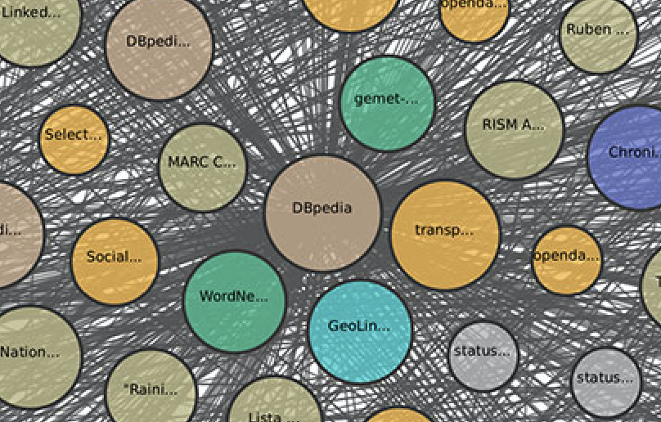
Background Knowledge Graph
Cities
  Population
  Area
  Country
  Location (Coordinates)
  Economic indicators
  …
Organisations:
  Revenues
  Board members
  …
Persons (e.g. celebrities, sports)
  Name
  Profession
  Height
Landmarks (e.g. famous buildings)
  Country
  Location
  Height
Events
  Dates
  Location
What’s in there?

Slide 16
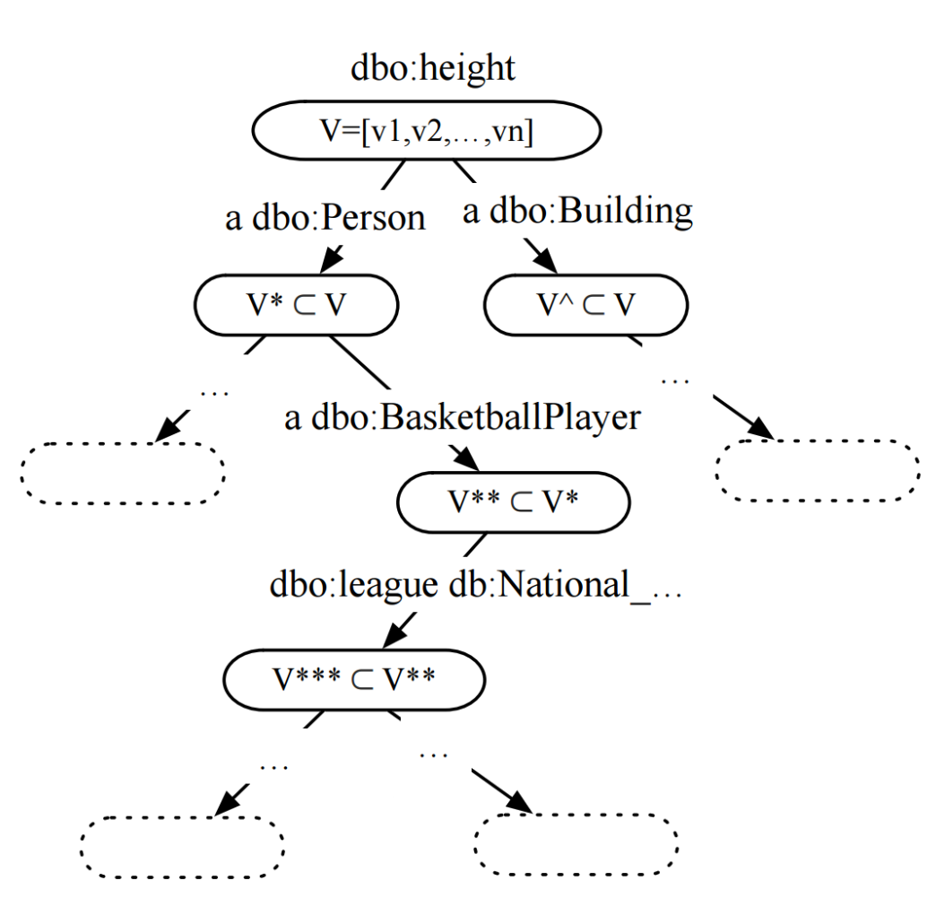
Background Knowledge Graph
Find properties with
numerical range
Hierarchical clustering approach
Two hierarchical layers:
  Type hierarchy
  (using OWL classes)
  Property-object hierarchy
  (shared property-object pairs)

Slide 17
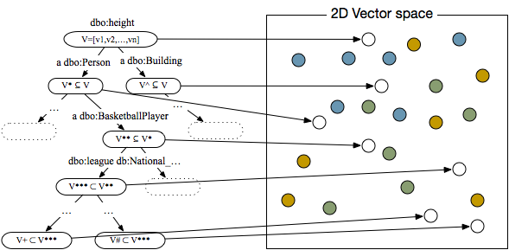
Label based on Nearest Neighbors
2
4
3
6
5
1
Notes:
Kolmogorov-Smirnov Test (Distribution similarity of samples with sistributions), other alternatives: min/max, overlapping value ranges, value SD, standard descriptive statistics)

Slide 18
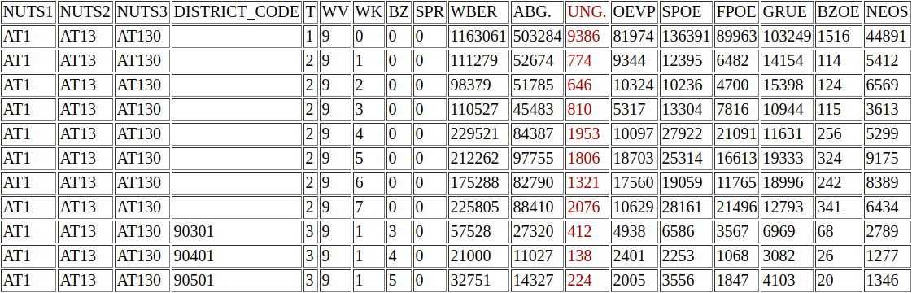
Example OD Labelling
  populationTotal (a Settlement)
  populationDensity (a City)
Source: http://data.wu.ac.at/iswc2016_numlabels/submission/col14.html
Notes:
Election results…. Number of invalid votes… not surprisingly correlated with population numbers or densities (although sure not directly matching).

Slide 19
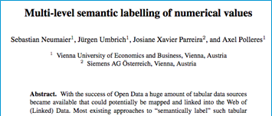
Lessons learned
We can assign fine-grained semantic labels
  If there is enough evidence in BK
However: Missing domain knowledge for labelling OD
Future work:
Complementary to existing approaches (column header labeling, entity linking and relation extraction)
Combined approaches may improve results
Focusing on core dimensions of specific domains e.g. city data, maye more promising than “general” value labeling.

Slide 20
What else can we do/use?
Focus on specific dimensions:
  Particularly temporal and geospatial queries require better support [2]
NUTS2 | LAU2_NAME | YEAR | SEX | AGE_TOTAL
AT31 | Linz | 2013 | 1 | 98157
AT31 | Steyr | 2013 | 1 | 18763
AT31 | Wels | 2013 | 1 | 29730
… | … |  | … | …
[2] | Emilia Kacprzak, et al.: A Query Log Analysis of Dataset Search. International Conference on Web Engineering (2017)

Slide 21
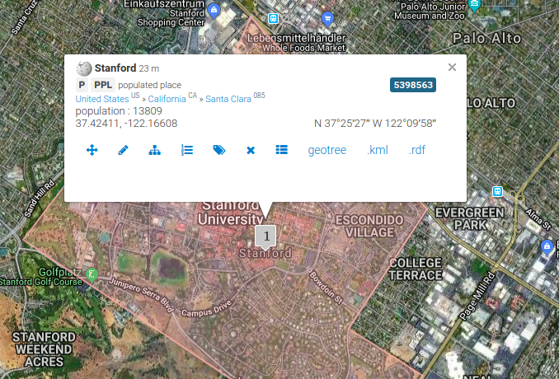
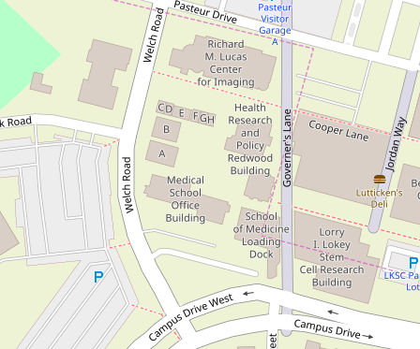


Available Geospatial Knowledge Bases

Slide 22
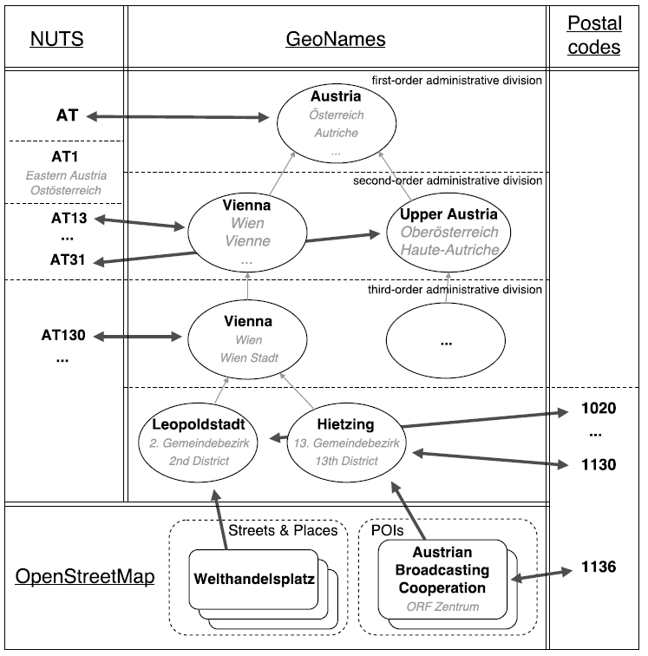
Geo-Knowledge Graph Construction
European Classification of Territorial Units
Wikidata, GeoNames
Wikidata links
Mapping OSM entities to GeoNames regions
Wikidata links
Extracting OSM streets and places

Slide 23
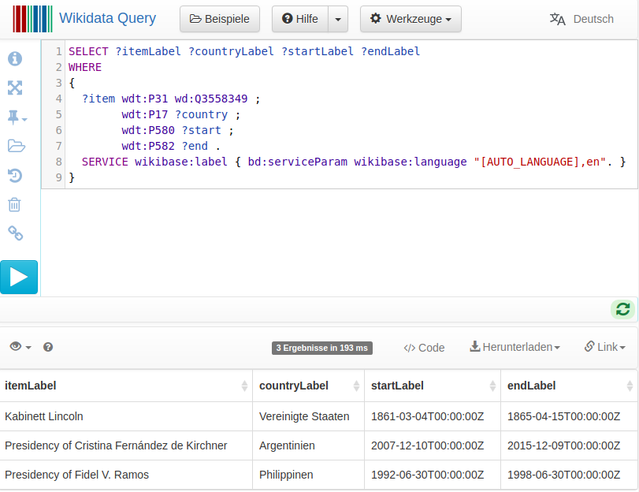
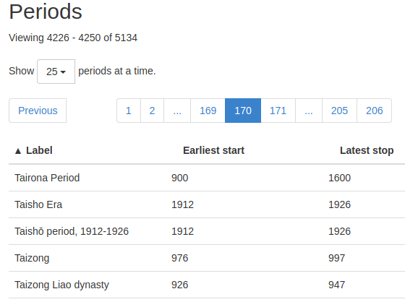


Available Temporal Knowledge

Slide 24
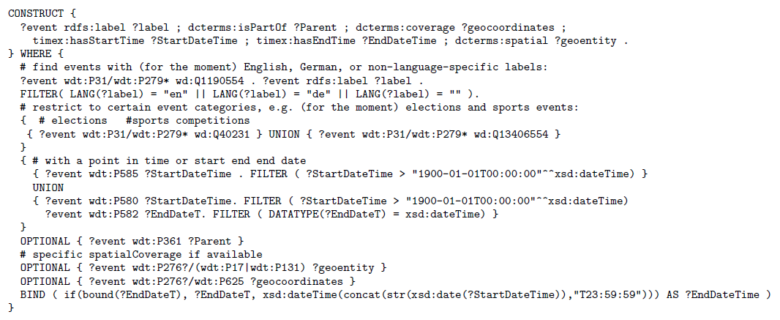
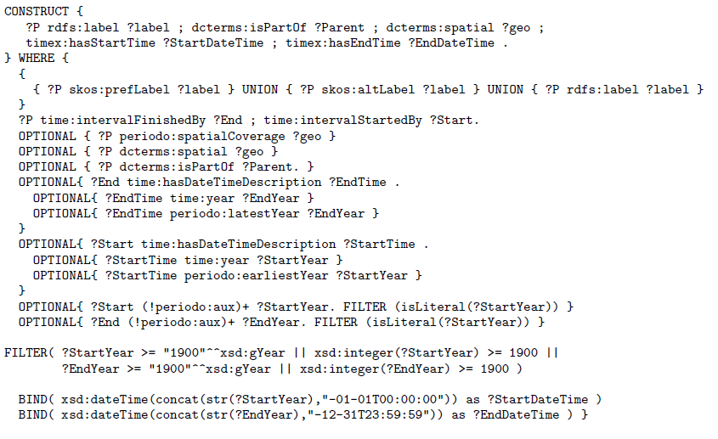
Temporal Knowledge Graph Construction
}
}
Named events and their labels
Links to parent periods
Temporal extent:
a single beginning and end date
Links to the spatial coverage

Slide 25
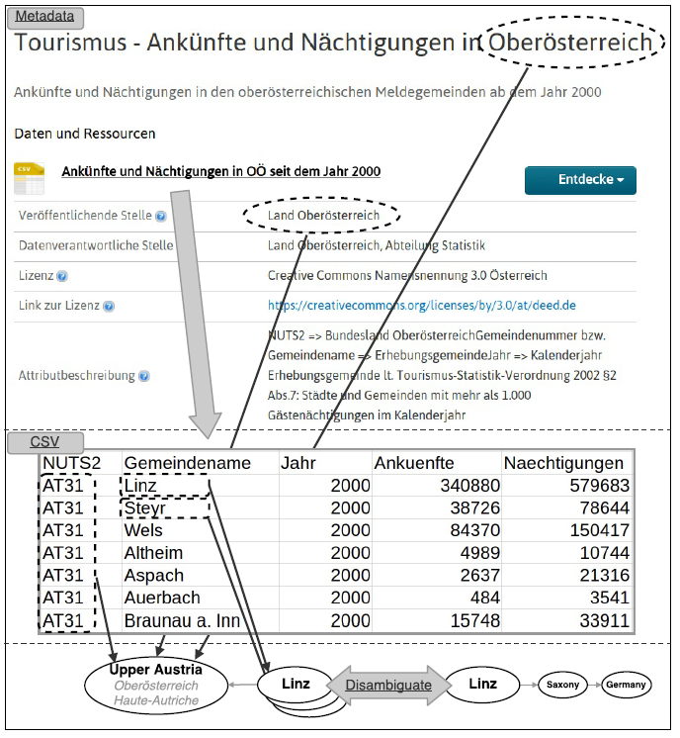
Dataset Labelling
Metadata descriptions
Geo-entities in titles, descriptions, organizations
Restricted to „origin“ country of the dataset (from portal)
Temporal tagging using Heideltime framework [3]
CSV cell value disambiguation
Row context:
  Filter candidates by potential parents (if available)
Column context:
  Least common ancestor of the spatial entities
[3] | Strötgen, Gertz: Multilingual and Cross-domain Temporal Tagging. Language Resources and Evaluation, 2013.
Notes:
Example China…

Slide 26
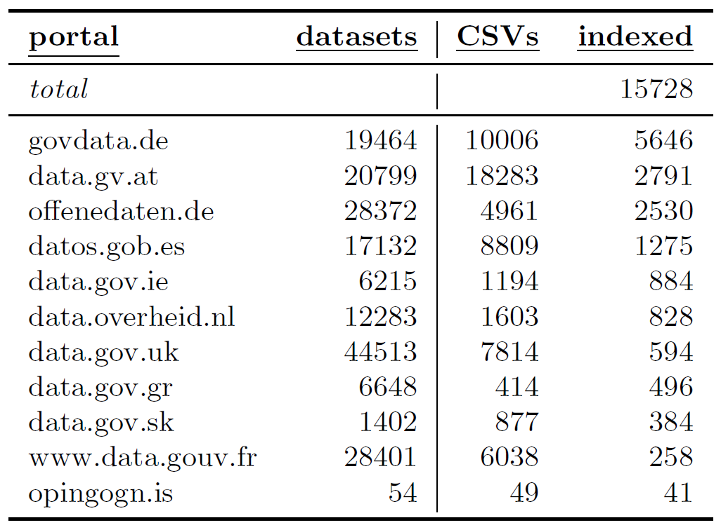
Indexed Datasets

Slide 27
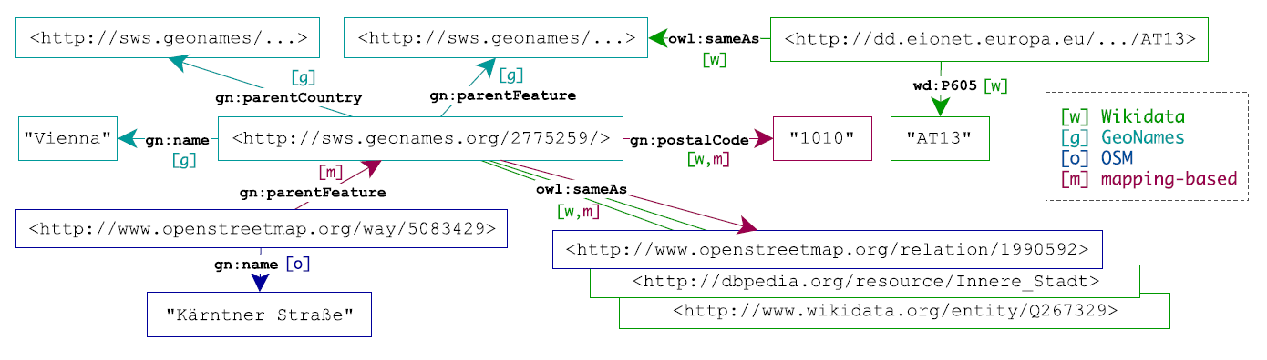
RDF Export 1/2:
Knowledge Graph
Spatial and temporal base knowledge graph
Annotated data points in metadata and CSV cells
CSV metadata using CSVW vocabulary
  e.g., delimiter, encoding, header, …

Slide 28
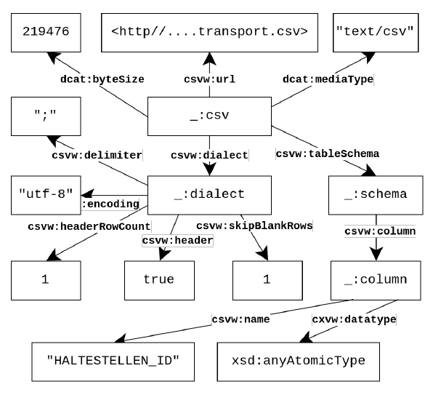
RDF Export 2/2:
CSV on the Web Metadata [4]
Note: no real cell level annotaitons, we needed to add those!
E.g.:
  csvwx:cell
    csvwx:hasTime
    csvw:refersToEntity
  …
  Details: cf.: http://data.wu.ac.at/ns/csvwx
[4] | R. Pollock et al., Metadata Vocabulary for Tabular Data, W3C CSV on the Web (2015)

Slide 29
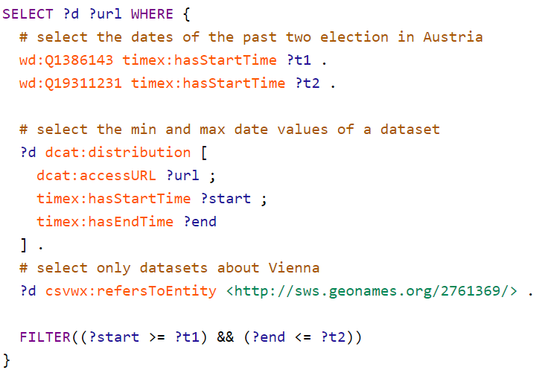
SPARQL Endpoint (1)
Find datasets within time-range and referring to geospatial entity:

Slide 30
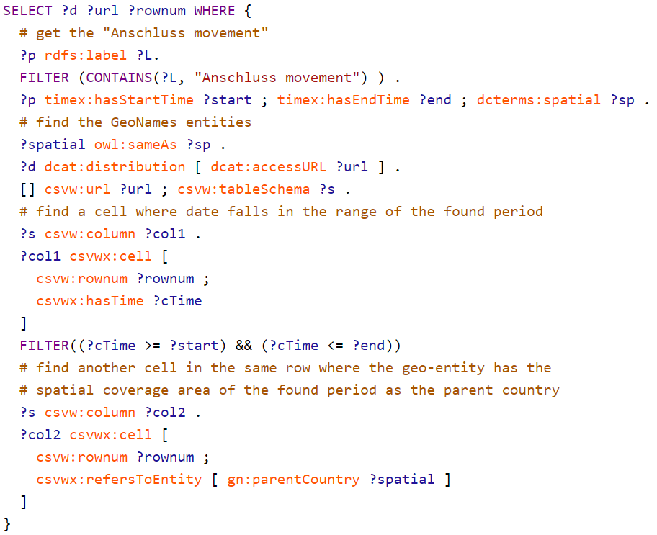
SPARQL Endpoint (2)
Text search for a time period and its temporal and spatial coverage
Query for cells within time period and referring to geo-entity

Slide 31
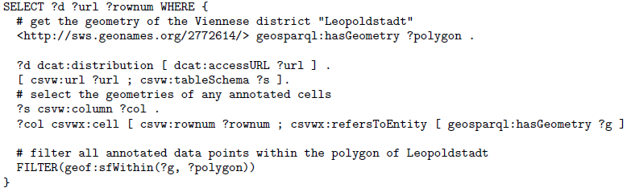
GeoSPARQL Queries
Standard for representation and querying of geospatial linked data
(Almost) no complete implementations of GeoSPARQL

Slide 32
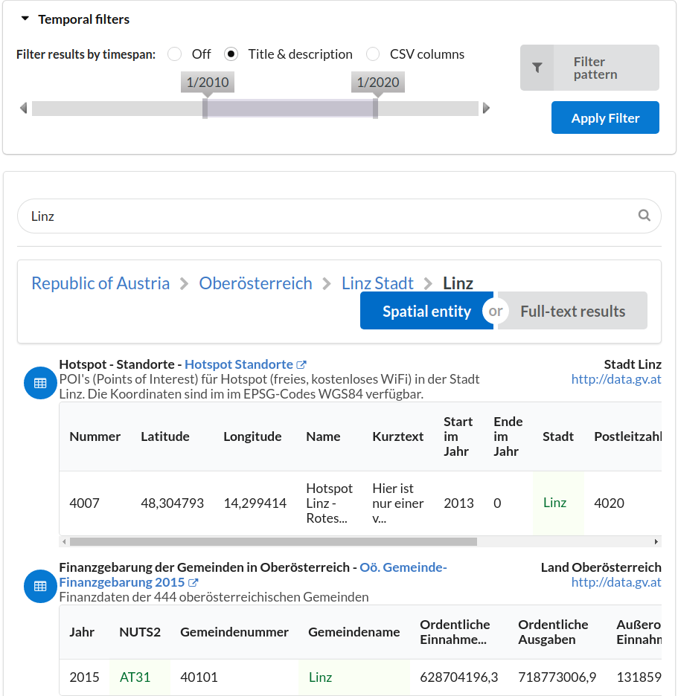
Search Interface
Faceted query interface:
Timespan
Time pattern
Geo-entities
Full-text queries
Back end:
MongoDB for efficient key look-ups
ElasticSearch for indexing and full-text queries
Virtuoso as a triple store

Slide 33
Conclusions & Outlook
Open (Structured) Data is a rich source of Knowledge worthwhile to tap into
Most of it is not (yet) Linked Data.
What we did:
Hierarchical knowledge graph of spatial and temporal entities
Algorithms to annotate CSV tables and their metadata descriptions
What‘s next:
Enable GeoSPARQL (or an alternative geospatial-query language)
Parsing coordinates in datasets
Parse other file fomats, e.g., XML, PDF, …
Test other domains such as tweets or web pages (e.g., newspaper articles)

Slide 34

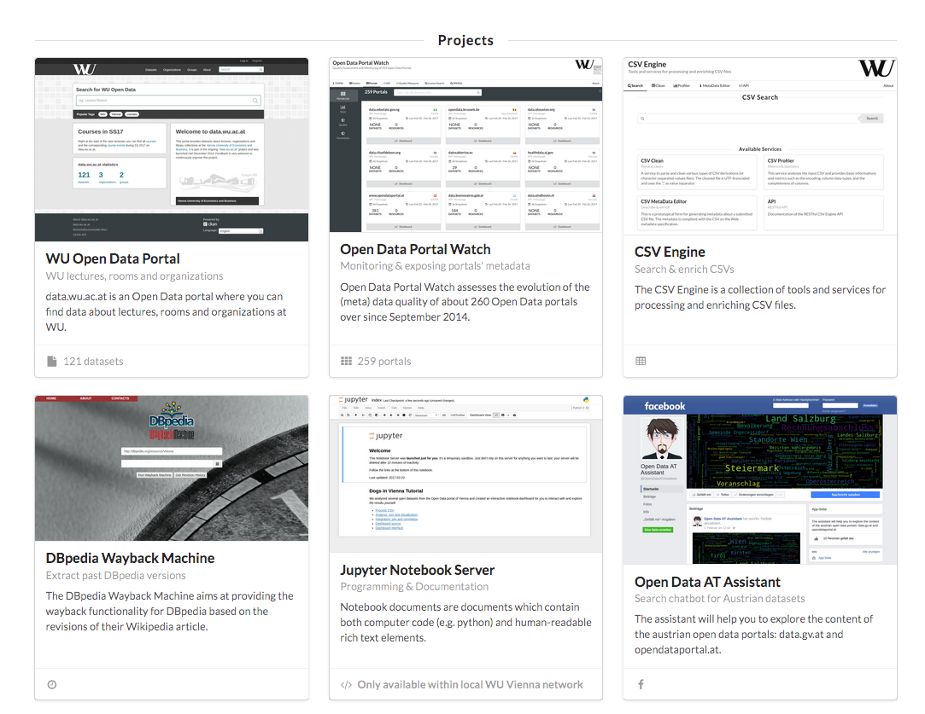
Other Ongoing Projects (data.wu.ac.at)

Slide 35
What else are we working on?
Open Data Portalwatch
  1) Monitoring Metadata quality
  2) Mapping to standard vocabularies
  3) Enriching Metadata to improve search (talked about that already)

Slide 36
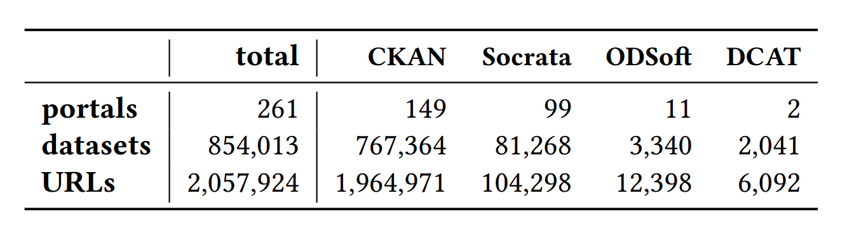
1) Monitoring and QA over evolving data portals
3/2015 [1]:
- 90 portals
- Only CKAN
8/2015 [2]:
- 6 quality metrics
- QA
6/2016 [3]:
- 260 portals
- CKAN, Socrata, OpenDataSoft
- 18 metrics
[1] | Towards assessing the quality evolution of open data portals. In ODQ2015: Open Data Quality Workshop, Munich, Germany
[2] | Quality assessment & evolution of open data portals. In: International Conference on Open and Big Data, Rome, Italy (2015)
[3] | Automated quality assessment of metadata across open data portals. ACM Journal of Data and Information Quality (2016)

Slide 37
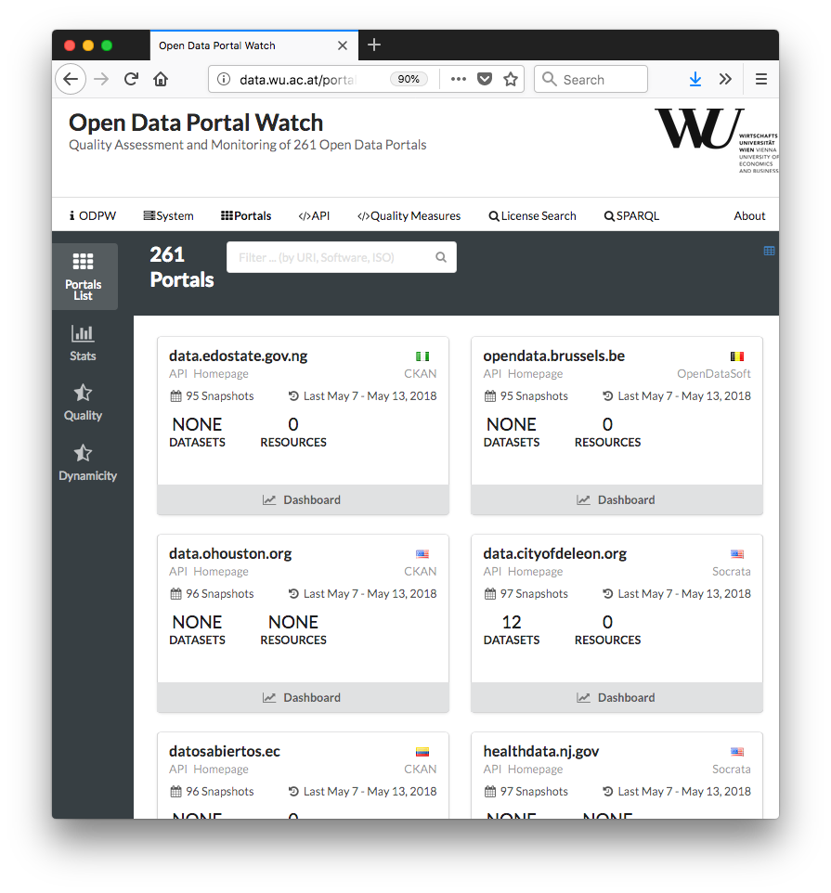
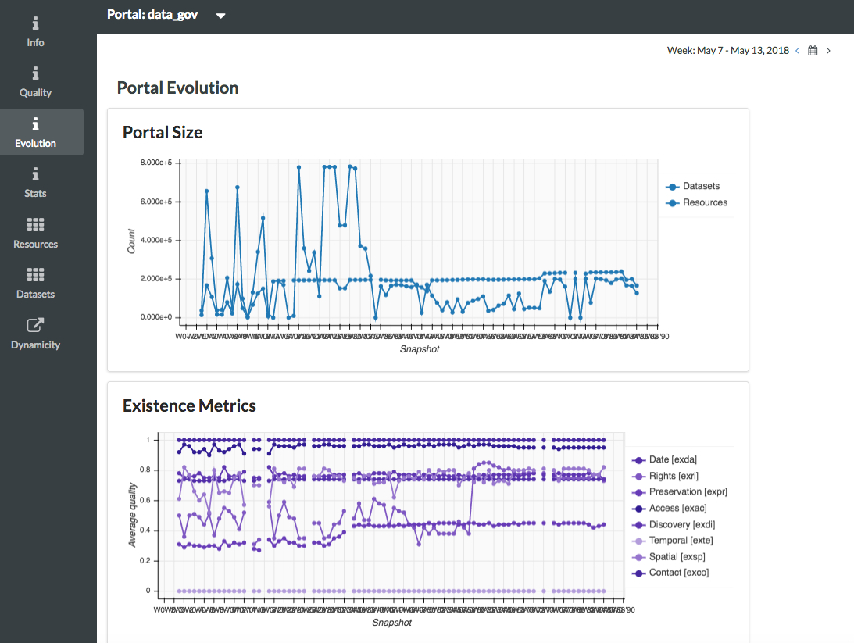
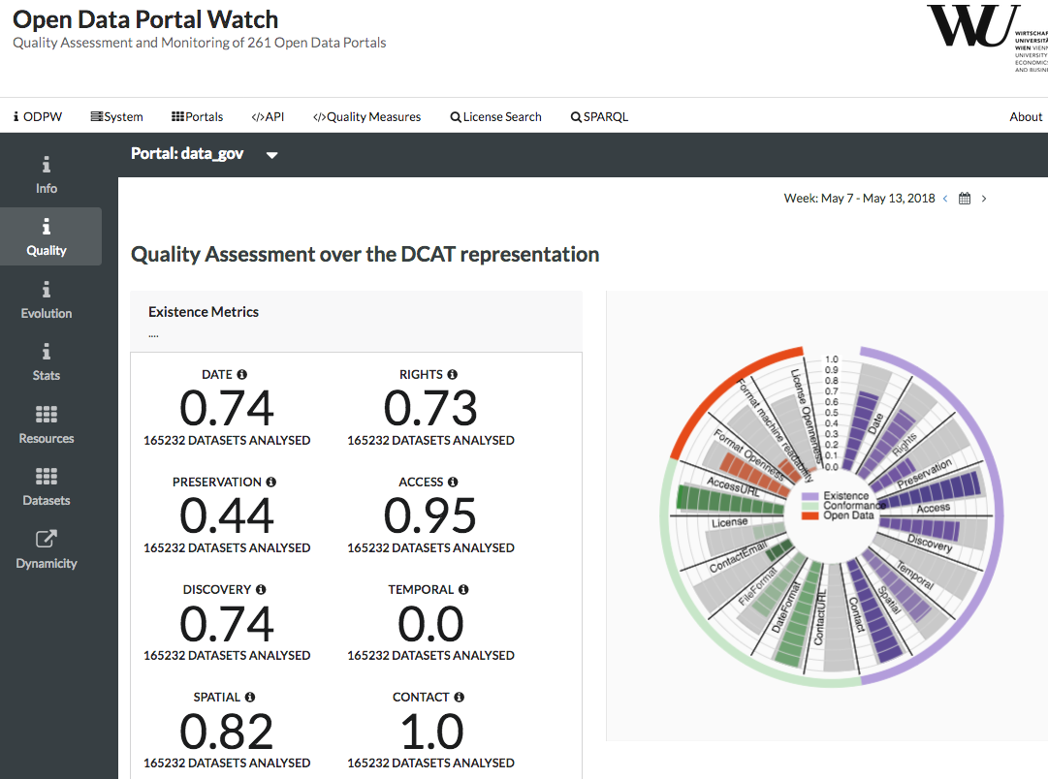
Demo:
http://data.wu.ac.at/portalwatch/portal/data_gov/1818

Slide 38
2) Mapping to Standard vocabularies & Linked Data
Mapping & Heuristic Enrichment
  DCAT
  PROV
  CSVW
  Schema.org
Enable uniform access:
  →SPARQL endpoint
  → Linked Data & Memento Protocol
[1] | http://data.wu.ac.at/portalwatch/sparql
[2] | http://data.wu.ac.at/odso/

Slide 39
Backup Slides

Slide 40
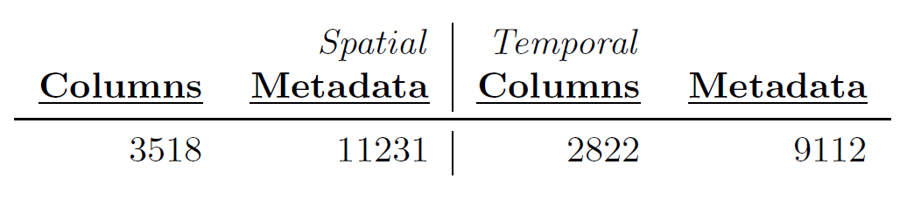
Spatio-temporal labelling –
Evaluation:
Total numbers of spatial and temporal annotations of metadata descriptions and columns:
10 random CSV datasets per portal (11 portals), 10 random rows per dataset:
In total inspected 101 datasets 1010 rows
87 Correctly assigned labels at the dataset level
37 CSV datasets that contain potentially missing annotations (e.g. text that would need to be parsed first, or malformed CSVs, etc.)
9 Incorrect links to GeoNames
9 Incorrect links to OSM

