Slide 1
Serving and Querying Open Knowledge Graphs on the Web - Part 1
KnowGraphs WinterSchool 2022
Axel Polleres
January 2022

Slide 2
What I've planned for today:
Part 1:
Interlude
Practical examples on querying Open KGs with SPARQL
Challenges/limitations of SPARQL over public endpoints
Part 2:
Serve and query KGs for local processing – HDT
Addressing the SPARQL endpoint bottleneck – where are we?
Linked Data Fragments
Smart-KG
Wise-KG

Slide 3
Standard format (RDF) & Standard Query language (SPARQL) for Graph Data
Data representation
RDF (= Resource Description Framework)
a standard Format for publishing Graph Data on the Web.
Can be seen as a labeled graph
Querying
SPARQL
a query language (similar to SQL) for RDF data

Slide 4
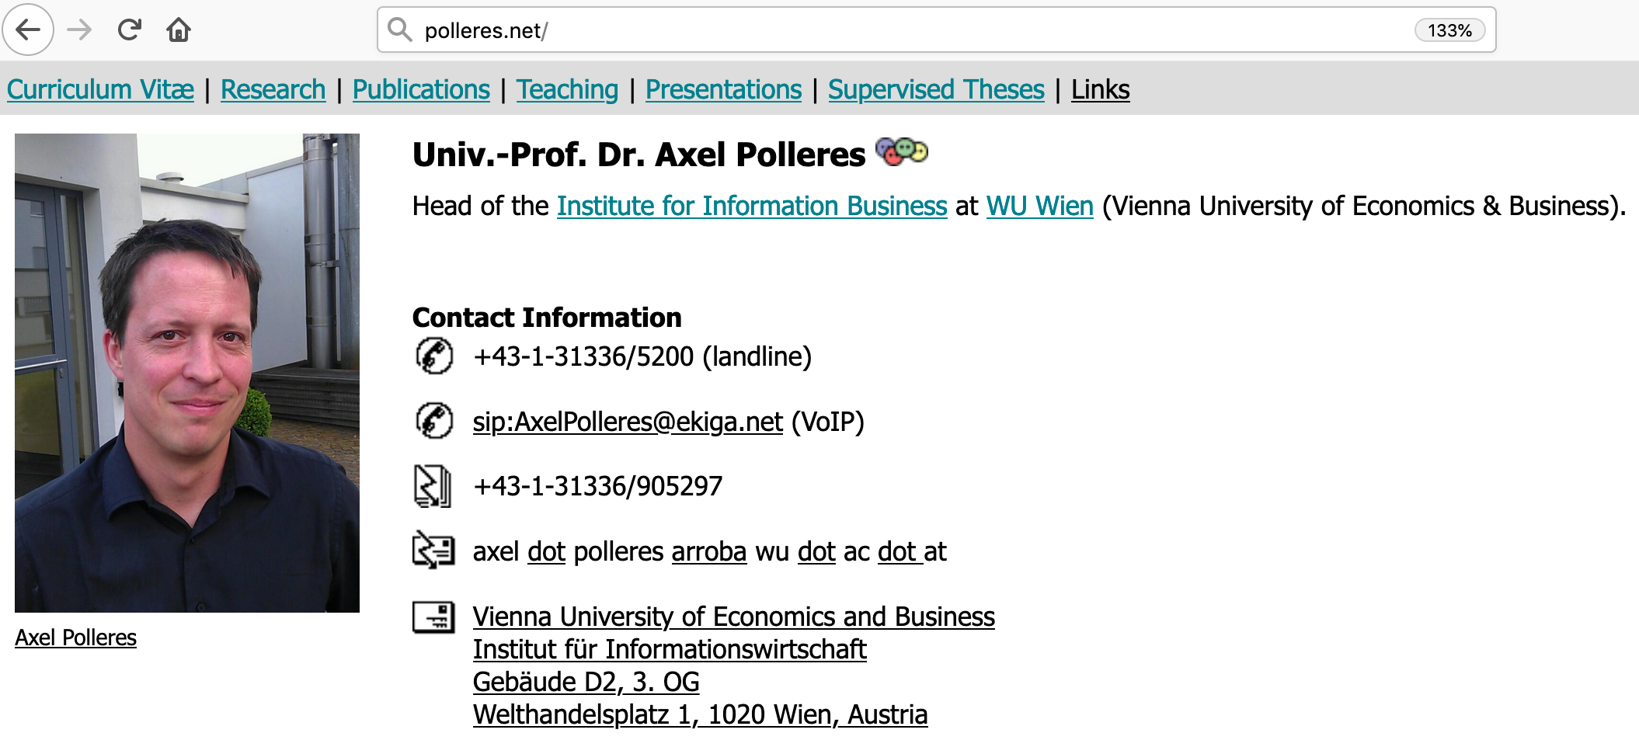
RDF was invented for the Web, for annotating Webpages with "typed links"
isA
http://xmlns.com/foaf/0.1/Person
http://xmlns.com/foaf/0.1/workplaceHomepage
RDF uses URIs for the links to define their Semantics, i.e.,
when you look up these links, you can find out what http://xmlns.com/foaf/0.1/workplaceHomepage
means!
You find such RDF links on my Homepage!
Click on on http://polleres.net

Slide 5
RDF Triple:
A triple of URLs
… can be seen as an edge in a Graph:
<http://www.polleres.net#me> <http://xmlns.com/foaf/0.1/workplaceHomepage> <http://www.wu.ac.at> .
polleres.net#me
workplaceHomepage
www.wu.ac.at

Slide 6
RDF vocabularies 1/2:
Vocabularies (collections of URIs to define meaning for Links) are identified by a common URI prefix:
The
RDF Core (rdf: http://www.w3.org/1999/02/22-rdf-syntax-ns#) and
RDFS Schema (rdfs: http://www.w3.org/2000/01/rdf-schema#)
vocabularies define basic meaning for relations such as is-A, subclasses/subproperties, (human-readable) labels,
etc. according to the RDF specification:
Important URIs that used for links (in many KGs):
http://www.w3.org/1999/02/22-rdf-syntax-ns#type (or short rdf:type)
http://www.w3.org/2000/01/rdf-schema#label (or short rdfs:label)
http://www.w3.org/2000/01/rdf-schema#subPropertyOf (or short rdfs:subClassOf)
http://www.w3.org/2000/01/rdf-schema#subClassOf (or short rdfs:subPropertyOf)
http://www.w3.org/2000/01/rdf-schema#domain (or short rdfs:domain)
http://www.w3.org/2000/01/rdf-schema#range (or short rdfs:range)

Slide 7
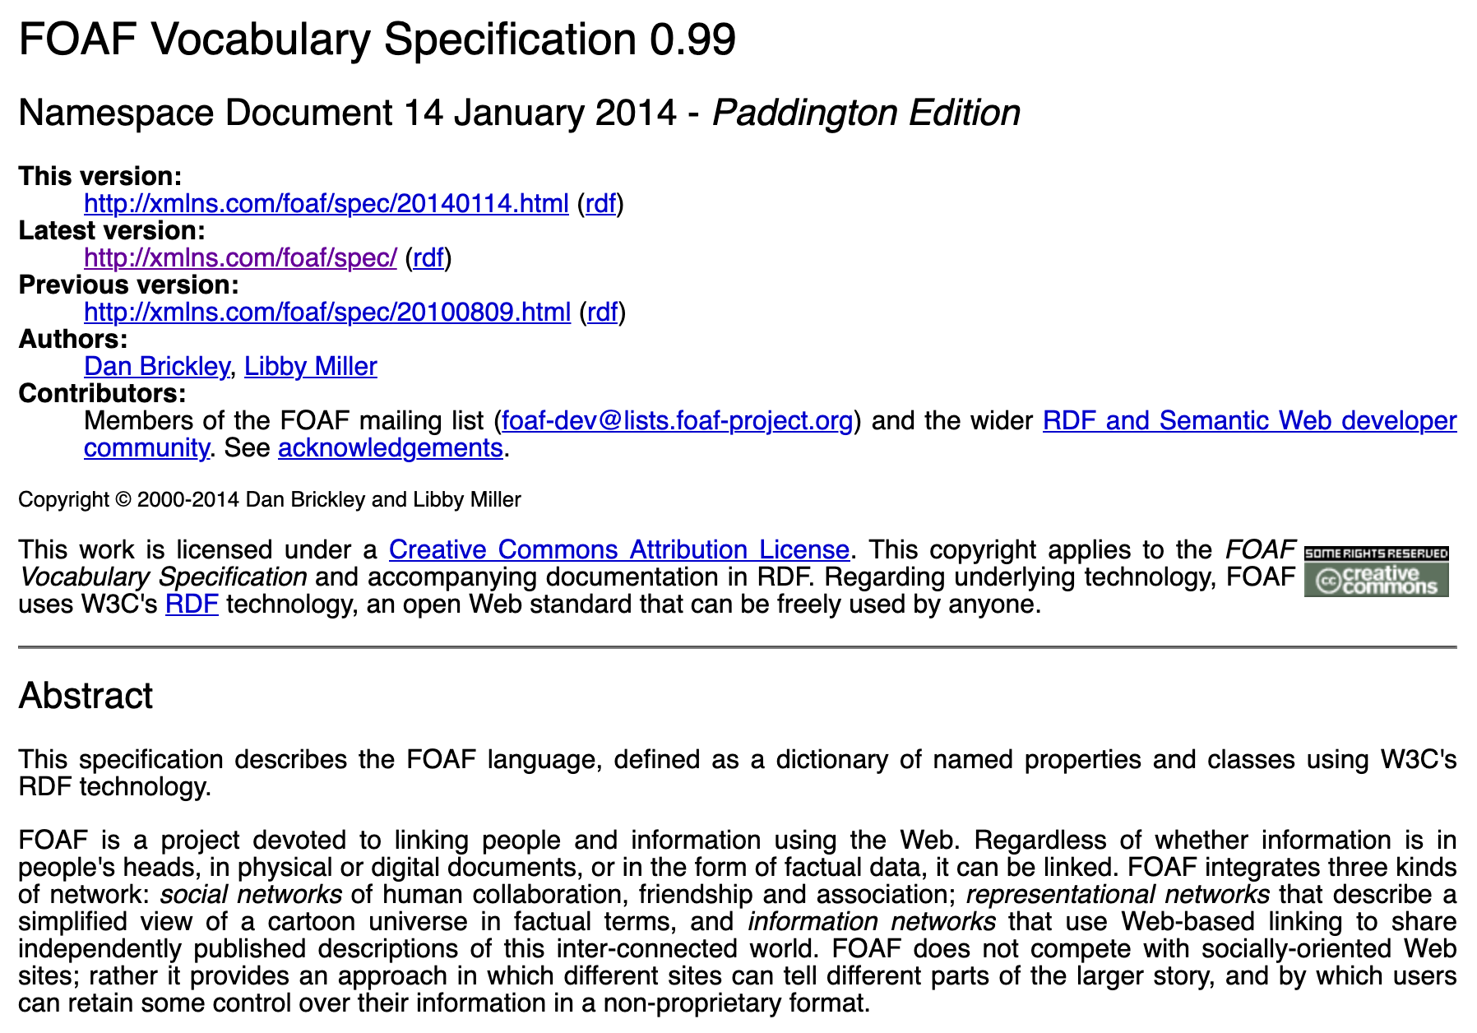
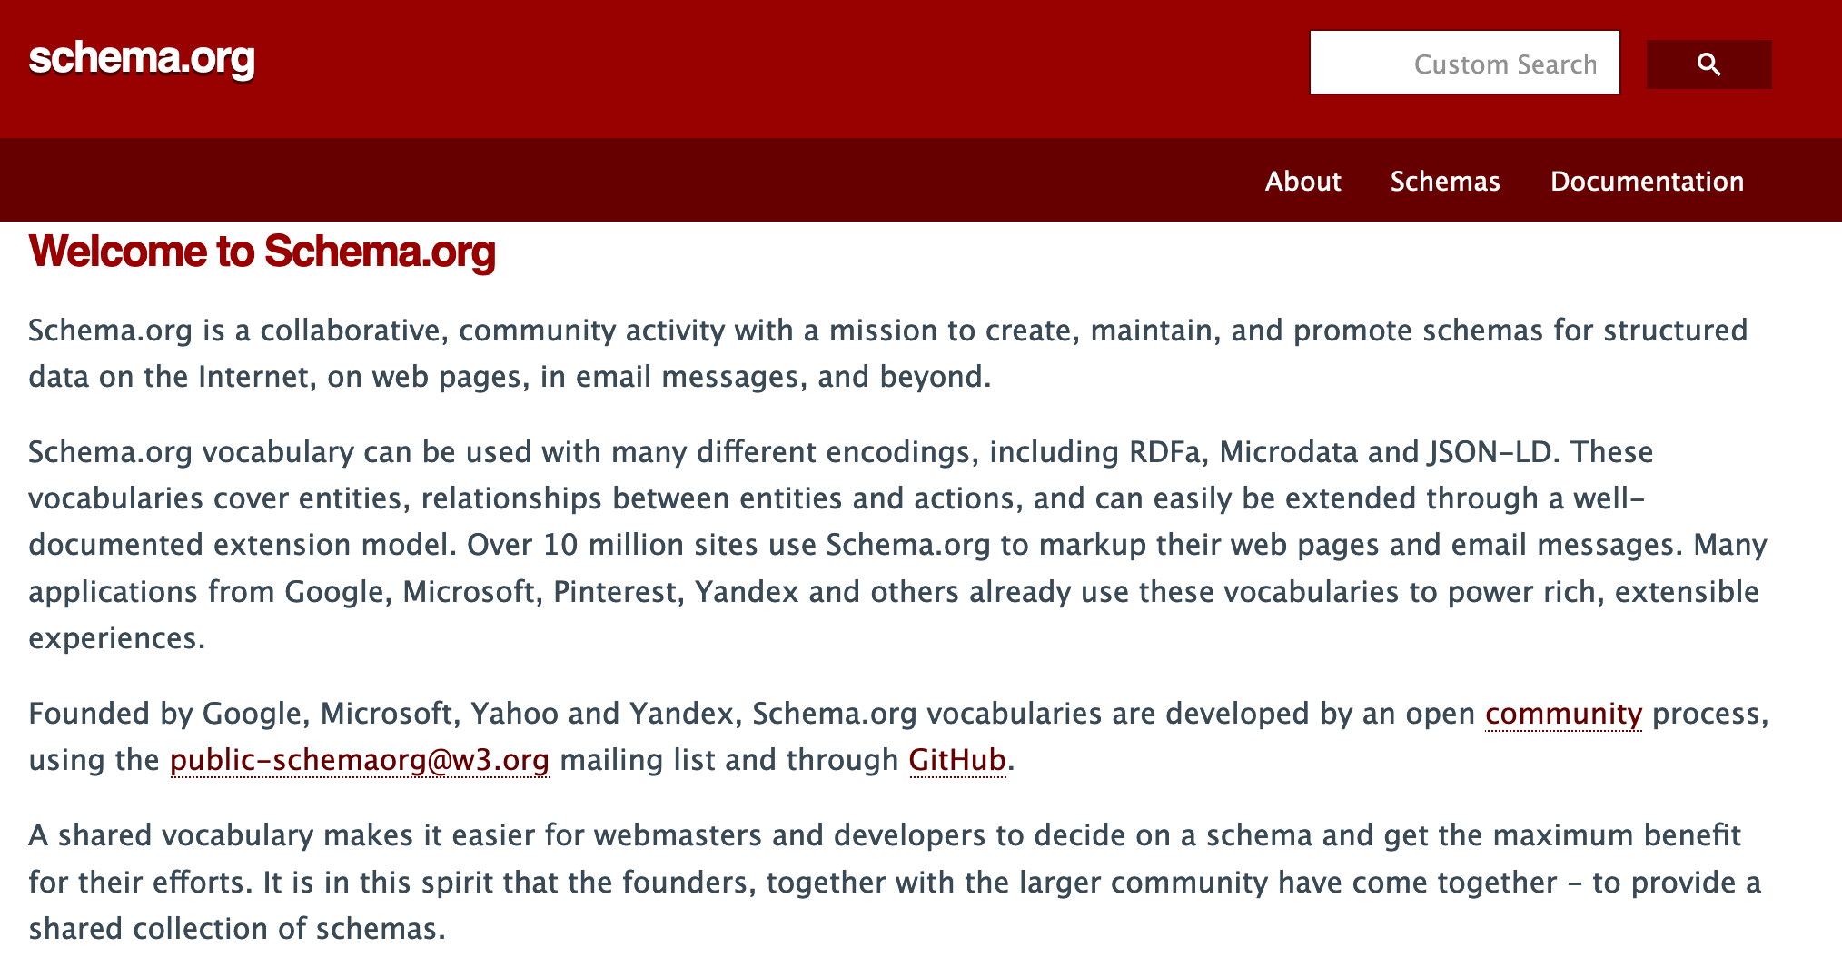
RDF vocabularies 2/2:
Other vocabularies:
foaf: Prefix: http://xmlns.com/foaf/0.1/ … The "Friend-of-a-friend' vocabulary models common properties of and classses relating to Persons and social relationships. E.g.:
Properties:
name
nickname
workplaceHomepage
knows
Classes:
Agent
Person
Document
Image
schema: Prefix: http://schema.org/ …
Classes and properties important for search engines
(founded by Google, Microsoft, Yahoo and Yandex)
or domain/KG-specific vocabularies, eg.
dbo: (DBpedia Ontology)
wd:, wdt: (Wikidata entities and properties)

Slide 8
RDF Syntaxes – A simple RDF file:
simple1.nt in NTriples Syntax :
<http://www.example.org/klaus> <http://xmlns.com/foaf/0.1/knows> <http://www.example.org/karl> .
<http://www.example.org/klaus> <http://xmlns.com/foaf/0.1/nickname> "Niki" .
<http://www.example.org/alice> <http://xmlns.com/foaf/0.1/knows> <http://www.example.org/bob> .
<http://www.example.org/alice> <http://xmlns.com/foaf/0.1/knows> <http://www.example.org/karl> .
<http://www.example.org/alice> <http://xmlns.com/foaf/0.1/name> "Alice Wonderland" .
<http://www.example.org/karl> <http://xmlns.com/foaf/0.1/name> "Karl Mustermann" .
<http://www.example.org/karl> <http://xmlns.com/foaf/0.1/knows> <http://www.example.org/joan> .
<http://www.example.org/bob> <http://xmlns.com/foaf/0.1/name> "Robert Mustermann" .
<http://www.example.org/bob> <http://xmlns.com/foaf/0.1/nickname> "Bobby" .

Slide 9
RDF Syntaxes – A simple RDF file:
simple1.ttl in Turtle (Terse RDF Language) Syntax is a bit more readable:
# using the FOAF vocabulary, see http://xmlns.com/foaf/spec/
@prefix : <http://www.example.org/> .
@prefix foaf: <http://xmlns.com/foaf/0.1/>.
:klaus foaf:knows :karl .
:klaus foaf:nickname "Niki".
:alice foaf:knows :bob .
:alice foaf:knows :karl .
:alice foaf:name "Alice Wonderland" .
:karl foaf:name "Karl Mustermann" .
:karl foaf:knows :joan.
:bob foaf:name "Robert Mustermann" .
:bob foaf:nickname "Bobby" .

Slide 10
RDF Syntaxes – A simple RDF file:
simple1.ttl in Turtle (Terse RDF Language) Syntax is a bit more readable –
Turtle Syntax also allows some shortcuts to group Triples with common subjects:
# using the FOAF vocabulary, see http://xmlns.com/foaf/spec/
@prefix : <http://www.example.org/> .
@prefix foaf: <http://xmlns.com/foaf/0.1/>.
:klaus foaf:knows :karl ;
foaf:nickname "Niki".
:alice foaf:knows :bob , :karl ; foaf:name "Alice Wonderland" .
:karl foaf:name "Karl Mustermann" ; foaf:knows :joan.
:bob foaf:name "Robert Mustermann" ; foaf:nickname "Bobby" .
Note: We will need Turtle Syntax for querying RDF data!

Slide 11
Standards have lead to big open KGs…
… some of which availabe on the Web
… queryable via SPARQL endpoints!
plus useful convenience tools:
http://prefix.cc/ … find out common URI prefixes for formulating queries
http://yasgui.triply.cc/ … really nice frontend for querying SPARQL endpoints, e.g. DBpedia
https://query.wikidata.org/ … really nice frontend specifically for querying Wikidata
Plus tons of APIs (e.g. Python, R packages, etc.)
1,101,215,718 triples/edges 13,602,048,837 triples/edges

Slide 12
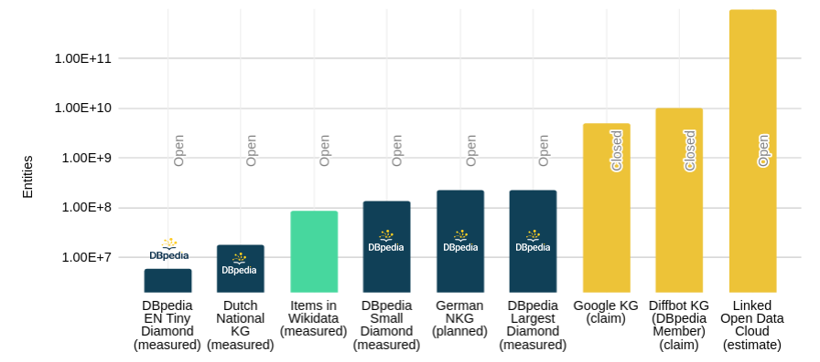
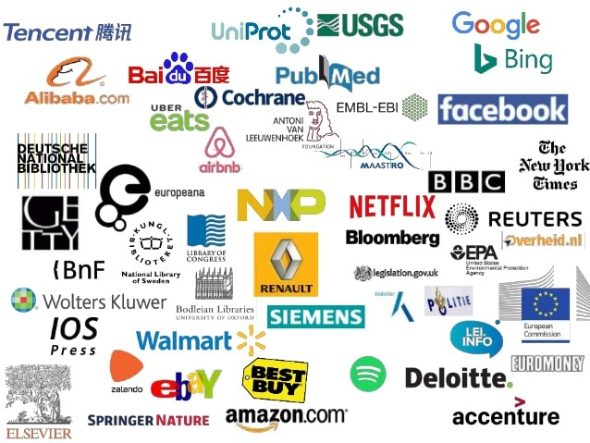
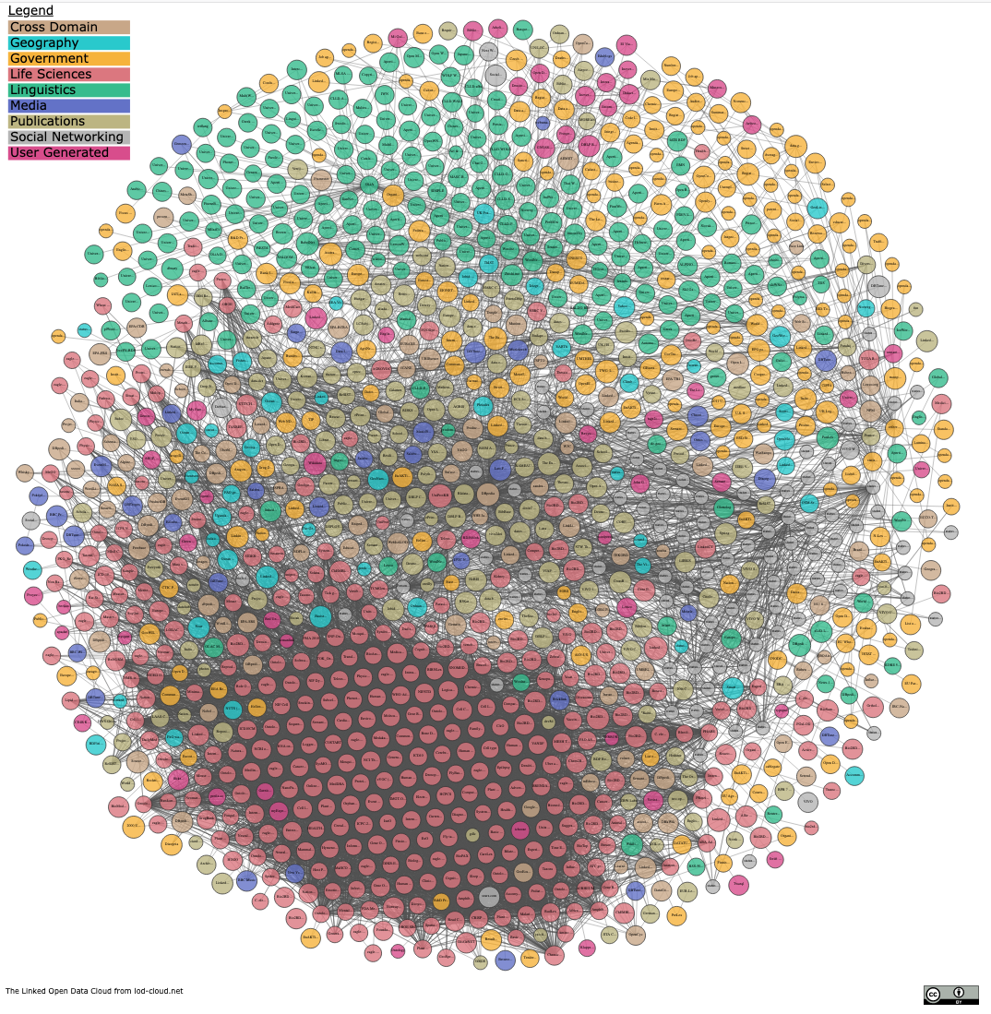
Standards have lead to big open KGs… … plus (even bigger?) closed KGs
… plus growing interest of Enterprises in KGs
Success stories of mainly monolithic (but huge) Knowledge Graphs rather than a network of Linked small KGs:
https://www.slideshare.net/Frank.van.Harmelen/adoption-of-knowledge-graphs-late-2019
https://www.dbpedia.org 2021
Notes:
https://www.slideshare.net/Frank.van.Harmelen/adoption-of-knowledge-graphs-late-2019

Slide 13
How do we query these KGs in practice?
… SPARQL!

Slide 14
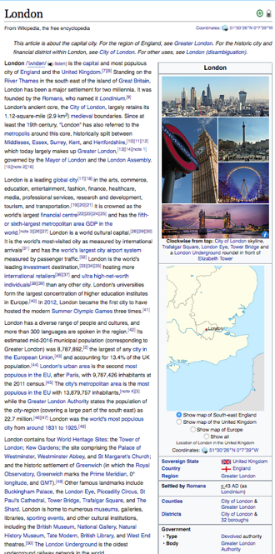
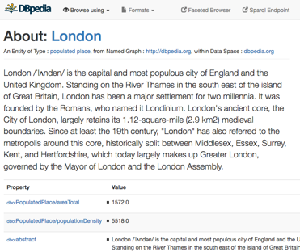
RDF used in practice on the Web: DBpedia - a "Database-version" of Wikipedia:
E.g. from
One of the central datasets of the Linked Open Data-Cloud
RDF extracted from Wikipedia-Infoboxes
You can use a language called SPARQL endpoint (roughly: SQL for RDF) to do structured queries over RDF:
„Cities in the UK with more than 1M population“:
Structured queries (SPARQL):
http://yasgui.org/short/UVOyhX8ft
https://en.wikipedia.org/wiki/London
http://dbpedia.org/resource/London
PREFIX : <http://dbpedia.org/resource/>
PREFIX dbo: <http://dbpedia.org/ontology/>
PREFIX yago: <http://dbpedia.org/class/yago/>
SELECT DISTINCT ?city ?pop WHERE {
?city a yago:City108524735 .
?city dbo:country :United_Kingdom.
?city dbo:populationTotal ?pop
FILTER ( ?pop > 1000000 )
}
Automatic Exctractors

Slide 15
RDF used in practice on the Web: Another Open Knowledge Graph: Wikidata
slightly different idea than DBpedia:
a Wikimedia foundation project itself
put simply: "replace factual data within Wikipedia by a (graph) Database"
Wikidata can also be queried as RDF with SPARQL!

Slide 16
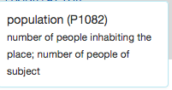
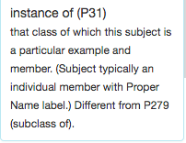
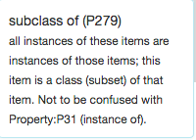
Let's learn some SPARQL with Wikidata
“Simple” surface query:
Which cities in the UK have more than 1M people?
What’s this?
SELECT DISTINCT ?city WHERE {
?city wdt:P31/wdt:P279* wd:Q515.
?city wdt:P1082 ?population .
?city wdt:P17 wd:Q38 .
FILTER (?population > 1000000) }
Page 16

Slide 17
Let's learn some SPARQL with Wikidata
You can try out the queries on http://query.wikidata.org/
https://www.wikidata.org/entity/Q41176 (wd:Q41176) … Building http://www.wikidata.org/prop/direct/P31 (wdt:P31) … instanceOf
Triple Patterns (TPs): Try this query for
"Give me 10 buildings"
https://w.wiki/4TAP

Slide 18
Let's learn some SPARQL with Wikidata
You can try out the queries on http://query.wikidata.org/
https://www.wikidata.org/entity/Q41176 (wd:Q41176) … Building http://www.wikidata.org/prop/direct/P31 (wdt:P31) … instanceOf
Basic Graph patterns (BGPs): "Join" between edges/triples:
"Give me 10 buildings in Austria"
https://w.wiki/4TAY

Slide 19
Let's learn some SPARQL with wikidata
You can try out the queries on http://query.wikidata.org/
https://www.wikidata.org/entity/Q41176 (wd:Q41176) … Building http://www.wikidata.org/prop/direct/P31 (wdt:P31) … instanceOf
UNION between patterns:
Try this query for "Give me 10 buildings in Austria or Germany"
https://w.wiki/4TAf

Slide 20
Let's learn some SPARQL with wikidata
You can try out the queries on http://query.wikidata.org/
https://www.wikidata.org/entity/Q41176 (wd:Q41176) … Building http://www.wikidata.org/prop/direct/P31 (wdt:P31) … instanceOf
FILTERs (similar to WHERE conditions in SQL):
"Give me the German labels of 10 buildings in Austria or Germany"
https://w.wiki/4TAk

Slide 21
Let's learn some SPARQL with wikidata
You can try out the queries on http://query.wikidata.org/
https://www.wikidata.org/entity/Q41176 (wd:Q41176) … Building http://www.wikidata.org/prop/direct/P31 (wdt:P31) … instanceOf
OPTIONAL (similar to OUTER JOIN in SQL):
"Give me the German labels of 10 buildings in Austria and their architect (if available)"
https://w.wiki/4TAn

Slide 22
Full details of SPARQL and many more examples:
https://www.w3.org/TR/sparql11-query/
Supported by various modern graph databases.

Slide 23
What I've planned for today:
Part 1:
Interlude
Practical tutorial on querying Open KGs with SPARQL
(some) Challenges/limitations of SPARQL over public endpoints
Part 2:
Serve and query KGs for local processing – HDT
Addressing the SPARQL endpoint bottleneck – where are we?
Linked Data Fragments
Smart-KG
Wise-KG

Slide 24
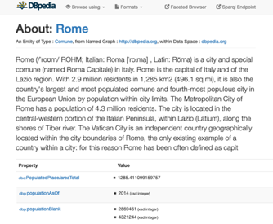
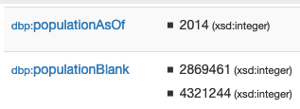
Challenge 1: Often, you also need to deal with contextualized information
E.g. from
Doesn’t work!
„Cities in the Italy with more than 1M population“:
Structured queries (SPARQL):
https://en.wikipedia.org/wiki/Rome
http://dbpedia.org/resource/Rome
http://yasgui.org/short/UVOyhX8ft
Automatic Exctractors
PREFIX : <http://dbpedia.org/resource/>
PREFIX dbo: <http://dbpedia.org/ontology/>
PREFIX yago: <http://dbpedia.org/class/yago/>
SELECT DISTINCT ?city ?pop WHERE {
?city a yago:City108524735 .
?city dbo:country :Italy.
?city dbo:populationTotal ?pop
FILTER ( ?pop > 1000000 )
}

Slide 25
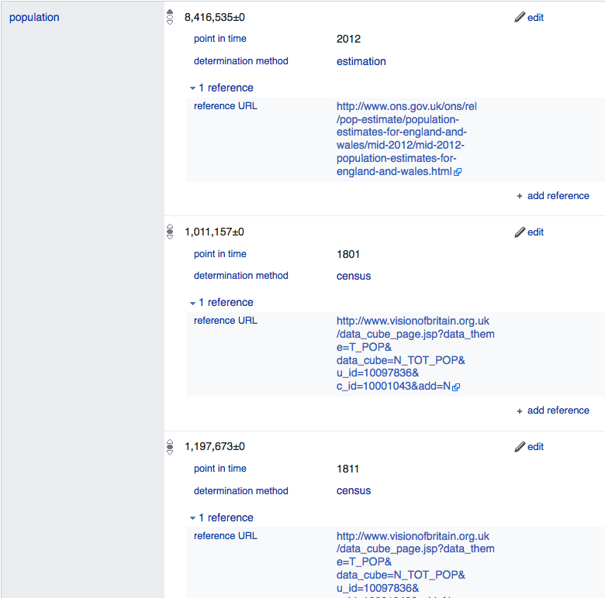
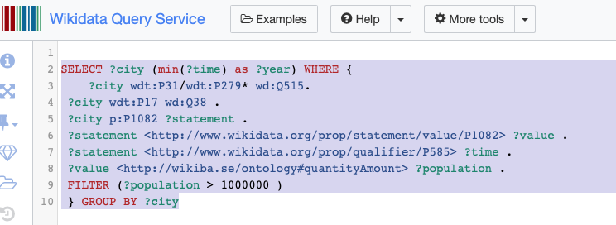
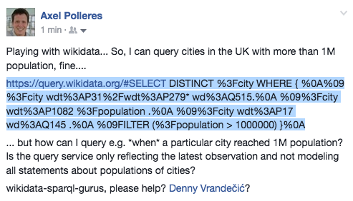
Challenge 1: Wikidata as RDF … In Wikidata even context information can be queried by SPARQL
However, Wikidata has more complex info: (temporal context, provenance,…)
Rome:
https://www.wikidata.org/wiki/Q220
… Can I query that with SPARQL?
Yes!
https://w.wiki/4rs
Page 25
Notes:
Not so easy, despite it’s Linked Data… no “common semantics by names”? And as far as I know in the Linked Data realm this is the exception, not the rule…

Slide 26
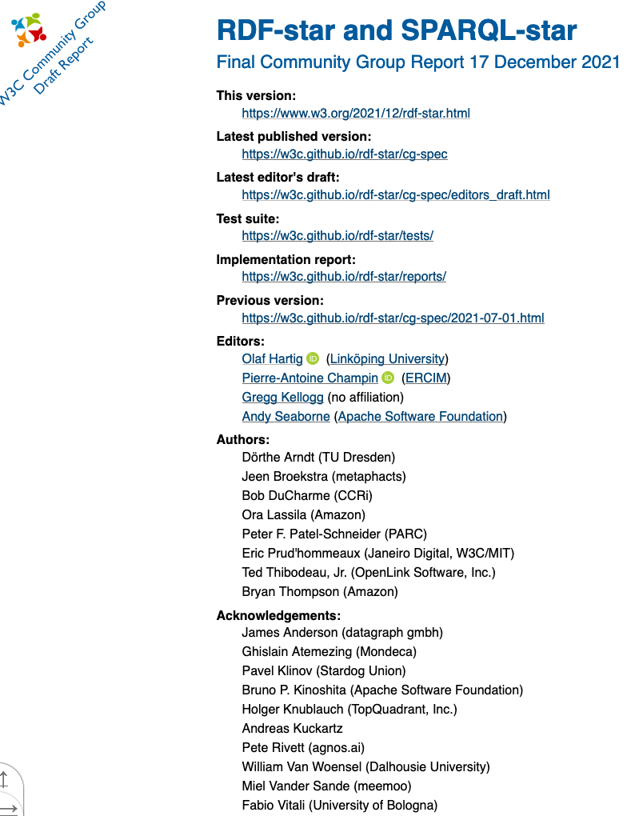
Challenge 1: Contextualized information in RDF
no standard as of yet. State of affairs:
Wikidata has its own proprietary extension (cf. last slide)
Alternative representations/engines involve Property Graphs
ongoing work: RDF*/SPARQL* community group
Rome
Italy
capitalOf
Q220
Q38
Q5119
type: capitalOf
added: 2019-06-12
author: @Bob
validityrFrom: 1861
Name: Rome
Type: City
added: 2019-06-11
author: @Alice
Name: Italy
Type: Country
added: 2019-06-11
author: @Chalrlie

Slide 27
Challenge 2: Path queries
While it is possible to do path queries in SPARQL via property path expressions, it is still not possible to return paths in SPARQL1.1:
i.e.: what is the (shortest) path ?Path connecting ?city and wd:Q515?
SELECT DISTINCT ?city ?Path WHERE {
?city wdt:P31/wdt:P279* wd:Q515.
?city wdt:P1082 ?population .
?city wdt:P17 wd:Q38 .
FILTER (?population > 1000000) }

Slide 28
Challenge 2: Path queries – prototype solution
Common problem in graphs, not doable with SPARQL, but with extensions [1]:
“Give me the (k) shortest paths between two nodes?”
Dataset 2
Dataset 1
E
:a :p :b.
:b :p :d, :e.
:c :p :b, :d.
:d :p :e.
:e :p :c.
B
A
C
D
rdf2hdt.sh -rdftype turtle testgraph.ttl testgraph.hdt
hdtsparql.sh testgraph.hdt "PREFIX ppf: <java:at.ac.wu.arqext.path.>
SELECT * WHERE{ ?path ppf:topk (:a :d 2) }"
We solved this by extending SPARQL [1] with bidirectional BFS over HDT
Open research question(s): e.g. But how to do this effectively in a Federated setting?
k=2
https://bitbucket.org/vadim_savenkov/topk-pfn/
1. Vadim Savenkov, Qaiser Mehmood, Jürgen Umbrich, and Axel Polleres. Counting to k, or how SPARQL 1.1 could be efficiently enhanced with top k shortest path queries. In 13th International Conference on Semantic Systems (SEMANTiCS), pages 97--103, Amsterdam, the Netherlands, September 2017. ACM. [ .pdf ]

Slide 29
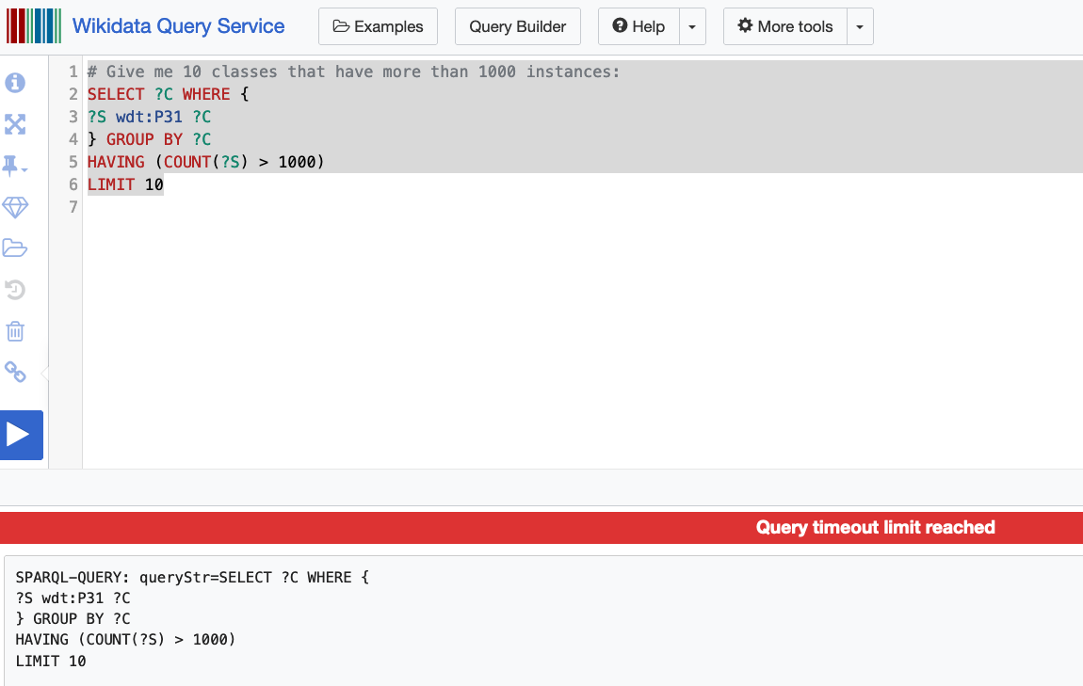
Challenge 3: Scalability of SPARQL endpoints?
Challenge 3.1: serve complex/long runnign queries to single users
Challenge 3.2: serve many queries to many users concurrently
https://w.wiki/4mTj
more on that in Part 2

Slide 30
Challenge 4: Reasoning and Inconsistencies
A lot of work has been done in the past on (deductive reasoning over KGs) in particular to retrieve implicit answers through
exploiting the OWL and RDFS semantics.
… e.g. by query rewriting or materialisation.
Howewer:
existing KGs are inconsistent
some important KGs don't use OWL and RDFS

Slide 31
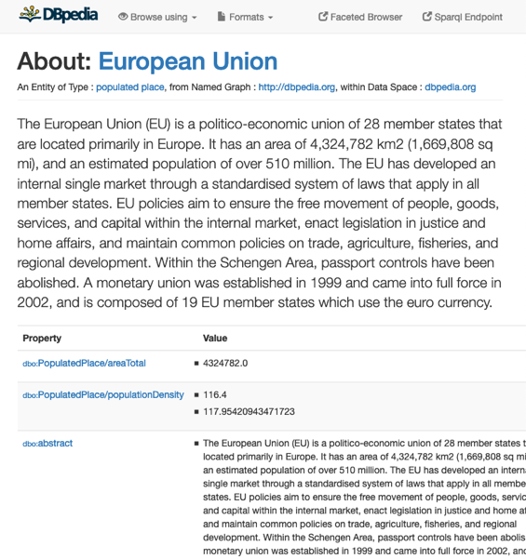
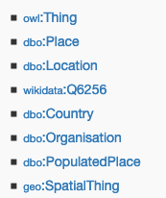
Existing KGs aren’t consistent ☹ [1]
Challenge 4: Reasoning and Inconsistencies
E.g.
Dbpedia Ontology:
dbo:Agent owl:disjointWith dbo:Place.
dbo:Country rdfs:subClassOf dbo:Place.
dbo:Organisation rdfs:subClassOf dbo:Agent.
Stefan Bischof, Markus Krötzsch, Axel Polleres, and Sebastian Rudolph. Schema-agnostic query rewriting in SPARQL 1.1. In Proceedings of the 13th International Semantic Web Conference (ISWC 2014), Lecture Notes in Computer Science (LNCS). Springer, October 2014. [ .pdf ]

Slide 32
Challenge 4: Reasoning and Inconsistencies
important KGs don't use OWL and RDFS
Wikidata!
use "somewhat similar" properties:
wdt:P31 ~ rdf:type
wdt:P279 ~ rdfs:subClassOf
SELECT DISTINCT ?city ?Path WHERE {
?city wdt:P31/wdt:P279* wd:Q515.
?city wdt:P1082 ?population .
?city wdt:P17 wd:Q38 .
FILTER (?population > 1000000) }

