Slide 1
From Semantic Web to Wisdom Web: A Retrospective on the Journey to 2043
ESWC² 2043
Extended Computer-Supported Wisdom Conference
Gary P. Tchat, Amin Anjomshoaa, Daniil Dobriy, Fajar J. Ekaputra, Elmar Kiesling, Axel Polleres and Marta Sabou

Slide 2
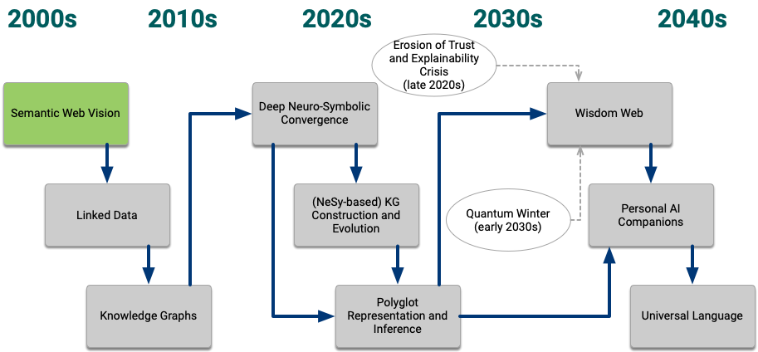
The Evolution of the Wisdom Web
Notes:
Let me just put that little fish in my ear to understand you all and make you all understand what I’m saying here in Classical Human Language, It’s lovely to see that such little tools became possible through Universal Language es well!
When looking back to the last 40 years, some of the older people in the room will remember this was once called the “Semantic Web Conference”, while others may not even remember where this actually started off, certainly because we still leave too many things to machines nowadays.

Slide 3
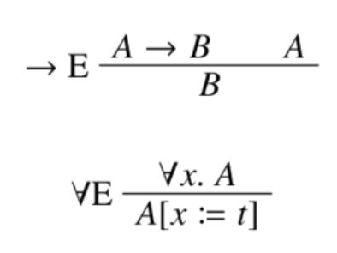
(Deep)Neuro-Symbolic Convergence
The 2020s
“human language”
”words and texts”
<rdf xmlns: …>
…
</rdf>
@prefix owl: <http://w3...>
ex:s ex:p ex:o.
RDF, RML,
SHACL, SPARQL…
(0.5,0.7 ,…, 0.9,0.3)
(0.5,0.8 ,…, 0.9,0.3)
(0.1,0.6 ,…, 0.2,0.1)
“knowledge graphs”
“vector representations”
Notes:
In the beginning of the 2020s we were still dealing with fundamentally different conceptual ideas of Wisdom representation,
through “written“ language,
through symbolic, formal languages and knowledge representation in logics,
but also through purely purely numeric, non-complex “vector space representations”
which were loosely coupled and we tried to teach machines to learn creating one from the other using
With
- intermediate “textual representations in between that were hard to read for both machines and humans, along with limited decidable reasoning algorithms.
- But also with neural network architectures that were creating such translations automatically and approximatively, based on statistical learning, using neural networks, the back then idea of how to represent Neural-brainlike reasoning, and that were used to “approximate” constraints, generate languages, but still had huge gaps in between them, in the sense that they created “hallucinated text” or obviouslogical inconcistenties.
This was somewhat addressed by the rise of neuro-symbolic systems that enabled a tight and controllable integration of deep neurosymbolic representations, deeply integrating constraints and symbolic reasoning

Slide 4
The 2020s (Deep)Neuro-Symbolic Convergence
Challenges Solved:
Robust integration of representations, different graph models, and inference mechanisms
Multi-modal mass construction of KGs from text and conversations
RXF protocol
Challenges Open:
Polyglot Representation: Still separate parallel numeric and (hand-crafted) symbolic representations
Scalability/resource consumption/ explainiabilty of neural part still unsolved
Knowledge fragmentation through decentral “links” between multiple neuro-symbolic translation models
”words and texts”
RxF
RDF, RML,
SHACL, SPARQL…
(0.5,0.7 ,…, 0.9,0.3)
(0.5,0.8 ,…, 0.9,0.3)
(0.1,0.6 ,…, 0.2,0.1)
Notes:
Which solved various challenges partially, but still left some challenges open:
…

Slide 5
The late 2020s
Ongoing Research:
Work towards LGMs, but not yet scalable
Work on overcoming the computational limitations of Noisy Intermediate Scale Quantum (NISQ)
Wider Implications:
transformation of virtually all economic sectors through AI
AI put in action too early
global societal disruptions
fail of capitalism
→ Providing the basis for cooperativism of the 2030
”words and texts”
?
(0.5,0.7 ,…, 0.9,0.3)
(0.5,0.8 ,…, 0.9,0.3)
(0.1,0.6 ,…, 0.2,0.1)
Notes:
In the late 2020s, research conccentrated on overcoming these limitations…
But in parallel business and industry adopted AI technologies too bravely…

Slide 6
The early 2030s LGMs
Wider implications of cooperativism impact research:
acceptance of Personal AI companions
emergent computer-assisted wisdom research
assisted capturing of tacit knowledge (Nonaka,2000) possible/accepted
Parallel technical developments:
From LLMs → LGMs → Universal Language
Convergence of human and emergent more efficient machine language!
Personal AI companions:Human cognition and multi-modal interaction
LGM
(0.5,0.7 ,…, 0.9,0.3)
(0.5,0.8 ,…, 0.9,0.3)
(0.1,0.6 ,…, 0.2,0.1)

Slide 7
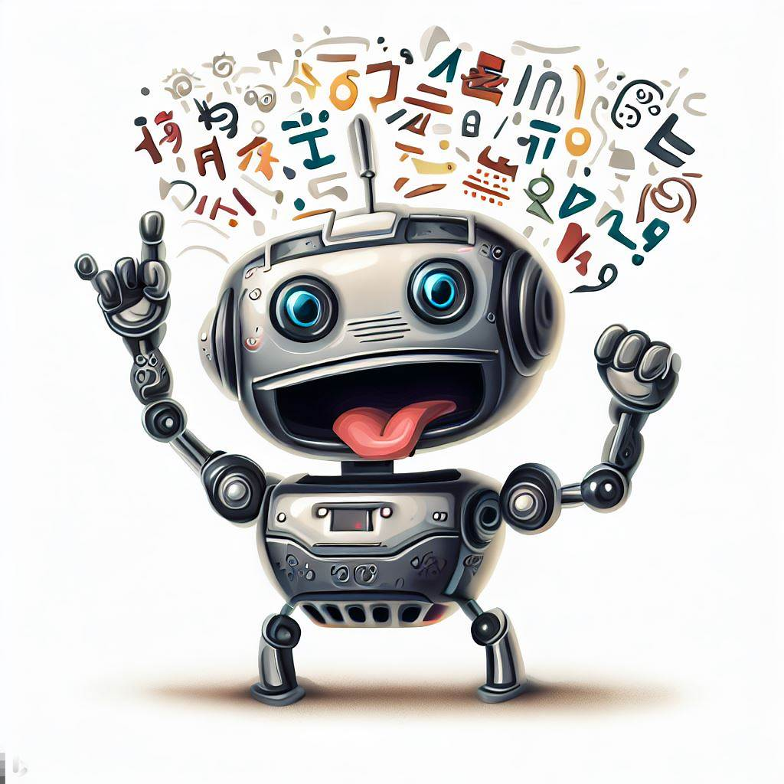
Illustration of language evolution:
In classical ~2020 language:
This paper reviews the evolution of the Wisdom Web and links its development to research on the Semantic Web – from its inception in the early 21st centuey to its current state in 2042. We discuss the key milestones, challlenges and innovations that have shaped the “Wisdom Web” landscape over the past decades, …

Slide 8
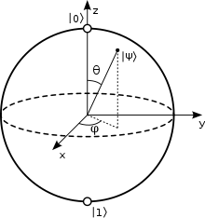
The 2030s CISQ & UDF
Note: LGMs and universal represantations
were only possible by CISQ (complex integrated scale Quantum Computing), as a basis for UDF.
Triple model → QHedge model:
enables entangles parallel representations
the basis for our current Universal Description Framework (UDF)
Entangled representations have replaced separate polyglot representations and the necessity to explicitly model "links”!
Illustration of Quantum Hyper-Edges
“QHedge”
(0.5,0.7 ,…, 0.9,0.3)
(0.5,0.8 ,…, 0.9,0.3)
(0.1,0.6 ,…, 0.2,0.1)
Key insight: Most compact entangled representations resemble and subsume traditional forms of mathematical logic! (Hayes jr. and Qcomp, 2041)

Slide 9
The Wisdom Web Vision – full potential:
ensure that knowledge is distributed across the globe scalably and resiliently
integrating the continuum of structured and unstructured data
humans and other intelligent agents to interact seamlessly at global scale
in a decentral and trustworthy manner
Notes:
Note: Not too different from the original Semantic Web vision ;-)

Slide 10
In summary: Questions we should have asked in 2023..
Which representations can be used to bridge in between embeddings and symbolic representations of Knowledge Graphs?
How will conversational AI agents interacting not only with humans but also amongst each other influence written and spoken language as well as the Semantic Web vision’s original idea of Personal (AI) agents?
Apart from what we now call knowledge representation, how can computational artefacts and models that also track interactions between agents and communities capture and represent (organisational) “wisdom”, commonly referred to as “tacit knowledge“ nowadays?
Can quantum computing and entanglement be used for knowledge representation and decentralized processing?

