Slide 1


Querying (Knowledge) Graphs
(vs. Graph Learning and LLMs?)
Recap of some past work and how it could connect to the present
Axel Polleres
Vienna University of Economics and Business (WU)
Institute for Data, Process and Knowledge Management
The presented research was funded in whole or in part by the Austrian Science Fund (FWF) [10.55776/COE12]

Slide 2
Outline
Background: Collaborative KGs
Efficient KG Archiving and Querying with HDT [1]
Applications:
  Making SPARQL endpoints more efficient [2,3]
  Making Message-Passing-based Graph processing more efficient [4]
Open Questions … many ☺
Notes:
Crisis Response and Intervention Supported by Semantic Data Pooling

Slide 3
Motivation
In our group we have done a lot of work on
querying,
analysing, and
improving the quality
of Collaborative KGs at scale

Slide 4

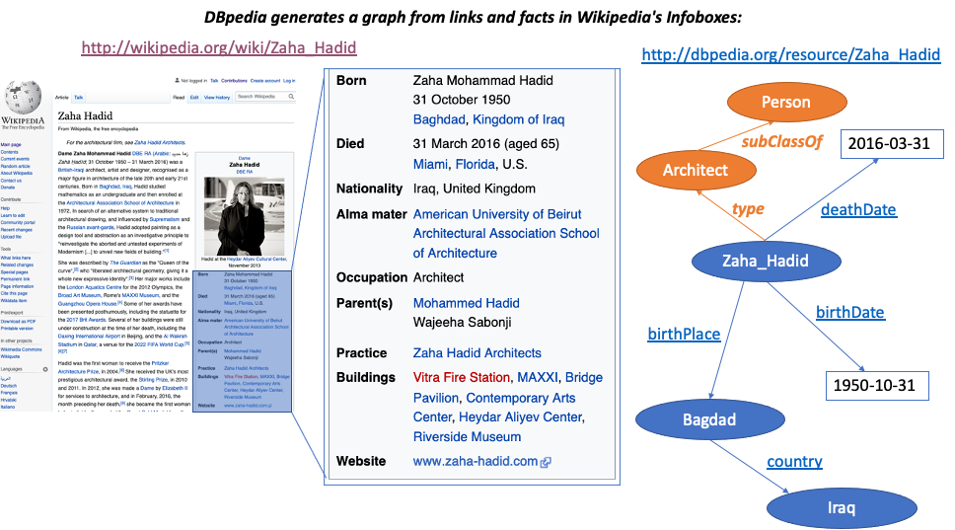
Collaborative, Open Knowledge Graphs:
DBpedia
RDF+OWL:
Data +
“Ontology” (i.e. class and property hierarchy) both encoded in a directed labeled graph:
4

Slide 5
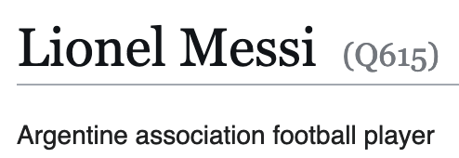
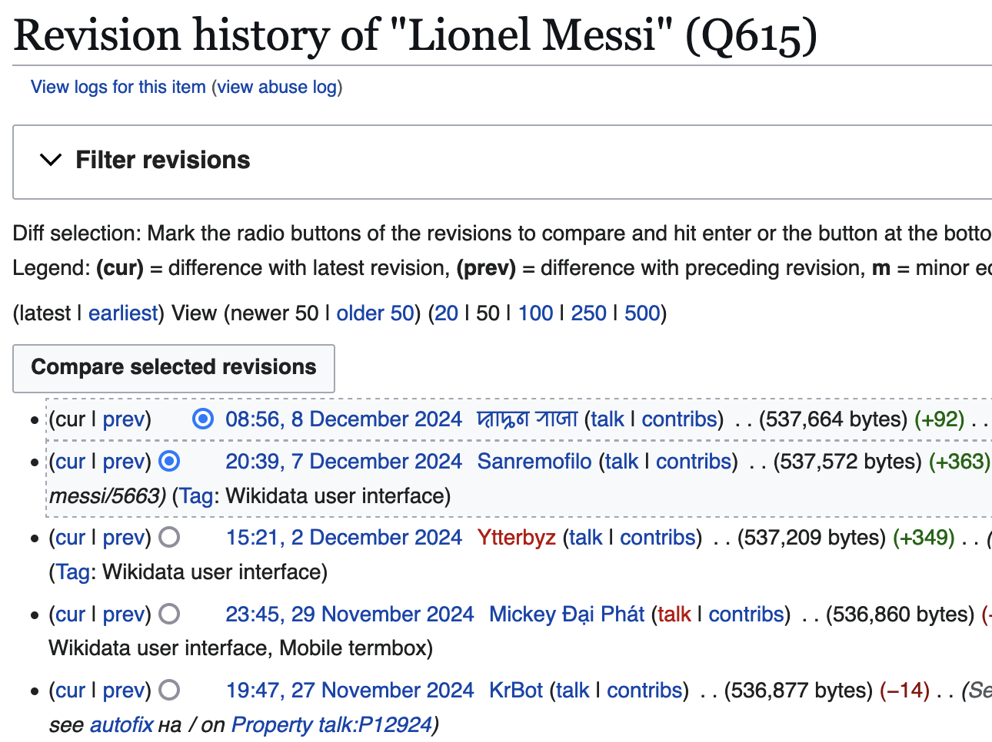

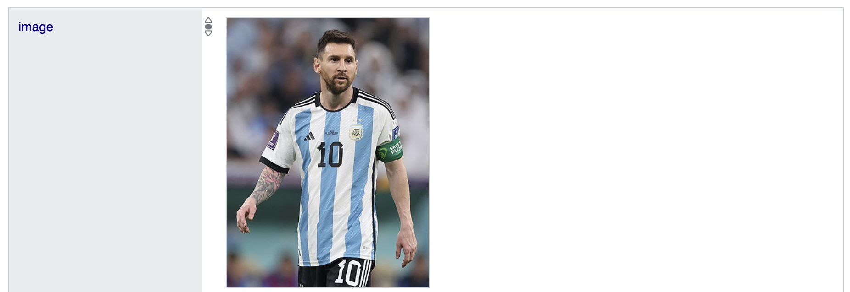
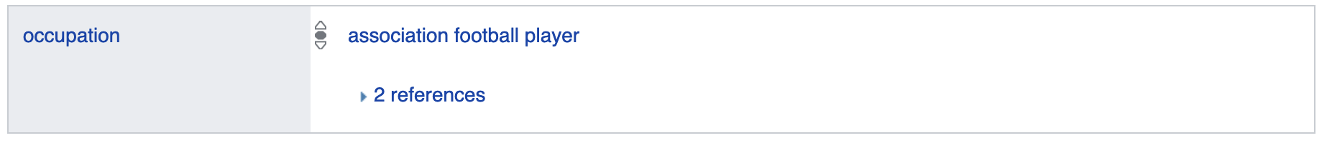
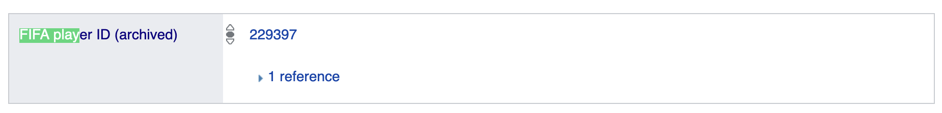
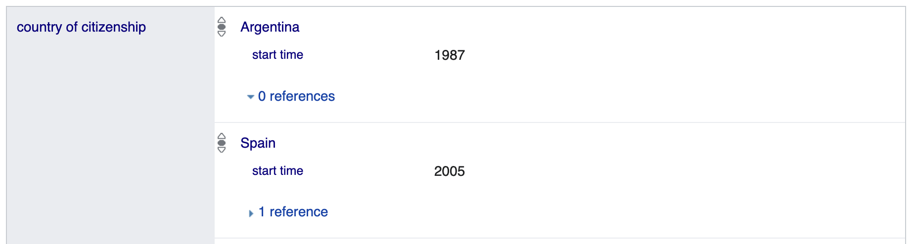
Collaborative, Open Knowledge Graphs:
Wikidata
5

Slide 6
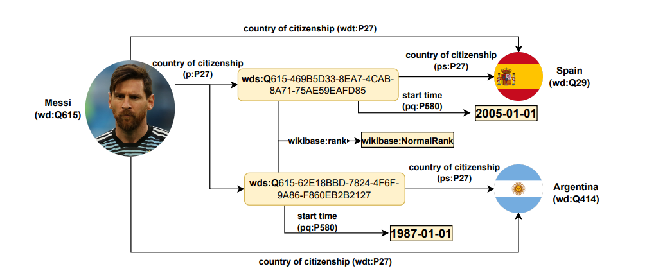
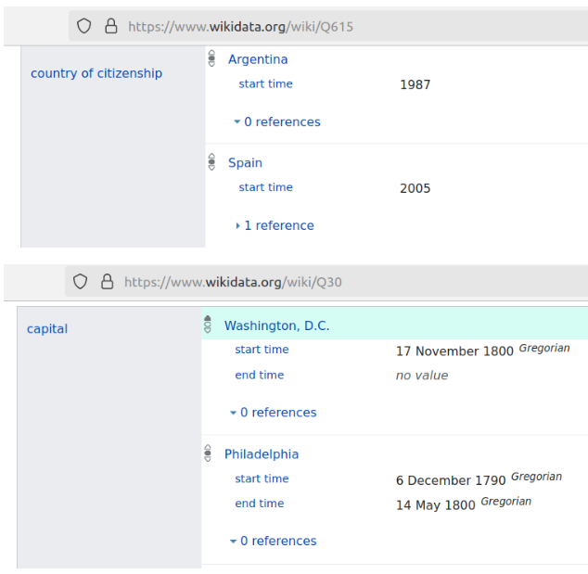
Expressing everthing as a labelled graph
Wikidata’s proprietary reification model
Wikidata’s internal Data Model, which consits of claims with additional context indormation is fitted into a “flat” RDF (directed labelled graph/triples) model:
  See our recent ISWC2024 tutorial: https://ww101.ai.wu.ac.at/
6

Slide 7
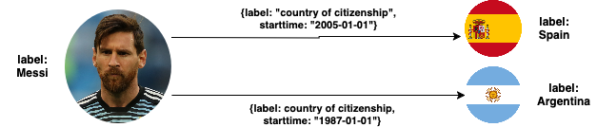
Not all Graphs are equal: Reification
i.e. this is just an ugly “reified” form in RDF…
… of what people often call a Labelled Property Graph (LPG)*:
* Side note: For more details on different (Knowledge) Graph data models and constraint languages see [8]
7

Slide 8
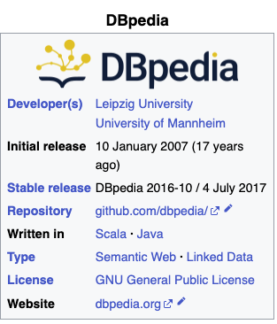
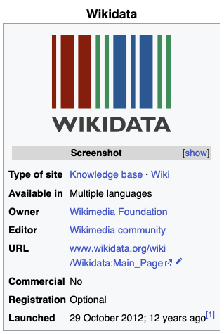



Scale: Let’s have a look at practical examples of such collaboratively curated Knowledge Graphs:
DBPedia (since 2007) vs. Wikidata (since 2012)
RDF
SPARQL (standard QL for RDF) endpoint
Standard Ontology Language (OWL)
Consistent
Context
58.167.851 #subjects/nodes
68.687 #properties
1.040.358.853 #triples/edges
1.790.689.565 #subject
(117,467,468 #nodes)
60.099 #properties
106.962 #classes
8.348.213.968 #triples/edges
8

Slide 9
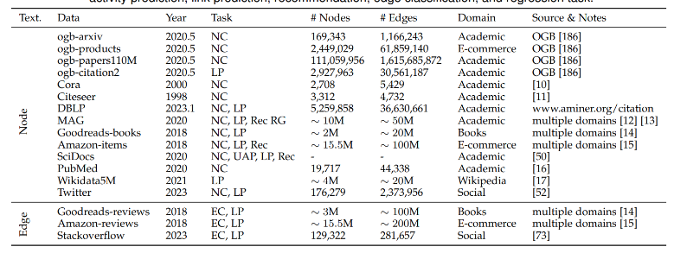
vs. Status of Graph learning?
Large Language Models on Graphs: A Comprehensive Survey (Jin et al. 2023) https://arxiv.org/abs/2312.02783
Open Graph Benchmark: Datasets for Machine Learning on Graphs (Hu et al. 2020) https://arxiv.org/abs/2005.00687
https://ogb.stanford.edu/docs/linkprop/#ogbl-wikikg2
Wikidata extract with 539 relation types…
9

Slide 10
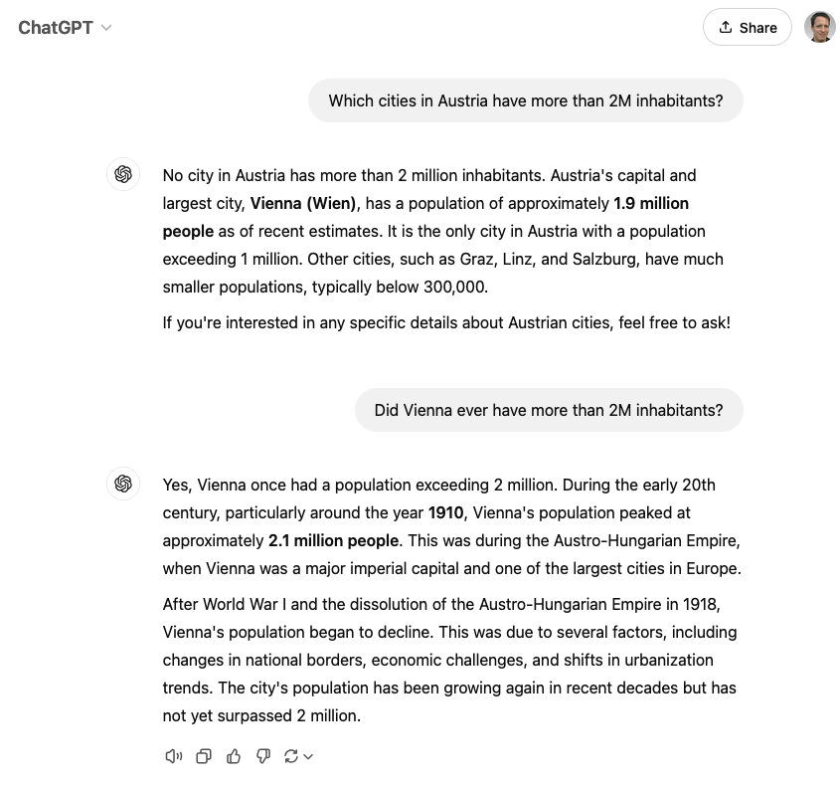
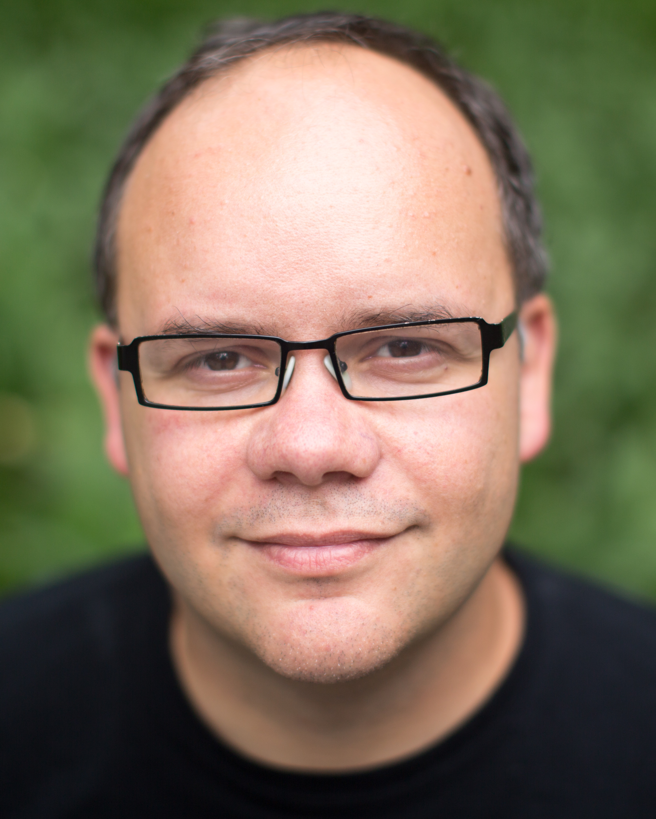
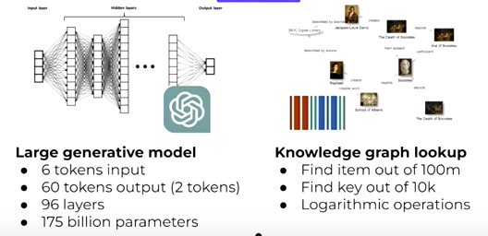
So, for what are these KGs actually good for in the age of LLMs and AI?
Main task:
Complete, factually reliable, efficient query answering
KGC23 Keynote: “The Future of Knowledge Graphs in a World of LLMs — Denny Vrandečić, Wikimedia”
https://www.youtube.com/watch?v=ww99npDh4cg

Slide 11

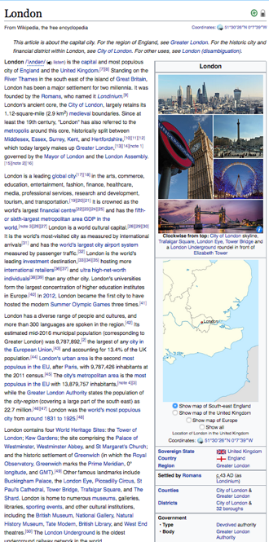
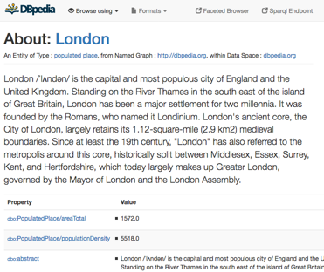
SPARQL: Using KGs to answer questions:
E.g. from
You can use a language called SPARQL endpoint (roughly: SQL for RDF) to do structured queries over RDF:
  „Cities in the UK with more than 1M population“:
Structured queries (SPARQL):
https://en.wikipedia.org/wiki/London
http://dbpedia.org/resource/London
https://api.triplydb.com/s/gZZskqRpQ
Automatic Exctractors
PREFIX : <http://dbpedia.org/resource/>
PREFIX dbo: <http://dbpedia.org/ontology/>
PREFIX yago: <http://dbpedia.org/class/yago/>
SELECT DISTINCT ?city ?pop WHERE {
?city a schema:City .
?city dbo:country :United_Kingdom.
?city dbo:populationTotal ?pop
FILTER ( ?pop > 1000000 )
}
11

Slide 12

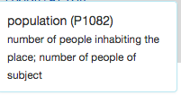
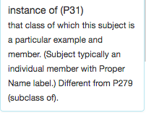
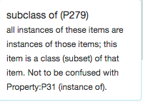


The same question as before in Wikidata:
Note: Wikidata does not use standard OWL
Note: Wikidata uses numeric IDs
“Simple” surface query:
Which cities in the UK have more than 1M people?
What’s this?
SELECT DISTINCT ?city WHERE {
?city wdt:P31/wdt:P279* wd:Q515.
?city wdt:P1082 ?population .
?city wdt:P17 wd:Q38 .
FILTER (?population > 1000000) }
12

Slide 13
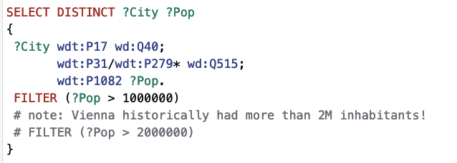
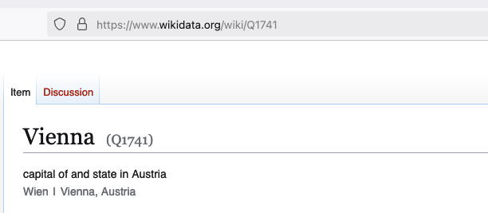
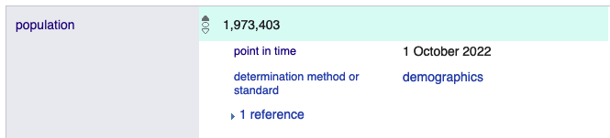

The same question as before in Wikidata:
https://w.wiki/BqRX
Which cities in the Austria have more than 1M/2M people?
  So, WHEN did Vienna have 2M inhabitants?
Note: Wikidata also has such contextual information!!!!
13

Slide 14
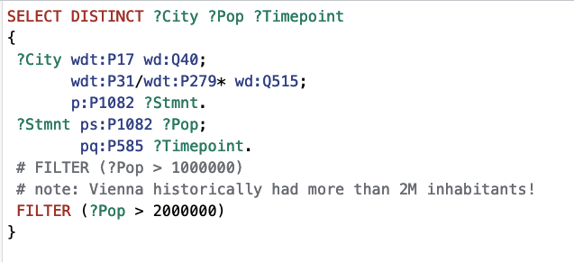
The same question as before in Wikidata:
https://w.wiki/BqRj
Which cities in the Austria have more than 1M/2M people?
  So, WHEN did Vienna have 2M inhabitants? Works!!!!
  But needs an understanding of Wikidata’s proprietary RDF reification model to model context!
See our recent ISWC2024 tutorial: https://ww101.ai.wu.ac.at/
14

Slide 15
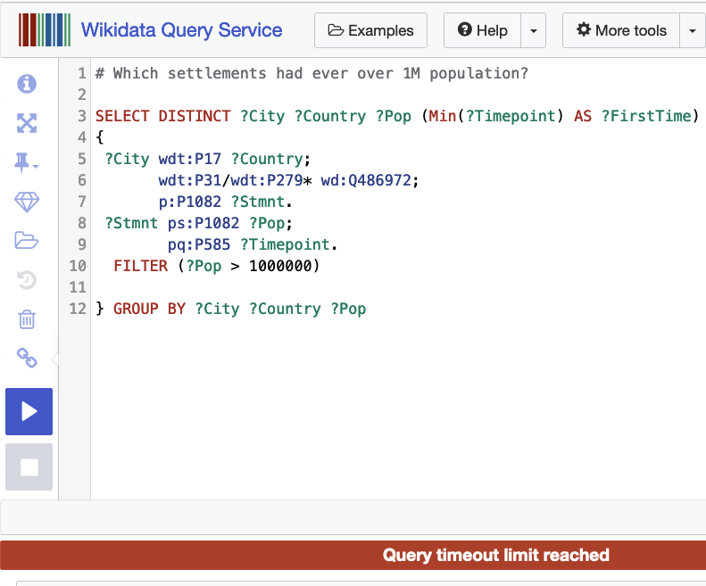
Admittedly, Denny didn’t talk about this…
… at least Wikidata also struggles on some questions: https://w.wiki/CLw9
Public query endpoints (SPARQL) hard to host
(Note: a bit like hosting/serving large LLMs to many users?)
Complex queries time out
Challenge: scaling queries to large-scale, schemaless KGs (complex joint, aggregations, … for many users)
For the records: comparison with GPT ;-)
https://chatgpt.com/share/675585c7-04cc-8006-a20e-c70d75619e13

Slide 16


Challenges:
Many queries on DBPEdia’s and Wikidata’s SPARQL endpoint time out
What can we do about it?
  Bespoke (Compressed) Indexing (HDT)
  Partitioning (smart-KG)
16

Slide 17
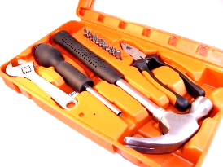


HDT - a “Knowledge Graph” hacker toolkit
  Compressed, queryable serialization of RDF
  Standardized? W3C member submission 2011: https://www.w3.org/Submission/HDT/
  Allows fast RDF retrieval in compressed space (without prior decompression)
    Includes internal indexes to solve basic queries with small memory footprint.
      Very fast on basic queries (triple patterns), x 1.5 faster than Virtuoso, Jena, RDF3X.
      Supports FULL SPARQL as the compressed backend store of Jena, with an efficiency on the same scale as current more optimized solutions
  Challenges:
    Publisher has to pay a bit of overhead to convert the RDF dataset to HDT (but then it is ready to consume efficiently!)
    Inefficient for (live) updates … (Note: another parallel to LLMs?)
837 M.triples 122 GB
 | NT + gzip 9.6 GB | HDT 13 GB
▷Slightly more but you can query!
17
Notes:
Put image of sparql availability in sparqles

Slide 18


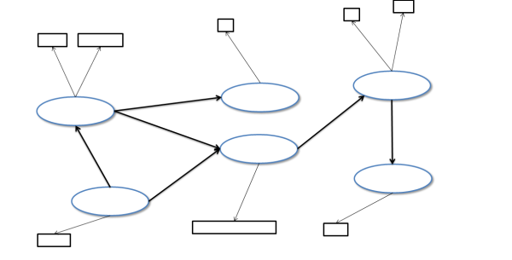

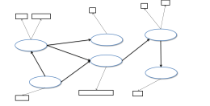
HDT (Header-Dictionary-Triples) Overview
Header
RDF
metadata describing the RDF dataset
Dictionary
ab..
bu ..
1 aa..
2 ab..
3 bu ..
Mapping between IDs 🡨🡪elements in the dataset
aa..
Triples
3
2
Structure of the data after the ID replacement
1
18
Notes:
Due to time restrictions I can’t go into details of HDT, I will give you a brief overview of the idea. An RDF dataset is converted to three components which give the name to HDT: Header, Dictionary and Triples
- A header, including logical and physical metadata describing the RDF data set. It
serves as an entrance point to the information on the data set.
- A dictionary, organizing all the identifiers in the RDF graph. It provides a catalog
of the information entities in the RDF graph with high levels of compression.
- A set of triples, which comprises the pure structure of the underlying RDF graph
while avoiding the noise produced by long labels and repetitions.

Slide 19
HDT – Header information:
$ hdtInfo wikidata20210305.hdt
<file://[latest-all.ttl.gz]> <http://www.w3.org/1999/02/22-rdf-syntax-ns#type> <http://purl.org/HDT/hdt#Dataset> .
<file://[latest-all.ttl.gz]> <http://www.w3.org/1999/02/22-rdf-syntax-ns#type> <http://rdfs.org/ns/void#Dataset> .
<file://[latest-all.ttl.gz]> <http://rdfs.org/ns/void#triples> "14578569927" .
<file://[latest-all.ttl.gz]> <http://rdfs.org/ns/void#properties> "38867" .
<file://[latest-all.ttl.gz]> <http://rdfs.org/ns/void#distinctSubjects> "1625057179" .
<file://[latest-all.ttl.gz]> <http://rdfs.org/ns/void#distinctObjects> "2538585808" .
<file://[latest-all.ttl.gz]> <http://purl.org/HDT/hdt#formatInformation> "_:format" .
_:format <http://purl.org/HDT/hdt#dictionary> "_:dictionary" .
_:format <http://purl.org/HDT/hdt#triples> "_:triples" .
<file://[latest-all.ttl.gz]> <http://purl.org/HDT/hdt#statisticalInformation> "_:statistics" .
<file://[latest-all.ttl.gz]> <http://purl.org/HDT/hdt#publicationInformation> "_:publicationInformation" .
_:publicationInformation <http://purl.org/dc/terms/issued> "2021-04-24T12:42Z" .
_:dictionary <http://purl.org/dc/terms/format> <http://purl.org/HDT/hdt#dictionaryFour> .
_:dictionary <http://purl.org/HDT/hdt#dictionarynumSharedSubjectObject> "1451915667" .
_:triples <http://purl.org/dc/terms/format> <http://purl.org/HDT/hdt#triplesBitmap> .
_:triples <http://purl.org/HDT/hdt#triplesnumTriples> "14578569927" .
_:triples <http://purl.org/HDT/hdt#triplesOrder> "SPO" .
_:statistics <http://purl.org/HDT/hdt#hdtSize> "159085366343" .
19

Slide 20
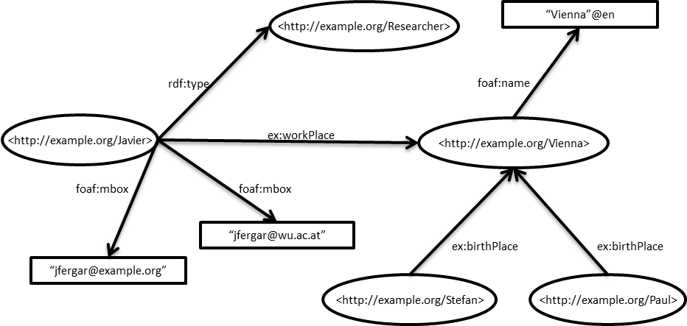
Dictionary+Triples partition
Hint: imagine HDT for now as "SPO-sorted triples"
ex:Vienna foaf:name "Vienna"@en.
ex:Javier ex:workPlace ex:Vienna;
foaf:mbox "jfergar@example.org",
"jfergar@wu.ac.at";
rdf:type ex:Researcher .
ex:Paul ex:birthplace ex:Vienna.
ex:Stefan ex:birthplace ex:Vienna.
20
Notes:
Applications managing huge RDF commonly represent the dataset
using the vocabulary + triples partition

Slide 21
Dictionary+Triples partition
1
2
3
4
5
6
7
8
9
10
11
12
13
ex:Vienna
ex:Javier
ex:Paul
ex:Researcher
ex:Stefan
ex:birthPlace
ex:workPlace
foaf:mbox
foaf:name
rdf:type
“jfergar@example.org”
“jfergar@wu.ac.at”
“Vienna”@en
4
13
10
9
2
7
1
8
8
12
6
6
11
5
3
21
Notes:
Applications managing huge RDF commonly represent the dataset
using the vocabulary + triples partition

Slide 22
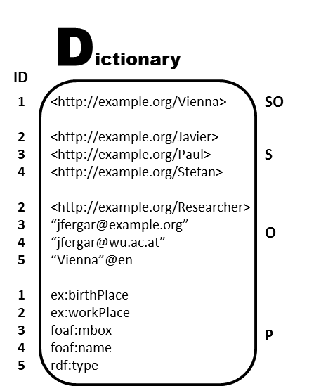
Dictionary (in practice)
1
2
3
4
5
6
7
8
9
10
11
12
13
ex:Vienna
ex:Javier
ex:Paul
ex:Researcher
ex:Stefan
ex:birthPlace
ex:workPlace
foaf:mbox
foaf:name
rdf:type
“jfergar@example.org”
“jfergar@wu.ac.at”
“Vienna”@en
Split by role
Prefix-Based compression for each role
  Efficient ID+String operations
i.e.,dictionary is not exactly "SPO-sorted" but "SO-S-O-P"-sorted

Slide 23
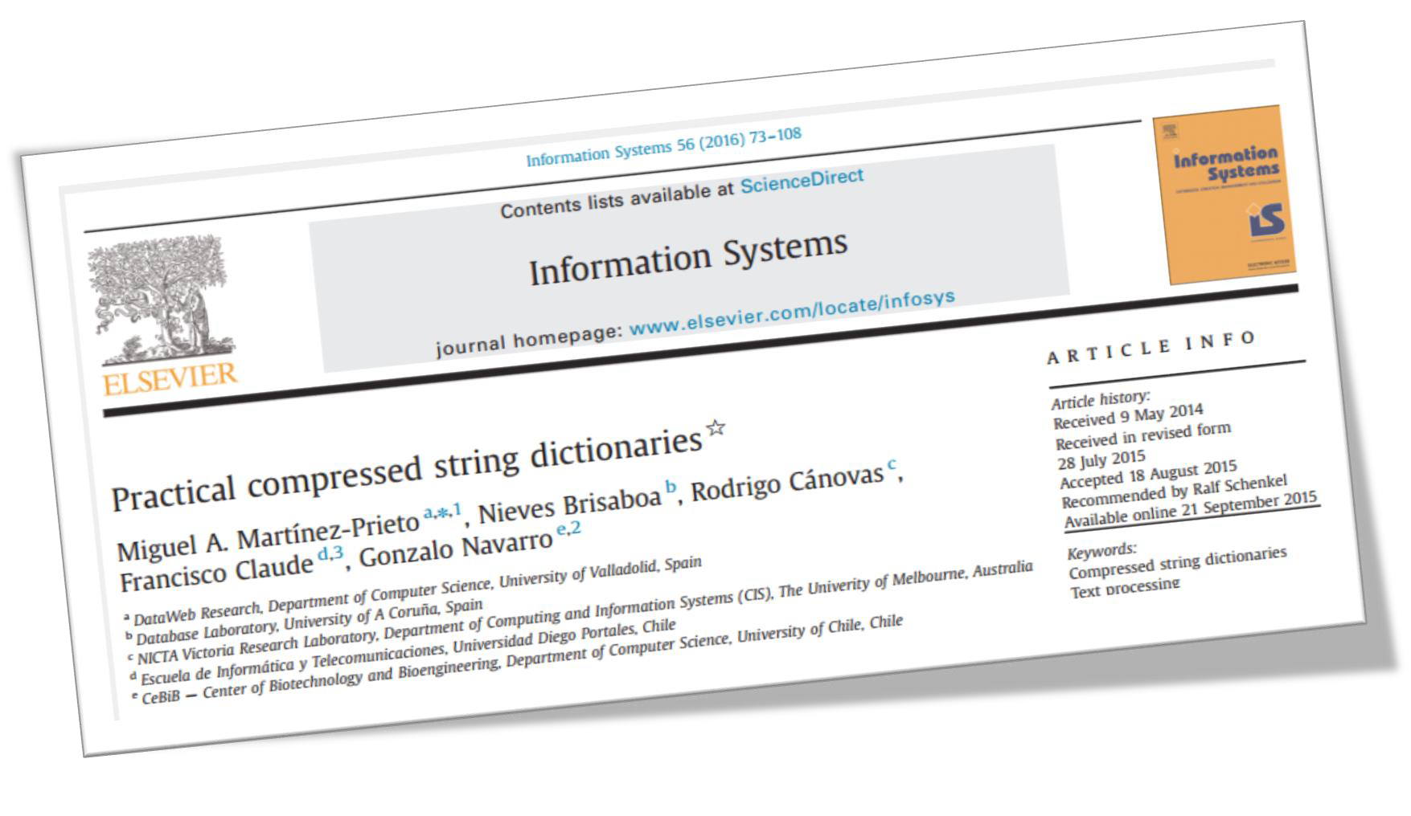

Dictionary compression: Plain Front Coding (PFC)
relies on prefix-based compression
  Each string is encoded with two values
    An integer representing the number of characters shared with the previous string
    A sequence of characters representing the suffix that is not shared with the previous string
A
An
Ant
Antivirus
Antivirus Software
Best
(0,a) (1,n) (2,t) (3,ivirus) (9, Software) (0,Best)
23

Slide 24
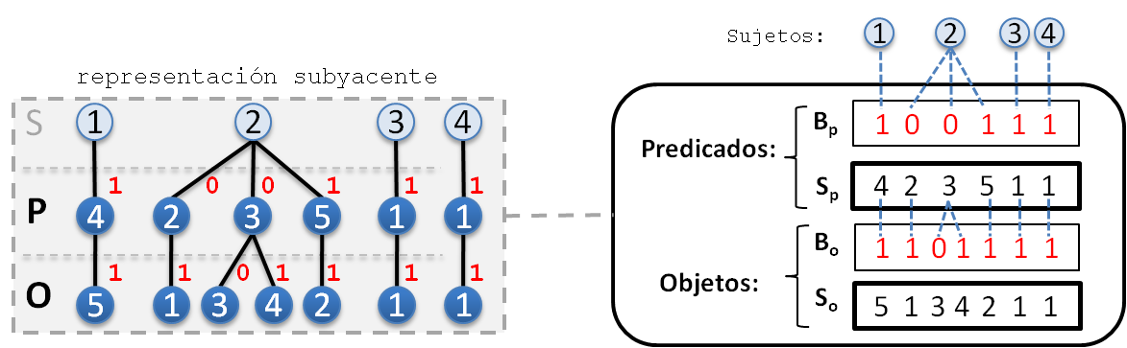
Bitmap Triples Encoding
Bitmap Triples, idea a bit similar to "sorted Turtle":
ex:Vienna foaf:name "Vienna"@en.
ex:Javier ex:workPlace ex:Vienna;
foaf:mbox "jfergar@example.org",
"jfergar@wu.ac.at";
rdf:type ex:Researcher .
ex:Paul ex:birthplace ex:Vienna.
ex:Stefan ex:birthplace ex:Vienna.
1 4 5.
2 2 1;
3 3,
4;
5 2.
3 1 1.
4 1 1.
subjects
Predicates:
Objects:
We index the bitsequences to provide a SPO index

Slide 25
Bitmap Triples Encoding
Bitmap Triples:
subjects
S P O
S P ?
S ? O
S ? ?
? ? ?
Predicates:
Objects:
E.g. retrieve (2,5,?)
  Find the position of the first and second ‘1’-bits in B_{p} (select)
  Binary search on the list of predicates S_{p} in this range, looking for 5
  Note that such predicate 5 is in position 4 of S_{p}
  Find the position of the fourth ‘1’-bit in B_{o} (select) -> 5th position
  i.e. retrieve 5th value of S_{o} -> 2
Notes:
Como vimos en ocasiones los ceros que delimitaban las listas en CT llevaba un sobrecoste, y además no tiene mucho sentido mezclar datos con separadores, si podemos marcar los separadores en otra estructura más pequeña. Pues es lo que realizamos, eliminamos los delimitadores de cada lista de las secuencias que teníamos antes Sp y So. Y tenemos dos bitmaps, Bp y So que nos indican estos separadores pero con bits. Antes teníamos separadores de enteros, ahora tenemos separadores de bits. Estos bits me indican con 0 que la lista continúa, y con 1 que ese elemento es final de lista. Por ejemplo el sujeto 1, con el 4 y es final de lista, y con el objeto 5 y es final de lista. El sujeto 2 con el predicado 2, (como hay un 0 en la misma posición en Bp hay más predicados), es decir el sujeto 2 también está con el 3, y también con 5, y ya no hay más predicados asociados con 2. Y de manera similar en los objetos.
En el fondo es similar a representar un árbol por cada sujeto, como se muestra en la figura, y marcar con un 1 el último hijo. (sería equivalente marcar el primero)

Slide 26
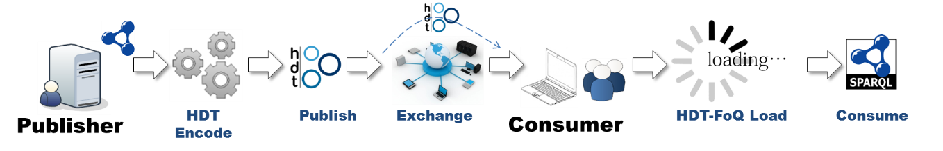
On-the-fly indexes:
HDT-FoQ (Focus-on-Querying indexes)
From the exchanged HDT to the functional HDT-FoQ:
  Publish and Exchange HDT (i.e., B_{p},S_{p},B_{o},S_{o} from last slide) and
  At the consumer:
Efficient “Triple pattern” matching, i.e.
“edge lookups”, e.g.:
{:vienna :country ?.}
Process | Type of Index | Patterns
index the bitsequences | Subject SPO | SPO, SP?, S??, S?O, ???
index the position of each predicate (just a position list) | Predicate PSO | ?P?, ?PO
index the position of each object | Object OPS | ??O
1
2
separate index
file , created by consumer client (or published as as well)
3
Martínez-Prieto, M., M. Arias, and J. Fernández (2012). Exchange and Consumption of Huge RDF Data. In Proc. of the 9th Extended Semantic Web Conference (ESWC), pp. 437-452.

Slide 27
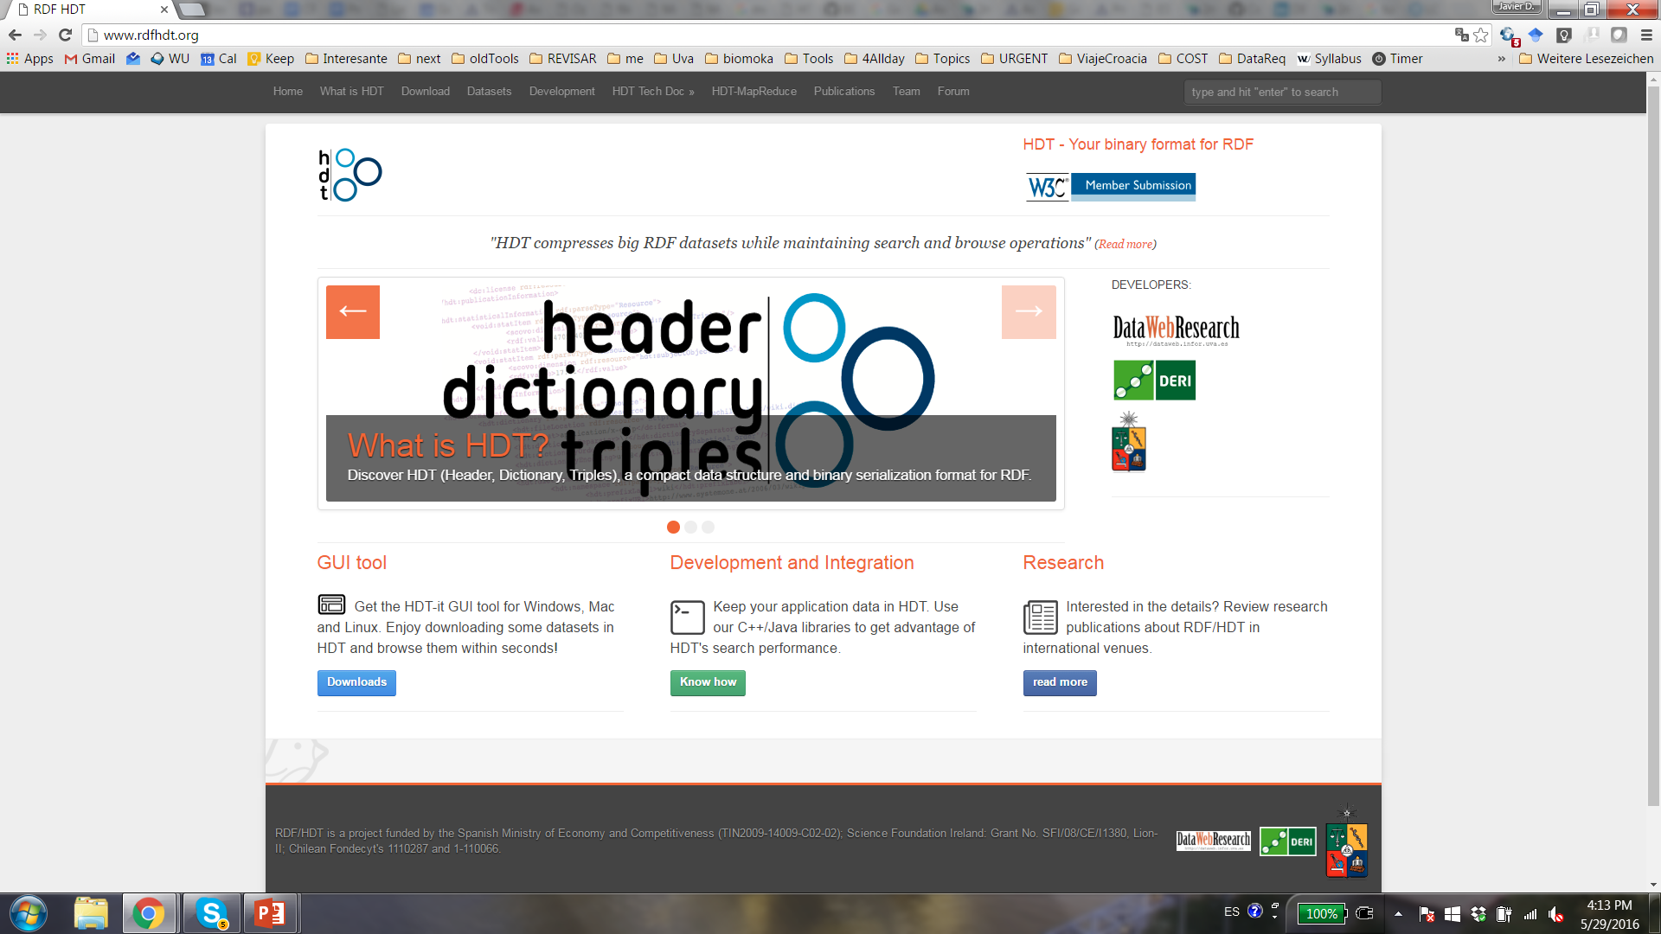
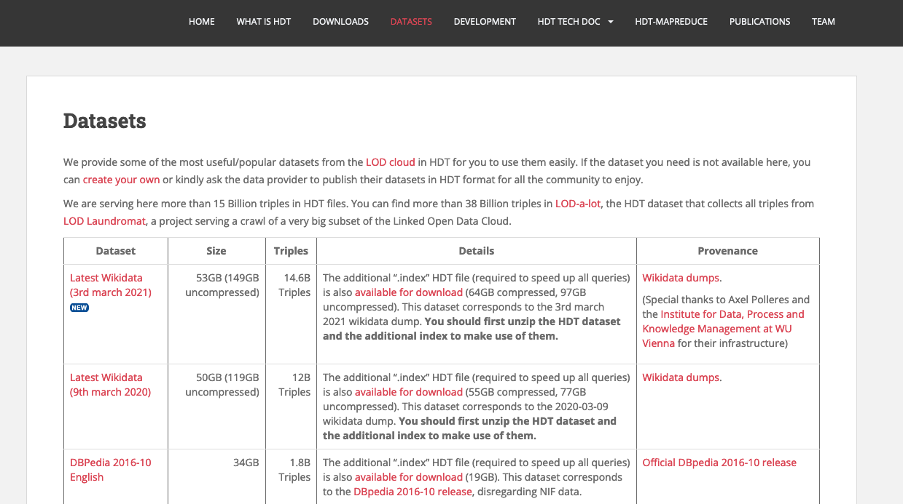
rdfhdt.org
https://github.com/rdfhdt C++ and Java tools
…. a bit like an “ollama for KG querying”
Notes:
Libraries, link to source code, datasets, updated specifications

Slide 28
Outlook/Summary: HDT
Useful tool for compressing, querying and exchanging large KGs (esp. triple patterns)
Data ready to be consumed in compressed format, 10-15x faster than loading it into an RDF triple store
  HDT size << any other RDF format || RDF engine
Competitive query performance.
  Very fast on triple patterns, x 1.5 faster (Virtuoso, RDF-3x).
Integration with Jena
  Joins on the same scale of existing solutions (Virtuoso, RDF-3x).
Status quo:
  Some company takeup (e.g. QA company, data.world), but Open Source HDT Development recently less active
  Current RDF Stores like Qlever use similar indexing ideas, https://dl.acm.org/doi/10.1145/3132847.3132921
Notes:
And some results: Data is ready to be consumed ten to fifteen times faster. This means that the consumer has all the engine ready, all the indexes loaded quickly. The following strange expression just means that HDT takes much less space than any other format or RDF engine (to the best of our knowledge), that it is still slightly bigger than gzip but just for exchange, in any case we can also compress HDT and be even more compressed than gzip.
Moreover the lightweight the client processing and we are competitive at query performance: one point five times faster on triple patterns over existing solutions, and joins on the same scale, with still much room for optimizations, in particular on query planning for complex questions.

Slide 29
Challenges:
Many queries on DBPEdia’s and Wikidata’s SPARQL endpoint time out
What can we do about it?
  Bespoke (Compressed) Indexing (HDT)
  Partitioning (smart-KG)

Slide 30



Server Solution: SPARQL Endpoint
Client:
Network:
Server:
SPARQL Endpoint
C1
C2
C3
C4
C5
C6
C7
C8
"Query Shipping"
fails under concurrency
Query Shipping
30
Notes:
A common way to expose open RDF Graphs is that each data publisher owns SPARQL endpoint, while RDF stores offer server-side solutions that have good performance in single queries. The client submits a SPARQL query to the server that executes it over RDF data store and then the server returns the query results back to the client.

Slide 31
Client Solution: Data Dump
Client:
Network:
Server:
Web (File) Server
C1
C2
C3
C4
C5
C6
C7
C8
Data Shipping: Dumps
might add prohibitive load on the network
Query Shipping
31
Notes:
A common way to expose open RDF Graphs is that each data publisher owns SPARQL endpoint, while RDF stores offer server-side solutions that have good performance in single queries. The client submits a SPARQL query to the server that executes it over RDF data store and then the server returns the query results back to the client.

Slide 32


Client Solution: Compressed Dumps
Client:
Network:
Server:
Web (File) Server
C1
C2
C3
HDT
HDT
HDT
C4
C5
HDT
C6
C7
C8
Data Shipping – using HDT
still might add prohibitive load on the network
(e.g. DBpedia 2016 Dump 34GB for 1.8B triples)
Query Shipping
32
Notes:
A common way to expose open RDF Graphs is that each data publisher owns SPARQL endpoint, while RDF stores offer server-side solutions that have good performance in single queries. The client submits a SPARQL query to the server that executes it over RDF data store and then the server returns the query results back to the client.

Slide 33
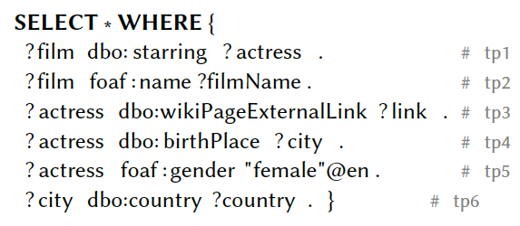




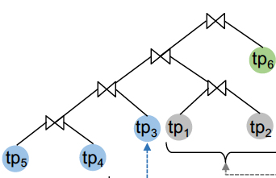
Triple Pattern Fragments (TPF):
Idea:
Execute single triple patterns on the server
Let the clients do JOINs etc. by themselves.
less footprint on the server, only triple patterns and intermediate results communicated.
can still have significant overhead by large intermediate results
C1
HDT
?film | ?act
… | …
… | …
… | …
… | …
R. Verborgh,, M. van der Sande, O. Hartig, J. Van Herwegen, L. De Vocht, B. De Meester, G. Haesendonck, P. Colpaert:
Triple Pattern Fragments: A low-cost knowledge graph interface for the Web. J. Web Semant. 37-38: 184-206 (2016)

Slide 34
Refinement: Binding-restricted
Triple Pattern Fragments (br-TPF):
Idea:
ship intermediate bindings with TP and let server only return results matching results
→ smaller intermediate results, "join work" distributed between client and server
C1
HDT
?film | ?actress
… | …
?actress
…
…
…
…
O. Hartig and C. B. Aranda. 2016. Bindings-Restricted Triple Pattern Fragments. In ODBASE 2016. 762–779

Slide 35
Can we do better? Remaining Problems:
High Availability
High Client cost
Low Server Cost
SMART-KG
High Availability
shared Client & server cost
Low Availability
Low Client Cost
High Server Cost
Data
Dump
(binding-restricted) TPF)
SPARQL
Endpoint
Our experiments show that in highly concurrent query loads, with TPF:
  still the server might get blocked
  still an unncecessarily high number of (uncompressed) intermediate results may be shipped
Idea 1: "Partition" Shipping

Slide 36
smart-KG server: "Family" Partitions
Partition Generator (PG): Upon loading a graph KG G, decompose it into partitions G₁,...,G_{m}, one per "predicate family".
Shawnee, OK
“Angelina Jolie"
"BradPitt"
“Emma Watson”
name
birthPlace
name
Los Angeles,CA
name
spouse
birthPlace
worksIn
birthPlace
Brad
spouse
Paris, FR
almaMater
Angelina
Emma
almaMater
University of Missouri
Oxford University
F1: {name, birthPlace, spouse, almaMater}
F2: {name, birthPlace, spouse}
F3: {name, birthPlace,almaMater, worksIn}
F4: {name, country, capitalOf}
F4: {name, founded, numberOfStudents}

Slide 37

smart-KG server: Predicate "Family" Generator
Partition Generator (PG): Upon loading a graph KG G, decompose it into partitions G₁,...,G_{m}, one per "predicate family" … and convert these to HDTs.
Family1.hdt
Family2.hdt
Family3.hdt
name
birthPlace
name
name
birthPlace
spouse
birthPlace
almaMater
spouse
worksIn
almaMater
Brad

Slide 38


Smart-KG query Processing:
Client decomposes BGPs into "stars"
Retrieve relevant information from server to make a query plan
Retrieve and joins matching HDT partitions one by one
(use TPF for 1-triple patterns and "pruned" partitions)
F?:{starring, name}
F?:{wikiPageExtLink, birthPlace, gender}
KG Partitions (separate HDTs)
C1
TPF

Slide 39
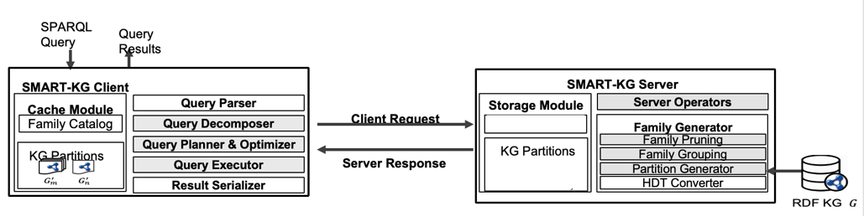
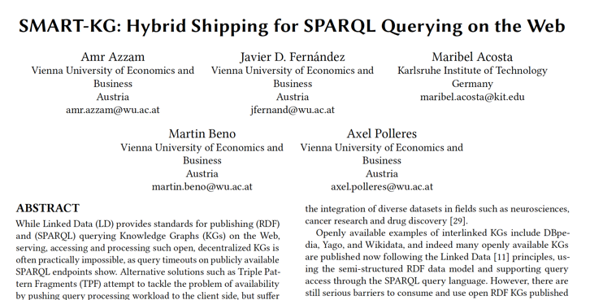
Smart-KG:
Further details, cf. [8]:
predicate-restricted families, i.e. pruning+merging:
  too rare or
  too common
  predicates for partitioning
  Example: for DBpedia, a naive partitioning would create +600k partially very large families, which are unfeasible to serve.
client-side partition caching
F1_2: {name, birthPlace, spouse, almaMater}
e.g
F1: {name, birthPlace, spouse, almaMater}
F2: {name, birthPlace, spouse}

Slide 40
Can we do (even) better? Refinements:
High Availability
High Client cost
Low Server Cost
SMART-KG
High Availability
shared Client & server cost
Low Availability
Low Client Cost
High Server Cost
[2,3]
Data
Dump
(binding-restricted) TPF)
SPARQL
Endpoint
In partition shipping, the server is mainly a Web Server distributing partial dumps
Desideratum: Server should process queries "as far as possible"
[3] Combined client & server processing
[2] Further refinement partitioning per node types (rather than predicates only).
40

Slide 41
Possible Discussion/Further ideas:
Could similar ideas for modularization work for (agent-based) models?
Combination of agent frameworks and KGs in extensions of (modular) Graph RAG?
(How to) take context information into account for partitioning/indexing?
41

Slide 42
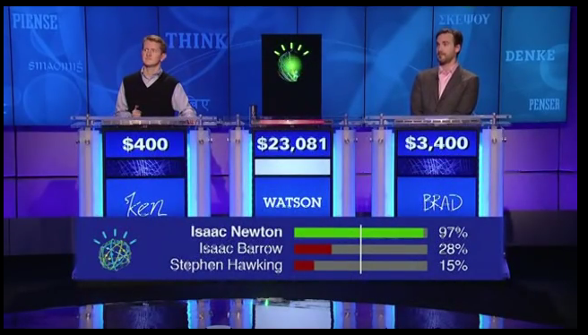
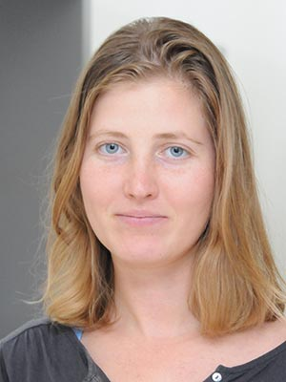

Another application:
How good or bad are KGs with Question answering?
How good or bad are KGs with Question can answering?
Interesting Note - IBM Watson - Jeopardy! (2011)
“Super-human” Question Answering was achieved by Knowledge Graphs before the LLM hype!
Our own contribution in this area:
  Svitlana Vakulenko, Javier Fernández, Axel Polleres, Maarten de Rijke, and Michael Cochez. Message passing for complex question answering over knowledge graphs. In Proceedings of the 28th ACM International Conference on Information and Knowledge Management (CIKM2019, pages 1431--1440, Beijing, China, November 2019. ACM.
will return to us via VRG grant!
42

Slide 43
Another application of HDT:
“Message-passing based” KGQA
Typical approach
Natural Language question:
“Which company assembles its hardtop style cars in Broadmeadows, Victoria?”
Map to a query (or graph matching) on a KG
Involves typically steps:
  Entity & Relation linking
  Query building (Relation directionality, …)
  …
Broadmeadows, Victoria
?C
company
?Car
assembly
style
Hardtop
SELECT ?C
WHERE { ?Car dbo:company ?C .
?Car dbo:assembly .
?Car style dbr:Breadmedows.}
43

Slide 44
Another application of HDT:
“Message-passing based” KGQA
Typical approach
Natural Language question:
“Which company assembles its hardtop style cars in Broadmeadows, Victoria?”
Map to a query (or graph matching) on a KG
  Problems:
    Language ambiguity
    Structure could look entirely different
    → (too) large search space
Broadmeadows, Victoria
located_in
?C
produces
?Car
style
Hardtop
44

Slide 45

Better approach:
Step 1:
  divide query into “hops” of simple (single “star-shaped”) subquestions
  Parse subquestion matching (in parallel) relevant entities and relations with confidence scores
Step 2: propagating and aggregate these confidence scores over the KG via message-passing
Idea: Possible answers are nodes with highest confidence
We model questions (roughly) as sequences over a number of hops where each hop consists of
E … (candidate) entity sets,
P … candicate property sets,
C … candidate class sets the enity belong to
Broadmeadows, Victoria
?C
company
?Car
assembly
hop 2
style
Hardtop
hop 1
45

Slide 46
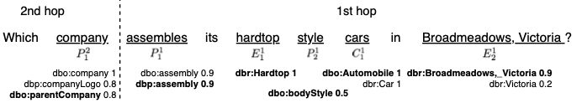
Better approach:
(b) for each entity (or property, class, resp.) reference in, we retrieve a ranked list of most similar entities from the KG along with the matching confidence score.
(a) Using sequence labeling with conditional random fields
Step 1: (a) Parse question and (b) matching (in parallel) relevant entities and relations with confidence scores
We model questions (roughly) as sequences over a number of hops where each hop consists of
E … (candidate) entity sets,
P … candicate property sets,
C … candidate class sets the enity belong to
hop 2
hop 1
46
Notes:
for each entity (or property, class, resp.) reference in, we retrieve a ranked list of most similar entities from the KG along with the matching confidence score.

Slide 47
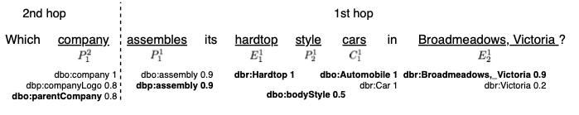
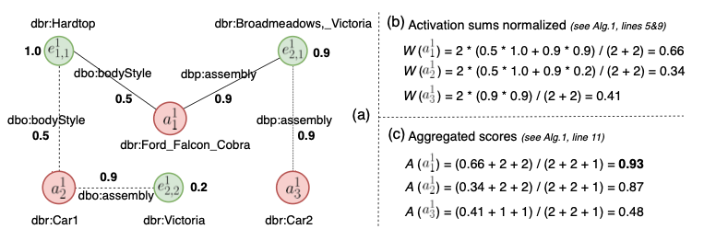
Better approach:
Step 2: propagating and aggregate these confidence scores over the KG via message-passing (hop, by hop)
Hop 1 candidate subgraph and score aggregation:
a^{i} … answers in hop i
Note:
The weight propagation is less important than the fact that we use HDT for very efficient retrieval of the relevant subgraphs in each step in the implementation.
Note: once retrieved we do not consider direction of the edges in the original graph here.
47

Slide 48

Bottomline:
message-passing in the undirected subgraphs and
efficient retrieval of these subgraphs (HDT), where sufficient to significantly improve over “query formulation” approaches on KGQA Benchmarks, e.g. QALD.
Note/Disclaimer:
  That’s where I left off
  The part I contributed in the paper was minor.
Discussion (we’re only starting to look into this):
Could similar ideas improve other Graph tasks?
How does this relate to other Graph Learning tasks that rely on efficient subgraph retrieval?
Tying back to the first part: Do these tasks need the whole graph can they also benefit from modularization/partitioning?
How scalable are other graph learning to Collaborative KGs?
(How) do efficent representations for exact retrieval (i.e., indexing) relate to vectorized graph representations (embeddings)…?
… and can we leverage retrieval-efficient representations in Graph-Learning?
+ ?
48

Slide 49

Motivation
In our group we have done a lot of work on
Querying
Analysing, and
Improving the quality
of Collaborative KGs at scale
More things I did not talkabout:
Link analysis [5,6]
Constraint checking and repair [7, ]
49

Slide 50
References:
Javier D. Fernández, Miguel A. Martinez-Prieto, Claudio Gutiérrez, Axel Polleres, and Mario Arias. Binary RDF Representation for Publication and Exchange (HDT). Journal of Web Semantics (JWS), 19(2), 2013 https://dl.acm.org/doi/10.1016/j.websem.2013.01.002
Amr Azzam, Axel Polleres, Javier D. Fernandez, and Maribel Acosta. smart-KG: Partition-based linked data fragments for querying knowledge graphs. Semantic Web -- Interoperability, Usability, Applicability (SWJ), 15(5):1791--1835, 2024. http://dx.doi.org/10.3233/SW-243571
Amr Azzam, Christian Aebeloe, Gabriela Montoya, Ilkcan Keles, Axel Polleres, and Katja Hose. WiseKG: Balanced Access to Web Knowledge Graphs. In Proceedings of the Web Conference 2021, pages 1422–--1434, Ljubljana, Slovenia, 2021. ACM / IW3C2. https://doi.org/10.1145/3442381.3449911
Svitlana Vakulenko, Javier Fernández, Axel Polleres, Maarten de Rijke, and Michael Cochez. Message passing for complex question answering over knowledge graphs. In Proceedings of the 28th ACM International Conference on Information and Knowledge Management (CIKM2019, pages 1431--1440, Beijing, China, November 2019. ACM. http://dx.doi.org/10.1145/3357384.3358026
Armin Haller, Javier D. Fernández, Maulik R. Kamdar, and Axel Polleres. What are links in linked open data? a characterization and evaluation of links between knowledge graphs on the web. ACM Journal of Data and Information Quality (JDIQ), 2(2):1–--34, May 2020. http://dx.doi.org/10.1145/3369875
Romana Pernisch, Daniil Dobriy, and Axel Polleres. The massive problem of remote changes in ontology reuse. In The Web Conference 2025, Sydney, Australia, 2025. WWW25 Companion Proceedings, to appear (short paper)
Nicolas Ferranti, Jairo Francisco de Souza, Shqiponja Ahmetaj, and Axel Polleres. Formalizing and validating Wikidata's property constraints using SHACL and SPARQL. Semantic Web -- Interoperability, Usability, Applicability (SWJ), 2024. https://journals.sagepub.com/doi/epub/10.3233/SW-243611
Shqiponja Ahmetaj, Iovka Boneva, Jan Hidders, Katja Hose, Maxime Jakubowski, Jose-Emilio Labra-Gayo, Wim Martens, Filip Murlak, Cem Okulmus, Axel Polleres, Ognjen Savković, and Mantas Simkus ans Dominik Tomaszuk. Common foundations for SHACL, PShEx, and PG-Schema. In The Web Conference 2025, Sydney, Australia, 2025. http://dx.doi.org/10.1145/3696410.3714694
50

