Slide 1


Why you should learn about
Data Science @WU?
Prof. Axel Polleres, Dr. Sabrina Kirrane
Find these slides at: http://polleres.net/presentations/

Slide 2
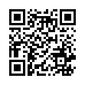
SBWL Web page:
  Info on our Webpage:
  description
  green card
  contact (for questions)
  registration details/dates
https://www.wu.ac.at/en/dpkm/teaching/sbwl-data-science

Slide 3
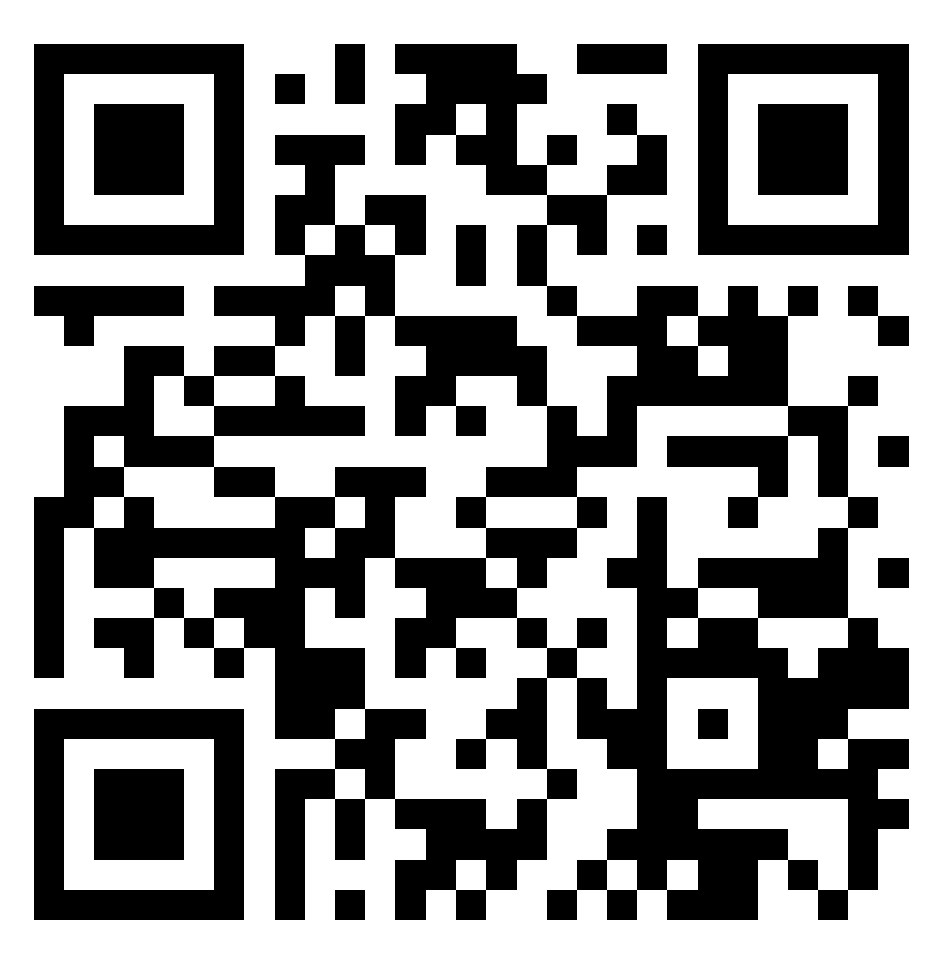
Where to find this Slidedeck & Key Dates?
Important Dates:
Important Dates:
Tutorials (Online):
Tue, 02.09.2025, 13:00-16:00
Wed, 03.09.2025, 13:00-16:00
Entry Exam (Online):
Tue, 09.09.2025, 8:00-10:30
Don’t miss the LPIS registration!
http://polleres.net/presentations/

Slide 4

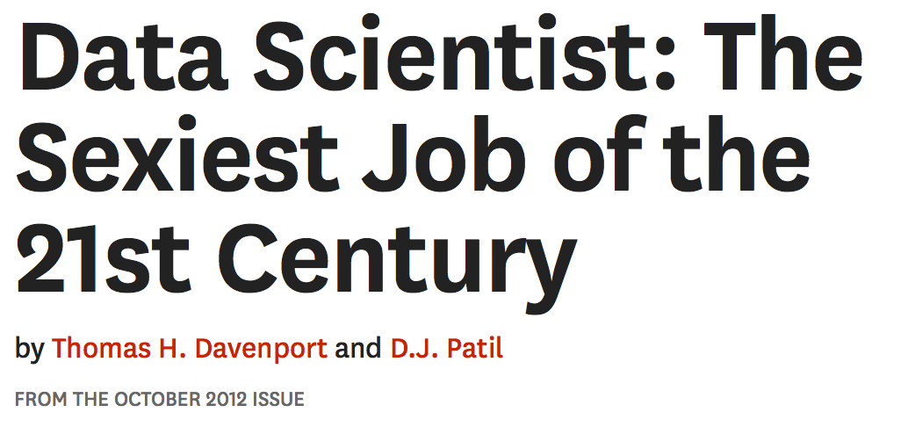
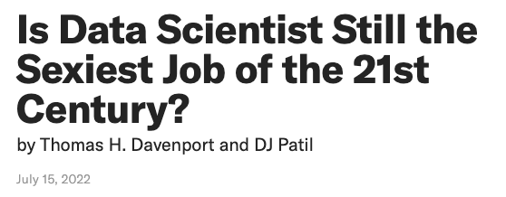
Why you should learn about
Data Science @WU?
~12 years ago
“…the scope of the job has been redefined, the technology it relies on has made huge strides, and the importance of non-technical expertise, such as ethics and change management, has grown”
https://hbr.org/2012/10/data-scientist-the-sexiest-job-of-the-21st-century
More current perspective:
https://hbr.org/2022/07/is-data-scientist-still-the-sexiest-job-of-the-21st-century

Slide 5
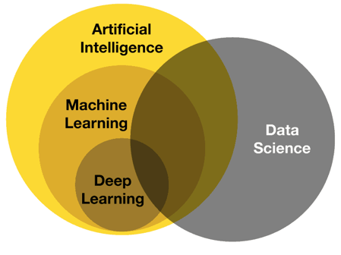
Why you should learn about
Data Science @WU?
Data Science today:
Artificial Intelligence – AI is the broad concept of developing machines that can simulate human thinking, reasoning and behavior.
Data Science – Data Science is the processing, analysis and extraction of relevant assumptions from data. It’s about finding hidden patterns in the data.
https://www.deviq.io/insights/artificial-intelligence-vs-machine-learning-vs-data-science

Slide 6


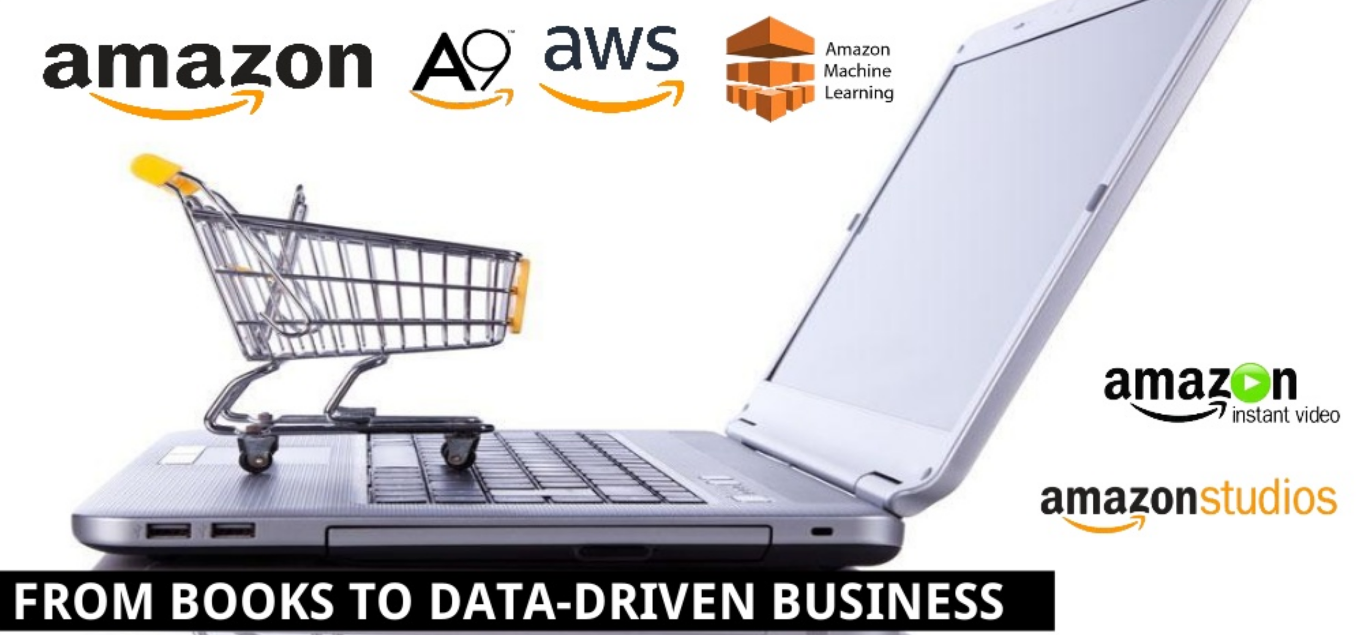




Data-driven Businesses everywhere:
Big Data as core business: Google does not hire anybody without IT-knowledge
Apple: from hardware company to data company (music and content)
Amazon:
Red Bull: Marketing increasingly requires Data Science
BMW: Supply-Chain, Intelligente Produktion,
in-car-Technologie (car-to-car communication,...), etc.
UN: One of the biggest providers of Open Data,
Disaster & Crisis Management, etc.
6

Slide 7
Other known examples of data-driven businesses:
Source:
https://www.slideshare.net/laroyo/keynote-at-international-conference-of-art-libraries-2018-rijksmuseum/27

Slide 8
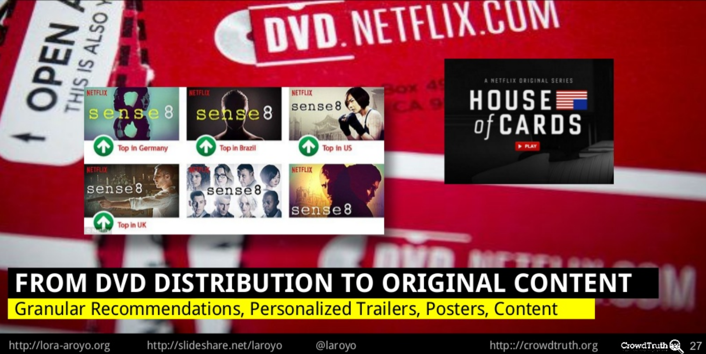
DataScience for (Generative) AI?
Did you know that Netflix creates their contents from Data about their customers?
Source:
https://www.slideshare.net/laroyo/keynote-at-international-conference-of-art-libraries-2018-rijksmuseum/27

Slide 9


Last, but not least… AI is data-hungry
AI depends on lots of data
Understand scalability issues!
Understand Data Quality & Data Governance requirements!
Learn how to curate and feed data into Machine-Learning
Understand risks and biases!

Slide 10
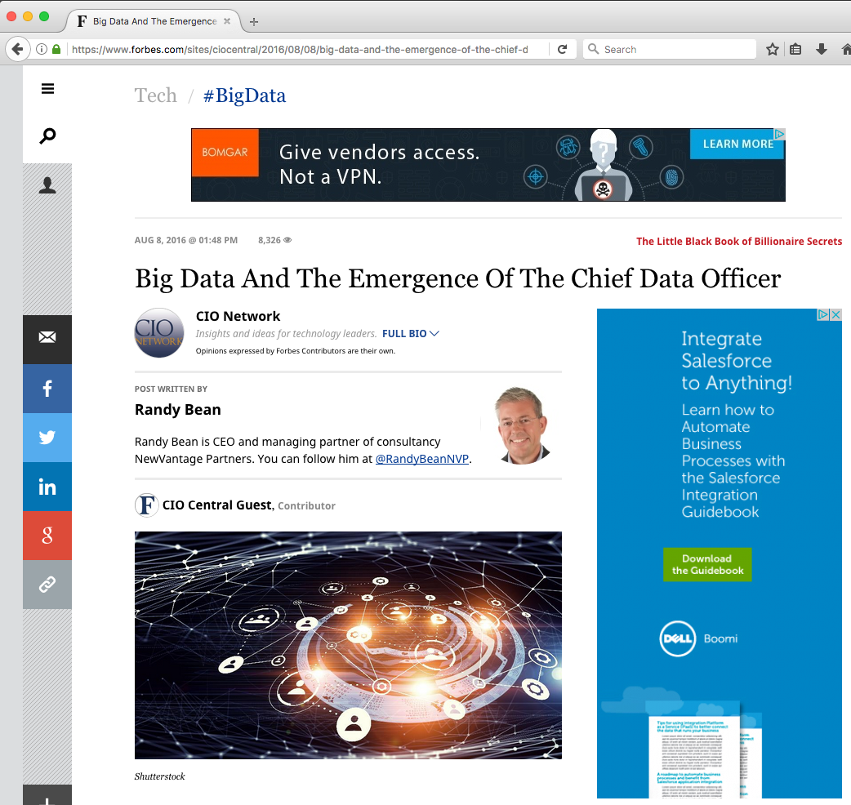
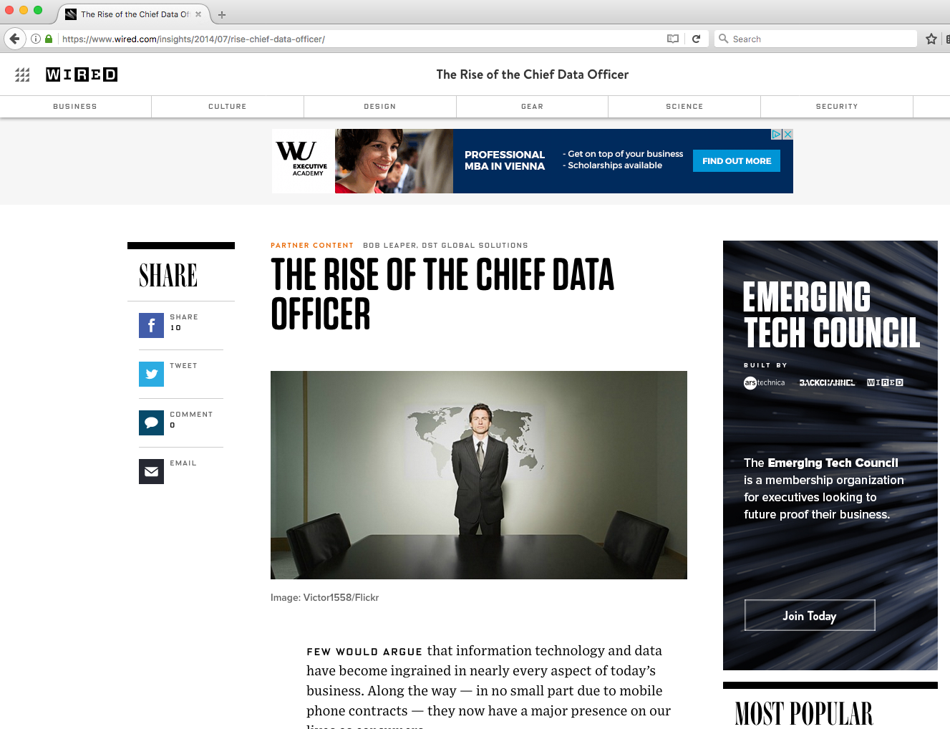
Job descriptions and roles
Data Science is becoming at all levels, incl. the Executive level!
  Data Stewards,
  Chief Data Officer,
  Chief Digital Officer

Slide 11

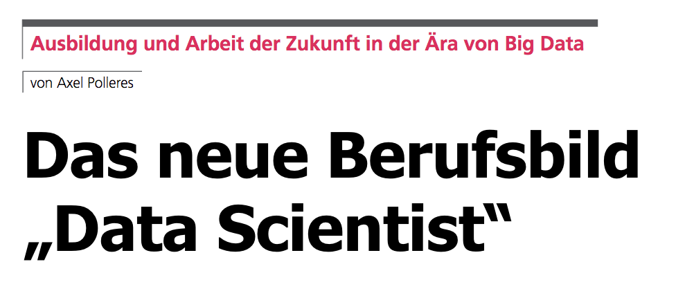
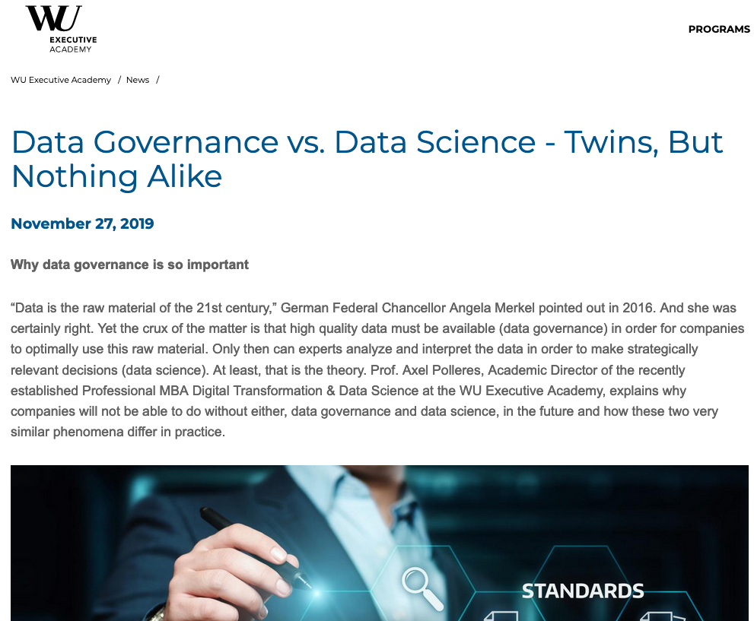
What is the new thing about Data Science?
Die Schlüsselposition „Data Scientist“ ist
für Unternehmen da, wo innovative neue
Lösungen entwickelt werden müssen,
abseits des „Tagesgeschäfts“.
http://www.ocg.at/sites/ocg.at/files/medien/pdfs/OCG-Journal1503.pdf#13
https://executiveacademy.at/en/news/detail/data-governance-vs-data-science-twins-but-nothing-alike

Slide 12
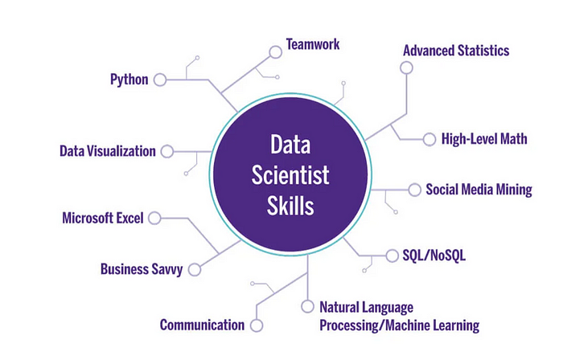
Data Scientists' Skills – What does it take?
https://bootcamp.berkeley.edu/blog/data-scientist-skills/ (and several other sources ;-))
Solid basis: Math, Statistics, Programming, Data Engineering
Curiosity& Creativity – find the needle in the „haystack“
Learn to learn new technologies quickly
Develop front-to-end solutions, often adhoc
Domain-specific background knowledge
communicative skills AND team spirit „Data Science Teams“

Slide 13
Data Science SBWL – How do you get there? https://www.wu.ac.at/dpkm/teaching/sbwl-data-science/
Interdisciplinary! International!
  6 Institutes:
      Data, Process and Knowledge Management,
      Production Management,
      Complex Networks,
      Statistics & Mathematics,
      Marketing,
      Business Law
  all courses taught in English
5 Courses (PI 2.0) :
  SBWL DS 1: Data Processing 1
  SBWL DS 2: Data Analytics
  SBWL DS 3: Data Processing 2: Scalable data processing,
  Legal & Ethical foundations of data science, Open Data
  SBWL DS 4: Applications of Data Science
  (Production Management, Supply Chain, Marketing, Process Management, Computational Social Sciences)
  SBWL DS 5: Data Science Lab,
  in collaboration with real data providers!
13

Slide 14
Data Science SBWL: Organisation https://www.wu.ac.at/dpkm/teaching/sbwl-data-science/
  Schedule:
  - Next cohort:
WS 2025/2026 | SS 2026
Data Processing 1 Data Processing 2 Data Analytics | Applications of Data Science Data Science Lab
SS 2026 | WS 2026/2027
Data Processing 1 Data Processing 2 Data Analytics | Applications of Data Science Data Science Lab

Slide 15
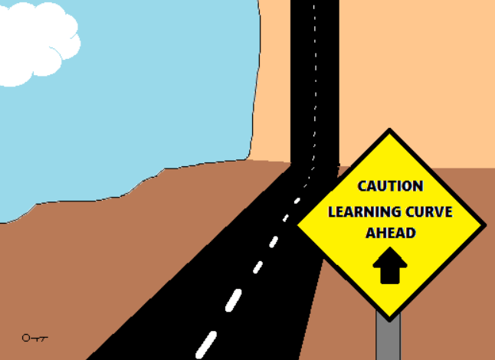
















Steep Learning curve?
Well, yes but…
You can prepare!
  "Algorithmic Thinking and Programming"course … recommended, but not strictly needed
  DataCamp python & R tutorials to get a glimpse (access will be provided through the courses)
We'll provide support!
  Our tutors provide help, particularly for students new to coding and programming (New: we'll provide separate ”bridging tutorials" to support you in the first assignments and get all "up to speed")
  Group works emphasizing on mixed skills and mutual support!
  Get help through our course online forums
  (we commit to response-within-a-day (except weekends ;-)))
Data Science is a team sport!
High reward, high impact!
You'll be trained up to solving real use case with real partners, e.g.:
Notes:
We'll provide DataCamp acccess with the entry tutorials already! But not prior programming skills necessary to pass the entry exam!
Some of the most successful team projects so far involved pople who didn't know a single line of coding/programming in the past!
We saw many of our project students come back the years after as coaches with now projects from the companyies they started to work with!

Slide 16

Data Science Lab – news!
WU Innovative Teaching Award 2023
Schwerpunkt „Gemeinsam Lehren: Innovative Kooperationen und Partnerschaften”
High reward, high impact!
You'll be trained up to solving real use case with real partners, e.g.:
Notes:
We'll provide DataCamp acccess with the entry tutorials already! But not prior programming skills necessary to pass the entry exam!
Some of the most successful team projects so far involved pople who didn't know a single line of coding/programming in the past!
We saw many of our project students come back the years after as coaches with now projects from the companyies they started to work with!

Slide 17


Data Science SBWL: Organisation https://www.wu.ac.at/dpkm/teaching/sbwl-data-science/
  Requirements:
    Willingness & Fun to work “hands-on” with data!
      Learn the most popular Data Science tools
    Willingness to work in teams and interdisciplinary!
    Willingness to solve (data) problems!
  Qualification to enter the SBWL:
  Register for the entry test/tutorials via LPIS!!!
    Factors taken into account:
    best grades transcripts/Avg grades
    plus, at max 10 "Green Cards":
    online entry exam – all recommended to take the entry exam (even if you qualify for a green card!
    Note: all (also green card holders need to register for the entry test/tutorials on LPIS! → counts as registration of interest to the SBWL)
Details described on our Web page:
https://www.wu.ac.at/dpkm/teaching/sbwl-data-science/
BaWISO/WiRe
Avg. grade 1.5 among these courses:
  Algorithmic Thinking and Programming
  Data and Knowledge Engineering
  Statistics
BBE - Avg. grade 1,5 among these courses:
  Quantitative Methods 1
  Quantitative Methods 2
  Business Analytics 2
Notes:
Exact mode currently discussed with VR teaching to ensure
fair chances between specializations (all welcome!)
- while still having a focus on relevent skills for the SBWL

Slide 18
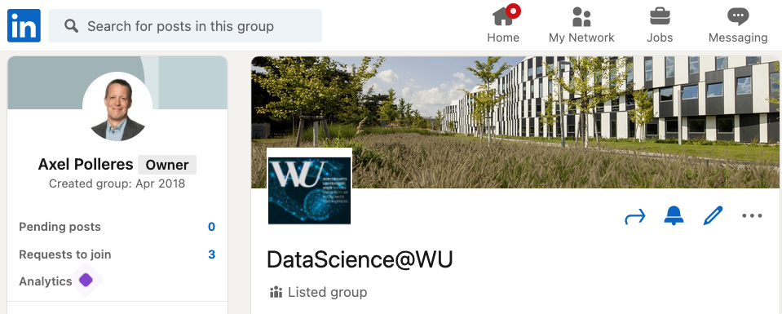

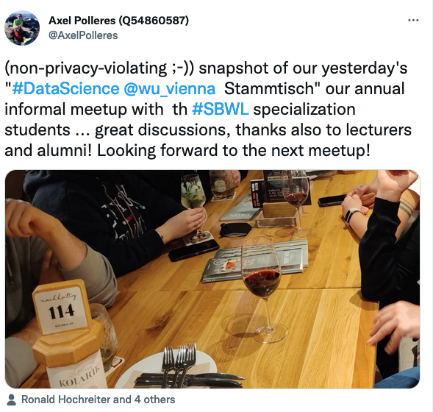
Our Data Science@WU Community:
DataScience@WU - Alumni network on LinkedIn
    Keep in touch with our company coaches, lecturers, current students and alumni!
  once per semester we meet at the
  "DataScience@WU-Stammtisch"
  with students, lecturers,
  industry coaches and alumni…
For our own research on
Data Science, Data Quality, etc. visit
http://data.wu.ac.at

Slide 19
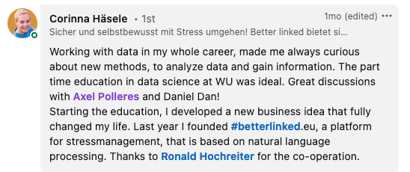
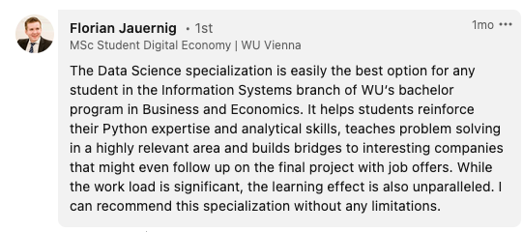
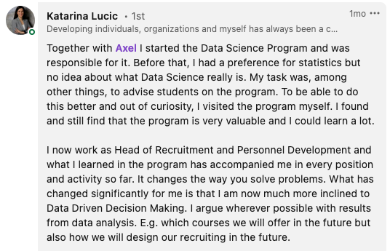
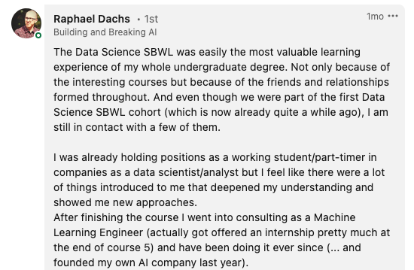
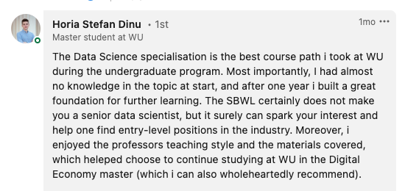
Our Data Science@WU Community:

Slide 20
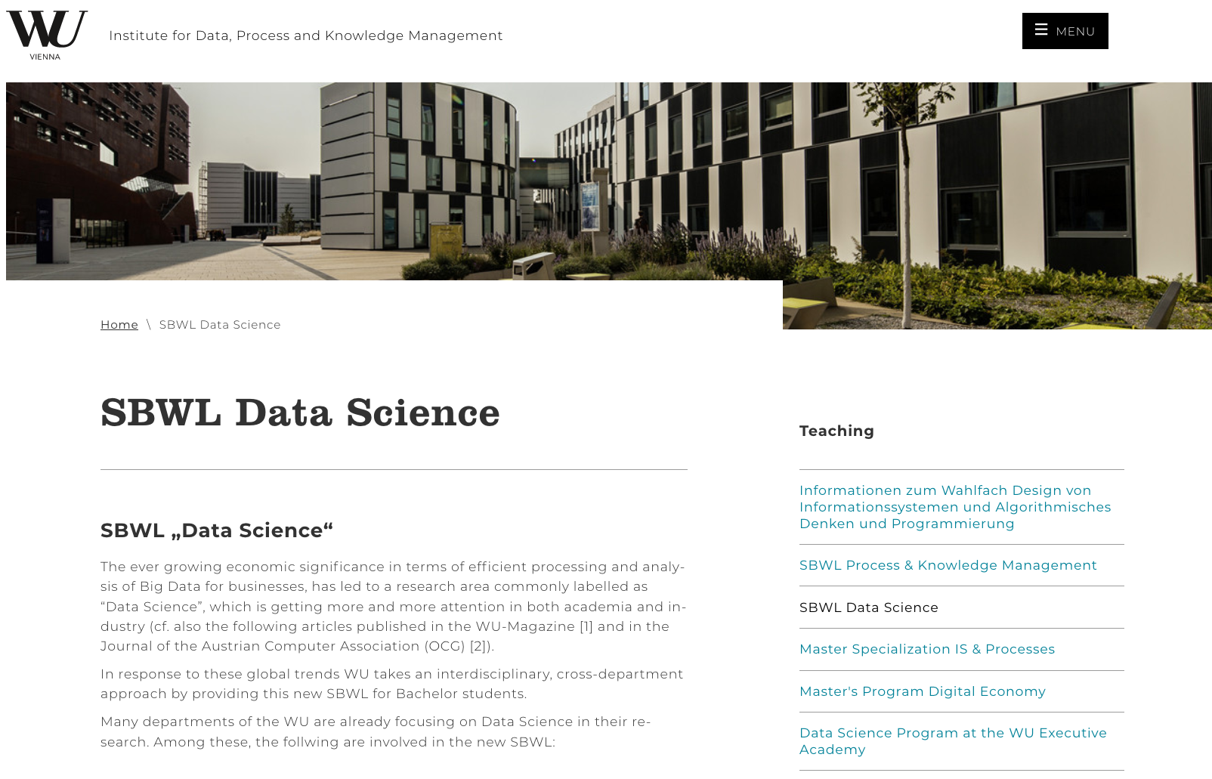
Data Science SBWL: Organisation
Questions?
Looking forward to seeing many of you in the coming semester!!
https://www.wu.ac.at/en/dpkm/teaching/sbwl-data-science
  All further info on
  our Webpage:
  description
  green card
  contact (for questions)
  registration details/dates

