Slide 1
Can we learn how to "Repair” Knowledge Graphs using constraints?
Axel Polleres, WU Vienna

Slide 2
Starting points/Base materials:
https://ww101.ai.wu.ac.at/
Tutorial: Wikidata Wizardry 101: From Query Spells to Data Charms (ISWC2024)
  Includes many Jupyter/GoogleColab notebooks about Wikidata and constraints in Wikidata
https://github.com/nicolasferranti/wikidata-constraints-formalization
  Formalization of Wikidata constraints in SPARQL and SHACL
  Accompanying paper: https://www.semantic-web-journal.net/content/formalizing-and-validating-wikidatas-property-constraints-using-shacl-and-sparql-0
https://colab.tuwien.ac.at/spaces/PBA/pages/339183111/Lecture+Series
  My talk “Querying Knowledge Graphs, Graph Learning and LLMs” on 22.05.2025
Great talk by Miguel 03.07.205 about “Knowledge Graphs and learning”, and various tasks e.g.
  Link prediction
  Node classification…
  We will talk about a slightly different task here: Graph repairs wrt Constraints!

Slide 3
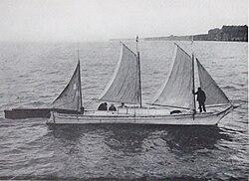
Knowledge Graphs
Simple (directed, labelled graph):
shooner
instanceOf
Tilikum
country of registry
Canada

Slide 4
Knowledge Graphs
ship
subclassOf
shooner
Simple (directed, labelled graph):
“Ontologogy” is part of the graph,
typically ”deductive” meaning
  i.e., allows to infer additional information
subclassOf
instanceOf
shooner
instanceOf
Tilikum
country of registry
Canada

Slide 5
Knowledge Graphs
ship
subclassOf
shooner
Simple (directed, labelled graph):
Could have property constraints,
such as:
“country conflicts-with country of registry”
  “i.e., an entity should not have both a “country” and a “country of registry”
subclassOf
shooner
instanceOf
Tilikum
country of registry
country
Canada

Slide 6
Checking constraints
Check Constraints on Graphs by looking for “graph patterns”
country of registry
Graph patterns can be checked by SPARQL queries:
SELECT * {
?P1 conflicts-with ?P2 .
?S ?P1 ?X.
?S ?P2 ?Y.
}
country
ATTENTION: This is a simplification, cf. https://github.com/nicolasferranti/wikidata-constraints-formalization/
https://github.com/nicolasferranti/wikidata-constraints-formalization/blob/main/constraints-formalization/conflicts-with%20/conflicts-with.rq

Slide 7
Knowledge Graphs
Tilikum
x
x
country of registry
country
Canada

Slide 8
Constraint Repairs
Additions or deletions of missing information.
For conflicts-with, e.g. deletion of either:
Tilikum
x
x
country of registry
country
Canada

Slide 9

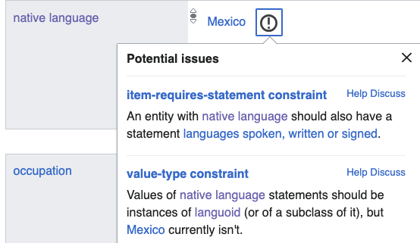
Constraint Repairs
Additions or deletions of missing information.
For item-required-statement constraint, or value-type-constraint, e.g. deletion or addition:
Spanish
Rodrigo_Lopez
languages spoken
languoid
native language
x
instanceOf
Mexico

Slide 10
Question: can we learn how to repair a graph by GNNs?

Slide 11
Group Task:
Understand the training data
Try to implement a GNN that learns such repairs, e.g. start with something small, e.g.
  conflicts with,
  item-requires-statement,
  type, Value-type,
  (single-value)
  constraints
Try to understand what it can (and can’t?) learn

Slide 12
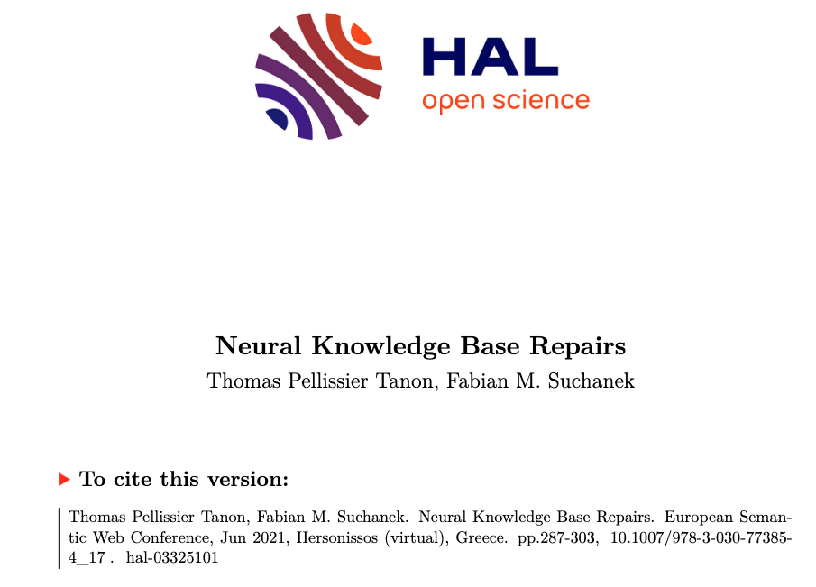
Good thing: We have training data!
https://hal.science/hal-03325101v1/

Slide 13
TODO: some slides or notebook to explain how the training data looks like…

Slide 14
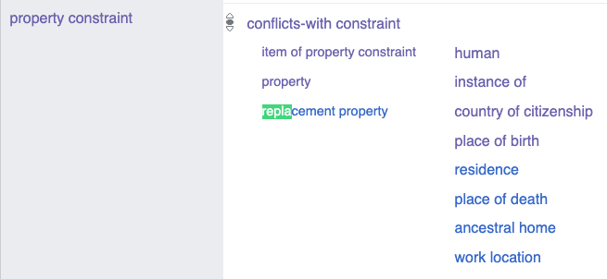
Challenge 1: Does an ML approach using this data learn the “right” repairs?
E.g. some constraints have a “replacement” property “suggestion” or “rule” in case of violations”
https://www.wikidata.org/wiki/Property:P17

Slide 15
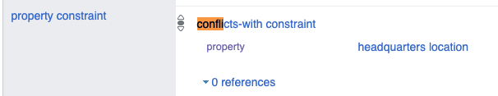
Challenge 2: In KGs, the constraints can also be graphs!
2019:
What if the constraint is changed?
Can we learn (when it’s better to do)
constraint repairs?
What if the constraint is changed?
We have data also for that! E.g.:
https://www.wikidata.org/w/index.php?title=Property:P131&oldid=824983023
BUT:
  constraint repairs are probably sparse
  Constraint changes may “trigger” new violations.
located in the administrative territorial entity
x
Conflicts-with
Had 18K violations in 2019,
deletion “fixed” a large amount of violations at once!
headquarters location

Slide 16
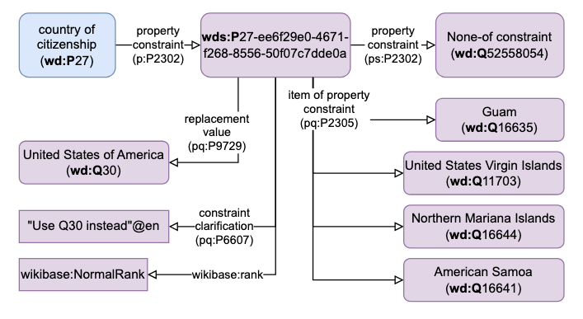
Challenge 3: Property Graphs: Qualifiers and contextual information – add complexity to repairs
Both instance data and constraints have additional qualifiers, such as ranks, temporal context, etc.:
When should a repair be marked a deprection?
When should a qualifier be added/removed?
Can we extend our approach to cover that?

Slide 17
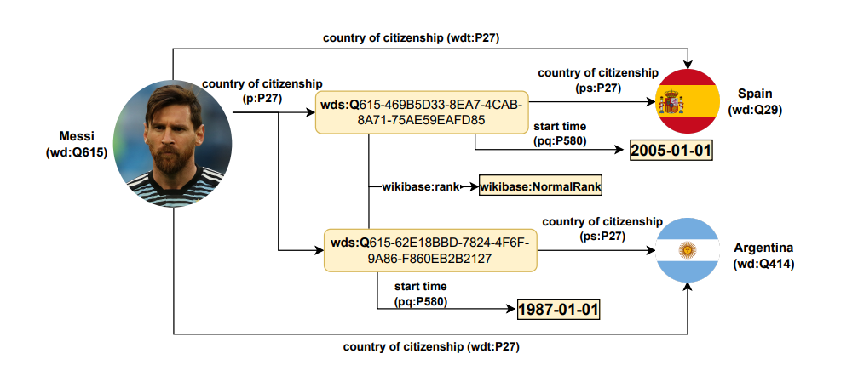
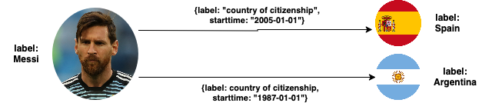
Example: contextual information in Wikidata instance data:
Challenge 3: Property Graphs: Qualifiers and contextual information – add complexity to violation checking and repairs
this is just an ugly “reified” form in RDF…
Some “repairs” could also be done by:
Changing “ranks” of statements
to only one wikibase:preferredRank
Adding disjoint start and end times
… of what people often call a Labelled Property Graph (LPG)*:

Slide 18
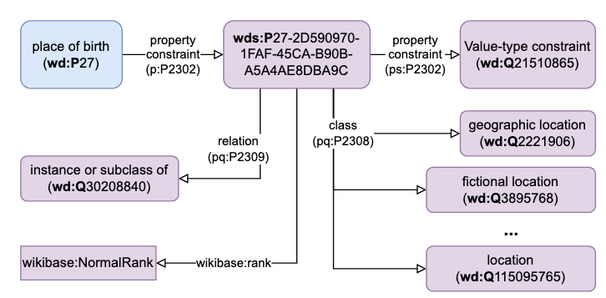
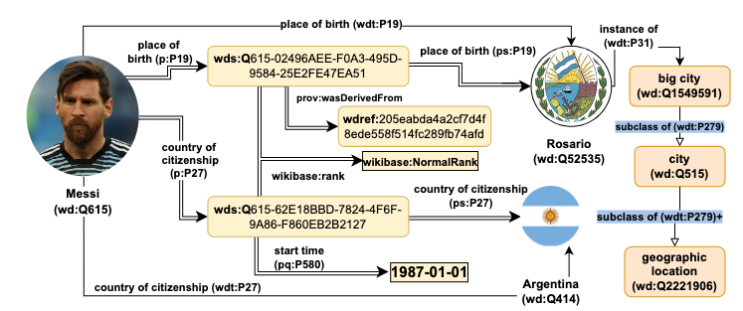
Example: contextual information in Wikidata constraint definitions:
Challenge 3: Property Graphs: Qualifiers and contextual information – add complexity to repairs
Some “repairs” could also be done by:
Adding “exceptions” to constrains
Changing the subclassOf hierarchy!

Slide 19
Challenge 4: How could “repairs” interact?
Can a (constraint) repairs or changes cause new violations?
Theoretically, yes!
Does that happen? Yes!
Empirical Observation:
the addition of the language of work or name (P407) qualifier to the existing Required-qualifier constraints for official website (P856) and described at URL (P973) properties after 2019 led to over 1.8 million new violations.

Slide 20
Summary:
We will try to learn repairs from looking at historical repairs!
… Extending an existing approach to GNNs
… We have training data
Time allowed: we can think about additional challenges, (such as constraint changes)

Slide 21
Group Task:
Understand the training data
Try to implement a GNN that learns such repairs, e.g. start with something small, e.g.
  conflicts with,
  item-requires-statement,
  type, Value-type,
  (single-value)
  constraints
Try to understand what it can (and can’t?) learn
Compare baseline approach to Tanon et al.
Think about how to tackle Challenges 1-4

