Slide 1
“Natural Data Understanding": LLMs, Agents, Knowledge Graphs - why they need each other to solve (your?) Data problems?
Axel Polleres
Inst. for Data, Process & Knowledge Management, WU Wien
Notes:
Test

Slide 2
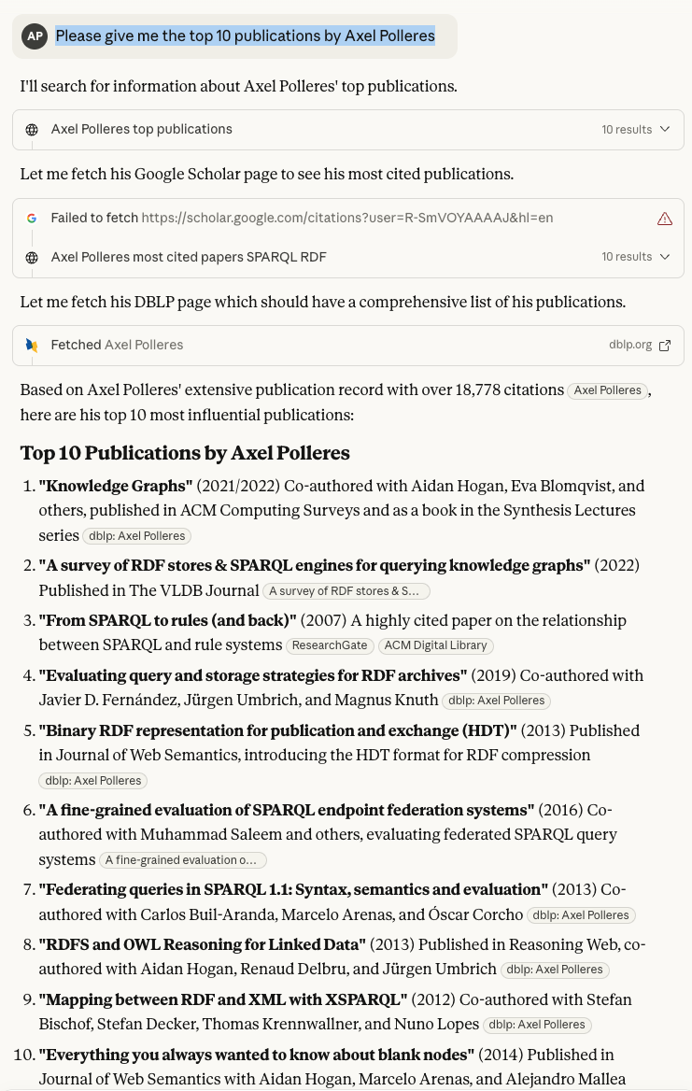

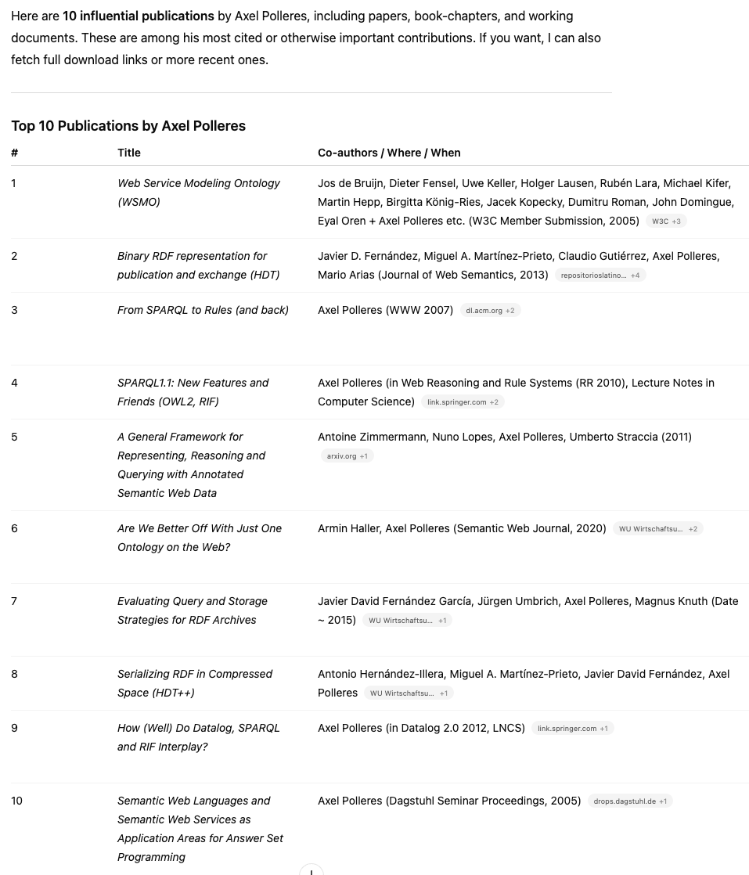

LLMs get better
“are supposed to be PhD level”
… but still (plausibly) hallucinate
Inspired by Georg Gottlob’s SEMANTiCS2025 keynote
Antother key insight from SEMANTiCS – Heng Ji’s keynote
Larger models are not necessarily better!
ok
ok
ok
ok
ok
ok
!
ok
ok
ok
ok
ok
!
!
ok
ok
ok
ok
ok
ok
Notes:
But this is a “chat-to-your-data use case”

Slide 3
Knowledge Graphs (and Databases) to the rescue…
LLM
KG/Database
RAG/MCP
Notes:
Sepp Hiochreiter: an LLM is actually a “database”… and the past slide example has shown, that this is not yet the end of the story… still room for improvement. We need to rethink this architecture, but we may also need to rethink our databases, because there’s another problem!

Slide 4
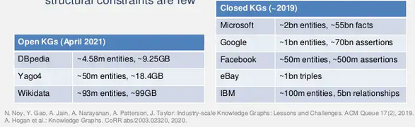
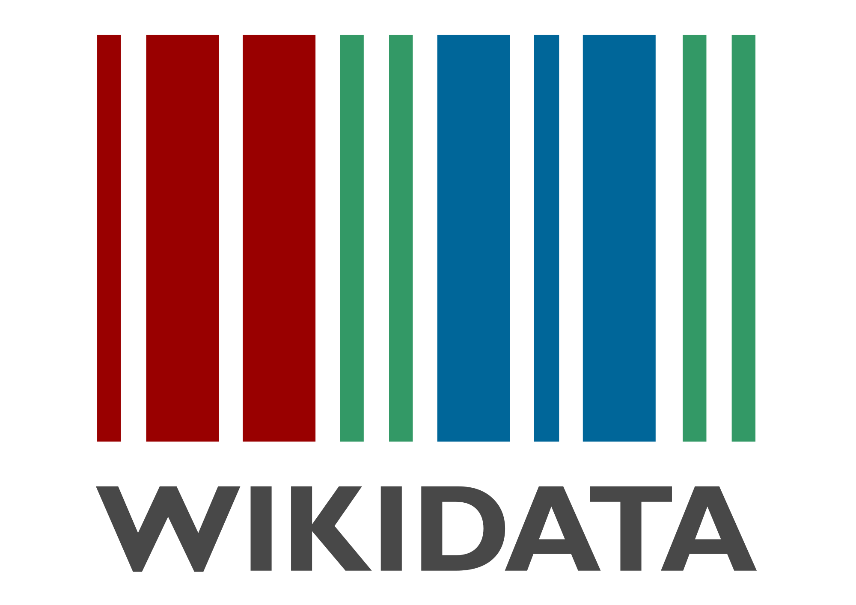
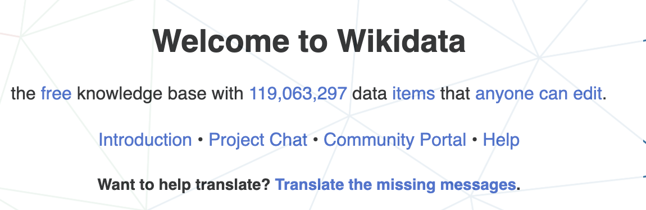
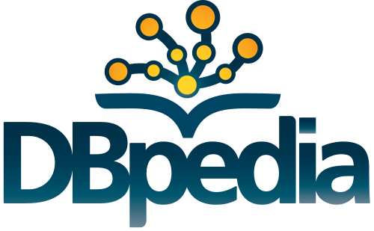
Knowledge Graphs (and Databases) to the rescue…
Closed KGs
  Google KG
  Enterprise KGs
  …
Open KGs
  Wikidata
  DBpedia
  DBLP
  …
Rapidly growing!

Slide 5
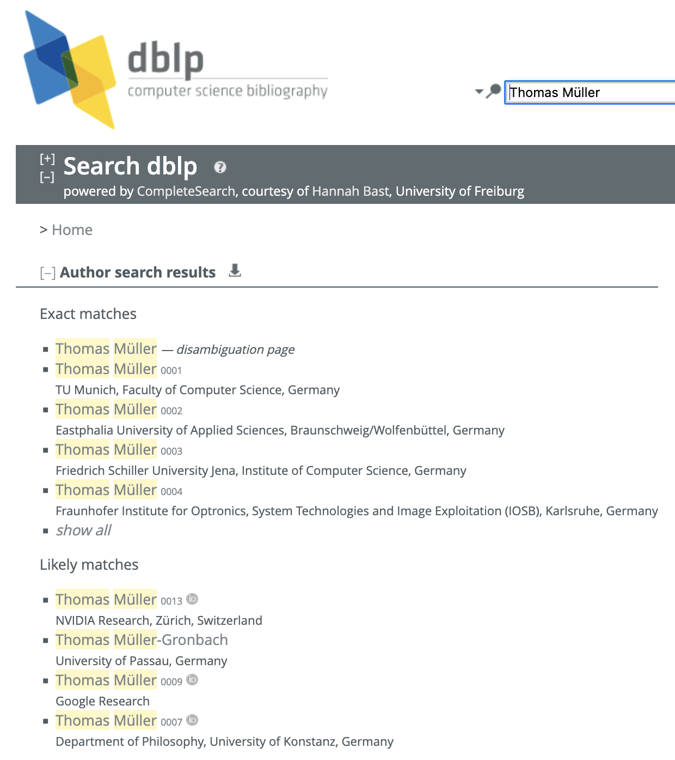
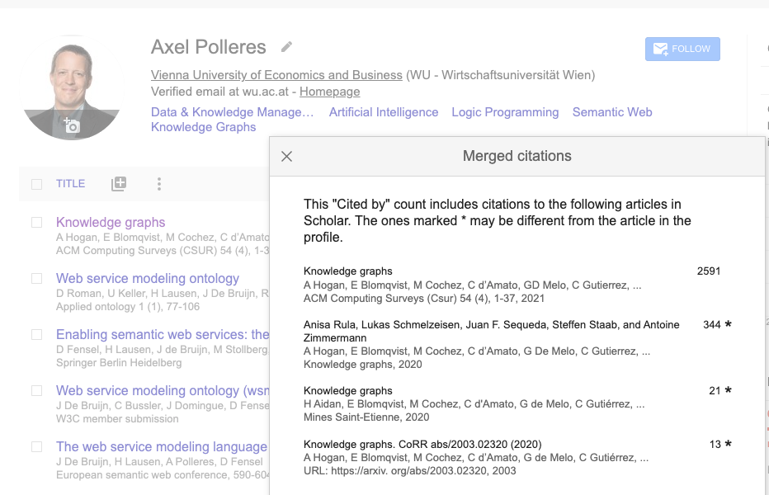
But are (your?) KGs & Databases actually better?
Google asks it’s users to manually correct/merge results
DBLP or scopus attempt to curate ambiguities by constraints (not always successful..)

Slide 6
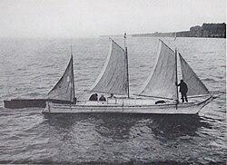
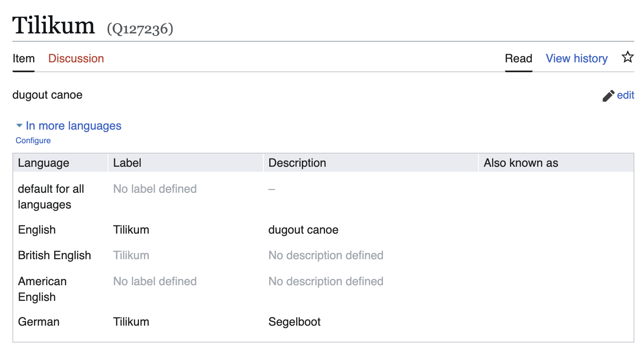
But are (your?) KGs & Databases actually better?
Example from Wikidata…

Slide 7
But are (your?) KGs & Databases actually better?
ship
subclassOf
shooner
Ontologies +
Constraints,
such as:
“country conflicts-with country of registry”
    “i.e., an entity should not have both a “country” and a “country of registry”
subclassOf
shooner
instanceOf
Tilikum
x
x
country of registry
country
Canada

Slide 8
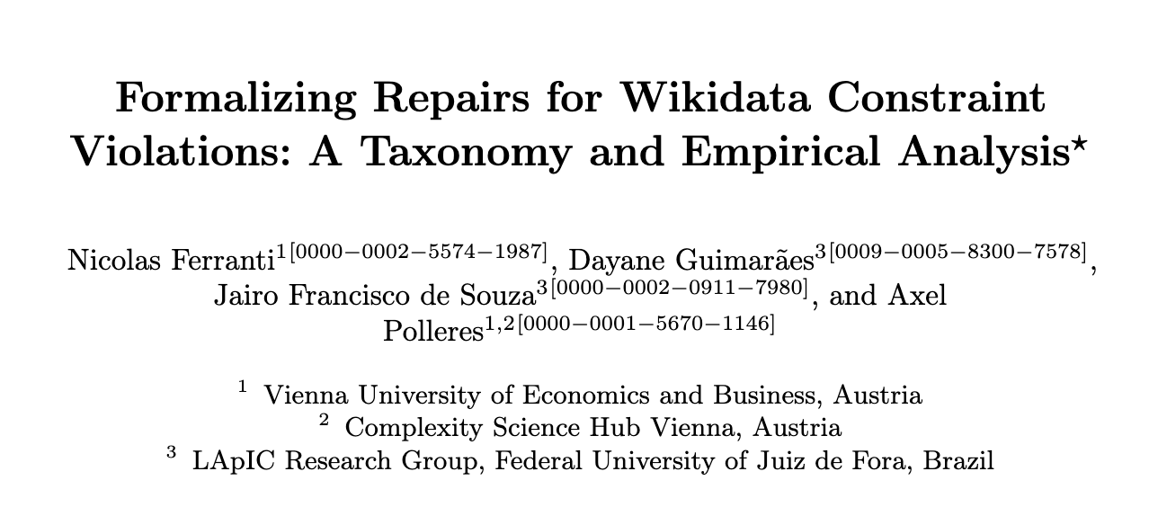
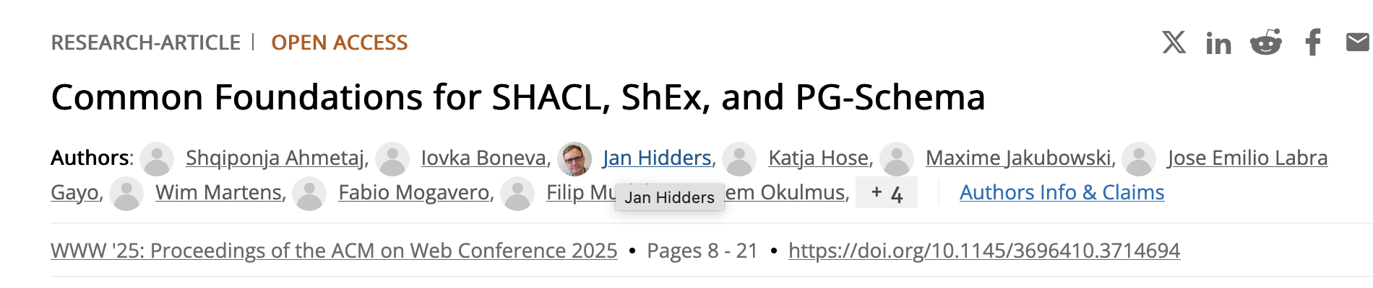

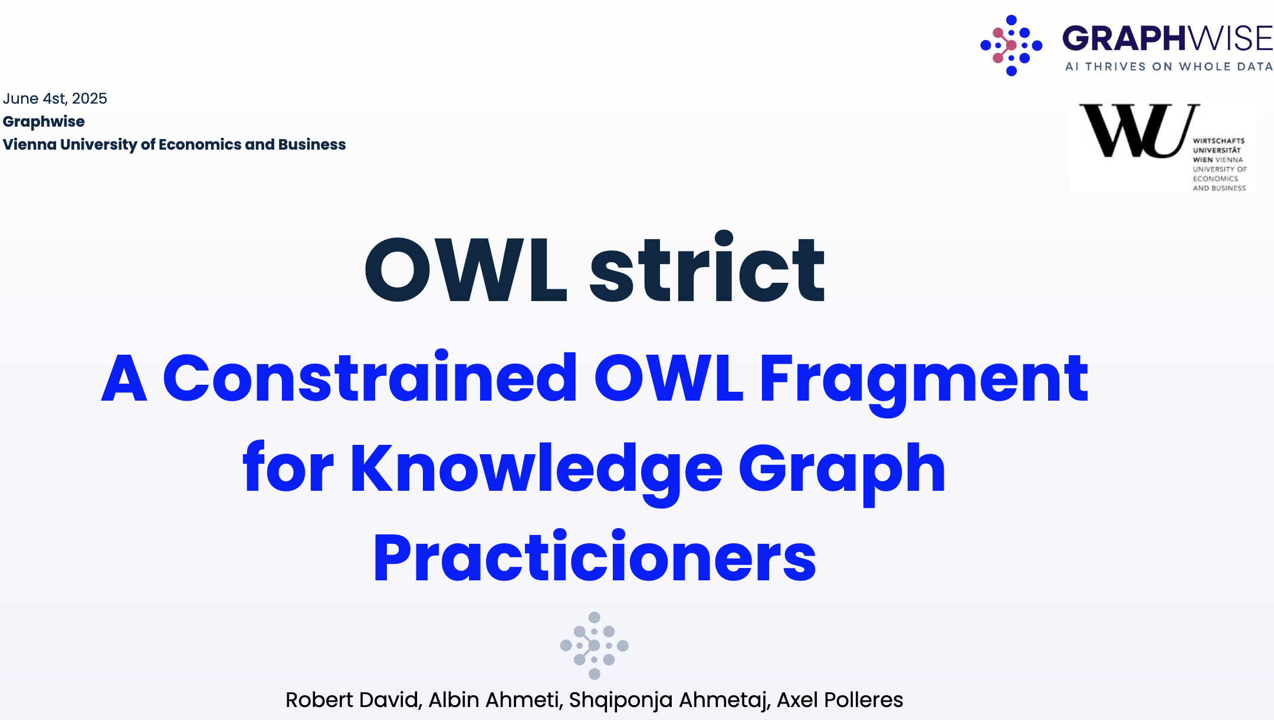
Why KGs can’t (scalably) be correct either:
ISWC2025
Collaborative Editing
Multi-sourced Automatic Extraction
Knowledge is distributed and evolving!
  Remote changes affect consistency
  Ontologies evolve as well
What can we do about it?
  Best of both worlds needs Bilateral AI approaches!
    Symbolic methods to repair inconsistencies
    Subsymbolic methods to resolve inconsistencies
      LLMs for resolving inconsistencies
      GNNs for learning repairs (from historical data, from users’ repairs)
      Iterative RAG and Agent-based pipelines to fix and construct KGs from text
Webconf2025
Forthcoming…
ESWC2025
Notes:
“Learn from hisrotical data” → We would be happy for your use cases

Slide 9


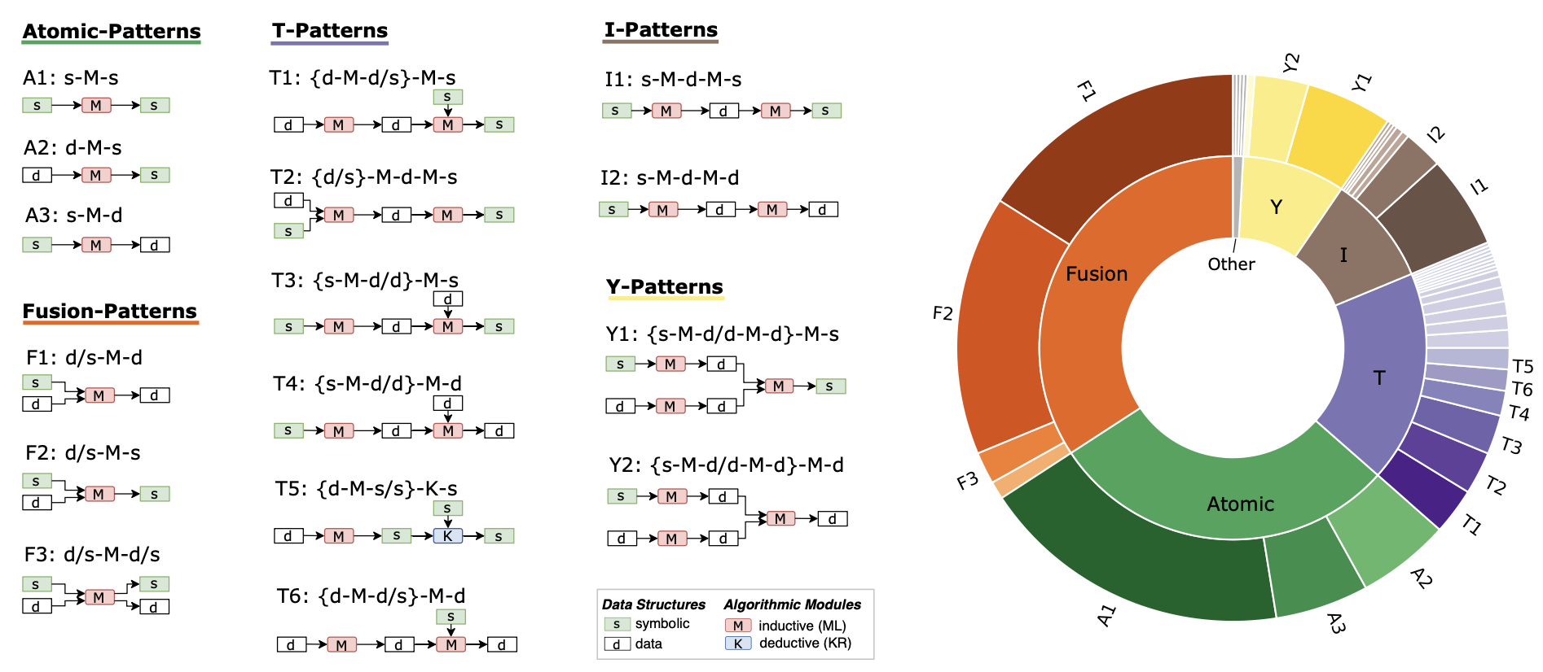
What’s next?
Neurosymbolic AI Systems
Prof. Marta Sabou
Ingredient1: We have a pretty good understanding of Engineering Neuro-Symbolic Systems…
A. Breit, L. Waltersdorfer, F.J. Ekaputra, M. Sabou, A. Ekelhart, A. Iana, H. Paulheim, J. Portisch, A. Revenko, A. ten Teije, and F. van Harmelen. 2023. Combining Machine Learning and Semantic Web: A Systematic Mapping Study. ACM Computing Survey. March 2023.

Slide 10
What’s next? Where should this go?
Ingredient 2: Expertise on Symbolic Data Integration and Repair. Before the LLM hype, we long worked on purely symbolic solutions to integrating decentralised Knowledge
  Linked Data
  Ontology-based Data Access
KG
KG
KG

Slide 11
What’s next? Where should this go?
Ingredient3: Combinations of LLMs and decentral KGs via RAG and Agent frameworks are one example of such Neuro-symbolic architectures:
KG
Planning/ Scheduling/
Configuration/
Policies
KG
“Agentic” models:
LLM/ReAct
KG

Slide 12

What’s next? Where should this go?
Caveat: Our data and knowledge is
  distributed and
  not always sharable with a central (API) model
  → we need decentralized solutions!
“Our knowledge will never go into a central LLM” – keynote Stefan Rohringer (Infineon) this morning
Catalog
Catalog
Catalog
Ingredient 4: “Data Spaces”

Slide 13
What’s next? Where should this go?
What is a solution we should jointly work towards?
Neuro-symbolic agents
Trustable Decentralized Agents
Small models
“Agent Spaces”
P
SLM
KG
P
P
SLM
SLM
KG
KG

