Slide 1
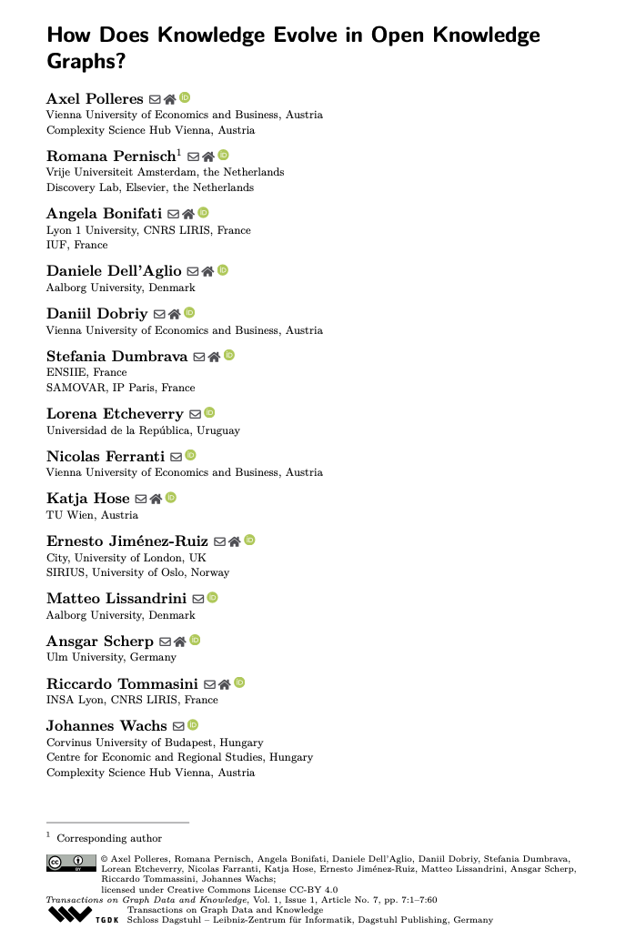
How Does Knowledge Evolve in Open Knowledge Graphs?
Axel Polleres, Daniil Dobriy, Nicolas Ferranti
(authors present here at ISWC)

Slide 2
Disclaimer: Our paper is/was a call for ACTION! Main questions raised (not answered!) in the paper:
Which publicly accessible, open KGs are observable in a manner that would allow a longitudinal analysis of their evolution and how?
Do we have the right metrics to analyse KGs’ evolution?
Do we have the right techniques to process evolving KGs?
→ What dimensions does evolution have at all?

Slide 3
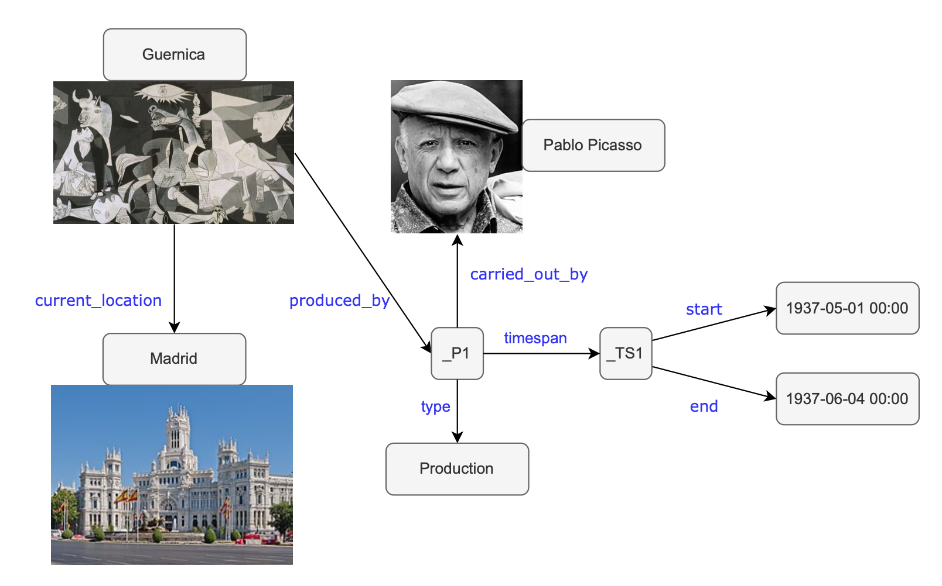
What dimensions does KG evolution have at all?
Temporal KGs: Time as Data (“valid time”, Dates/Timestamps, Intervals, start/end events)
Time-varying KGs: Time as meta-data/log data (“transaction time”, Edit events(Dates/Timestamps)
“Pablo Picasso” (Q5593) added on 1 November 2012
“Guernica” (Q175036) was created on 28 November 2012 in Wikidata
Bottomline:
Tracing is time in published KGs is not standardized:
Not observable/ recorded for many KGs
Modeled within or outside of the KG
Using different forms of reification
The statement that Picasso created Guernica was only created in Wikidata in March 2013
“Guernica” (Q175036) was painted between May and June 1937
Notes:
Doesn’t fit the flat RDF model…

Slide 4
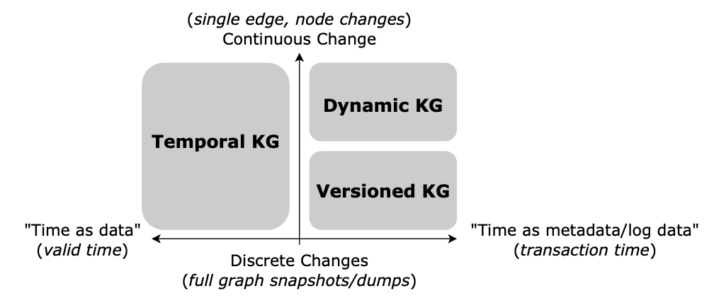
What dimensions does evolution have at all?
Instance evolution
Schema evolution
Collaboration models
Time-Varying KG

Slide 5
What dimensions does evolution have at all?
additional
Instance evolution
Schema evolution
Collaboration evolution
Structural evolution
Dynamics (change frequencies, etc.)
Timeliness (recency of temporal information, delays)
Monotonicity (“growth” vs. “deletions”)

Slide 6
Main questions:
Which publicly accessible, open KGs are observable in a manner that would allow a longitudinal analysis of their evolution and how?
Do we have the right metrics to analyse KGs’ evolution?
Do we have the right techniques to process evolving KGs?

Slide 7
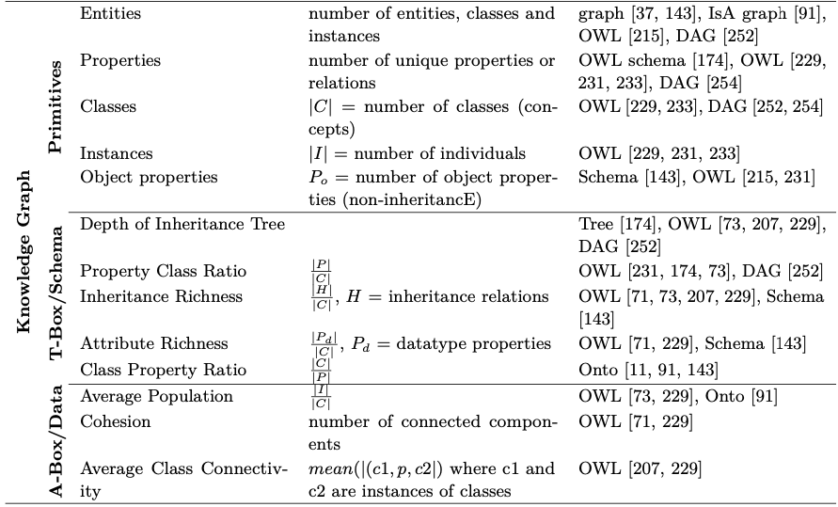
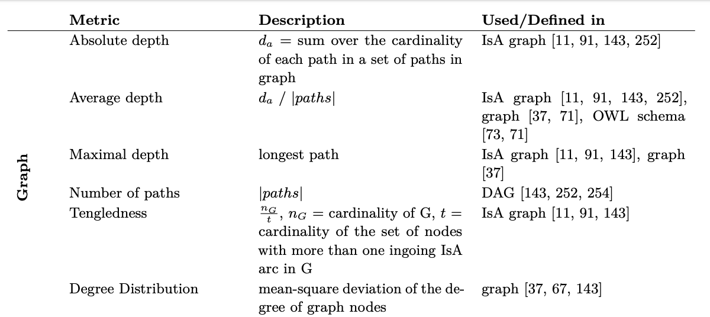
From static metrics to dynamic metrics
Basic (static) (Knowledge) Graph metrics “over time”…
… are not ENOUGH to understand evolution!

Slide 8
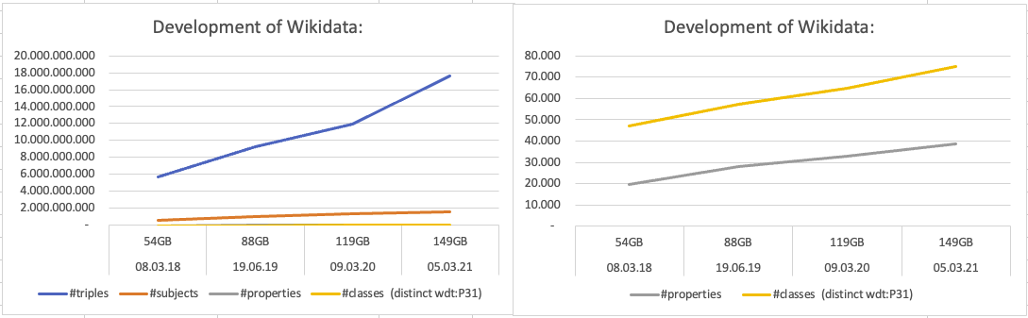


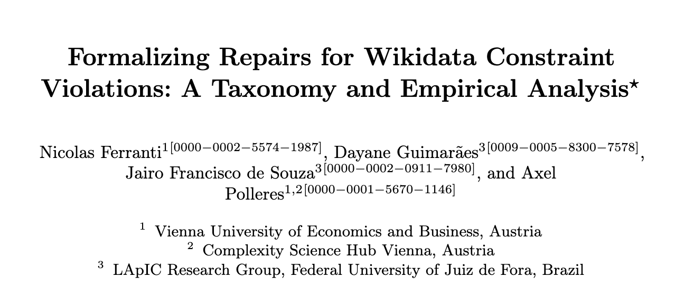


Challenge: What do these metrics tell us over time?
(shameless self-advertisement ;-)) Our work towards such metrics since the TGDK paper:
How “remote” ontology updates affect reasoning closure for linked data? WebConf2025:
How constraint repairs evolve over time? Check our main conf. paper!
Bottomline/Challenges:
We need to track changes on a finer granularity level
We need new metrics (from other fields):
Time series analyses (change frequencies, seasonality)
Network science (dynamics of networks)
etc.
Metrics to track the evolution of consistency in KGs?

Slide 9
Main questions:
Which publicly accessible, open KGs are observable in a manner that would allow a longitudinal analysis of their evolution and how?
Do we have the right metrics to analyse KGs’ evolution?
Do we have the right techniques to process evolving KGs?

Slide 10
Do we have the right techniques to process evolving KGs?
What (else) will you find here in our paper? Survey of …
Storage techniques for evolving KGs
Reasoning & Querying techniques for evolving KGs
Learning & Embeddings for evolving KGs
Challenges:
How do we make these methods scale to large-scale, evolving, collaborative KGs?
E.g.
How to reason and query over evolving KGs?
How to scale and modularize existing techniques over highly reified KGs?

