Slide 1
Knowledge Graphs as a backbone for Bilateral AI and Intelligent Data Management
Axel Polleres

Slide 2

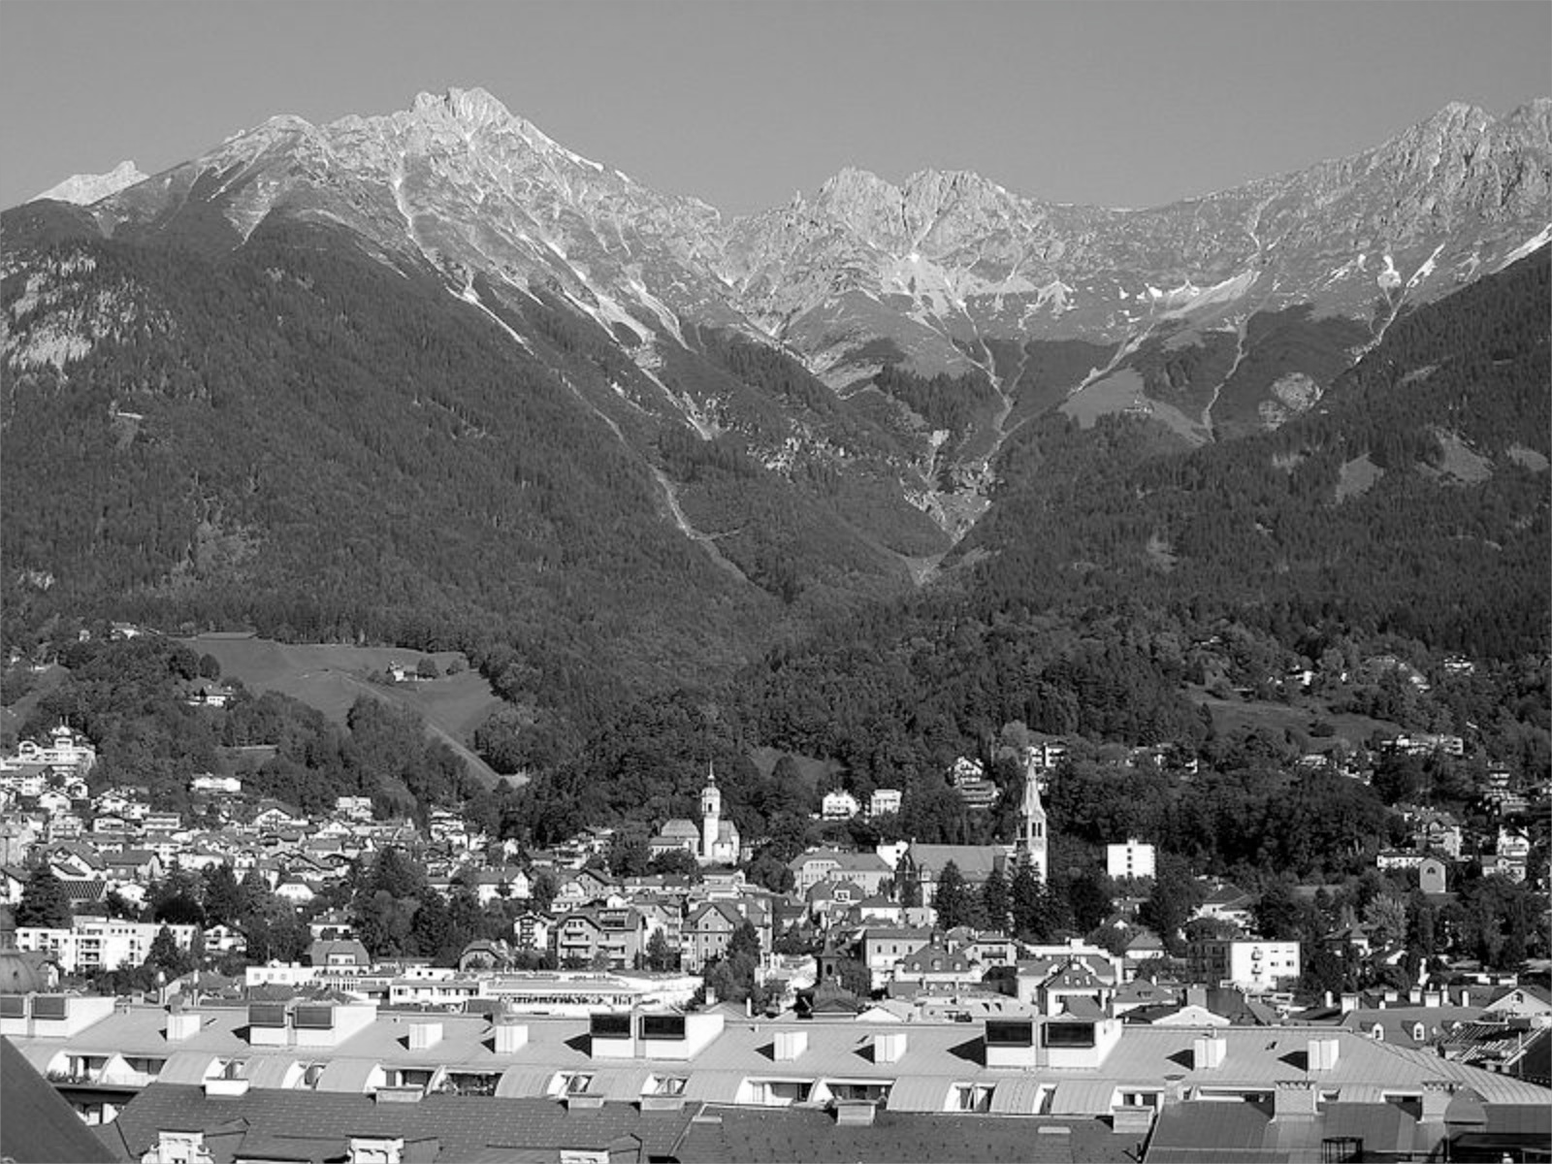




My background…
Logic Programming, “Symbolic” Artificial Intelligence
Semantic Web, Knowledge Representation & Reasoning
Web Standard
Query Language (SPARQL)
Data Integration, Open Data
Knowledge Graphs
“Bilateral” AI
Linked Data
2003
2005
2007
2011
2013
~2020
LLMs
TU Vienna
Univ. Innsbruck
Univ. Rey Juan Carlos Madrid
DERI, NUI Galway, Ireland
Siemens AG Österreich
WU Vienna

Slide 3
Abstract:
In the course of the talk I would suggest to first introduce the concept of Knowledge Graphs (KGs) and it’s evolution and (current) applications, and then provide some mixed outlook on own research and trends where KGs are usable Hybrid (Neuro-Symbolic, Agentic) AI applications and systems to power Data Understanding and Data management. As an application case, I will mainly refer to open, collaboratively edited Knowledge Graphs such as Wikidata. In case, you can find materials of several of my prior talks and presentations on my Webpage: http://polleres.net/presentations/
The history of the Semantic Web and Knowledge Graphs is tightly interwoven with applications of different techniques and methods of AI, but also with the idea of Agents collaborating in a decentralised manner. In this talk I will give an overview of this history from predominant symbolic AI methods in the beginning towards the seeming dominance of GenAI and LLM approaches nowadays.
Yet, as we will see, the still open challenges call for Hybrid or - as we call them - “Bilateral” AI” approaches. In the course of of the talk, we will particularly focus on the central role of graph-based knowledge representation in Knowledge Graphs, which, as we argue, while having been influenced by both, neither can be viewed purely as (graph) databases nor as ontologies in a narrow sense. Lastly, we aim at giving an overview of ongoing trends and our current research in the Knowledge Graphs community with hopefully inspirations for potential collaborations.

Slide 4
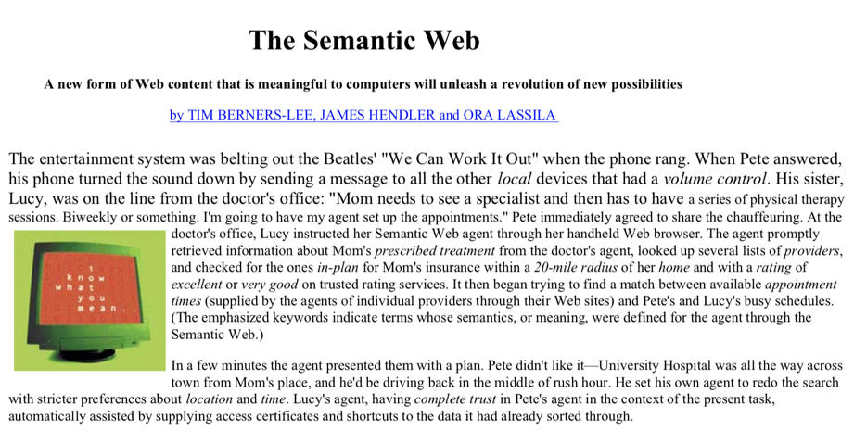
“[…] The agent promptly
retrieved information about Mom's prescribed treatment from the doctor's agent, looked up several lists of providers,
and checked for the ones in-plan for Mom's insurance within a 20-mile radius of her home and with a rating of excellent or very good on trusted rating services[…]”
Appointment detection in emails
Semantic Search
Ratings of products/services
"If HTML and the Web made all the online documents look like one huge book, RDF,
schema and inference languages will make all the data in the world look like one huge
database"
Tim Berners-Lee, Weaving the Web, 1999
Instead of its initial focus on agents the “Semantic Web”…
… has then mostly become the basis for the "Web of Data"…
… and its more recent focus on Open Knowledge Graphs…
" huge knowledge bases, also known as knowledge graphs, have been automatically constructed from web data, and have become a key asset for search engines and other use cases.
Gerhard Weikum, Knowledge Graphs 2021: A Data Odyssey, VDLB 2021

Slide 5
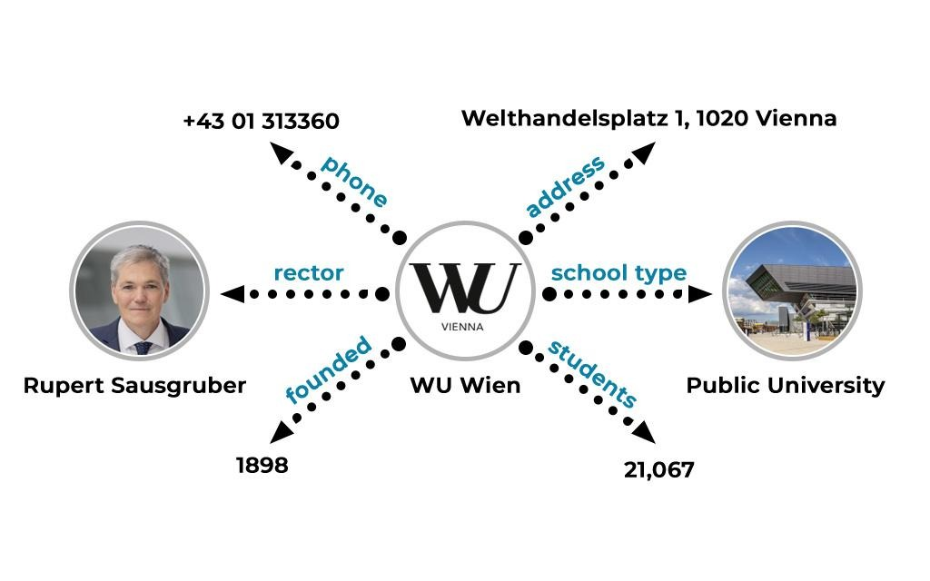
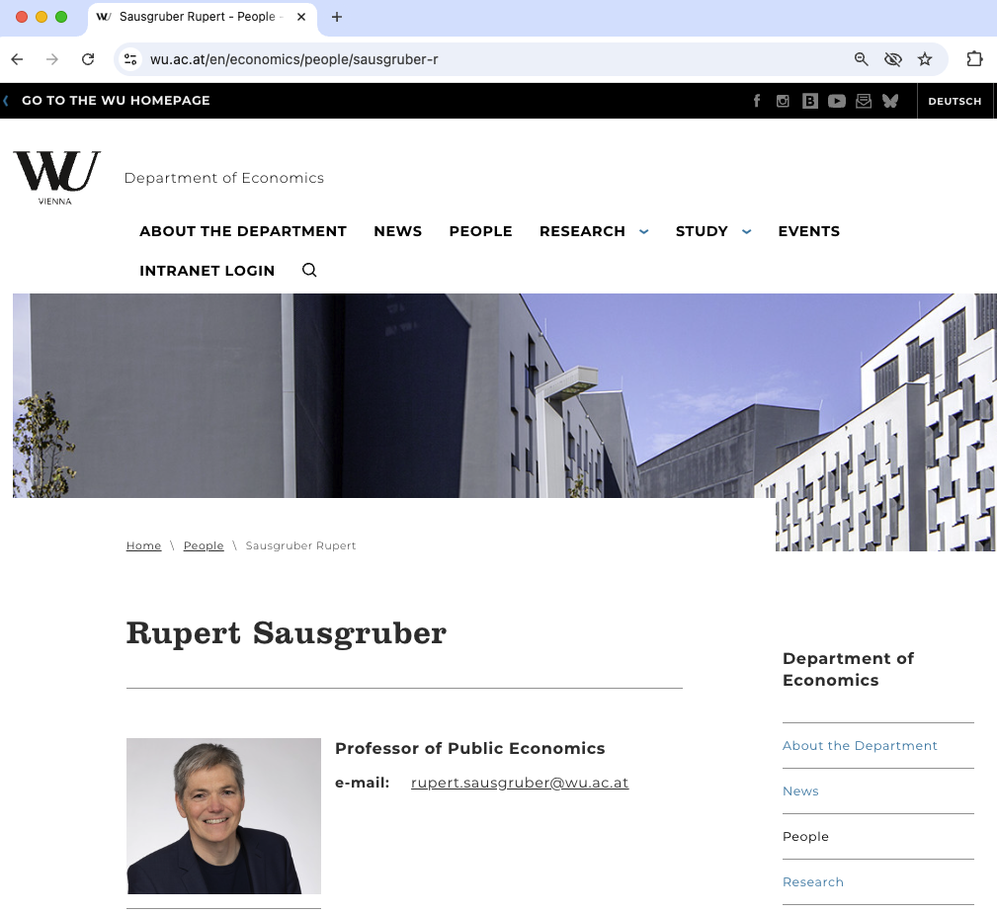
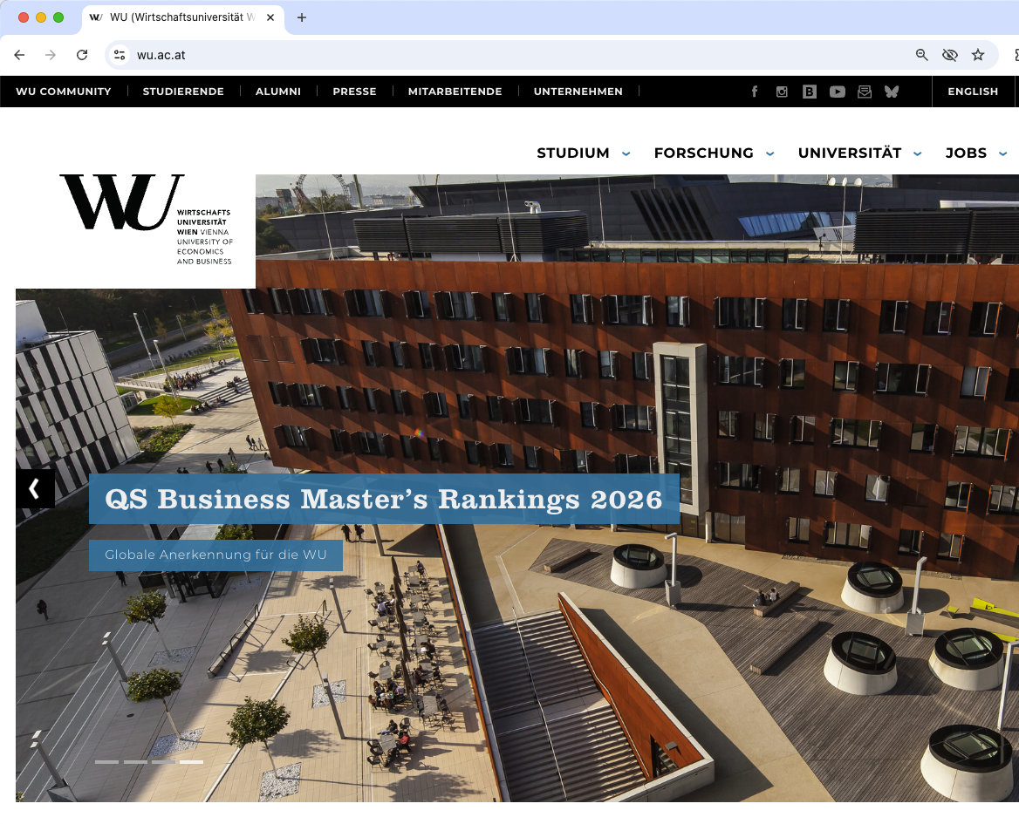
Phase 1: RDF – Linked “Metadata”
“Typed links” describing Ressources (such as Web pages)
<a ref=“ruper”>our rector</a>

Slide 6
Phase 1: RDF (Ressource Description framework) – Linked “Metadata”
Typed links “triples” describing Ressources (such as Web pages)
<http://www.wu.ac.at#wuwien>
<http://www.wu.ac.at#hasRector>
<http://www.wu.ac.at/Rupert_Sausgruber>

Slide 7
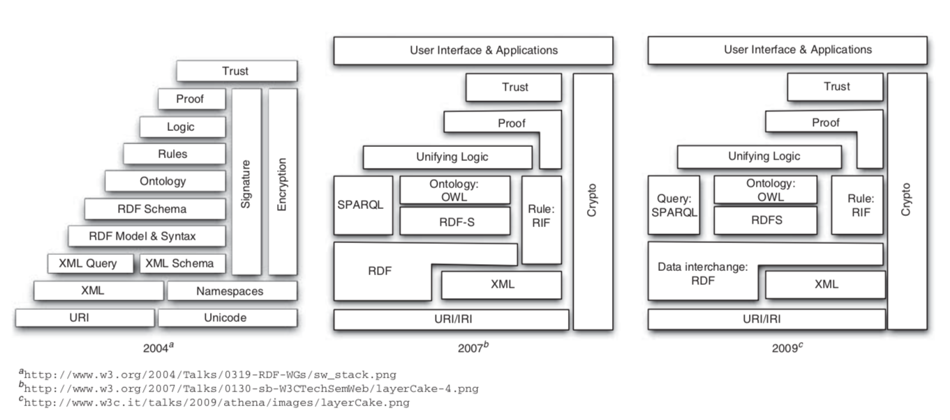

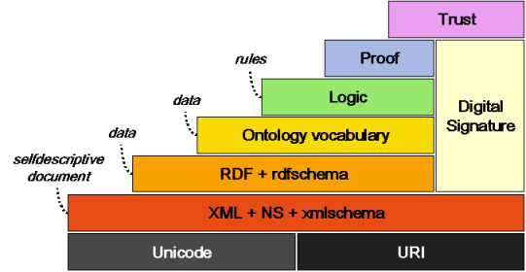

Semantic Web: Standard formats,
Reasoning & Logics
(2000s - ca. 2009)
Work on “Unified Logics”
Description Logics or Rules?
(Contextualized Reasoning?)
Good news! Standards meant a Boost in KR/AI research:
We know very well which ontological reasoning
approaches are decidable and how they scale
→ RDF, OWL, SPARQL Ontology-based Data Access but also: constraint checking (SHACL)
Semantic Web Activity
Olivier Boissier, Marco Colombetti, Michael Luck, John-Jules Meyer, and Axel Polleres. Norms, organizations, and semantics. The Knowledge Engineering Review, 28(1):107--116, March 2013.
Notes:
Goal: Make Data on the Web machine readable… enabled by declarative inference

Slide 8
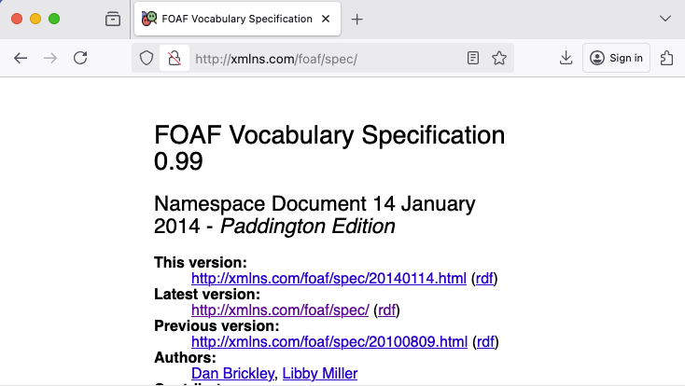
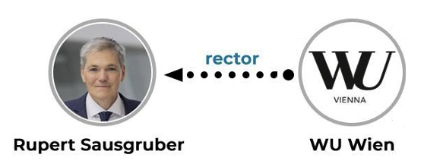
Phase 2: RDF, RDF Schema, OWL
Linked “Metadata” with Rules and Ontologies.
SELECT ?P
{ ?P a foaf:Person .
?P foaf:workPlace wu:WUWien. }
foaf:Organization
FOAF “Ontology”
RDFS:domain
foaf:Person
foaf:workplace
OWL:inverseOf
employs
RDFS:range
RDFS:subpropertyOf
foaf:Person
foaf:Organization
type
type
workplace
Notes:
Still with theWeb in mind – completely Decentalized inference.

Slide 9
Phase 2: RDF, RDF Schema, OWL,
Linked “Metadata” with Rules and Ontologies.
SPARQL
"If HTML and the Web made all the online documents look like one huge book, RDF,
schema and inference languages will make all the data in the world look like one huge
database"
Tim Berners-Lee, Weaving the Web, 1999
SELECT ?P
{ ?P a foaf:Person .
?P foaf:workPlace wu:WUWien. }
foaf:Person
foaf:Organization
type
type
workplace
Notes:
Still with theWeb in mind – completely Decentalized inference.

Slide 10

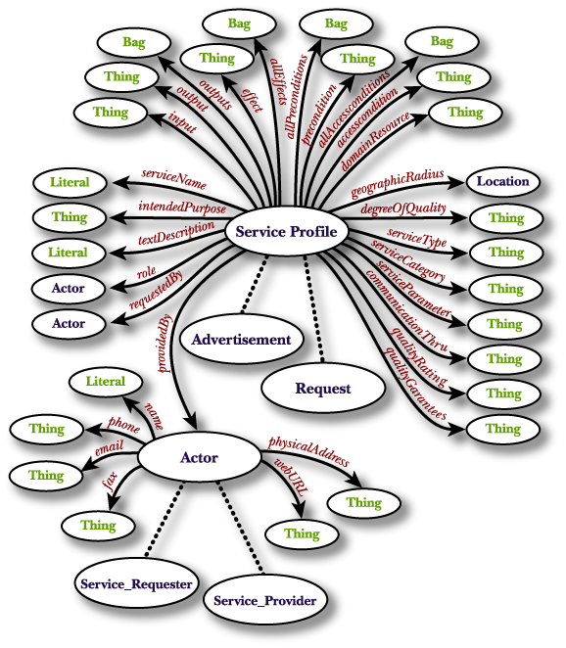
Phase 2 “interlude”
Semantic Web Services: We cannot only describe Websites and Metadata, but also Services and APIs! (~2002-2007)
            Main Idea:
              Describing Services & Agents in a declarative manner
              using ontologies…
              … should enable automated composition, execution
On hindsight: automated composition by purely symbolic inference … was maybe maybe ahead of its time…
Mark H. Burstein, Jerry R. Hobbs, Ora Lassila, David L. Martin, Drew V. McDermott, Sheila A. McIlraith, Srini Narayanan, Massimo Paolucci, Terry R. Payne , Katia P. Sycara:
DAML-S: Web Service Description for the Semantic Web. ISWC 2002: 348-363
Dumitru Roman, Uwe Keller, Holger Lausen, Jos de Bruijn, Rubén Lara, Michael Stollberg, Axel Polleres, Cristina Feier, Christoph Bussler, Dieter Fensel:
Web Service Modeling Ontology. Appl. Ontology 1(1): 77-106 (2005)

Slide 11


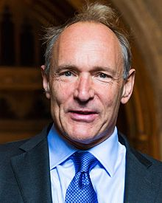
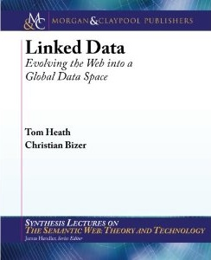
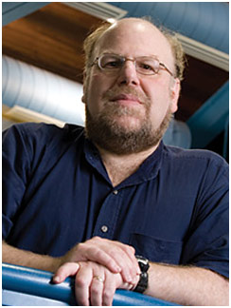
Focus on Data: Linked Data
(ca. 2006/7 – ca. 2013)
  Main question: How can I publish “Knowledge on the Web” …
Linked Data Principles
LDP1: use URIs as names for things
LDP2: use HTTP URIs so those names can be dereferenced
LDP3: return useful – RDF? – information upon dereferencing those URIs
LDP4: include links using externally dereferenceable URIs.
https://www.w3.org/DesignIssues/LinkedData.html (originally published 2006-07-27)
“A Little Semantics Goes a Long Way” (Jim Hendler)
http://linkeddatabook.com/editions/1.0/
https://www.cs.rpi.edu/~hendler/LittleSemanticsWeb.html
Notes:
So, how does this work? Strong reliance on standards and standard formats and query languages, such as SPARQL which make it eas to compile and aggregate these connected knowledge graphs to new special purpose knowledge graphs for your application!

Slide 12
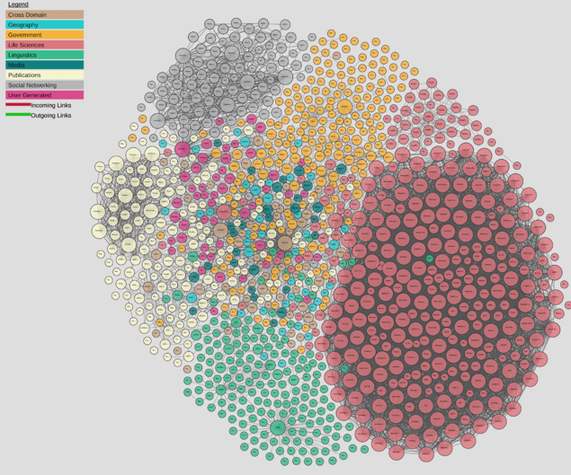

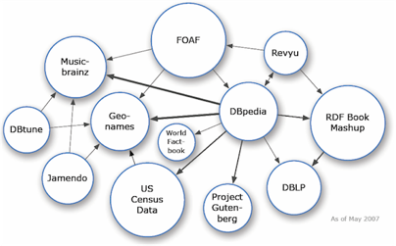
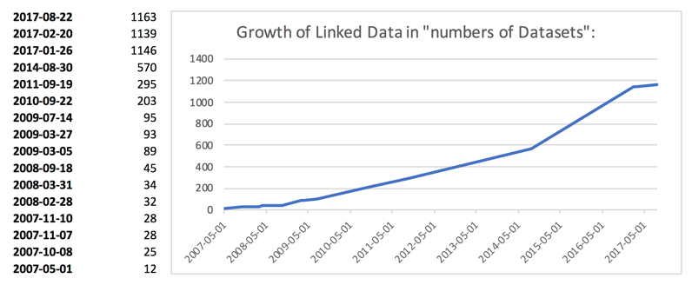
Phase3: From Semantic Web to Linked (Open) Data
(ca. 2006/7 – 2012)
  Main question: How can I publish “Knowledge on the Web” …
    Linked Open Data… growth slowed down a bit
    A lot of active developments to publish and link RDF Data
    also in Enterprises (“Enterprise Linked Data”)
http://lod-cloud.net/
Axel Polleres, Maulik R. Kamdar, Javier D. Fernández, Tania Tudorache, and Mark A. Musen. A more decentralized vision for linked data. In Decentralizing the Semantic Web (Workshop of ISWC2018).

Slide 13
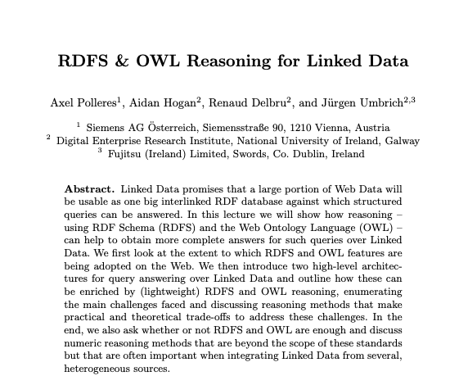
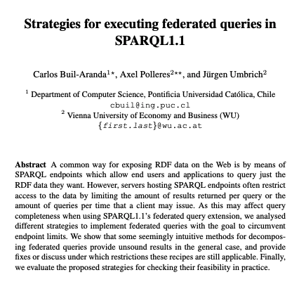
Phase3: From Semantic Web to Linked (Open) Data
(ca. 2006/7 – 2013)
  Main question: How can I publish “Knowledge on the Web” …
  Side question(s):
  Can deductive symbolic inference and queries scale to a
  decentralized
  Web?
Reasoning Web. Semantic Technologies for Intelligent Data Access (Reasoning Web 2013)
International Semantic Web Conference (2014)

Slide 14
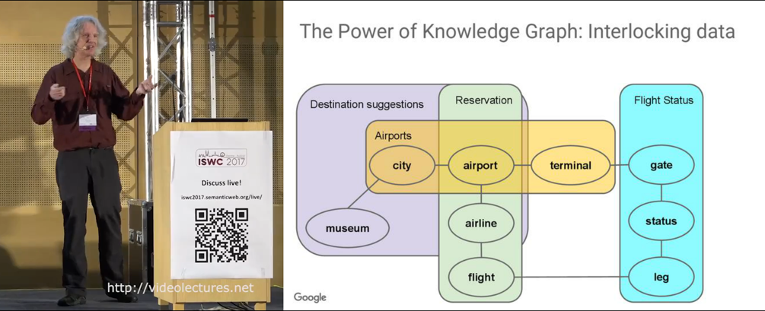
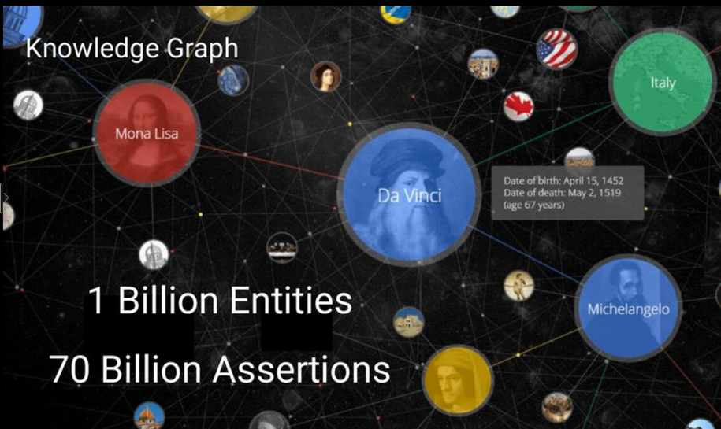
From Linked Open Data to Knowledge Graphs:
2013: Google adopts Semantic Web ideas under a new name
Jamie Taylor, Google, Inc., Keynote ISWC2017
Actors, Directors, Movies
Art Works & Museums
Cities & Countries
Islands, Lakes, Lighthouses
Music Albums & Music Groups
Planets & Spacecraft
Roller Coasters & Skyscrapers
Sports Teams [...]
Notes:
Remarkable: Big companies so far had largely ignored Semantic Web….

Slide 15
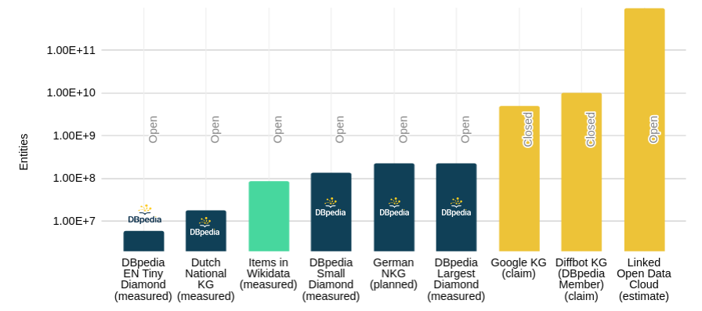
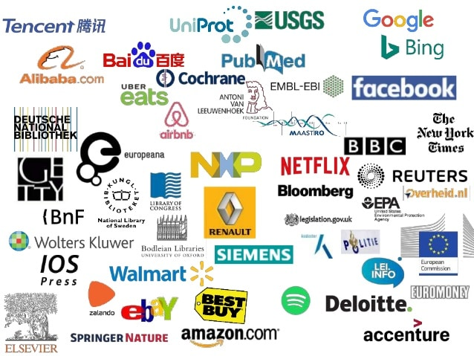
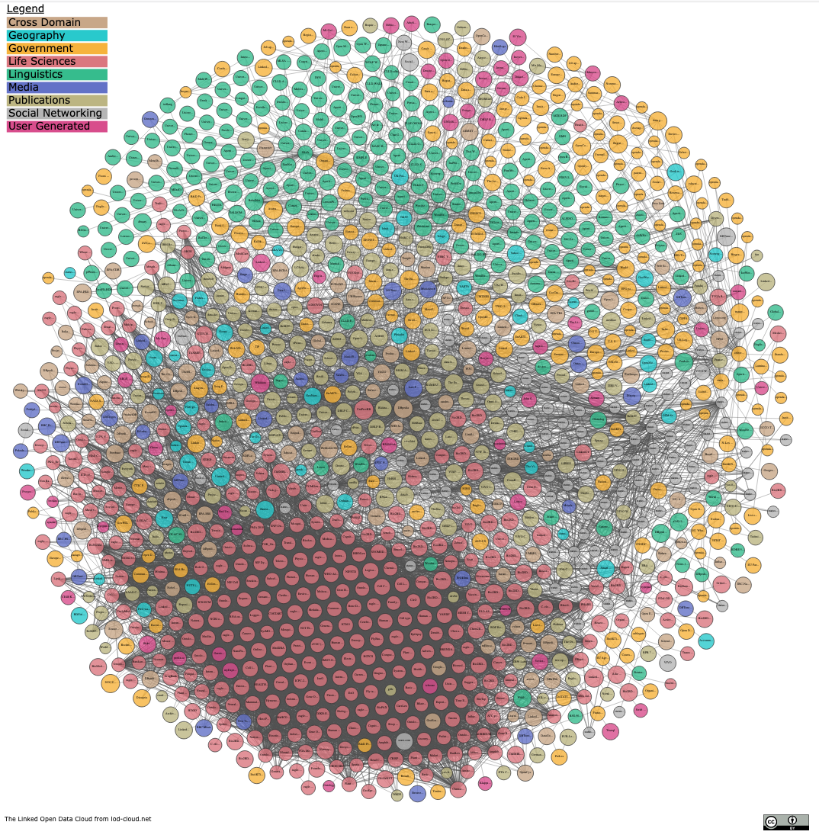
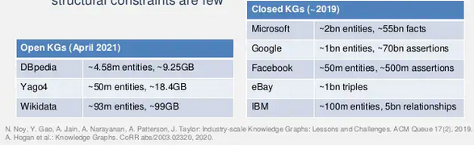

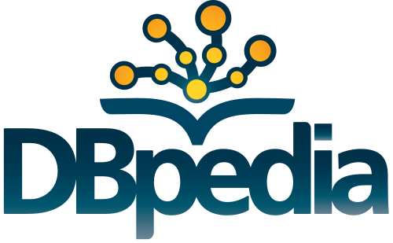
From Linked Open Data to Knowledge Graphs:
  Success stories of mainly monolithic (but huge) Knowledge Graphs rather than a network of Linked small KGs:
https://www.slideshare.net/Frank.van.Harmelen/adoption-of-knowledge-graphs-late-2019
https://www.dbpedia.org 2021
Notes:
https://www.slideshare.net/Frank.van.Harmelen/adoption-of-knowledge-graphs-late-2019

Slide 16
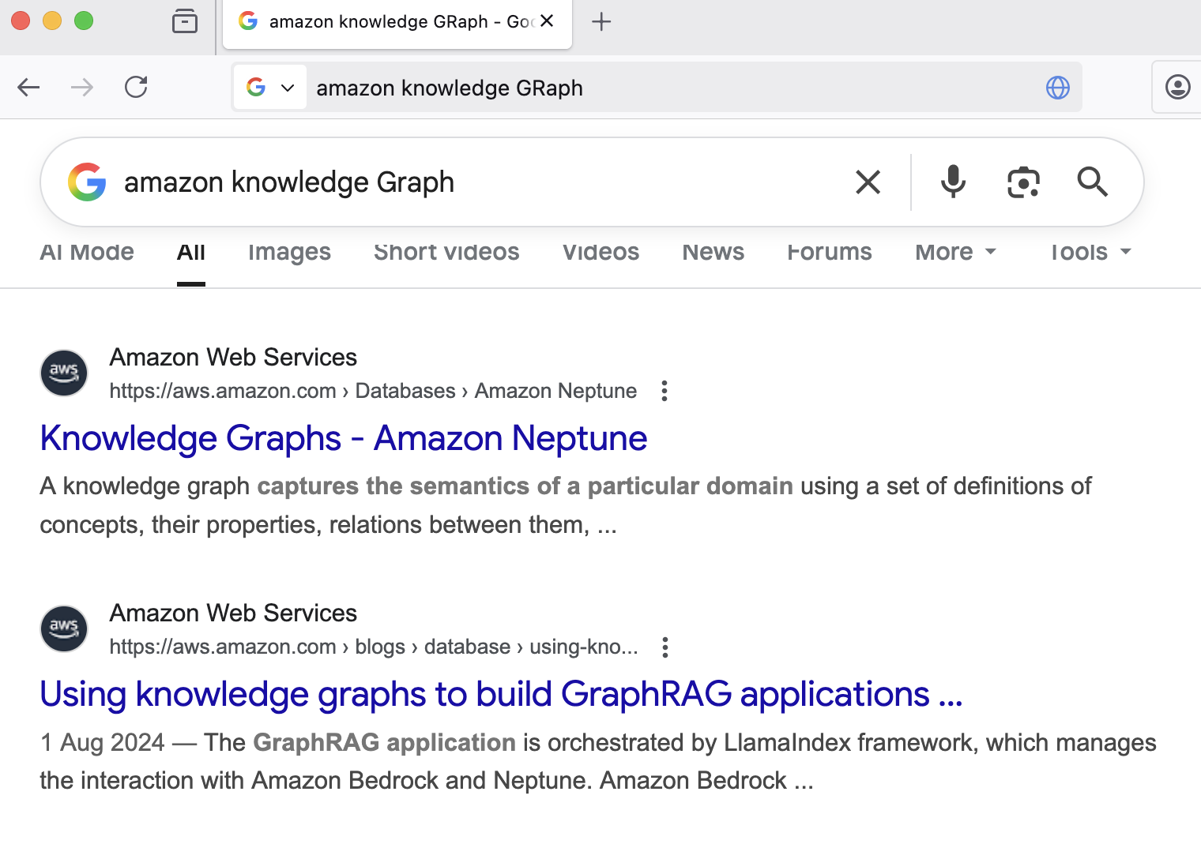
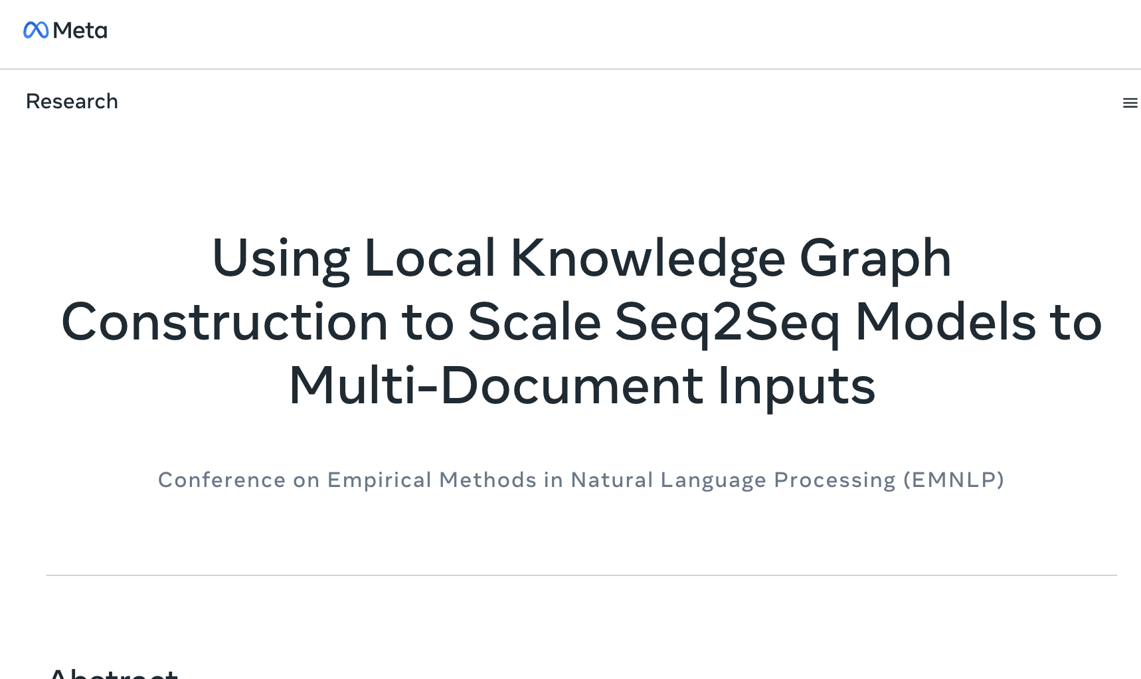
It’s not only Search – Oviously… User Recommendation, Language Technologies, …
Sice then, industry has become a main driver in scaling and using KG Technologies…

Slide 17
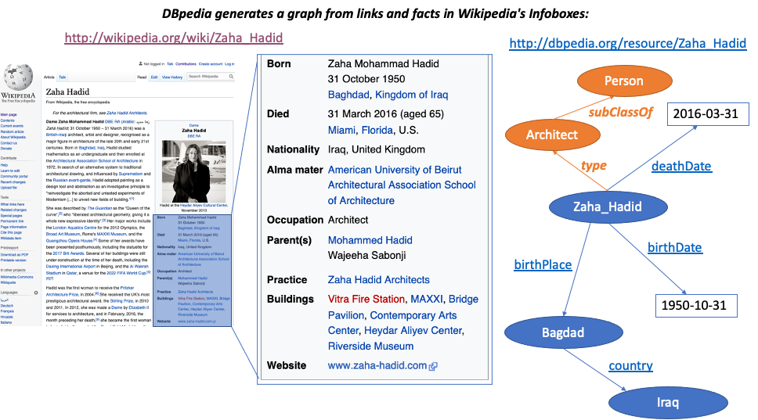
Collaborative, Open Knowledge Graphs:

Slide 18

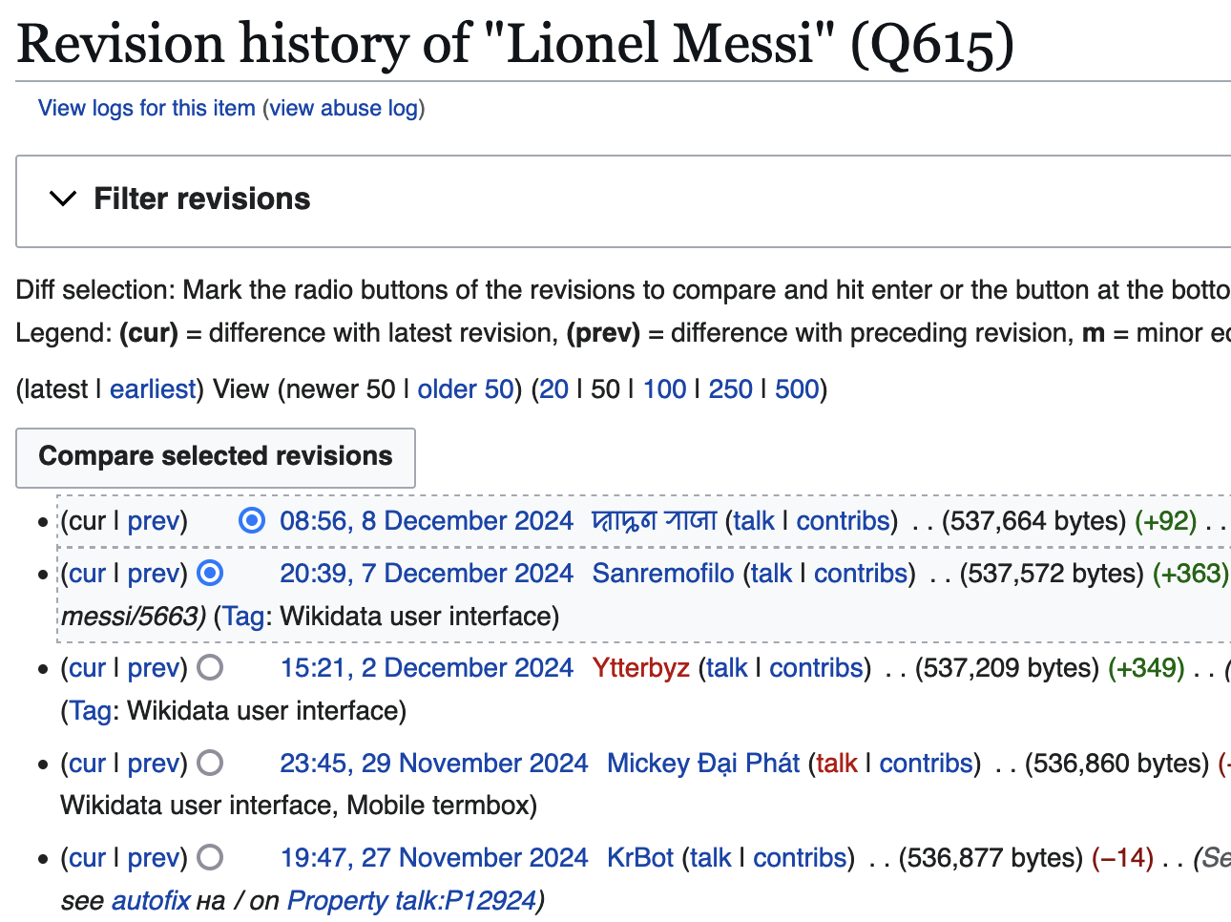

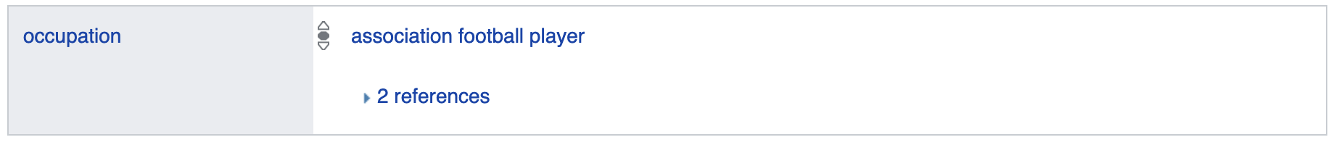
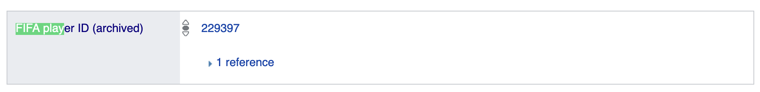
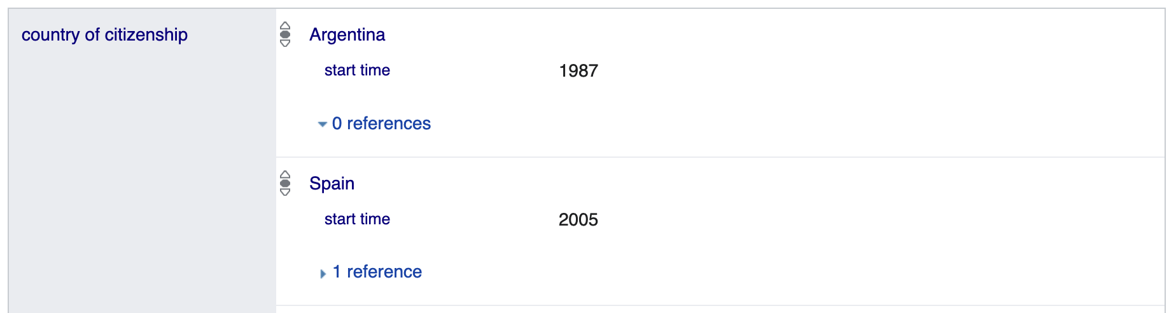
Collaborative, Open Knowledge Graphs:

Slide 19
From Linked Open Data to Knowledge Graphs:
What’s the state of affairs?
    Large-scale, still data-focused (rather than schema-focused)
    Often monolithic, rather than linked/decentralised
    Knowledge extraction rather than Knowledge engineering
    Collaborative large-scale KGs:
      Collectively created (automated or curated)
      Notoriously incomplete
      (Logical) consistency not a must
    Enterprise KGs: knowledge necessary to power applications
    Ontological expressivity not central – BUT: Expresssing context is!
Jamie Taylor, Google, Inc., Keynote ISWC2017
Actors, Directors, Movies
Art Works & Museums
Cities & Countries
Islands, Lakes, Lighthouses
Music Albums & Music Groups
Planets & Spacecraft
Roller Coasters & Skyscrapers
Sports Teams [...]
Answer whether (something like RDF and/or triple stores are used under the hood answered vaguely…
For instance:
Provenance
Temporal context
Confidence

Slide 20
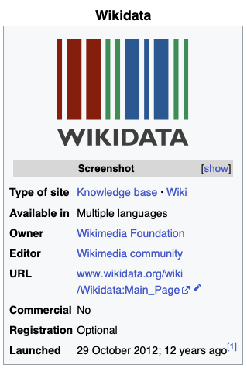
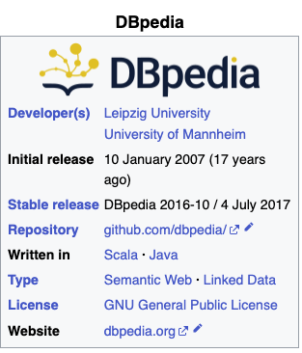


Let’s have a look at practical examples of such collaboratively curated Knowledge Graphs:
DBPedia (since 2007) vs. Wikidata (since 2012)
RDF
Standard ontology language (OWL)
SPARQL endpoint
Consistent
Context

Slide 21

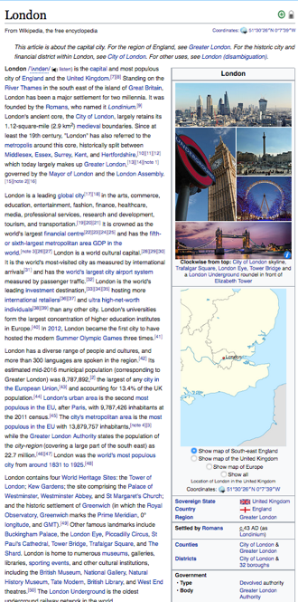
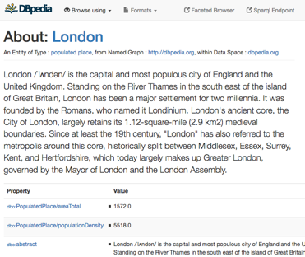
SPARQL: Using KGs to answer questions:
E.g. from
One of the central datasets of the Linked Open Data-Cloud
RDF extracted from Wikipedia-Infoboxes
You can use a language called SPARQL endpoint (roughly: SQL for RDF) to do structured queries over RDF:
  „Cities in the UK with more than 1M population“:
Structured queries (SPARQL):
https://api.triplydb.com/s/gZZskqRpQ
https://en.wikipedia.org/wiki/London
http://dbpedia.org/resource/London
PREFIX : <http://dbpedia.org/resource/>
PREFIX dbo: <http://dbpedia.org/ontology/>
PREFIX yago: <http://dbpedia.org/class/yago/>
SELECT DISTINCT ?city ?pop WHERE {
?city a schema:City .
?city dbo:country :United_Kingdom.
?city dbo:populationTotal ?pop
FILTER ( ?pop > 1000000 )
}
Automatic Exctractors

Slide 22
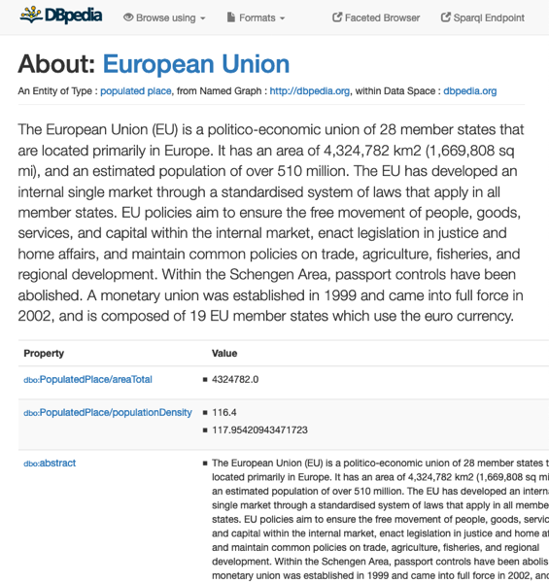

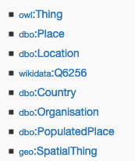

Knowledge Graphs like Dbpedia are not logically consistent! ☹ [1]
E.g.
Dbpedia Ontology:
dbo:Agent owl:disjointWith dbo:Place.
dbo:Country rdfs:subClassOf dbo:Place.
dbo:Organisation rdfs:subClassOf dbo:Agent.
Stefan Bischof, Markus Krötzsch, Axel Polleres, and Sebastian Rudolph. Schema-agnostic query rewriting in SPARQL 1.1. In Proceedings of the 13th International Semantic Web Conference (ISWC 2014), Lecture Notes in Computer Science (LNCS). Springer, October 2014. [ .pdf ]

Slide 23
Wikidata is also not “consistent”, but doesn’t use OWL

Slide 24

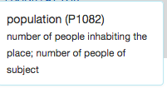
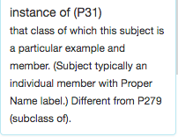
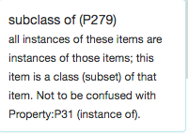


The same question as before in Wikidata:
Note: Wikidata does not even use standard OWL
Note: Wikidata uses numeric IDs
“Simple” surface query:
Which cities in the UK have more than 1M people?
What’s this?
SELECT DISTINCT ?city WHERE {
?city wdt:P31/wdt:P279* wd:Q515.
?city wdt:P1082 ?population .
?city wdt:P17 wd:Q38 .
FILTER (?population > 1000000) }
Page 24

Slide 25
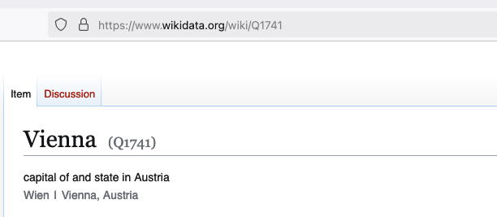
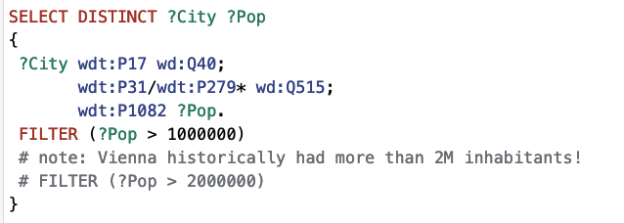
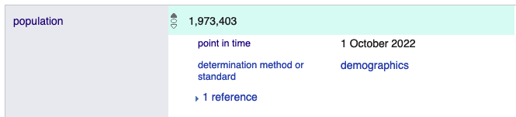

The same question as before in Wikidata:
https://w.wiki/BqRX
Which cities in the Austria have more than 1M/2M people?
  So, WHEN did Vienna have 2M inhabitants?
Note: Wikidata also has such contextual information!!!!
Page 25

Slide 26
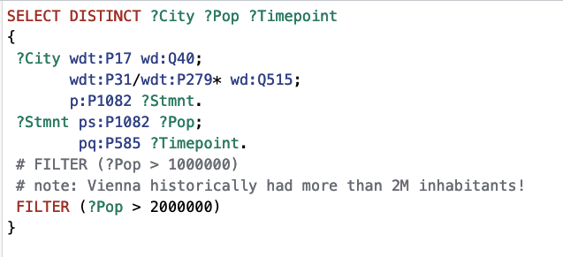
The same question as before in Wikidata:
https://w.wiki/BqRj
Which cities in the Austria have more than 1M/2M people?
  So, WHEN did Vienna have 2M inhabitants? Works!!!!
  But needs an understanding of Wikidata’s proprietary RDF reification model to model context!
See our recent ISWC2024 tutorial: https://ww101.ai.wu.ac.at/
Page 26

Slide 27
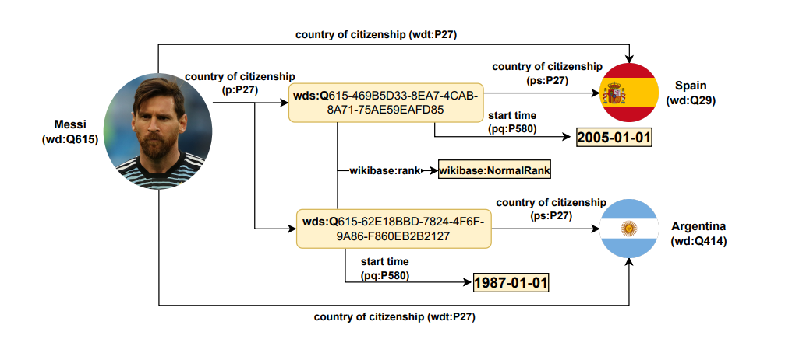
Phase 4: Knowledge Graphs:
“Graph data with Metadata”
“(Less Linked)
Aka Labelled property graphs
{startTime: 1987}
{startTime: 2005,
reference: https://cadenaser.com/ser/2005/09/26/deportes/1127690892_850215.html}

Slide 28
So, what are these KGs actually good for in the age of LLMs and AI?
Logic Programming, “Symbolic” Artificial Intelligence
Semantic Web, Knowledge Representation & Reasoning
Web Standard
Query Language (SPARQL)
Data Integration, Open Data
Knowledge Graphs
“Bilateral” AI
Linked Data
2003
2005
2007
2011
2013
~2020
LLMs
i.e.,Large-scale, partially incomplete, inconsistent, labelled property graphs
(rather than curated ontologies)
TU Vienna
Univ. Innsbruck
Univ. Rey Juan Carlos Madrid
DERI, NUI Galway, Ireland
Siemens AG Österreich
WU Vienna

Slide 29
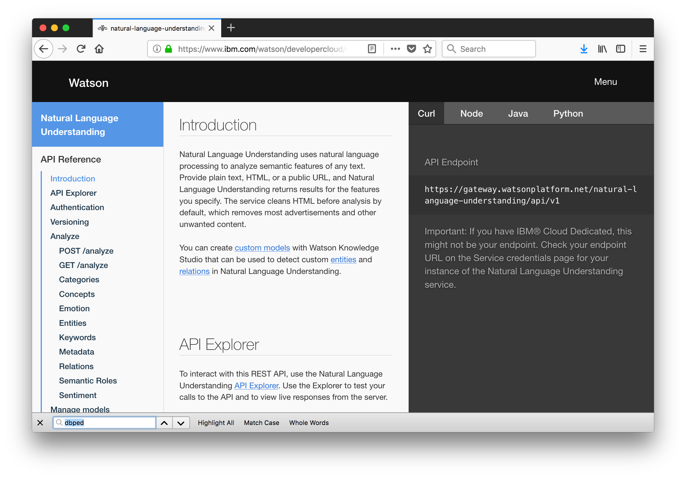
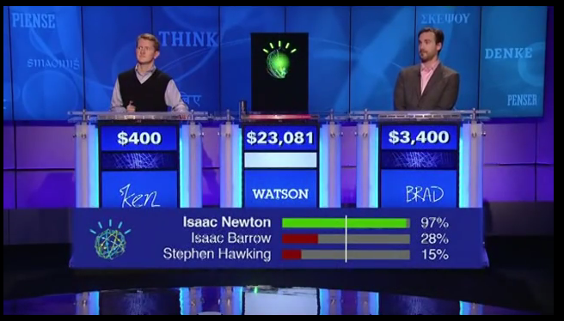
So, for what are these KGs actually good for in the age of LLMs and AI?
Interesting Note - IBM Watson - Jeopardy! (2011)
“Super-human” Question Answering was achieved by Knowledge Graphs before the LLM hype!
https://youtu.be/P0Obm0DBvwI?t=951

Slide 30
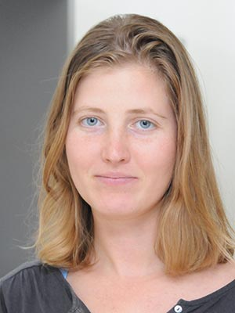
Some of our own research in this area:
How good or bad can KGs deal with Question answering?
  By essentiall y translating Questions to SPARQL queries (Watson)?
  By other beskpoke techniques such as Message passing:
  Svitlana Vakulenko, Javier Fernández, Axel Polleres, Maarten de Rijke, and Michael Cochez. Message passing for complex question answering over knowledge graphs. In Proceedings of the 28th ACM International Conference on Information and Knowledge Management (CIKM2019, pages 1431--1440, Beijing, China, November 2019. ACM.

Slide 31
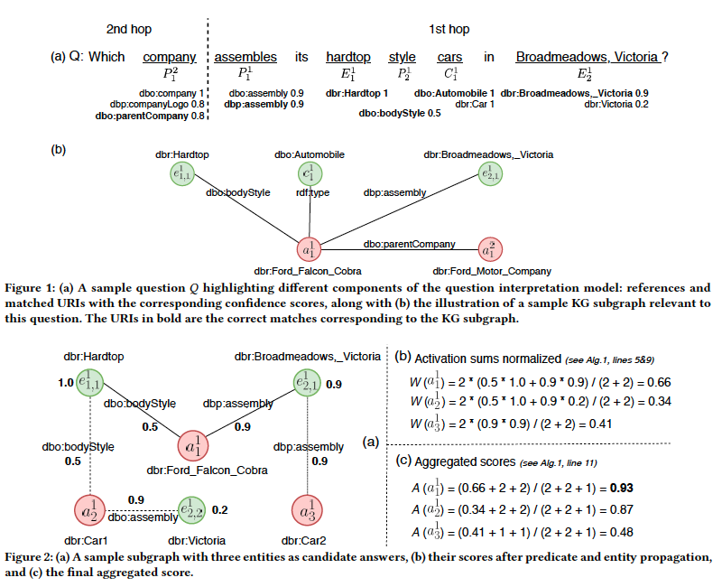
Some of our own research in this area:
Idea: use unsupervised message passing to propagate confidence scores obtained by parsing an input question and matching terms in the knowledge graph to a set of possible answers.
How good or bad can KG swith Question can answering?
  Svitlana Vakulenko, Javier Fernández, Axel Polleres, Maarten de Rijke, and Michael Cochez. Message passing for complex question answering over knowledge graphs. In Proceedings of the 28th ACM International Conference on Information and Knowledge Management (CIKM2019, pages 1431--1440, Beijing, China, November 2019. ACM.
Explanbility “for free”

Slide 32
Some of our own research in this area:
How good or bad can KGs deal with Question answering?
  By essentiall y translating Questions to SPARQL queries (Watson)?
  By other beskpoke techniques such as Message passing:
  Svitlana Vakulenko, Javier Fernández, Axel Polleres, Maarten de Rijke, and Michael Cochez. Message passing for complex question answering over knowledge graphs. In Proceedings of the 28th ACM International Conference on Information and Knowledge Management (CIKM2019, pages 1431--1440, Beijing, China, November 2019. ACM.
How good or bad are LLMs with Question answering compared with KGs?
  Gerhard Georg Klager and Axel Polleres. Is GPT fit for KGQA? -- preliminary results. In Proceedings of the International Workshop on Knowledge Graph Generation from Text (Text2KG2023), co-located with Extended Semantic Web Conference 2023 (ESWC 2023), May 2023.
Admittedly things have improved dramatically, since then!

Slide 33



So, for what are these KGs actually good for in the age of LLMs and AI?
For instance:
Explainable answers, fact-checking against hallucinating
Potentially less resource consumption!
KGC23 Keynote: “The Future of Knowledge Graphs in a World of LLMs — Denny Vrandečić, Wikimedia”
https://www.youtube.com/watch?v=ww99npDh4cg

Slide 34






What’s good for what?
LLMs, Search Engines, KGs

Slide 35


So, let us better combine KGs and LLMs!

Slide 36











Bilateral AI
Notes:
Methods:
Foundation Models (e.g. xLSTMS)
Knowledfe Graphs
Advanced lofical Reasoning, incl. E.g. Deontic Reasoning, Norms
Automata & Architectures
Causality and Simulation
Industry Board:

Slide 37




Bilateral AI

Slide 38
BILATERAL AI – First results and plans from our Institute and other BILAI partners…

Slide 39




What’s next?
Neurosymbolic AI Systems
Prof. Marta Sabou
Ingredient1: We have a pretty good understanding of Engineering Neuro-Symbolic Systems…
A. Breit, L. Waltersdorfer, F.J. Ekaputra, M. Sabou, A. Ekelhart, A. Iana, H. Paulheim, J. Portisch, A. Revenko, A. ten Teije, and F. van Harmelen. 2023. Combining Machine Learning and Semantic Web: A Systematic Mapping Study. ACM Computing Survey. March 2023.

Slide 40
One such architecture… For instance:
LLM
KG/Database
RAG/MCP
WE
Vector database
Notes:
Sepp Hochreiter: an LLM is actually a “database”… and the past slide example has shown, that this is not yet the end of the story… still room for improvement. We need to rethink this architecture, but we may also need to rethink our databases, because there’s another problem!

Slide 41




LLMs get better
“are supposed to be PhD level”
… but still (plausibly) hallucinate
Inspired by Georg Gottlob’s SEMANTiCS2025 keynote
Heng Ji’s SEMANTiCS2025 keynote
“Larger models are not necessarily better!”
ok
ok
ok
ok
ok
ok
!
ok
ok
ok
ok
ok
!
!
ok
ok
ok
ok
ok
ok
Notes:
But this is a “chat-to-your-data use case”

Slide 42


General Data managenemt issue, not KG-specific!
But are KGs (& Databases) actually better?
Google asks it’s users to manually correct/merge results
DBLP or scopus attempt to curate ambiguities by constraints (not always successful..)

Slide 43


But are KGs actually better?
Example from Wikidata…

Slide 44
But are KGs actually better?
ship
subclassOf
shooner
Ontologies +
Constraints,
such as:
“country conflicts-with country of registry”
    “i.e., an entity should not have both a “country” and a “country of registry”
instanceOf
Tilikum
x
x
country of registry
country
Canada

Slide 45




Why KGs can’t (scalably) be correct:
ISWC2025
Collaborative Editing
Multi-sourced Automatic Extraction
Knowledge is distributed and evolving!
  Remote changes affect consistency
  Ontologies & Constraints evolve as well
What can we do about it?
  Best of both worlds needs Bilateral AI approaches!
    Symbolic methods to repair inconsistencies
    Subsymbolic methods to resolve inconsistencies
      LLMs & KG embeddings for resolving inconsistencies
      GNNs for learning repairs (from historical data, from users’ repairs)
      Iterative RAG and Agent-based pipelines to fix and construct KGs from text
Webconf2025
Forthcoming…
ESWC2025
Notes:
“Learn from hisrotical data” → We would be happy for your use cases

Slide 46



Further starting points in BILAI:
Notably, in BILAI, colleagues from TU Vienna (Sallinger, Pavlovic) work on KG Embeddings that can capture (certain) rules and constraints already:
  Similar to Word embeddings and LLMs, Knowledge Graph Embeddings allow to
    predict missing edges in incomplete KGs
    predict inconsistencies & possible repairs
Open Problems:
  Scaling KG Embeddings to full, decentralized KGs …
  … but (1) modularization might help here, relation to the
  (2) corresponding trend to LLMs-based “multi-agent frameworks”
Slide: Emanuel Sallinger
Notes:
We’re also starting to use embeddings for repairs

Slide 47
So we actually need this?
Mutually improve each other
LLM
KG/Database
WE
KGE
Context enrichment
…
Quite some work at current ISWC2025, e.g. RAGE-KG workshop is looking into such extensions…

Slide 48

What’s next? Where should this go?
Caveat: Our data and knowledge is typically:
  Distributed/decentralized and
  not always sharable with a central (API) model
  → we need decentralized solutions!
“Our knowledge will never go into a central LLM” – BILAI industry network keynote Stefan Rohringer (Infineon)
Catalog
Catalog
Catalog
Ingredient 4: “Data Spaces”

Slide 49
What’s next? Where should this go?
Ingredient 2: Expertise on (Symbolic) Data Integration and Repair. Before the LLM hype, we long worked on purely symbolic solutions to integrating decentralised Knowledge
  Linked Data
  Ontology-based Data Access
KG
KG
KG

Slide 50





Scalable data access to decentralized KGs:
50
Starting Points:
    graph partitioning and splitting processing between clients and SPARQL endpoints the performance, the problems of central query endpoints can be significantly alleviated
    Investigating how the asynchronous evolution of KGs affects consistency
Interesting Open Problems:
    E.g. Synchronisation/Updates/Repairs in Polyglott Databases
SWJ (2024) https://doi.org/10.3233/SW-243571
50

Slide 51


Isn’t there something missing?
Ora Lassila (Keynote ISWC2024) https://www.lassila.org/publications/2024/lassila-iswc2024-keynote.pdf
Knowledge Graphs
“Agentic” Models … and maybe a revival?
LLMs

Slide 52

What’s next? Where should this go?
Ingredient3: Combinations of LLMs and decentral KGs via RAG and Agent frameworks are one example of such Neuro-symbolic architectures:
KG
Example: Federated querying of KGs via agents (work in progress):
Planning/ Scheduling/
Configuration/
Policies
KG
“Agentic” models:
LLM/ReAct
KG

Slide 53
What’s next? Where should this go?
What is a solution we should jointly work towards?
Neuro-symbolic agents
Trustable Decentralized Agents
Small models (e.g. “Model Destillation”)
“Agent Spaces”
P
SLM
KG
P
P
SLM
SLM
KG
KG

Slide 54

Thanks!
Austrian National “Cluster of Exellence” BILAI:
  Broad AI
  (Knowledge) Graph-Based AI plays a key role in BILAI
Knowledge Graphs are symbolic AI with “features” of LLMs:
  Large-scale
  Not always consistent
(Dezentralized) Agents, KGs and LLM combined, could realize BILAI’s vision of a broad, robust AI, and change the way we access and manage Data
Ingredient1: Neurosymbolic Architectures
Ingredient2: scalable distributed,federated data symbolic processing
Currently running!
https://www.bilateral-ai.net/

Slide 55
Thank you!
Summary:
  (Semantic) Web & Knowledge Graphs play in important role in latest trends in AI
    GraphRAG, NeuroSymbolic Systems powered by KGs, etc.
  GenAI could help to create, improve and curate KGs (but symbolic constraints will be needed!)
  Collaborative, Open Knowledge Graphs like Wikidata are a particularly interesting subject of study (observable!)
    evolution, repairs, etc.
    embeddings
    but also: collaboration patterns
  My guess: agents will play an important role!
    Getting back to decentralized approaches needed to scale & democratize AI
    Also for trends I didn’t talk about, e.g. Data Spaces
https://www.bilateral-ai.net/

