Slide 1
Institute for
Data, Process and Knowledge Management
Marta Sabou, Axel Polleres
www.wu.ac.at/dpkm

Slide 2
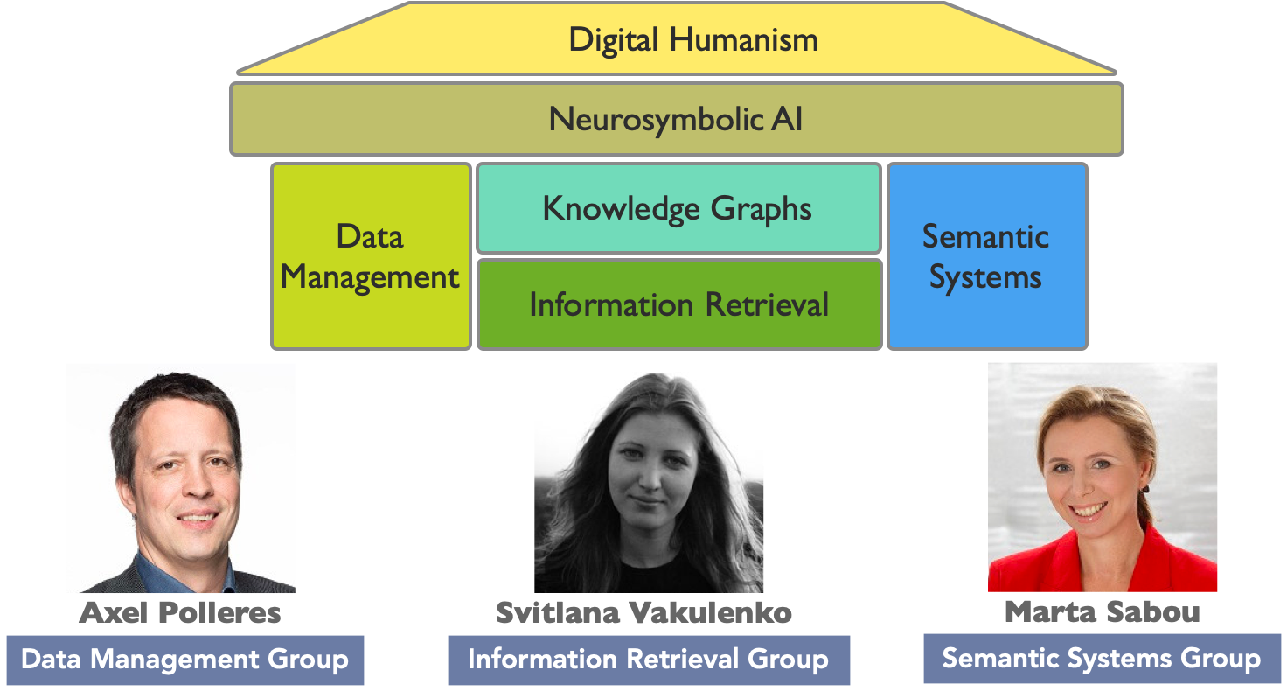

DPKM – at a glance
Knowledge Management Group
AI areas of interest:
Hybrid AI Systems
and Representations
Digital Humanism and AI
AI for Engineering
AI for Data Ecosystems/
Data Ecosystems for AI

Slide 3
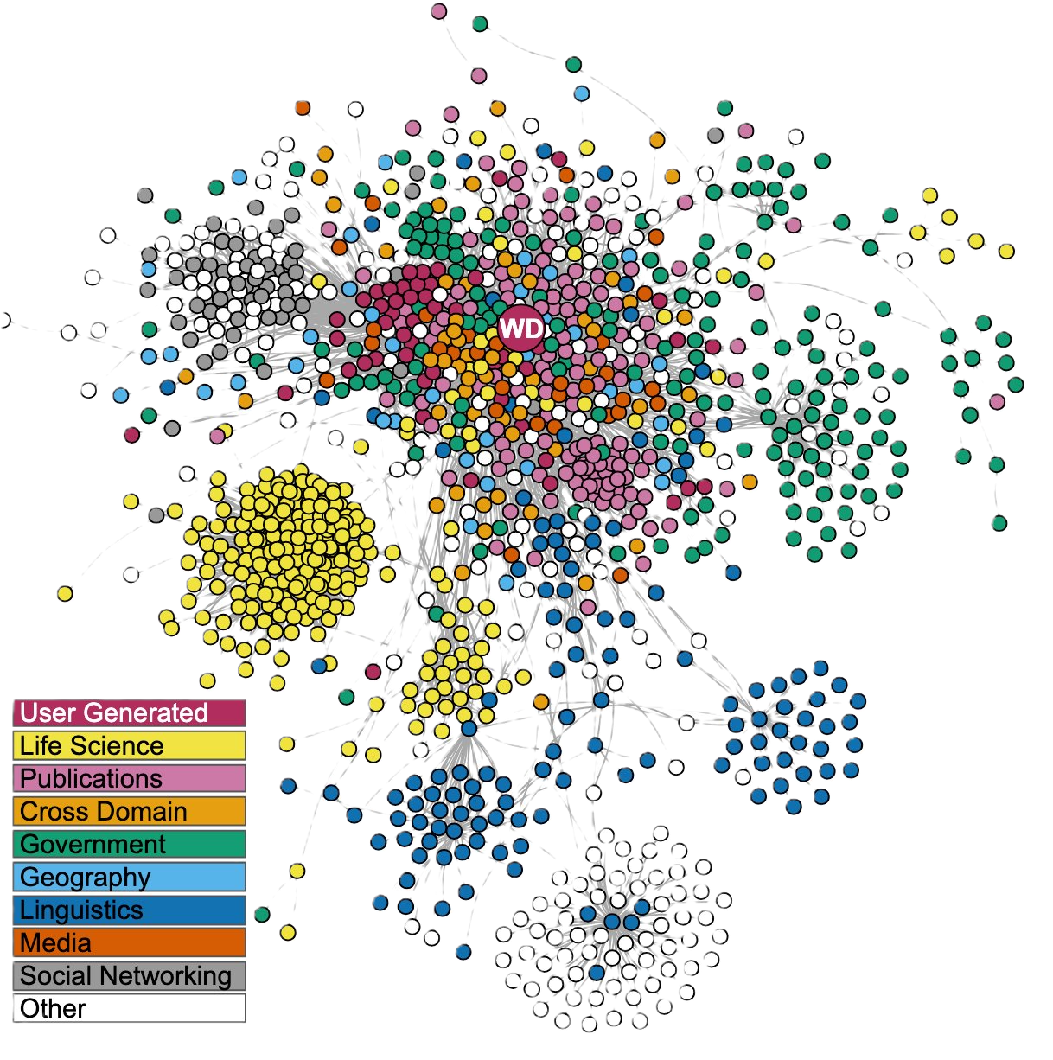
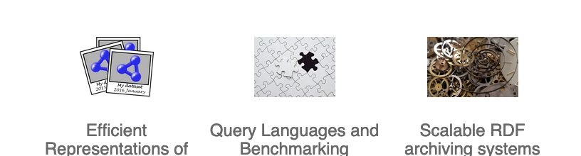
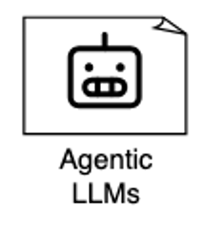

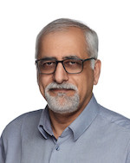






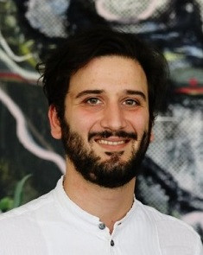


DPKM/Data Management Group:
https://data.wu.ac.at/
Research Topics
Knowledge Engineering
Complex Cyber-physical Systems
AI Risk Management
Industry applications
Graph Embeddings
Agent Spaces
AI for Transport (ÖBB/ERA)
AI for Crisis and Disaster Management
FFG FAIR-AI​
(2024-2027)
BILAI​ FWF CoE
(2024-2029)
Research Projects
Fredi
Application Domains
Open Knowledge Graphs/Open Data
Enterprise Knowledge Graphs & Agents
Transport/ Mobility
Crisis & Disaster Management
AI Risk Management
Cyber Security
Bilateral AI:
RM1:Graph-based structures
Notes:
TODO:
- Add Ikhsan
Add Diego
Add Arief

Slide 4

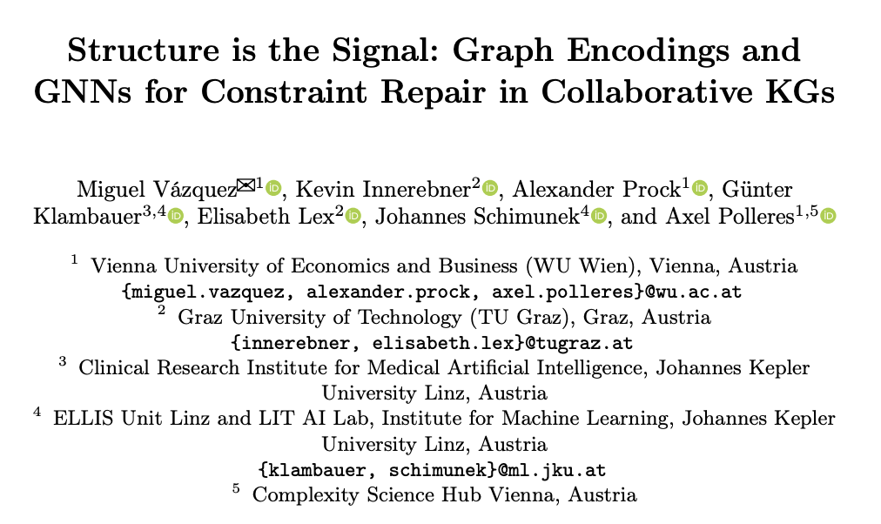
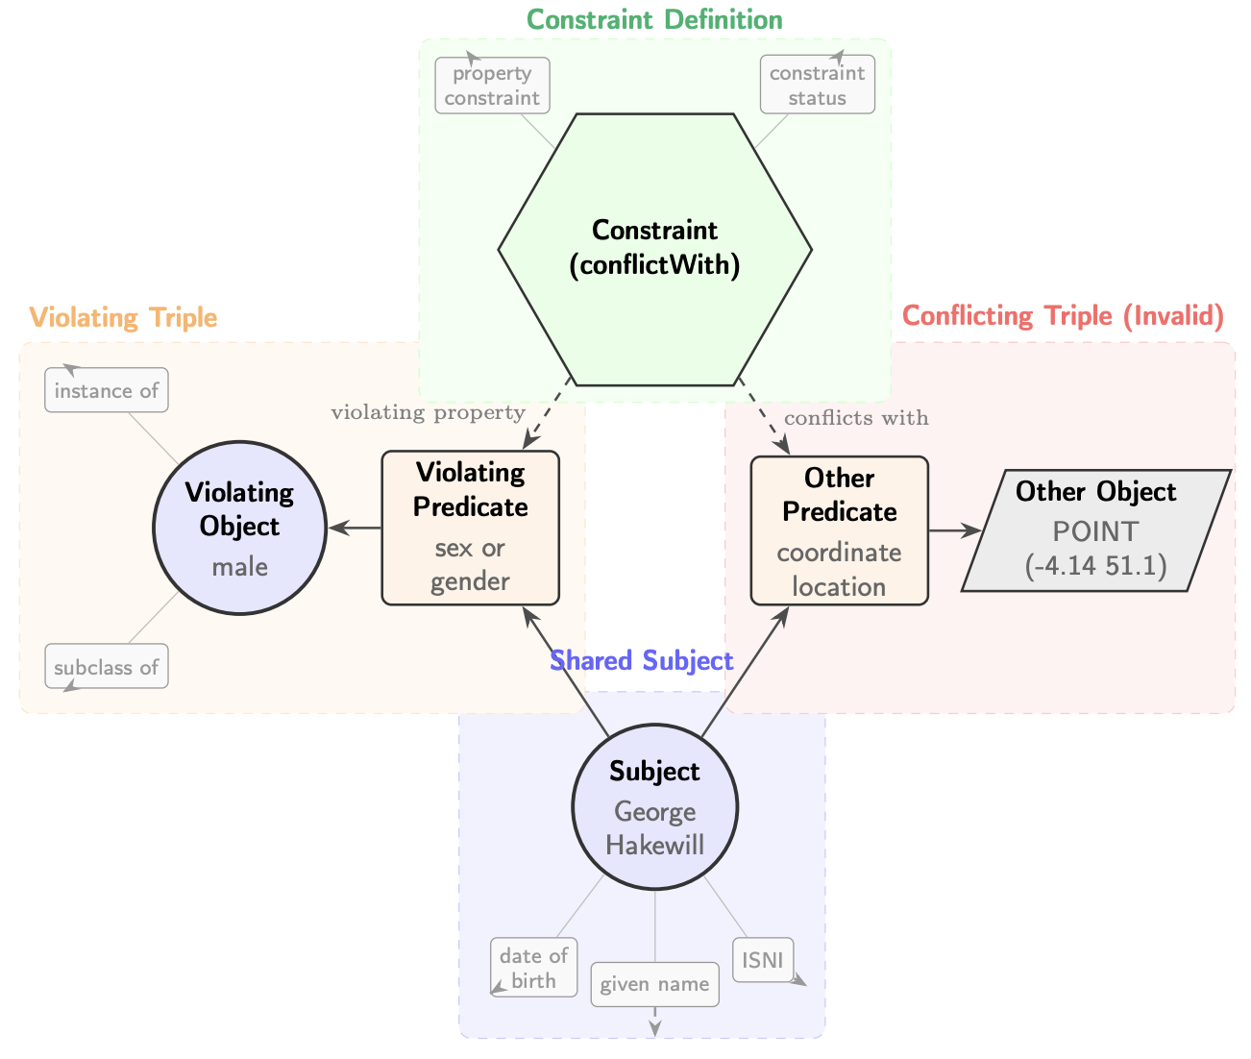
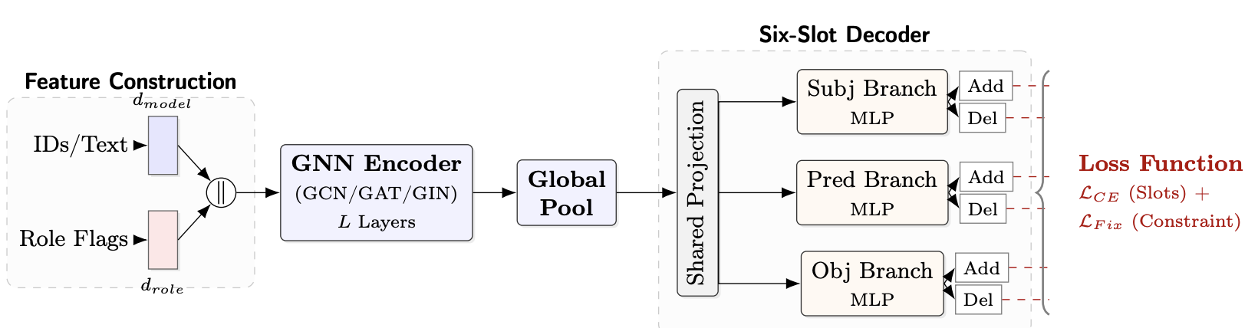
Neuro-Symbolic Repairs of Knowledge Graphs
ESWC2026 paper :
Deploying GNNs to learn KG repairs:
Next steps:
Combine Symbolic Repairs, GNNs, and LLMs for KG repairs

Slide 5

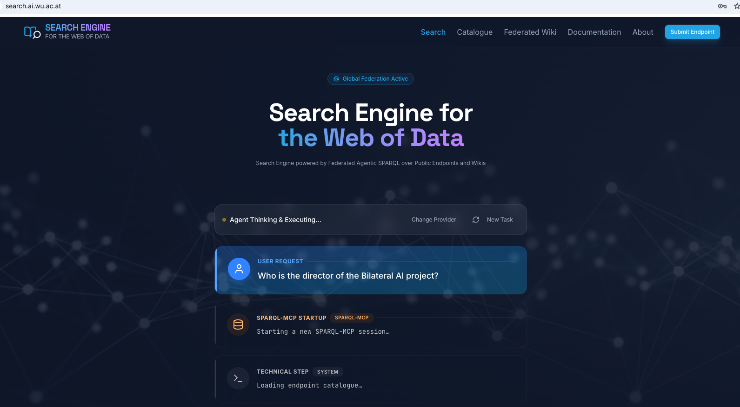
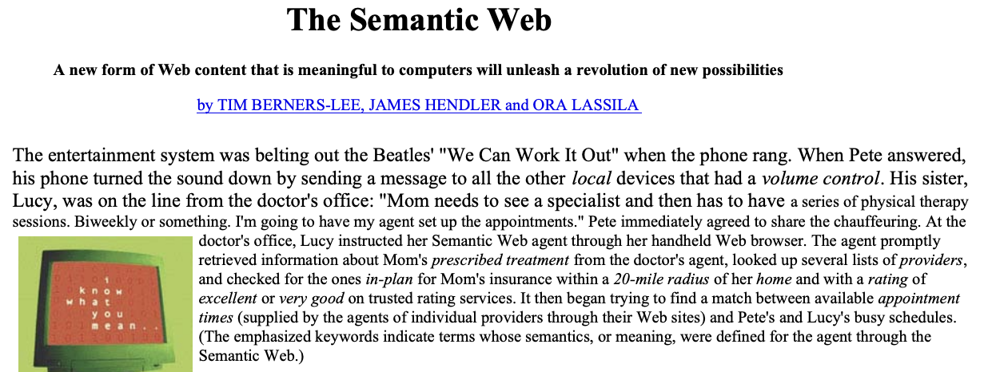
SPARQL-MCP
Project lead: Daniil Dobriy (BILAI PhD)
https://search.ai.wu.ac.at/
Automatic Catalog generation
Federated query generation/optimization
Benchmark, Search Engine
Ongoing/Planned:
Collaboration with La Sapienza (R. Navigli) on KG-based Question answering
Collaboraiton with UGhent (R. Taelman) on Federated query Optimization and reducing Server load
Ambitious goal:
“Game-changer” application!
5

Slide 6
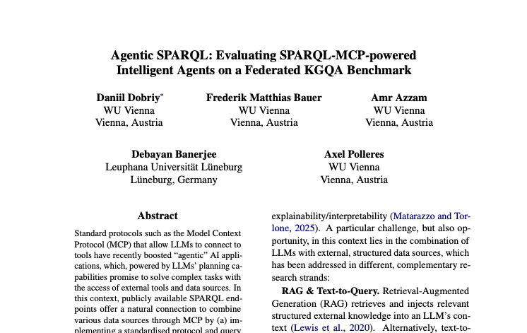


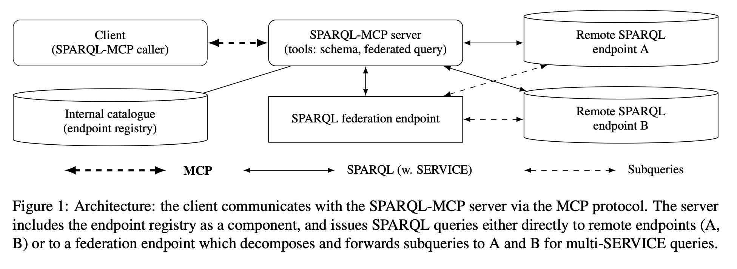
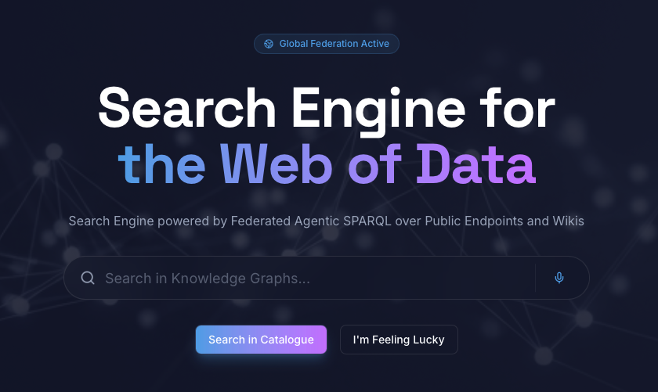
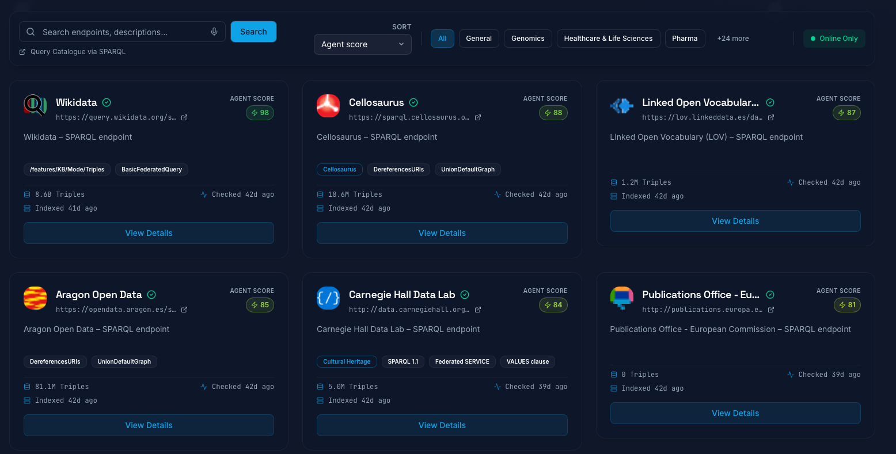
Agentic SPARQL & Global Data Catalogues
Agentic SPARQL with SPARQL-MCP
Data Search Engine & Data Catalogue
from http://lod-cloud.net/

Slide 7
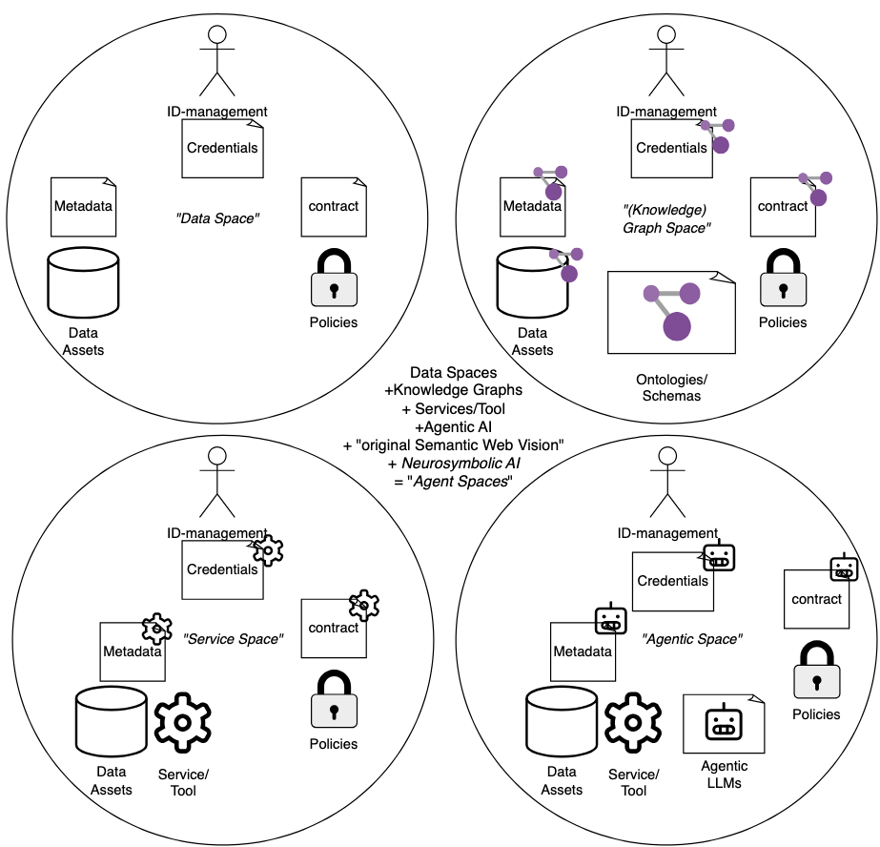
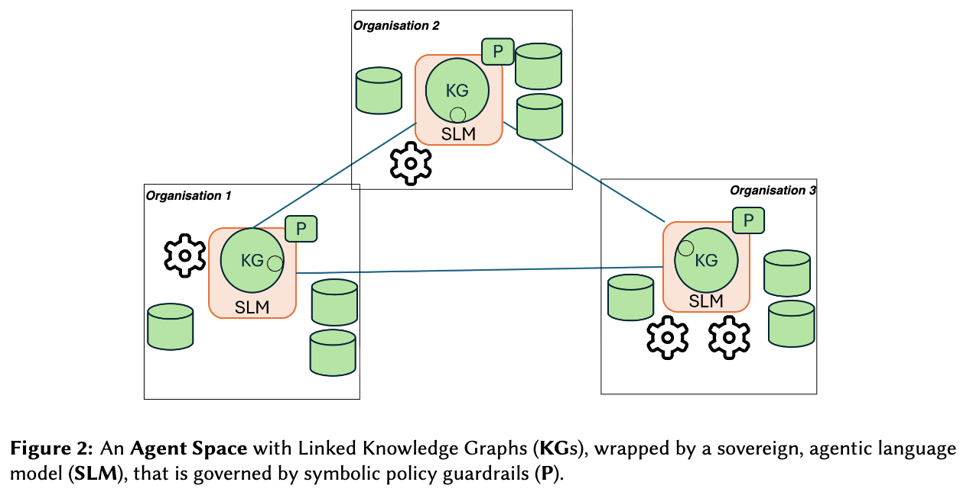
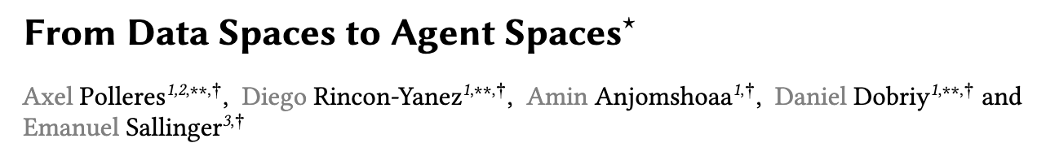
Vision paper - Agent Spaces
Notes:
Applications: e.g. data exchanve in SEPs… in AT talk maybe with Platform Registerforschung, Industrial Data Spaces?

Slide 8
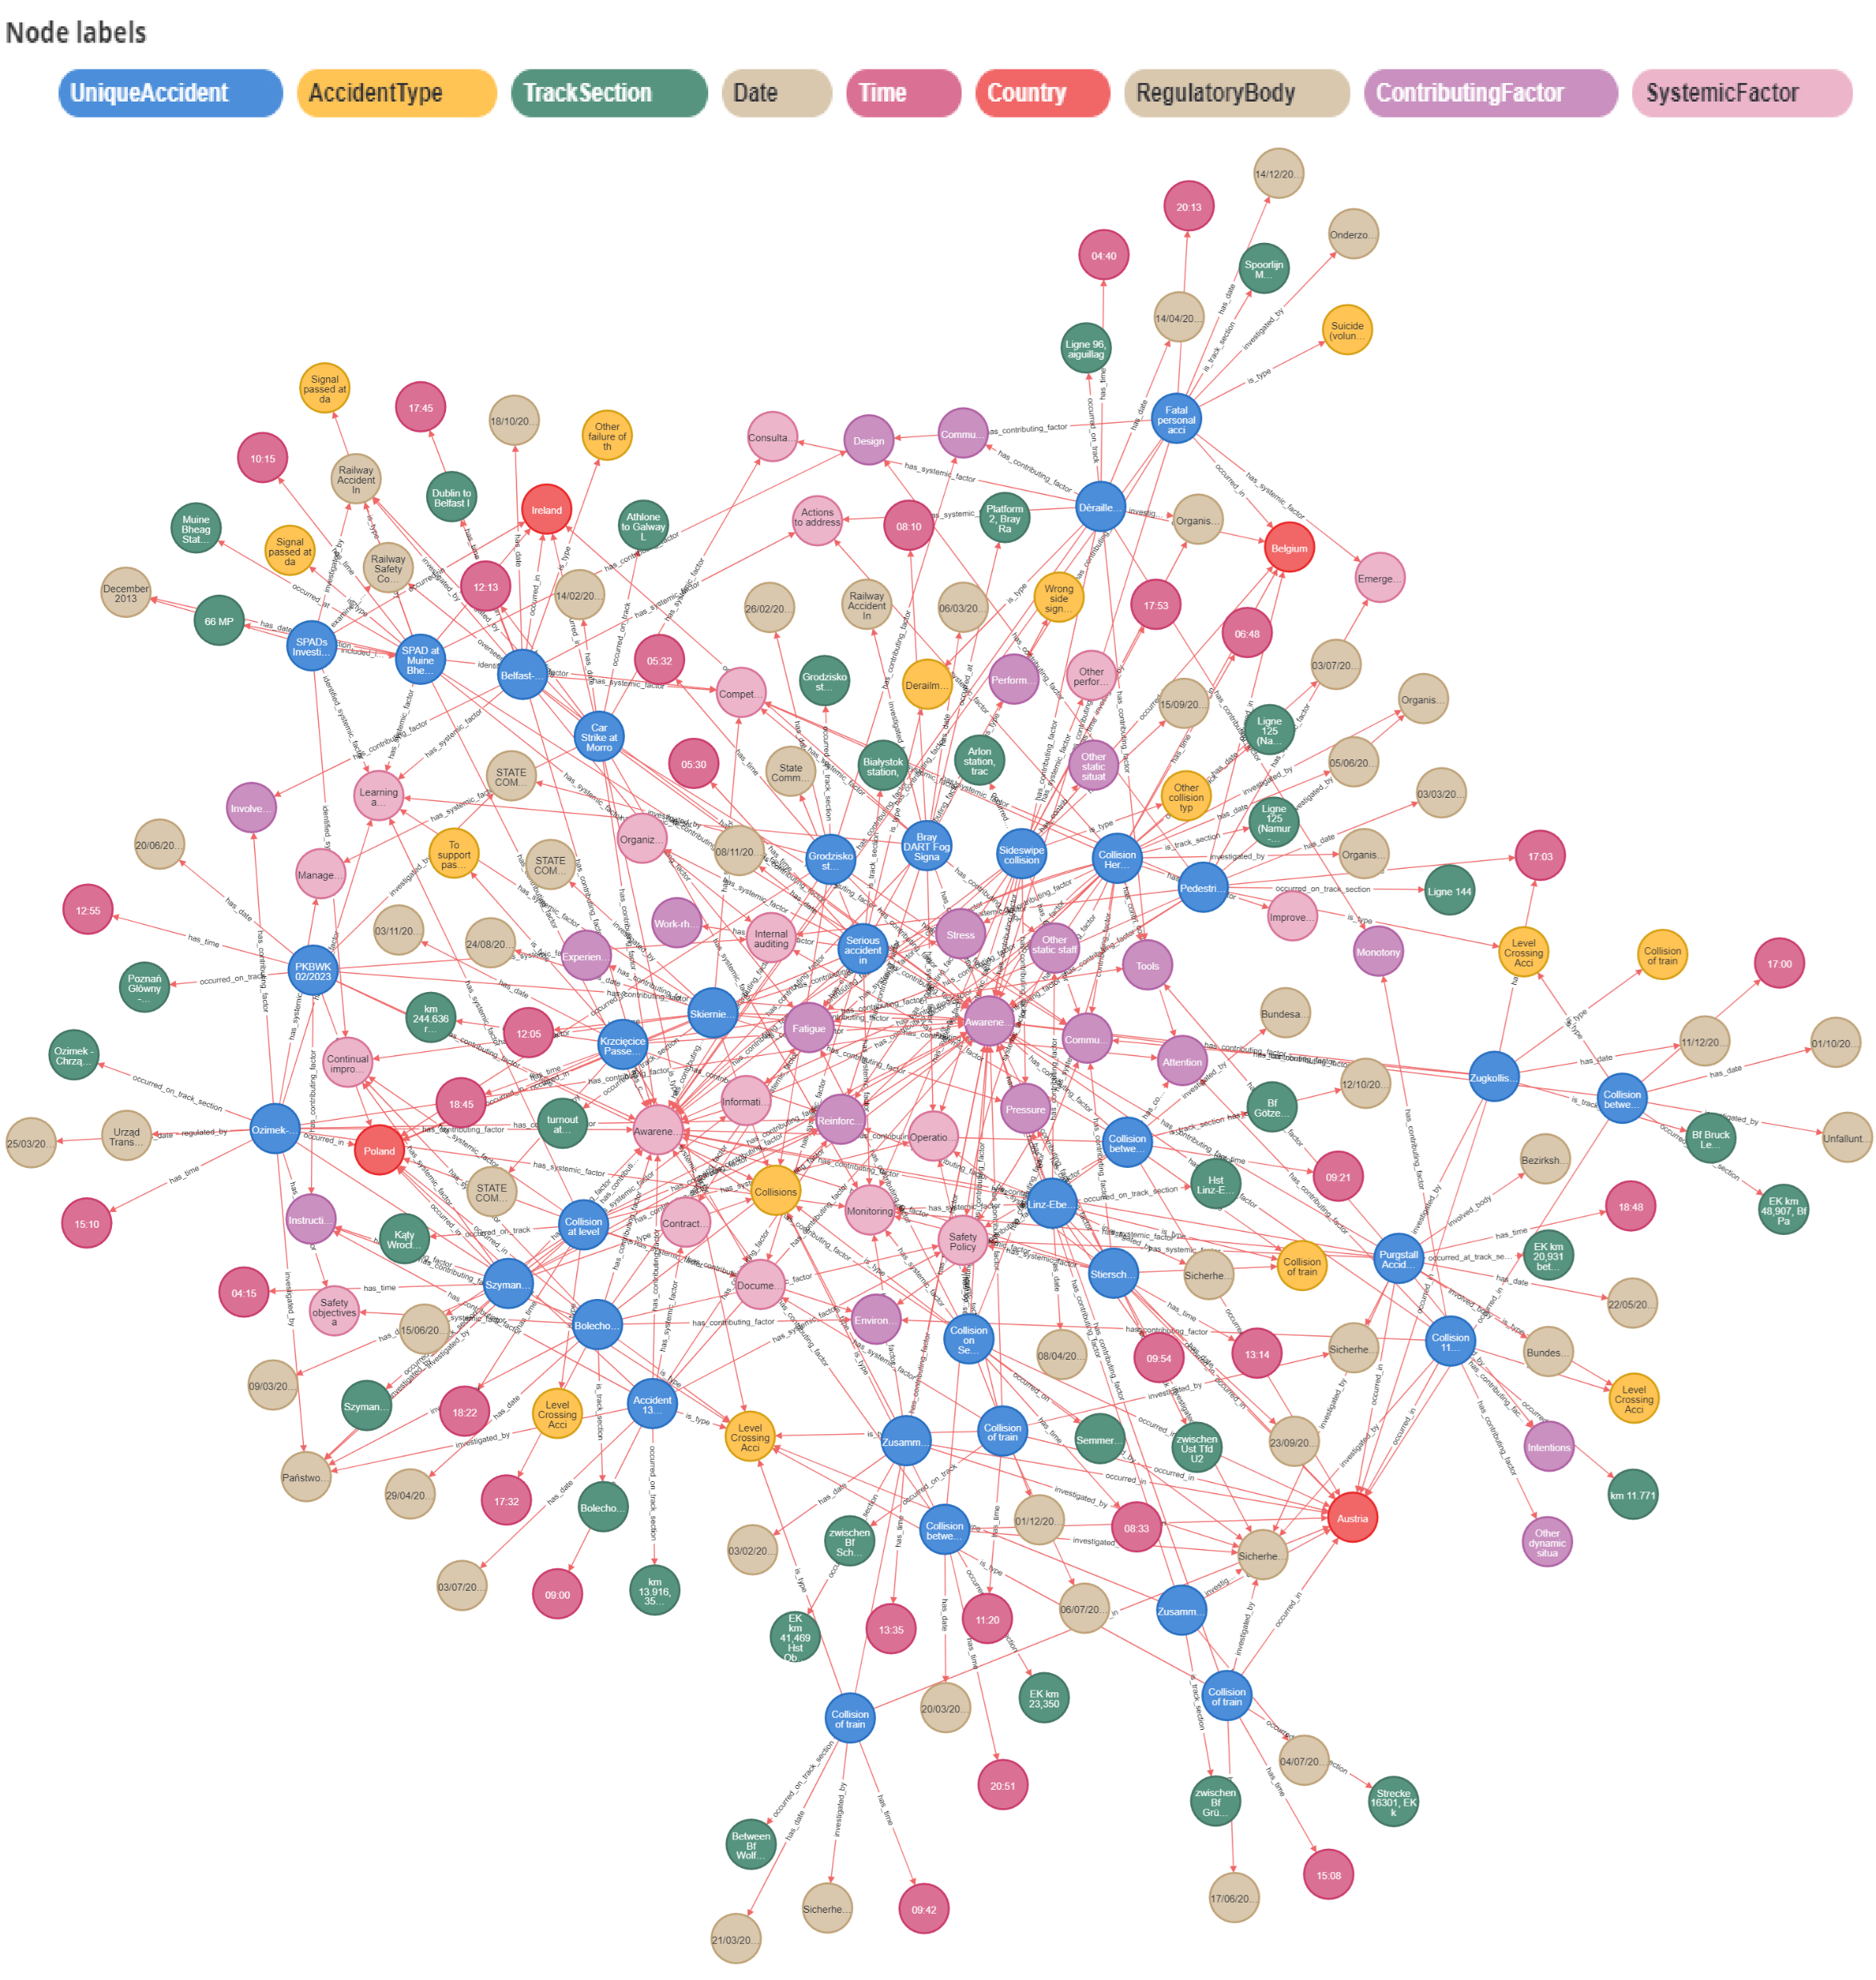



AI for Transport
Extraction and linking railway disaster graph,
Integrate it in European Railway Agency KG
Experiment Language Models for Cross-Border Messages of Locomotive Drivers
Sohi, S. (2025). “Semantic Technologies for Harmonising European Railway: Improving Interoperability, Data Integration, and Operational Efficiency.” In The Semantic Web: ESWC 2025 Satellite Events. Springer.
Sohi, S., Balan, D., Anjomshoaa, A., & Polleres, A. (2025). “Towards Harmonised Rail Safety Knowledge: LLM Techniques for EU Accident Report Processing.” In Proceedings of the RAGE-KG Workshop at ISWC 2025, 169–174.

Slide 9


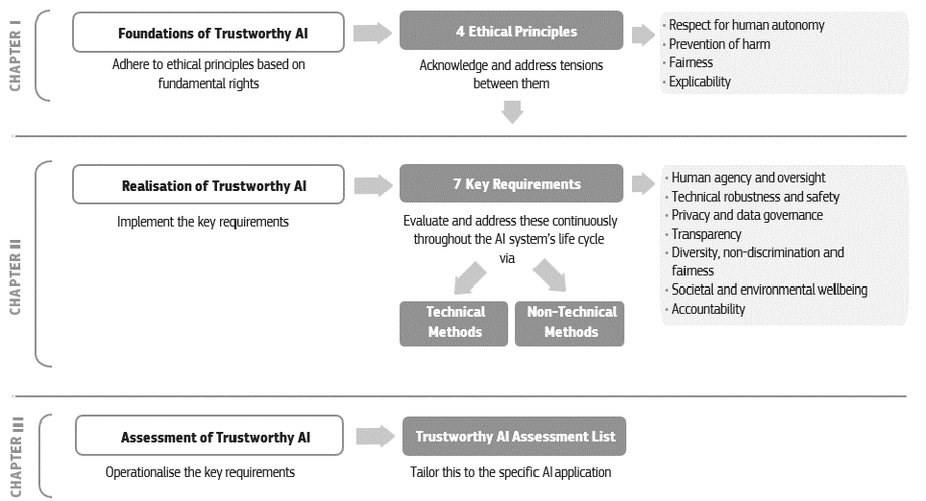








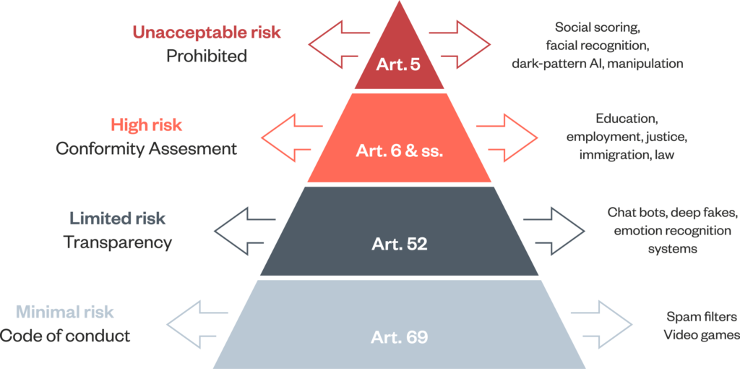













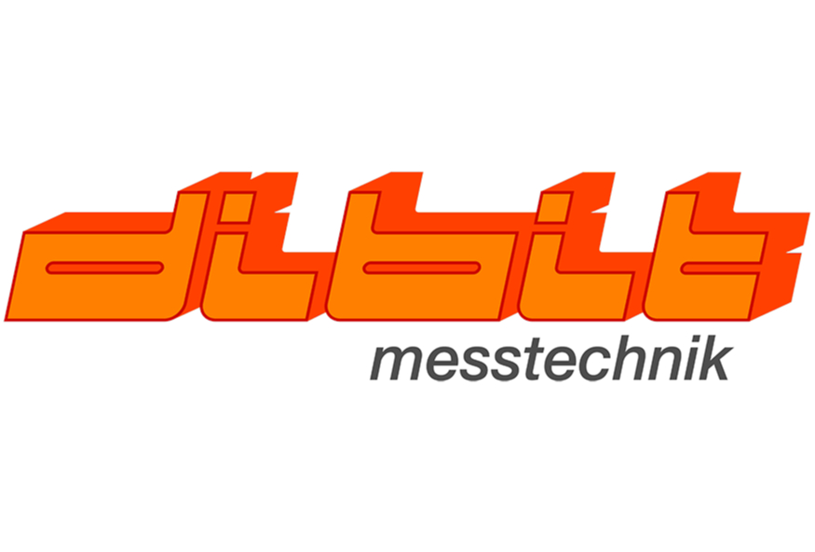

e
FAIR-AI
Fostering Austria’s Innovative strength and Research excellence in Artificial Intelligence
Open Access Platform (WP8)
WP2 - AI Application
Scenarios
WP3 - AI Systems Engineering
AI-System
Design Patterns
RM1
RM2
RM3
…
RM7
WP4 - Tools for AI System Monitoring
Tool Repository
Risk Assessment
WP5 - Ethics and
Legal Tools
Ethics & Legal Tools
Risk Mitigation
Model Monitoring
WP6 - Evaluation,
Education and
Standardization
Best Practices
Development & Operation
Bias Analysis
Ethics by Design
T2.4 - Co-Creation: AI Systems Engineering
Lead: WU
Explainable AI
Legal by Design
Evaluation
project goals
Education & Training
T2.5 - Co-Creation: Tools for AI System Monitoring
Normative Concepts
Evaluation re- search modules
Standardization
T2.6 - Co-Creation: Ethics and Legal Tools
Education and Training
T2.7 - Use case Evaluation

Slide 10
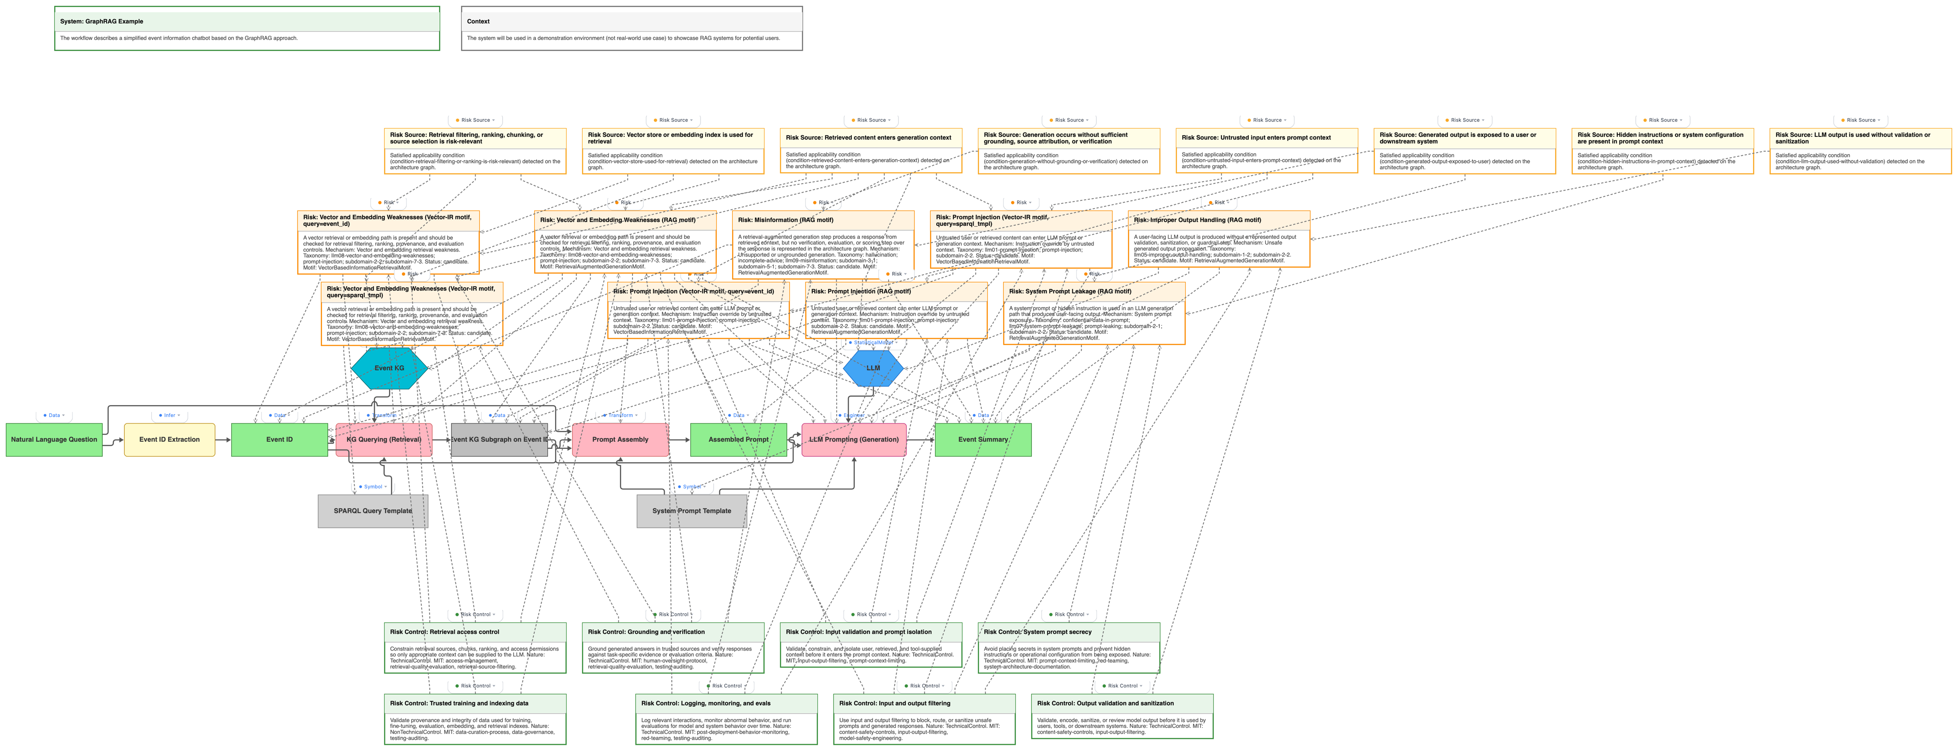
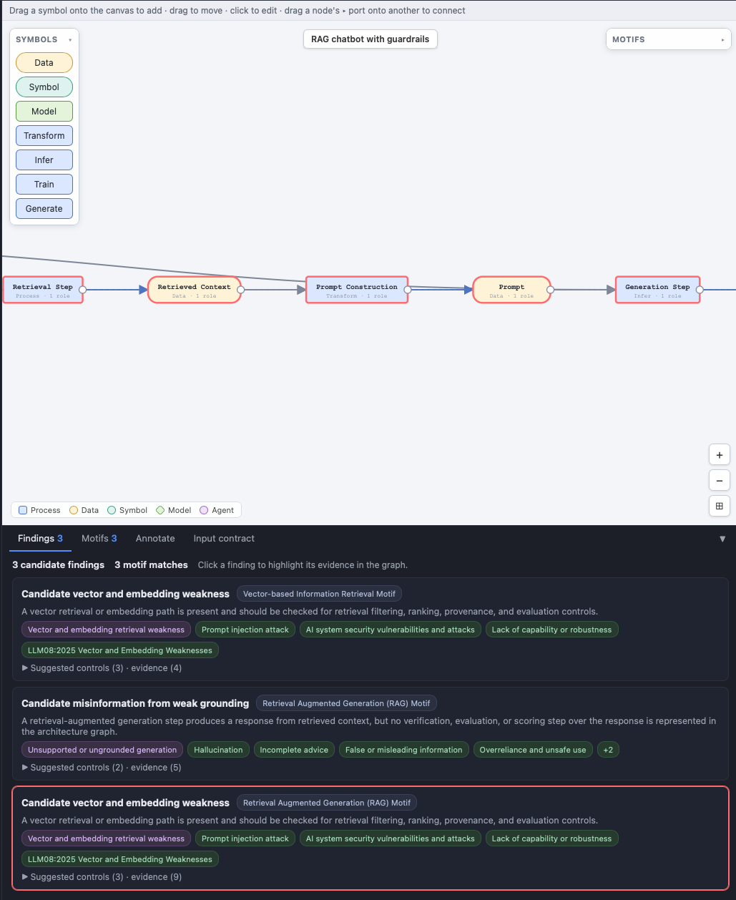
AI Systems Engineering:
Risk Assessment
Systematic methodology for designing trustworthy AI systems
Semantic foundations for KG-supported risk assessment
Aligned with state-of-the-art standards, guidelines, lists and tools
(e.g., MIT Risk Repository, IBM Risk Atlas, ISO/IEC 23894, ISO/IEC 42001, DPVCG, AIRO etc.)
Ekaputra, F. J., Prock, A., & Kiesling, E. (2025). “Towards Supporting AI System Engineering with an Extended Boxology Notation.” Proceedings of the 2nd International Workshop on Knowledge Graphs for Responsible AI (KG-STAR) @ ESWC 2025.
Ikhsan, M., Kiesling, E., Mahmoud, S., Prock, A., Revenko, A., & Ekaputra, F. J. (2025). “Pattern-based AI Risk Assessment: A Taxonomy Expansion Use Case.” in D. Chaves-Fraga, I. Heibi, D. Garijo, D. Collarana, A. Salatino, & S. Vahdati (Hrsg.), The Second Workshop on Knowledge Graphs and Neurosymbolic AI (KG-NeSy): co-located with SEMANTiCS’25: International Conference on Semantic Systems (vol. 4064). CEUR Workshop Proceedings. https://ceur-ws.org/Vol-4064/
Ikhsan, M. (2026). “AI Risk Management for System Design: An Ontology-Driven Approach Integrating Engineering Principles and Ethical Insights.” In: Curry, E., et al. The Semantic Web: ESWC 2025 Satellite Events. ESWC 2025. Lecture Notes in Computer Science, vol 15832. Springer, Cham. https://doi.org/10.1007/978-3-031-99554-5_39 {nominated for Best PhD Symposium Paper}
Kubesch, J., Kiesling, E., Ekaputra, F.J., Serles, U., Toma, I., Havas, C. (2025). “Exploring the Benefits of Iterative Retrieval-Augmented Generation for Risk Mitigation in LLM Responses.” In: Fischer, L., et al. Database and Expert Systems Applications - DEXA 2025 Workshops. DEXA 2025. Communications in Computer and Information Science, vol 2615. Springer, Cham. https://doi.org/10.1007/978-3-032-02003-1_1
Notes:
A risk-driven approach is mandated by the AI Act
There are established methodologies as well as emerging standards for risk management and representation
However, these are typically not linked to key design decisions

Slide 11
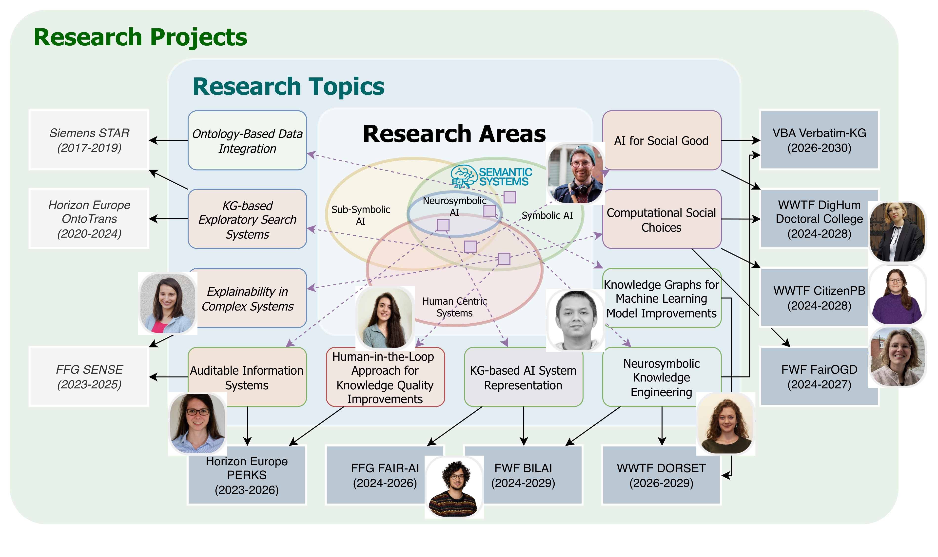

DPKM/SemSys
https://semantic-systems.org/
Notes:
PERKS – „Eliciting and Exploiting Procedural Knowledge in Industry” extract procedural knowledge from documentation in a manufacturing context
Siemens ORE – another project directly funded by industry on extracting rules in manufacturing specifications
FFG Sense (Semantics-based explanations of Cyber-physical systems) – generate explanations from events in complex systems (particularly Smart Energy systems)
FWF-Honest - Combining Human Computation (HC) and Ontologies
H2020 OntoTrans - Translation between use case owners and engineers in materials engineering: Ontology-based Open Translation Environment

Slide 12


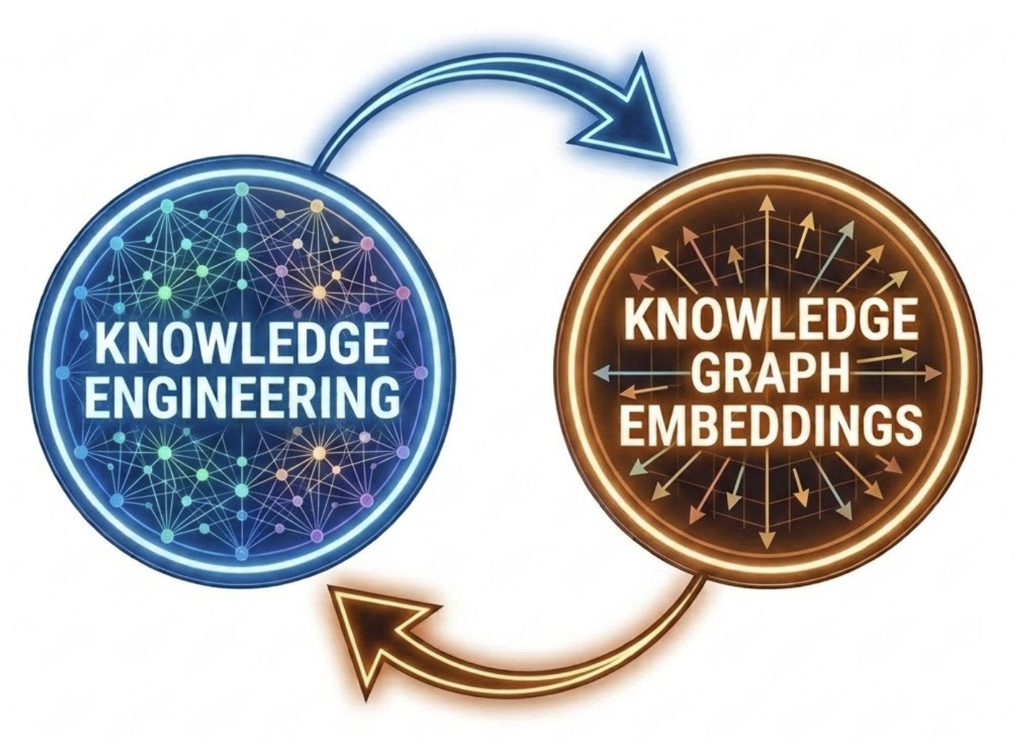
From Structures to Vectors:
Decoding How Knowledge Graph Characteristics Shape Embedding Strategies
Which KG characteristics impact embedding performance, and how?
Do we need to rethink KG creation and evaluation?
How to design KGE benchmarks and methods that are aware of KG characteristics?

Slide 13
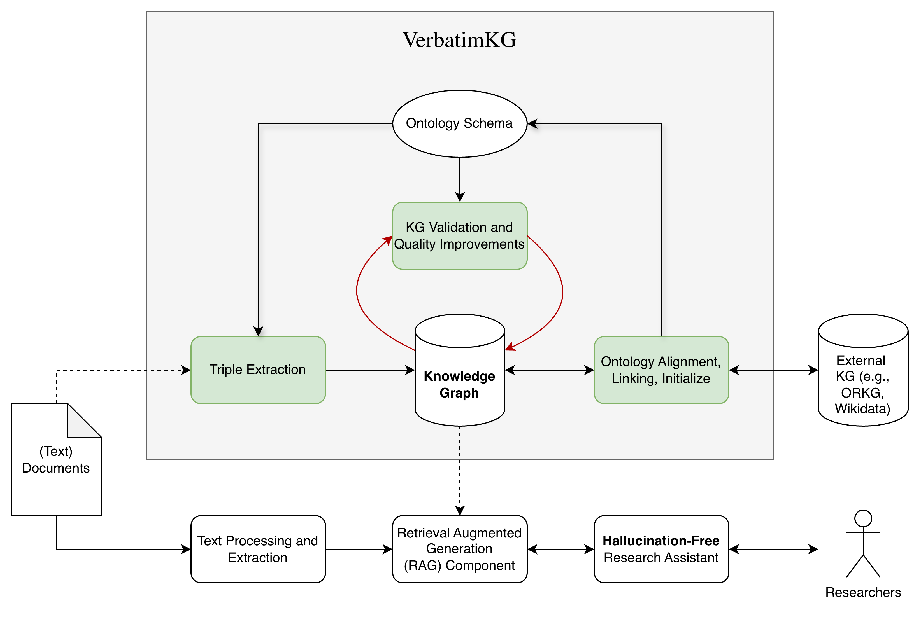
Project: VBA VerbatimKG
Verbatim (https://verbatim.krlabs.eu/) is an AI research platform for hallucination-free question-answering (QA) based on text documents.
Core hypothesis: Extraction, re-use of and alignment to structured scholarly knowledge will enhance the trustworthiness of (LLM-based) research assistant, such as Verbatim platform.
The VerbatimKG project focus on the following RQs:
  To what extent can we improve information extraction by considering a domain ontology?
  How can we improve the trustworthiness of the system’s knowledge by aligning to external sources?
  How can we improve the quality of the extracted knowledge?

Slide 14

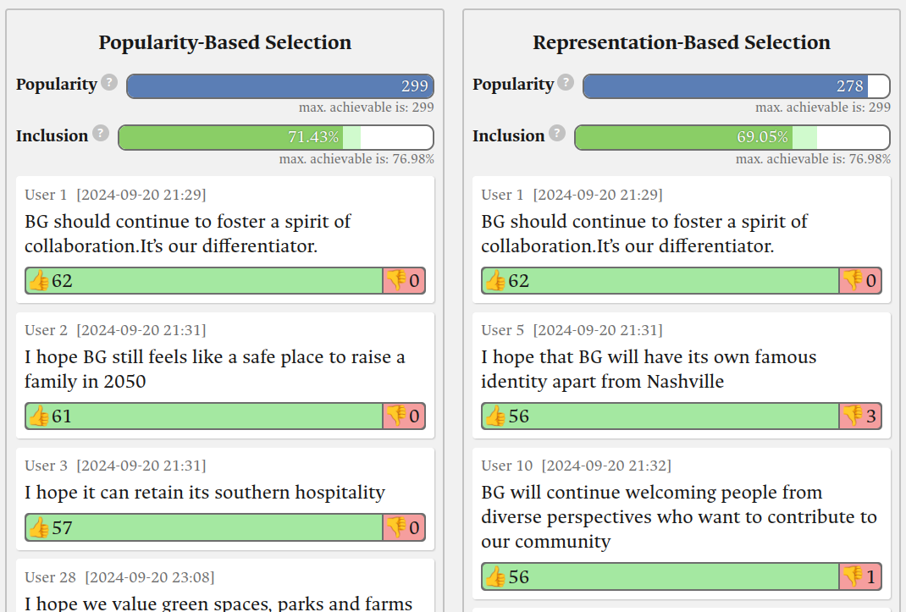


Digital Humanism
Fair Online Decision Making
Citizen-Centered Participatory Budgeting
Interdisciplinary Doctoral College with 18 PhD students across WU Wien, TU Wien and Uni Wien.
The college is dedicated to critically examining and shaping the digital transformation of society.-
Marta Sabou and Jan Maly act as Scientific Coordinators on the side of WU
Joint project with Carolina Plescia from the Department of Government, Uni Wien
Understanding citizens' preferences for the voting rules used in Participatory Budgeting
Developing algorithms respecting these preferences as much
Leveraging recent advances in our understanding of fairness and proportionality to provide a novel tool-box for fair group decision making in online applications.

Slide 15

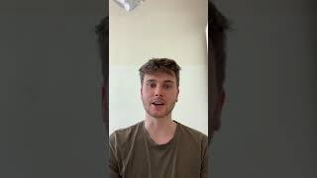


DPKM/KEOS
https://keos.ai.wu.ac.at/
Research Topics
Information Retrieval
Representation
Learning
Reasoning for LLMs
Conversational AI
Research Projects
WWTF VRG
(2025-2033)
FWF BILAI​ (2025-2029)
WU Jubiläumsfonds
(2026-2027)
Application Domains
Legal Tech
Web Search
Graph-based structures
Cultural Heritage
Notes:
TODO:
- Add Ikhsan
Add Diego
Add Arief

