Slide 1
Resilient Software (eco-systems) through Agent Spaces
Axel Polleres, WU (Vienna University of Economics and Business)
Abstract:
Connected Software Systems involving different stakeholders operating across organisational boundaries need to guarantee the stakeholders' sovereignty. That means that such software systems should be considered as "Agent Spaces" [1]: borrowing and building upon the metaphor of "Data Spaces" as multi-stakeholder, decentralized, spaces that allow sovereign sharing of data, we therefore also need to ensure that the involved/shared software tools, services, agentic language models themselves act in a sovereign manner, i.e., on behalf of the involved stakeholders. However - especially as these models are operating upon API-based services themselves, potentially make questions about sovereignty shift, as (i) they involve the model provider as a new stakeholder (ii) that operate in a centralized manner.
Agentic language models and Knowledge graphs (as an abstraction layer on top of data assets), on the one hand, have boosted to make data integration and service mediation appear more seamless in such settings, as opposed to earlier, historic attempts, such as (Semantic) Web Services [2]. On the other hand, AI agents that build upon tool-calling language models add a lot of uncertainty that requires safe guardrails, even within a closed scope "agent space".
In my talk I argued to consider these two aspects: (a) how to scope systems and their components shared by a set of stakeholders within "Agent spaces" that operate under a common governance; (b) what core concepts and distinctions we should recall from Semantic Web Services (e.g. service, capability, goal, description, discovery, composition).
Axel Polleres, Diego Rincon-Yanez, Amin Anjomshoaa, Daniel Dobriy, and Emanuel Sallinger. From data spaces to agent spaces. In The Fourth International Workshop on Semantics in Dataspaces (SDS 2026), co-located with ESWC, Dubrovnik, Croatia, May 2026. to appear. cf. https://short.wu.ac.at/towards-agent-spaces
Axel Polleres, Frederik Bauer, Daniil Dobriy, Tobias Käfer, Lukas Kubelka, Andreas Harth, and Thomas Wehr. On the historic roots of Agentic AI in Semantic Web Services. In WWW Companion '26: Companion Proceedings of the ACM Web Conference 2026, pages 10--14, June 2026. extended abstract, History of the Web track). https://doi.org/10.1145/3774905.3795076

Slide 2


Resilient Software (eco-systems) through Agent Spaces
Axel Polleres
WU Wien (Vienna University of Economics and Business)

Slide 3
What do I mean by
“Agent Spaces”
… and what does this have to do with
(Semantic) Web Services?

Slide 4
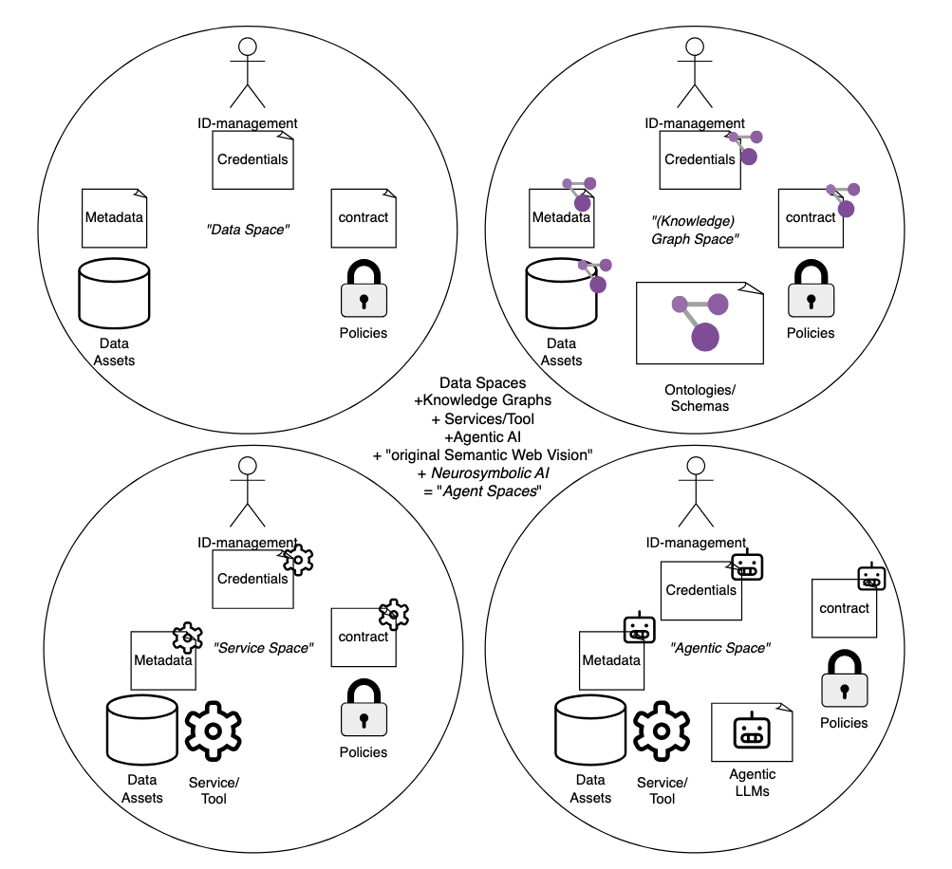
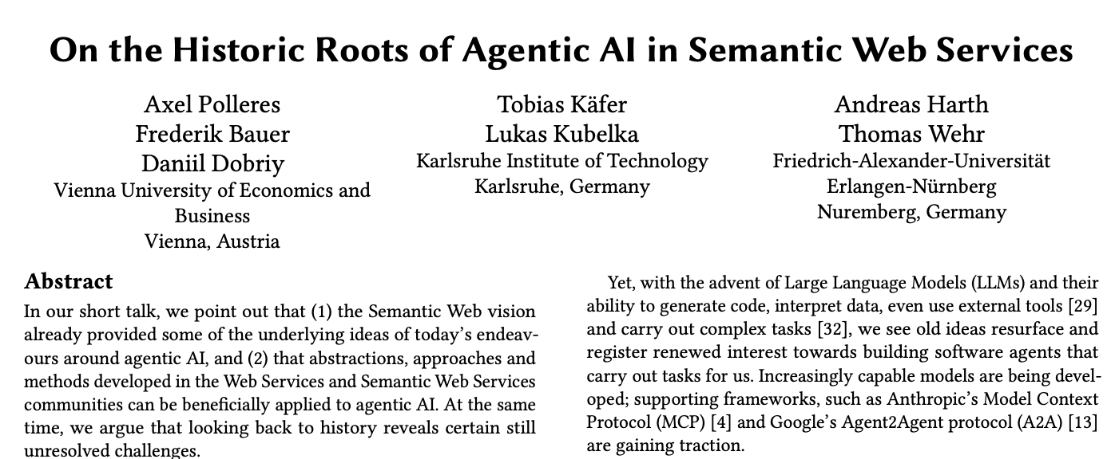
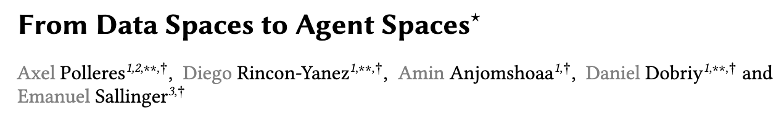
2 recent papers related to resilient AI systems:

Slide 5
catalog
“Data Space”:
Should guarantee:
sovereign
decentralized
multi-stakeholder (scoped)
data sharing

Slide 6
Semantic Web (uniform graph based data format, joint symbolic schemata)+
Data Spaces =
“Knowledge Graph Spaces”:
Should guarantee:
sovereign
decentralized
multi-stakeholder (scoped)
Interoperable data sharing+
Ontological agreement
Symbolic AI
catalog

Slide 7
Tools/Services+
Data Spaces =
“ServiceSpaces”:
sovereign
decentralized
multi-stakeholder (scoped)
Interoperable data and serivce sharing
catalog
Web Services ~2000s
Semantic Web Services ~2005

Slide 8
Adding Agents….
“Agentic Spaces”
sovereign ?
decentralized ?
multi-stakeholder +1
Interoperable data and serivce sharing
catalog
Web Services ~2000s
Semantic Web Services ~2005

Slide 9
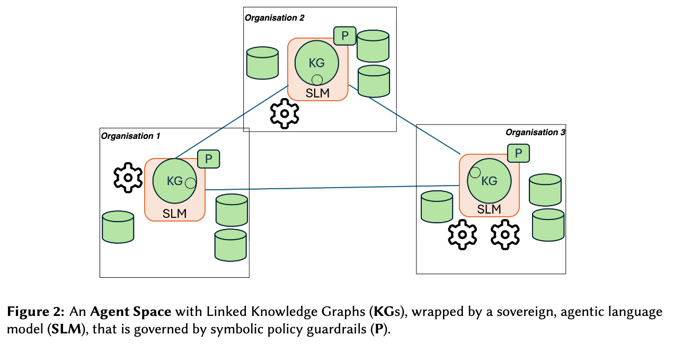


Neuro-Symbolic approaches
Agent-space:
Resilient eco-system
Sovereign,
Decentralized,
Stakeholder-controlled Models/Agents (scoped!)
Symbolic guardrails
Agreed policies

Slide 10
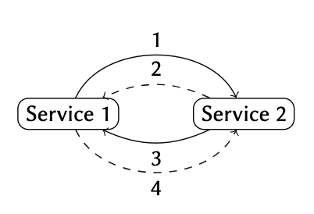
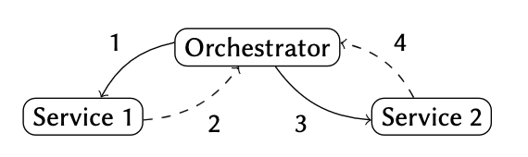
Why it might be good to recall some concepts from “Semantic Web Services”:
service: “tools” ("operations” or function ~MCP) vs. “service” ("provision of an (abstract) value or product”) ”[Preist, 2004]) vs. “agent” ((“service provided by LLM” ~A2A)
description: formal symbolic/verifiable vs. informal NL description.
  skill
  capability
  interface
discovery: (trustable) matching/catalogs/negotiation
composition (orchestration/choreography)

Slide 11
p.s.: I have an extra slide, if needed ;-)

